Slide 1
ODTP ODTP-SC

Slide 2
At its 31st session, the IOC Assembly established the “Ocean Decade Tsunami Programme” and its Scientific Committee (SC-ODTP) by Decision A-31/3.4.1.

Slide 3
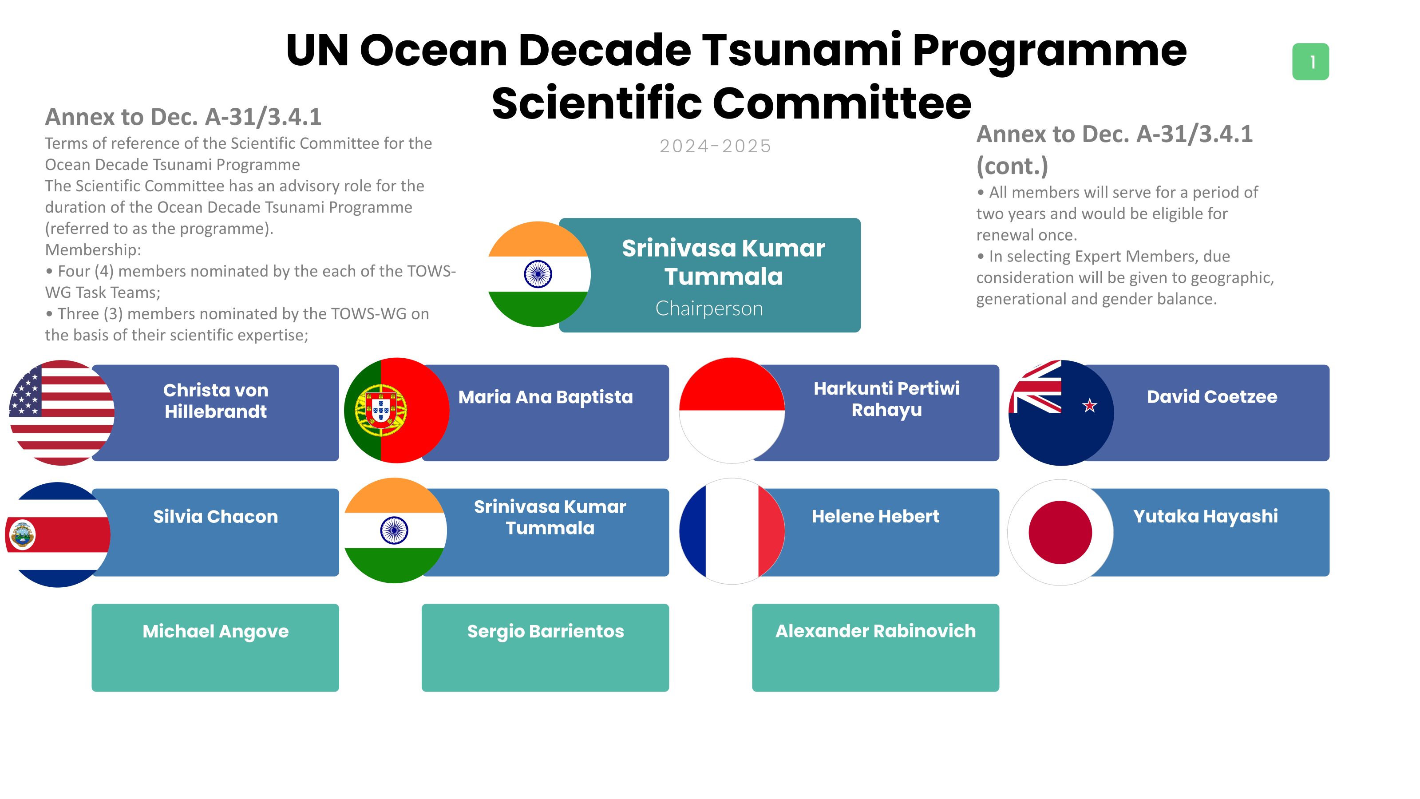
Dr Laura Kong, Chairperson for Tsunami Ready Coalition ad hoc new member
Tech Secretaries

Slide 4
Ocean Decade
Ocean Decade Coordination Unit
TRS/ ODTP
/ODTP-SC
Focal Point/ coordinator
Denis Chang Seng

Slide 5

The SC has an advisory role to TOWS-WG for the duration of the Ocean Decade Tsunami Programme.
One of its core task was to develop a 10-Year Research, Development and Implementation Plan for the Ocean Decade Tsunami Programme which was presented and endorsed at the 32nd session of the IOC Assembly in June 2023.[ Completed]

Slide 6
Other tasks
Identify and address gaps in global tsunami hazard assessment
Identify gaps in tsunami detection, measurement, forecasting, with a special emphasis on tsunamis generated close to populated coastlines.
Propose to enhance sensing and analysis strategies to enable the rapid characterization of tsunami sources
Propose a roadmap for collaboration with the ITU/WMO/IOC SMART Joint Task Force cable initiative
Consider and propose strategies, programmes and content to enhance societal resilience for tsunami and other ocean hazards.
Overview the consolidation of inputs received to IOC Circular Letter 2825 on Inventory of actions

Slide 7
ODTP-SC Meetings
4 meetings already organized
16-17 January 2025, Paris.
Overall aim
To review and harmonize current UN Ocean Decade Tsunami Programme and UNESCO-IOC Tsunami Programme related initiatives with the activities proposed in the context of the Research, Development, Implementation Plan for the Ocean Decade Tsunami Programme. With that purpose the 5th SC-ODTP will examine and propose way forward in relation to the 2024 Ocean.

Slide 8
Key Discussions
Decade Conference Barcelona Outcome Statement and the Vision 2030: White Paper of “WG-6: Increase Community Resilience to Ocean Hazards.
The Group will reflect on the 2nd UNESCO- IOC Global Tsunami Symposium held in Banda Aceh, Indonesia, its outcome statement and the way forward.
It will explore how best to further engage with DCC structures (DCC-CR).
It will receive updates regarding next TOWS WG and TTs meetings.
The group will review on the proposed Implementation Plan for the Tsunami Ready Coalition.
The SC will also review the progress so far in implementing the ODTP-updated information on current and latest initiatives of the UN Ocean Decade related to Challenge 6, new actions submitted under call 7 of the Decade, as well as guidance and needs for Decade call 8.
The SC will discuss ICGs initiatives and coordination schemes for ODTP, (EW4ALL etc)
Additionally, the meeting serves as an opportunity to revisit, particularly the ODTP-Implementation Plan to better support implementation, tracking and monitoring of the ODTP.

Slide 9
END

