Slide 1

Decisions and Recommendations
from TT-TE
Coordinated by Task Team on Tsunami Exercise
(co-chairs: Ceren Ozer Sozdinler - Marinos Charalampakis)
19th session ICG/NEAMTWS 27 – 29 November 2024

Slide 2
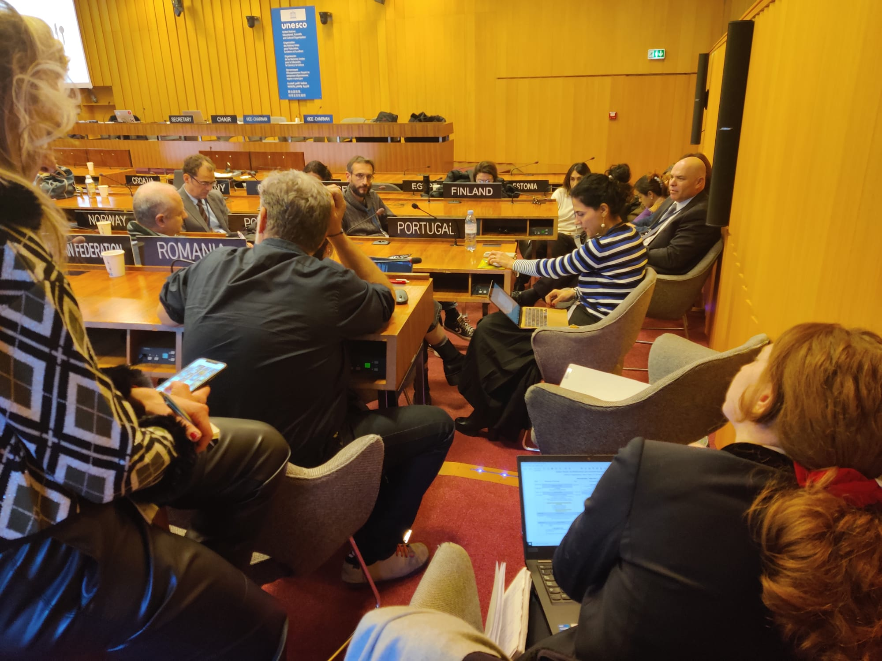
Sessional Committee Meeting

Slide 3
Sessional Committee Meeting
Collaboration between TSPs and NTWCs: IOC can provide names/contact details of NTWCs; then TT-TE can send contact NTWCs by email for asking their intent to collaborate with the TSPs
Collaboration between TSP and NTWC will be about the preparation of exercise scenarios; not about the implementation of exercise
More relaxed exercise schedule: Depending on the number of scenarios, we can have 1 or 2 scenarios per week.
Subscription mechanism: less information about the exercise details; contact information update, if needed
Evaluation forms should be prepared carefully to focus on obtaining the feedbacks of the exercise participants more efficiently.
19th session ICG/NEAMTWS ● 27 – 29 November 2024

Slide 4
Sessional Committee Meeting
TSPs Final Evaluation Report: TT-TE can prepare template for a simpler TSP evaluation report only including a summary of exercise performance, along with suggestions and recommendations.
It is suggested to prepare NEAMWave Final Evaluation Report in a simpler format to make it more user-friendly.
TSPs can co-operate and prepare one or more joint exercise scenarios and make the exercise more challenging in such a way that they can disseminate different alert messages for the same joint scenario.
Online NEAMWave26 preparation meetings will be organized between TT-TE and exercise actors, i.e. TSPs, NTWCs, CPAs, TWFPs etc.
19th session ICG/NEAMTWS ● 27 – 29 November 2024

Slide 5
ICG Decides:
To organize the next NEAMWave exercise in March 2026. The exercise scenarios would be created through collaboration between TSPs and NTWCs, with one or more single or joint scenarios proposed to meet the specific needs of the MS.
To change the name of the Task Team to “NEAMWave Exercise”.
26
19th session ICG/NEAMTWS ● 27 – 29 November 2024

Slide 6

Thank you!
TT-NEAMWave
Co-chairs: Ceren Ozer Sozdinler & Marinos Charalampakis
19th session ICG/NEAMTWS ● 27 – 29 November 2024

