Slide 1
ODTP-SC 5th Meeting
VISION 2030 WG-6 WHITE PAPER: INCREASE COMMUNITY RESILIENCE TO OCEAN HAZARDS
Agenda 2a
Paris 16 – 17 Jan 2025
Srinivasa Kumar Tummala
Head, ICG/IOTWMS Secretariat
Nadia Pinardi
Director – UN DCC on Coastal Resilience & Co-Chair WG-6

Slide 2
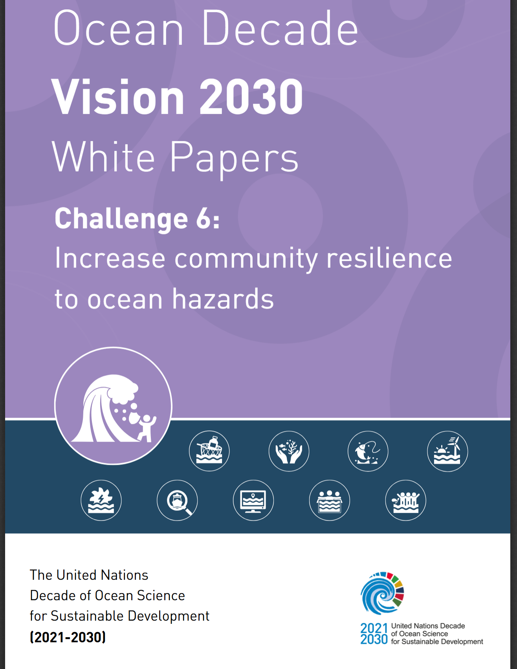
WORKING GROUP 6 MEMBERS
CO-CHAIRS
Nadia Pinardi, DCC for Coastal Resilience, University of Bologna, Italy
Srinivasa Kumar Tummala, DCC for Indian Ocean Region, INCOIS, India (Former)
MEMBERS
Alessandra Burgos - Oregon State University, United States
Andrea Valentini - DCC for Coastal Resilience, University of Bologna, Italy
Antoine Queval - Alcatel Submarine Networks, France
David Cabana - Helmholtz-Zentrum Hereon, Climate Service Center, Germany
Dwikorita Karnawati - Indonesia Agency for Meteorology, Climatology and Geophysics, Indonesia
Enrique Alvarez Fanjul - OceanPrediction Decade Collaborative Center, Mercator Ocean International, Fance
Giovanni Coppini - Euro-Mediterranean Centre on Climate Change Foundation, Italy
Hellen J. Kizenga - Institute of Marine Sciences, University of Dar es Salaam, Tanzania
Iris Monnereau - Food and Agriculture Organization of the United Nations
Jason Holt - National Oceanography Centre, UK
Joel Kamdoum Ngueuko - Naturalia Environment, France
Joseph Ansong - University of Ghana, Ghana
Juliet Hermes - South African Environmental Observation Network, National Research Foundation, South Africa
Loreto Duffy-Mayers - Caribbean Alliance for Sustainable Tourism
Martin D. Smith - Nicholas School of the Environment, Duke University, United States
Martina Müller - United Nations Office for Disaster Risk Reduction
Mitchell Harley - UNSW Sydney, Australia
Purificació Canals - MedPAN, Spain
Sunanda Manneela - Indian National Centre for Ocean Information Services, India
*ECOPs

Slide 3
OCEAN AND COASTAL HAZARDS
Ocean Decade Challenge 6:
Enhance multi-hazard early warning services for all geophysical, ecological, biological, weather, climate, and anthropogenic related ocean and coastal hazards, and mainstream community preparedness and resilience.
Geophysical/Geological: Tsunamis, Landslides, Subsidence, Volcanic eruptions, Coastal erosion, Earthquakes
Biological: Harmful algal blooms, invasive species, aquatic diseases, nuisance blooms
Ocean, Weather, Hydrology and Climate: Tropical and extratropical cyclones and storms, sea-level rise, storm surge, meteo-tsunami, coastal flooding, waves and wave runup, currents, marine heat waves, glacial melt, heavy rainfall and river flooding, saltwater intrusions, droughts
Ecological: Wetland degradation, acidification, de-oxygenation, biodiversity loss, seabed habitat loss, coral bleaching, eutrophication, connectivity
Local Anthropogenic: Coastal urbanization pressures, coastal wastewater system outflow, marine pollution, overfishing, chemical spills, oil spills, nuclear waste, agricultural runoff, coastal tourism pressures, political interference and corruption, maladaptive planning
Definition of Coastal Resilience from the UN International Strategy for Disaster Reduction: “Resilience is the capacity of a system, community or society to resist or to change so that it may obtain an acceptable level in functioning and structure.”

Slide 4
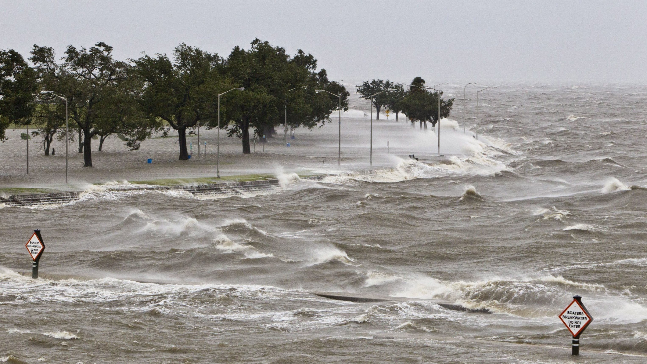
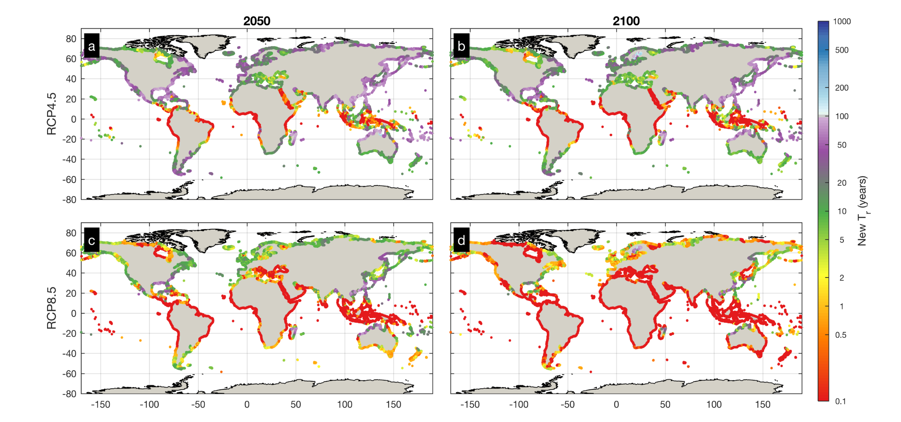
WHY COASTAL RESILIENCE TO OCEAN HAZARDS IS IMPORTANT?
Image credit: NOAA
FROM: L. M .Bouwer and S. N Jonkman 2018 Environ. Res. Lett. 13 014008
GLOBALLY, during the 1900-2015 there have been:
121
EXTREME storm surge events
172 500 000
people affected
From: Vousdoukas et al., Nature communication, 2018
967 000
fatalities
THE FUTURE:
How frequent will the present 100-year sea level extremes be?

Slide 5
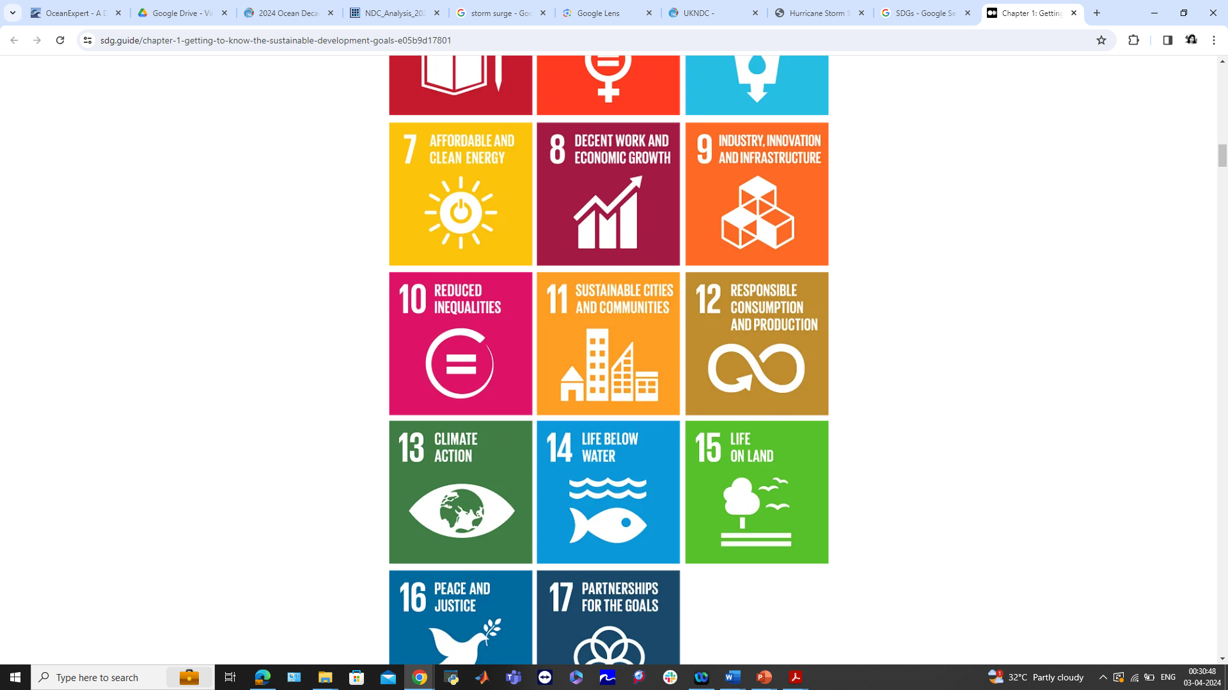
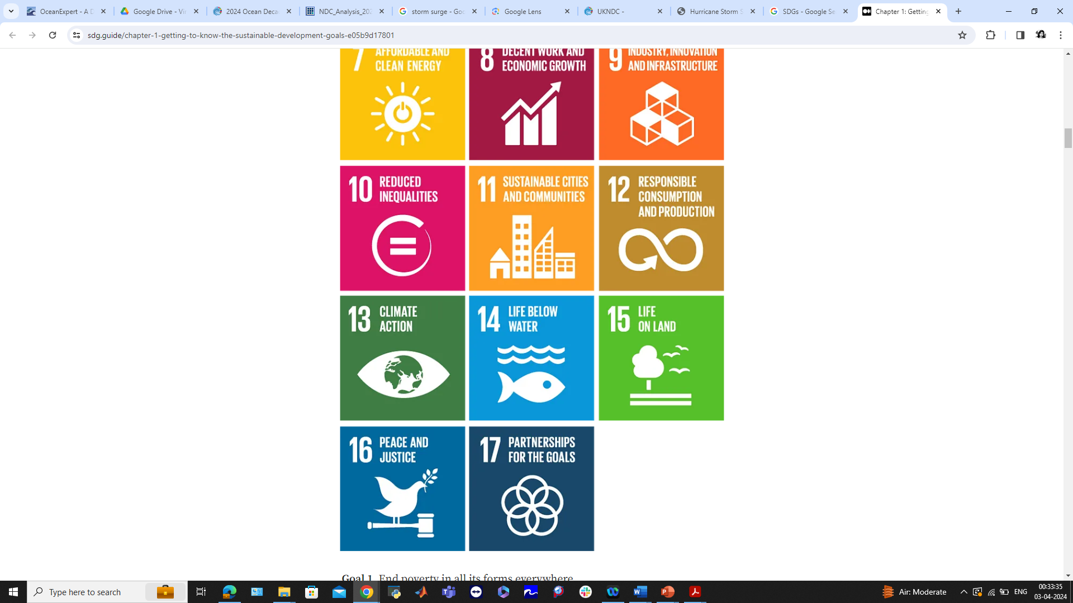
RELEVANCE TO SDGs
Coastal Resilience aligns with multiple SDG targets, particularly:
SDG 14: Positive impact on oceans and marine resources
SDG 13: Strong alignment with Climate Action goals
SDG 11: Supports sustainable cities with a focus on disaster risk reduction
Generation of information for Adaptation and Early Warning systems are essential for coastal resilience, contributing to population well-being, environmental protection, and infrastructure resilience
Challenge 6 enhances risk management, supporting inclusive and participatory decision-making (Goal 17).
Plays a pivotal role in urbanized coastal areas by addressing economic losses and infrastructure damage due to disasters
Gaps in SDGs: Need for more comprehensive inclusion of coastal resilience targets and indicators within the SDGs

Slide 6
COMPONENTS OF COASTAL RESILIENCE
- Multi-hazard evaluation frameworks
- Multi-level, multi-sector risk analysis
-
- Monitoring, Forecasting and Early warning systems (multi-hazard)
- Digital twins
-
- Marine and Maritime Spatial Planning
- Disaster recovery planning
- Exposure and vulnerability analysis
- Warning Dissemination & Communication
- Sectoral medium to long term planning (zoning, infrastructure)
- Nature-based solutions
- Governance Framework
- Equitable coastal resilience
- Government investments, financing and insurance
- Capacity building
- Corporate social responsibility
-
Risk Assessment
Risk Reduction
Institutional/
Governance/
Social Transformation

Slide 7
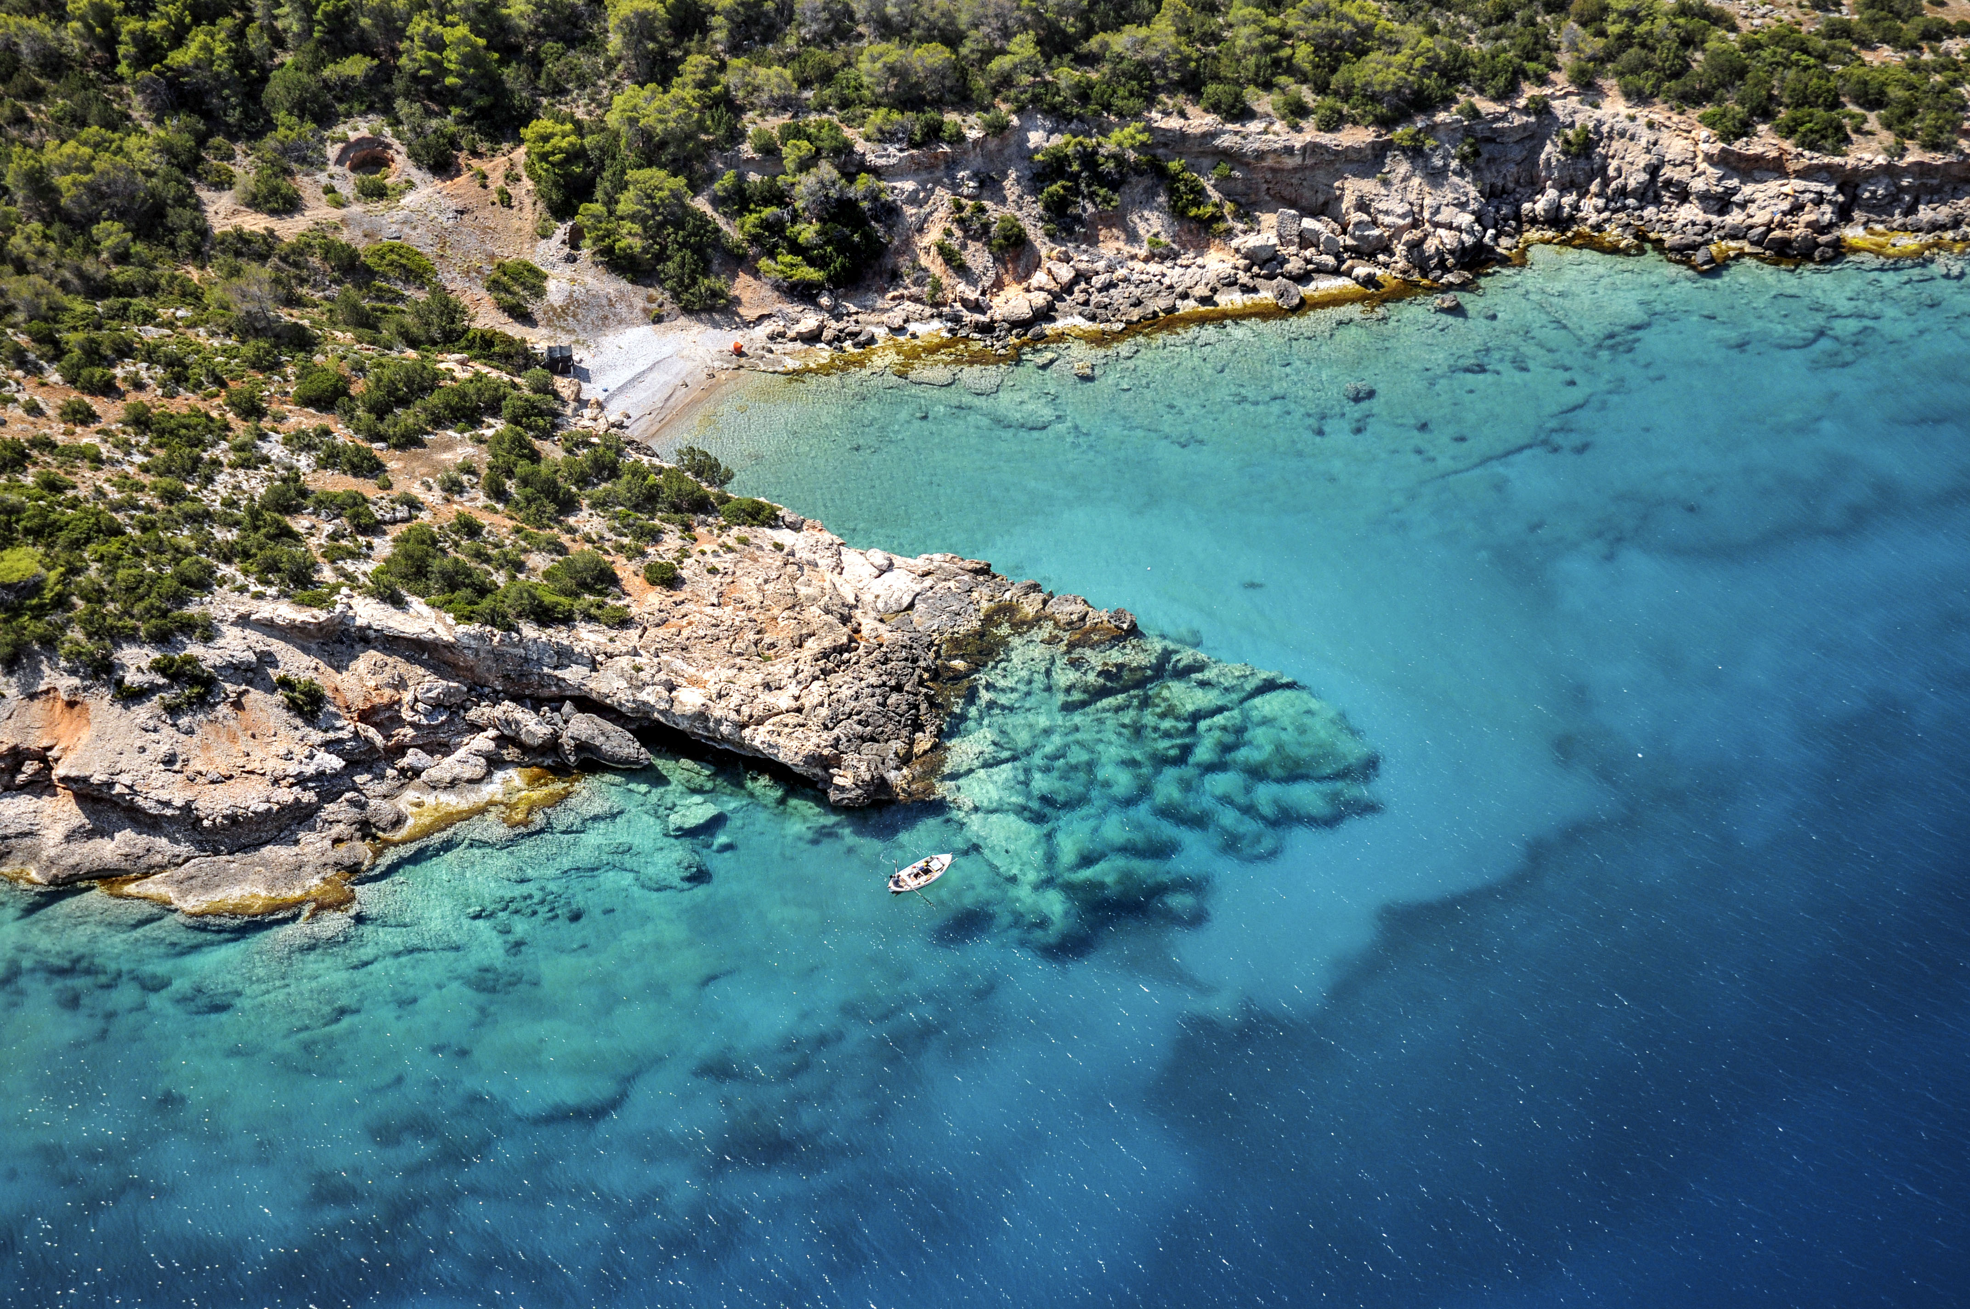
STRATEGIC AMBITION & USERS
Analysis of user needs and priorities is crucial for developing resilient solutions
Aids to develop customized plans to hazards, challenges and priorities of communities
Outcome 1
Design people-centred
multi-hazard early warning systems
Outcome 2
Design adaptation planning strategies
to increase coastal resilience
GOAL:
A safe ocean where life and livelihoods are protected from ocean-related hazards
Stakeholder Engagement, Shared Responsibility, Accessible Communication, Institutional CB
Use the new data from the Ocean Decade to prepare updated plans and solutions
Intermediate
Downstream
Upstream
Knowledgeable users that customize products for specific needs
Use information for risk reduction and governance
Collect observations and produce analysis and forecast

Slide 8
.
.
.
.
.
.
.
Priority datasets
Technology and innovation solutions
KEY ELEMENTS FOR
COASTAL RESILIENCE
Knowledge generation and sharing
Capacity development exchange needs
Infrastructure requirements for early warning systems
Partnerships & resources

Slide 9
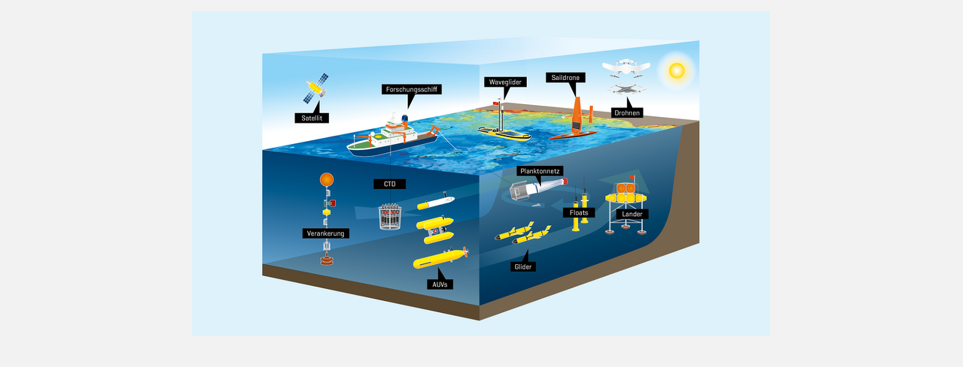
Priority Datasets
Meteorological
Seismic & Geophysical
Hydrological
Oceanographic
Human activities
Seabed habitat
Bathymetry, terrain & geological data
Climate downscaled scenarios
Human health
Vital Role of Observations
Global Data Sharing
Crucial datasets for Warnings
Adaptation Planning Data
Notes:
Vital Role of Observations: Observations are essential inputs for early warning systems, especially in predicting high-impact weather and ocean hazards within a few days
Global Data Sharing: Early warning systems depend on countries freely sharing data globally, using advanced computing centers for processing
Crucial Datasets for Warnings: these datasets are a suitable combination of past information (observations) and predictions by numerical modelling or AI
Adaptation Planning Data: Adapting to climate change requires downscaling climate scenarios and carry out impact modeling

Slide 10
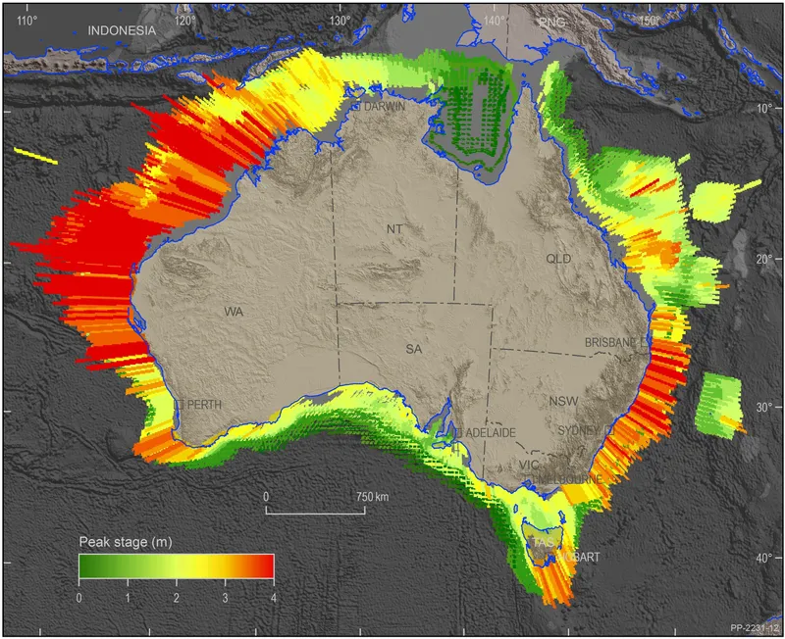
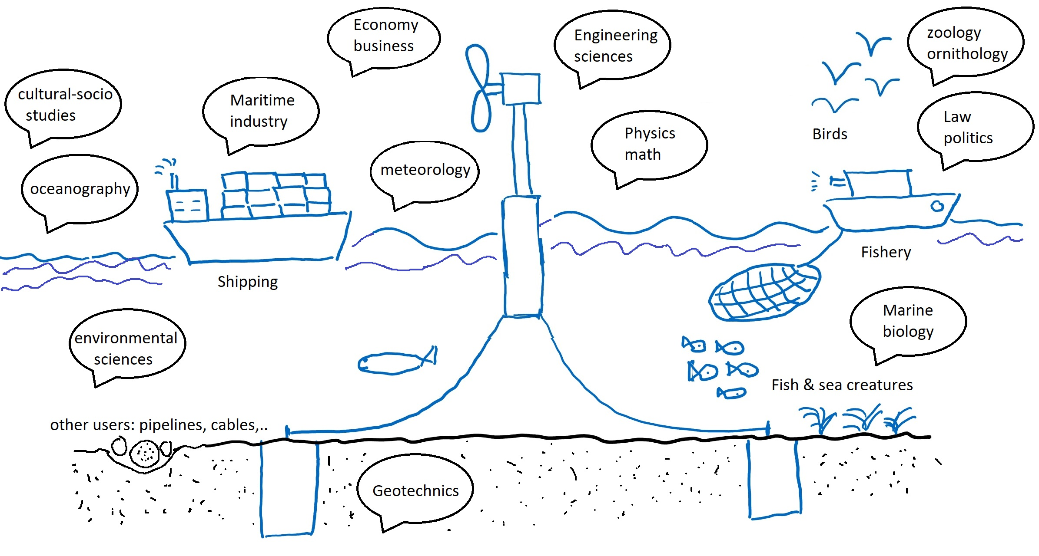

Knowledge Generation and Sharing
Systematic Risk Knowledge Building
Initiatives for Enhanced Risk Knowledge
Dissemination
Courtesy – Geoscience Australia
Notes:
Systematic Risk Knowledge Building: Building risk knowledge relies on collecting data systematically and communicating region-specific hazards and vulnerabilities to communities
Initiatives for Enhanced Risk Knowledge: Primary initiatives involve investing in interdisciplinary research, leading to innovative tools for data analytics, risk mapping, and accessible repositories.
Dissemination: training programs are essential. Examples include initiatives such as the WMO Global Multi-hazard Alert System (GMAS), the UNESCO-IOC International Tsunami Information Center (ITIC) training program, and the Ocean Teacher Global Academy (OTGA) of UNESCO-IOC.

Slide 11
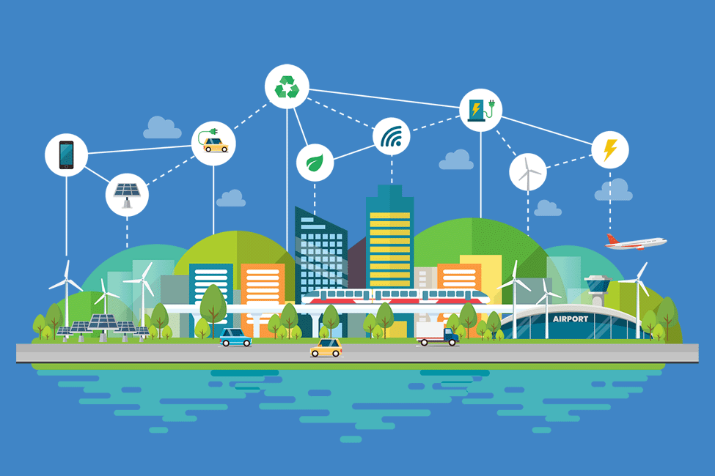
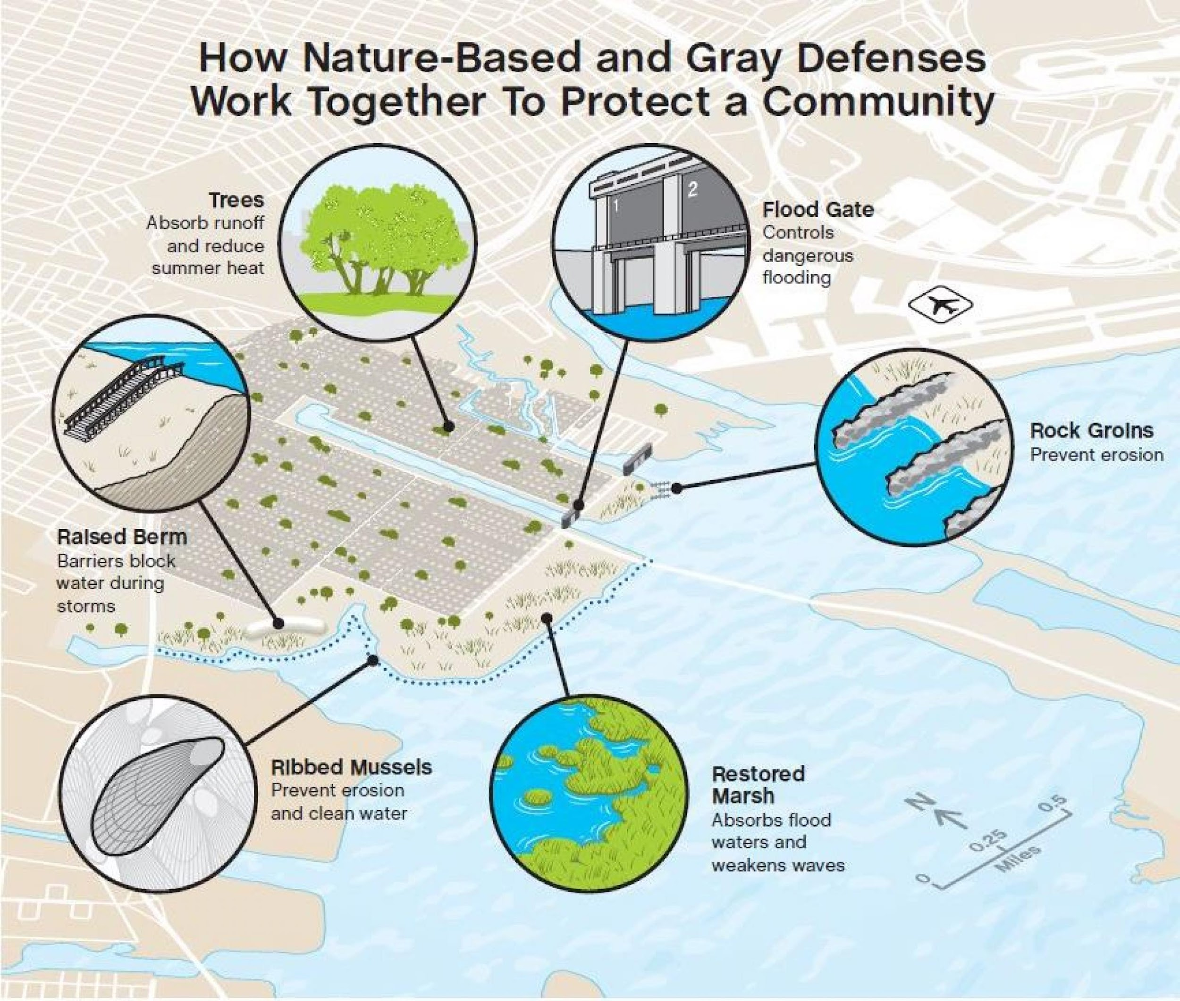
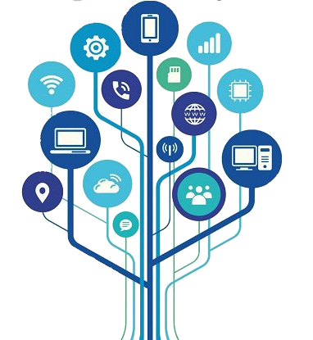
Technology and Innovation Solutions
Technology for Resilience
Climate-Resilient Infrastructure
Effective Communication with ICT
Notes:
Technology for Resilience: Advanced sensors, satellites, and AI/ML is vital for early warnings against ocean hazards, following F.A.I.R. principles. Numerical modeling and Digital Twin Frameworks improve forecasting.
Climate-Resilient Infrastructure: Mix grey and green infrastructure with smart technologies for climate resilience. Innovations in sand mobilization, sustainable aquaculture, and waste management contribute to overall resilience.
Effective Communication with ICT: Use emerging ICT technologies, such as cellphone apps, for efficient early warnings, especially in vulnerable communities. Detailed technology requirements are listed in Annex 4.

Slide 12


KEY RECOMMENDATIONS
Developing an open and accessible system for risk assessment and management
Integrating coastal resilience targets into SDGs, specifically SDG 11, SDG 13, and SDG 14.
Initiating a Coastal Resilience Review of Requirements (C3R)

Slide 13
MILESTONES
2025
2027
2030
01
03
05
Identifying Stakeholder groups
Formulation of the Coastal Resilience Review of Requirement Strategy
Construction and implementation of an open and accessible information system
2026
2028
Strengthened partnerships with UN programs
02
Enhanced knowledge and communication for multi-risk assessment and preparedness
04

Slide 14
INDICATORS
Indicators for improved knowledge in coastal multi-hazard identification and comprehension, including cascading effects
Best practices indicators for data sharing in early warning systems
Advancement indicators for best practices and standards in risk reduction Indicators
Indicators of effective capacity-building and educational practices
Demonstrating successful development of international partnerships
Resilient and equitable infrastructure planning
Changes in institutional and legislative frameworks for coastal resilience

Slide 15
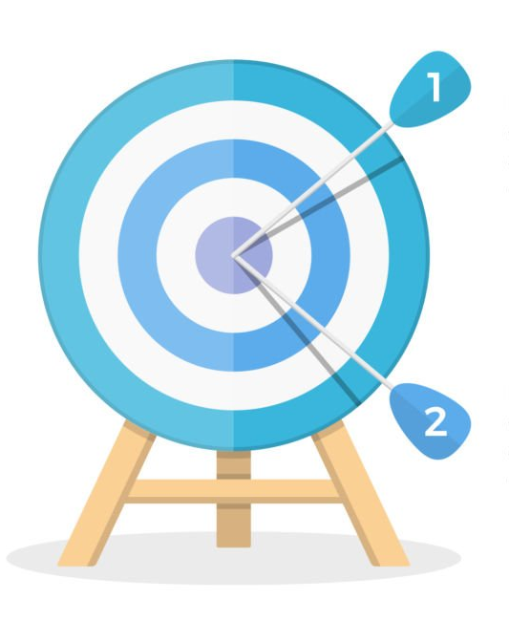
UN Ocean Decade Tsunami Programme
Key Elements
Tsunami Risk Knowledge
Tsunami Detection, Analysis and Forecasting
Warning, Dissemination and Communication
Preparedness and Response Capabilities
Capacity Development, SIDS and LDCs, Multi-hazard Framework
Governance and Pathways to Implementation
To develop the warning systems’ capability to issue actionable and timely tsunami warnings for tsunamis from all identified sources to 100% of coasts at risk
100% of communities at risk be prepared and resilient to tsunamis by 2030 through programmes like the IOC-Tsunami Ready Recognition Programme (TRRP)
The Scientific Committee developed the draft 10-Year Research, Development and Implementation Plan for the Ocean Decade Tsunami Programme which was presented and endorsed at the IOC Assembly in June 2023
Notes:
Expand Existing Observation Systems to fill the Gaps – Optimal Sensor Grid Design From Angove, M., Gledhill, K., Bill Fry., Christopher Moore., Tummala, S., 2024 (pers)
Deploy new technologies – SMART
Wider Data Access, Availability & Analysis for Data from SL, Sesimic, GNSS Systems
Collection of Coastal Topo/Bathy Data
All NTWCs have access to Data, Tools, Communications Systems, SOPs & Training
TR Communities – TRRP, Equivalency, TR Coalition

Slide 16
ODTP and Ocean Decade Challenge 6 WG: Joint Working Areas ?
ODTP Goals (Warning Systems, Community Resilience) and Ocean Decade Challenge 6 Outcomes (MHEWS, Design Adaptation Planning Strategies) are closely intertwined
TEWS is a key element for enhancing broader Coastal Resilience. It is a proven framework that can form the basis for building “user-centric multi-hazard early warning systems”
ODTP-SC and WG-6 collaborations:
  develop an open and accessible system for risk assessment and management,
  integrating coastal resilience targets into SDGs
  initiating a coastal resilience review of requirements.
  Performance Monitoring Frameworks.
  Strengthen Stakeholder Collaboration (WG-6, ODTP-SC, DCCs, ICGs, etc.) for Joint Projects (Co-design, Co-implement, Co-benefit), Exchange best practices, Capacity Development
  DCC-CR and DCC-IOR proposal for the next Decade Call for Action to follow up on the recommendations from the WG-6 White paper

Slide 17
THANK YOU

