Slide 1
GOSUD
steering group meeting

Slide 2
Agenda
Map for 2024
SNO-SSS
German Research Vessel
NOAA
Ferryboxes
SOOP
New format
IODE and GOSUD

Slide 3
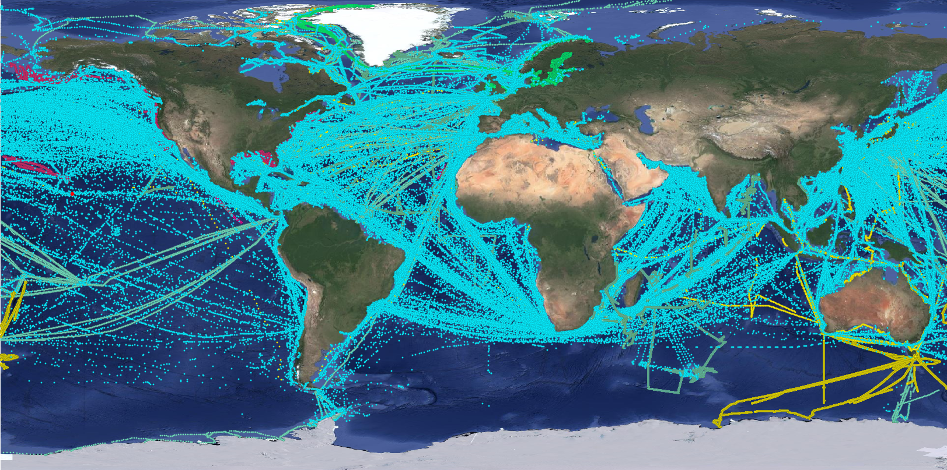
Map for 2024:

Slide 4
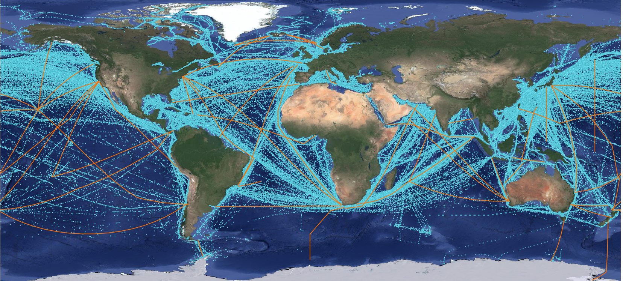
Erddap OSMC - SHIP with sea temp (in database but not exported)
these platforms are not exported - issue has been fixed. These new platforms will be disseminated in GOSUD

Slide 5
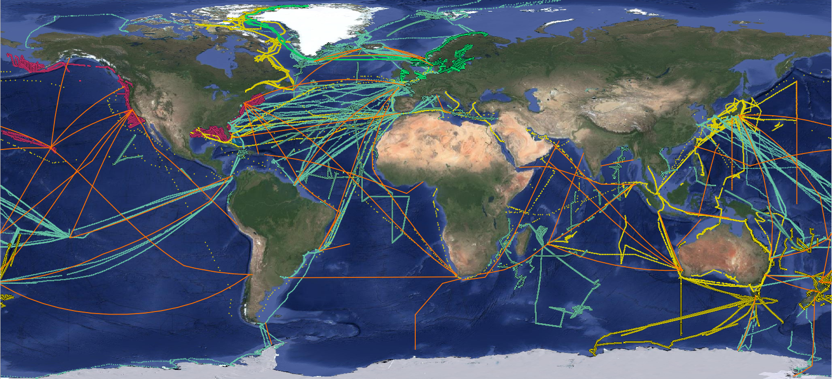
Map for 2024 :

Slide 6
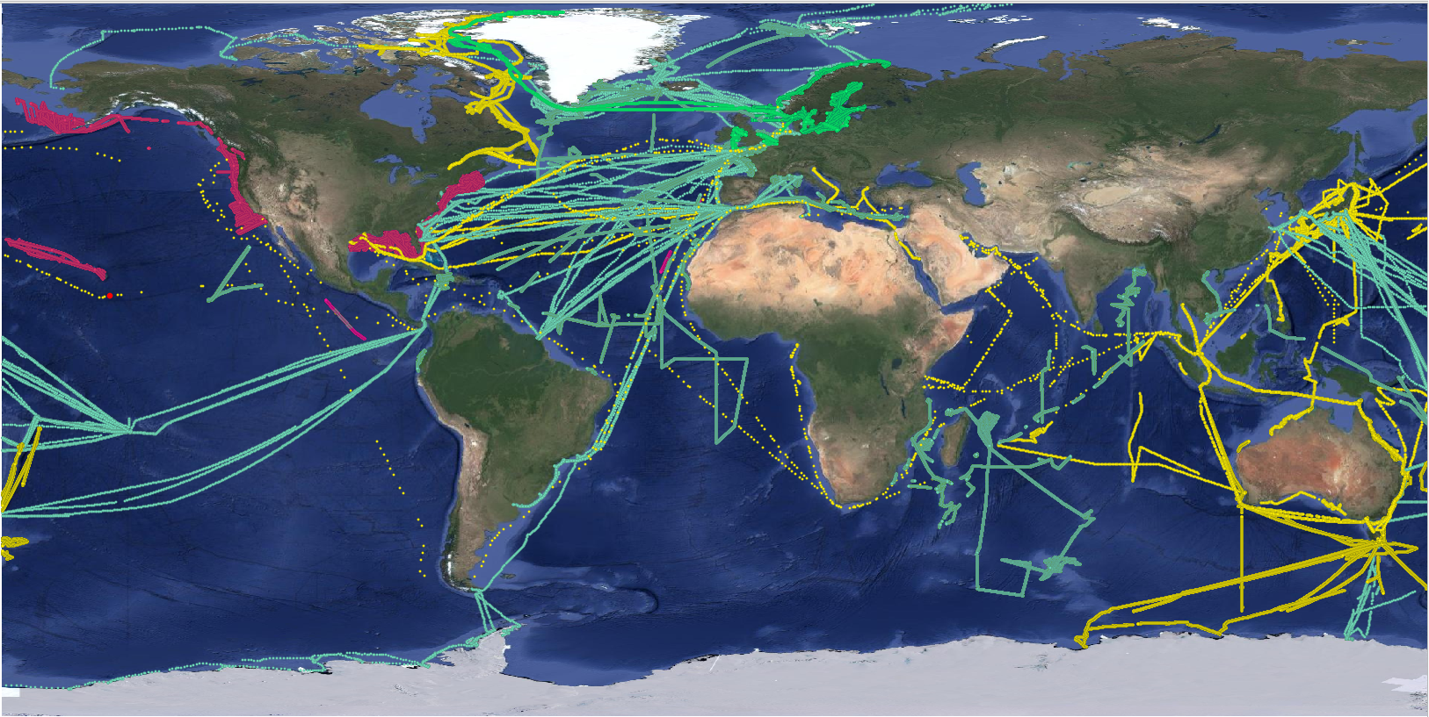
Map for 2024 :

Slide 7
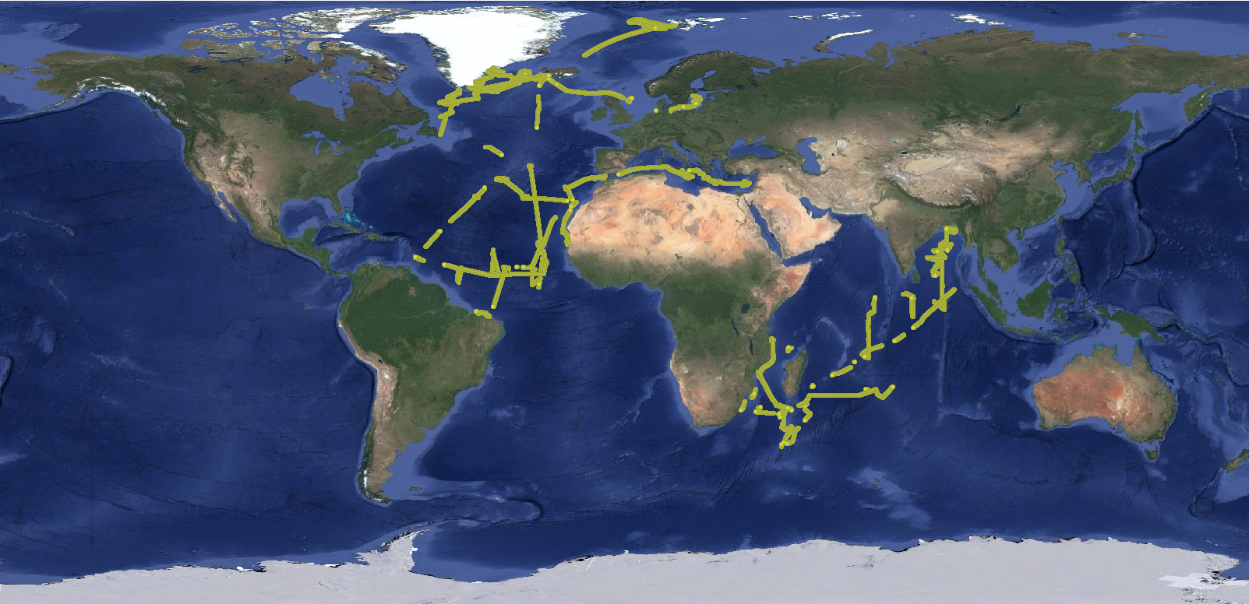
Map for 2024 DBBE, DBBH, DBBT (no DBND):

Slide 8
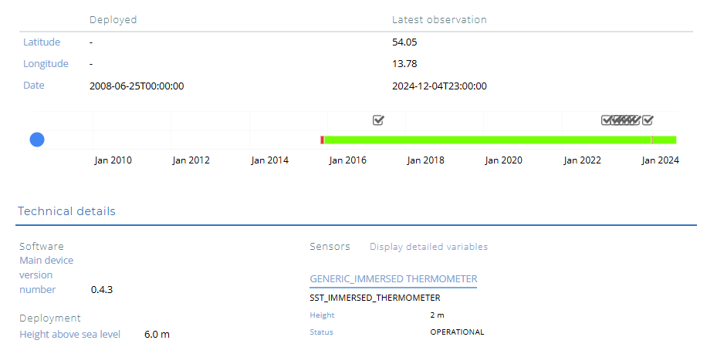
DBND

Slide 9
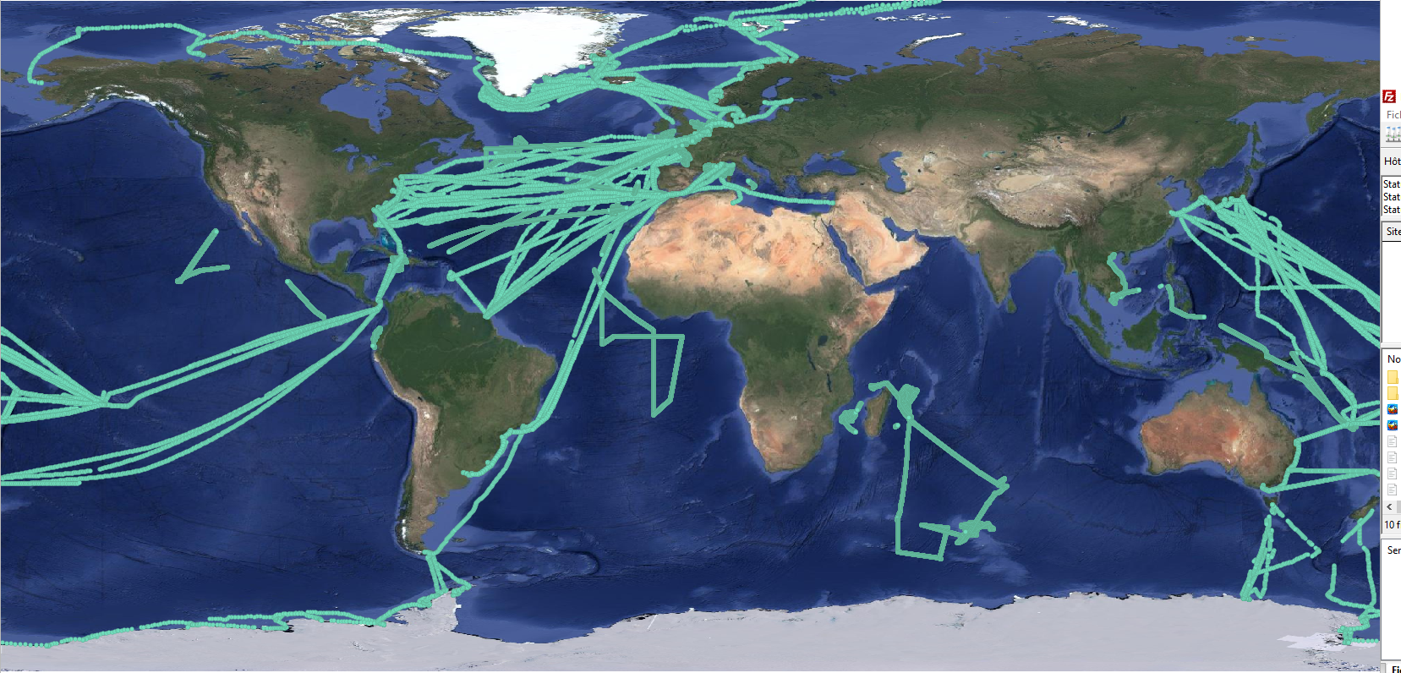
Map for 2024 SNO SSS:

Slide 10
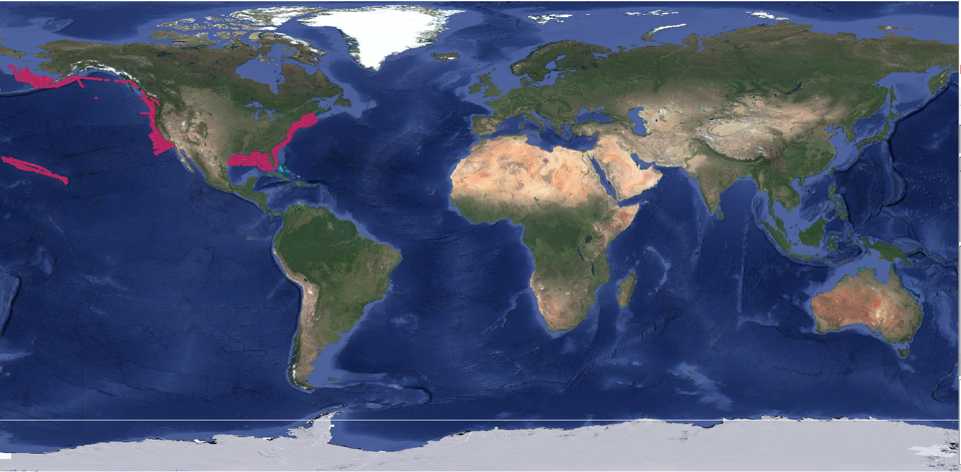
Map for 2024 NOAA:

Slide 11
NOAA Research Vessel
WTDO OREGON II
WTEG Reuben Lasker
WTER MALCOLM BALDRIDGE
WTDL PISCES
WTDF HENRY B. BIGELOW
WTEP OCEANOGRAPHER
WTED BELL M SHIMADA
WTEE OSCAR ELTON SETTE

Slide 12
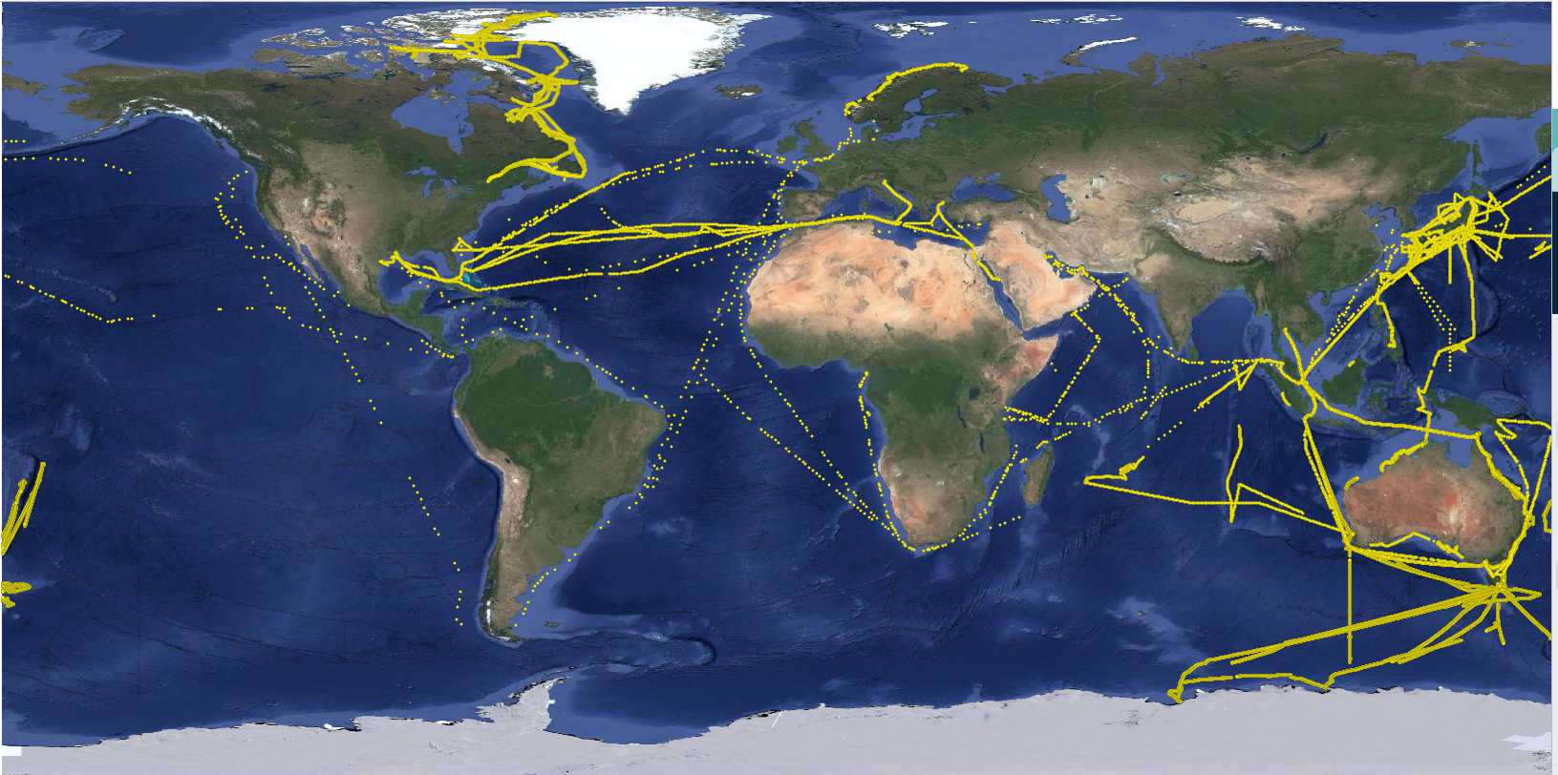
Map for 2024 GTS Trackob:

Slide 13
GTS - TRACKOB (✅ => SST Sensor IMMERSION known , SOT-ID)
2ICI4 BRITISH RESOLUTION
6LDRRAL EUCAWS/NEPTUNE
7KPB GENERIC MANUAL ✅
9HA3731 CMA CGM ELBE
C6YT4 QUETZAL ARROW✅
CGDT AMUNDSEN
DCQP2 ESSEN EXPRESS
DIGX2 MSC LA SPEZIA
DJDS2 LEVERKUSEN EXPRESS
JDSS HAKUHO-MARU ✅
JPBN KEIFU MARU✅
KSKM MAERSK DURBAN✅
LLZY MS Vesteraalen✅
LMSD M/S COLOR FANTASY
UYBWCVN EUCAWS/NEPTUNE ✅
V7DJ7 STI CONNAUGHT
VLMJ Investigator✅
VMFR TURBOWIN+ MANUAL✅
VMIC NUYINA
VMQ9273 SOLANDER✅
VNCF CAPE FERGUSON✅
VNSZ MILOS 500 - YOURLINK
VRDE7 OOCL Houston✅
VROJ8 HIGHLAND CHIEF✅
VRRX9 PEARL ISLAND
WDE9586 ENDURANCE✅
WDF9323 OCEAN FREEDOM✅
XJBI OCEANEX CONNAIGRA✅
XPJ6VHP GENERIC MANUAL✅
ZMFR TANGAROA✅

Slide 14
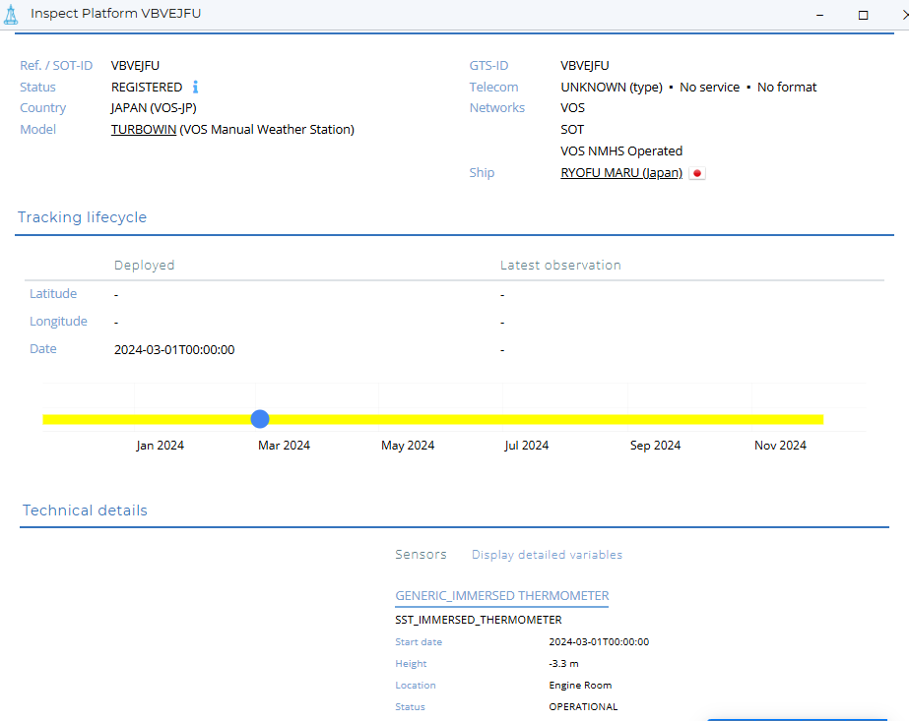
trackob / SBD #100
Weather station
SBD #100
SST
FM62 TRACKOB
??
Weather station
weather +
tsg
SBD #100
SST
FM62 TRACKOB

Slide 15
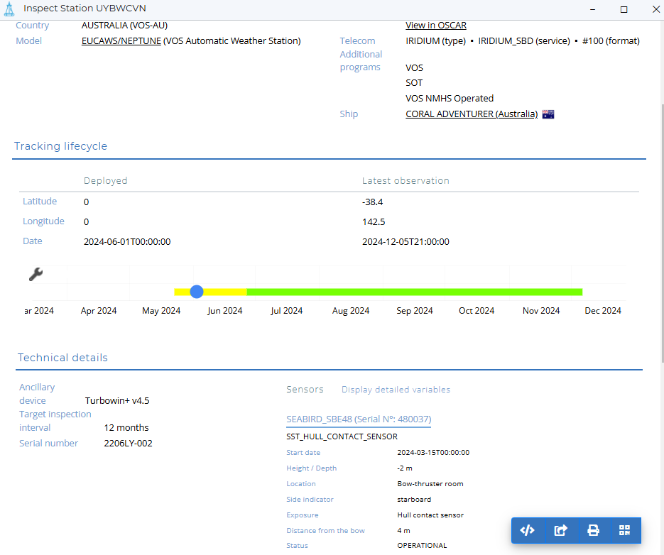
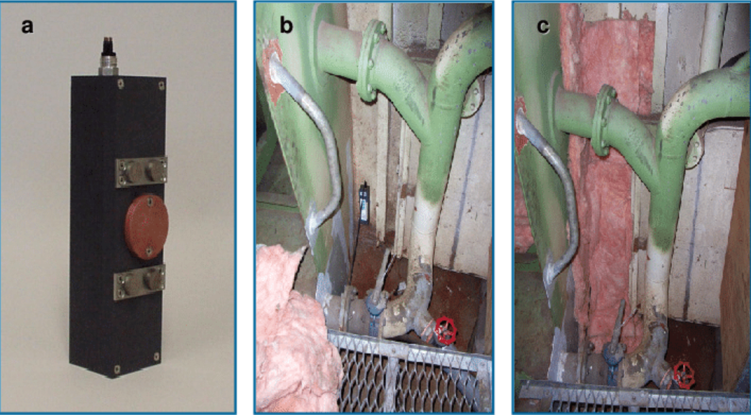

Slide 16
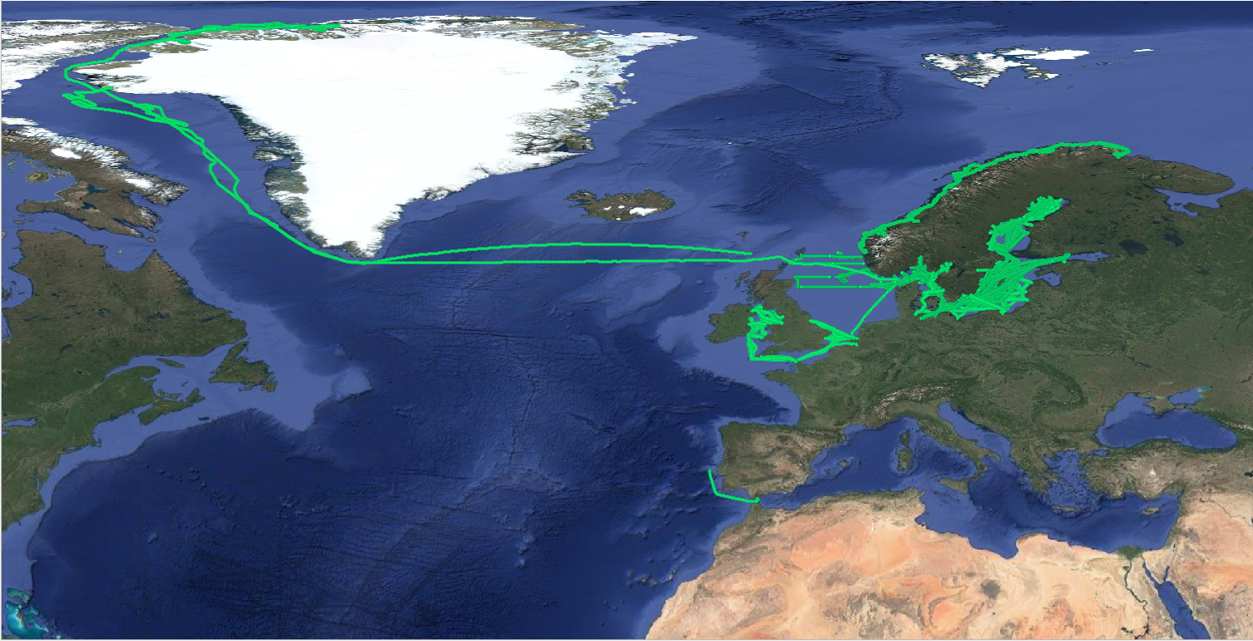
Map for 2024: Ferryboxes

Slide 17
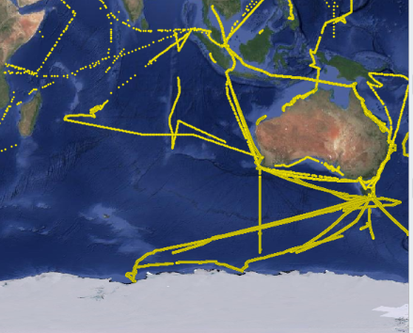
GOSUD for GOSHIP
2024 USA THOMAS G. THOMPSON I08S => no TSG : who should I contact ?
2024 AUS VLMJ =>

Slide 18
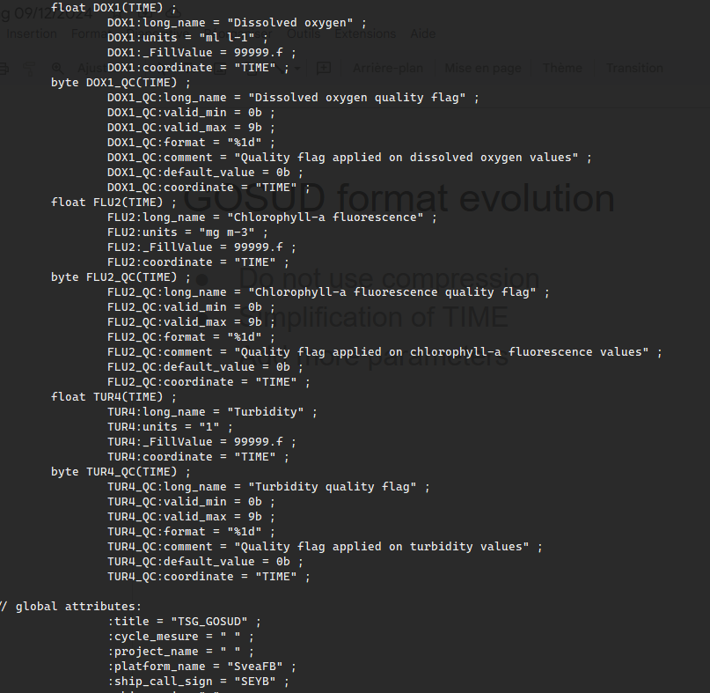
GOSUD format evolution
NetCDF 4 classic
no compression (gunzip)
Simplification of TIME
More parameters

Slide 19
Erddap is under configuration
New format will ease the set up of ERDDAP
It should be available within 3 months
delay due to priority not due to the amount of work
https://erddap.ifremer.fr

Slide 20
GOSUD and IODE
Message from Peter:
Many experts are involved in all three programs, but due to commitments to other well-funded projects, we have limited time to dedicate to these unfunded/volunteer initiatives.
Perhaps a consolidated program encompassing all three could be a more efficient solution.
=> come to IODE-28 with a concrete proposal.
=> An alternative is that IODE_28 establishes an inter-sessional working group to discuss this further

Slide 21
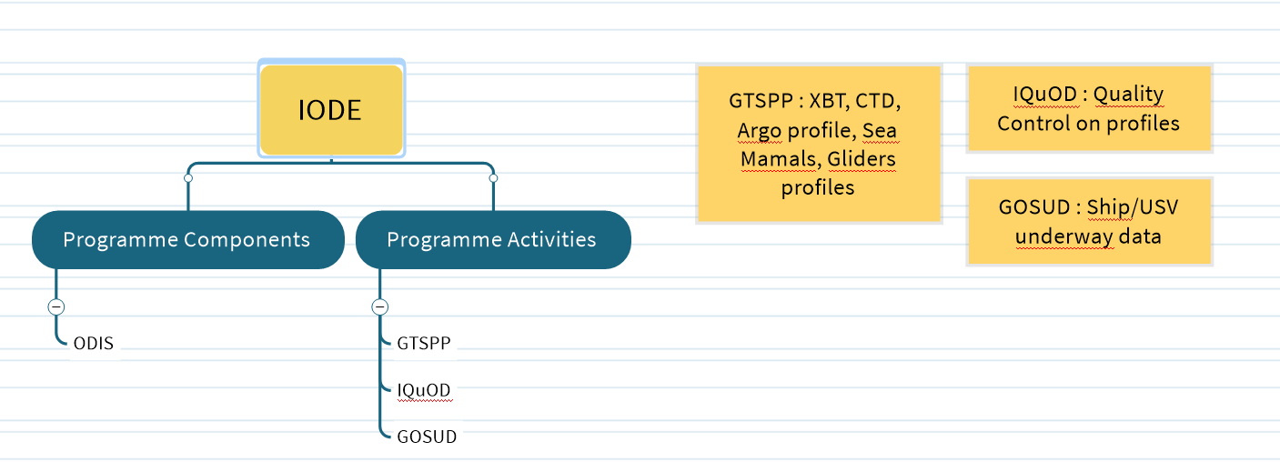

Slide 22
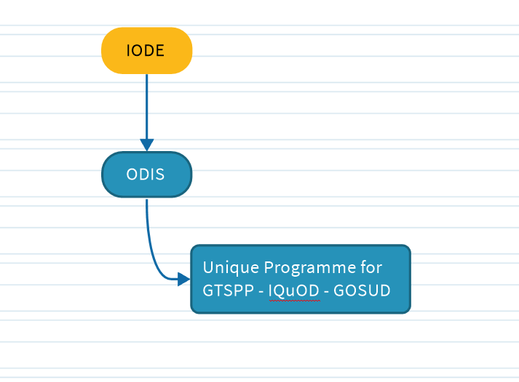

Slide 23
Become an OCG Network
=> OCG Network on its own
or Integrate in SOOP

