Slide 1



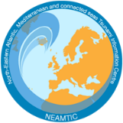


Resp-1: A community tsunami emergency response plan is approved.
Dr. Musavver Didem Cambaz
Kandilli Observatory and Earthquake Research Institute (KOERI)
UNESCO-IOC EU DG ECHO CoastWAVE 2.0 Project
UNESCO-IOC Regional Tsunami Ready Recognition Programme (TRRP) Workshop
Online, January 14-15, 2024

Slide 2
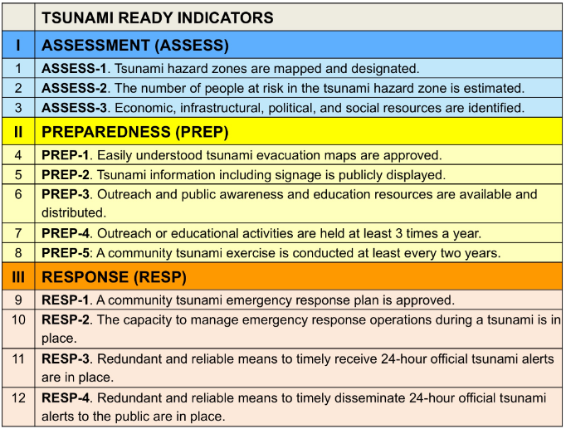
IOC-UNESCO Tsunami Ready Recognition Programme (TRRP) Workshop

Slide 3
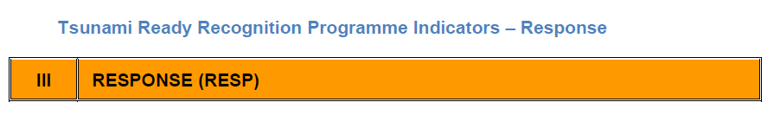
IOC-UNESCO Tsunami Ready Recognition Programme (TRRP) Workshop
For communities with local tsunami hazards;
Response Actions should recommend that during a local tsunami event,
all at-risk individuals should immediately self-evacuate
Individuals, including emergency personnel, will need to take personal responsibility to evacuate immediately after recognizing the natural tsunami warnings or environmental clues of a possible or imminent tsunami.
(MG74)

Slide 4
IOC-UNESCO Tsunami Ready Recognition Programme (TRRP) Workshop
The main purpose of an Emergency Response Plan (TERP) is to prepare for effective response in order to saving and protecting the general public
The TERP covers arrangements for warnings and evacuations and public awareness of these arrangements
The TERP is a written set of instructions detailing what must be done during a tsunami emergency, how people and property are protected and how resources are used
A TERP is supported by agency-specific SOPs that will be activated on the receipt of a tsunami warning or during a local source earthquake that may generate a tsunami
(Harald Spahn; 2022)

Slide 5
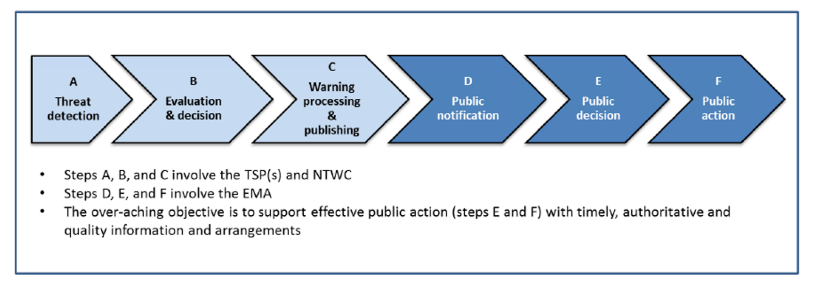
IOC-UNESCO Tsunami Ready Recognition Programme (TRRP) Workshop
End to end Warning and Response Steps during tsunami
(MG76)

Slide 6
IOC-UNESCO Tsunami Ready Recognition Programme (TRRP) Workshop
MG76 provides information on the Emergency Management Authorities (EMA), Tsunami Emergency Response Plans, Tsunami Emergency SOP’s and assist in the preparation of National EMA Tsunami Emergency Response (TER) plans and SOPs.
It covers the role of EMAs during tsunami events as well as their role in the development and maintenance of tsunami response capability.
(Because of the variations in the sizes and complexities of EMAs, their plans and SOP contents vary from one country to another.)
MG76

Slide 7
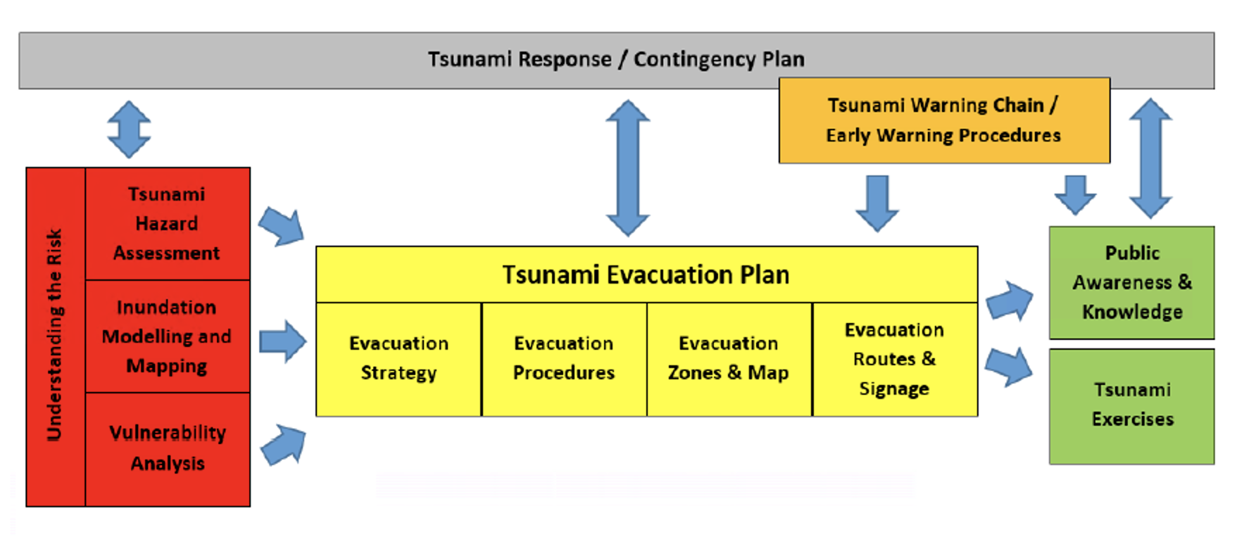
IOC-UNESCO Tsunami Ready Recognition Programme (TRRP) Workshop
Key Elements of community tsunami preparedness and evacuation planning and their interrelationship compiled by (Harald Spahn; 2022)

Slide 8
IOC-UNESCO Tsunami Ready Recognition Programme (TRRP) Workshop
The core responsibilities of the EMA in a tsunami warning are:
To receive official tsunami warning and cancellation messages from the NTWC.
To conduct further threat assessments and decide appropriate action.
To communicate the warnings, with instructions, via public alerting systems and the media.
To activate appropriate emergency response measures, including deciding and managing evacuations.
To communicate the “All Clear” when the threat is over.
* EMA core responsibilities in a tsunami emergency (subject to national protocols)
MG76

Slide 9
IOC-UNESCO Tsunami Ready Recognition Programme (TRRP) Workshop
Tsunami Emergency Response Plans should be developed to specify the arrangements for:
Public awareness and education
Receipt of warnings (from the NTWC), threat assessment and decision criteria
Activation of response arrangements, including public notification mechanisms
Evacuation arrangements.
MG76

Slide 10
IOC-UNESCO Tsunami Ready Recognition Programme (TRRP) Workshop
Tsunami Emergency Response (TER)
The actions taken to ensure public safety by responsible agencies after notification by the TWFP, typically the NTWC.
It includes Standard Operating Procedures (SOP) and Protocols for emergency response and action, organizations and individuals involved and their roles and responsibilities, contact information, timeline and urgency assigned to action, and means by which both ordinary citizens and special needs populations (physically or mentally handicapped, elderly, young children, transient, and marine populations) will be alerted.
For tsunami response, emphasis is placed on the rapidness, efficiency, conciseness, and clarity of the actions and instructions to the public. A Tsunami Emergency Response Plan should also include post tsunami actions and responsibilities for search and rescue, relief, rehabilitation, and recovery.
MG76

Slide 11
IOC-UNESCO Tsunami Ready Recognition Programme (TRRP) Workshop
Tsunami Emergency Response SOP’s
SOPs describe how the operational activities that are covered in the TER plans are to be
performed.
Specific SOPs must be created for each individual TER plan.
They must be trained to ensure that response staff are familiar with them, and they must be exercised to identify gaps or improvements that are to be made.
MG76

Slide 12
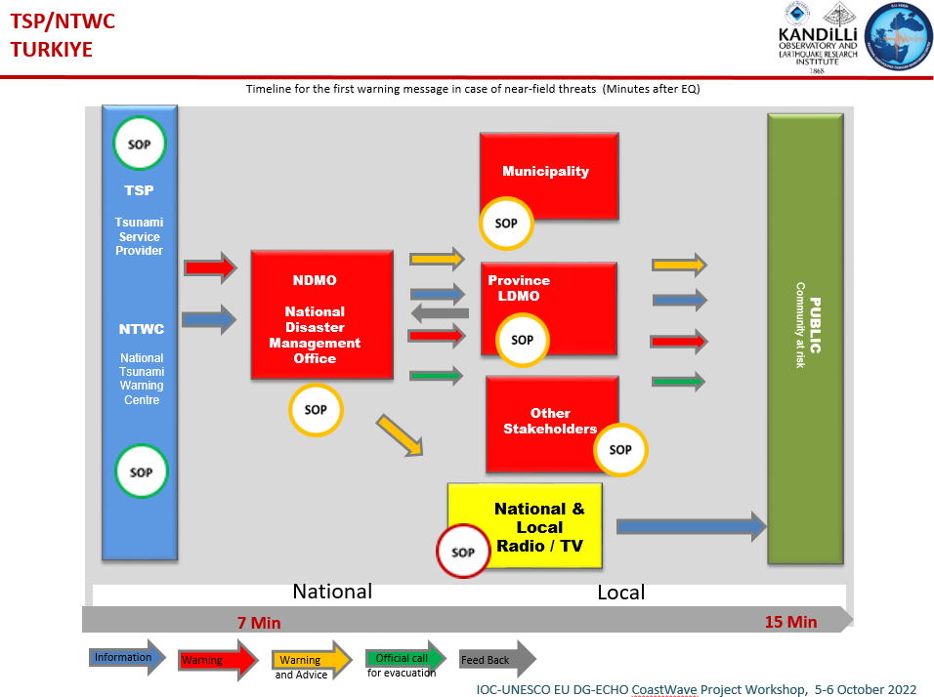
IOC-UNESCO Tsunami Ready Recognition Programme (TRRP) Workshop
IOC-UNESCO EU DG-ECHO
CoastWave Project Workshop, 5-6 October 2022

Slide 13
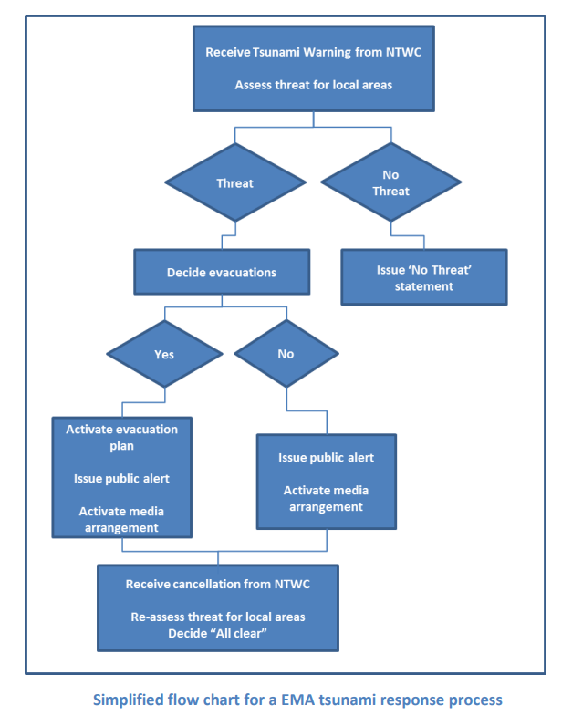
IOC-UNESCO Tsunami Ready Recognition Programme (TRRP) Workshop
Simplified flow chart of EMA
MG76

Slide 14
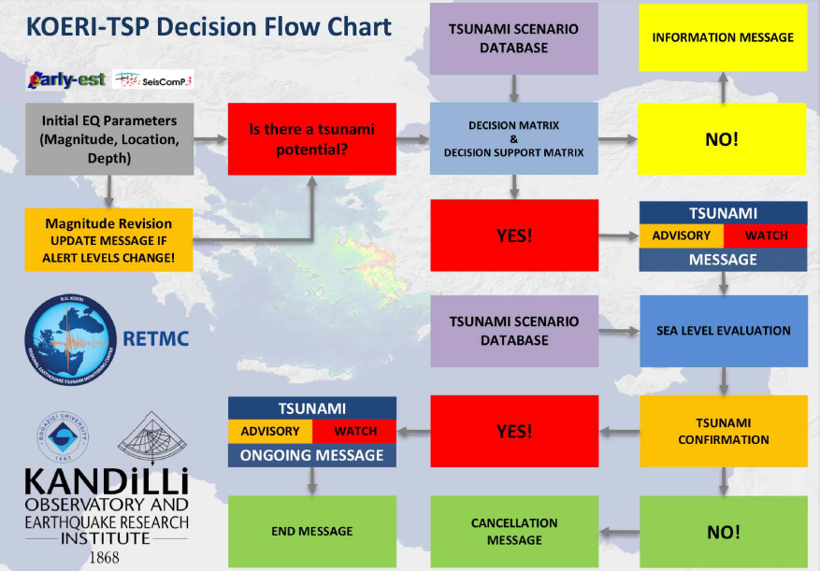
IOC-UNESCO Tsunami Ready Recognition Programme (TRRP) Workshop
Simplified event flow chart for a TSP.
The TSP is responsible for issuing a tsunami warning when there is a potential for a destructive tsunami to hit its coastlines. When waves are no longer dangerous, the TSP will ends/cancels warning.

Slide 15
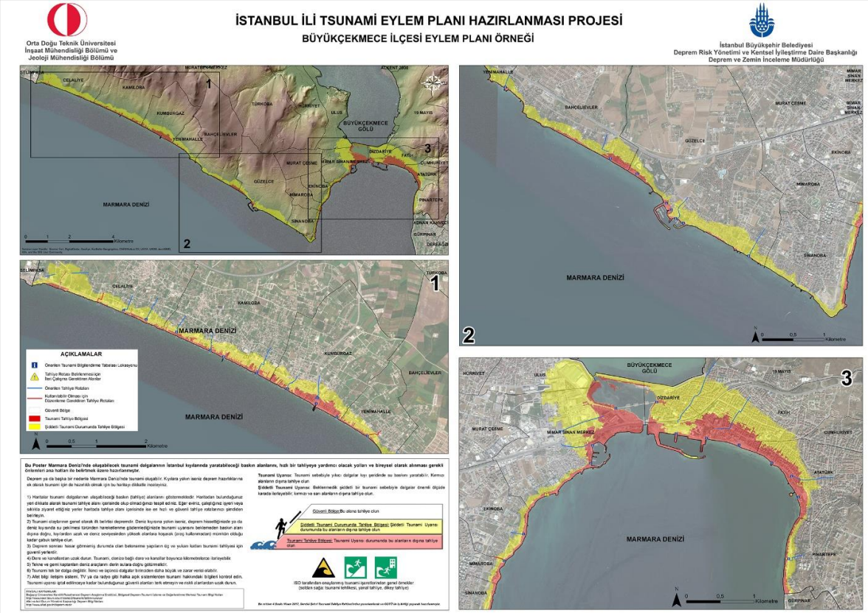

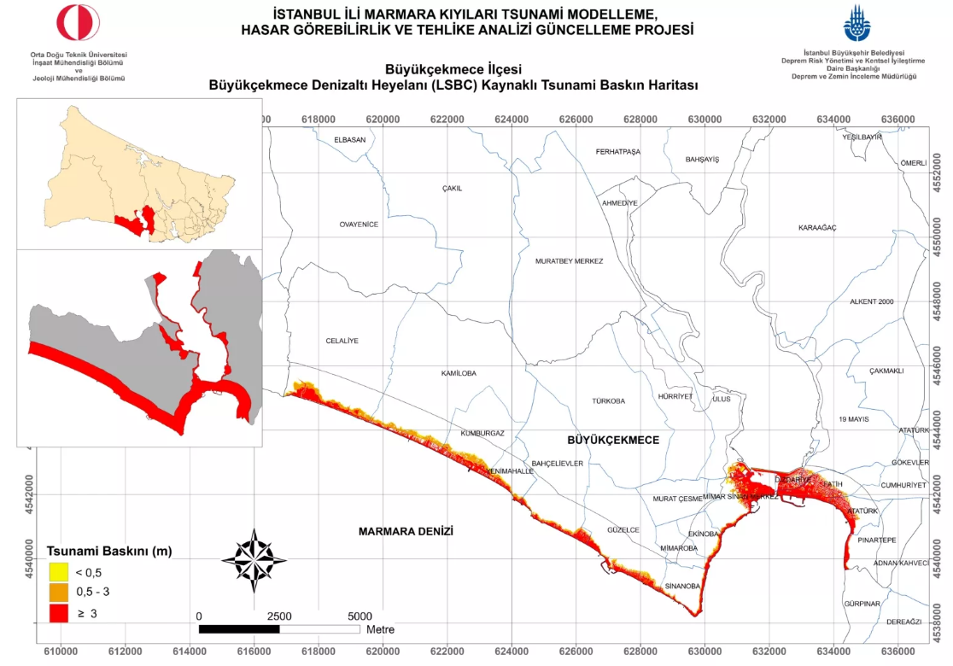
IOC-UNESCO Tsunami Ready Recognition Programme (TRRP) Workshop
https://depremzemin.ibb.istanbul/uploads/prefix-buyukcekmece-tsunami-666af15179435.pdf

Slide 16
IOC-UNESCO Tsunami Ready Recognition Programme (TRRP) Workshop
REFERENCES
Spahn H., 2022. TTF-31 Project “Strengthening tsunami early warning in the North West Indian Ocean region through regional cooperation”.
UNESCO/IOC. 2022. Standard Guidelines for the Tsunami Ready Recognition
Programme. Paris. (IOC Manuals and Guides,74) English.
UNESCO/IOC. 2020. Preparing for Community Tsunami Evacuations: from inundation to
evacuation maps, response plans and exercises. Paris, UNESCO. (Manuals and Guides, 82)
UNESCO/IOC. 2017. Plans and Procedures for Tsunami Warning and Emergency Management. Paris, Intergovernmental Oceanographic Commission of UNESCO 2017. 72 pp.
(IOC Manuals and Guides No.76) English.

Slide 17
UNESCO
Intergovernmental Oceanographic Commission (IOC)
UNESCO-IOC DG ECHO CoastWAVE 2.0 project
Tsunami Resilience Section

