Slide 1

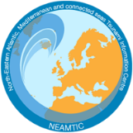
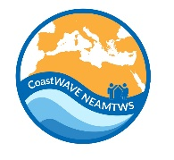
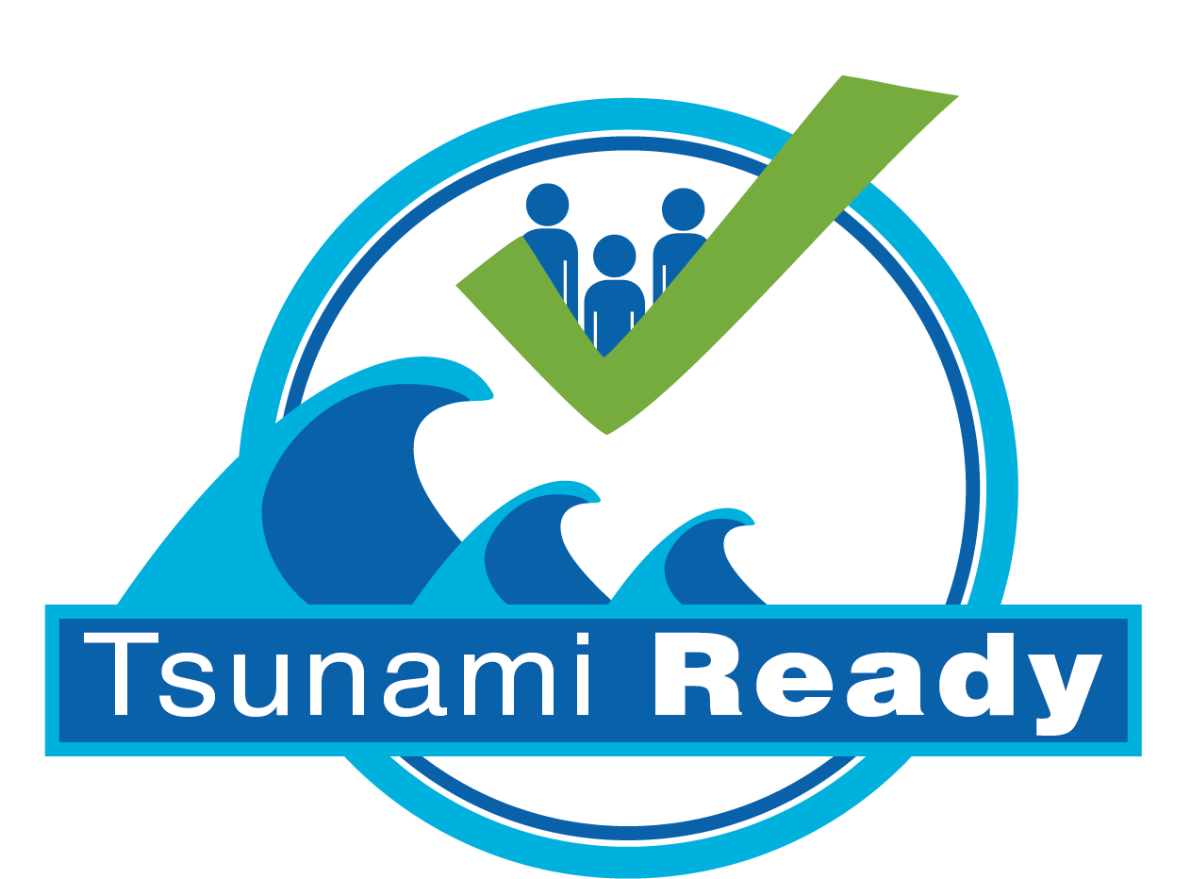
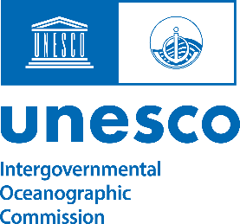
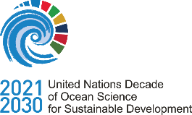
Case Studies: Tsunami Ready Implementation from the CoastWAVE Project
Dr. Derya Vennin
UNESCO-IOC Tsunami Resilience Section
UNESCO-IOC EU DG ECHO CoastWAVE 2.0 Project
UNESCO-IOC Regional Tsunami Ready Training
Online, January 14-15, 2025

Slide 2
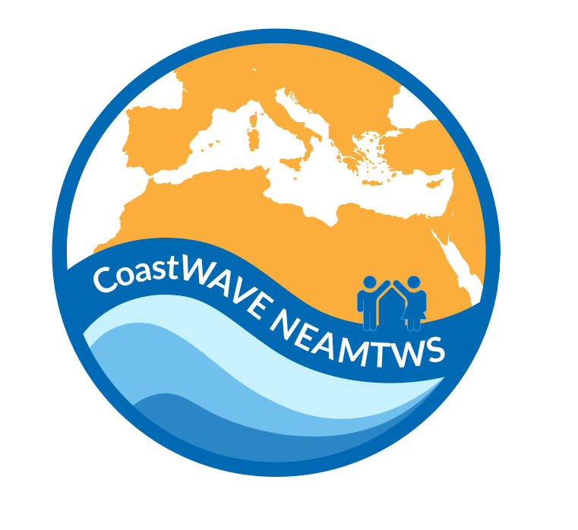
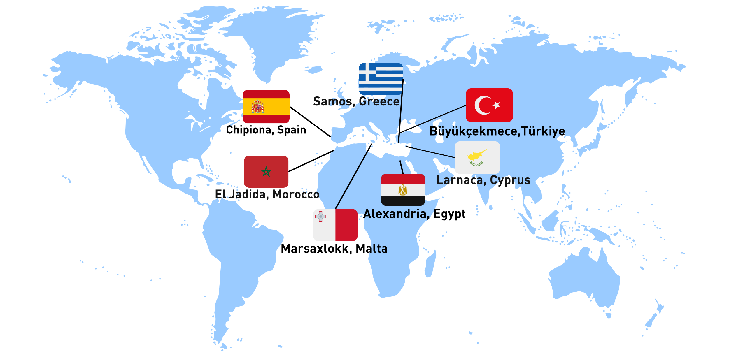
UNESCO-IOC Regional Tsunami Ready Training for NEAM Region
CoastWAVE Project
Objective: Strengthening tsunami preparedness and resilience in the project’s coastal communities.
Focus Areas:
  Implementation of the Tsunami Ready Recognition Programme (TRRP).
  Addressing unique challenges of NEAM regions.
Key Outcomes:
  Enhanced community awareness.
  Improved response protocols and infrastructure.
Notes:
Let’s begin by introducing the CoastWAVE Project, an initiative dedicated to enhancing tsunami preparedness and resilience in coastal communities, particularly in the North-eastern Atlantic, Mediterranean, and Connected Seas (NEAM) region.
The primary focus of the project is implementing the Tsunami Ready Recognition Programme (TRRP) to address the unique challenges faced by these regions. The CoastWAVE Project has already demonstrated its effectiveness through enhanced community awareness and improved response protocols. Today, we will review specific case studies that showcase how the project has been implemented in real-world scenarios.

Slide 3
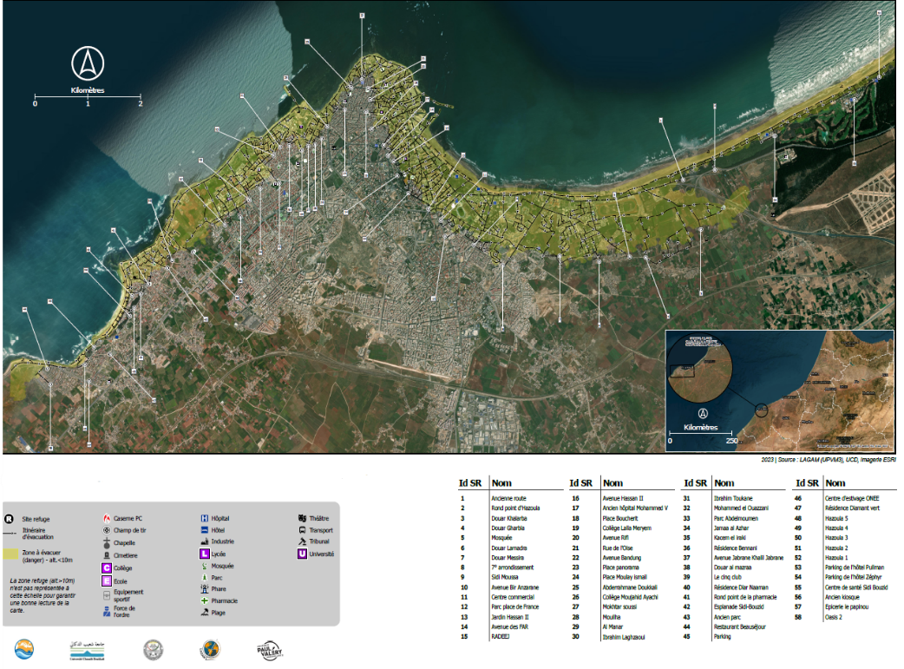
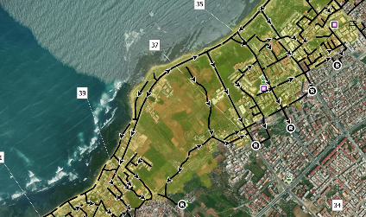
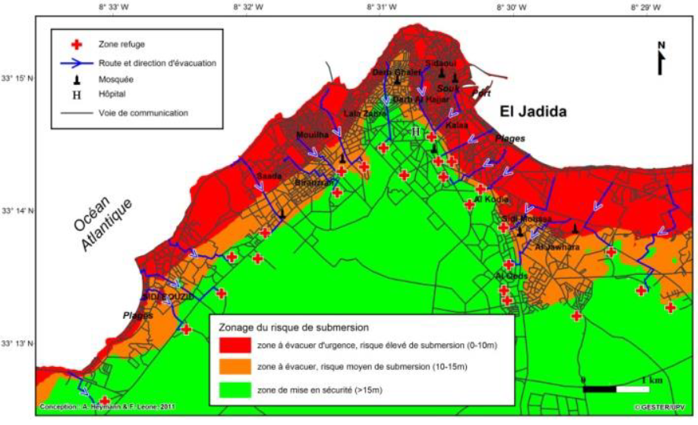
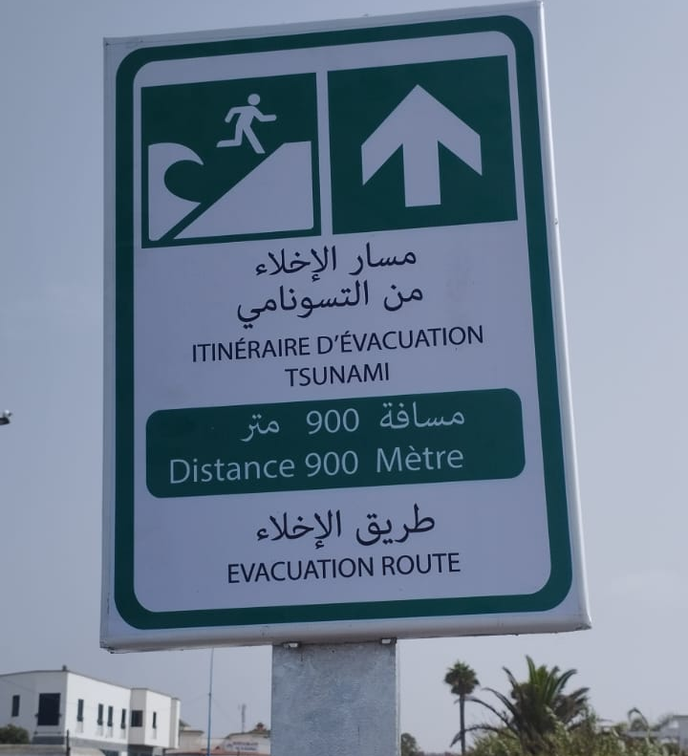
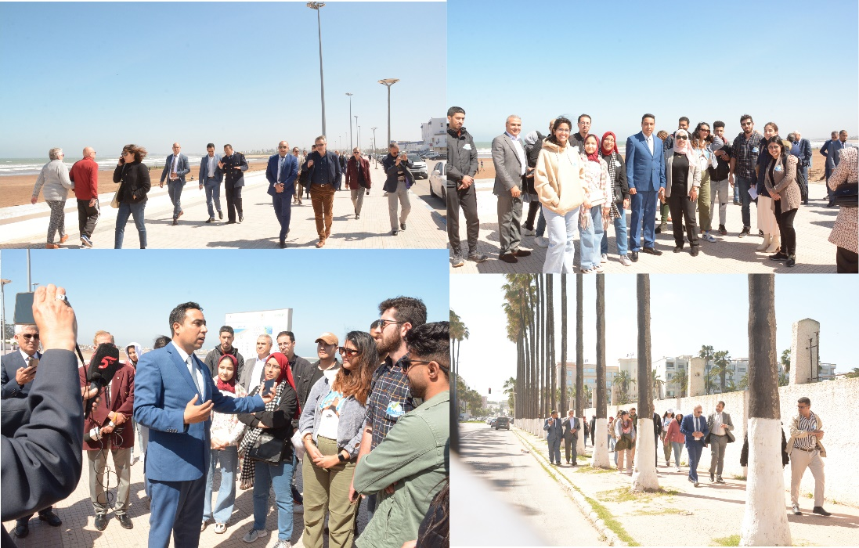
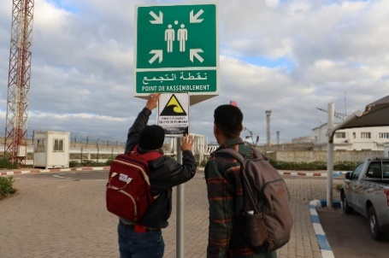
UNESCO-IOC Regional Tsunami Ready Training for NEAM Region
Case Study 1 –El Jadida, Morocco
Key Actions Implemented:
Tsunami Evacuation Maps:
  Developed evacuation routes tailored to local geography.
Public Awareness Campaigns:
  Distribution of educational materials.
  Outreach through schools and community events.
Tsunami Drills:
  Regularly conducted, involving residents and local authorities.
Notes:
Our first case study takes us to [Community Name].
This community implemented three key actions:
Tsunami Evacuation Maps were developed with routes tailored to the local geography, ensuring that residents could quickly and safely evacuate during a tsunami.
Public Awareness Campaigns played a vital role in educating the community. Materials were distributed, and schools and community events were used to spread critical information.
Tsunami Drills were conducted regularly, involving not only residents but also local authorities to improve coordination.
As a result of these efforts, the community demonstrated increased understanding of tsunami risks and showed improved preparedness during drills. This underscores the value of localized planning and active community engagement.

Slide 4
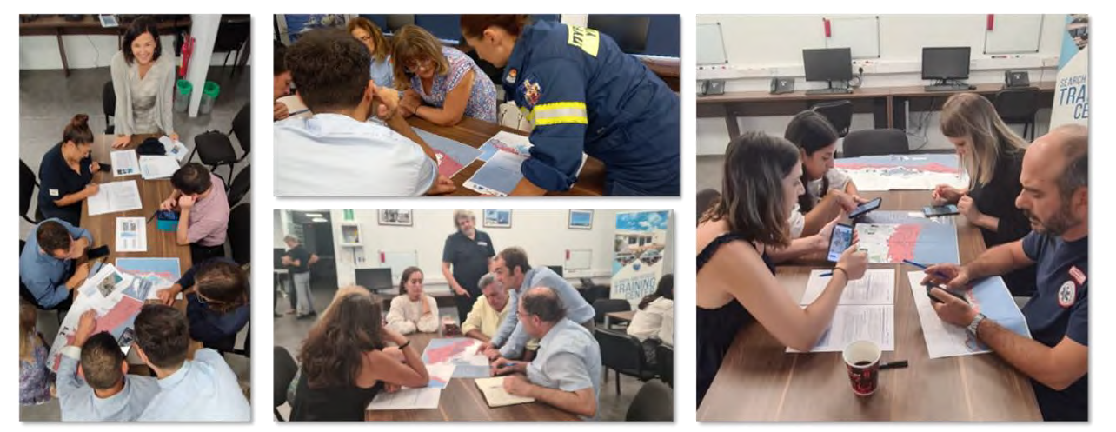
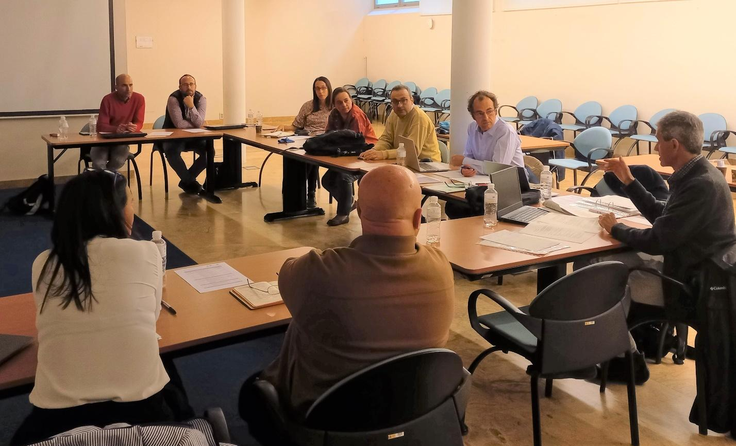
UNESCO-IOC Regional Tsunami Ready Training for NEAM Region
Case Study 2 –Chipiona, Spain
Key Actions Implemented:
Warning Systems:
  Installation of redundant communication networks.
Training for Emergency Responders/ SOP Workshops:
  Capacity building for timely alerts and response.
Engagements in National and local levels:
  Formation of local and national tsunami preparedness committees.
Notes:
Next, let’s examine the second case study from [Community Name].
This community focused on three primary initiatives:
Warning Systems were installed, featuring redundant communication networks to ensure alerts could be received promptly.
Training for Emergency Responders helped build capacity for timely and effective emergency response during tsunami events.
Community Engagement saw the formation of local preparedness committees, which played a key role in organizing and mobilizing residents.
The results were significant. Response times during emergencies were reduced, and trust between local authorities and the community was strengthened, creating a more resilient population.

Slide 5
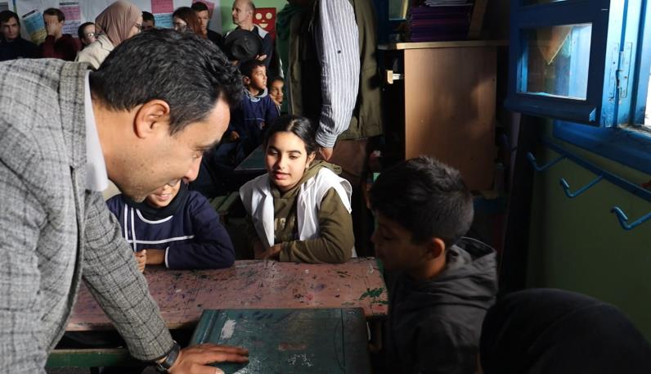
UNESCO-IOC Regional Tsunami Ready Training for NEAM Region
Lessons Learned
Local Adaptation is Key: Solutions must be tailored to specific community needs and geography.
Community Involvement Matters: High engagement ensures greater preparedness and ownership.
Regular Drills Enhance Readiness: Periodic exercises improve response efficiency and highlight areas for improvement.
Collaboration Works: Partnerships between international organizations, local governments, and residents yield sustainable results.
Notes:
From these case studies, we can derive several important lessons:
First, local adaptation is key. Communities must tailor their solutions to meet their specific needs and challenges.
Second, community involvement matters. Engaged residents are more likely to take ownership of preparedness efforts and act decisively in emergencies.
Third, regular drills enhance readiness. These exercises not only improve response efficiency but also help identify areas for improvement.
Finally, collaboration works. Partnerships between international organizations, local governments, and community members yield the best results for disaster preparedness.

Slide 6
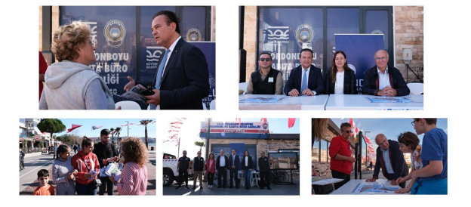
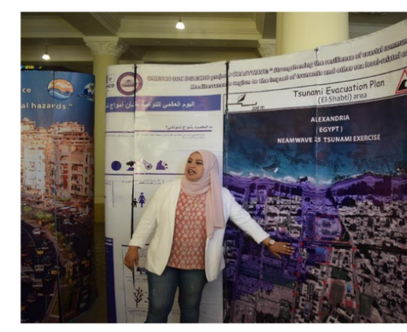
UNESCO-IOC Regional Tsunami Ready Training for NEAM Region
Moving Forward
Expand the implementation of the Tsunami Ready Programme to additional communities.
Leverage the success of CoastWAVE to:
  Share knowledge and tools with global coastal regions.
  Strengthen international collaboration for disaster risk reduction.
Continue to foster a culture of preparedness and resilience.
Notes:
As we move forward, the lessons from the CoastWAVE Project provide a roadmap for expanding the Tsunami Ready Programme to additional communities. By sharing the knowledge and tools developed here, we can strengthen tsunami resilience in coastal areas worldwide.
Let’s leverage the success of the CoastWAVE Project to:
Promote collaboration across regions,
Foster a culture of preparedness, and
Build safer, more resilient communities for generations to come.
Thank you for your attention, and I look forward to any questions or discussions you may have.

Slide 7
UNESCO
Intergovernmental Oceanographic Commission (IOC)
UNESCO-IOC DG ECHO CoastWAVE 2.0 project
Tsunami Resilience Section

