Slide 1
ICG/CARIBE EWS, Steering Committee 27 & 29 January 2025
Working Group 1: Risk Knowledge – progress report
Chair: Frédéric Dondin (France)
Vice-Chair: Raphaël Paris (France)
Recommendations to WG1, last ICG CARIBE EWS meeting, April 2023:
To organize an Experts Meetings on “Non-Seismic Sources of Tsunamis for the Caribbean”.
To organize an Experts Meetings on “Seismic Sources of Tsunamis in the NW Caribbean”.
To compile and prioritize a list of non-seismic sources; encourages models of scenarios to be available, when possible.
To provide WG2 with the parameters, including associated files (e.g., shapefiles, geotiff, etc.) of tsunami scenarios once they are available for future Caribe Wave exercises.
To organize a regional training on the development of digital elevation models (DEMs) for tsunami inundation modeling.

Slide 2
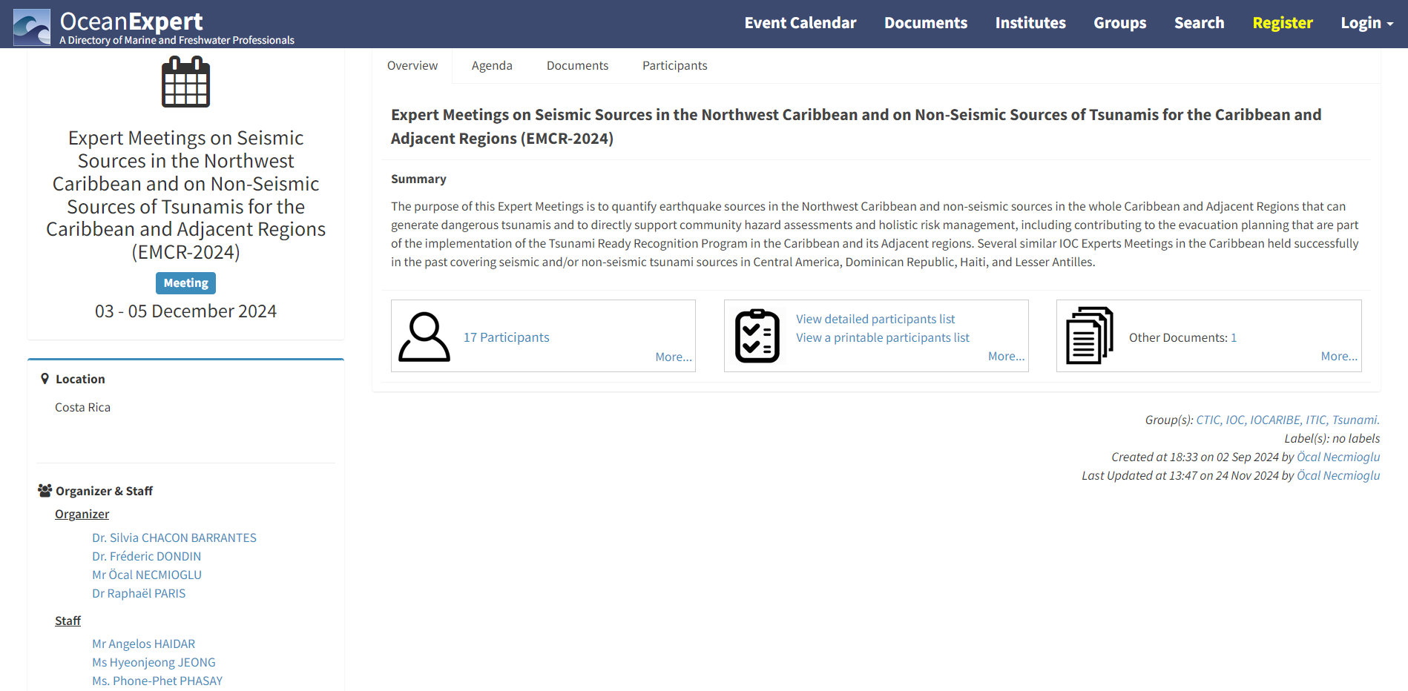
Summary
The purpose of this Expert Meetings is to quantify earthquake sources in the Northwest Caribbean and non-seismic sources in the whole Caribbean and Adjacent Regions that can generate dangerous tsunamis and to directly support community hazard assessments and holistic risk management, including contributing to the evacuation planning that are part of the implementation of the Tsunami Ready Recognition Program in the Caribbean and its Adjacent regions.

Slide 3
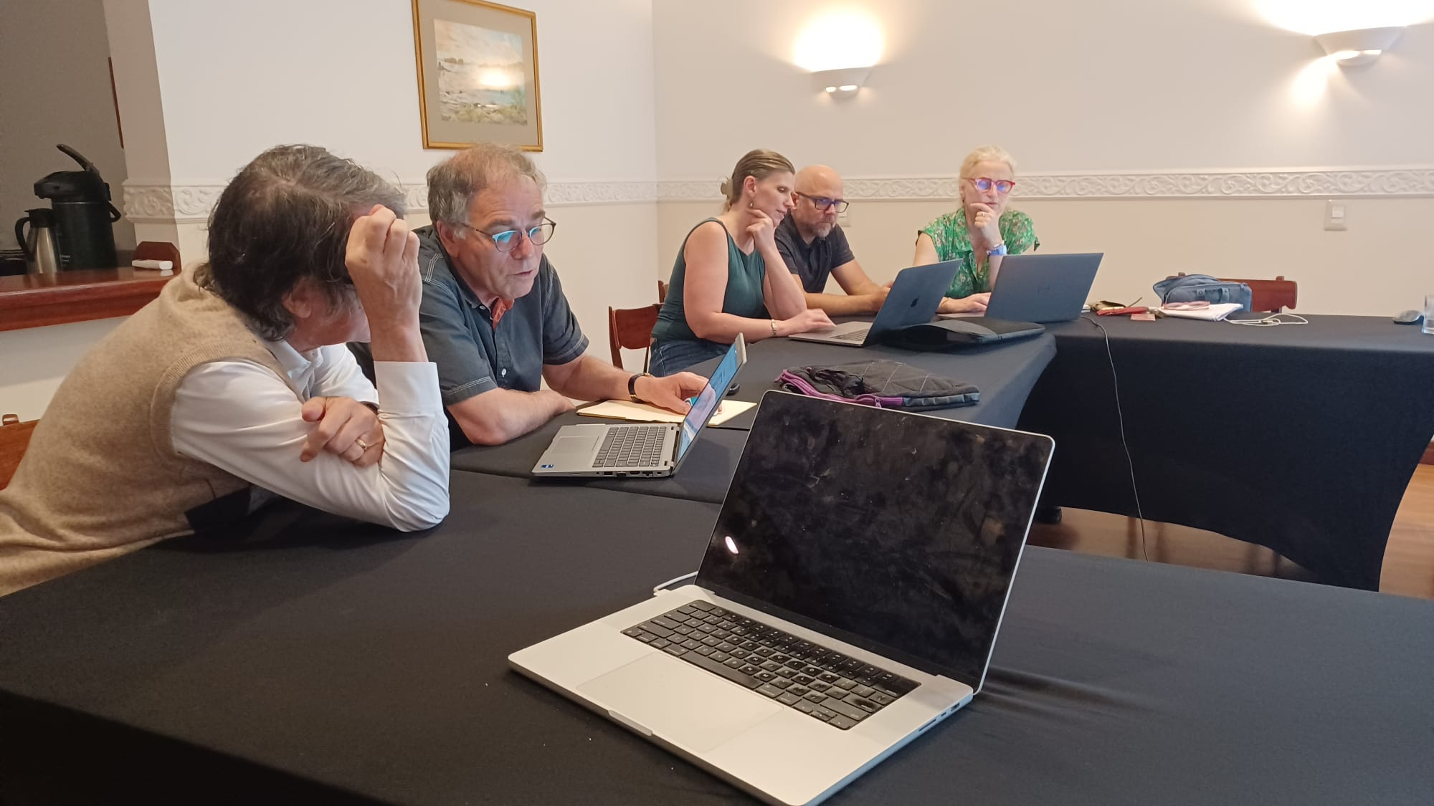
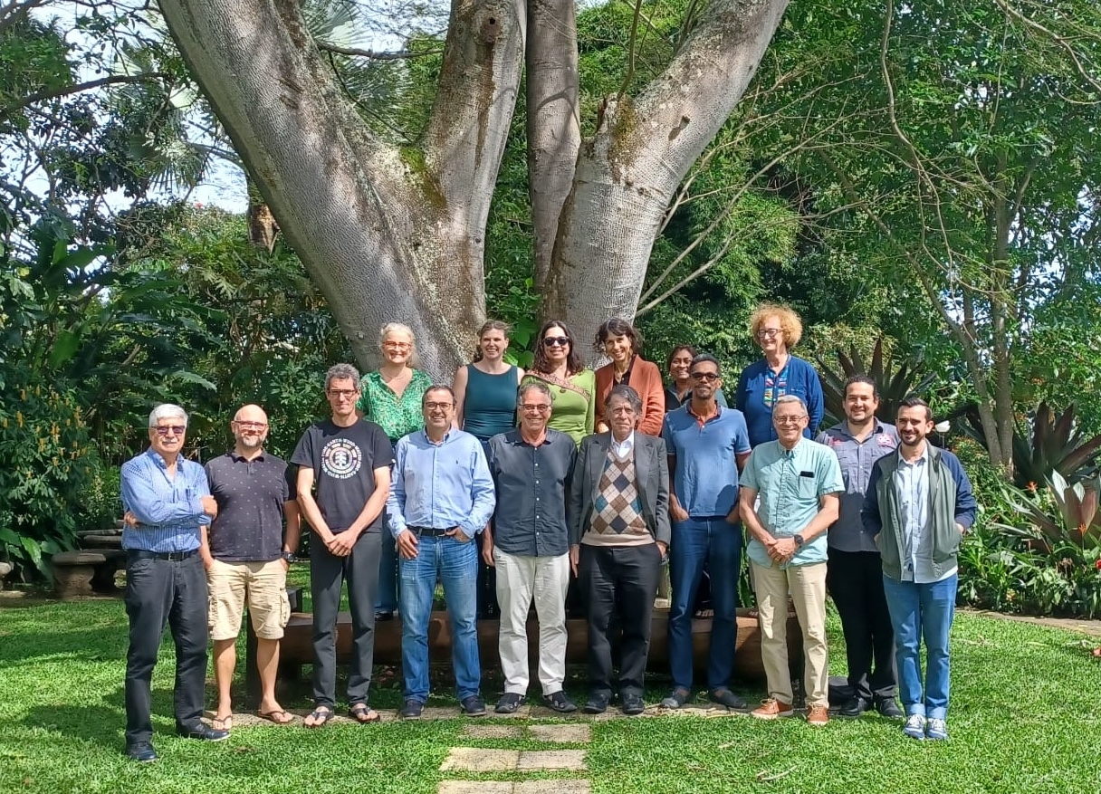
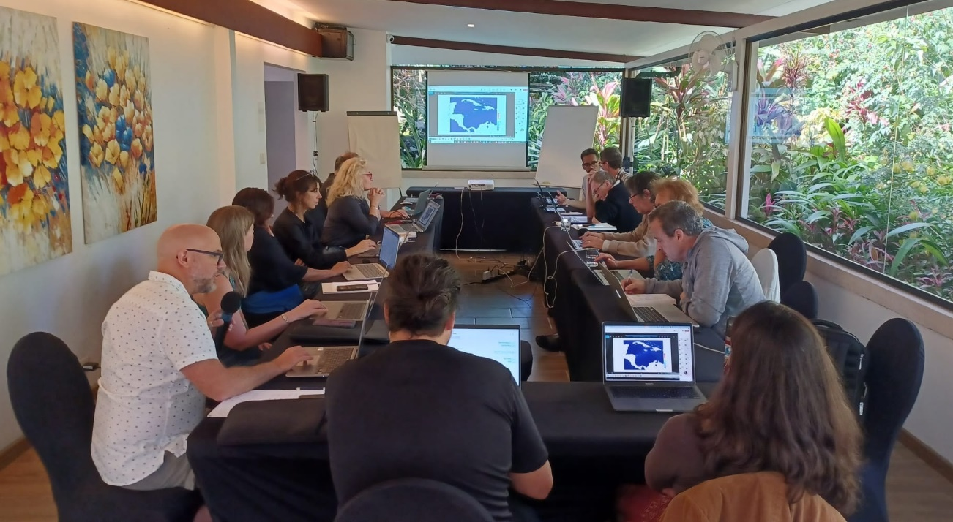
La Heredia, Costa Rica, December 3-5, 2024
With local support from SINAMOT- Universidad Nacional
21 experts from 6 different countries

Slide 4
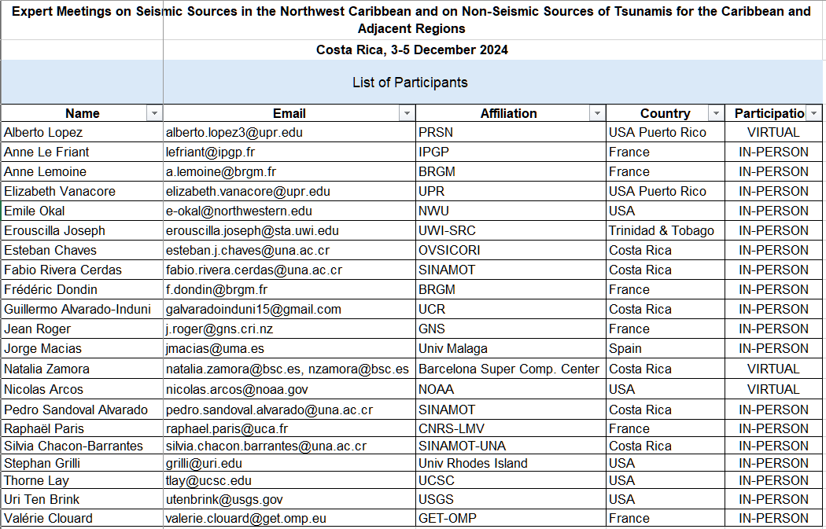

Slide 5
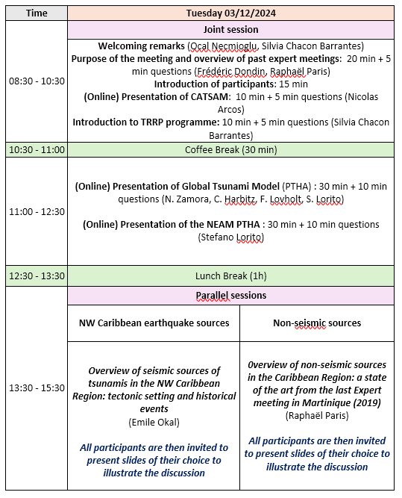
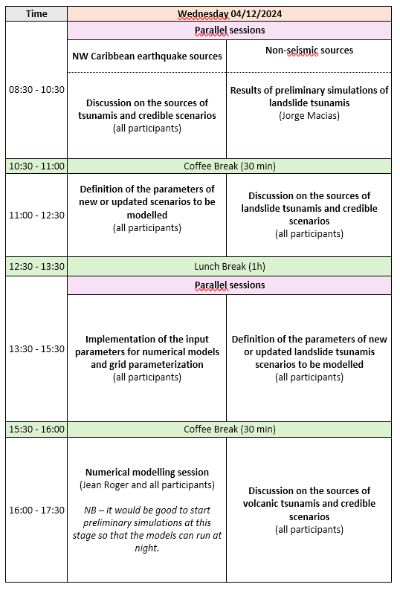
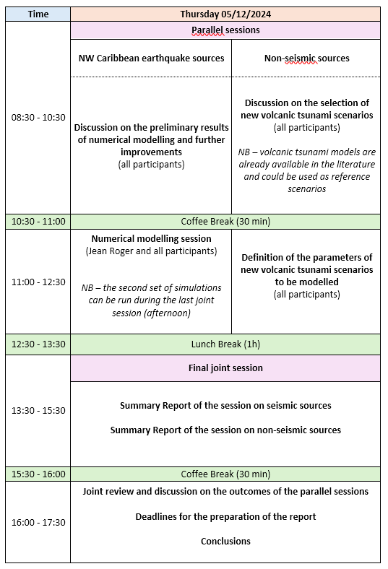
Agenda of the meeting: a hybrid meeting with both joint and parellel sessions

Slide 6
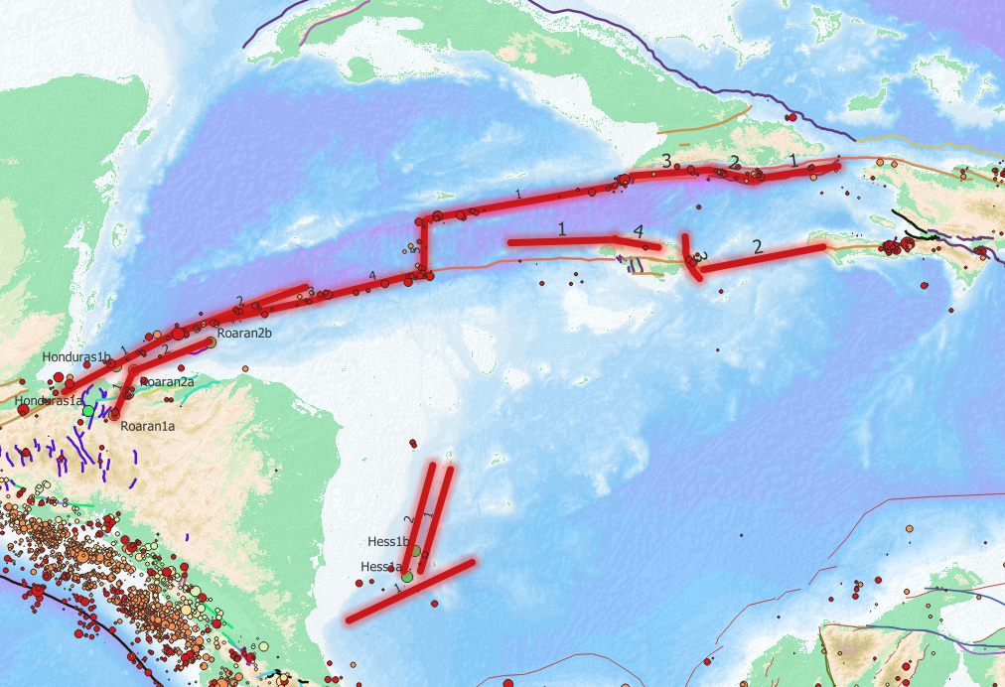
Seismic sources NW Caribbean
The experts reviewed the literature and the scenarios currently implemented in the CATSAM.
The experts proposed new and/or updated scenarios of seismic ruptures for 6 subregions: the Cuba Southern Deformation Belt, Jamaica, the Mid-Cayman Spreading Center, the Oriente and Swan Faults, the Montagua Fault and Roatan, the San Andres Rift, and the Hess Escarpment.
Some preliminary numerical simulations were run during the meeting.

Slide 7
Non-seismic sources of tsunamis in the Caribbean
The experts reviewed the list of non-seismic tsunami scenarios found in the literature (and simulated) and they proposed to implemented a scenario of landslide offshore Mount Pelée (Martinique, Poulain et al., 2023) in the CATSAM database, together with a landslide in the Mona Passage (Lopez-Venegas et al., 2008).
The expert designed a list of new scenarios of non-seismic tsunamis to be simulated in the future: 3 scenarios of non-volcanic landslides (with 3 sub-scenarios corresponding to different volumes), and 5 scenarios of volcanic tsunamis (see table below). Most of them will be simulated before the final report is delivered.

Slide 8
The experts discussed the feasibility of a probabilistic framework for tsunamis generated by submarine landslide in the Caribbean, taking as an example the study realized on the East Coast of the US (Grilli et al., 2009).
To reach this goal, the experts underlined the need for a Caribbean-scale dataset of bathymetric grids to derive slope maps. Other useful data include sediment mechanical properties (inferred from core drilling), and seismic profiles. The experts reviewed the different opportunities of external funding to address the challenge task of building a submarine landslide PTHA for the Caribbean.
For the volcanic sources of tsunamis, a Bayesian Event-tree approach is proposed, as developped by Paris et al. (2019) in the Campi Flegrei caldera (Italy).

Slide 9
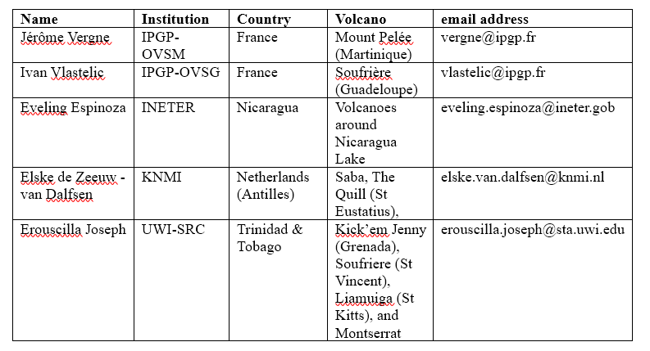
Both seismic and non-seismic experts agreed to propose a hybrid scenario combining earthquake and landslide along the Muertos Trough -> CATSAM and future CaribeWave scenario.
Discussion on the relevance of a meeting between volcano observatory staff and a selection of members of WG1, WG2, and WG3. To be organized during the second half of 2025?
For information, below is an updated list of the people to contact:

Slide 10
Recommendations last ICG CARIBE EWS meeting, April 2023:
To organize a regional training on the development of digital elevation models (DEMs) for tsunami inundation modeling.
Still relevant but ranked as priority 2 compared to the two expert meetings.
As a reminder, the aims of the training would be to:
1. Review and evaluate the required methods and data sets, including
bathymetry and coastal topography for determining the coastal hazards.
2. Advise the member states on the requirements for operating the
appropriate models.
3. Develop capacity building for the appropriate modelling.
Discussions with NOAA and Univ. Colorado are underway to define the arrangements for the workshop (number and selection of participants, tentative period, technical needs, etc.).

