Slide 1
The Intergovernmental Coordination Group for the Tsunami and Other Coastal Hazards Warning System for the Caribbean and Adjacent Regions (ICG/CARIBE-EWS)
4.3 WG3: Tsunami Warning Dissemination and Communication Progress Report and Recommendations
Christa von Hillebrandt, Chair
Susan Hodge, Vice Chair
January 24, 2025
#TSUNAMIREADY

Slide 2
Terms of Reference
Purpose: To examine current and developing capacities and advise the ICG about the definition and composition of early warnings and tsunami products and the methods and best practices for effective end-to-end dissemination and communication.
Tasks:
- Explore and document the dissemination capabilities and existing alert guidance in the countries of the region.
- Identify the difficulties and challenges existing in the region that hinder the impact of “end to end” dissemination and communication of early warnings.
- Establish strategies for the development and implementation of methods and technologies to strengthen the interaction with the media and dissemination of early warnings within the countries of the region.
- Evaluate communication tests and tsunami exercises, in order to identify weaknesses and make recommendations to help strengthen these delivery systems
- Create communication protocol and standardized information identifying the minimum acceptable levels for communication and dissemination of tsunami early warning in all countries for approval by the ICG.
- Provide feedback to the Tsunami Service Providers on its products and communication procedures.
- Serve as a reviewing and approving body for proposed changes to TSP products for the CARIBE-EWS, or determine if proposed changes warrant going to the ICG for review and approval.
- Present a progress report based on the Key Performance Indicators related to the UN ODTP.
- Promote the sharing of experience and expertise, and capacity building essential to effective tsunami warning dissemination and communication.
#TSUNAMIREADY

Slide 3
The Focus Area of WG 3

Slide 4
Membership
21 members, 17 regular (including TSP’s PTWC and CATAC), 2 Ex Officio (ICG Chair and ICG Executive Secretary), and representative of UNDRR Americas (Jair Torres) and WMO Representative for North America, Central America, and the Caribbean (Rodney Martinez)
CARIBE-EWS Member States in WG 3
Barbados, UK (Cayman Islands, Anguilla), USA (PR, USVI, PTWC), Costa Rica, France, Guatemala, Nicaragua, Saint Lucia
CARIBE-EWS Observers in WG 3
PRSN

Slide 5
WG 3 Workplan
ACTION | Lead | DEADLINE
Hold quarterly meetings of the WG | Chair/Co-Chair | February 2025 April 2025
Using the Inventory document the dissemination capabilities and existing alert guidance in the countries of the region, especially best practices, including traditional and technological solutions. | WG 3 with support ITIC-CAR
Evaluate CARIBE WAVE 25, in order to identify weaknesses and make recommendations to help strengthen these delivery systems and develop recommendations tsunami warning dissemination and communication actions for CARIBE WAVE 25 and future exercises | WG 3 | July 2024 April 2025
Evaluate and Provide input to the SOPs of the TSP and the UNESCO/IOC Tsunami Watch Operation Global Service Definition Document | WG 3
Evaluate how WG 3 could support the MS and the Secretariat to have up to date SOPs and designations of warning authorities | WG 3 | February 2025
Upon request, provide feedback to the Tsunami Service Providers on its products and communication procedures and reviewing and recommend actions for proposed changes to TSP products | WG 3
Review and revise Technical, Logistical and Administrative Requirements of a Regional Tsunami Service Provider for CARIBE-EWS and present at its XVIII session at the latest | WG 3 | May 2025

Slide 6
Activities since ICG XVII
Disseminated the Inventory of Communication Methods
Meetings
October 8, 2024
January 24, 2025

Slide 7
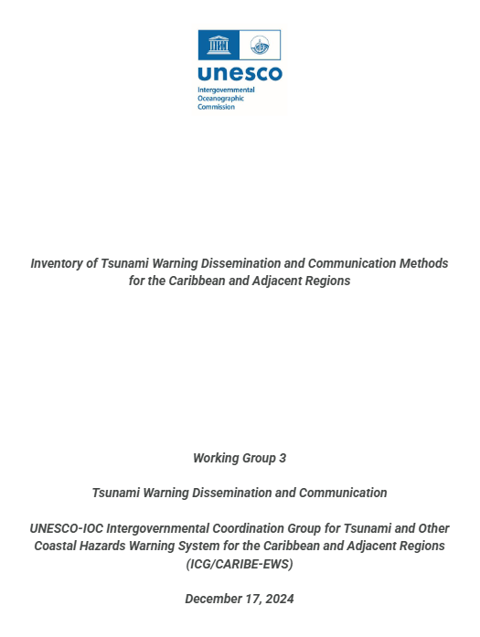
Working Group 3 with support of ITIC-CAR
Inventory of > 30 methods available for the reception of TSP products and dissemination and reception of tsunami warnings and other related products.
Overview of the methods and mechanisms used at different level and agencies from TSP’s through national authorities down to the private sector, media and communities and local governments.
Challenges of redundant and robust methods.
Systems for people with disabilities.
Basis for inventory within MS and to identify Capacity Development activities
#TSUNAMIREADY

Slide 8
Inventory of Tsunami Warning Dissemination and Communication Methods for the Caribbean and Adjacent Regions
Antigua & Barbuda
Bahamas
Barbados
Belize
Brazil
Canada
Colombia
Costa Rica
France (Guadeloupe, Saint Barthelemy, Saint Martin, Martinique, Guyane)
Grenada
Guatemala
Guyana
Haiti
Honduras
Jamaica
Mexico
Nicaragua
NL (Curacao)
Panama
Saint Kitts and Nevis
Saint Vincent and the Grenadines
UK (British Virgin Islands)
US (Puerto Rico)
Venezuela
Cuba
Dominica
Dominican Republic
NL (Aruba, Bonaire, Saba, Sint Eustatius, Sint Maarten)
Saint Lucia
UK (Anguilla, Bermuda, Cayman Islands, Montserrat, Turks and Caicos)
US (U.S. Virgin Islands)
24 Total responses from 31 member states as of: 1/23/2025
Pending:

Slide 9
Inventory of Tsunami Warning Dissemination and Communication Methods for the Caribbean and Adjacent Regions
Most use
METHOD | RECEPTION | DISSEMINATION | TOTAL
Email | 23 | 20 | 23
Phone call/tree | 9 | 16 | 17
Websites | 11 | 16 | 19
Social Media (FB, X, Instagram) | 5 | 17 | 17
SMS | 6 | 12 | 13
Whatsapp | 4 | 16 | 16
Television | 4 | 10 | 11
CISN Display | 10 | 1 | 11
Megaphones | 2 | 11 | 11

Slide 10
Inventory of Tsunami Warning Dissemination and Communication Methods for the Caribbean and Adjacent Regions
Least Use
METHOD | RECEPTION | DISSEMINATION | TOTAL
EMWIN/HRIT | 3 | 0 | 3
Emergency broadcast radios (e.g. NOAA Weather Radio) | 3 | 1 | 3
Advanced Weather Interactive Processing System (AWIPS) | 2 | 1 | 2
GEONETCast Americas (GNC-A) | 2 | 0 | 2
AISR/AFTN | 1 | 0 | 1
RANET Alert Watcher (RAW) | 1 | 0 | 1
Really Simple Syndication (RSS) | 0 | 1 | 1
Slack | 1 | 1 | 1
WMO Global Maritime Distress and Safety System | 1 | 1 | 1

Slide 11
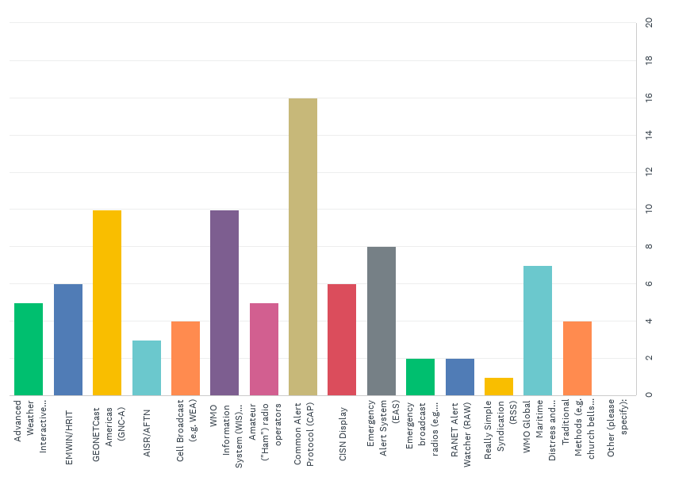
Training Priorities

Slide 12
Member States/Territoires comments
Nicaragua: “Referring the Fax Point, I think is important to evolve to Apps instead of Fax to disseminate information. It was a good decision to give time for the transition until March 31st, 2025”
Guatemala: “For our institution, the GEONETCast method was of great interest since this method was intended to be implemented in the institution some years ago, however, we lacked the costs and necessary supplies to complete the project, however, we are interested in resuming training for this type of system since we do not have a wide range of reception and dissemination of information and this could be a good starting point for a new method of reception and dissemination of warning information in case of a tsunami that affects our coasts.”
Curacao: “* Add use of channels for whatsapp for dissemination of messages as pro, and con the use of whatsapp group for disseminating messages to larger groups is cumbersome. * Chapter on Volcanic generated Tsunamis is very technical, should be revised to layman's terms”
Haiti: “I suggest to translate the document in French and Spanish. The document needs some images and color in the structure. It has to be updated from time to time.” France: “Our NTWCs indicate that dissemination methods should be different according to the ETA: for example, in case of far field tsunami, they will use radio and TV, while for local tsunami, they have no means to directly interrupt radio and TV programs. Can it be mention somewhere ?

Slide 13
Feedback re Inventory and Survey
Noting the strong interest of the MS on training on CAP UNDRR informed that as part of EW4ALL initiatives regional and national CAP trainings have been taken place, but the focus has been Hydromet offices Given that 60% of tsunami warning authorities in the Caribbean are not Hydromet offices Request the UNESCO/IOC Tsunami Resilience Sector to enhance coordination with UNDRR, International Telecommunications Union and WMO on CAP

Slide 14
Other Pending Actions
WG3 to review and revise Technical, Logistical and Administrative Requirements of a Regional Tsunami Service Provider for CARIBE EWS. On October 8 committee was formed but was not able to meet– given that document goes beyond the purview of just WG3 suggests that this task be taken up by the Steering Committee
Consider the UNESCO/IOC Draft Global Service Definition Document. It has been shared with members. Awaiting final version that should be approved by UNESCO/IOC TOWS in Feb. 2025.
Review of PTWC updated Users’ Guide (review, comments, and recommendation for approval next ICG-CARIBE-EWS Session) - SHARED OCTOBER 7, no mayor comments received, look forward to its consideration and approval at ICG XVIII
Integration of EEW applications for disseminating its tsunami services and products to its TWFP and NTWCs. CATAC has made advancements in this field and will be sharing and integrating aspects into the CATAC Users Guide.
Update of CATAC Users Guide, taking into account the new processing methods, messaging formats and channels. CATAC will finalize and have available for distribution by end of February 2025 for consideration of PTWS and CARIBE EWS.
Evaluate how WG 3 could support the MS and the Secretariat to have up to date SOPs and designations of warning authorities - Ongoing between Chair and Secretariat
WG 3 will consider report on CW 25 for its next work plan

Slide 15
Thank You!
#TSUNAMIREADY

