Slide 1
4.3. Report of the Caribbean Tsunami Information Centre (CTIC)
ICG/CARIBE EWS Steering Committee Meeting (Online)
27 & 29 January 2025
Alison Brome (Programme Officer, CTIC)

Slide 2
Presentation Outline
Status on CTIC activities May 2024 – Jan 2025
Considerations, ICG/CARIBE EWS XVII Recommendations and Challenges

Slide 3
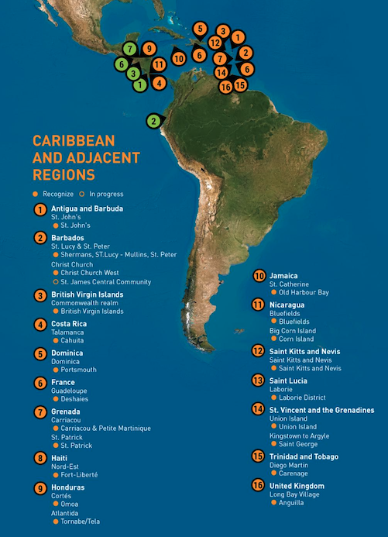
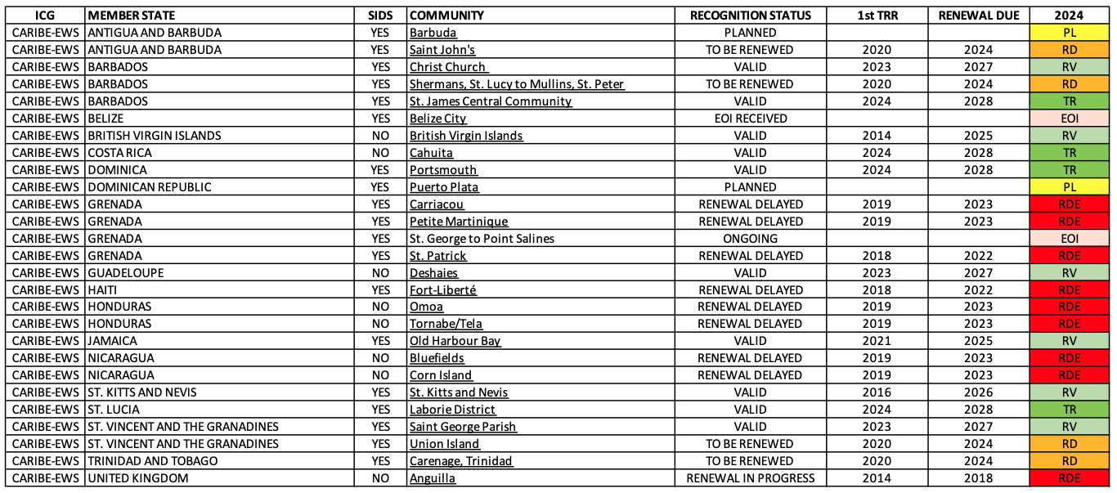
ICG/CARIBE-EWS Progress in TRRP
Antigua and Barbuda (1)
Barbados (3)
British Virgin Islands (1)
Costa Rica (1)
Dominica (1)
France-Guadeloupe (1)
Grenada (3)
Haiti (1)
Honduras (2)
Jamaica (1)
Nicaragua (2)
Saint Kitts and Nevis (1)
Saint Lucia (1)
St. Vincent and Grenadines (2)
Trinidad and Tobago (1)
United Kingdom – Anguilla (1)

Slide 4
Status on CTIC activities May 2024 – Jan 2025
Support to TRRP Communities:
St. George’s, Grenada: Finalisation and testing of EOP, installation of billboards on-going
NORAD Project communities in Barbados, Jamaica and Trinidad and Tobago: Tsunami Ready facilitator in conjunction with ITIC-CAR and IOC
Puerto Plata and Sabana Grande de Palenque, Dominican Republic internal consultations
St. James Central, Barbados supported the administration and Tsunami Ready Ceremony WTAD 2024
Renewal of Sherman’s to Mullins, Barbados advanced through PAE
Renewal of St. John’s City, Antigua and Barbuda initial discussions convened
Renewal of St. Patricks & Petite Martinique and Carriacou, Grenada discussions advanced, constrained by significant devastation due to Hurricane Beryl, July 2024
Renewal of Union Island, St. Vincent and the Grenadines discussions advanced, constrained by significant devastation due to Hurricane Beryl, July 2024
Carenage, Trinidad and Tobago initial discussions convened
Renewal of Fort Liberte, Haiti no action taken
Corn Islands & Bluefields, Nicaragua no action taken
ITIC-CAR: Tsunami Ready Ceremonies in Portsmouth, Dominica and Laborie, St. Lucia
ITIC-CAR: identification of new communities in Dominica and Saint Lucia
ITIC CAR: select support to on-going TR Projects
Tsunami Ready Summit: Joint ITIC-CAR & IOC funding, initial consultations including with proposed host country of Panama, concept note and budget to be developed

Slide 5
Status on CTIC activities May 2024 – Jan 2025
CTIC MOU with Government of Barbados: signed 29 May 2024
UNESCO-CDEMA MOU: signed 14 December 2024 in Barbados
HOSTING OF ICG/CARIBE EWS XIX, 2026 in Barbados, strong support to national efforts
CARIBE WAVE 2025: supported Exercise planning and webinars in conjunction with the CARIBE WAVE Task Team & IOC
Joint training on Manuals and Guides 86 and CARIBE WAVE Task Team meeting – CTIC, ITIC-CAR & IOC funding advanced planning in consultation with national authorities in Antigua and Barbuda for February 2025. Logistical challenges and staffing constraints resulted in rescheduling to March 2025 tentatively
CTIC Brochure: finalized revision of English & Spanish versions with ITIC-CAR & IOC
CTIC Flyer: English version under testing & finalization with ITIC-CAR, IOC, WG4, WID and other partners
CTIC Website – full integration into IOC management structure on-going, with IOC Intern support
Distribution of PAE products and support Member States outreach and capacity building initiatives continued
WTAD 2024 – CDEMA 13th CCDM Conference 2-6 December 2024 - PPT and presentation of tokens to St. Kitts and Nevis

Slide 6
Status on CTIC activities May 2024 – Jan 2025
Tsunami Ready Evaluation Survey execution in association with ITIC-CAR, TR TT and IOC
EW4All Regional Mechanism participated in the 1st EW4All Regional Mechanism meeting on 20 September with IOCARIBE & engaged UNDRR including 13th CCDM Conference 04-06, December 2024
Collaboration with World Institute on Disability
2nd Global Tsunami Symposium: printing and presentations. Mission not possible due to financial and logistical constraints

Slide 7
Considerations, ICG/CARIBE EWS XVII Recommendations & Challenges
CTIC Resource (financial and human) Constraints - impacting performance and service levels to Member States and partners and sustainability in respect to implementation of TR projects and mobilizing interests, development of public awareness and education materials, evaluations
CTIC Governance and Collective Ownership requires enhancement to support improvement on performance and service levels to Member States and partners and foster sustainability
IOC-led project for determination of global target number of communities in the CARIBE-EWS for Tsunami Ready recognition by 2030 under review
Coordinate the posting and distribution of the current version of the CARIBE-EWS Tsunami Signage Inventory and Report and provide an updated version for the next ICG session (CTIC, ITIC-CAR, IOC) not advanced

Slide 8
Considerations, ICG/CARIBE EWS XVII Recommendations & Challenges
Revamp CTIC Board Meetings CTIC & IOC discussions advanced
Facilitate the testing and use of the OTGA Tsunami Awareness and Tsunami Ready courses (WG4 and CTIC not advanced
Strategic review of the staffing resources needed to ensure adequate capacity at the CTIC to effectively execute and implement the programmatic and project activities to support the ICG/CARIBE EWS and EW4All frameworks initiated

Slide 9
Thanks for your attention
a.brome@unesco.org

