Slide 1
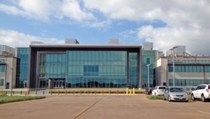
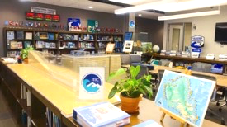
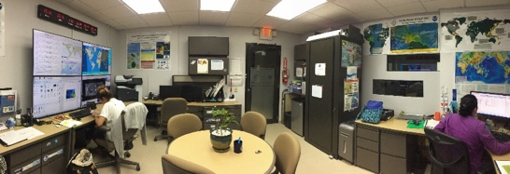
International Tsunami Information Center Caribbean Office (ITIC-CAR) Update Update for ICG CARIBE EWS Steering Committee Meeting January 27 and 29, 2025
ITIC
Hawaii Office
Dr. Laura Kong
Director, ITIC, USA NOAA
Christa von Cdr. Matías Sifón Hillebrandt –Andrade
Associate Director, ITIC, Chile SHOA Deputy Director, ITIC, USA NOAA
Manager, ITIC Caribbean Office
Puerto Rico Office

Slide 2
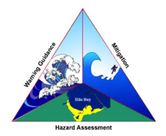
ITIC Services – supporting the CARIBE EWS
UNESCO/IOC Tsunami Ready with USAID Funding
Implementation in Countries
Recently Completed (2023-2024) Projects in Barbados, Dominica, Saint Lucia, Saint Vincent and the Grenadines, Cayman Islands (Hazard Assessesment and Training)
Current Projects in Anguilla, Antigua and Barbuda, Belize, Dominica,Honduras and Saint Lucia
Implementation of CARIBE EWS Tsunami Ready Pilot Survey with NOAA Lapenta Scholar
Tsunami Ready Summit TBC – 2025
Regional Tsunami Ready Facilitator to be based at CTIC (Coming Soon)
CARIBE WAVE and Tsunami Exercises
Support Conduct through the Development of Handbooks, Presentations, Reports, Surveys, Promotion since 2011
Proposed MG 86 Training TBC 2025 (with USAID funding)

Slide 3
ITIC Services – supporting the CARIBE EWS (Cont)
Develop and Provide Training
Ocean Teachers Global Academy Tsunami Awareness Course – self paced https://oceanexpert.org/event/4369
Ocean Teachers Global Academy Tsunami Ready Course w/IOTIC – self paced https://oceanexpert.org/event/4610
In person Tsunami Awareness and Response
ITP Chile (2024) and Hawaii TBC (2025) – support for CARIBE EWS by USAID
Decision Support Services
In case of real event support decision support
Training, presentations and videos on PTWC Tsunami Services and Products
Inventory and Survey on Tsunami Warning Communication Systems (WG 3)
Updated with Secretariat on TWFP, NTWC and TNC Contact Information
Support for operation and reporting of Sea Level and Seismic Stations including publication "Characterizing Sea Level and Barometric Disturbances in the Caribbean and Adjacent Regions from the Hunga Tonga-Hunga Ha’apai 2022 Eruption" in Journal Ocean and Coastal Research (Jelis Sostre et al, 2024)

Slide 4
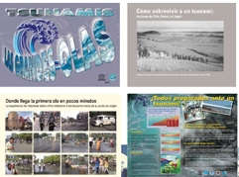
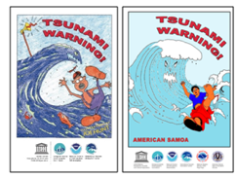
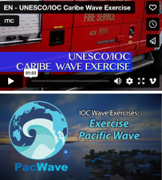
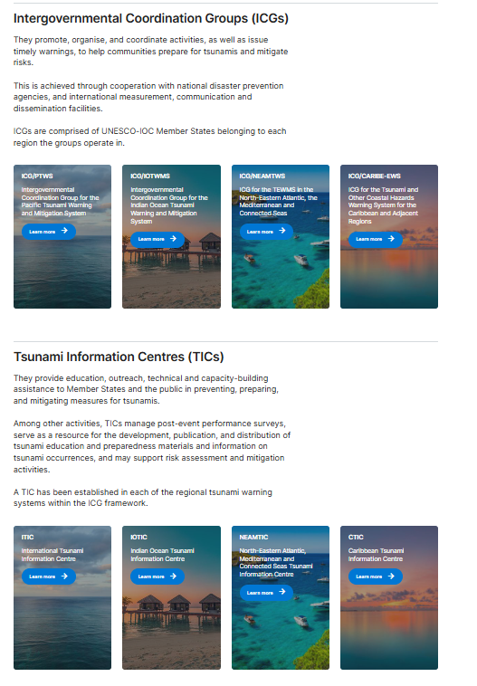
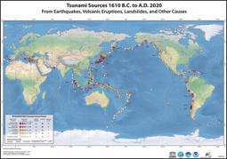
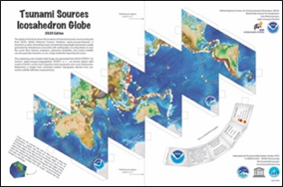
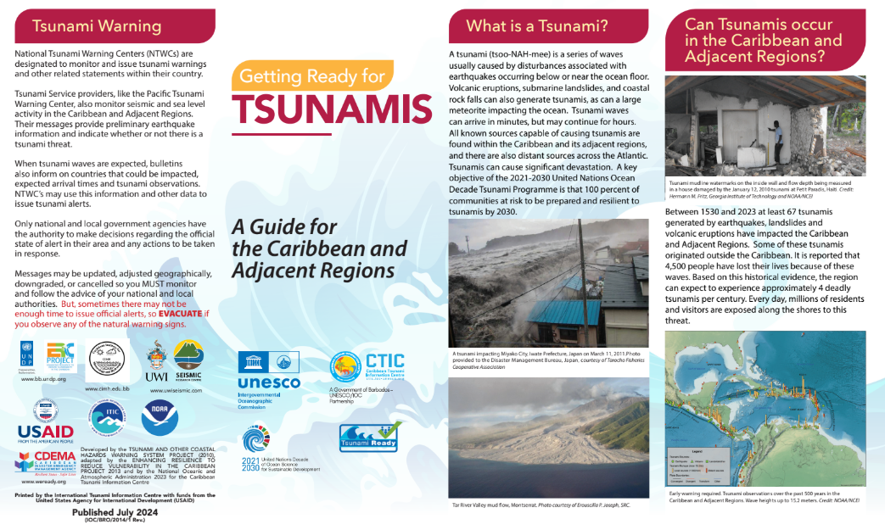
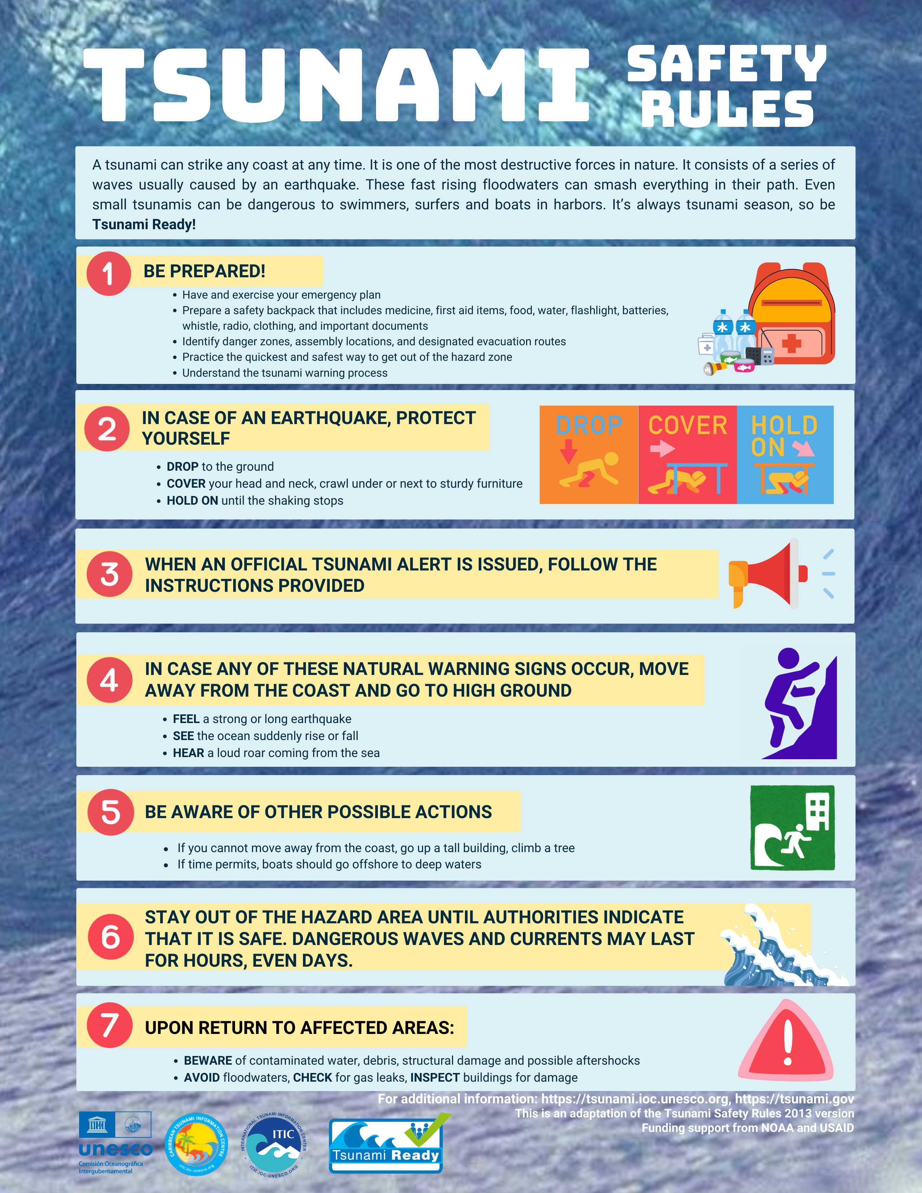
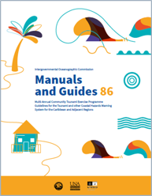
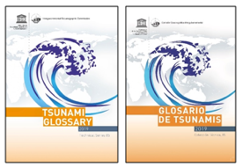
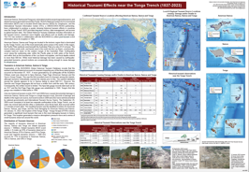
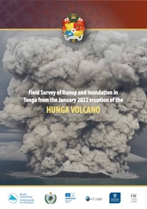
ITIC – Info Services and Products
Web Site – from ITIC to UNESCO/IOC
Compile Technical Information
Vertical Evacuation 117 references
Ports and Harbors 100 references
Develop International Manuals and Guides
SOPs, Evac Planning, Intl / Community Exercises
Create Education, Awareness Materials
Tsunami Glossary – update to 2023
ITIC-NCEI Hazard Posters - update to 2022
Updated CARIBE EWS Tsunami Brochure
Updated CARIBE EWS Safety Rules
Post-Event Response – event IDSS
Post-event Hunga-Tonga-Hunga-Ha'apai Tsunami

Slide 5
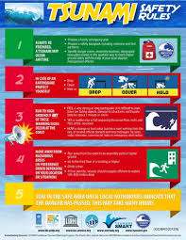
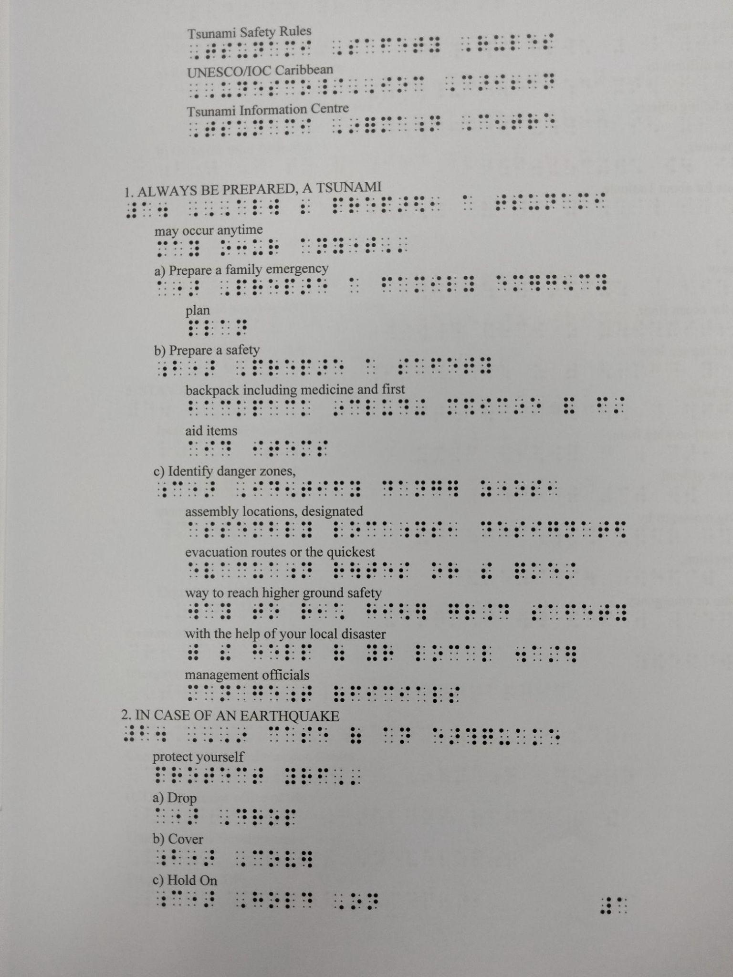
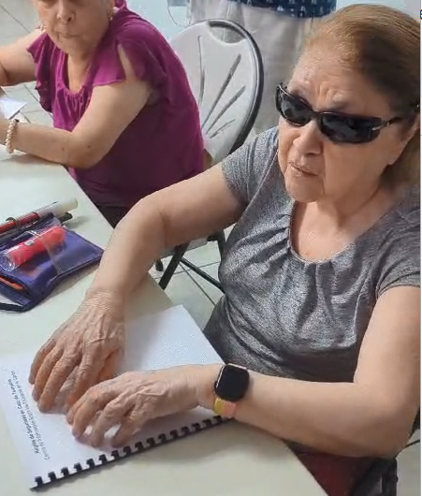
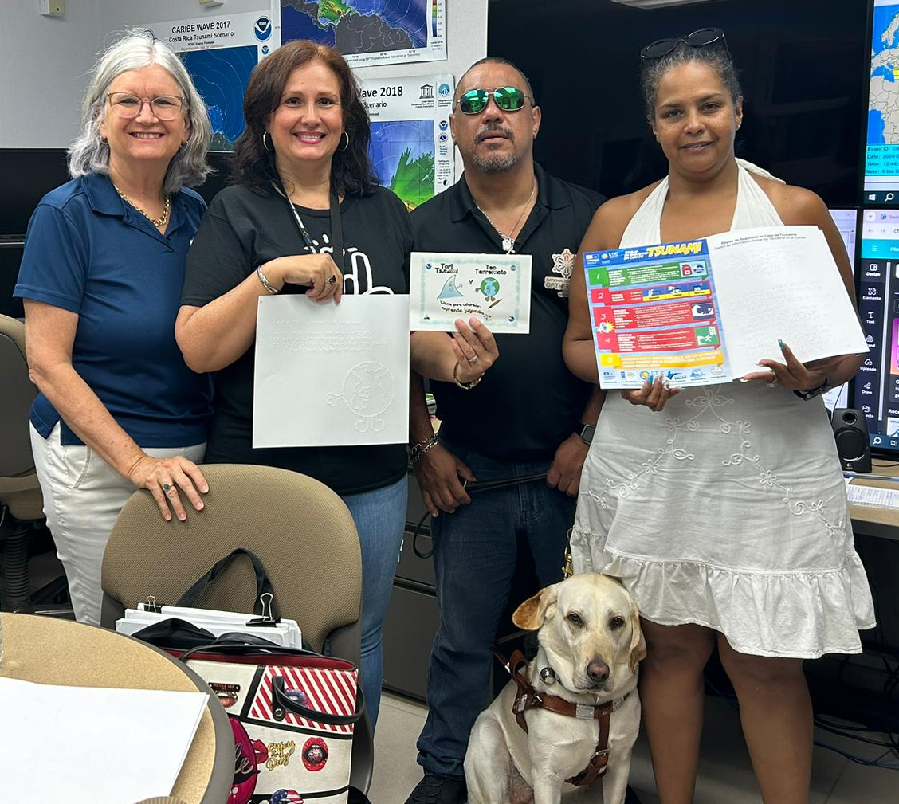
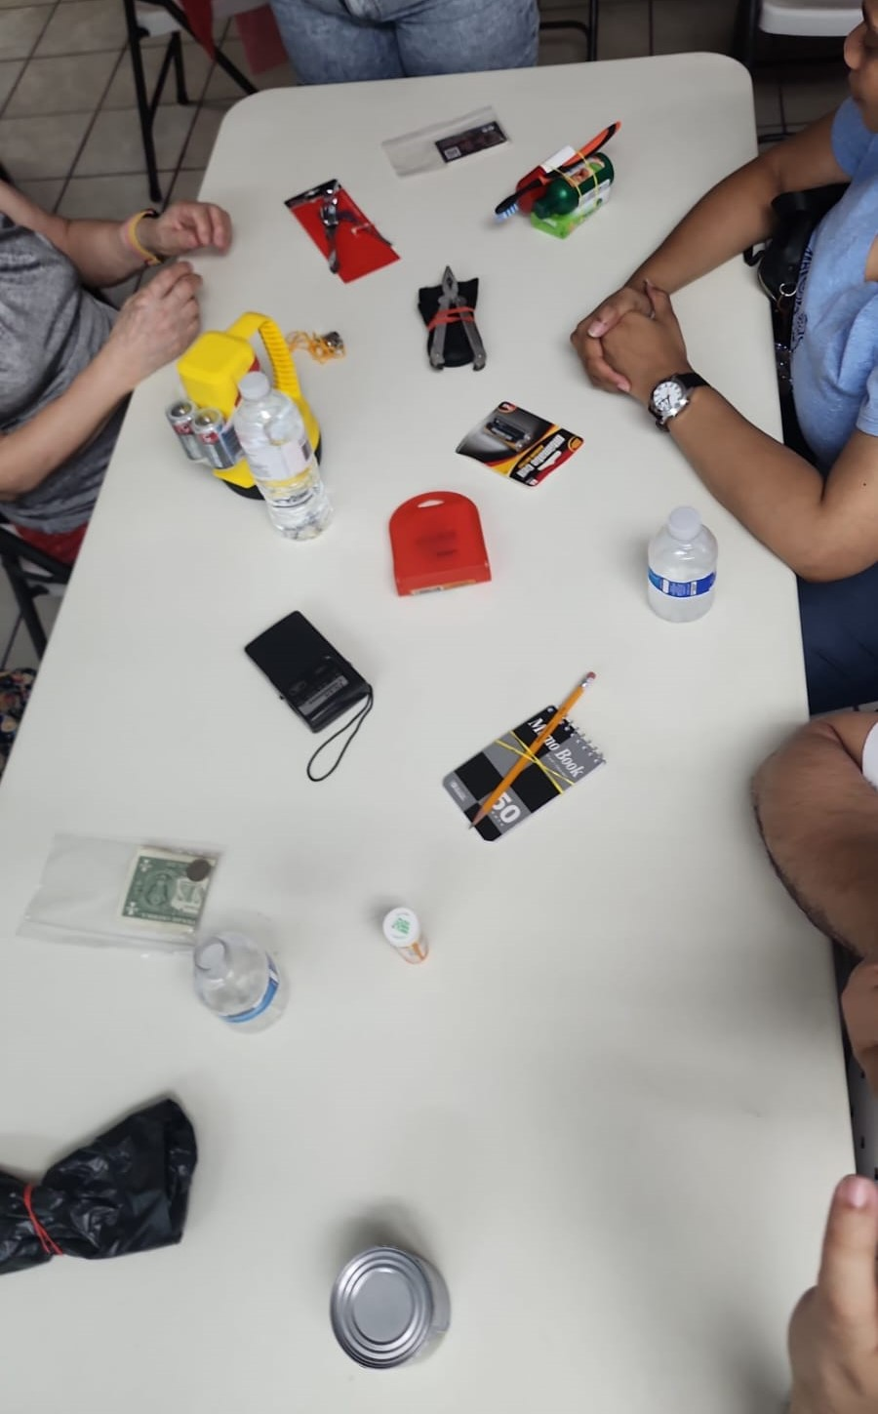
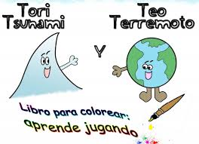
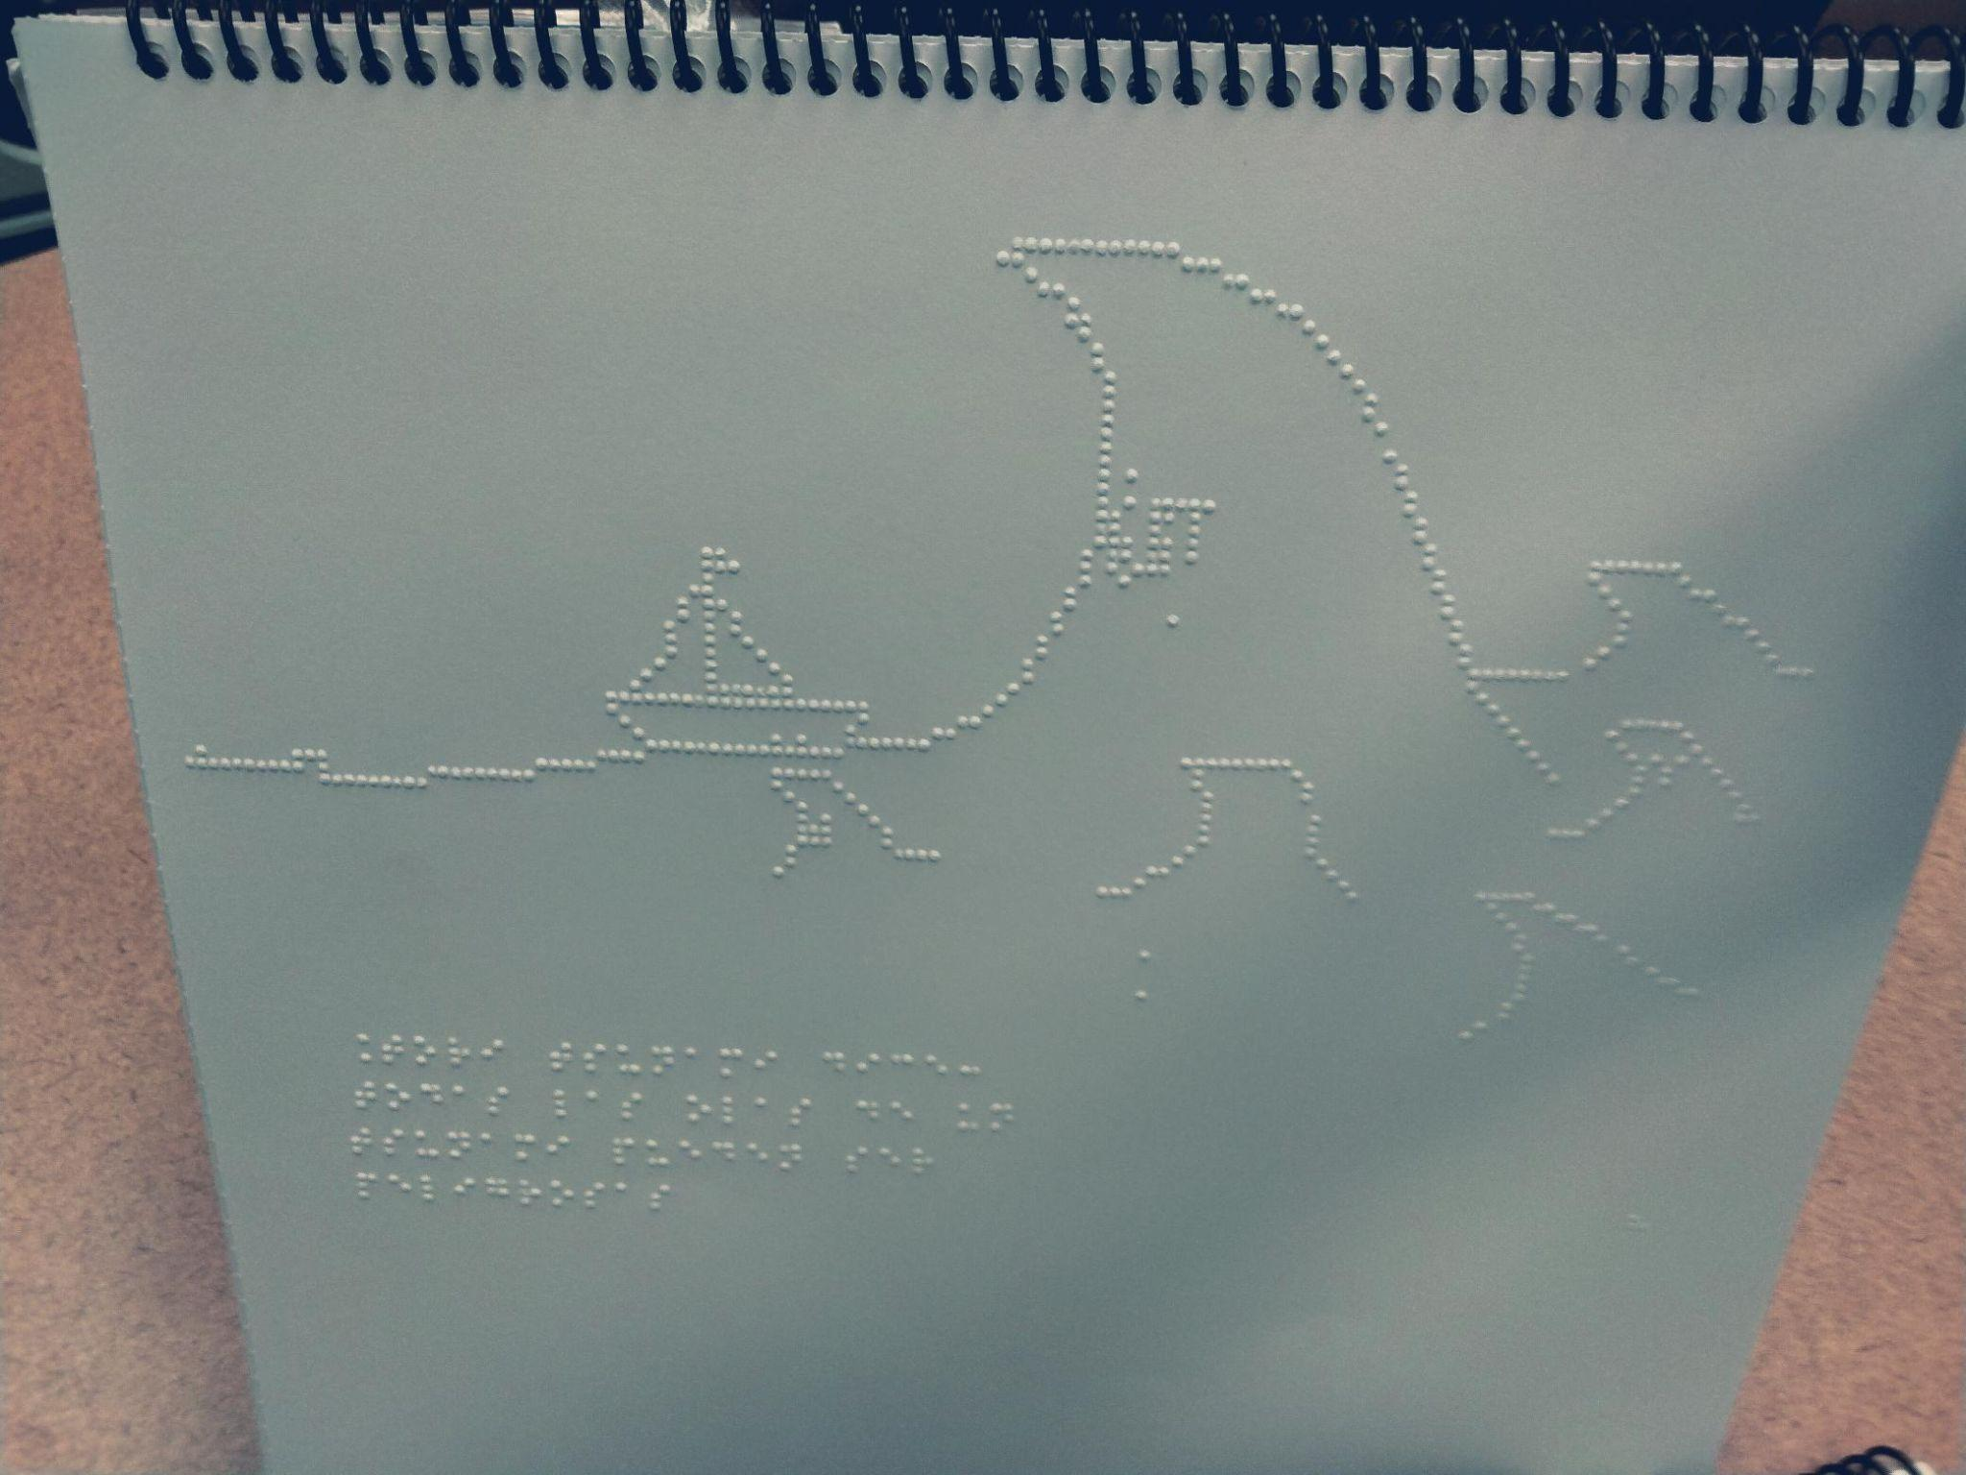
Tsunami Safety for the Blind
Tsunami Safety Rules flyer in Braille (English/Spanish)
Testing the flyer and collecting feedback from the blind communities in PR.
Braille coloring/story book
Educational activity

