Slide 1
Do not edit
How to change the design
Join at slido.com #8471285
Presenting with animations, GIFs or speaker notes? Enable our Chrome extension
Notes:
📣 This is Slido interaction slide, please don't delete it. ✅ Click on 'Present with Slido' and the joining instructions will appear when you get to this slide.

Slide 2
Data Workshop
Elizabeth Lawrence, Pieter Provoost, Ward Appeltans​
2025-02-05
Sopot

Slide 3
Outline
IOC Digital Ecosystem initiative
Preparing for (field) data collection
Darwin Core
Using “computer language” for collected variables
Demo: Publishing data to OBIS (IPT)
Demo: Accessing & using OBIS data
Data products discussion

Slide 4
1. IOC Digital Ecosystem

Slide 5
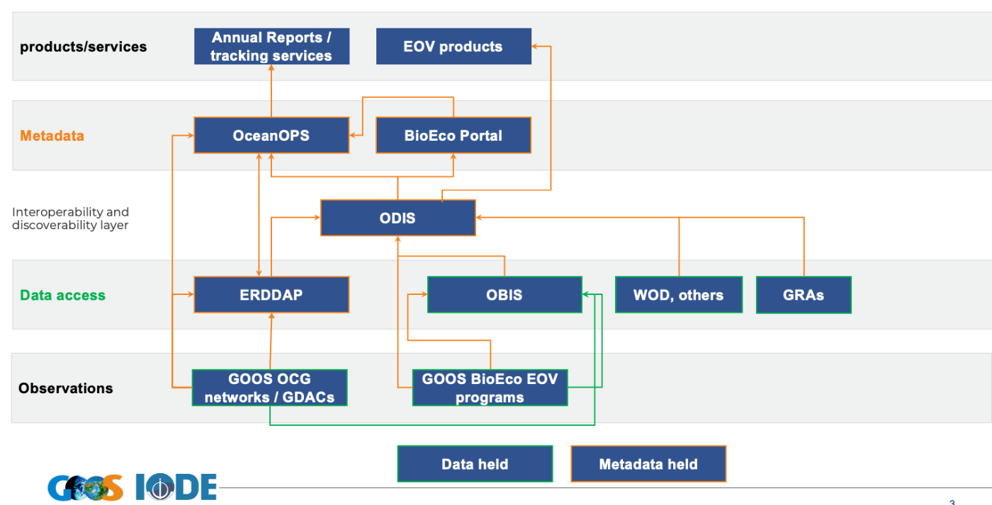
IODE & GOOS
Notes:
GOOS OCG Physics works with networks. In BioEco world we don’t have recongized networks yet in the GOOS OCG. They agree to use ERDDAP
In the BioEco world we agree to use OBIS for data + metadata for datasets and programme metadata to BioEco Portal combos w/data. Making sure we are compatible with Ocean OPS
In both data streams metadata is available through ODIS
Key message: OBIS is super GDAC for BioEco EOVs
And OBIS will function as OceanOPS for BioEco
[gdac = centre where all data flows

Slide 6
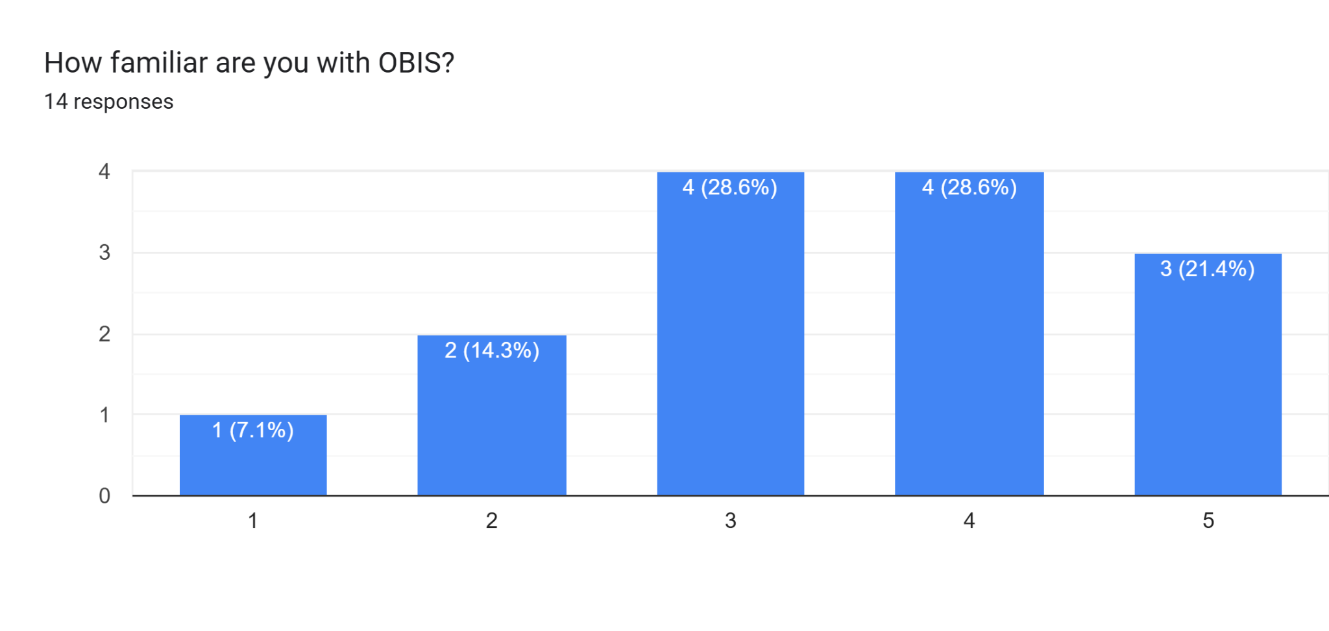
the Ocean Biodiversity Information System
obis.org
Notes:
Brief intro to obis – standardized and integrated datasets

Slide 7
the Ocean Biodiversity Information System
obis.org
The world’s largest open-access repository for standardized marine biodiversity data
>136,000,000 occurrence records
>5,400 marine datasets
Notes:
Brief intro to obis – standardized and integrated datasets

Slide 8
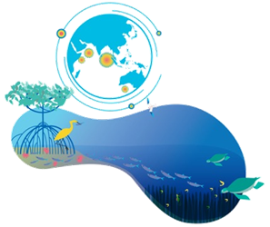
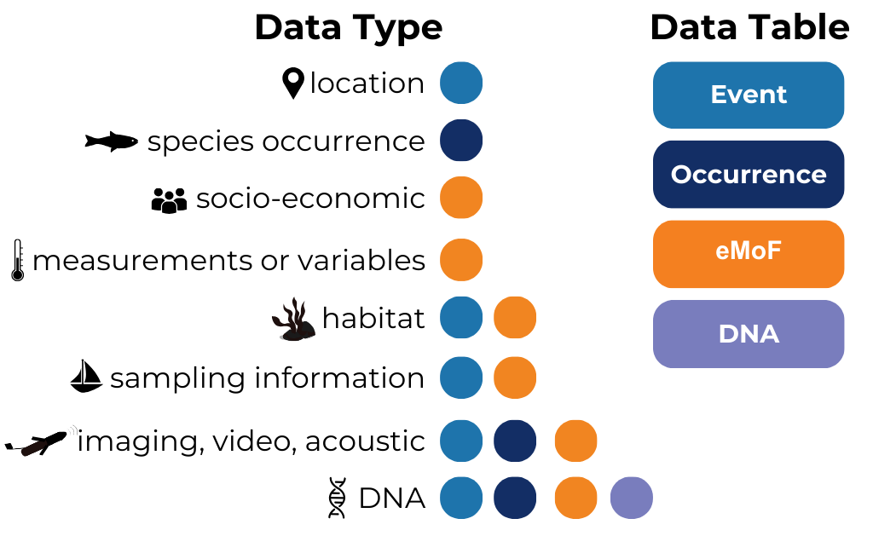
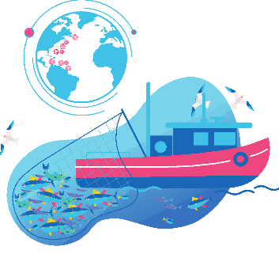
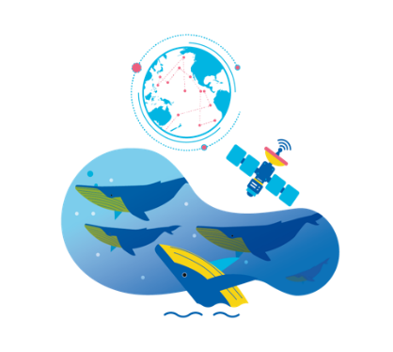
obis.org
Habitat,
ecosystems
DNA-derived
data
More than just species occurrences
>181,480,000 measurements
Tracking
biologging
Abundance,
biomass
Notes:
Obis has >181 million measurement data. Can include DNA, tracing, biologging, abundance, biomass…

Slide 9
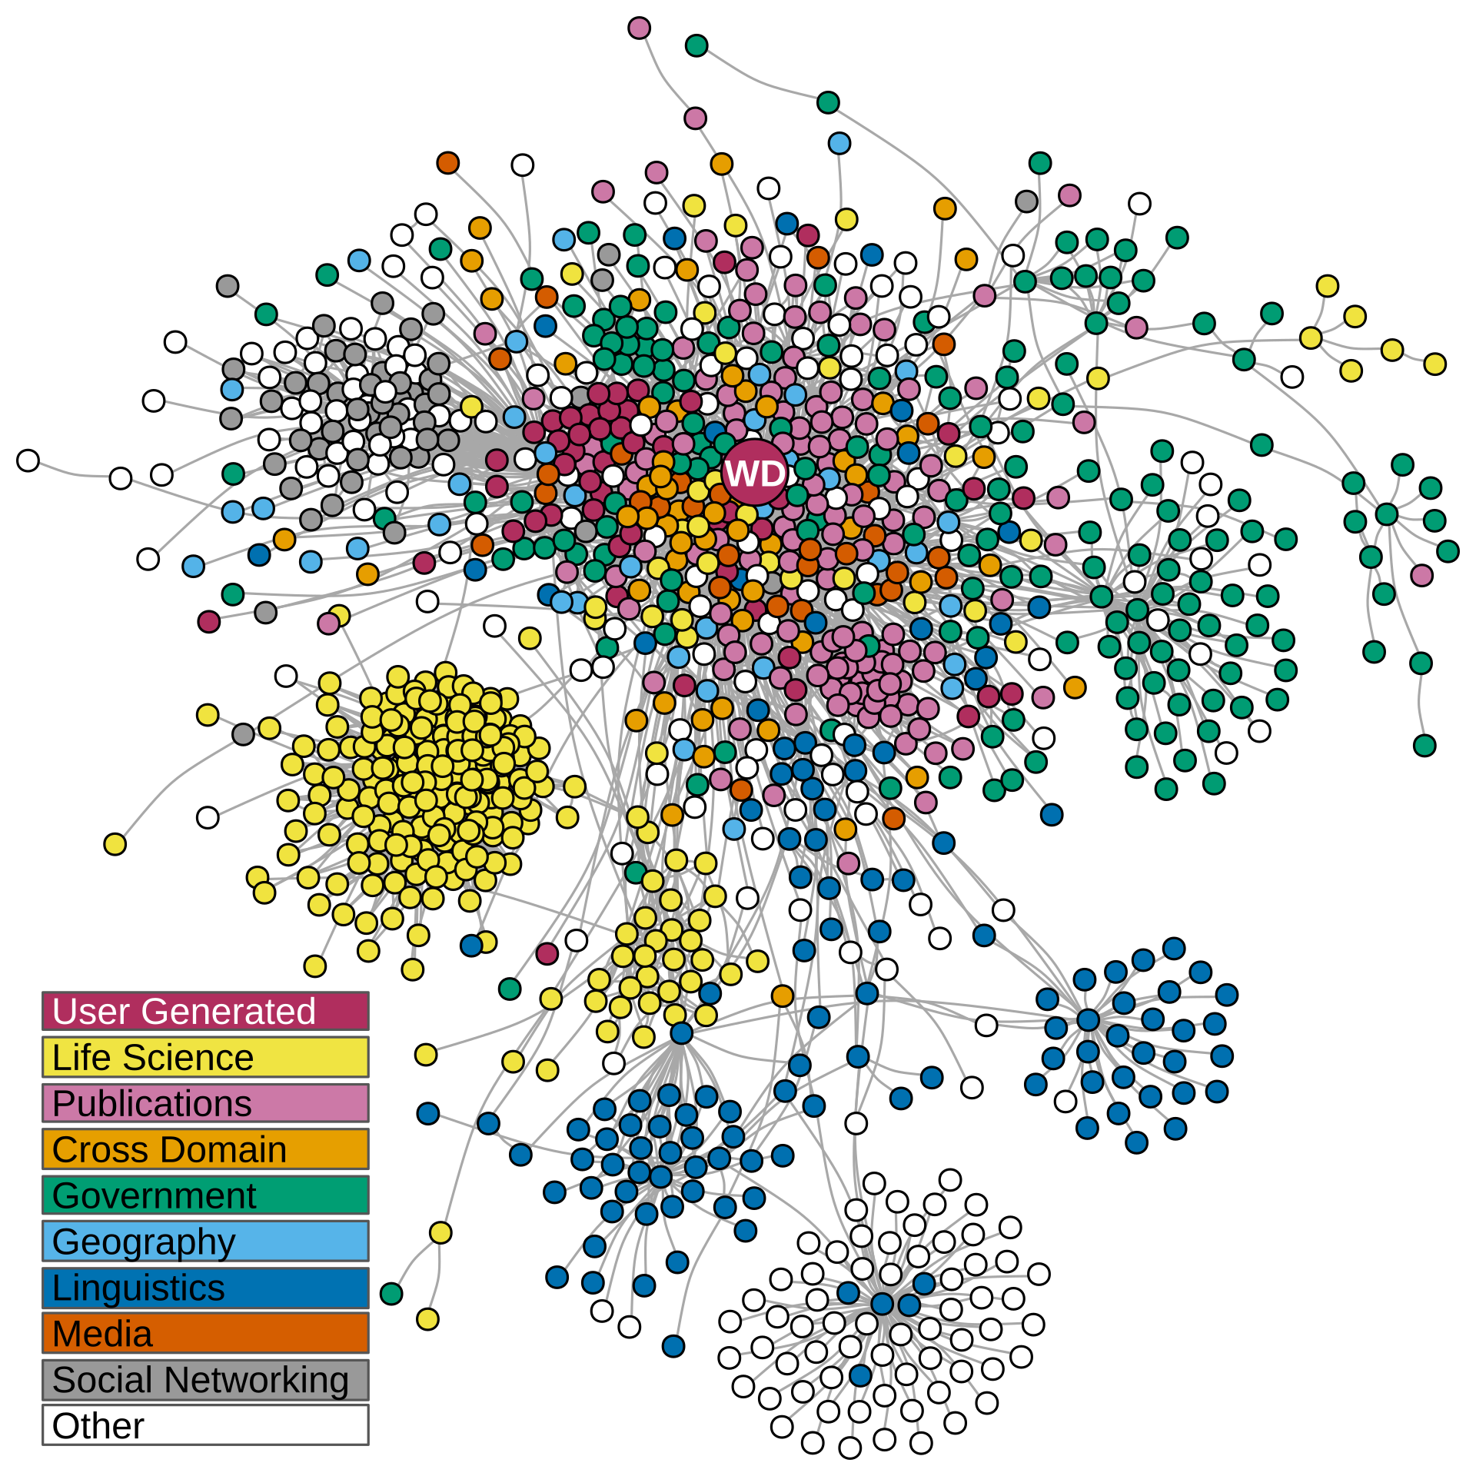
book.odis.org
Making resources more discoverable and interoperable using “web architecture”
interlink distributed systems
Notes:
Obis has >181 million measurement data. Can include DNA, tracing, biologging, abundance, biomass…

Slide 10
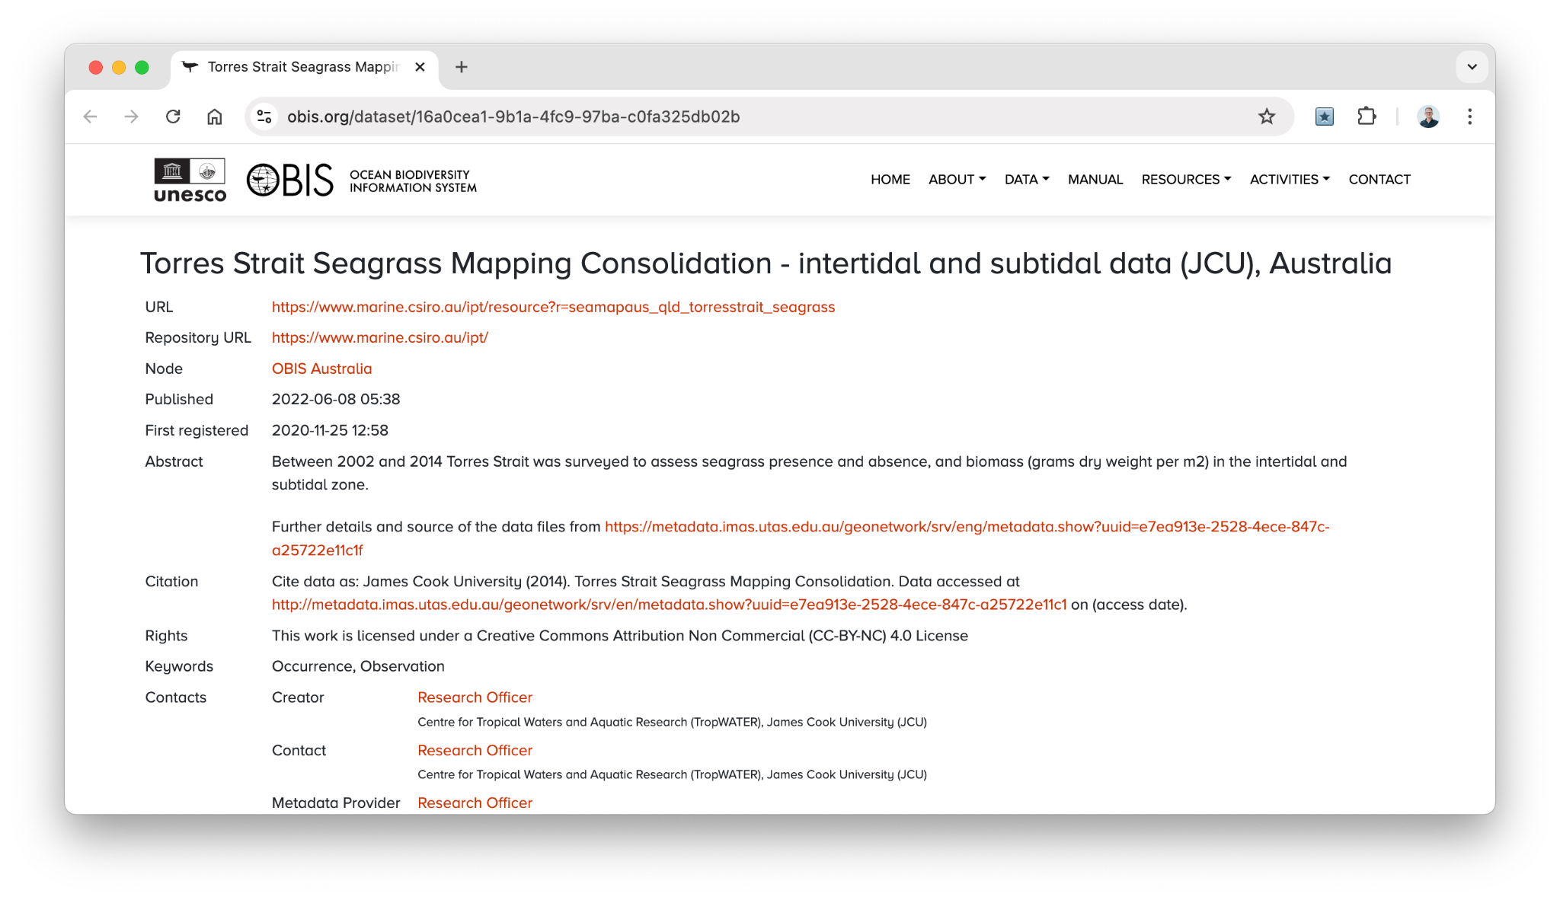
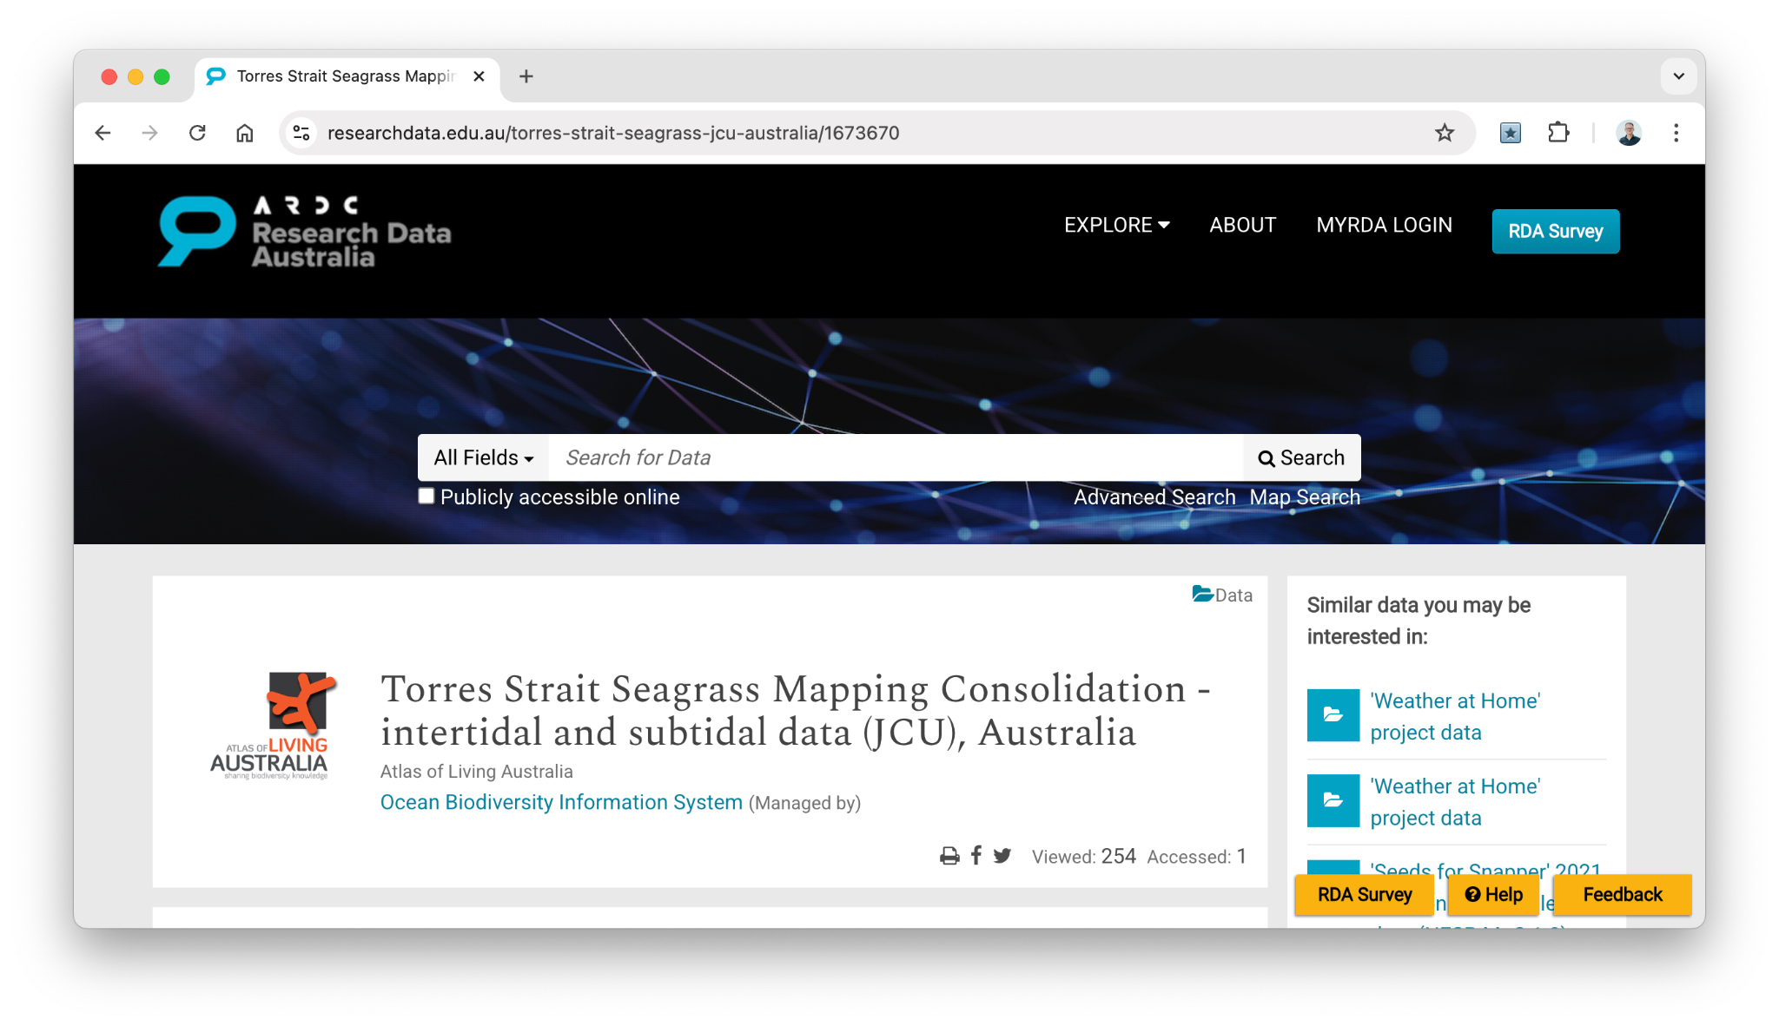
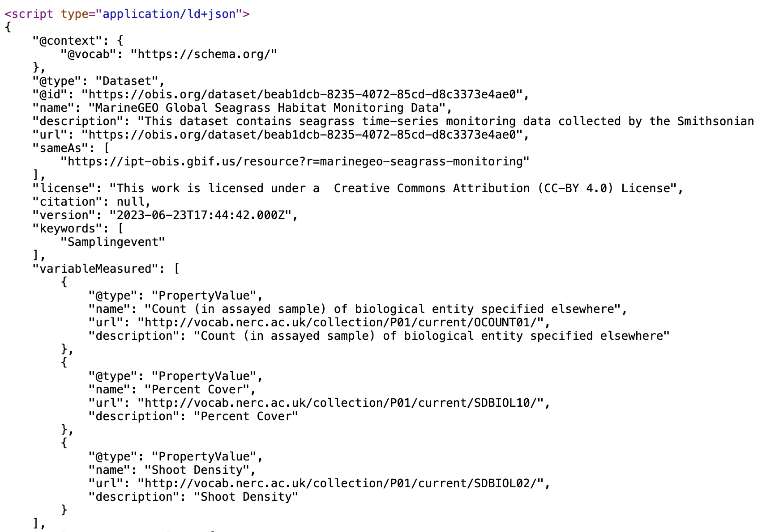
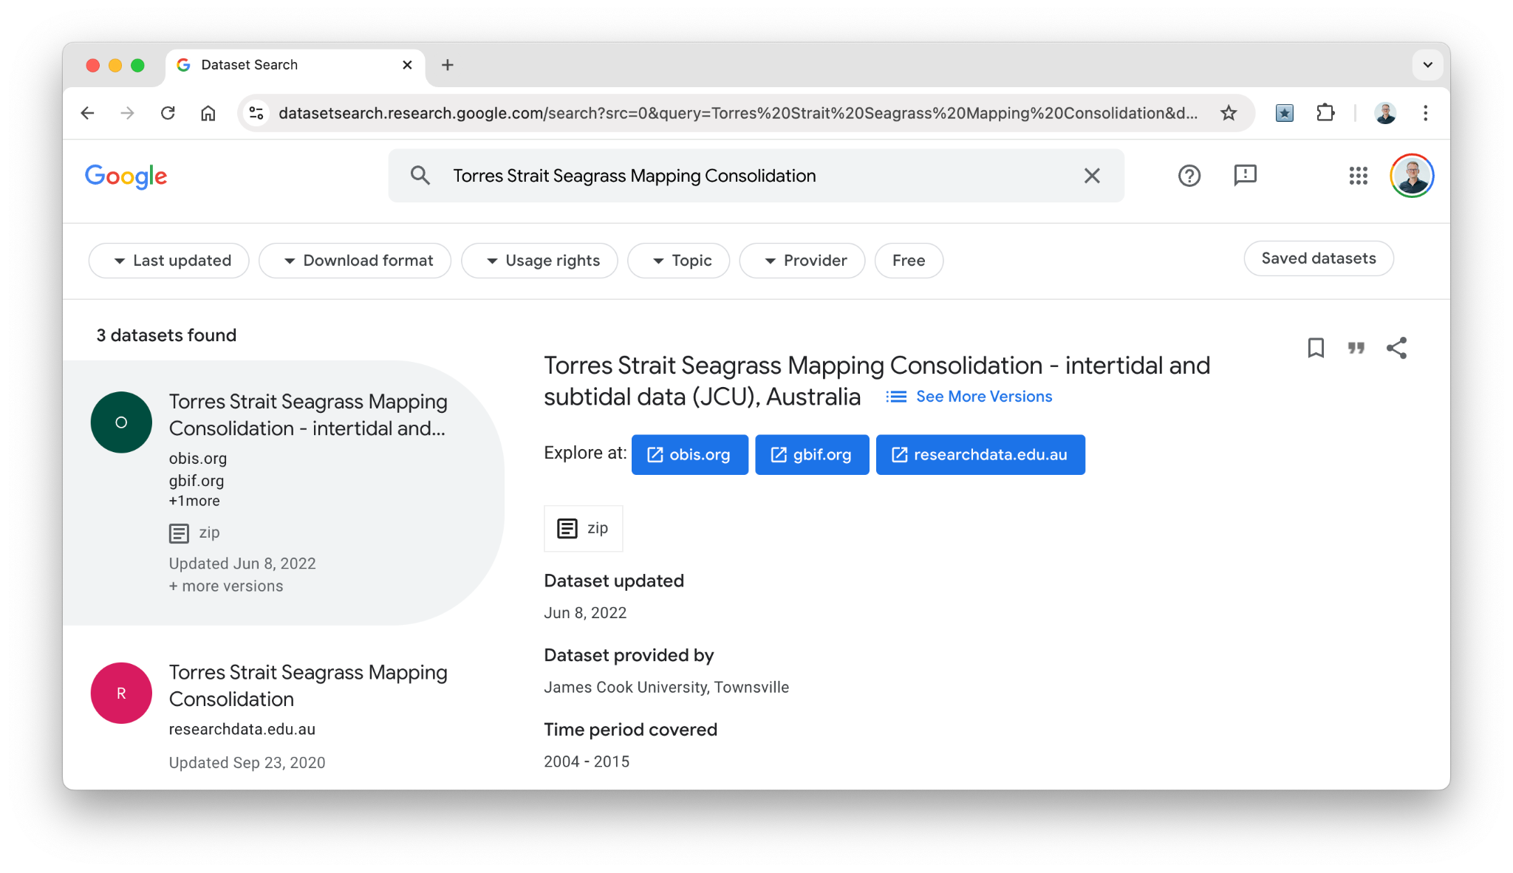
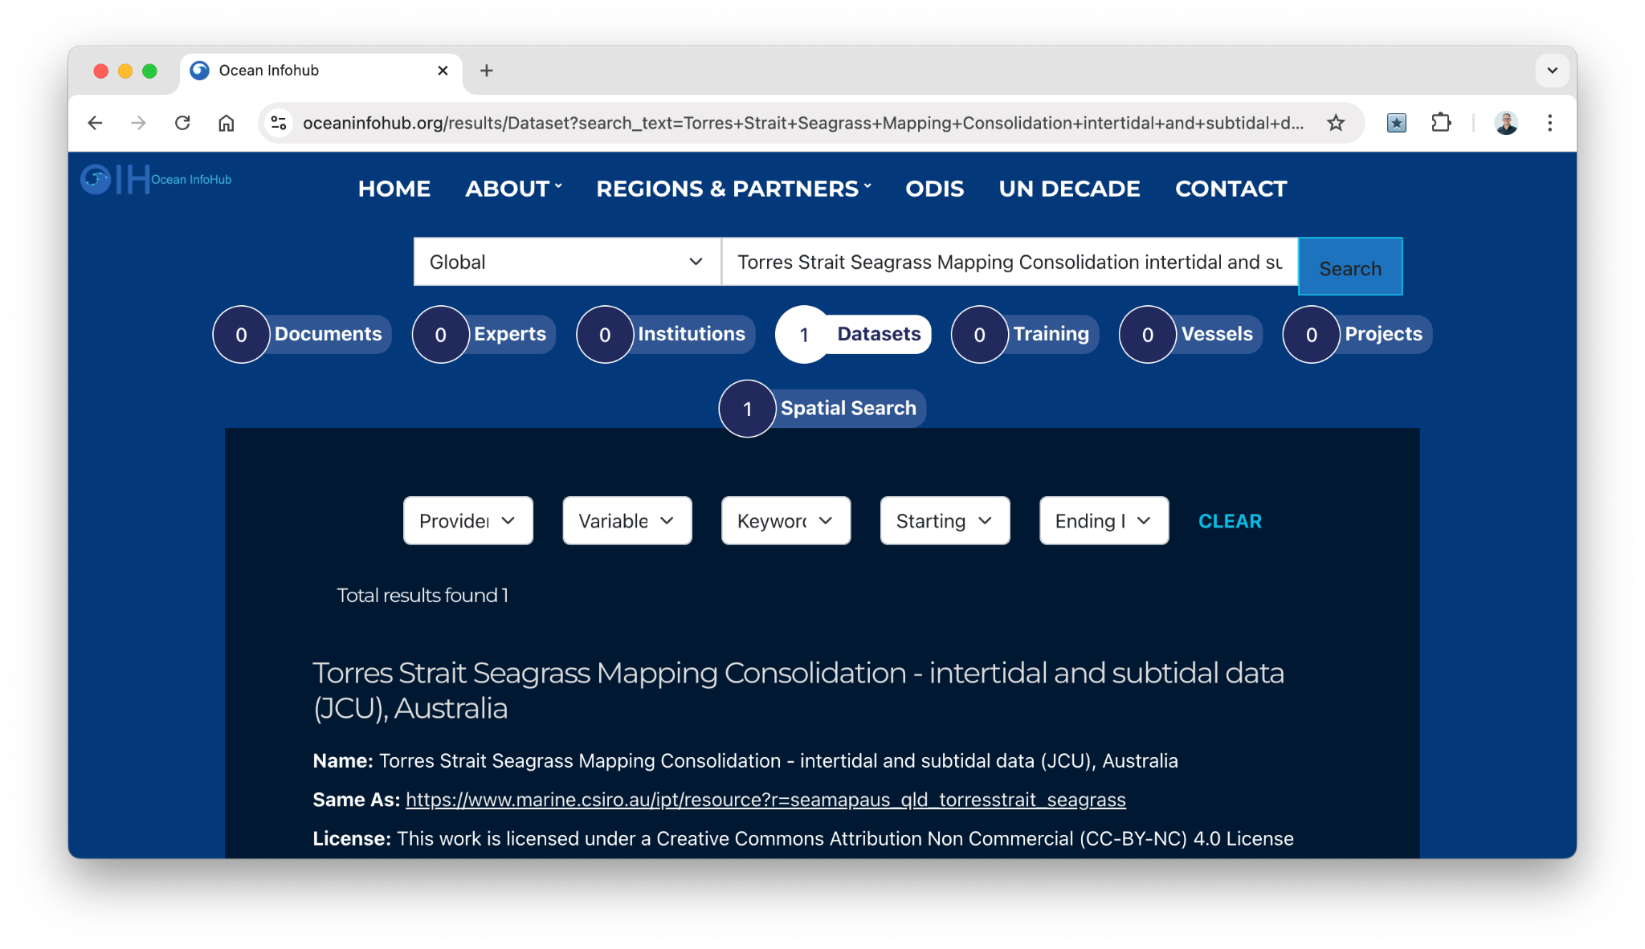

Slide 11
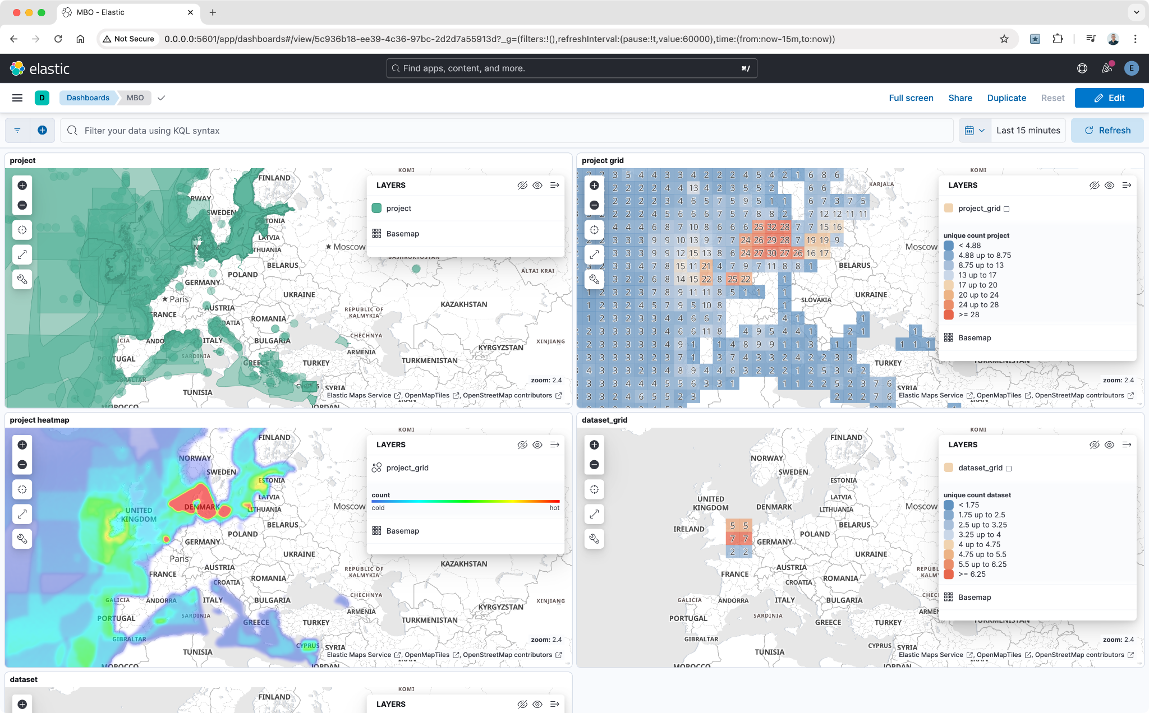
Notes:
The developing BioEco portal will be based on ODIS architecture
Web presence, or use our tool

Slide 12
GOOS, OBIS, ODIS

Slide 13
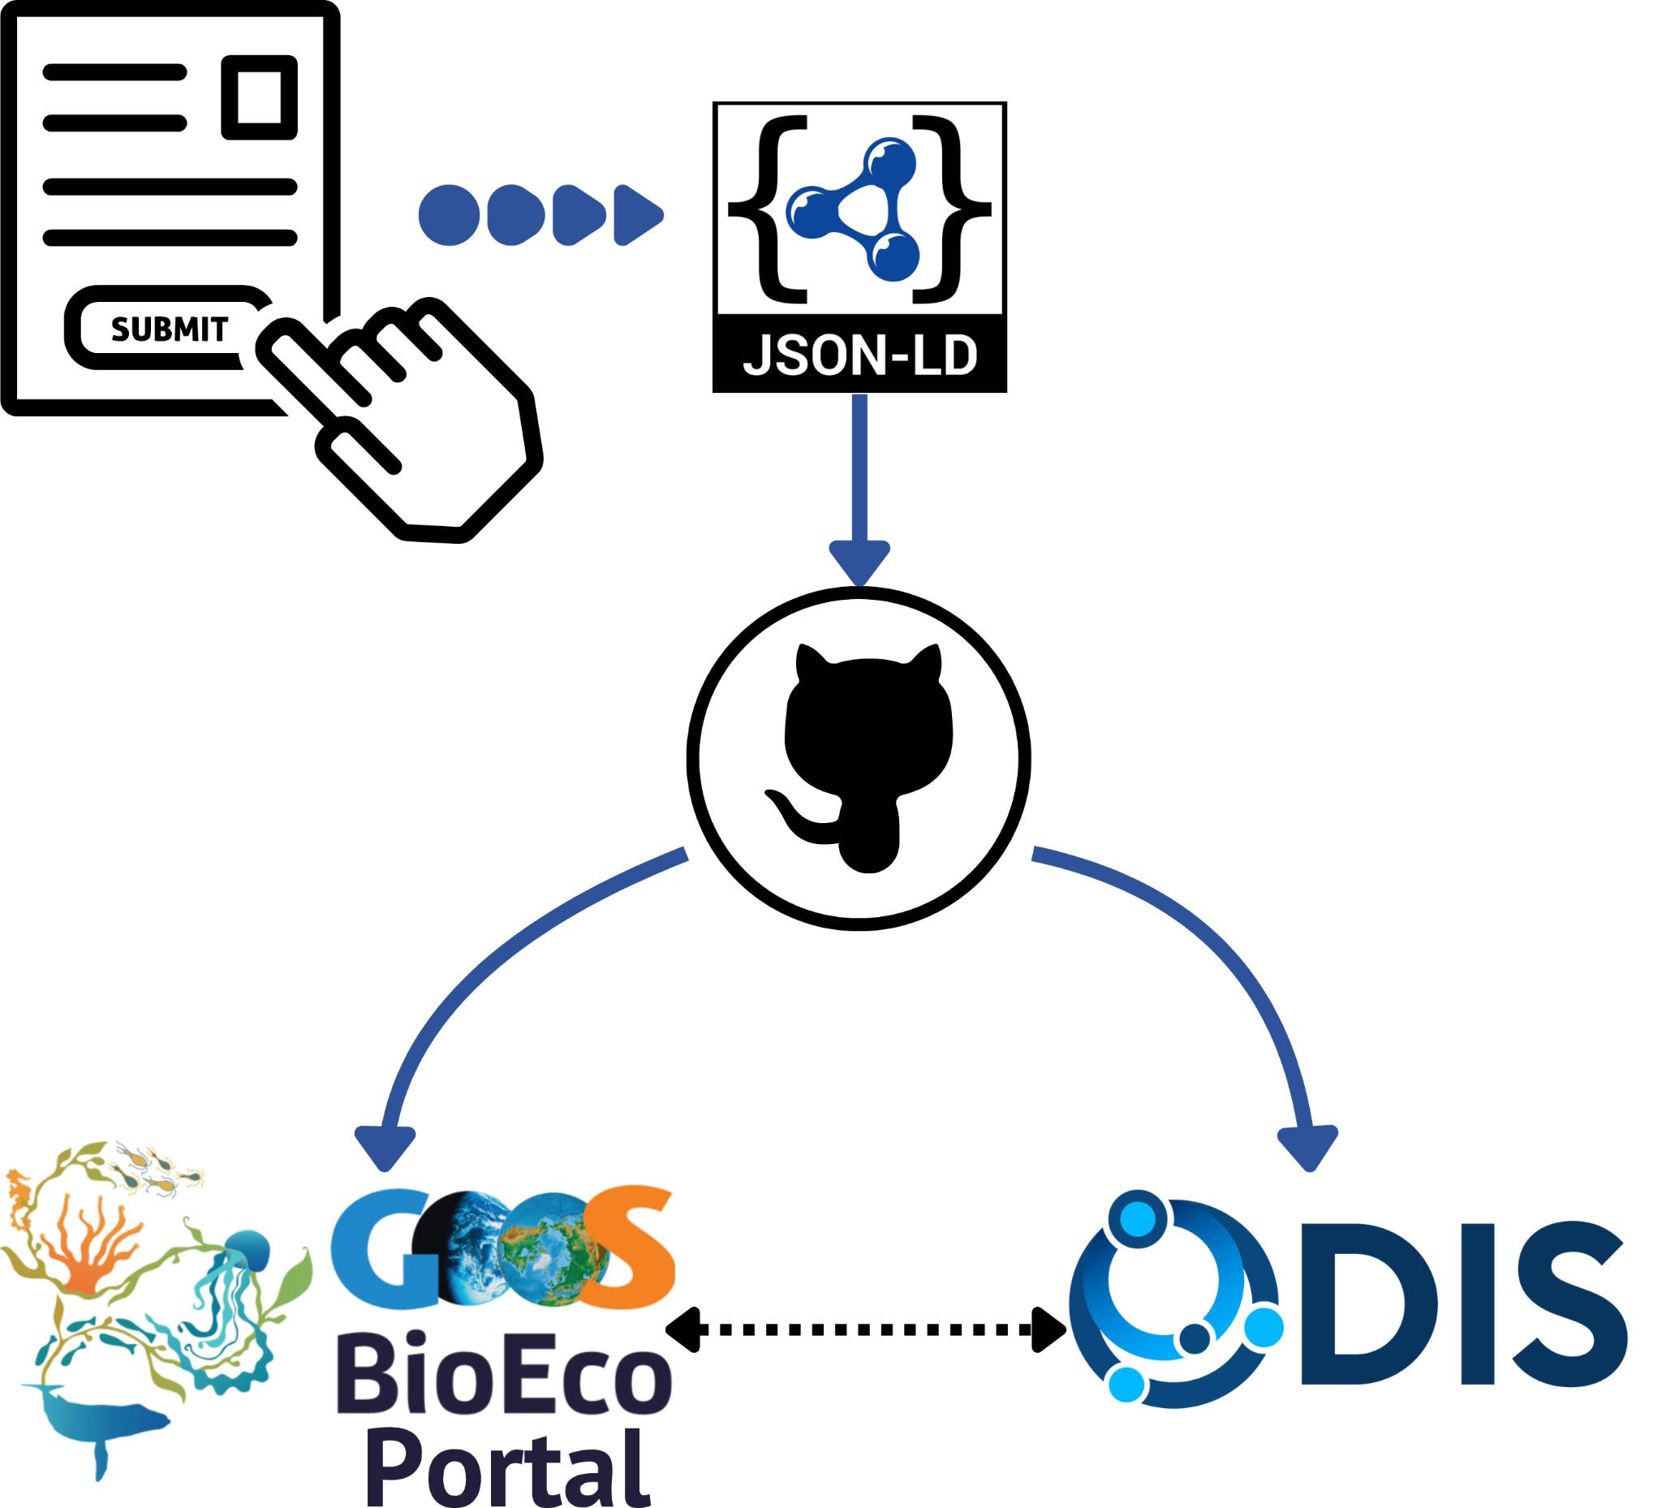
BioEco EOV Programme Metadata Submission App
eovmetadata.obis.org
BioEcoOcean development
Facilitate integration into IOC Digital Ecosystem
*There are many ways of getting data into ODIS
Notes:
BioEcoOcean development
Facilitate integration into IOC Digital Ecosystem
Entry point to BioEco Portal
Easy to use, creates JSON metadata files

Slide 14
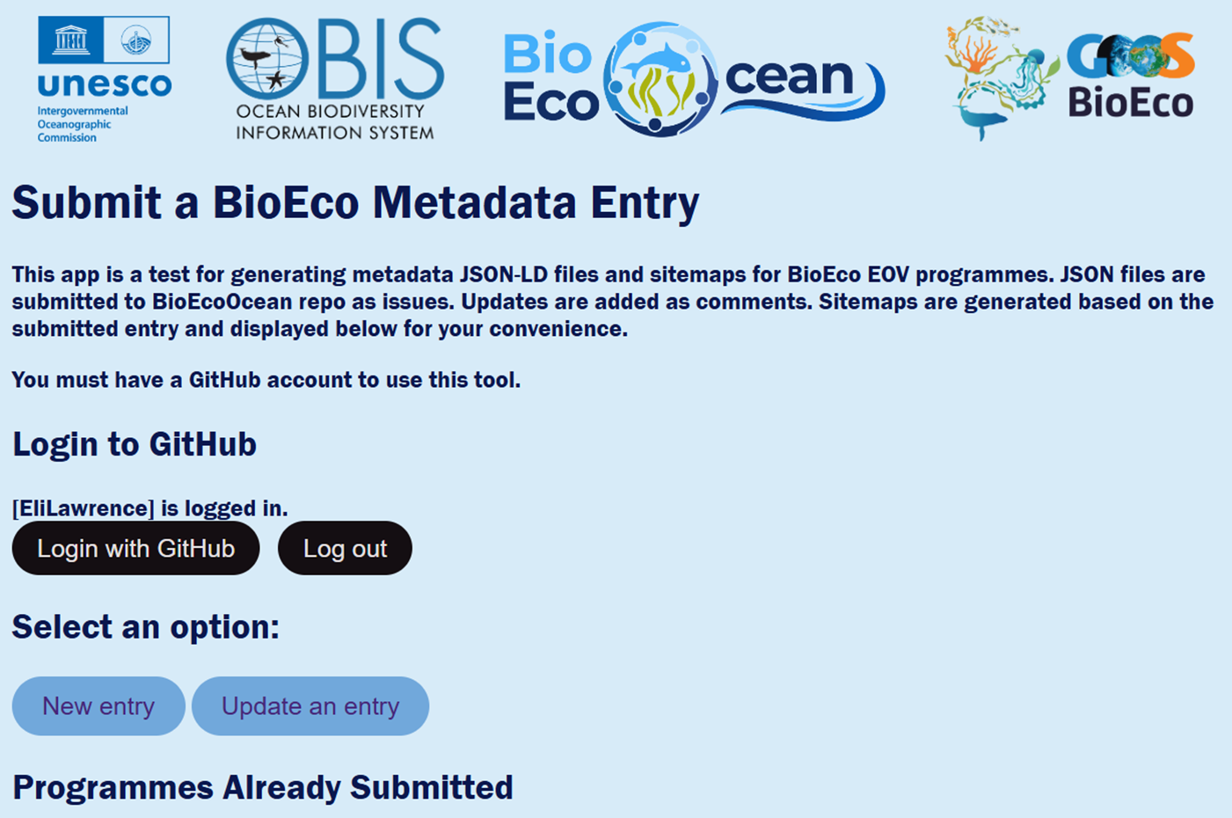
demo

Slide 15
2. Preparing for (Field) Data Collection

Slide 16
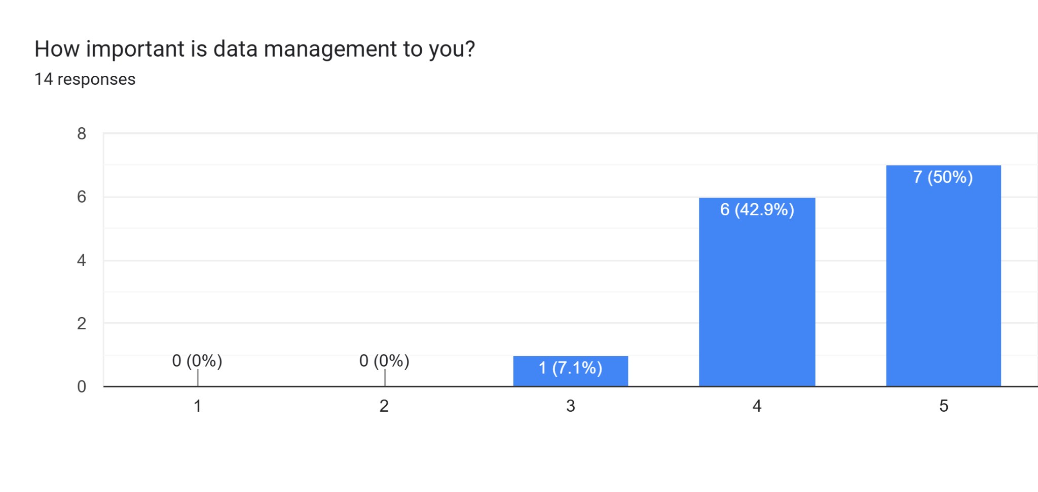
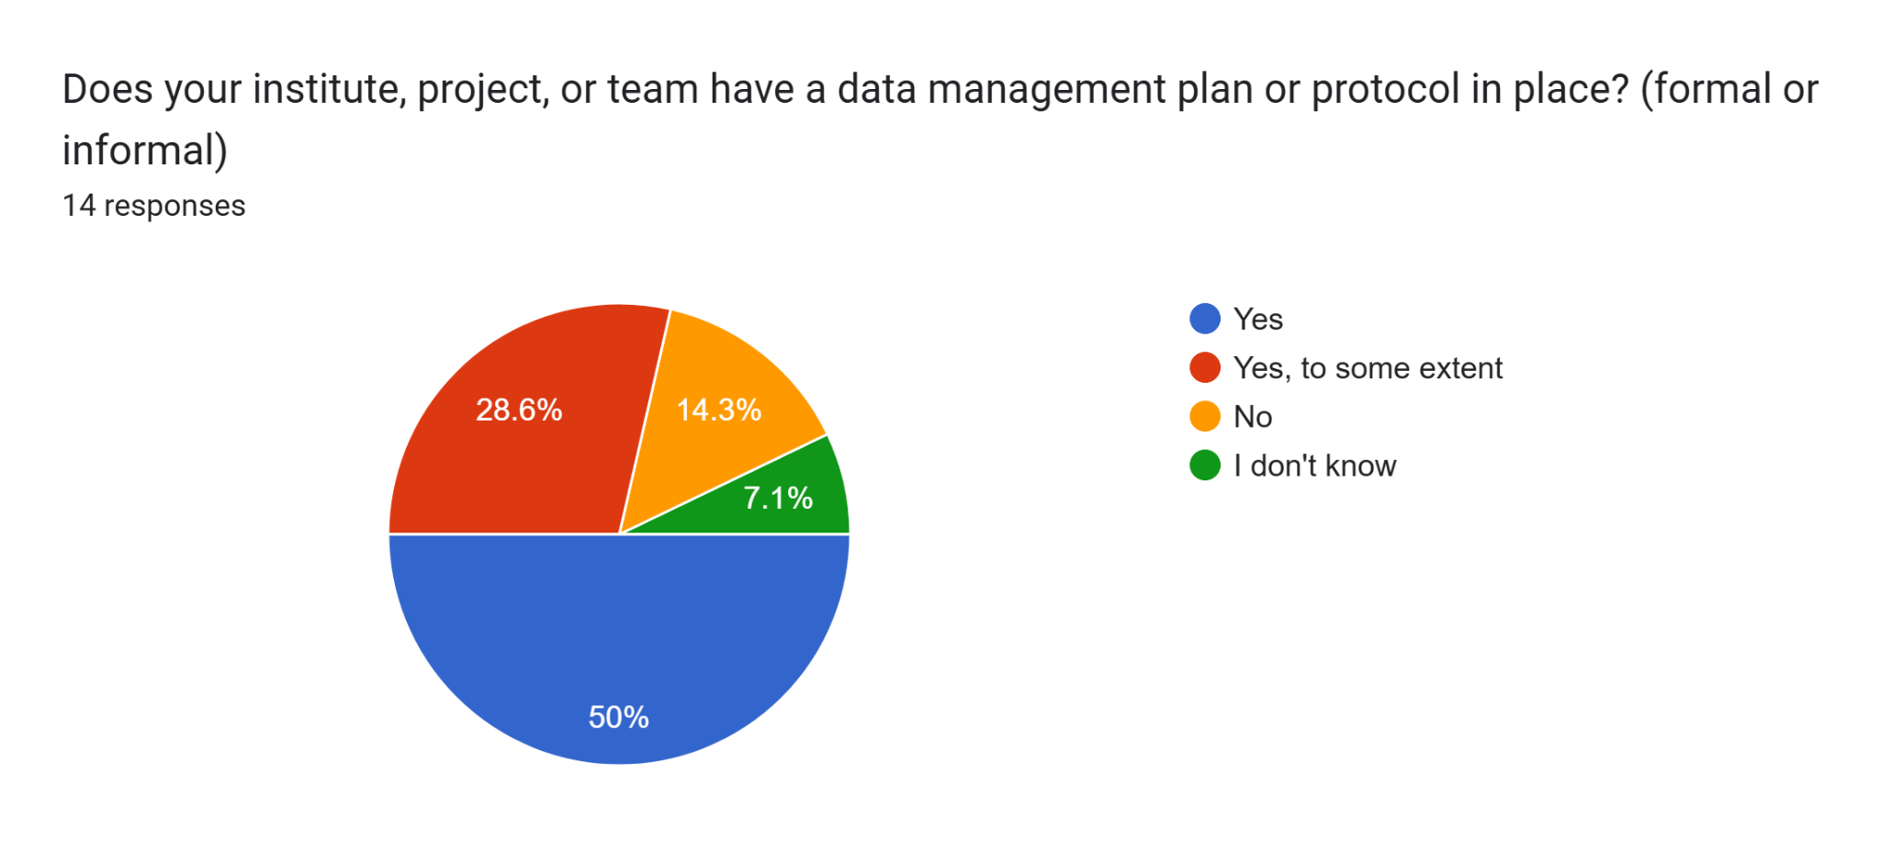
https://forms.gle/EoMsHR5vp5QVqbtBA

Slide 17
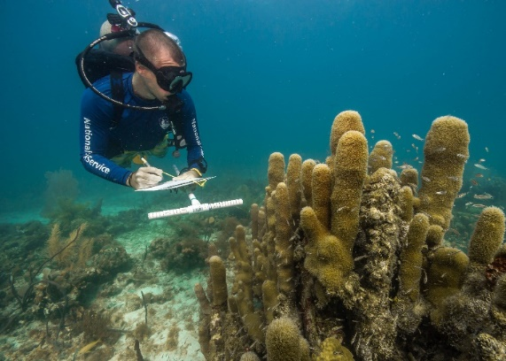
Field Data Collection
Before going into the field need to know…
What to collect
How to record to facilitate downstream data integration
Shaun Wolfe / Ocean Image Bank
Notes:
Ensuring Your Data Flows Seamlessly to OBIS and GOOS
What to Collect: Biological, abiotic, and metadata linked to events and occurrences.
How to Collect: Use standardized formats like Darwin Core terms. Document protocols, sampling details, and key measurements clearly.
Why It Matters: Streamlined data integration ensures discoverability, interoperability, and impact through OBIS and GOOS networks.

Slide 18
What (meta)data is required?
Identifiers
People, Affiliations
Coverage
(geographic, time)
Info on:
Taxa name
Presence
Occurrence
Info on: Instruments
Operations
Platforms
Hardware
Extra: Methodology, software, provenance, derived products..
Notes:
This is about the DATA data not necessarily the programme

Slide 19
Do not edit
How to change the design
What (meta)data do you record? What pieces of information are important to you?
Presenting with animations, GIFs or speaker notes? Enable our Chrome extension
Notes:
📣 This is Slido interaction slide, please don't delete it. ✅ Click on 'Present with Slido' and the poll will launch automatically when you get to this slide.

Slide 20
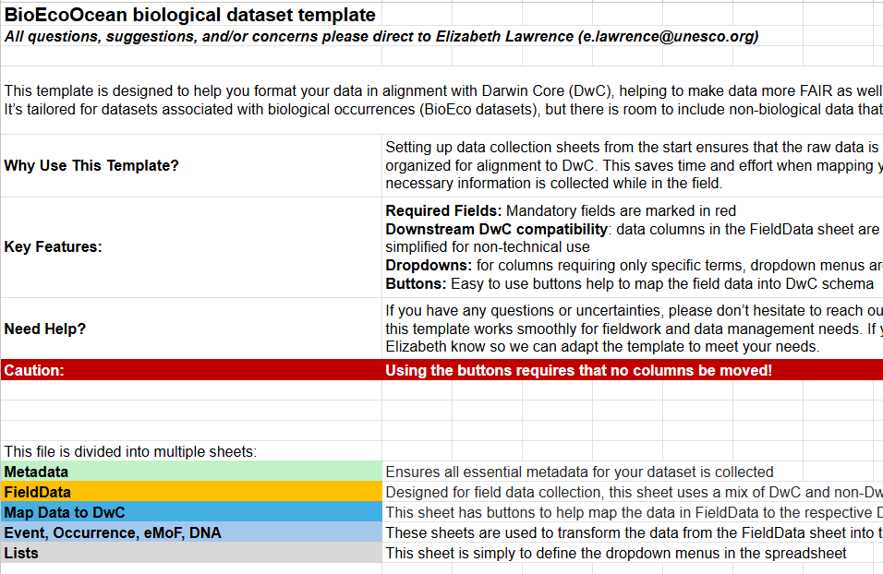
BioEco Excel Field Data template
demo
Support field data collection
Groundwork for data alignment
Question (later): do multiple data field collection need to be created?
Notes:
Field data template - ideally one generic one that can be useful for all types of (biological) field data collection.
It’s the precursor to data alignment, so SOME DwC but also meant to be simpler than aligning to DwC right away. Providing building blocks for building identifiers

Slide 21
Discussion Points
Minimum requirements to be EOV compliant (data, metadata, collection) and IOC Digital Ecosystem alignment
Is the Panel involved in discussions with regional coordinated activities on metadata and data standards (e.g. pan-Arctic Distributed Biological Observatories)

Slide 22
Coffee Break

Slide 23
3. Darwin Core & Data Schemas

Slide 24
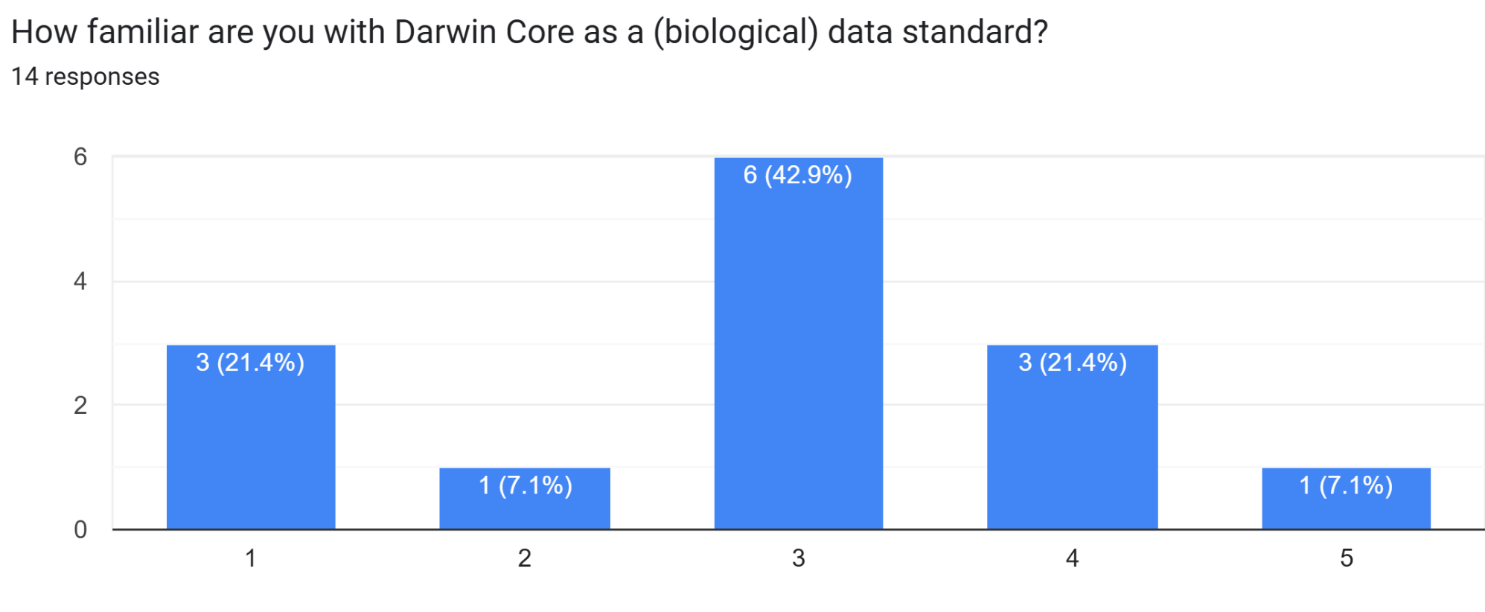
Data Schema (DwC)
https://forms.gle/EoMsHR5vp5QVqbtBA

Slide 25
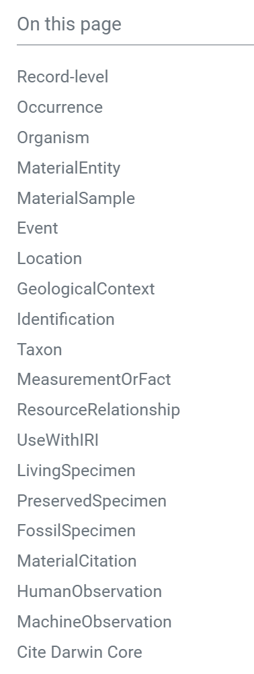
Darwin Core
Standard terms
https://dwc.tdwg.org/terms/
e.g.
Maintained by TDWG
(Re)usable
Publish

Slide 26
Data schemas
One Core data table
Two main Core types
Notes:
DwC also provides data schemas. Which is just a framework for how the data sheets are organized.
DwC schema used by OBIS currently uses ONE core table which contains the main type

Slide 27
Data schemas
Any number optional Extension tables
Notes:
DwC also provides data schemas. Which is just a framework for how the data sheets are organized.

Slide 28
Zipped with a Metadata file
DwC-Archive
Data schemas
Notes:
DwC also provides data schemas. Which is just a framework for how the data sheets are organized.

Slide 29
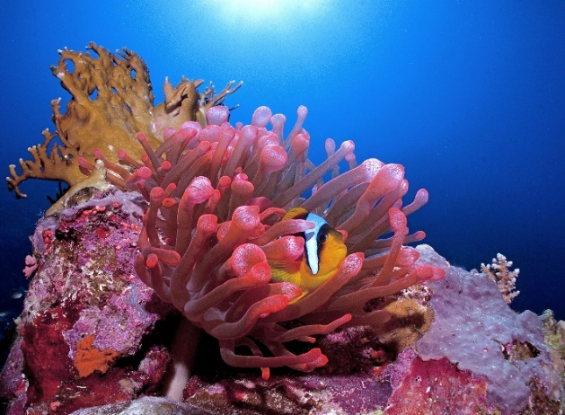
Occurrence core
Event core
Data pertains to a biological occurrence
No event hierarchies or diverse measurements tied to sampling events
Includes details on sampling events & parameters rather than just on organisms
Relationships between samples are important (e.g. nestedness)
Cinzia Osele Bismarck / Ocean Image Bank
Shaun Wolfe / Ocean Image Bank
Notes:
Occurrence core = data focuses specifically on biol occurrences
Event core = data also include sampling and relationships bt samples need to be represented

Slide 30
extendedMeasurementOrFact table
Extension table to record all types of measurements (abiotic, biotic, sampling...)
Measurements in long format
ID | measurementType | measurementValue | measurementUnit
spp1 | length | 15 | um
spp1 | net diameter | 30 | cm
spp1 | net length | 60 | cm
spp1 | temperature | 10 | C
spp1 | name of net | KC Denmark AS small plankton net
ID | Length (um) | Temperature (C) | Net type
spp1 | 15 | 10 | 30cm Denmark AS small plankton net
spp2 | 30 | 12 | 30cm Denmark AS small plankton net
spp3 | 23 | 11 | 100 cm Denmark AS small plankton net

Slide 31
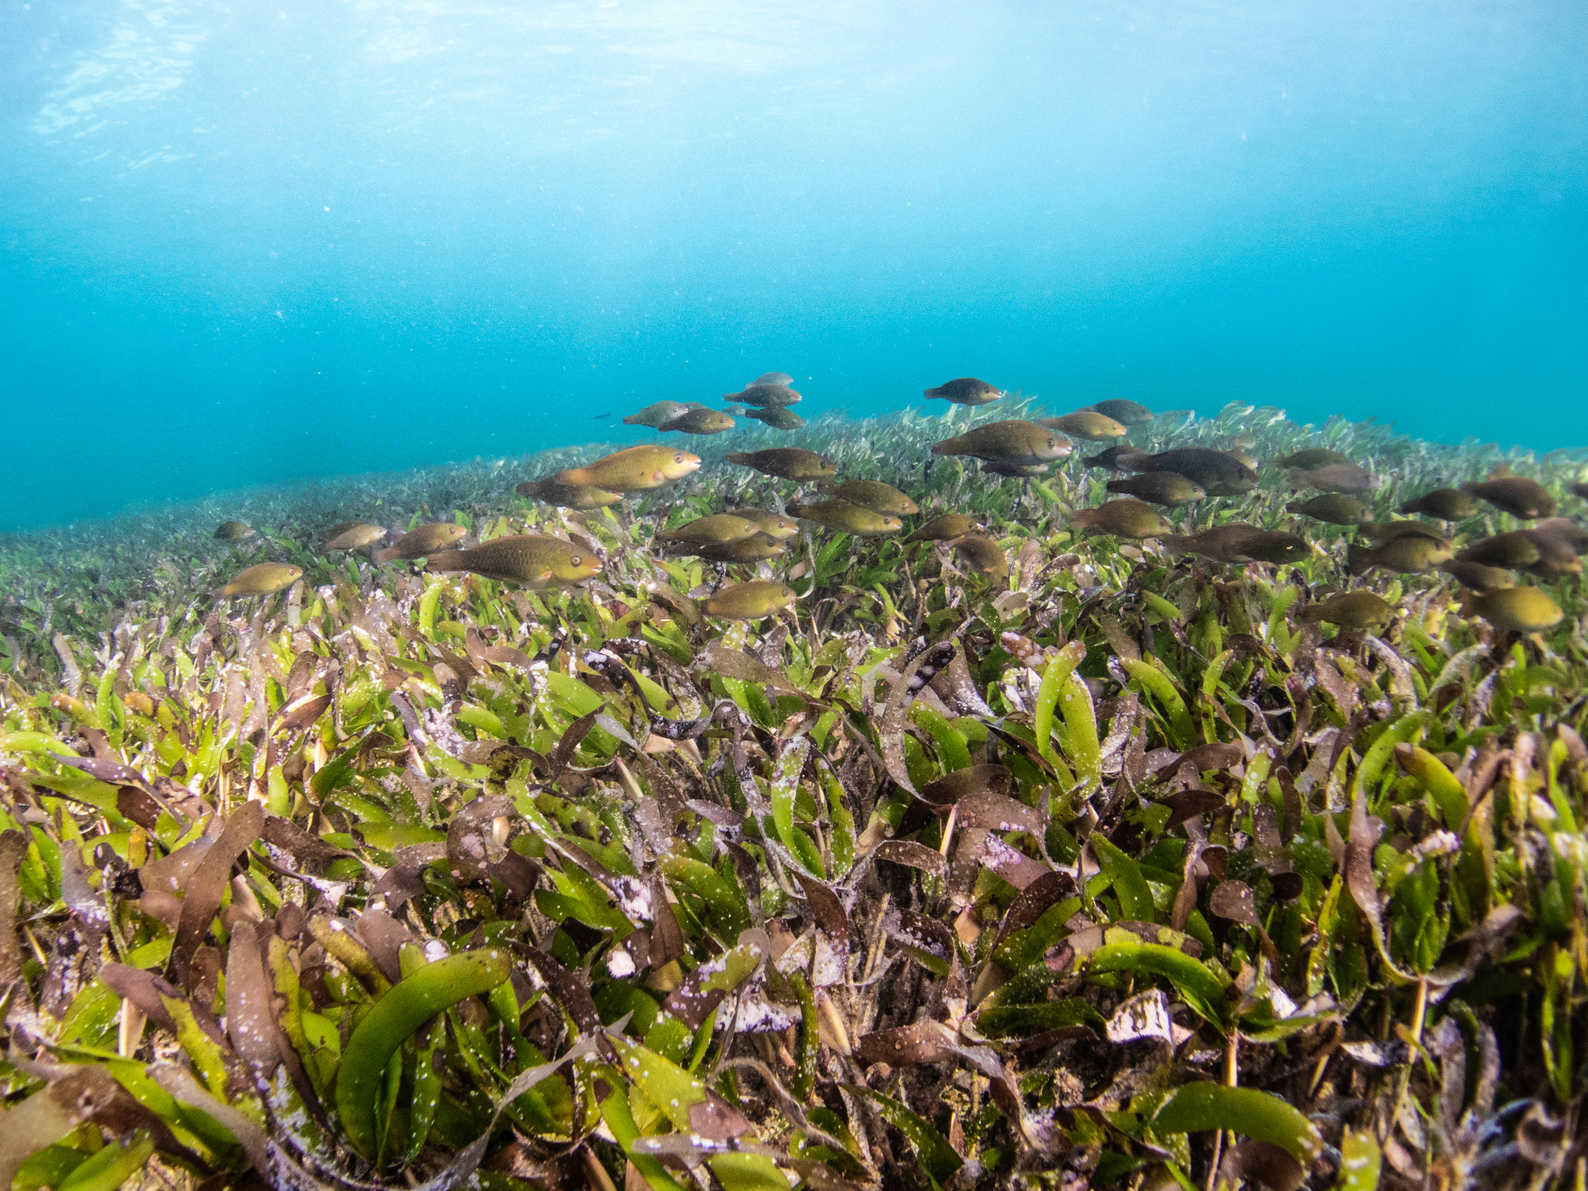
Example: Mapping EOV Data to DwC
Fish predation rate and occurrence were estimated with the MarineGeo "squid-pop" sampling protocol in which 25 baits were placed in the seagrass; one GoPro camera was set to record the presence of fishes approaching one of the baits. Consumption rate was registered after 1 hour and 24 hours baits deployment (squid-pops), counting the number of baits present or absent. In each seagrass patch, four parallel transects lines with the squipops were deployed. In each patch's area, three quadrats were haphazardly deployed for cover and abundance estimates. Also, three sediments cylinders were extracted for estimating the seagrass biomass by plant sections (green leaves, non green leaves, shoots, rizomes, roots, other seagrass
Ben Jones / Ocean Image Bank
Based on: https://ipt.iobis.org/caribbeanobis/resource?r=seagrasssurvey_colombia
Notes:
Let’s now look at an example of what some field notes could look like when mapped to DwC

Slide 32
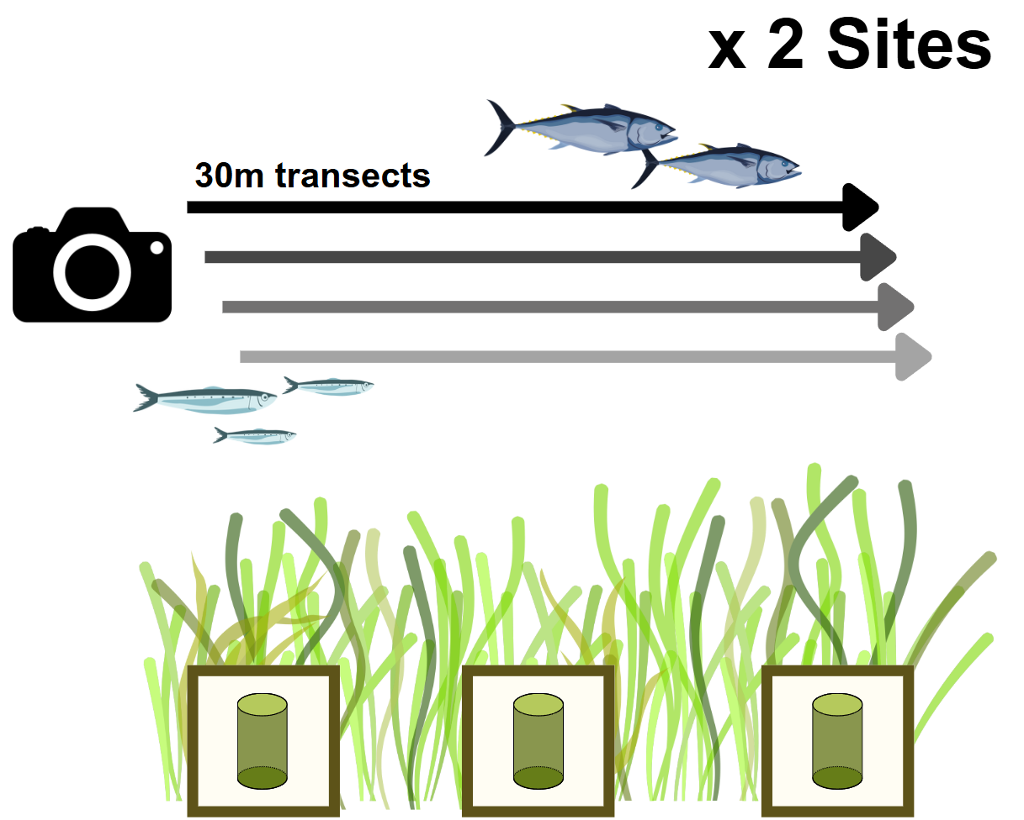
Example: Mapping EOV Data to DwC
Fish predation rate and occurrence were estimated with the MarineGeo "squid-pop" sampling protocol in which 25 baits were placed in the seagrass; one GoPro camera was set to record the presence of fishes approaching one of the baits. Consumption rate was registered after 1 hour and 24 hours baits deployment (squid-pops), counting the number of baits present or absent. In each seagrass patch, four parallel transects lines with the squipops were deployed. In each patch's area, three quadrats were haphazardly deployed for cover and abundance estimates. Also, three sediments cylinders were extracted for estimating the seagrass biomass by plant sections (green leaves, non green leaves, shoots, rizomes, roots, other seagrass
Sampling
2 sites, 4 x 30m transects
3 quadrats per site
Sediment cylinders
Fish occurrences
MarineGeo "squid-pop" sampling protocol
Baited GoPro camera
Variables measured
Water Temperature
Dissolved Oxygen
Biomass green leaves
Based on: https://ipt.iobis.org/caribbeanobis/resource?r=seagrasssurvey_colombia
Notes:
Let’s now look at an example of what some field notes could look like when mapped to DwC

Slide 33
Example:
EOV Data to DwC Event table
Based on: https://ipt.iobis.org/caribbeanobis/resource?r=seagrasssurvey_colombia

Slide 34
Example:
EOV Data to DwC Occurrence table
Based on: https://ipt.iobis.org/caribbeanobis/resource?r=seagrasssurvey_colombia

Slide 35
Example:
EOV Data to DwC eMoF table
Based on: https://ipt.iobis.org/caribbeanobis/resource?r=seagrasssurvey_colombia

Slide 36
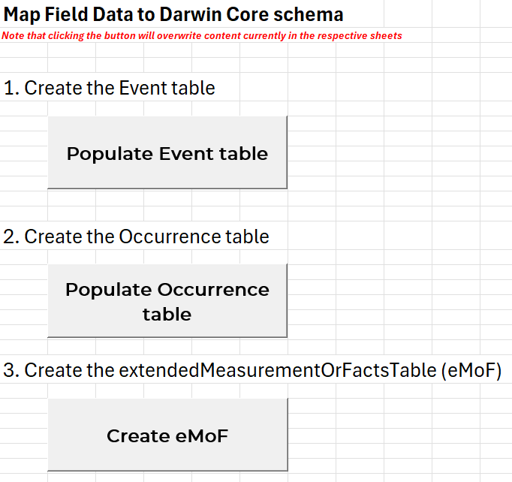
BioEcoOcean Field Data Template
*macros must be enabled
Many ways to do
Other schemas may already exist
e.g. seagrass, macroalgae
DwC Schema
Template uses button macros to facilitate alignment to DwC
*In development
Notes:
I used the buttons to help map the EOV data to DwC on the previous slides
Still in development, will need testing, and will need someone somewhat comfortable w/ DwC to always check the output

Slide 37
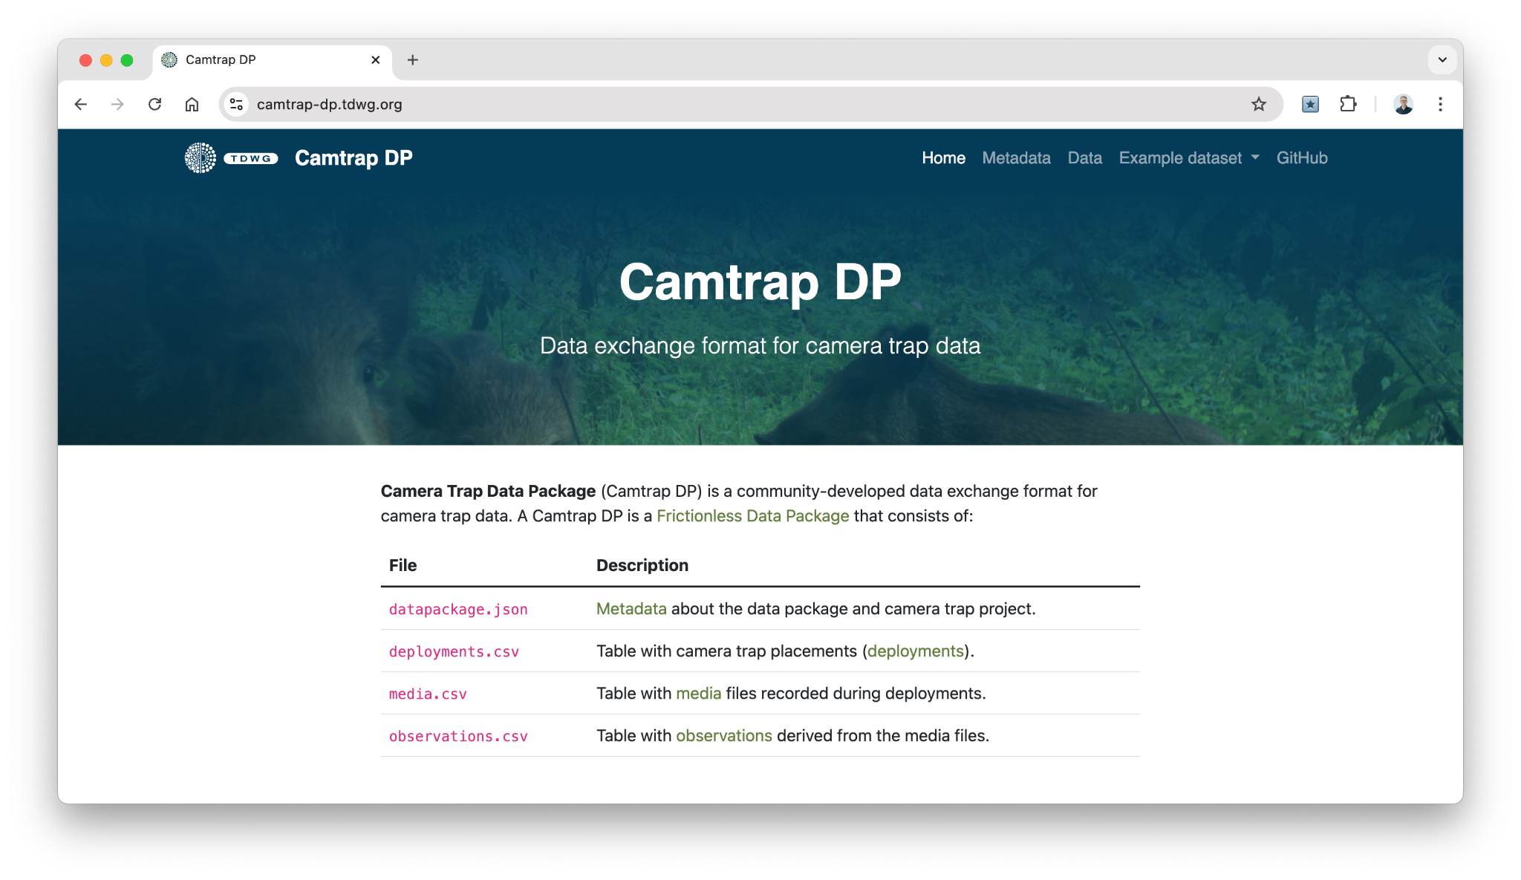
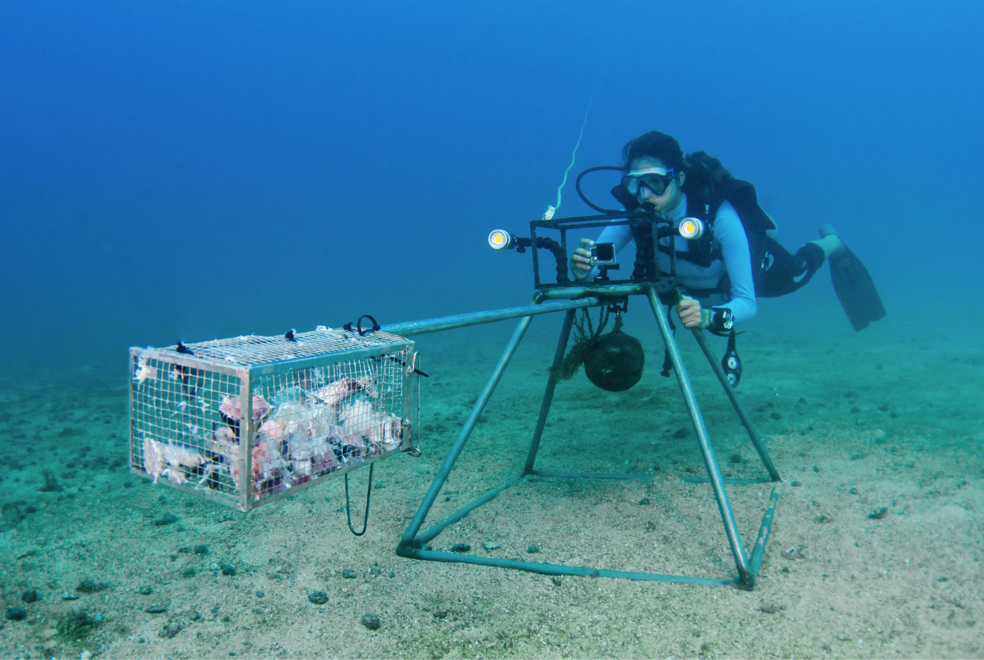
Formal schema descriptions by EOV
Notes:
EOV datasets will be DwC but they’ll all have their own specificites. So every EOV a formal description of the data schema

Slide 38
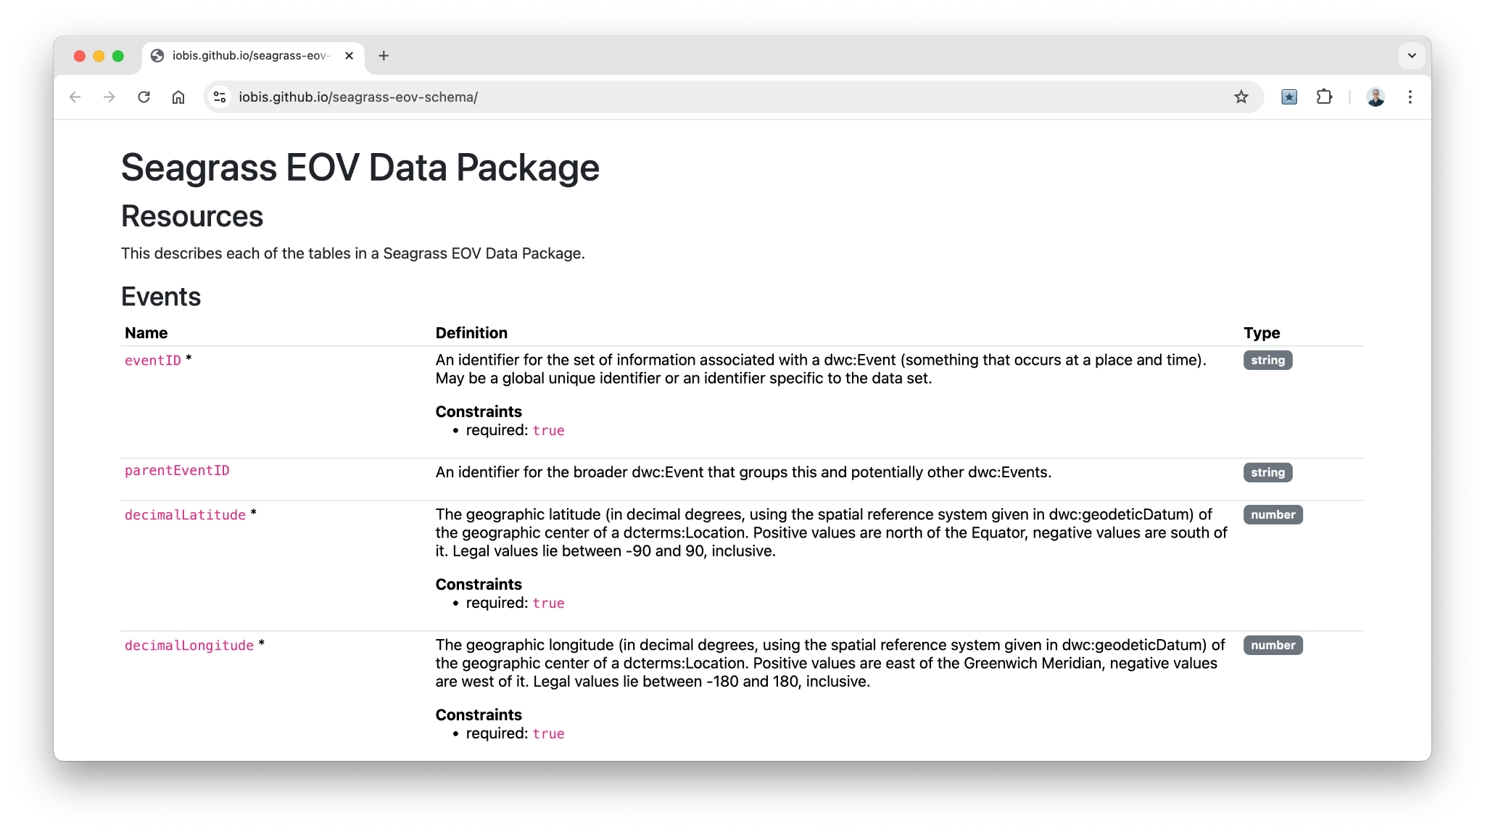
https://github.com/iobis/seagrass-eov-schema

Slide 39
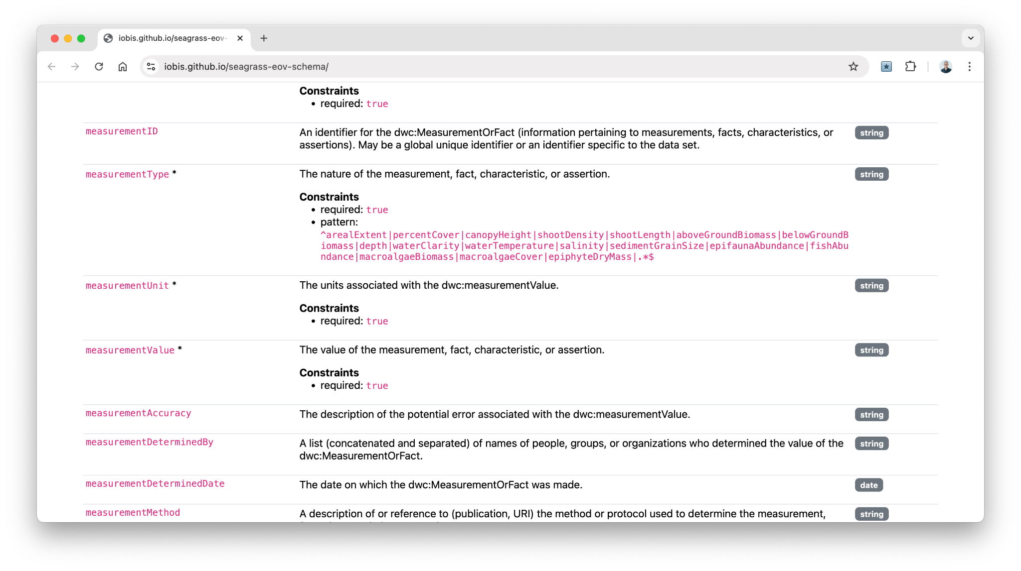
https://github.com/iobis/seagrass-eov-schema

Slide 40
Do not edit
How to change the design
Any immediate feedback/thoughts on the Field Data template? E.g. Missing fields, clarification, multiple types vs one “master”, etc.
Presenting with animations, GIFs or speaker notes? Enable our Chrome extension
Notes:
📣 This is Slido interaction slide, please don't delete it. ✅ Click on 'Present with Slido' and the poll will launch automatically when you get to this slide.

Slide 41
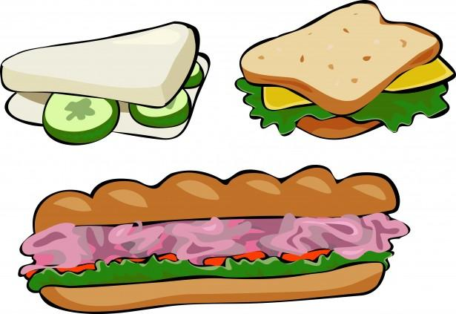
Lunch Break

Slide 42
4. “Computer Language”

Slide 43
What is it
Standardized way of recording or defining information. Enables computer communication.
What did the authors mean by “distance”?
What is this dataset about? Are there other datasets measuring the same things? Are there other connections to this dataset?
Dataset
The name of this species isn’t accepted anymore, how can I be sure which species it is?
User
Here are links that:
Define the measured variable
Provide a taxon ID (WoRMS)
Provide complete metadata
Show connected data
Computer
Notes:
Controlled vocab
Allows your data and computers to “talk”
Allows users to understand and interpret more accurately

Slide 44
Why use it
Variables and measurements are typically recorded as free text = heterogeneity
Consistent data entry
Improve accessibility
Makes data interoperable
Minimizes misunderstandings
len
carapace length
length
lnth
survey length
fork length
longueur
fish length
largo
total length
mean length
standard length
FAIR
Notes:
Why use controlled vocab?

Slide 45
Where to use it
Standard data column names
Measurements or variables
Standard descriptions when possible
Include vocabulary codes from machine-readable collections
NERC/BODC, ENVO, ICES…

Slide 46
Controlled vocabulary example: Darwin Core
basisOfRecord:
HumanObservation
MaterialSample (e.g. for DNA samples)
MachineObservation
LivingSpecimen
PreservedSpecimen
FossilSpecimen
…
lifeStage:
zygote
larva
juvenile
adult
seedling
flowering
fruiting
vitality:
alive
dead
mixedLot
uncertain
notAssessed
Vocabulary

Slide 47
Controlled vocabulary example: eMoF
Identifiers for each eMoF column (as applicable)
measurementTypeID
measurementValueID
non-numeric values
measurementUnitID
Notes:
Emof lets you attach a vocab identifier to each of the emof columns. Makes it so that measurements are more easily comparable and interoperable

Slide 48
Example: Mapping Field Data to DwC: eMoF
measurementType | measurementValue | measurementUnit
habitat | seagrass
water temp | 29.23 | Degrees Celsius
dissolved oxygen | 6.58 | Milligrams per litre
sampling device | GoPro Camera
transect length | 30 | M
Dry biomass of green leaves | 0.05575 | Grams per square metre
2
Notes:
Very flexible to be able to link various measurements and information to the different events
Point out the info linked to the general site vs the tide pool

Slide 49
Example: Mapping Field Data to DwC: eMoF identifiers
measurementType | measurementTypeID | measurementValueID | measurementUnitID
habitat | http://vocab.nerc.ac.uk/collection/P01/current/UKMH9706/ | http://vocab.nerc.ac.uk/collection/M24/current/SSIMSSGR/
water temp | http://vocab.nerc.ac.uk/collection/P01/current/TEMPPP01/ |  | http://vocab.nerc.ac.uk/collection/P06/current/UPAA/
dissolved oxygen | http://vocab.nerc.ac.uk/collection/P01/current/DOXYSE02/ |  | http://vocab.nerc.ac.uk/collection/P06/current/UMGL/
sampling device | http://vocab.nerc.ac.uk/collection/P01/current/NMSPINST/ | http://vocab.nerc.ac.uk/collection/L22/current/TOOL1203/
transect length | http://vocab.nerc.ac.uk/collection/P01/current/LENTRACK/ |  | http://vocab.nerc.ac.uk/collection/P06/current/ULAA
Dry biomass of green leaves | http://vocab.nerc.ac.uk/collection/P01/current/SDBIOL08/ |  | http://vocab.nerc.ac.uk/collection/P06/current/UGMS/
Notes:
Can tell by looking at the links most are from NERC but also have used some vocab from NOAA’s CMECS for habitat (recently got URIs!)

Slide 50
Help selecting controlled vocabulary
OBIS Manual and YouTube
Vocabulary community
OBIS Slack
BODC GitHub
SeaDataNet Facet Search
BioEcoOcean – Elizabeth!
Notes:
Reminder for project partners to record variables so I can map them
(can also help w/EOV sub-vars → MBO collab?)

Slide 51
5. Publishing Data to OBIS

Slide 52
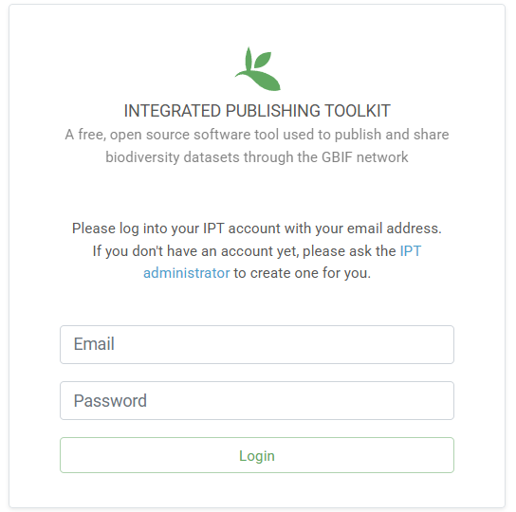
Publishing on the IPT
(Integrated Publishing Toolkit)
OBIS & GBIF use IPTs to publish and register datasets
IPTs generate DwC-Archives using uploaded data
OBIS Nodes host IPTs
But so can anyone! (with the tech to do so)
Can assign DOIs (DataCite account needed)
Notes:
IPTs are web apps that …

Slide 53
IPT Demo
https://ipt.obis.org/secretariat/

Slide 54
Discussion Points
How to choose an IPT?
BioEcoOcean preference for IPT instance
Set up instances for each living lab?
Organization will be seen as publisher
OBIS Secretariat IPT
Other OBIS node IPT

Slide 55
Coffee Break

Slide 56
6. Accessing OBIS Data

Slide 57
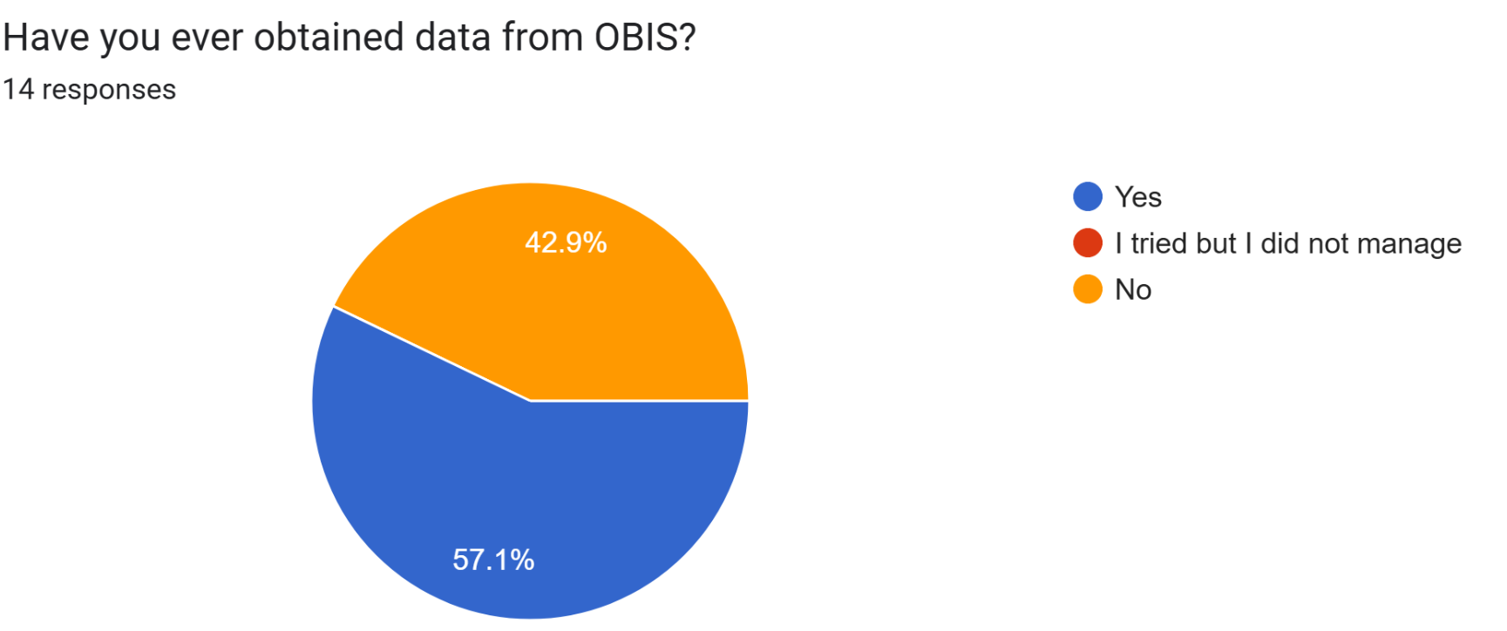
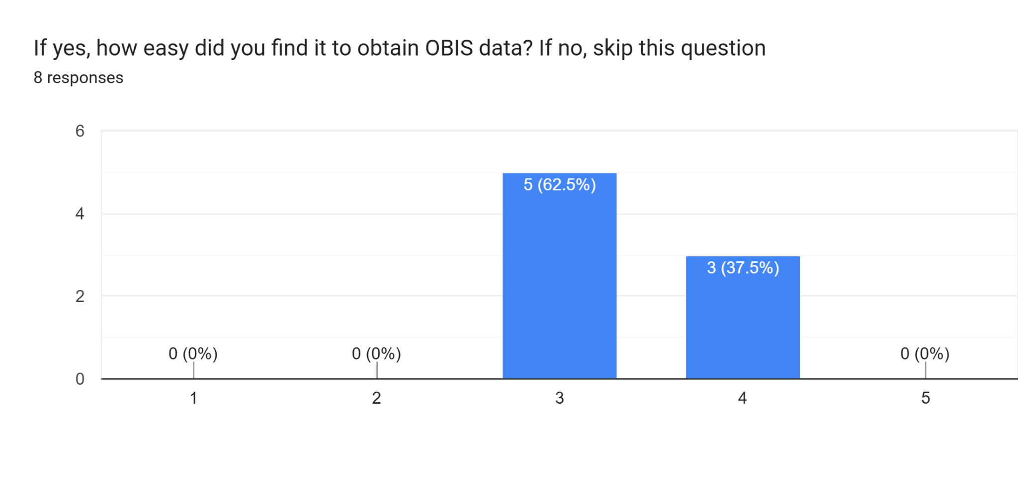
https://forms.gle/EoMsHR5vp5QVqbtBA

Slide 58
Demo: OBIS Data Access
OBIS.org Web Portal
OBIS Mapper
robis R package
Full exports

Slide 59
OBIS Mapper Demo
https://mapper.obis.org

Slide 60
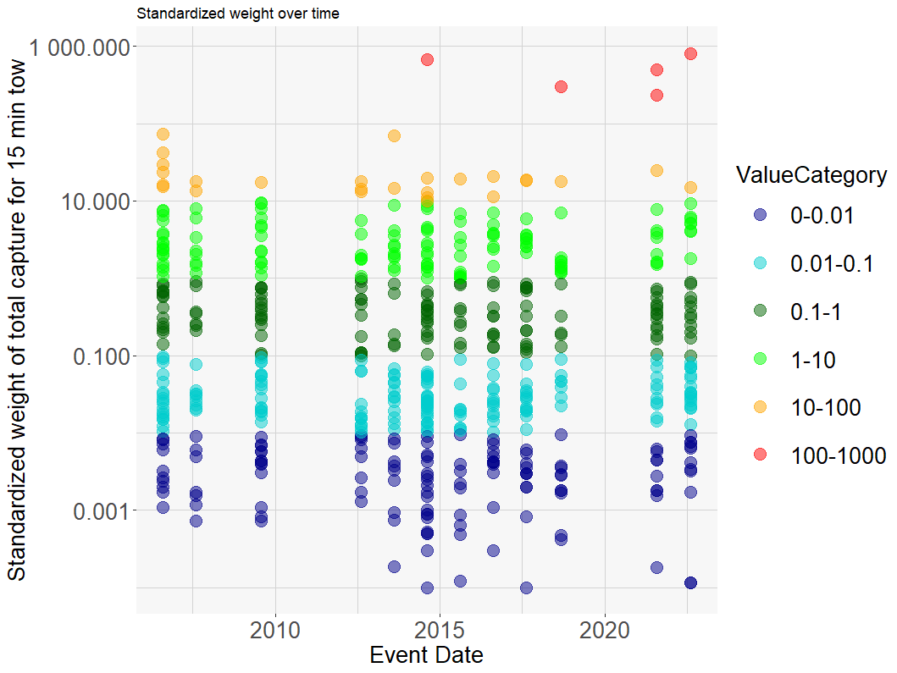
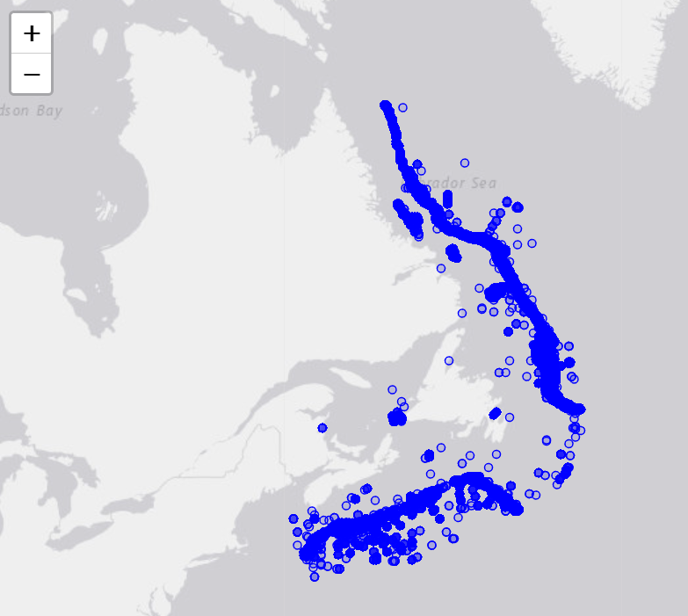
robis
https://github.com/iobis/robis
occurrence()
dataset()
unnest_extension()
>occurrence(areaid = 34, startdepth = 500, mof=T)
>unnest_extension(df=occ, extension= "MeasurementOrFact")
Taxonomic name
Area identifier
Geometry (polygon)
Depth filters
Extract info associated with occurrence data
Notes:
Canada north Atlantic below 500m (area=34)
measurementValue = Standardized weight of total capture from 15 min tow. Mostly from DFO bottom trawl survey datasets

Slide 61
robis Google colab
https://colab.research.google.com/github/iobis/obis-intro-pres/blob/main/notebooks/R/robis_da.ipynb
*run first block to install packages, takes a while
https://github.com/iobis/obis-intro-pres
Notes:
Canada north Atlantic below 500m (area=34)
measurementValue = Standardized weight of total capture from 15 min tow. Mostly from DFO bottom trawl survey datasets

Slide 62
7. EOV Data Products

Slide 63
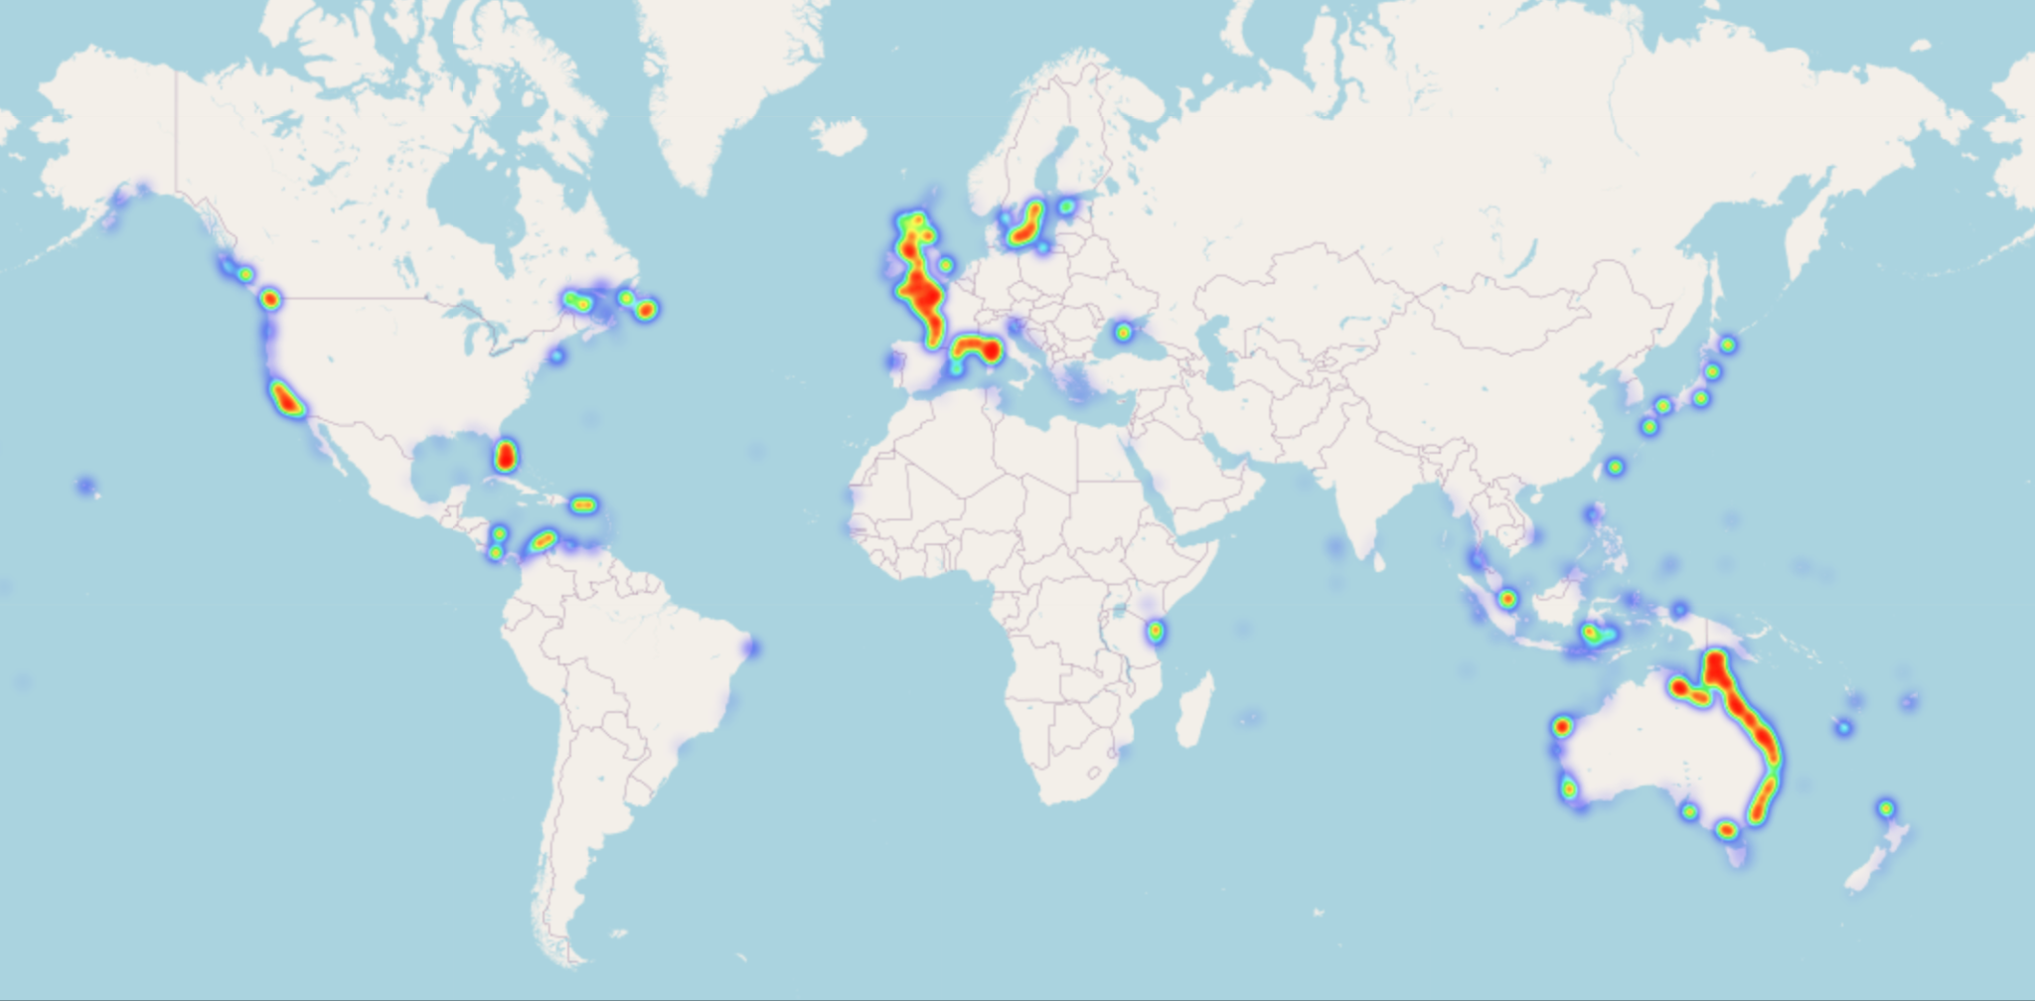
Seagrass heatmap
Improved by increased usage of controlled vocabulary

Slide 64
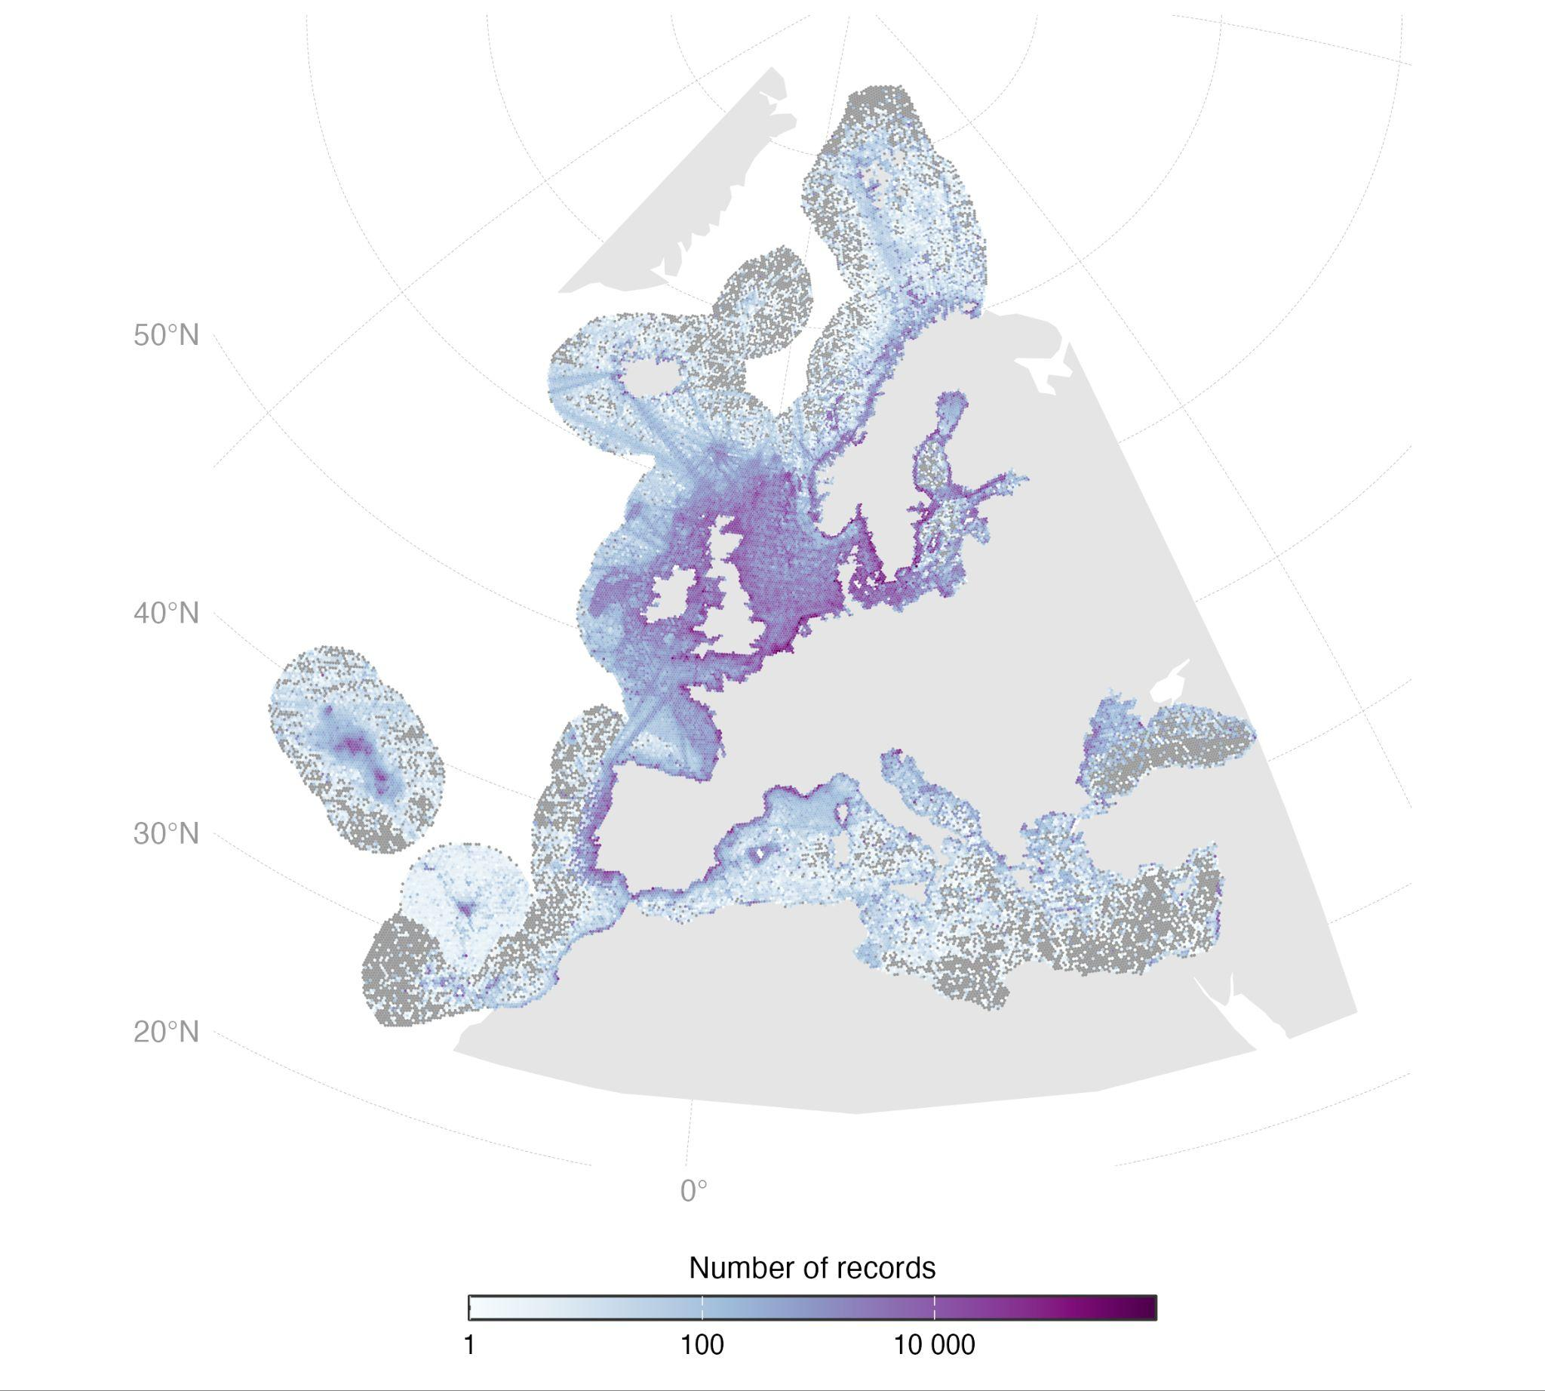
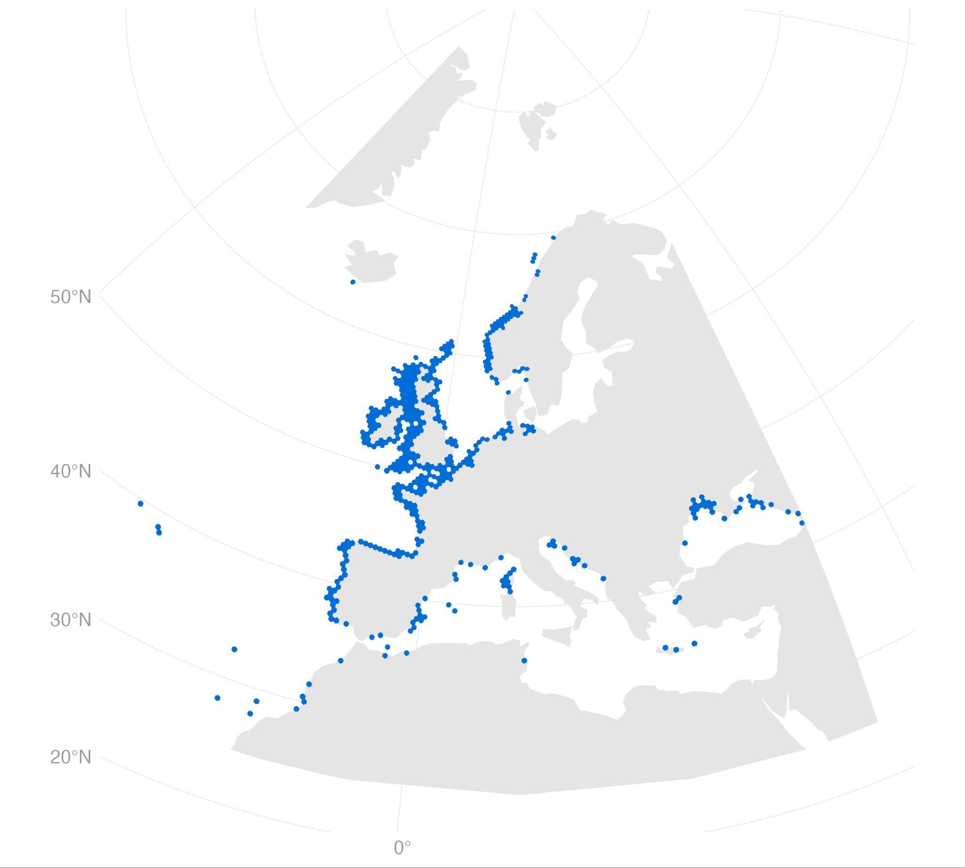
Species & biogenic habitat distributions to support prioritisation
Overcoming data limitations: species distribution
Actinia equina (distribution records)

Slide 65
From today to future → climate resilient MPAs
Current period
Actinia equina
Future - 2100
SSP3 (7.0)
Increase in suitability
Decrease in suitability

Slide 66
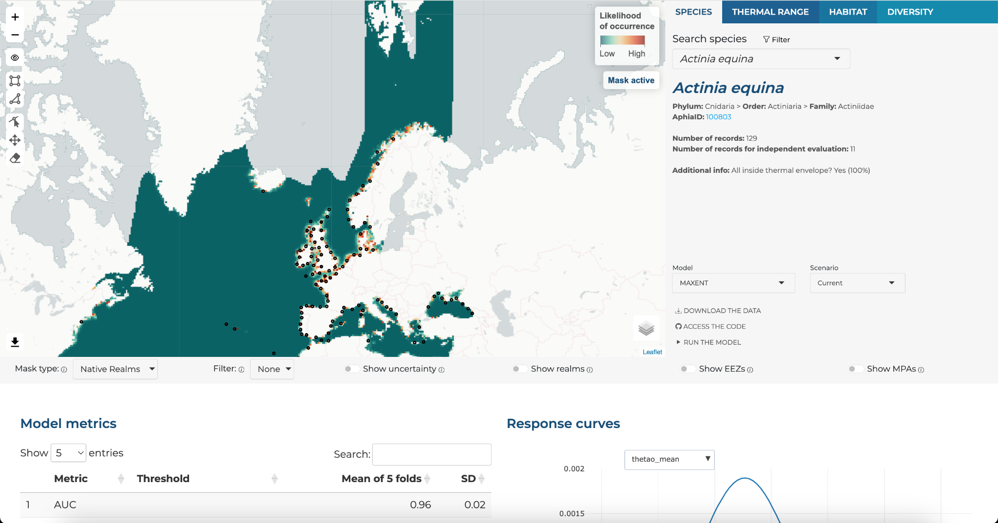
shiny.obis.org/distmaps

Slide 67
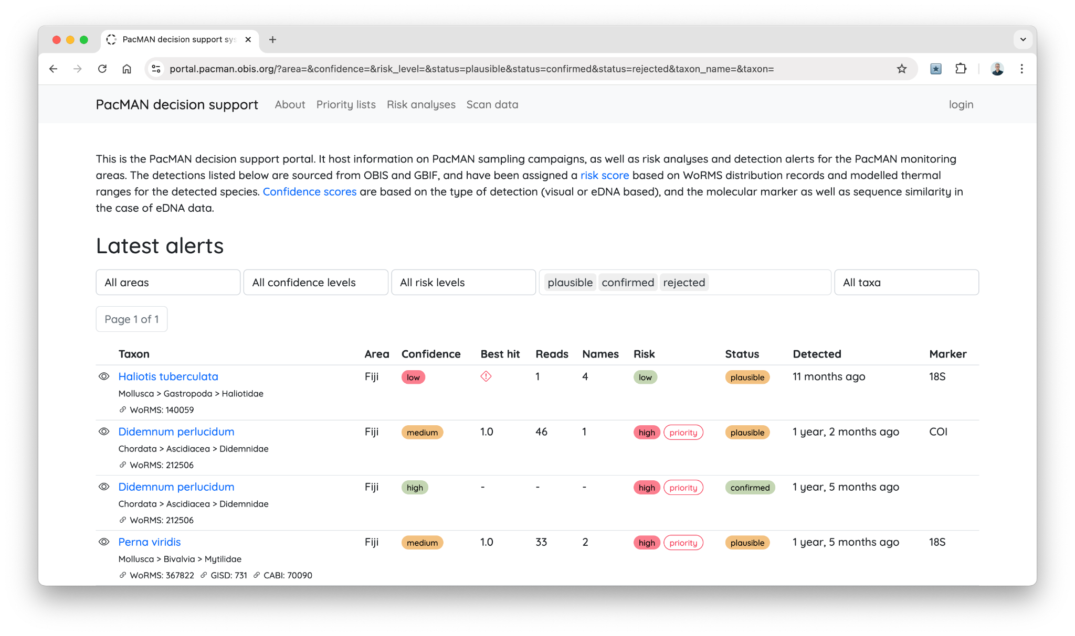
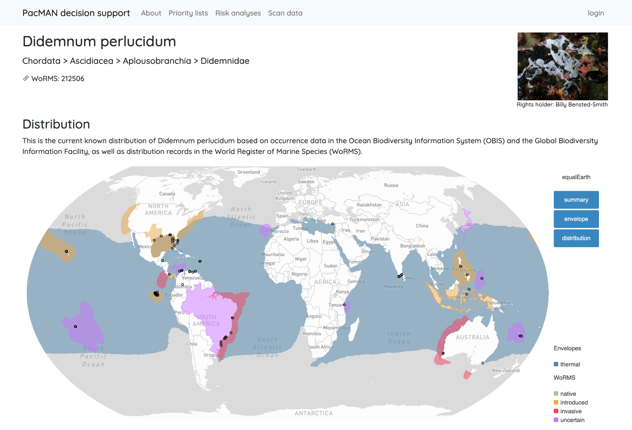
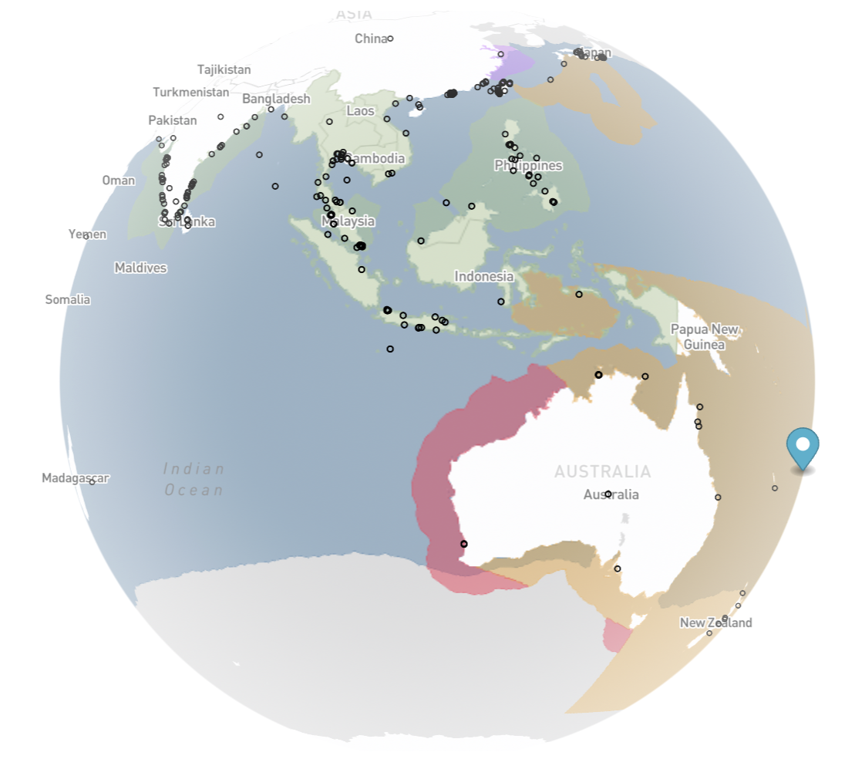
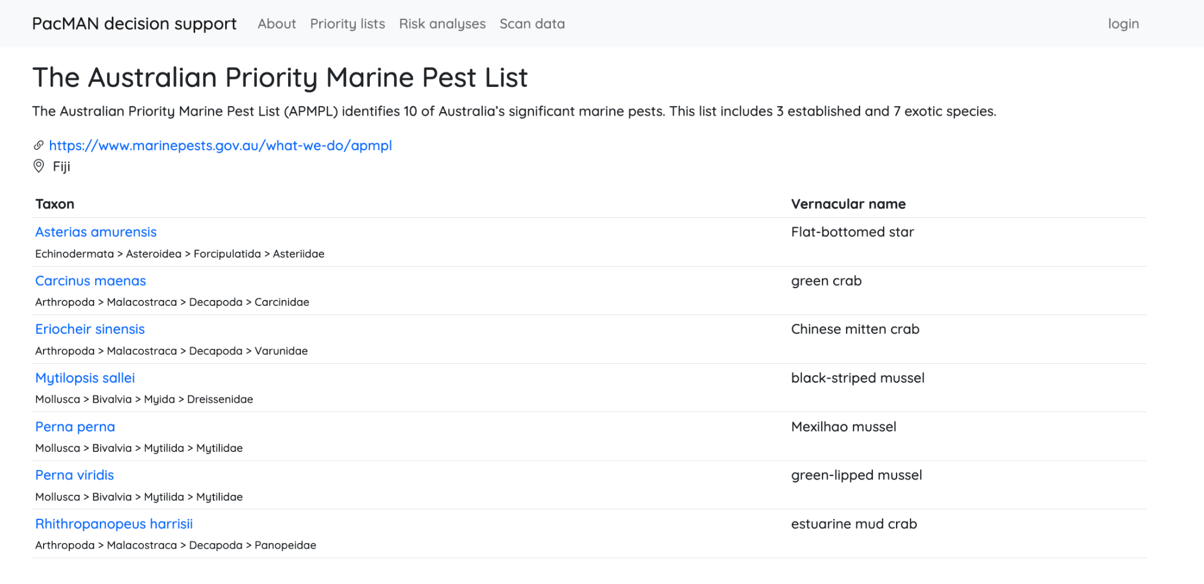
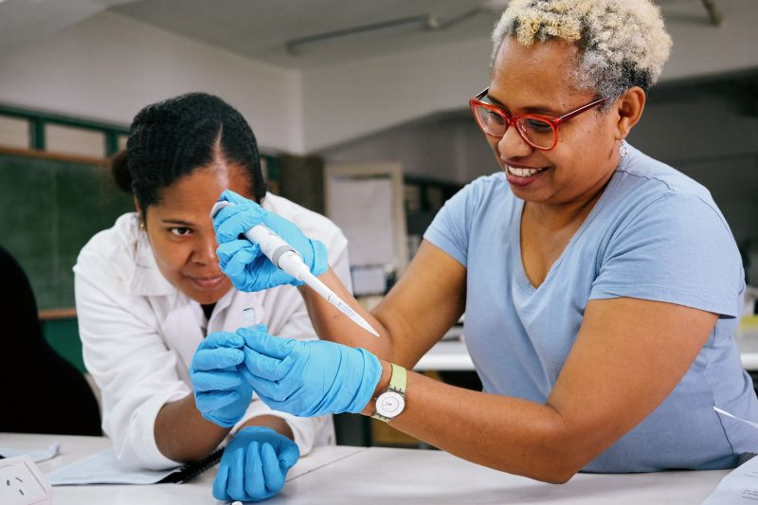

Slide 68
Do not edit
How to change the design
What kinds of EOV-data derived products would be useful?
Presenting with animations, GIFs or speaker notes? Enable our Chrome extension
Notes:
📣 This is Slido interaction slide, please don't delete it. ✅ Click on 'Present with Slido' and the poll will launch automatically when you get to this slide.

Slide 69
e.lawrence@unesco.org
helpdesk@obis.org

