Slide 1
TOWS TTDMP Meeting 2025
Tsunami Ready ‘Equivalency’
In the Pacific
Task Team Tsunami Ready Co Chairs:
Laura Kong, ITIC
Ashleigh Fromont, NZ NEMA

Slide 2
TOWS TTDMP Meeting 2025
TRRP “Equivalency”
The UN Ocean Decade Goal is to make ”100% of communities at risk of tsunami prepared for and resilient to tsunamis by 2030 through the implementation of the UNESCO/IOC Tsunami Ready Recognition Programme and other initiatives.”
For the proposed ‘equivalency’ concept, the 12 indicators of the Tsunami Ready Recognition Programme are taken as the definition of ‘prepared and resilient’
The purpose of this ‘equivalency approach’ is to ensure that every country can contribute to progress reporting for the UN Ocean Decade Goal.
This process does not require application to IOC/UNESCO for formal TR recognition but will support ICG reporting.
.

Slide 3
TOWS TTDMP Meeting 2025
TRRP “Equivalency”
The approach proposed at ICG/PTWS-XXX (September 2023) has the following principles:
Countries have a strong motivation to ensure tsunami resilience
Builds upon existing programmes, capacities and strengths
We use the 12 indicators of the Tsunami Ready Framework
Contributes to ICG progress reporting for UNOD Tsunami Programme
Where possible, the TRRP should be implemented as a first option
Notes:
Last one is a new one

Slide 4
TOWS TTDMP Meeting 2025
TRRP “Equivalency” is a country action
Approach proposed at ICG/PTWS-XXX had 4 steps, since simplified to 3:
Identify / establish national governance
Assess tsunami preparedness & resiliency against TRRP indicators
Report progress toward UNOD Goal to ICG.
This process would be applied to the most pragmatic definition of community, so that the assessment can be conducted in a meaningful but sustainable manner.
It is important that this is appropriate for each countries existing disaster management context
The Tsunami Ready Recognition Programme gives similar flexibility.
Notes:
There was discussion at the Task Team meeting about the challenges of this definition, and for some cases, it may not be possible to apply this meaningfully, and still have the resources to apply the equivalency. This is not dissimilar to some of the resourcing challenges facing the Tsunami Ready Recognition Programme as well.
As part of this process, the community will be defined, and the total number of at-risk communities calculated. Before the ICG we intend to include some examples of communities from different contexts

Slide 5
TOWS TTDMP Meeting 2025
1. Identify or Establish Governance
National governance should be in place in order to provide oversight of this process. In many cases an existing governance body may be able to be identified for this purpose to avoid duplication, or a bespoke National Tsunami Ready Board could be established.
The functions of this governance group will be to:
Provide expert interpretation of the tsunami ready indicators in the country's own context
Provide expert commentary on the definition of community in the country’s own context
Approve the implementation of this equivalency process
Should formal Tsunami Ready Recognition appropriately wish to be pursued by any individual community, this governance structure may be able to be utilized for the recognition process as per IOC MG 74.

Slide 6
TOWS TTDMP Meeting 2025
2. Cross-Referencing Process
A cross-referencing guide is provided in the documentation, which is intended to be broad enough for multiple contexts, while remaining a high standard of tsunami preparedness. For example, if it is believed that the preparedness activities conducted by the communities in accordance with the law contribute appropriately to an indicator in the communities, this can be appropriately recorded as justification to meet the overall indicator.
This process is a self-assessment, and countries are encouraged to apply it according to the principles of the equivalency process.
This review, along with supporting documentation such as plans, should then be reviewed by the established governance mechanism.
The cross-referencing process should be completed at least once every four years, in alignment with the Tsunami Ready Recognition Programme renewal timeframe.
Notes:
At a national level, a review should be conducted of all existing activities and strategies that contribute to tsunami preparedness as described by the Tsunami Ready Recognition Programme indicators. The purpose of this is the identification of where Tsunami Ready indicators are already being met through existing national or community disaster management or tsunami preparedness efforts. Before the ICG we will be trying to provide examples of how this might practically be applied in a few countries

Slide 7
TOWS TTDMP Meeting 2025
3. Reporting
PTWS Member States should report the progress of the preparedness and resilience of at-risk communities either through the Tsunami Ready Recognition Programme Implementation or through the equivalency approach through national reporting to the ICG.
Ideally, these should be integrated with future PTWS KPI and National Reporting frameworks, but reporting could be along the lines of the following:
What % of your at-risk communities are ‘prepared for and resilient to tsunami’?

Slide 8
TOWS TTDMP Meeting 2025
Next Steps
The PTWS Task Team will be providing examples of community definitions, and an indication of the usability of this guidance in their own context by the time of the ICG
The drafted guidance will be presented at ICG/PTWS-XXXI, and the recommendation will likely be to run as a couple of pilots in countries with existing DRR programmes before final approval at ICG/PTWS-XXXII.
We welcome any and all feedback from TOWS TT-DMP
Alongside this, the PTWS Task Team will also look into whether there is more that can be done to recognise and celebrate the benefits of formal Tsunami Ready Recognition.

Slide 9
TOWS TTDMP Meeting 2025
Opt: Example in Practice

Slide 10
TOWS TTDMP Meeting 2025
Tsunami Ready in New Zealand
New Zealand has an existing Tsunami governance group called the National Tsunami Reference Group, consisting of national and local NDMO offices, the national tsunami warning centre, and the science community.
We will modify their terms of reference to include:
Verification of an analysis of tsunami preparedness, in the context of the Tsunami Ready Framework
New Zealand are prepared to use this Board to also approve formal Tsunami Ready Recognition should a community want to pursue that.

Slide 11
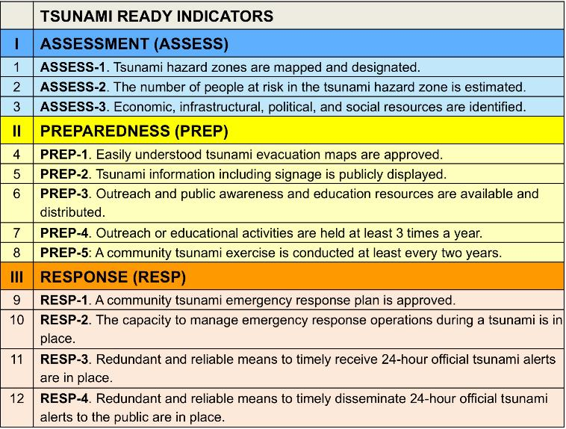
TOWS TTDMP Meeting 2025
Early comparison against indicators
Risk assessment is legally required by all communities.
These variably occur across communities depending on their risk and will need investigation community by community relative to their risk. We will do this through our usual community engagement
Legally required across all communities, and reported on a 5-year cycle
In place for all communities (national capability)

Slide 12
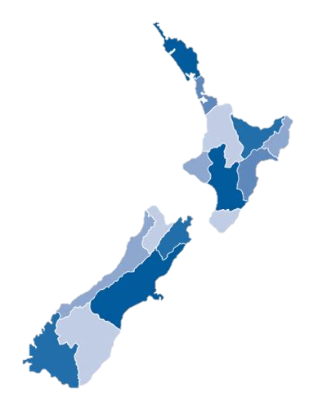
TOWS TTDMP Meeting 2025
Early comparison against indicators
We are working to be able to say:
XX out of 16 communities ( %) are prepared for & resilient to tsunami

