Slide 1
TOWS-WG 18th Session
Task Team on Tsunami Watch Operation
21 – 22 February 2025
Agenda 8. Updates on Products for Maritime Community
NISHIMAE Yuji
TTTWO Chair

Slide 2
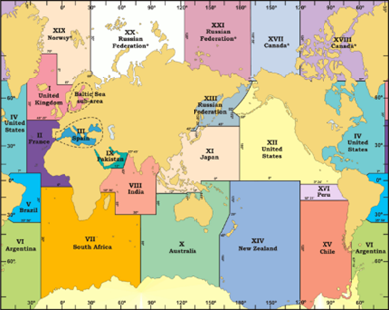
Recommendations at the TOWS-WG for TSP Messages to the Maritime Community
IOC Decision A-32/3.4.1
Warning and Mitigation Systems for Ocean Hazards
TOWS-WG Instructs the regional Intergovernmental Coordination Groups (ICGs) to;
IOC/TOWS-WG-XVII DECISIONS AND RECOMMENDATIONS
The TOWS-WG Group recommended to Intergovernmental Coordination Groups (ICGs):
TSPs in collaboration with NAVAREA operators of the International Hydrographic Organization (IHO) test the tsunami maritime safety products in 2023/24, with a view to operationally implementing them in 2024-2025
TSPs identified for each ICG to trial dissemination of maritime bulletins to respective NAVAREA operators in their Area of Service (AoS) in the second half of 2024 for full operational implementation in 2025;
Trial Transmission of a dummy message to the NAVAREA coordinators in the PacWave24

Slide 3
Timeline for full-scale operation of provision of special tsunami maritime safety products to the NAVAREA coordinators in the ICG/PTWS
Time | Event | Remarks
18 – 20 September | ICG/PTWS Steering Committee | Finalization of the timeline to the full-scale operation
5 November 2024 | Trial Transmission in the PacWave 24 | Trial transmission of the dummy test message to the NAVAREA Coordinators
6 February 2025 | Meeting with the WWNWS | Direct Transmission from PTWC to NAVAREA Coordinators NAVAREA Coordinators updated by WWNWS
February 2025 | TOWS-WG and TOWS-WG TTTWO
April 2025 | ICG/PTWS- XXXI Session | Finalization of the information format Finalization of the date for the full-scale operation
June 2025 | IOC 33rd Assembly
September 2025 | WWNWS Meeting
Within 2025 | Full Scale Operation

Slide 4
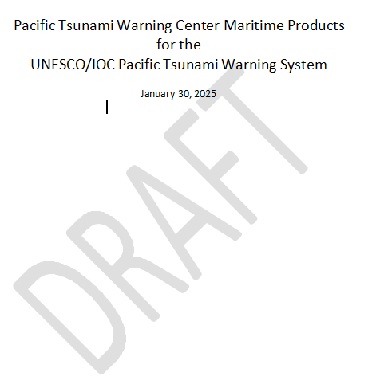
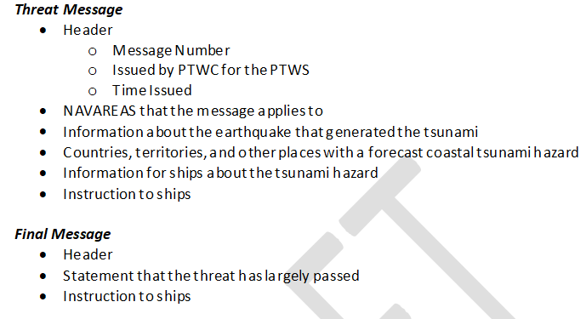
(Draft) Pacific Tsunami Warning Center Maritime Products
for the UNESCO/IOC Pacific Tsunami Warning System

Slide 5
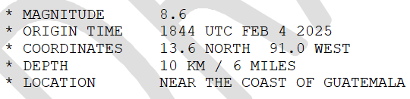
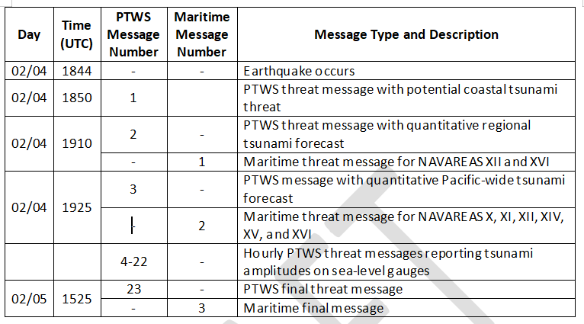
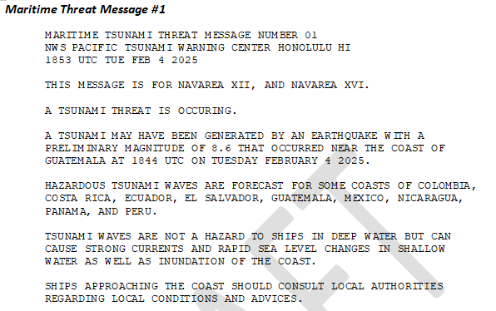
(Draft) Timeline and Sample maritime message
Earthquake Parameters
Timeline of message issuance

Slide 6
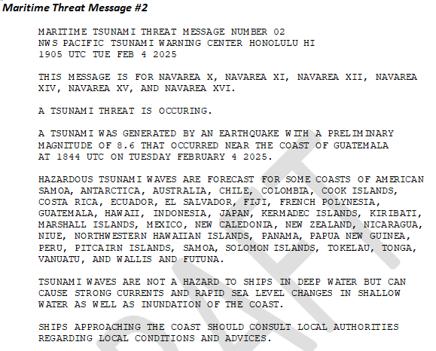
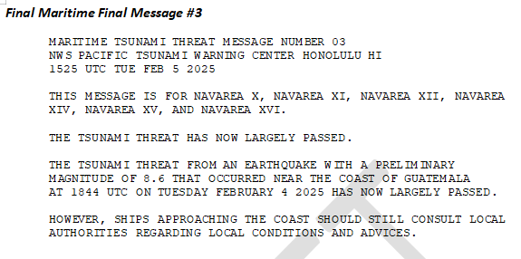
Sample maritime message

