Slide 1
TOWS-WG 18th Session
Joint Task Team Meeting
20 February 2024
Exercise Pacific Wave 24
NISHIMAE Yuji
TTTWO Chair

Slide 2
PacWave Exercises Task Team
Members (PacWave24)
Chile, China, Colombia, Fiji, France-French Polynesia, France-New Caledonia, Guatemala, Indonesia, Japan, Republic of Korea, New Zealand, Panama, Solomon Islands, Tonga, USA (ITIC and PTWC), and Vanuatu
Co-Chairs
Margarita Martinez – Chile
Laitia Fifita – Tonga
4 meetings
Also, Regional Exercises organized by Regional Working Groups
Tsunami Warning and Mitigation System in the South China Sea Region
Tsunami Warning and Mitigation System on the Central American Pacific Coast
Tsunami Warning and Mitigation System in the Southeast Pacific Region
Pacific Island Countries and Territories

Slide 3
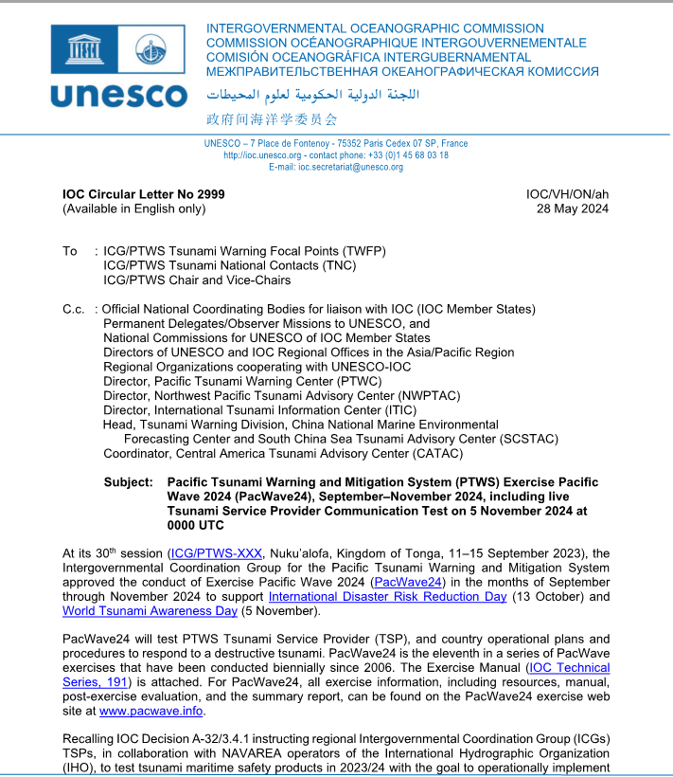
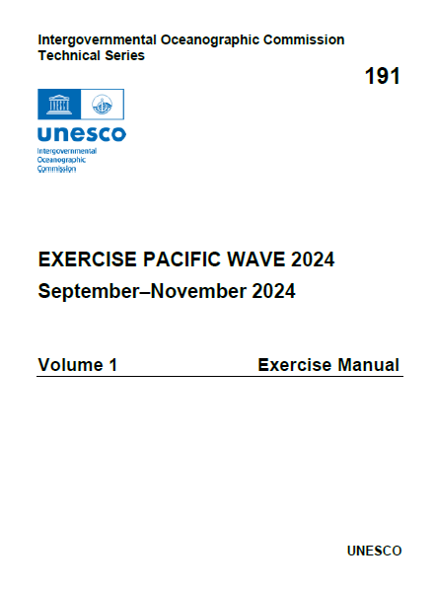
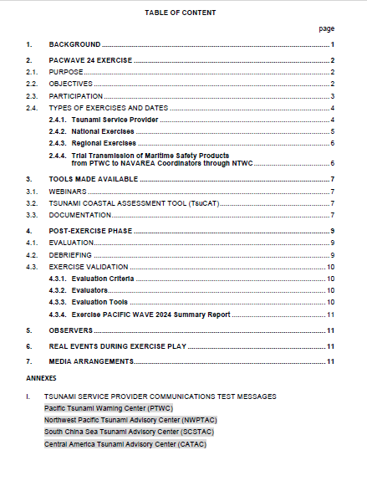
IOC Circular Letter No 2999 and the Exercise Manual (IOC Technical Series, 191)

Slide 4
Exercise Aim and Objectives (1)
PacWave24 will test PTWS Tsunami Service Provider (TSP), and country operational plans and procedures to respond to a destructive tsunami. PacWave24 is the eleventh in a series of PacWave exercises that have been conducted biennially since 2006.
Steering Committee decided to provide special tsunami maritime safety products to NAVAREA coordinators through the NTWC from the PTWC, and further decided to conduct a trial dissemination of the dummy message from the PTWC to the NAVAREA coordinators through the NTWCs as part of Exercise Pacific Wave 2024.

Slide 5
Exercise Aim and Objectives (2)
PTWS Member States should choose to participate in all applicable modes of exercise outlined below:
(i) One Live Communication Test from the PTWS TSPs to PTWS Member States on 5 of November 2024 at 0000UTC.
(ii) One NAVAREA Live Communication Test from PTWC to the NAVAREA Coordinators referred above through concerned NTWCs, or in the absence of an NTWC, upon request to the PTWS Technical Secretary, directly to the NAVAREA Coordinator, on 5 of November 2024 at 0100 UTC.
(iii) A national exercise from September to November 2024; and/or
(iv) A regional exercise involving neighbouring Member States within a region, such as within the PTWS Regional Working Groups where applicable, with a common scenario.

Slide 6
ICG/PTWS Steering Committee September 2024
Timeline Milestones
(IOC Circular Letter No 2999)

Slide 7
Timeline Milestones (1)
KEY DATES
31 August 2024 | Deadline for PTWS Regional Working Groups to inform TSPs if products needed, copied to ITIC
1 September – 30 November 2024 | PacWave24 Member State national exercise
2 weeks before Regional Exercise (5 Nov.) | TSP products available on regional exercise webpage
5 November 2024 (0000 UTC) | Live TSP Communications Test
5 November 2024 (0100 UTC) | Live NAVAREA Coordinators Communication Test from PTWC through concerned NTWC
4 November 2024 | Pacific Island Countries and Teritories Regional Exercise
21 November 2024 | South East Pacific Regional Exercise
.

Slide 8
Timeline Milestones (2)
KEY DATES
15 December 2024 | Deadline for Member States to complete and submit online PacWave24 Post-Exercise Evaluation Surveys for: • Live TSP Communication Test •Live NAVAREA Coordinators Communication Test •National Exercise •Regional Exercise
15 December 2024 | Deadline for Submission of Regional Exercise Reports. •PICT Regional Exercise •SEP Regional Exercise
10 days prior to ICG/PTWS-XXXI (April 2025) | Draft PacWave24 Summary Report shared with Member States
30 June 2025 | Final PacWave24 Summary Report published and posted at http://www.pacwave.info/

Slide 9
ICG/PTWS WG3 Task Team on Tsunami Ready July 2024
PacWave24 Post-Exercise
evaluation form

Slide 10
Exercise evaluation forms
Comm test and NAVAREA 2024 Post-Exercise Evaluation Form
National/Regional Communication and Cooperation Post-Exercise Evaluation Form

