Slide 1
TOWS-WG 18th Session
Joint Task Team Meeting
20 February 2024
Significant Events from February 2024 to February 2025
NISHIMAE Yuji
ICG/PTWS Chair

Slide 2
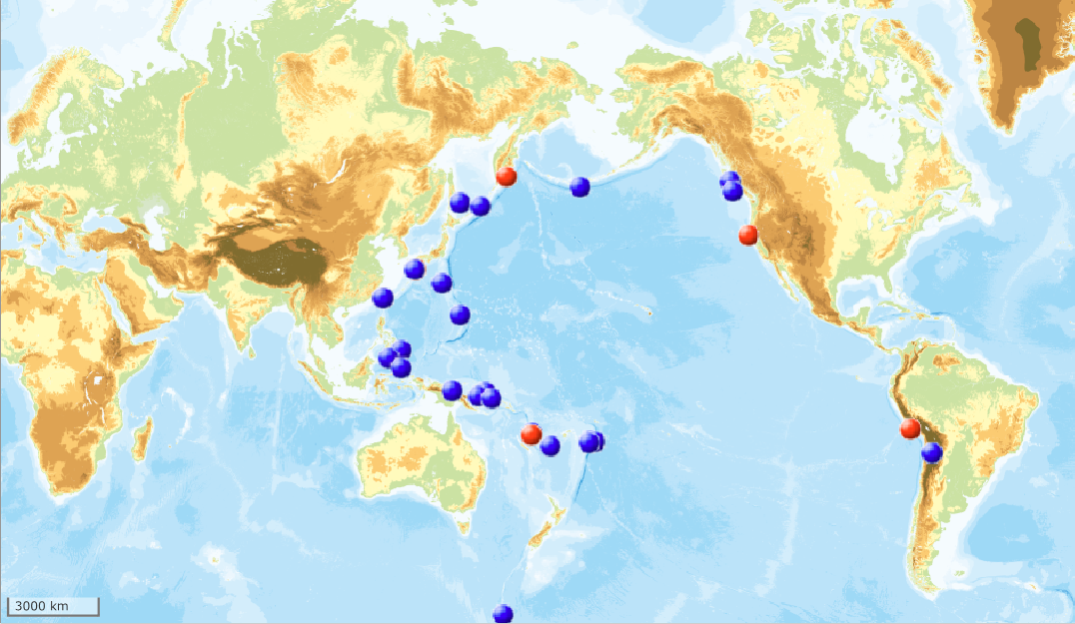
Tsunami Bulletin issued by the PTWC from February 2024 to February 2025
Events PTWC issued messages
PTWC
The number of events： 28
The number of bulletins： 41
The number of tsunami threat message: 16
The number of tsunami information statement: 25
Tsunami threat message issued
Tsunami information statement issued

Slide 3
Significant Earthquakes from February 2024 to February 2025 ( M>7.0)
 | date | time (UTC) | latitude | longitude | depth(km) | mag | mag type | places | Max. tsunami height (m)
1* | 2024/4/2 | 23:58:12.173Z | 23.84 | 121.6 | 40 | 7.4 | mww | 15 km S of Hualien City, Taiwan | 1*
2* | 2024/6/28 | 05:36:36.902Z | -15.83 | -74.45 | 24 | 7.2 | mww | 10 km WSW of Atiquipa, Peru | 0.2*
3* | 2024/7/11 | 02:13:18.585Z | 6.08 | 123.15 | 640 | 7.1 | mww | 106 km WSW of Sangay, Philippines | No Tsunami
4* | 2024/7/19 | 01:50:48.571Z | -23.08 | -67.84 | 127 | 7.4 | mww | 41 km ESE of San Pedro de Atacama, Chile | No Tsunami
5* | 2024/8/8 | 07:42:55.206Z | 31.76 | 131.5 | 24 | 7.1 | mww | Hyuganada Sea, Japan Earthquake | 0.51**
6* | 2024/12/17 | 01:47:25.741Z | -17.69 | 168.08 | 54 | 7.3 | mww | 24 km WNW of Port-Vila, Vanuatu | 0.25*
*) Earthquake Source Parameters by USGS
**) Earthquake Source Parameters by Japan Meteorological Agency
Tsunami height by;
*: NGDC/WDS Global Historical Tsunami Database
**: Japan Meteorological Agency

Slide 4
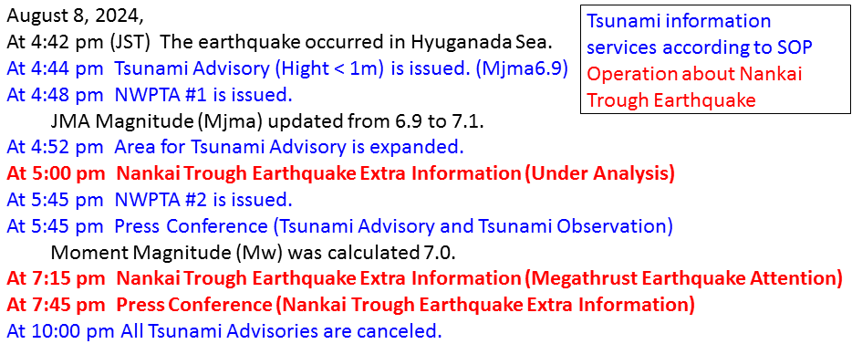
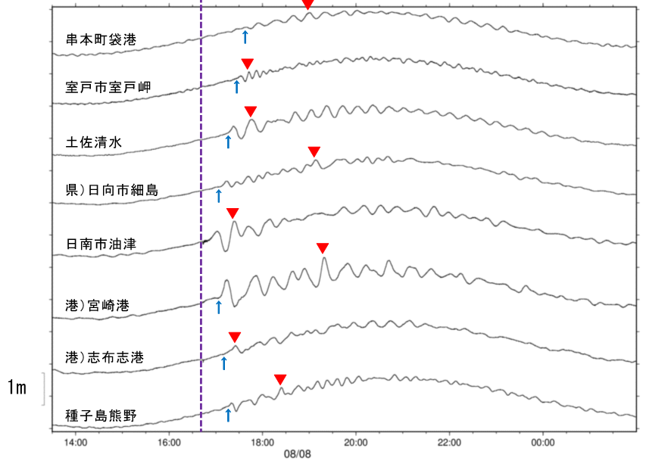
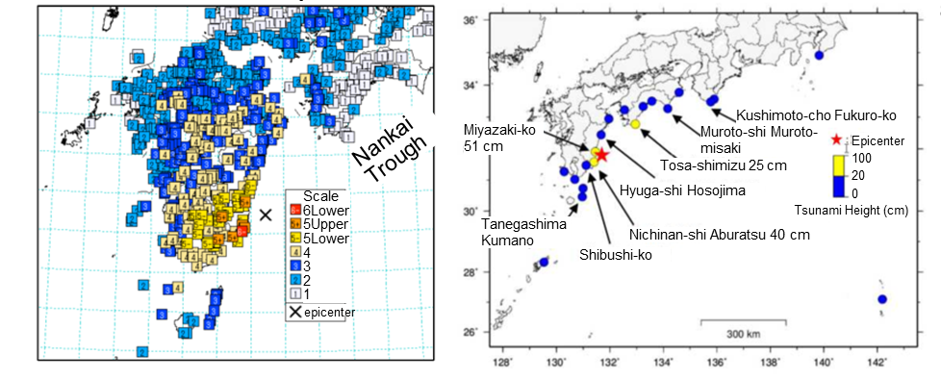
Earthquake in Hyuganada on August 8
The earthquake with a JMA magnitude (Mjma) of 7.1 occurred in the Hyuganada Sea off SE Kyushu in the Nankai Trough around 4:42 p.m. on August 8 (JST).
Tsunami waves were observed from Chiba to Kagoshima.
Seismic activity increased immediately after the earthquake, then the number of earthquakes has decreased over time.
Tsunami waveforms
Occurrence of the earthquake
Seismic Intensity Observations
Tsunami Observations
Kushimoto-cho Fukuro-ko
Muroto-shi Muroto-misaki
Tosa-shimizu
Hyuga-shi Hosojima
Nichinan-shi Aburatsu
Miyazaki-ko
Shibushi-ko
Tanegashima Kumano
Notes:
At 4:42 pm on August 8, the earthquake with a moment magnitude of 7.1 occurred in the Hyuganada Sea off Miyazaki in Kyushu.
Due to this earthquake, tsunami advisory was issued by JMA.
After this earthquake, JMA issued “Nankai Trough Earthquake Extra Information (Under Analysis)” because this earthquake occurred in the possible epicenter area for Nankai Trough Earthquake.

Slide 5
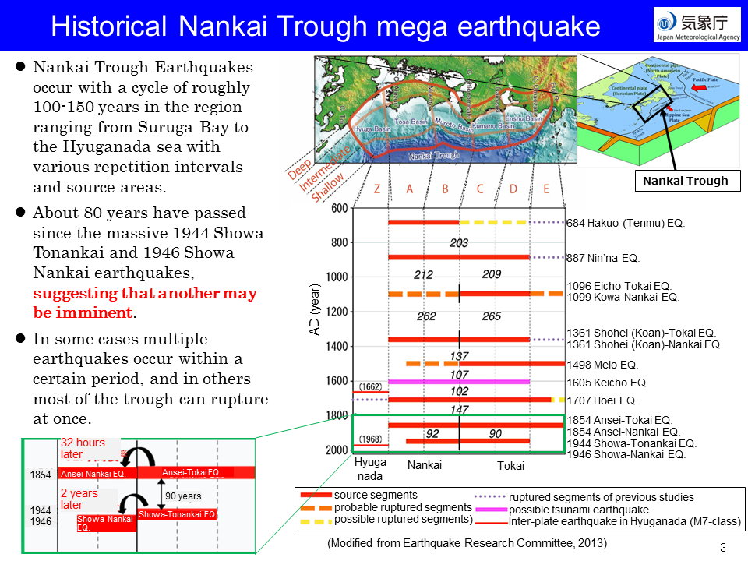
Historical Nankai Trough mega earthquake
Notes:
Nankai Trough is located where the Philippine Sea plate subducts under the continental plate at the southwest of Japan. Earthquakes occurred in the Nankai Trough mainly are the interplate earthquake type caused by the subduction of the Philippine Sea Plate under the continental plate.
Nankai Trough Earthquakes occur with a cycle of roughly 100-150 years in the region ranging from Suruga Bay to the Hyuganada sea with various repetition intervals and source areas.
About 80 years have passed since the massive 1944 Showa Tonankai and 1946 Showa Nankai earthquakes. This suggests that another mega earthquake is imminent.
In some cases, multiple earthquakes occur within a certain period, and in others most of the trough can rupture at once.
For example, in 1854, 32 hours after an earthquake occurred on the east side of the plate, another earthquake occurred on the west side. Ninety years later, an earthquake occurred on the east side of the plate, and two years after that on the west side.

Slide 6
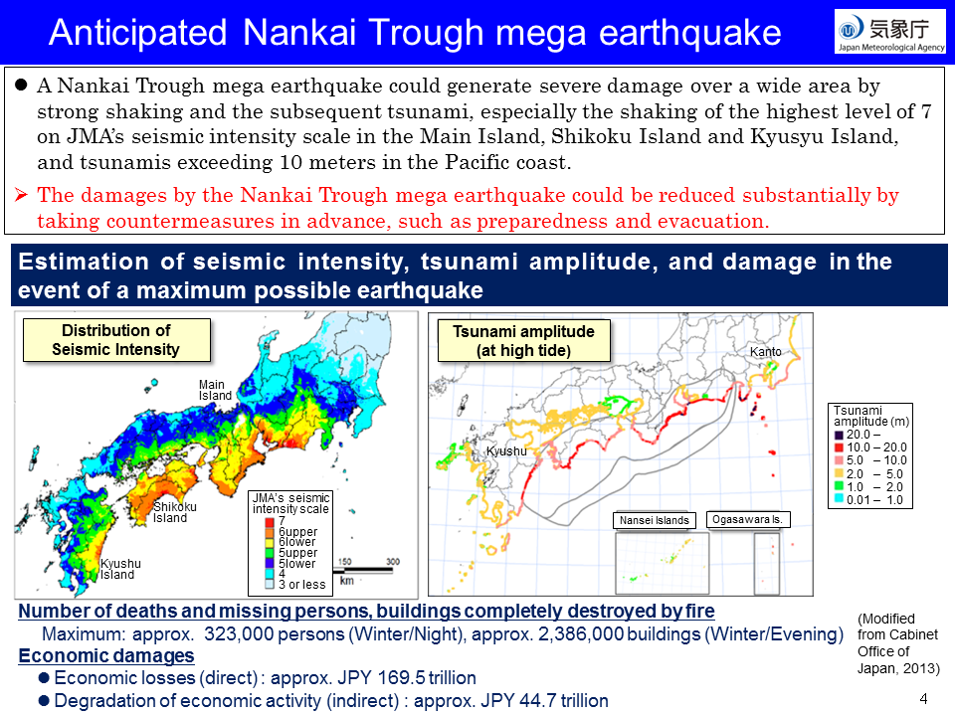
Anticipated Nankai Trough mega earthquake
Notes:
A Nankai Trough mega-earthquake could cause severe damage over a wide area due to strong shaking and subsequent tsunami.
Strong shaking is estimated to occur over the Main Island, Shikoku Island and Kyusyu Island. Tsunamis exceeding 10 meters in height are estimated to occur over large areas along the Pacific coast.
The number of victims in the worst-case scenario is estimated at more than 320,000. The damages by the Nankai Trough mega earthquake could be greatly reduced by taking countermeasures in advance, such as preparedness and evacuation.

Slide 7
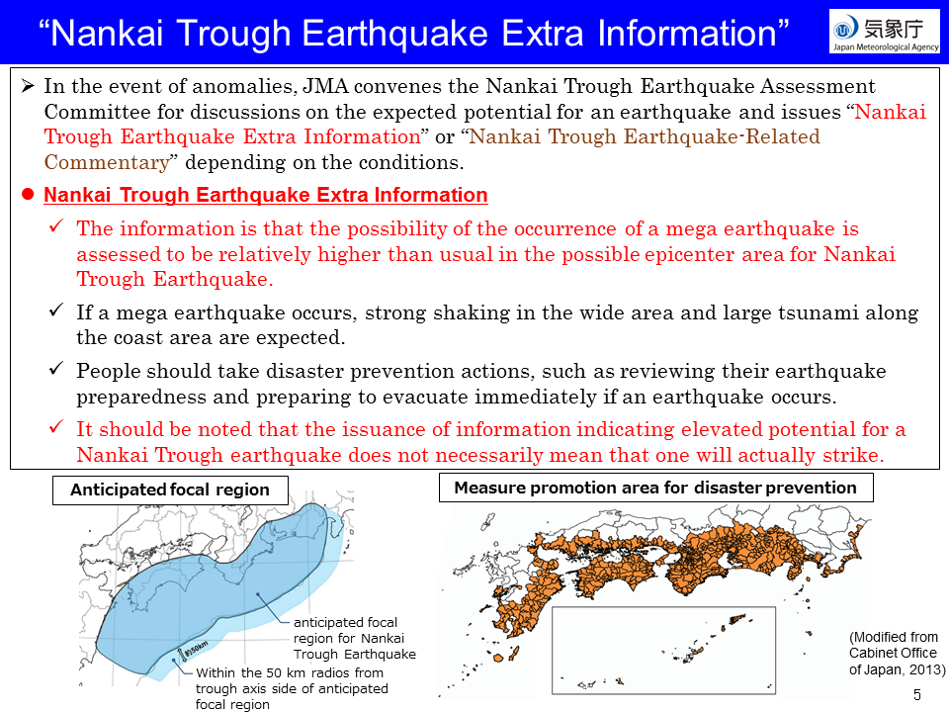
“Nankai Trough Earthquake Extra Information”
Notes:
JMA monitors the Nankai Trough around the clock. In the event of anomalies, JMA convenes the Nankai Trough Earthquake Assessment Committee for discussions on the expected potential for an earthquake and issues “Nankai Trough Earthquake Extra Information” as needed.
Nankai Trough Earthquake Extra Information is that the probability of a mega-earthquake occurring is assessed to be relatively higher than usual. It should be noted that this information does not necessarily mean that the Nankai Trough Earthquake will actually strike.
In order to reduce damage, based on a law, the Japanese government has designated areas where earthquake disaster prevention measures should be promoted in preparation for a Nankai Trough earthquake.

Slide 8
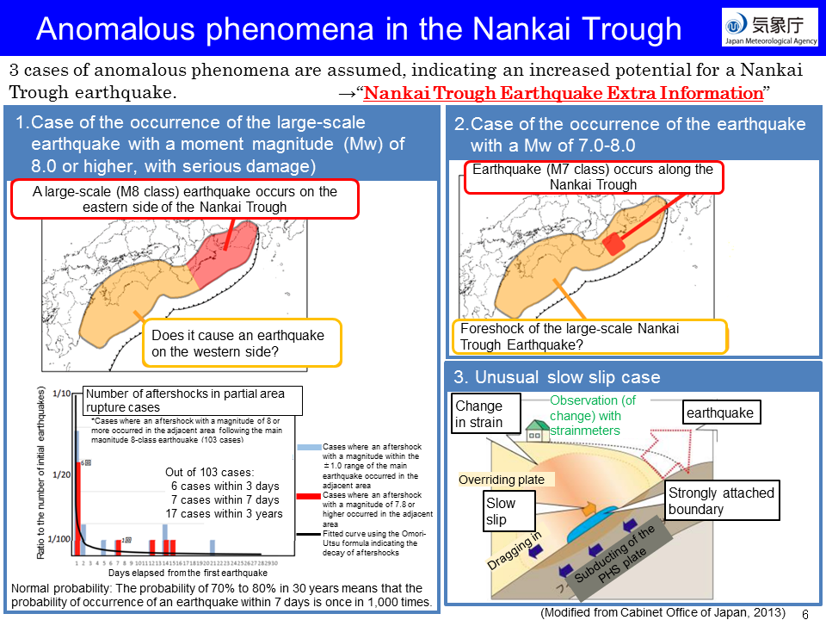
Anomalous phenomena in the Nankai Trough
Notes:
Three cases of anomalous phenomena are assumed, indicating an increased potential for a Nankai Trough earthquake.
The first case is the the occurrence of the large-scale earthquake with a moment magnitude of 8.0 or higher, with serious damage. This figure shows an example that a magnitude 8-class earthquake occurs on the east side of the Nankai Trough. Based on the statistics, in this case, the probability of a mega earthquake occurring along the other side of the Nankai Trough is considered to be higher than normal.
The second case is the occurrence of the earthquake with a moment magnitude between 7.0 and 8.0. In this case a magnitude 7-class earthquake occurs along the Nankai Trough. There is a possibility that this earthquake is a foreshock of the mega earthquake.
The third case is unusual slow slip is case. Normally, at the Nankai Trough, the Philippine Sea plate is subducting under the continental plate and the boundary between the two plates is strongly attached. The continental plate is dragged in, and strains build up. Slow slip occurs when strains build up to the limit. It is similar to a mega-earthquake in that the strain exceeds a limit, but the slip on the fault plane in a slow-slip is slow. The JMA monitors slow slip with strainmeters.

Slide 9
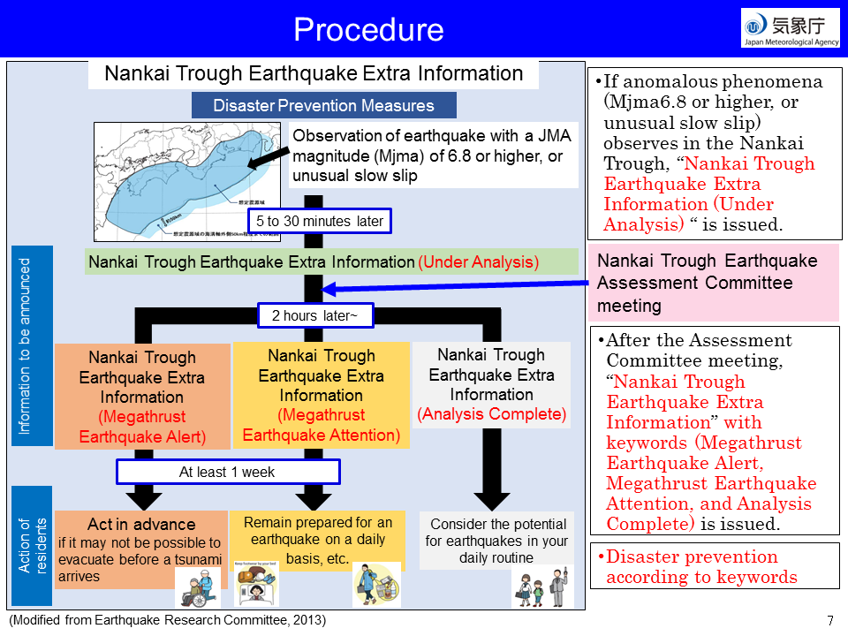
Procedure
Notes:
If anomalous phenomena (JMA magnitude 6.8 or higher, or unusual slow slip) observes in the Nankai Trough, “Nankai Trough Earthquake Extra Information (Under Analysis) “is issued.
The JMA then holds a meeting of the Nankai Trough Earthquake Assessment Committee to analyze the anomalous phenomena and probability of the Nankai Trough Earthquake. The committee is composed of six researchers. In order to use the observation data along the Nankai Trough in the assessment, research institutes in Japan participate in the activities of the committee.
After the Assessment Committee meeting, “Nankai Trough Earthquake Extra Information” with keywords (Megathrust Earthquake Alert, Megathrust Earthquake Attention, and Analysis Complete) is issued.
On the occasion of Megathrust Earthquake Alert or Megathrust Earthquake Attention, the government calls for special attention to be prepared for an earthquake for at least one week.

Slide 10
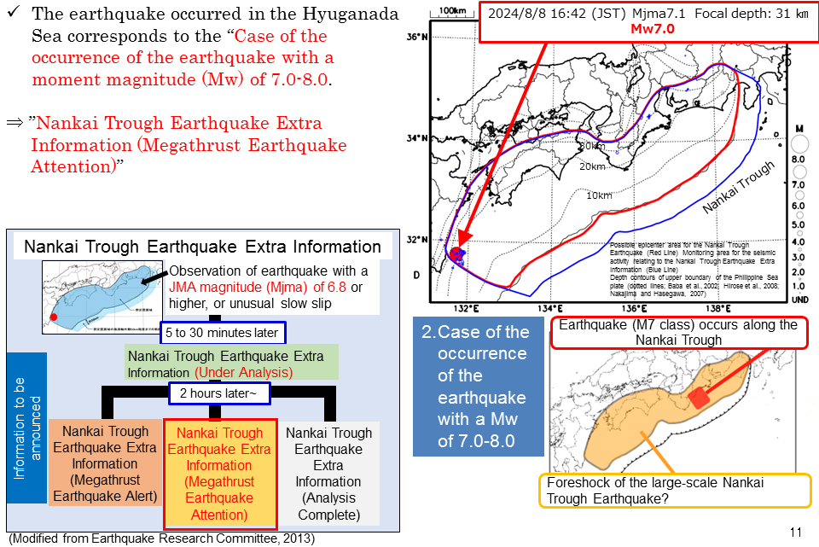
“Nankai Trough Earthquake Extra Information” for the earthquake occurred in Hyuganada
Notes:
This earthquake in the Hyuganada Sea corresponds to the “Case of the occurrence of the earthquake with a moment magnitude between 7.0 and 8.0” because this earthquake had a moment magnitude of 7.0 and occurred in the possible epicenter area for Nankai Trough Earthquake.
In this case there is a possibility that this earthquake is a foreshock of the great Nankai Trough earthquake. So, the JMA issued the information of Megathrust Earthquake Attention.

Slide 11
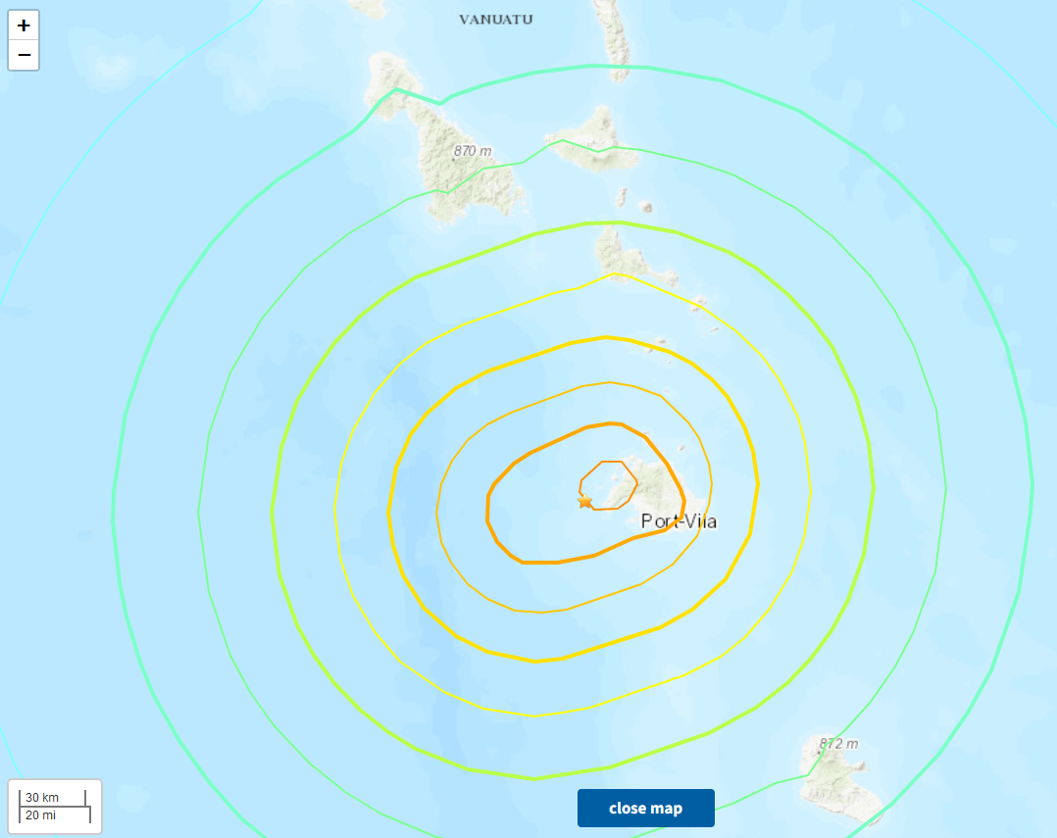
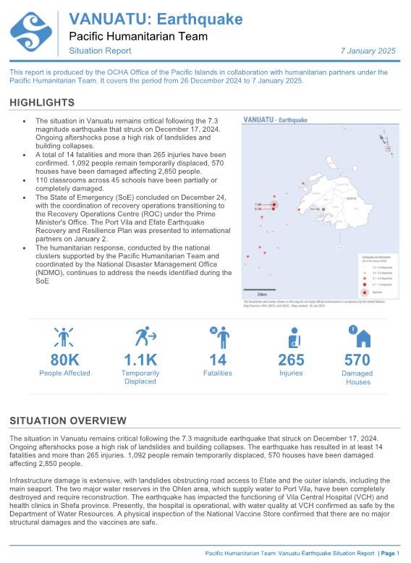
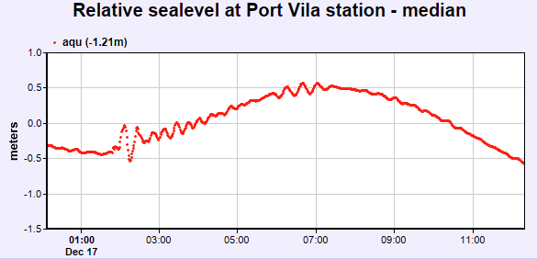
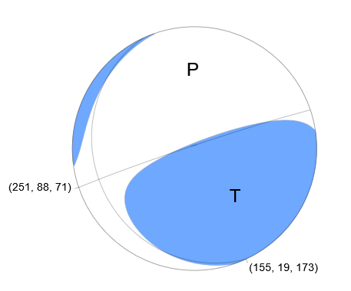
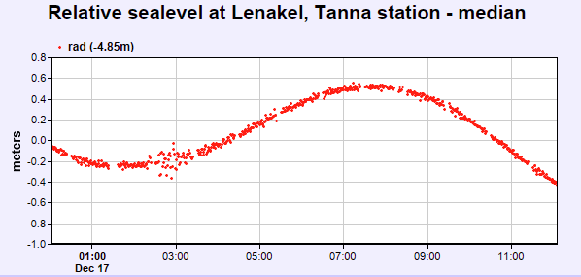
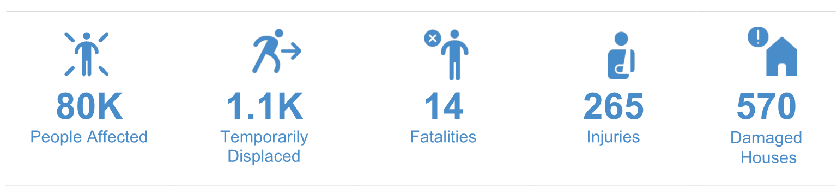
Earthquake (Mw 7.3) near Vanuatu on 17 December
PTWC messages
Date | Message No | Type of Message | Reported Tsunami Amplitude
0152 UTC December 17 | 1 | Tsunami Threat Message
0221 UTC December 17 | 2 | Tsunami Threat Message | Port Vila VU 0.25 m Lenakel VU 0.17m
0314 UTC December 17 | 3 | Final Tsunami Threat Message
2024-12-17 01:47:25 (UTC) 17.691°S 168.084°E 54.4 km depth
Report of the OCHA dated on 7 Jan. 2025
Observed sea level changes at Port Vila and Lenakel
W-phase moment tensor (Mw 7.3)
Notes:
津波より地震動による被害が大きかった。OCHAによりまとめられた資料によれば、死者14名

Slide 12
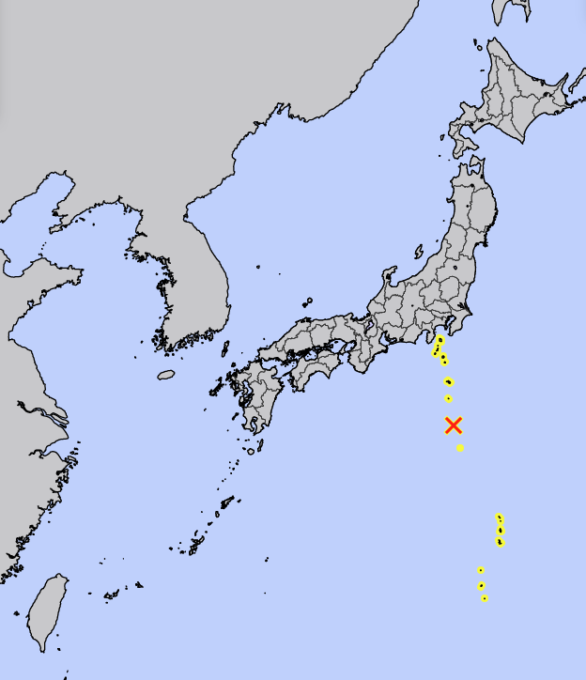
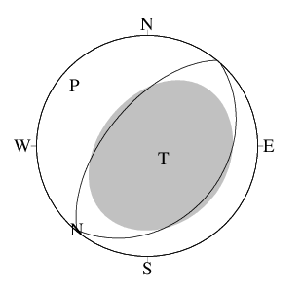
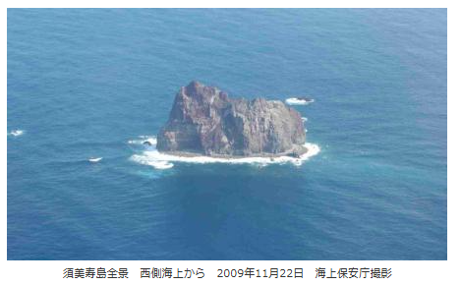
Earthquake (Mw 5.7) near Sumisujima (Smith Rock) on 24 September (1)
Source Parameters
CMT Solutions
OT: 08:14:16.8 JST Sep. 24th
Lat. 31°29.0’N
Lon. 140°07.8’E
Depth 19km
M(JMA) 5.8
Moment magnitude | 5.7 (by JMA)
Centroid depth | 12km
Tsunami Advisories issued by the JMA
Timeline
Date and Time (JST)
08:14:16.8 September 24th | Earthquake Occurred
08:20 September 24th | Tsunami Advisory Issued
08:40 ~ 08:50 September 24th | The first arrival of tsunamis observed at Hachijou Island
11:00 September 24th | All tsunami Advisories lifted
The JMA was able to issue tsunami advisories before tsunami arrivals.

Slide 13
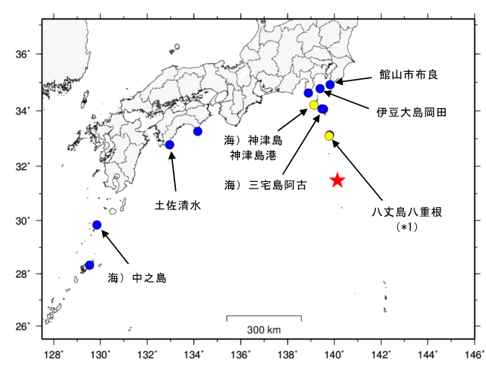
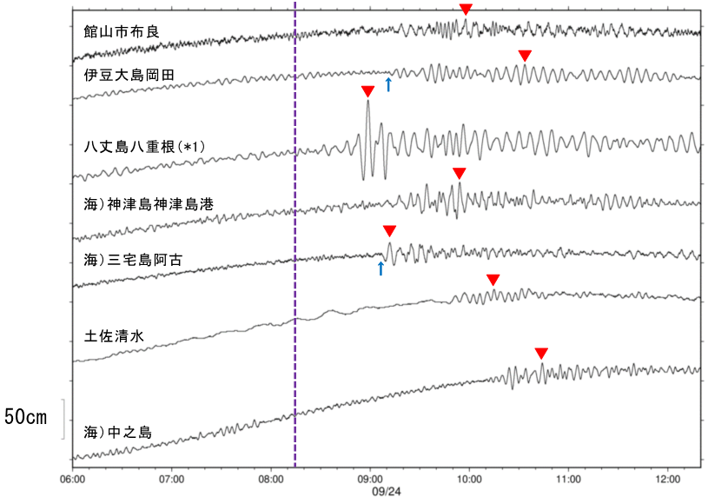
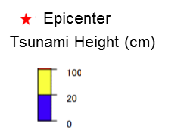
Earthquake (Mw 5.7) near Sumisujima (Smith Rock) on 24 September (2)
Tsunami height observed at coastal gauges
Tsunami waveforms
Occurrence of the earthquake
Tateyamashi Mera
Tateyamashi Mera
Izuoshima Okada
Izuoshima Okada
Hachijojima Yaene
Kozushima Kozushimako
Kozushima Kozushimako
Miyakejima Ako
Tosashimizu
Miyakejima Ako
Hachijojima Yaene
Tosashimizu
Nakanoshima
Nakanoshima

Slide 14
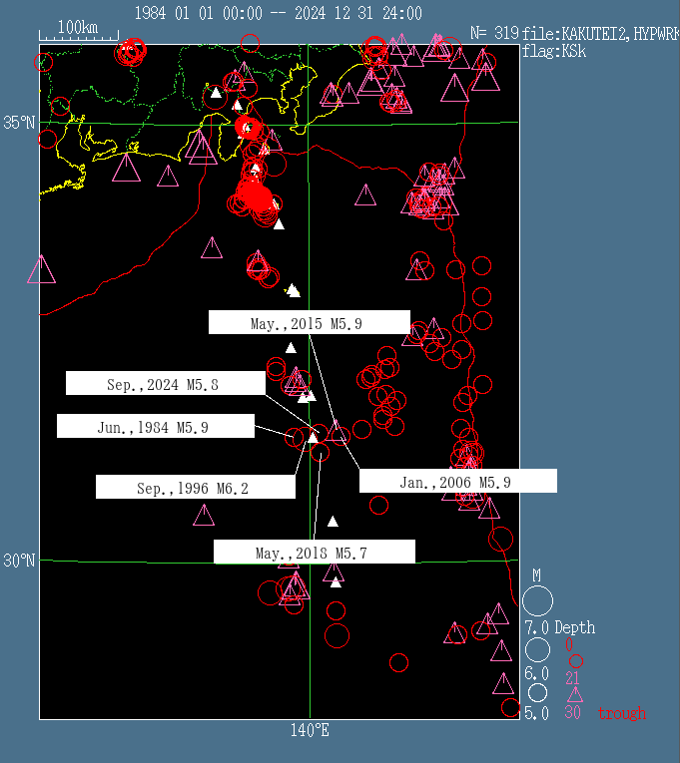
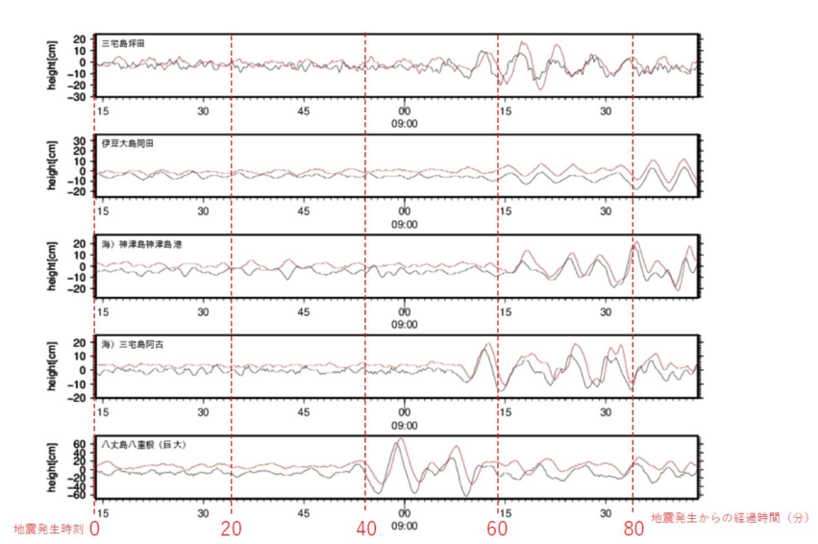
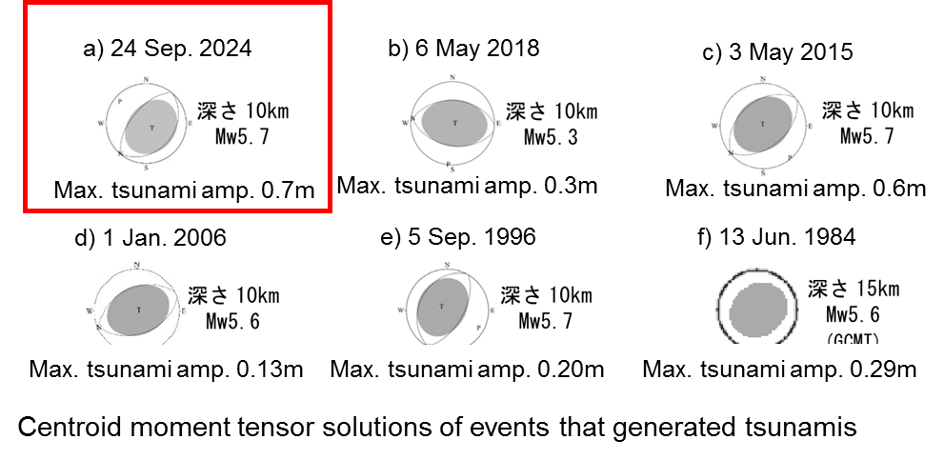
Earthquake (Mw 5.7) near Sumisujima (Smith Rock) on 24 September (3)
Miyakejima Tsubota
Izuoshima Okada
Sumisujima (Smith Rock)
Kozushima Kozushimako
Miyakejima Ako
Hachijojima Yaene
Depth 10km
Depth 10km
Depth 10km
Comparison tsunami waveforms between the tsunami on 24 September 2024 and the tsunami on 3 May 2015
Depth 10km
Depth 10km
Depth 15km

