Slide 1
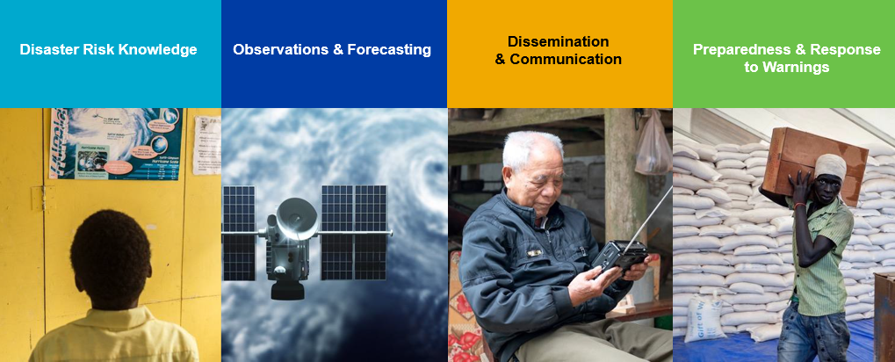

Early Warnings for All
Global EW4All Multi-Stakeholder Forum
2-4 June 2025
8th GPDRR(2025)
2-6 June 2025
Prepared by Denis Chang Seng
Tsunami Resilience Section
UNESCO-IOC
For TOWS Meetings

Slide 2



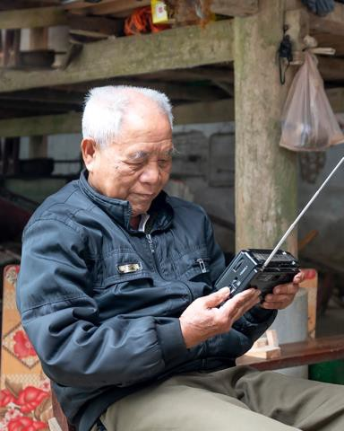
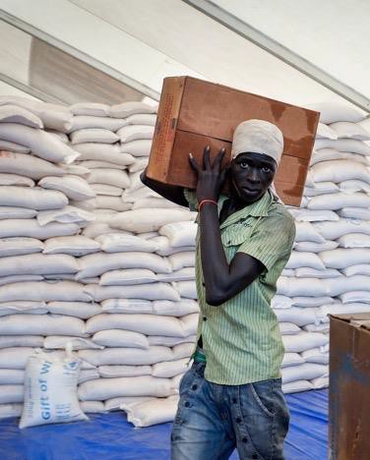




Early Warnings for All
Global EW4All Multi-Stakeholder Forum , 2-3 June 2025, Geneva
Disaster Risk Knowledge
Observations & Forecasting
Dissemination & Communication
Preparedness & Response
to Warnings

Slide 3
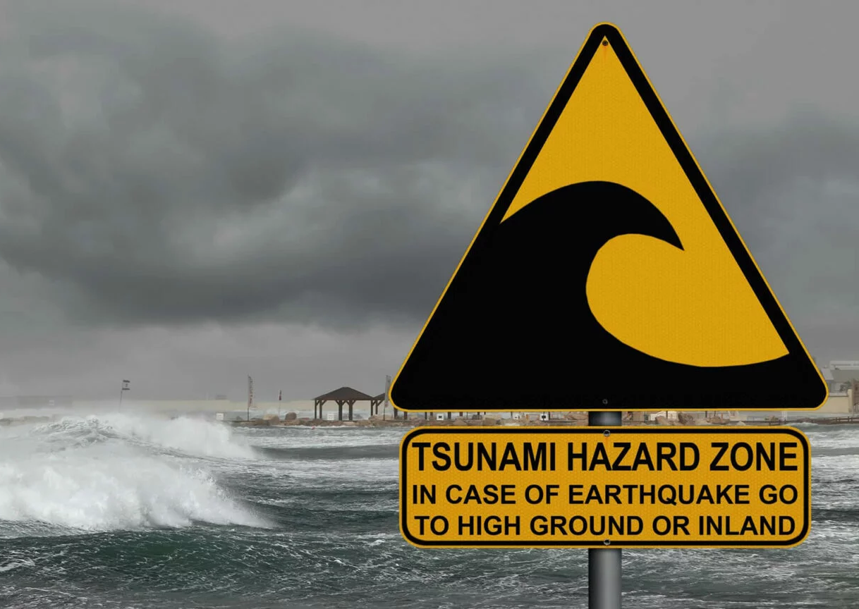
Aim and Objectives
The EW4All MSF is an opportunity to review key accomplishments, share skills, experience and expertise within an active network of Early Warning practitioners
Objectives:
Re-energize implementation and accelerate action for the EW4All initiative and other efforts to strengthen EWS worldwide as a contribution to Sendai Target G.
Present and showcase solutions on the Sendai Midterm Review recommendations related to enhancing people-centred, inclusive and end-to-end Multi-Hazard Early Warning Systems.
Share knowledge, experience and good practices in implementing effective Early Warning Systems.
Create a space to promote synergies, scale-up partnerships, while enhancing ownership and sustainability beyond the initiative timeframe.

Slide 4
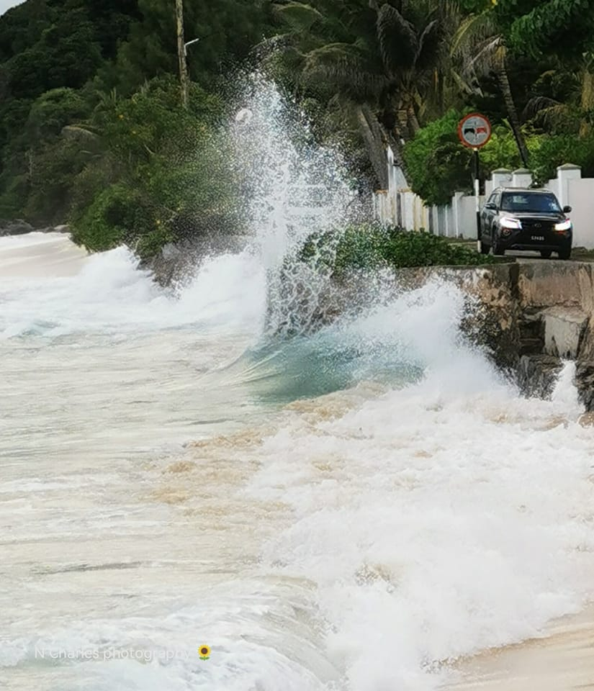
Early Warnings for All Global Multi-Stakeholder Forum
UNDRR & WMO
ITU
IFRC
CREWS
REAP
UNDP
UNEP
FAO
OCHA
UNESCO (Denis IOC/TRS, Soichiro Yasukawa, UNESCO DRR Unit
WFP
SEM
GNDR
EOSG CAT

Slide 5
Session Themes
Thematic Session 1: People-centered and inclusive multi-hazard Early Warning –Early/Anticipatory Action
Thematic Session 2: How can we enable and scale MHEWS in fragile and conflict settings
Thematic Session 3: Effective Governance Models to support MHEWS Suggested
Thematic Session 4: Leverage science, technology and innovation to advance MHEWS
Thematic Session 5: Fostering international, regional and national cooperation and partnerships Co-organizers UNESCO-IOC, UNDP and WMO
Thematic Session 6: Increase investments in EWS

Slide 6
The following table gives more details and proposes a timeline for the committee’s (SC ,Organizing Committee) contributions.
Month | Action
Phase 1: Global Forum Agenda preparation
May - Jul 2024 | Global Forum Selection of themes
Aug – Sept 2024 | Global Forum Agenda Development / List of sessions
Oct-24 | Selection of session focal points
Phase 2: Session preparation
Nov 2024 – Dec 2024 | Development of concept note
December - January 2025 | Identification of speakers
End of January 2025 | Session finalization
End of January 2025 | Speaker invites
February - March 2025 | Website
February - May 2025 | Speaker preparation
Phase 3: In-situ
Jun-25 | In-situ session management
June – July 2025 | Development of Outcome document
June – July 2025 | Thank you notes to speakers
Source EW4ALL documents

Slide 7








Early Warnings for
All Multi-Stakeholder Fora
Source EW4ALL documents
Asia Pacific Regional Platform for DRR – Manila, the Philippines 14-17 October 2024
Regional Platform for DRR Europe – Budva, Montenegro
06-08 November 2024
Regional Platform for DRR - Arab States Kuwait City, – Kuwait
9-12 February 2025
13th Caribbean Comprehensive Disaster Management Conference Saint Kitts and Nevis
02-06 December 2024
Africa Regional Platform for DRR – Windhoek, Namibia
21-24 October 2024
Global Platform for DRR
Geneva, Switzerland
4-6 June 2025
Regional MSF
15 – 17 Oct 2024
Regional MSF
21 Oct 2024
Regional MSF
08 Nov. 2024
08.30 - 11.30 AM
Regional MSF
05 Dec. 2024
Regional MSF Between 9-12 February 2025, exact date TBC
Global MSF
2 – 3 June 2025

Slide 8
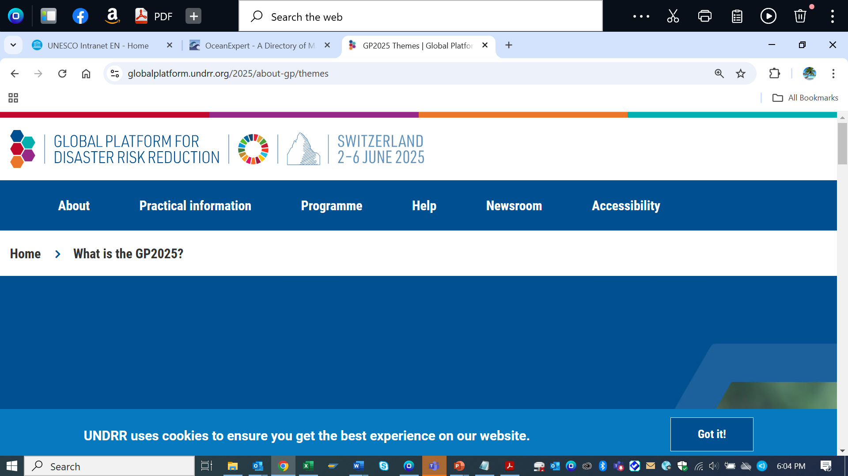
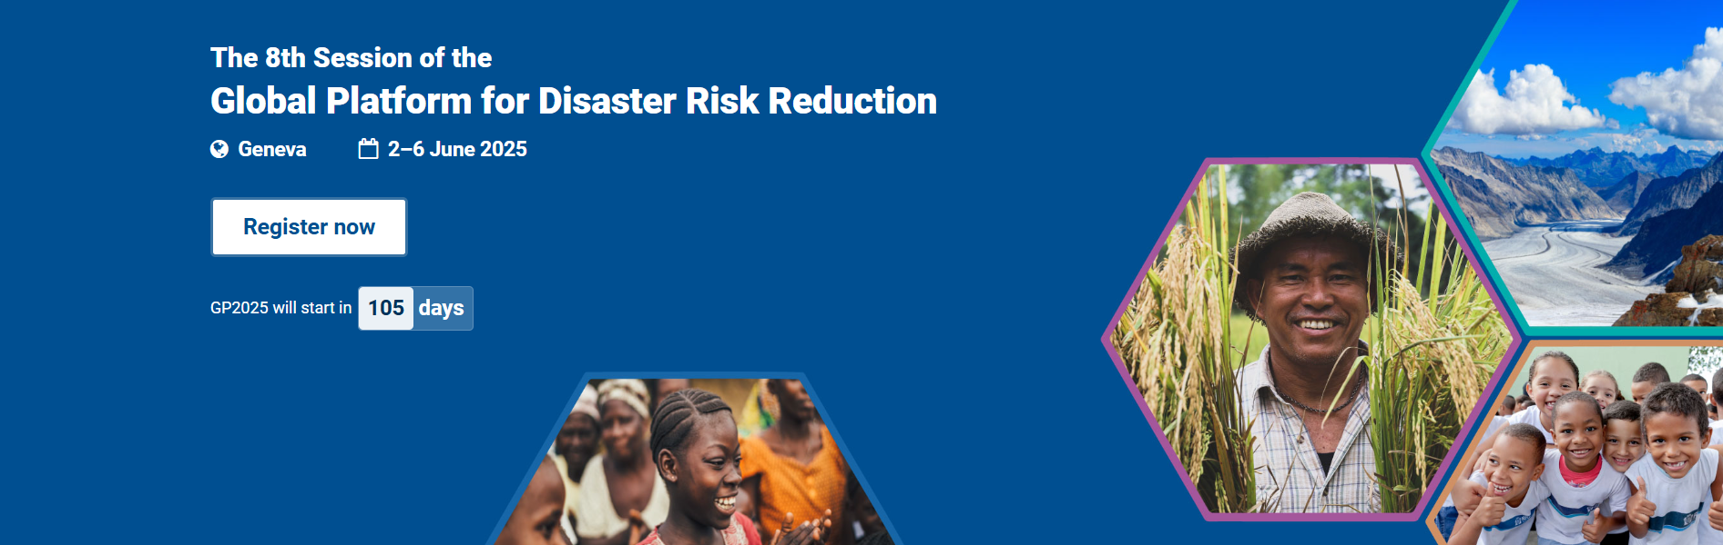
OVERALL THEMES
Every Day Counts, Act for Resilience Today

Slide 9
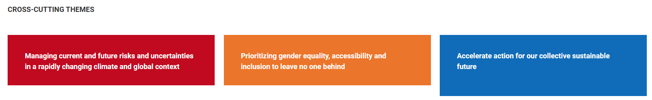
CROSS –CUTTING THEMES

Slide 10
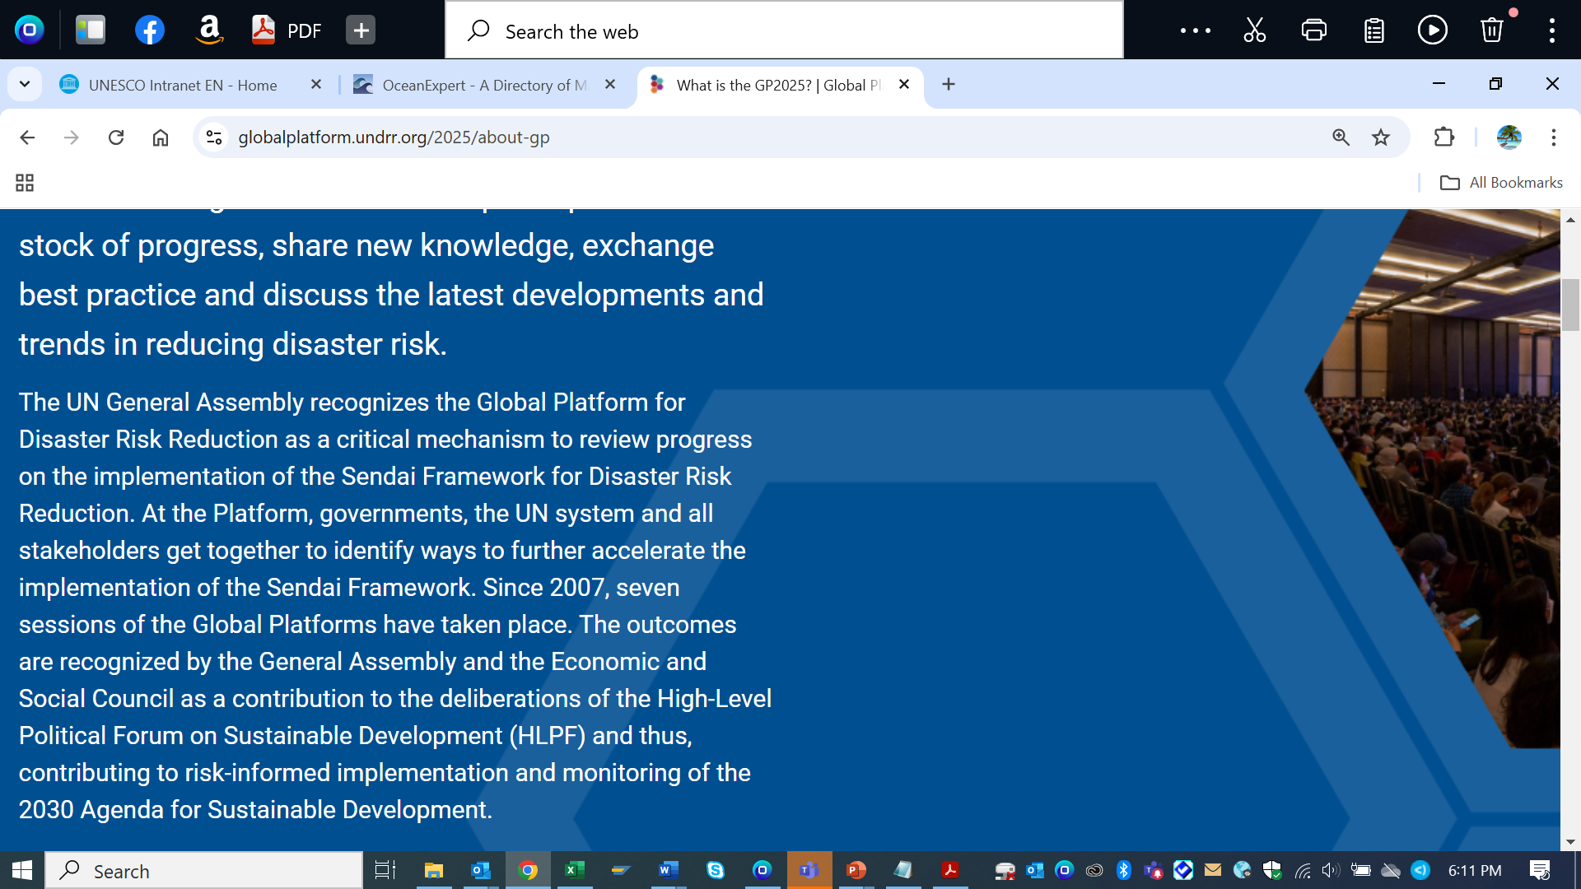
Key Expectations
The next Global Platform will constitute an important milestone between the High-Level meeting on the midterm review of the Sendai Framework (May 2023) and the five final years before the Sendai Framework will come to an end.
assess and discuss progress made in the implementation of the recommendations put forward through the Political Declaration adopted by the UN General Assembly in May 2023
Give practical guidance to accelerate its further implementation.
GP2025 offers a chance for all stakeholders to recommit, with urgency, to accelerate progress on DRR towards the achievement of sustainable development.

Slide 11
GPDRR Programme
Preparatory Days (2-3 June 2025)
Third Stakeholder Forum on DRR
Global EW4ALL Multi-stakeholder Forum [ IOC/TRS/Denis/UNDP/WMO on TS 5 Cooperation and Collaboration ]
World Resilient Recovery Conference
Official Programme (4-6 June 2025)
The Official Programme of the 2025 Global Platform will comprise of:
4 High-Level Dialogues [ Vidar Helgesen, IOC Executive Secretary around the topic Twenty Years of Developing the Tsunami Early Warning and Mitigation System)(TBC)]
2 Special Sessions
3 Special Events
3 Multi-stakeholder Plenaries
15 Thematic Sessions
2 Ministerial Roundtables

Slide 12
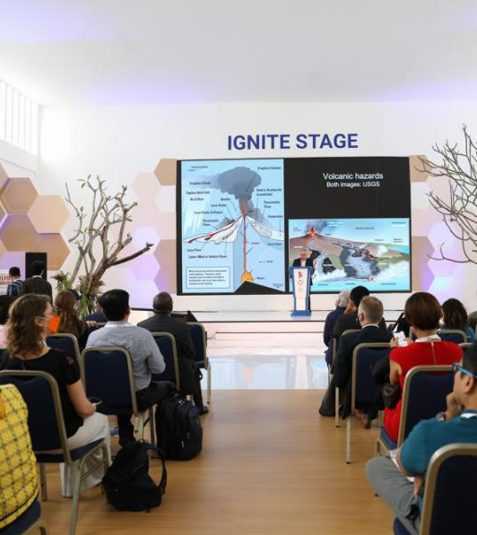
Informal Programme
(4-6 June 2025)
The Informal Programme :
Side Events [Increasing Coastal Community Disaster Resilience through Machine Learning and Innovative Observing Systems to Scale Up and Transform Early Warning Systems- Not successful]
IGNITE Stage [ CoastWAVE project and Tsunami Ready]
Learning Labs
Innovation Platform
Field Visits

Slide 13
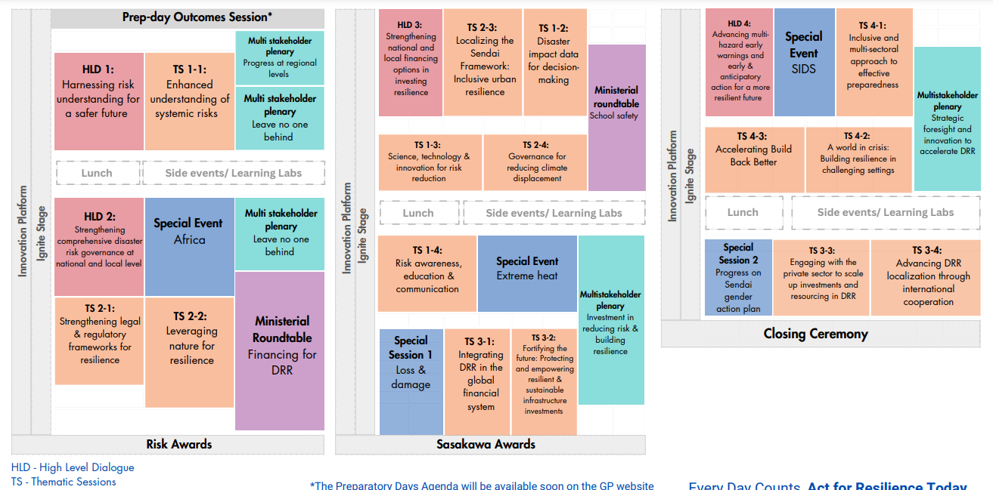
Download Tentative GP2025 Official Days Programme (PDF).

Slide 14

Increasing Collaboration and Networking with UNDRR Regional Office
Regional Office for Asia and the Pacific anita.cadonau@un.org
Regional Office for Europe and Central Asia rosalind.cook@un.org
Regional Office for Africa adair.ackley@un.org
Regional Office for the Americas and the Caribbean thereza.antunesjatoba@un.org
Regional Office for Arab States rania.hammad@un.org

