Slide 1

NEAMTWS Tsunami Watch Operations status and plans
Alessio Piatanesi & Helene Hebert
TOWS-WG TT-TWO meeting
Unesco, Paris, 21-22 February 2025

Slide 2
NEAMTWS EVENT CALENDAR
After the last TT-TWO meeting on February 2024 we had:
13 May 2024: Steering Committee
6-7 June, 2024 (Athens, Greece): Joint Meeting of TT on Operations, TT on Documentation, TSP representatives, on OUG revision
30 Sept-1 Oct, 2024 (Roma, Italy): Joint Meeting of TT on Operations, TT on Documentation, TSP representatives, on OUG revision
26 Nov, 2024 (Unesco, Paris): Steering Committee
27-29 Nov, 2024 (Unesco, Paris): ICG/NEAMTWS XIX Session

Slide 3
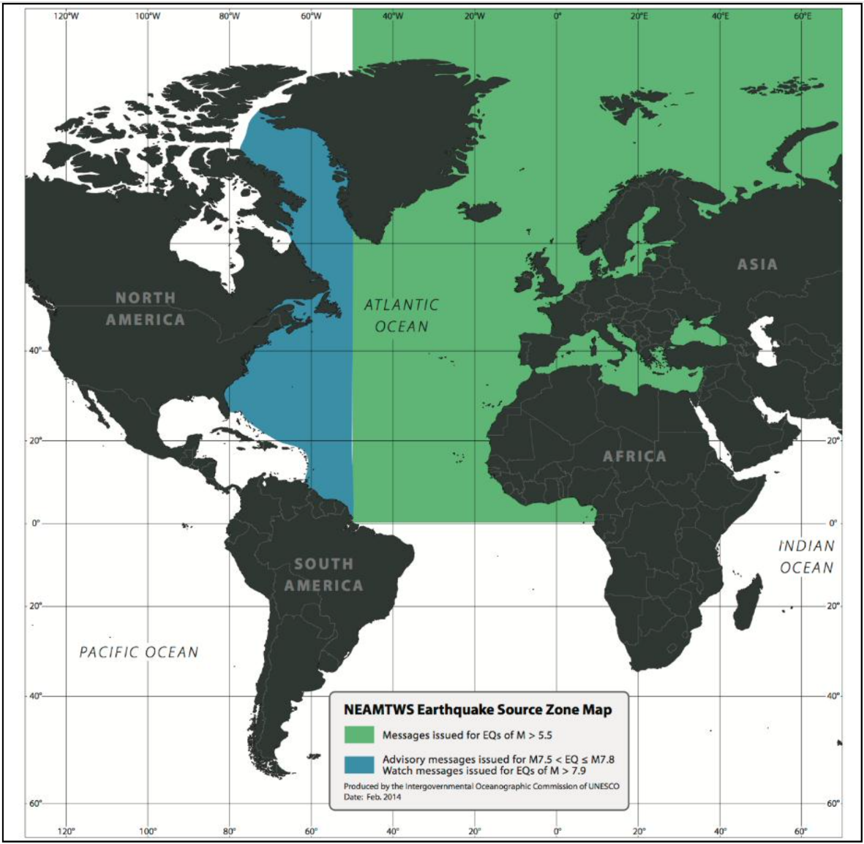
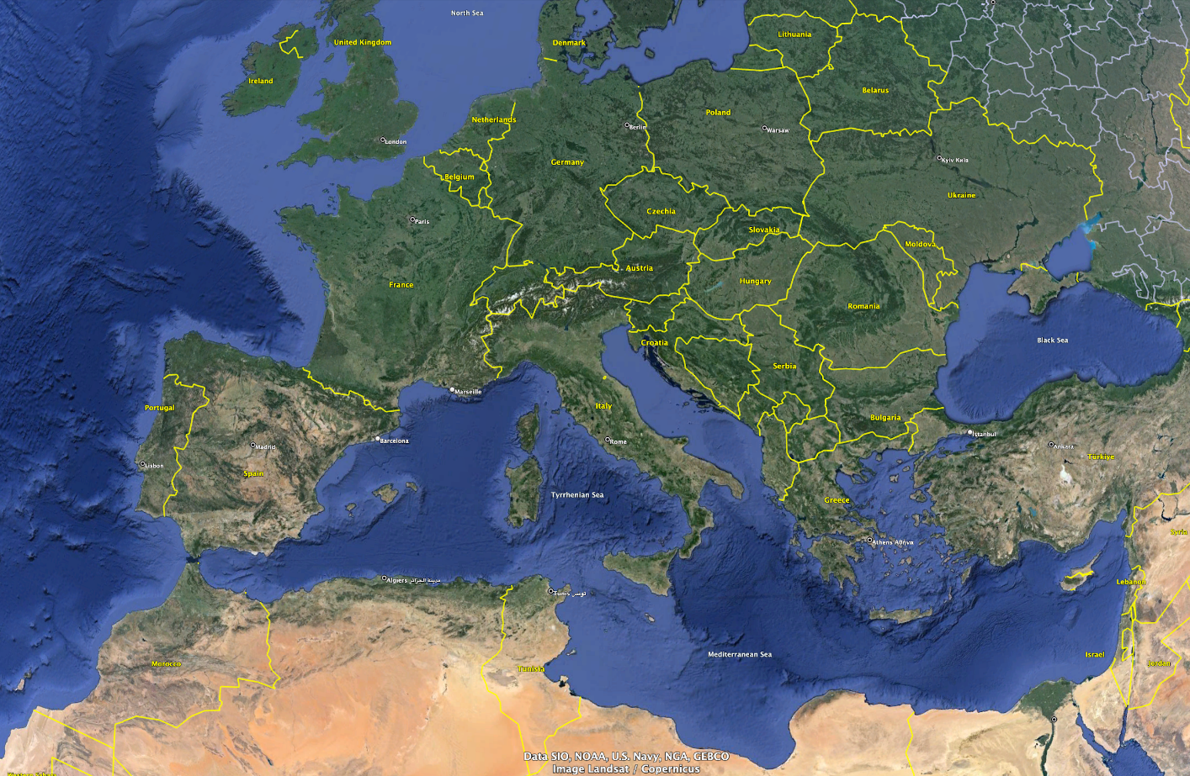
NEAMTWS OVERVIEW
5 TSPs operating in the region: IPMA (Portugal), CENALT (France), INGV (Italy), NOA (Greece), KOERI (Turkey)
Different and partly overlapping monitoring area
CENALT
IPMA
INGV
KOERI
NOA

Slide 4
The ICG/NEAMTWS activities/advancements 2023-2024
Key messages from ICG Chair, ICG/NEAMTWS XIX (A. Amato, INGV):
Recalling the NEAMTWS Strategic plan and goals
Continued operations (monitoring, warning, meetings, etc.) by 5 TSPs
6 recognized Tsunami Ready communities (and others coming soon)
Improved response in the NEAMWave23 (+ local exercises)
Closing of CoastWave project (2022-2024), Phase-2 started July 2024 (DG-ECHO)
Other projects on tsunami science and hazard - risk mitigation (+ EPOS, GTM, etc.)
New Task Team on Non-seismic tsunami sources (Stromboli test case, etc.)
New developments and technologies:
New tide gauges in several MS coastal areas (20 in Marmara Sea, Türkiye)
First cabled deep-ocean sensors connected to TSPs
Two DART-like buoys coming in the Ionian sea (2025) + 1 near Stromboli
Probabilistic Tsunami Forecasting - PTF implementation

Slide 5

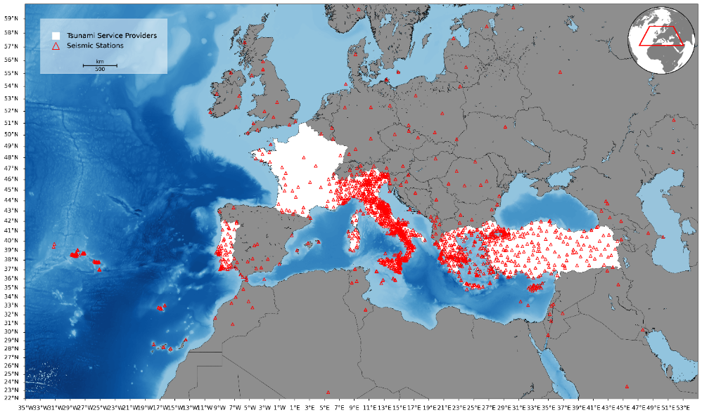
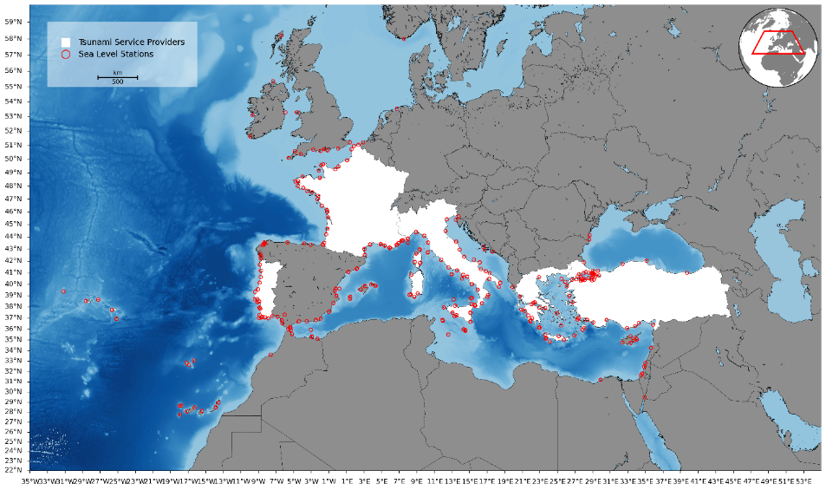
Seismic, Geophysical and Sea Level measurements
Seismic and Sea Level Data Base in NEAM REGION (2024)
Seismic Stations Monitored by TSP
Sea-Level Stations Monitored by TSP
Instrumental gap
Instrumental gap
WG2&WG3 – Seismic, Geophysical & Sea Level Measurements IOC-UNESCO ICG/NEAMTWS, 27-29 November 2024, Paris, France

Slide 6
NEAMTWS OVERVIEW
Alert levels
All TSPs are using the same 3 levels at the forecast points:
INFORMATION: no damage or relevant effect expected
ADVISORY: wave height < 0.5 m and/or runup < 1 m
WATCH: wave height > 0.5 m and/or runup > 1 m
Alert levels and Threat levels
ICG/NEAM XIX (Nov 2024) agrees to adopt the threat levels according to the request by the TT-TWO which is reflected in the draft of the new Global Service Definition Document (GSDD)
TT Operations to prepare a template for the implementation of the threat levels in the TSP messages until December for consideration and feedback of the WG4 which agreed
Tsunami forecast method
All TSPs are using Decision Matrices (DMs) (differentiating between NE Atlantic and Mediterranean Sea)
ICG/NEAM XIX (Nov 2024) welcomes the continued progress of the investigation and the possibility to adopt tsunami forecasting methods by TSPs which represent an improvement over DMs presently in use with a view to reducing uncertainty and false alarms, particularly the forecasting methods which consider tsunami numerical modeling and uncertainty quantification (e.g., the Probabilistic Tsunami Forecasting ( PTF), pre-calculated scenario databases, etc.);

Slide 7
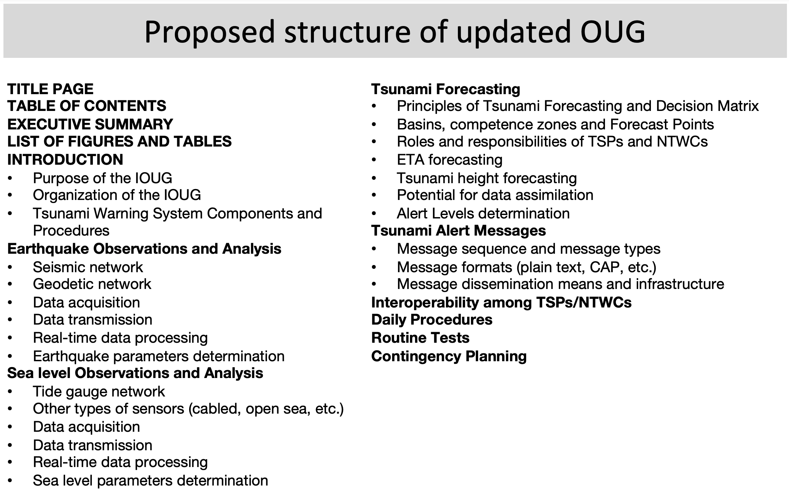
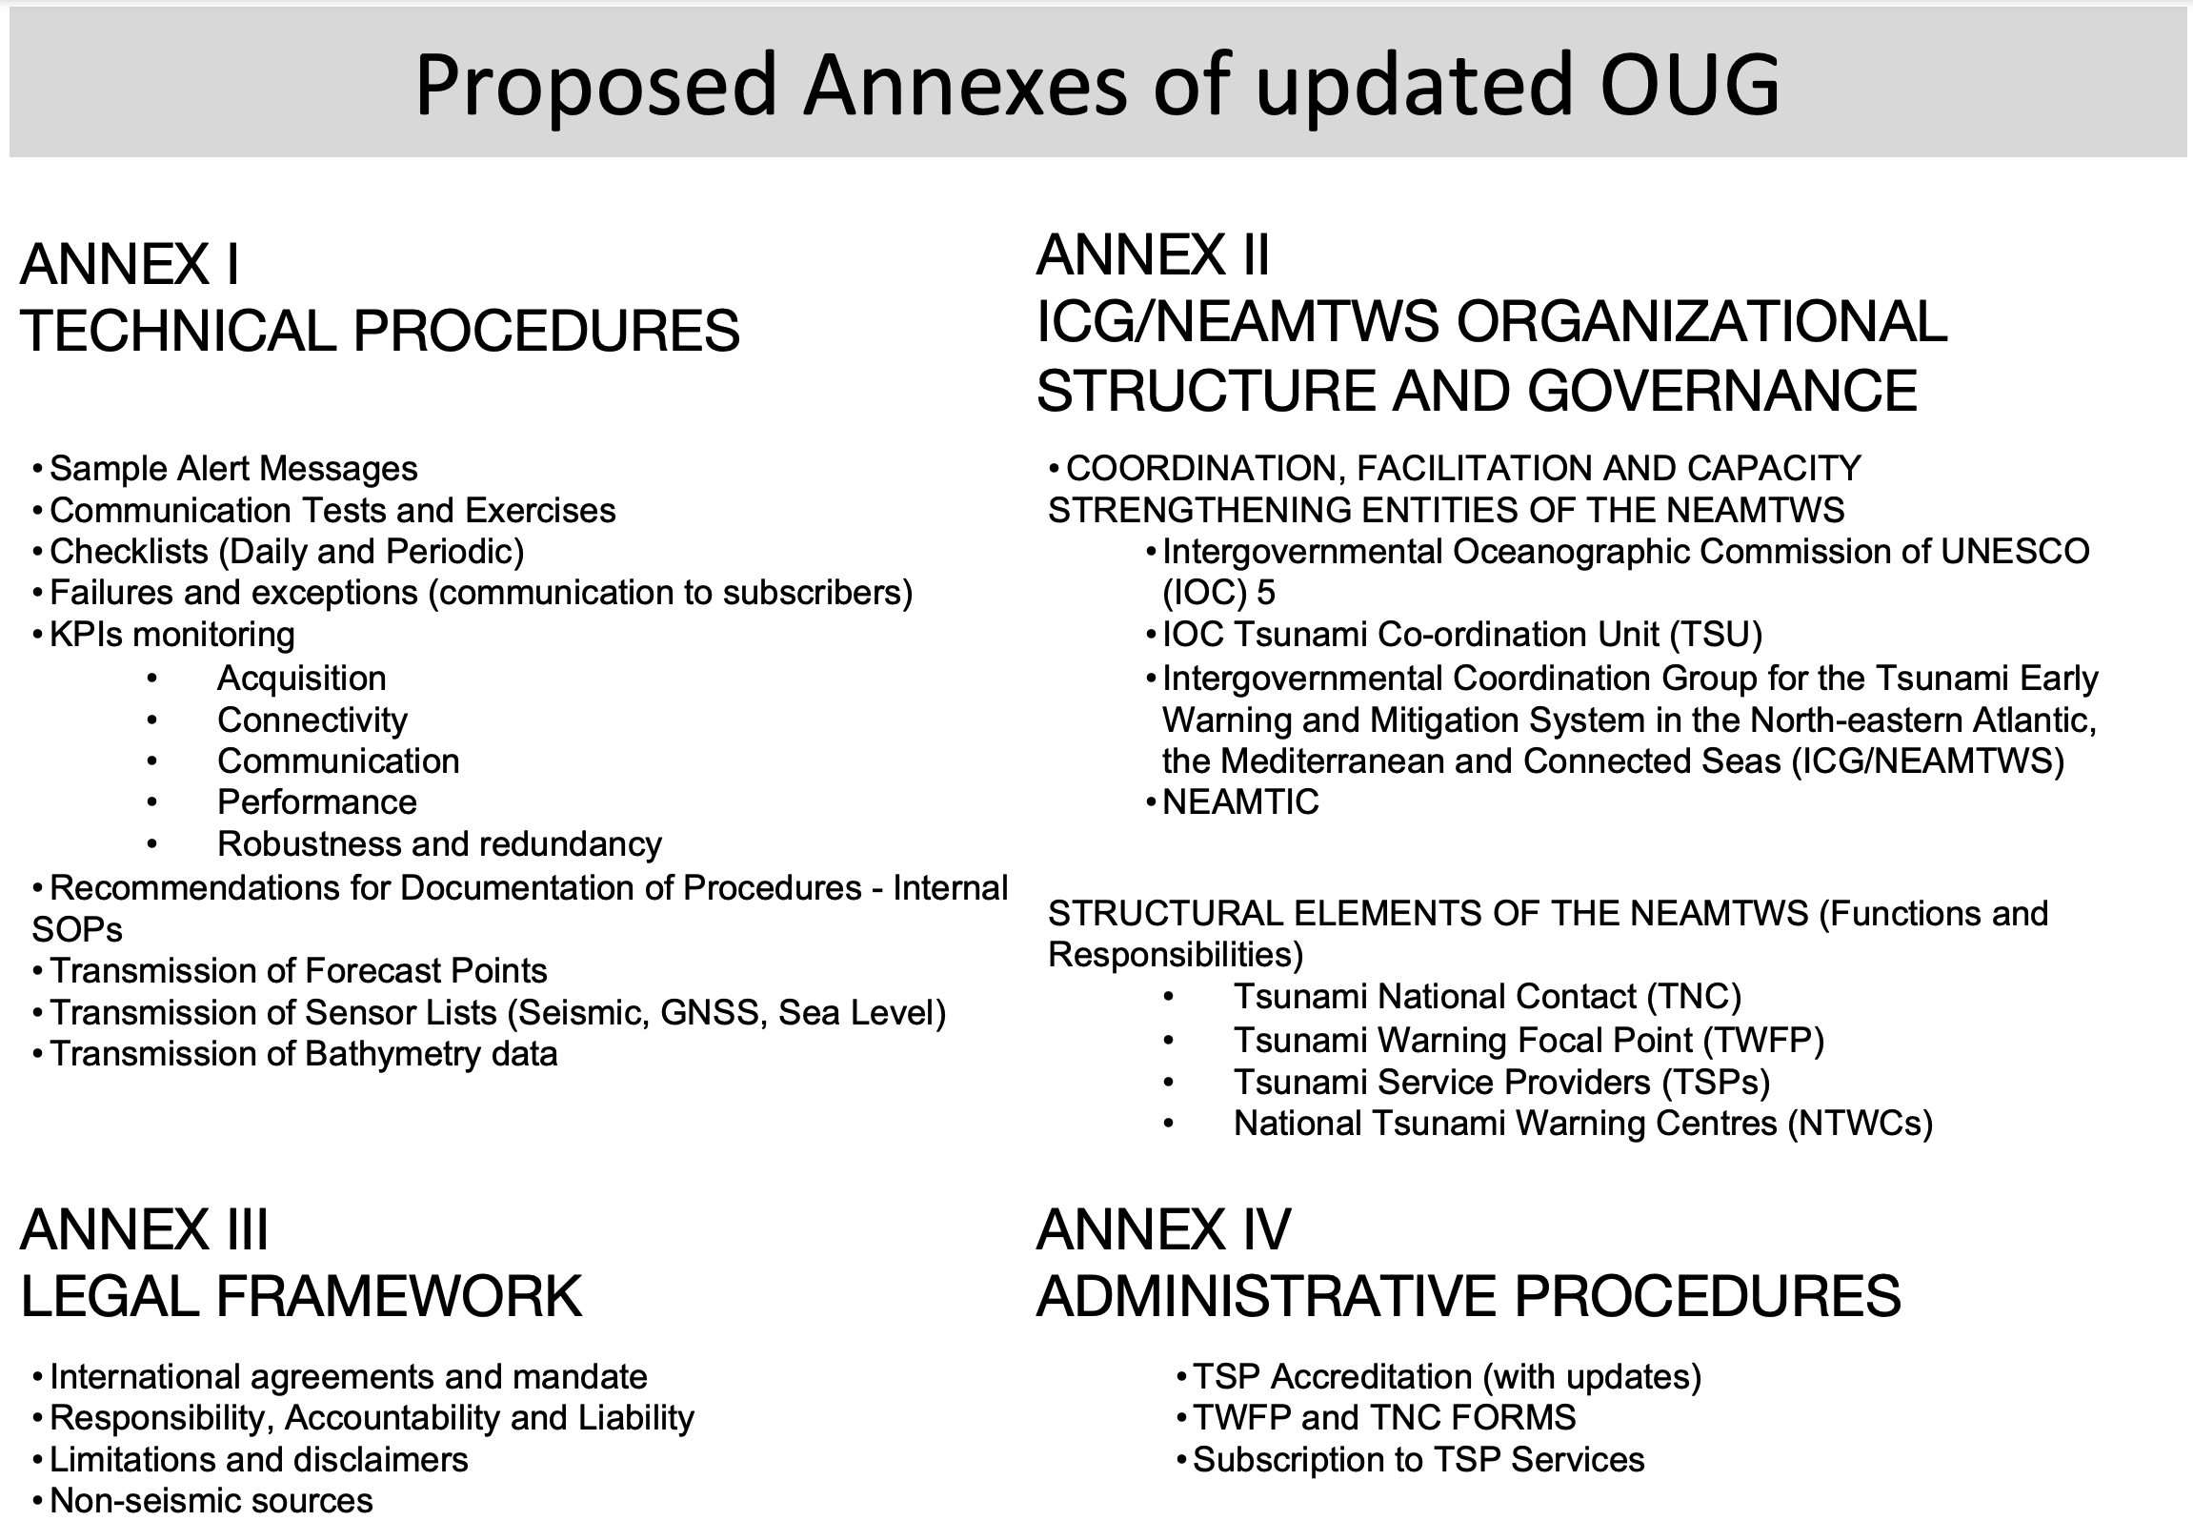
ONGOING ACTIVITIES: NEW OPERATIONAL USER GUIDE

Slide 8
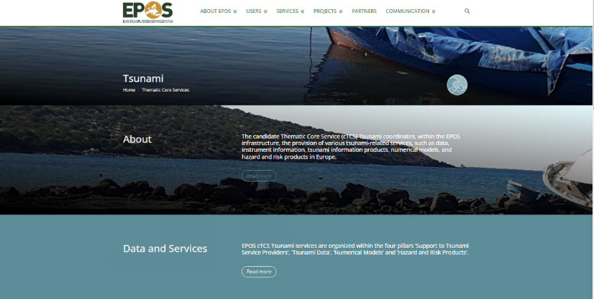

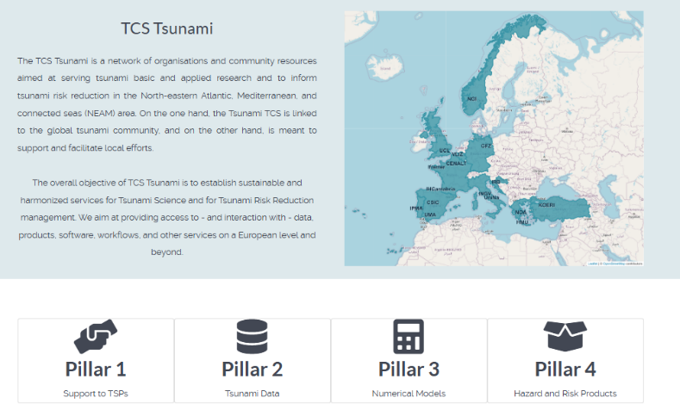
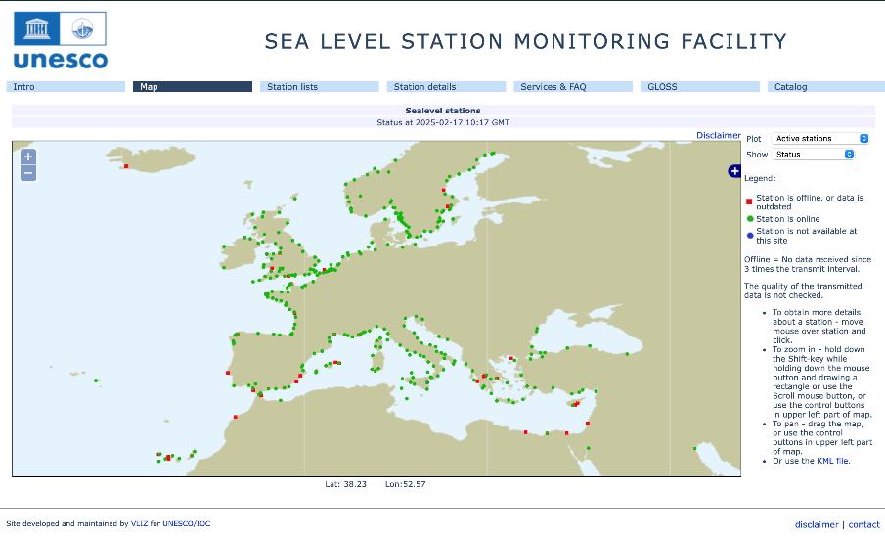
ONGOING ACTIVITIES: EPOS EU Research Infrastructure
Establishment of the Technical Core Service (TCS) Tsunami (February 2024)
tsunamidata.org
EPOS-ON Horizon Europe project funds the development of the TSP-IOT prototype
This service is a virtual access to a web service including a common database (forecast points, sensor locations, bathymetry and topography models, etc.) that, along with additional tools will help warning centres to make their early warning operations interoperable and consistent, and to increase redundancy and fall-back solutions during event processing.
This activity is supported in the framework of EPOS (European Plate Observing System) – The European distributed Research Infrastructure for solid Earth science

Slide 9
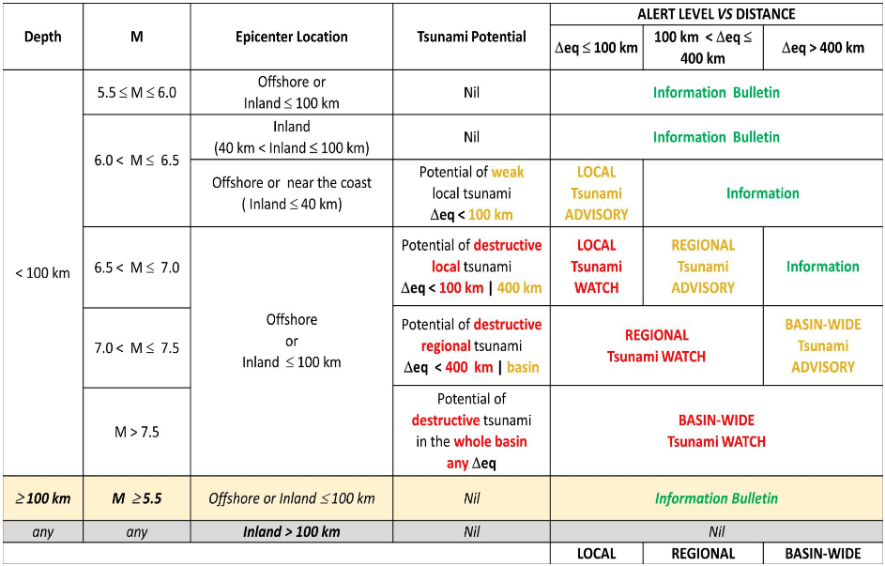
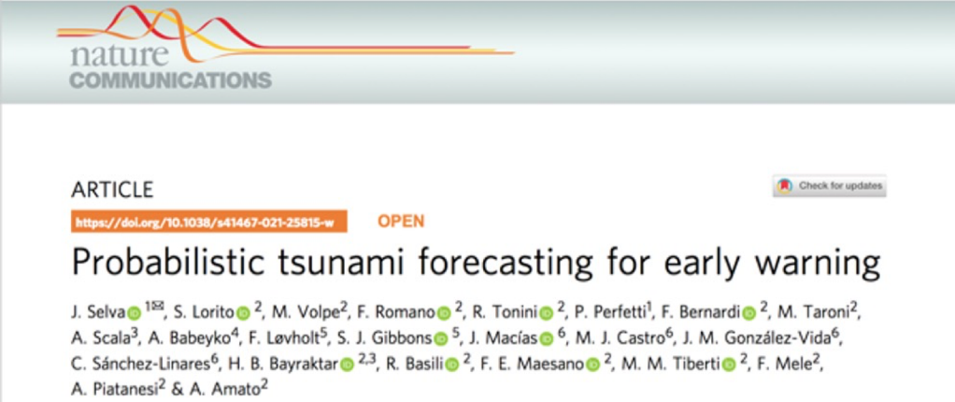
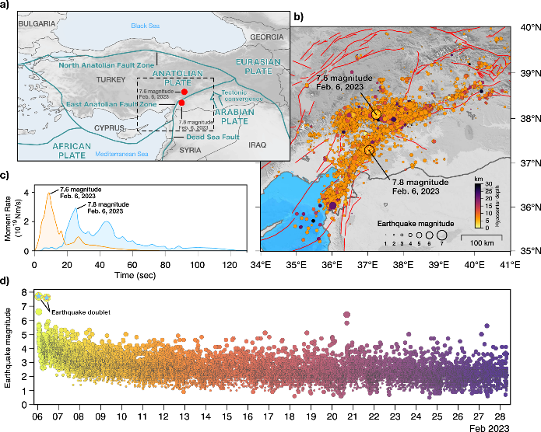
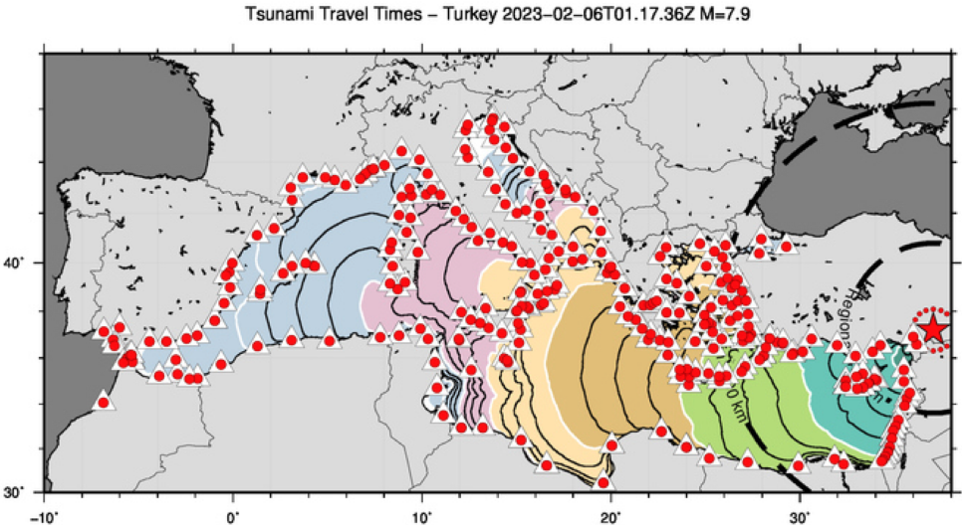
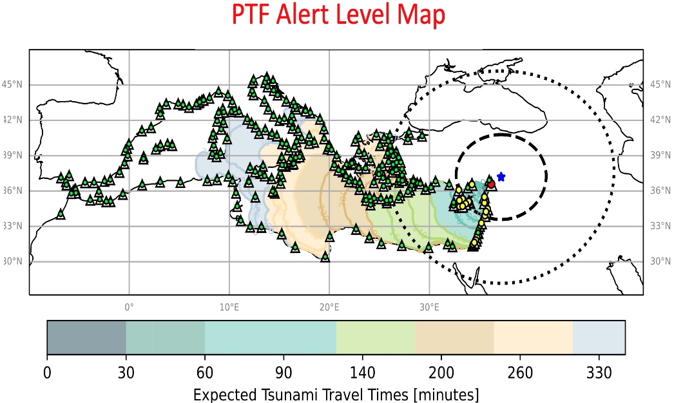
ONGOING ACTIVITIES: PROBABILISTIC TSUNAMI FORECASTING
The 2023 February 6 Mw 7.8 earthquake was the first one of a doublet which shook Türkiye and Syria causing about 60,000 casualties.
Decision Matrix
In response to the tsunami warning, trains were stopped in different locations in Southern Italy for several hours, and evacuation of some coastal areas was enforced.
However, only a relatively small tsunami was recorded by Turkish close-by tide-gauges in the Eastern Mediterranean, with a maximum recorded amplitude of less than 50 cm.

Slide 10
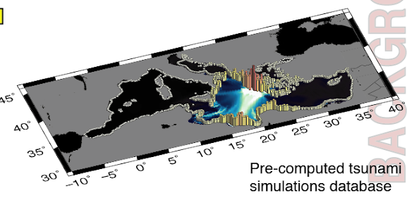
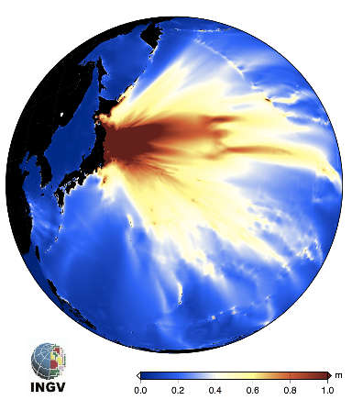
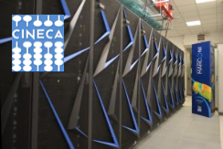


ONGOING ACTIVITIES: PROBABILISTIC TSUNAMI FORECASTING
PRE-CALCULATED SCENARIOS
EARLY WARNING VERSION
Targeting few to tens of seconds execution time.
Using hundreds to thousands pre-calculated scenarios
It works in near-real time at the INGV Tsunami Warning Centre
It is in the Calibration/Validation + Threshold defiinition phase towards the fully Operational Phase
On-the-fly SCENARIOS (Urgent Computing)
POST-EVENT ASSESSMENT VERSION
Prototype for event analysis at INGV and potentially other Tsunami Service Providers worldwide. Global scope.
Simulation ensembles to be run from scratch on large enough HPC clusters in urgent computing mode.
Targeting minutes to tens of minutes execution time

Slide 11
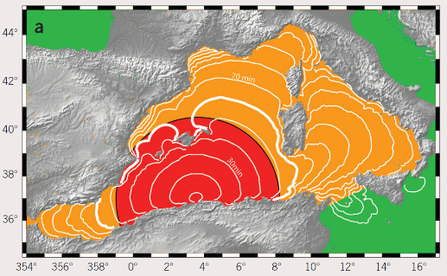
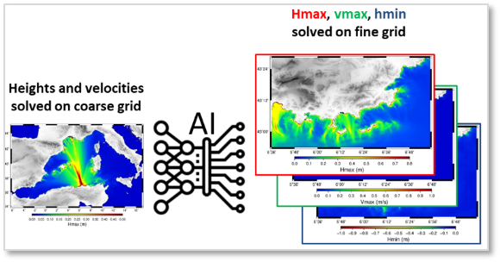
ONGOING ACTIVITIES: COASTAL TSUNAMI FORECAST
TOWARDS USING AI APPLICATIONS (CENALT DEVELOPEMENT)
00:05 Seismic source characterization
00:15 Watch message to French civil protection
01:00 to 01:30 Tsunami hits French coastline
HPC high resolution modeling ~ 1h
AI high resolution modeling ~1s once Focal mechanism available
1 h 30
1 h
30 min
Applicable as soon as HR bathymetry is available for the coastal sites
Cooperation needed among NEAM TSP’s subscribers to strengthen data sharing (seismic data, bathymetry)
NEAM TSPs meeting, Lisbon (5-6 March 2025)
Discussion on PTF and other forecast methodologies implementation

Slide 12
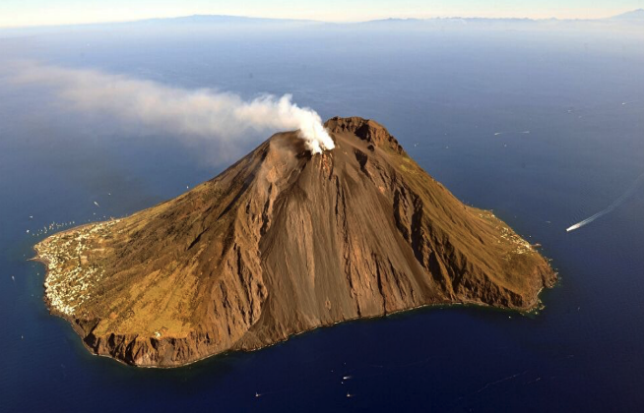
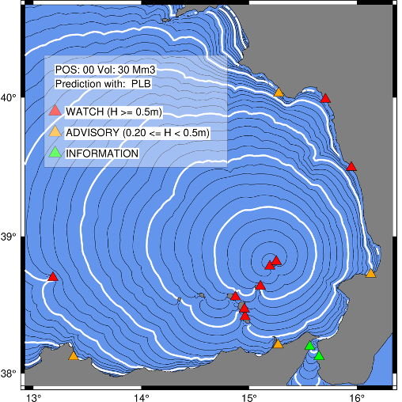
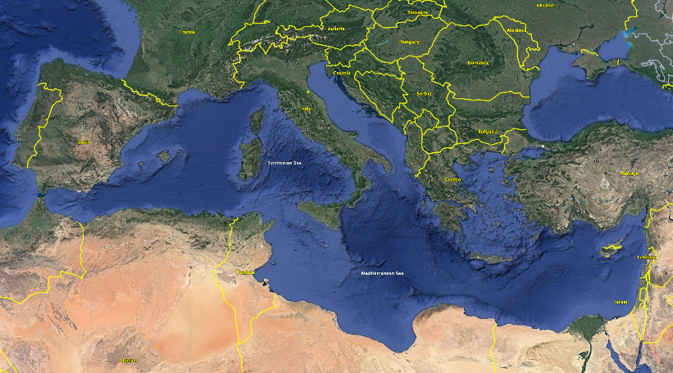
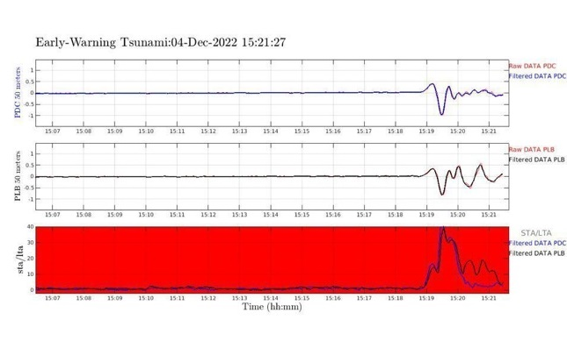
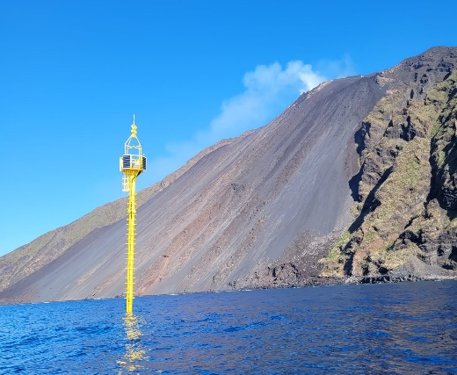
ONGOING ACTIVITIES: NON-SEISMIC TSUNAMI SOURCES
The ICG/NEAMTWS at the February 2024 session DECIDED to establish a new
Task Team on Non-Seismic Tsunami
An international workshop was held in Stromboli (5-7 October 2024) on volcano tsunamis
Among other issues, this TT will be important to foster the integration of TWS specifically conceived for non-seismic tsunami with those already operating for seismic tsunami: Stromboli volcano is a good case-study for such a task
Local TEWS for Stromboli volcano, Italy

Slide 13
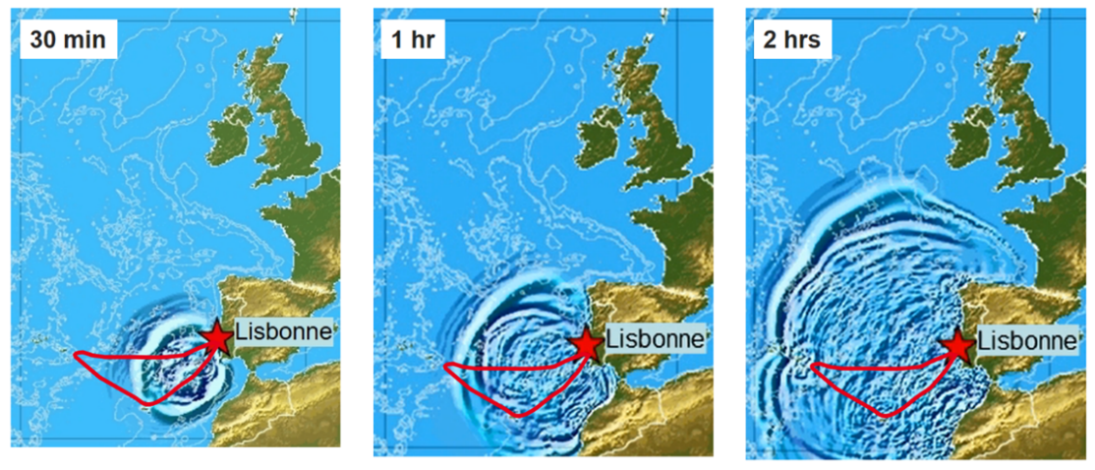
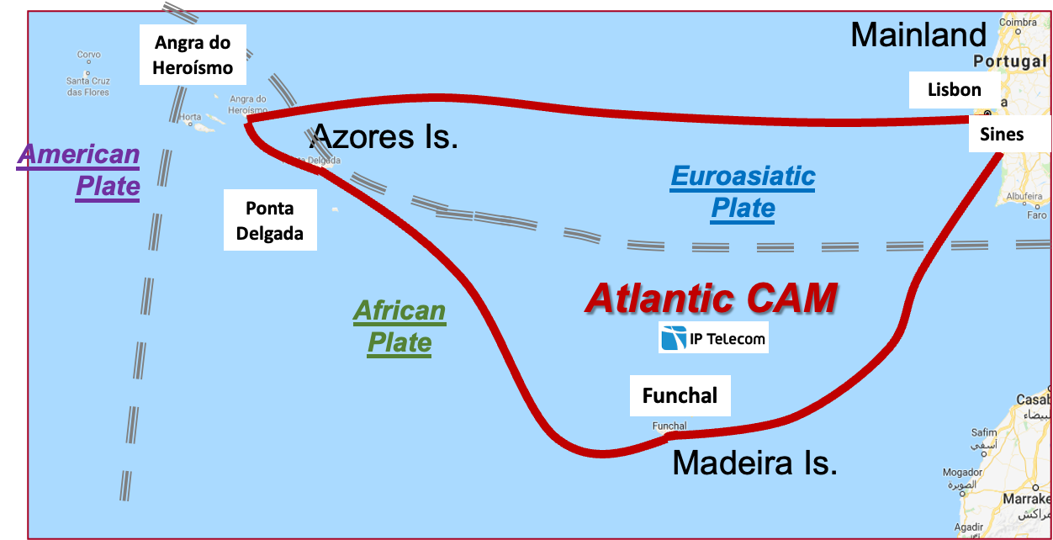
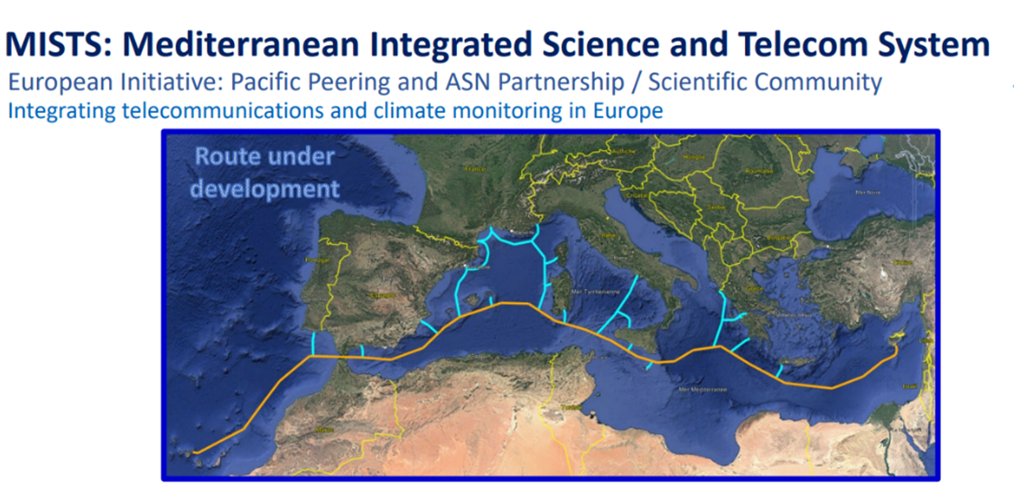
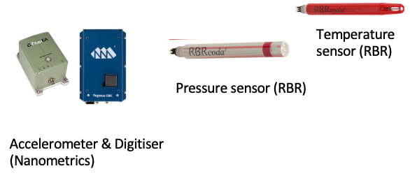
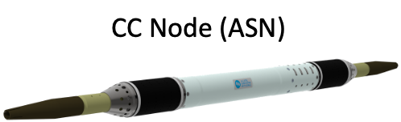
ONGOING ACTIVITIES: SMART CABLES
New Submarine Cable Ring connecting Portugal Mainland-Azores-Madeira
Supported by Portugal
Operational in second half of 2026
Timeline of 1755-like tsunami propagation in NE Atlantic

Slide 14
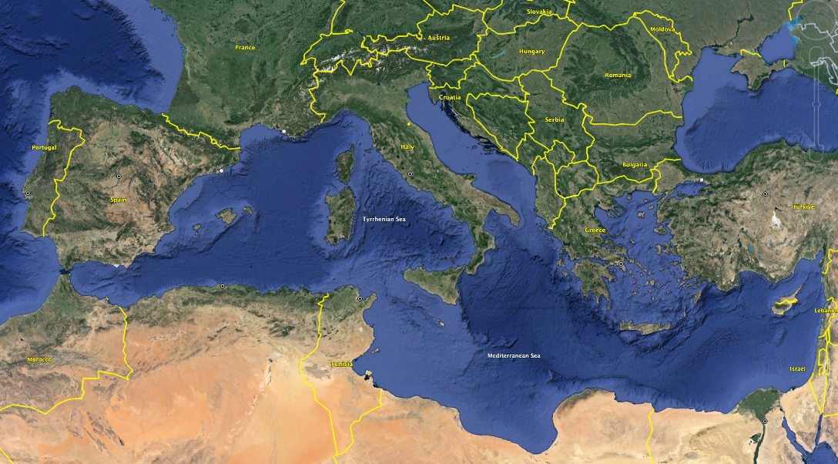
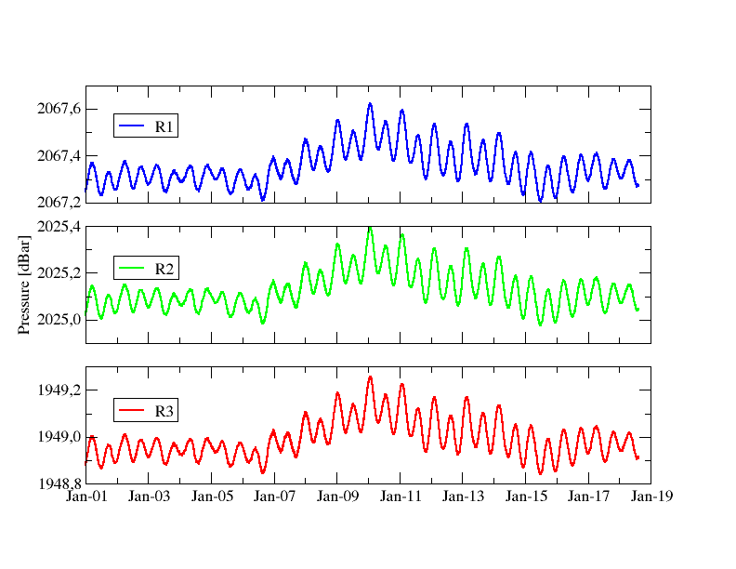
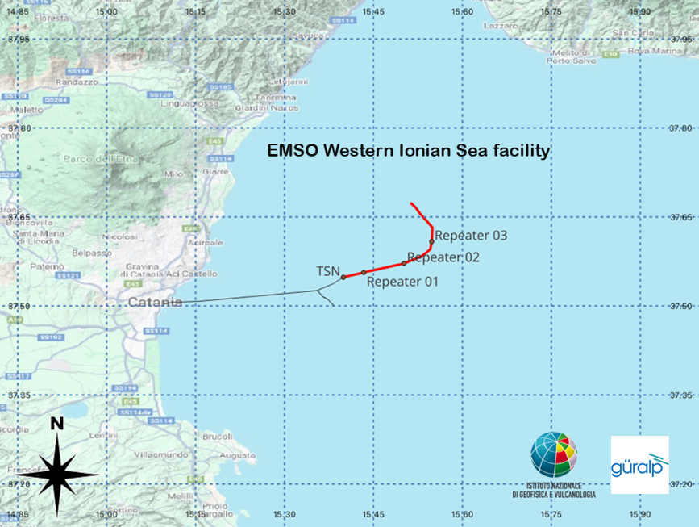
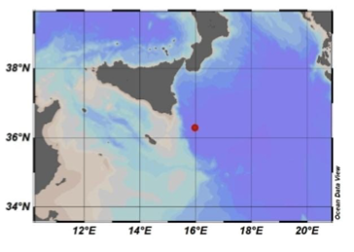
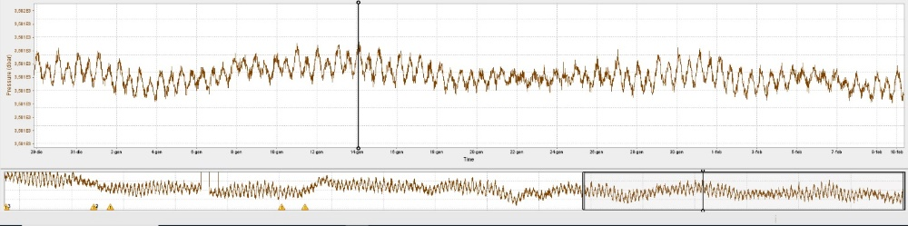
ONGOING ACTIVITIES: CABLED DEEP OCEAN OBSERVATORY
Wester Ionian Sea Infrastructure: deployed in December 2023
50 km from the coast, about 2000 m depth
INFN Km3NeT Observatory @3500 m depth
Trillium 120s + hydrophone + Pressure sensor
Cabled with optical fiber to land (100 km)
Courtesy of Giuditta Marinaro, INGV
Courtesy of Sergio Sciré, INGV

Slide 15
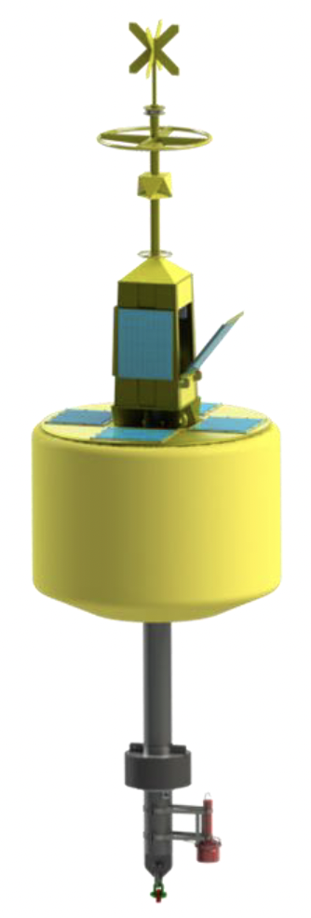
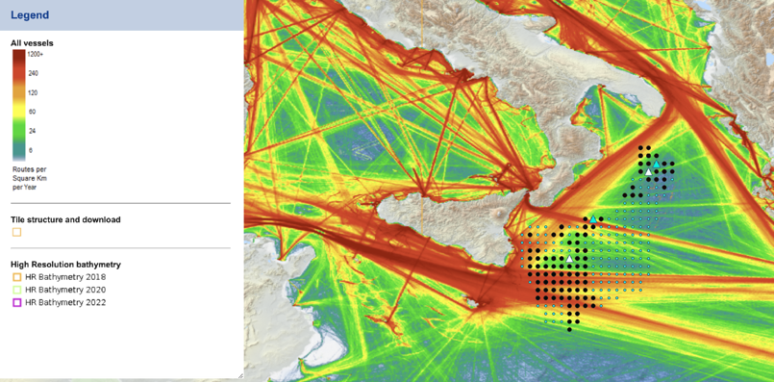
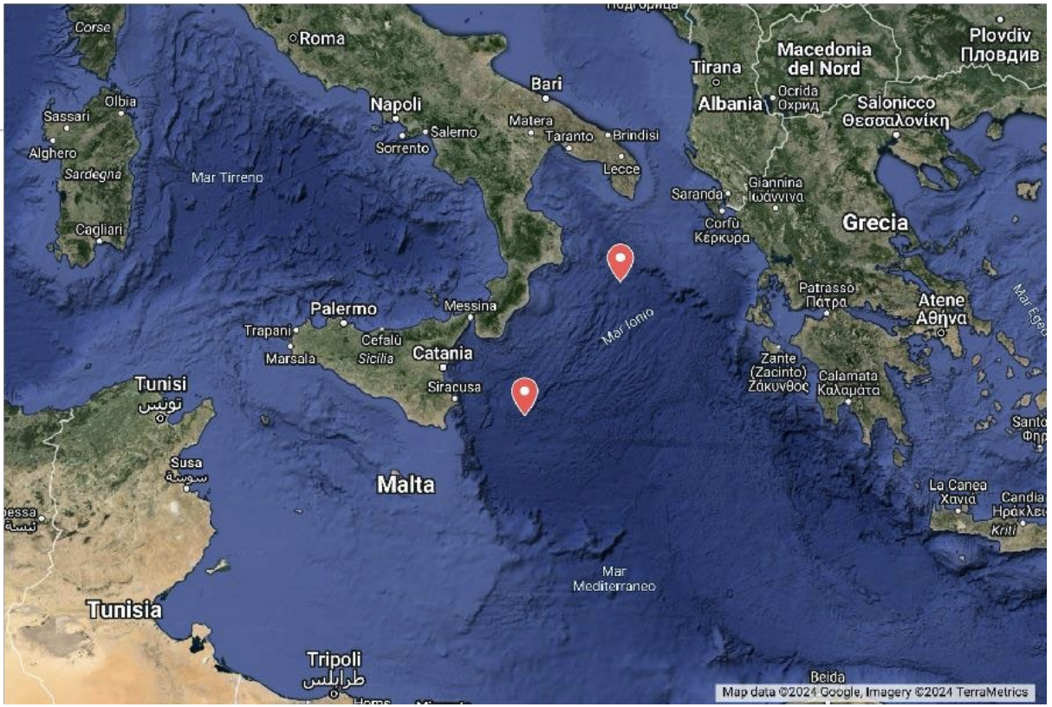
ONGOING ACTIVITIES: TSUNAMI BUOYS
2 (+2 spare) tsunami buoys will be installed in the Ionian sea during summer 2025
Location and technical requirements decided
The European tender has been won by MSM (Spain)

Slide 16
Thank you for your attention

