Slide 1
ISO 22328-3 Security and resilience –Emergency Management- Part 3 : Guidelines for the Implementation of a Community-Based Early Warning System for Tsunami
ICG Meeting
Jakarta, 17-19 November 2024

Slide 2
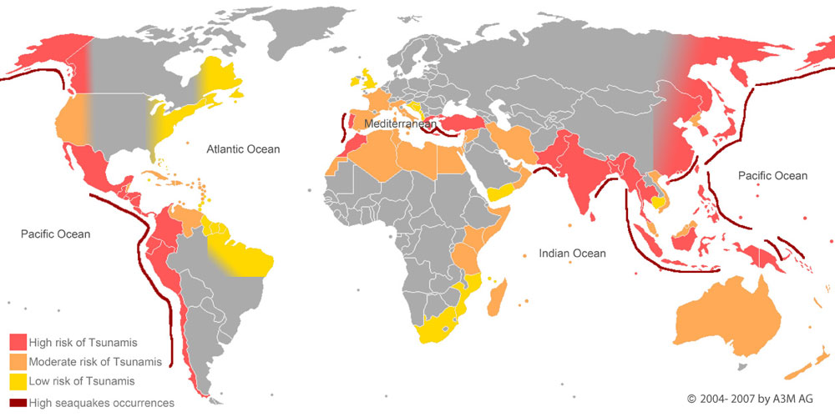
Background
“The urgency in executing best-practice of tsunami mitigation to minimize the risk”
“coastal communities throughout the world threatened by tsunami, yet rapidly developing to be most strategic area for business
Notes:
In tsunami-prone countries, a tsunami causes catastrophic disaster, loss of lives, damage to the ecosystem and great socioeconomic losses. Many area of tsunami high risk tend to be coastal region around the pacific, indian ocean and atlatic ocean.

Slide 3
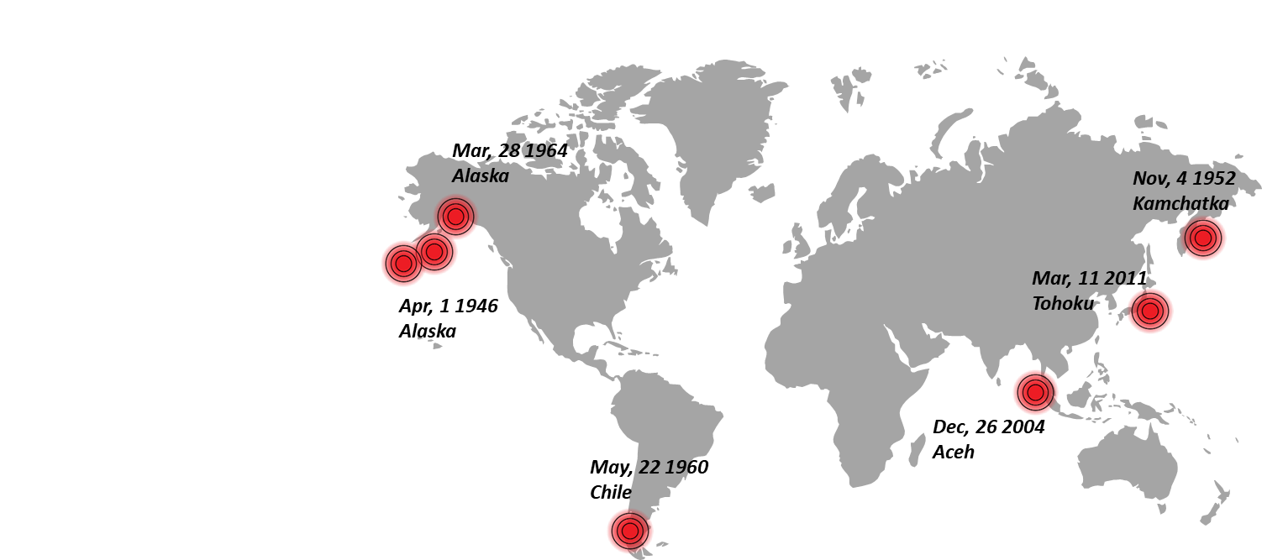
Background: What is it?
“A guideline consist of standard procedures and requirements in executing end-to-end tsunami early warning system”
“specifies the definition, understanding, method, procedure, implementation, as well as types of activities”

Slide 4
Background : Grand Objectives
Building a reliable early warning system within a community jurisdiction.
Be a practical instrument to be referred by critical infrastructure/industry/private sector/public sector as well as local authority prone to tsunami.
Help ensuring the professional performance with respect to safety management system of the business or community.
Help business ensuring the success of their business continuity.

Slide 5
Background : Who’s benefit from the ISO?
 | Benefits/ Impact | Examples of organization
Industry and commerce – large and micro industry | Human & Resource safety | Chemical Industry, Power Plan, Transportation company, Hotel & Restaurant, etc
Government | Human & Resource Safety; sustainable and resilient communities | National & Local Government
Academic and Research Bodies | Research material and topic | Academic and research bodies focusing on tsunami hazard
Critical Infrastructure | Human & Resource Safety, Legal licensing | Port, harbour, hospital

Slide 6
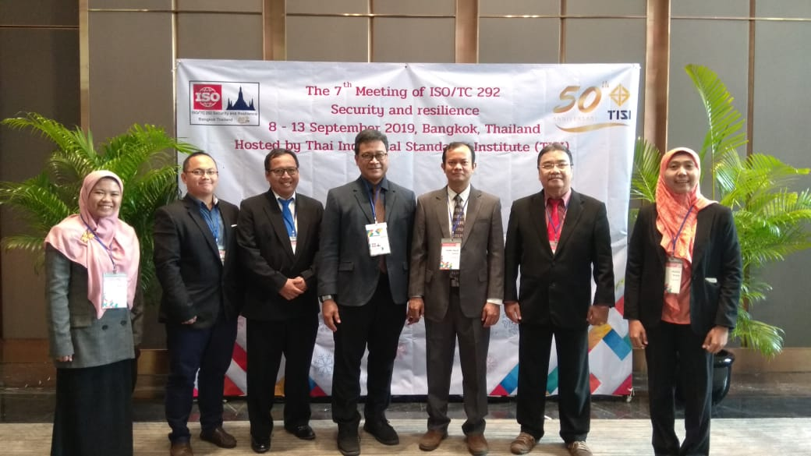
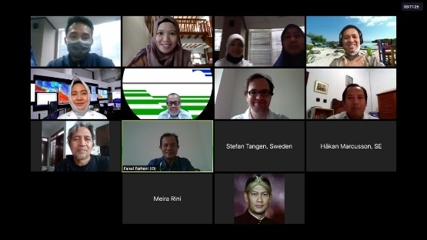
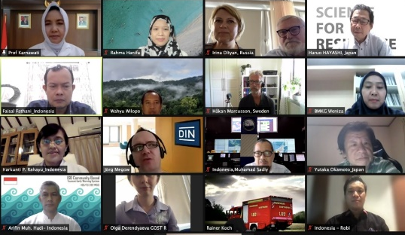
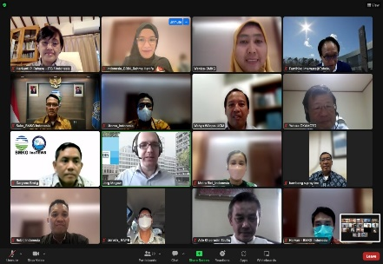
Process and Timeline
NWIP
(New Work Item Proposal)
2020-02-17
CD
(Committee Draft)
2021-03-30
IS (International Standard and Publication) :
2022-12-30
2018&2019
2020
2021
2020
WD
(Working Draft)
2020-06-30
2021
DIS (Draft International Standard)
2021-11-30
2022
The 10th Plenary Meeting of ISO/TC 292, Virtual, 14 - 23 June 2021
The 11th Plenary Meeting of ISO/TC 292, Virtual,10-15 June 2022
The 6th Plenary Meeting of ISO/TC 292, Sydney, 11-16 March 2018
The 7th Plenary Meeting of ISO/TC 292, Thailand, 08-14 September 2019
TOWS Meeting, Paris, 17 Feb 2020
The 9th Plenary Meeting of ISO/TC 292, Virtual, 24-25 June 2020

Slide 7
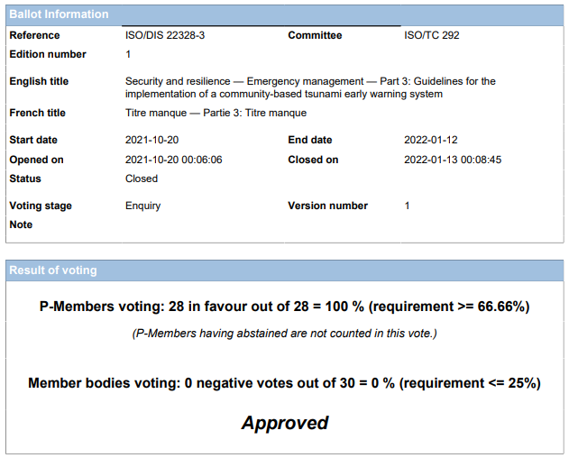
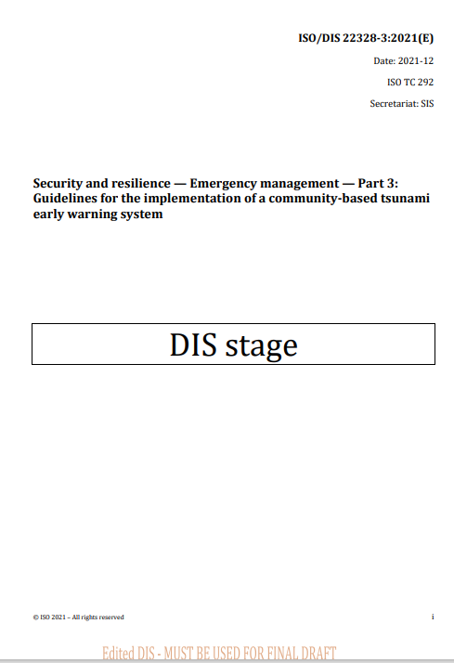
Result of Voting– ISO 22328-3 : DIS
1. Result of Voting DIS
2. Comment from Ms. Perou
Detailed Voting Result:
Member Responses (57) :
28 Countries Agree,
19 Abstain
0 Disagree
Comment (51);
Countries :
Austria-AT (1),
Japan-JP (8),
Mauritius-MU (1);
Sweden-SE (12),
ISO Sec-Ms.Perou (29)
Type of comment : General (6), Technical (14), Editorial (31)

Slide 8
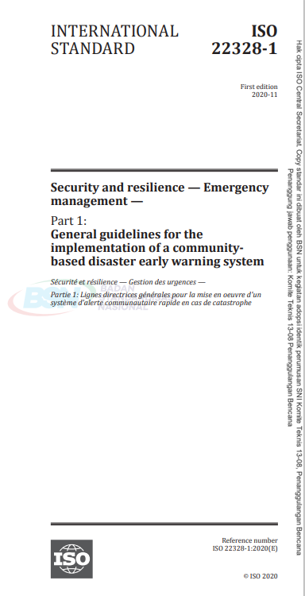
Components of ISO
1. Risk Assesment
2. Dissemination and Knowledge Communication
3. Monitoring and Warning Service
4. Response Capability
5. Commitment of the authority and community
Understanding of tsunami hazard
Understanding of tsunami vulnerability
Development of tsunami risk reduction plan
Develop a public display of tsunami information
Develop and disseminate customized public education materials to meet local information
Conduct public education, campaign and/or advocacy
Monitoring system (Seismic and onshore)
four stages of warning
Dissemination mode
The community disaster preparedness team task
Determining the evacuation shelters
Developing of tsunami evacuation map and routes
Developing SOP
function 24 hours a day
readily receive and disseminate warning messages
joint complete assessment
Notes:
The community disaster preparedness teams should conduct a risk identification to understand the combination of tsunami hazard and vulnerability at one particular location.
A tsunami hazard map should be developed and updated by community-preparedness teams to identify the geographical areas susceptible to a tsunami. The tsunami hazard map should actively involve public participation in its development, address local knowledge,
A vulnerability assessment analyses the exposure, conditions, assets and capacities the community at risk has to deal with related to the tsunami hazard. It considers the physical, economic, social and cultural dimensions of community vulnerability.
The hazards should be documented and mapped for people or communities located along the identified coastline.

Slide 9
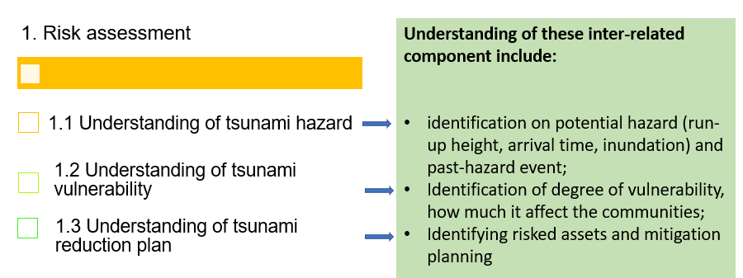
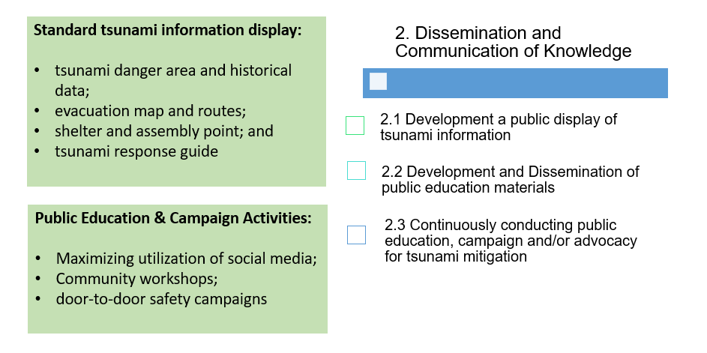
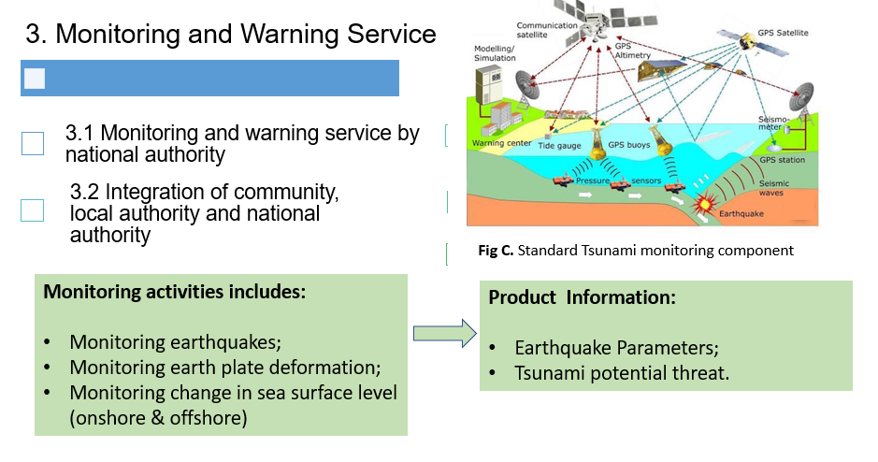
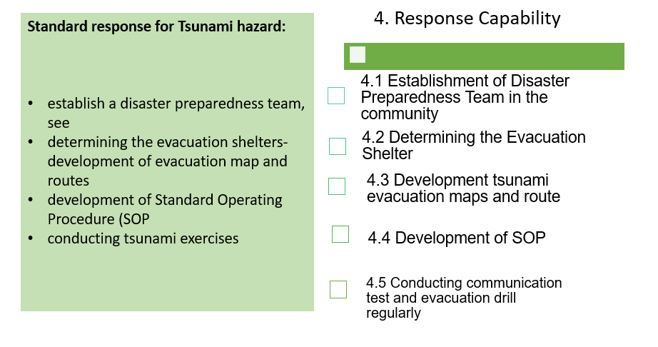
Components of ISO

Slide 10
Components of ISO

Slide 11
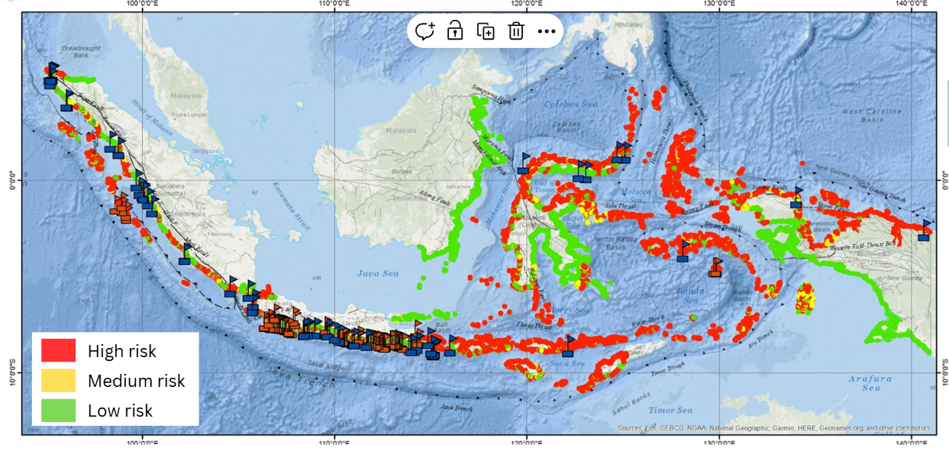
Implementation Plan
ISO targets:
5,732 tsunami-risk villages/ communities across Indonesia;
35 commercial airports (National and International).
111 commercial seaports.

Slide 12
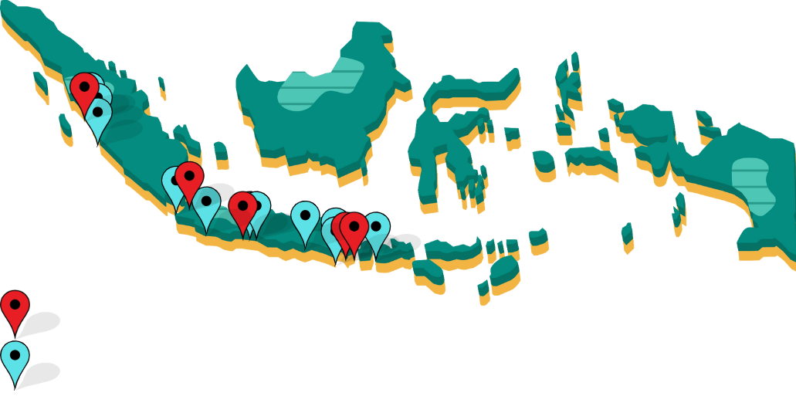
Implementation Plan
ISO implementation starts in 10 communities and 5 critical infrastructure (Airport ,Seaport, Industrial area);
Implementation is done through BMKG Earthquake and Tsunami Field School and other outreach activities.
3 Airports, 1 Seaports, 1 Industry
10 Communities across 10 Regencies

Slide 13
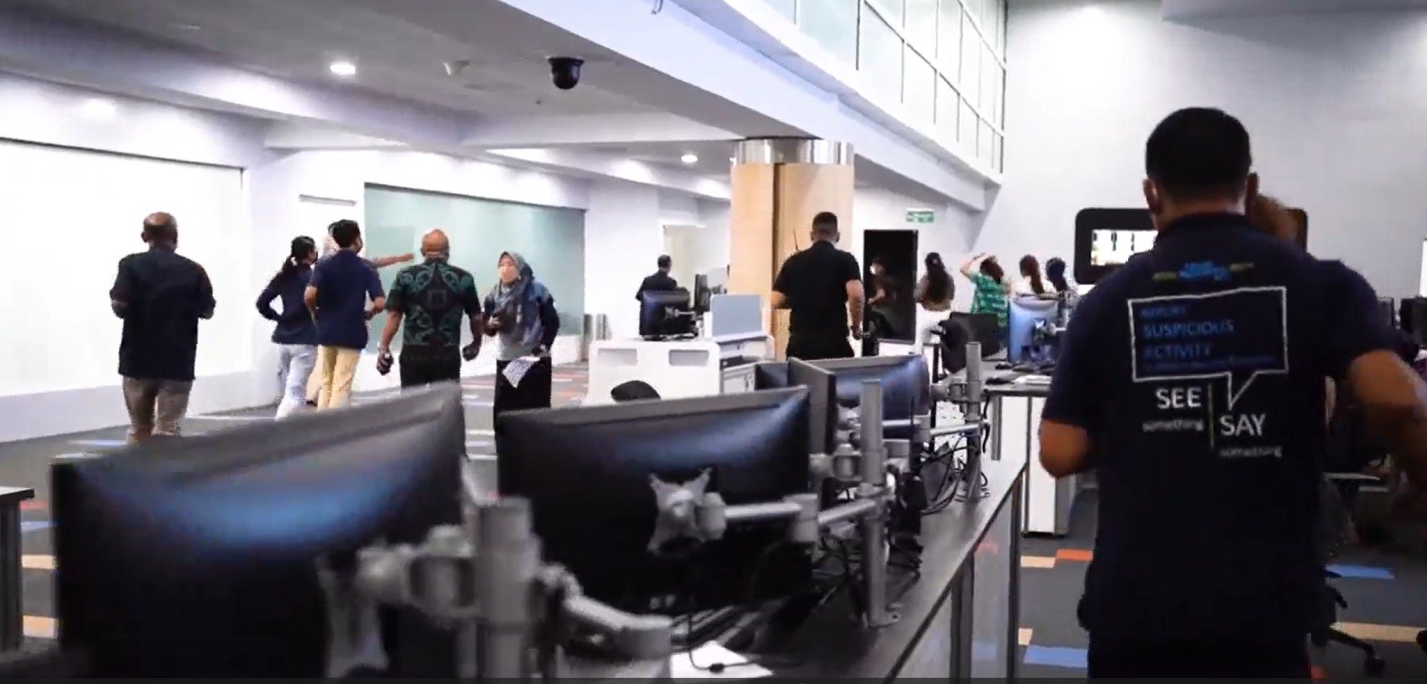
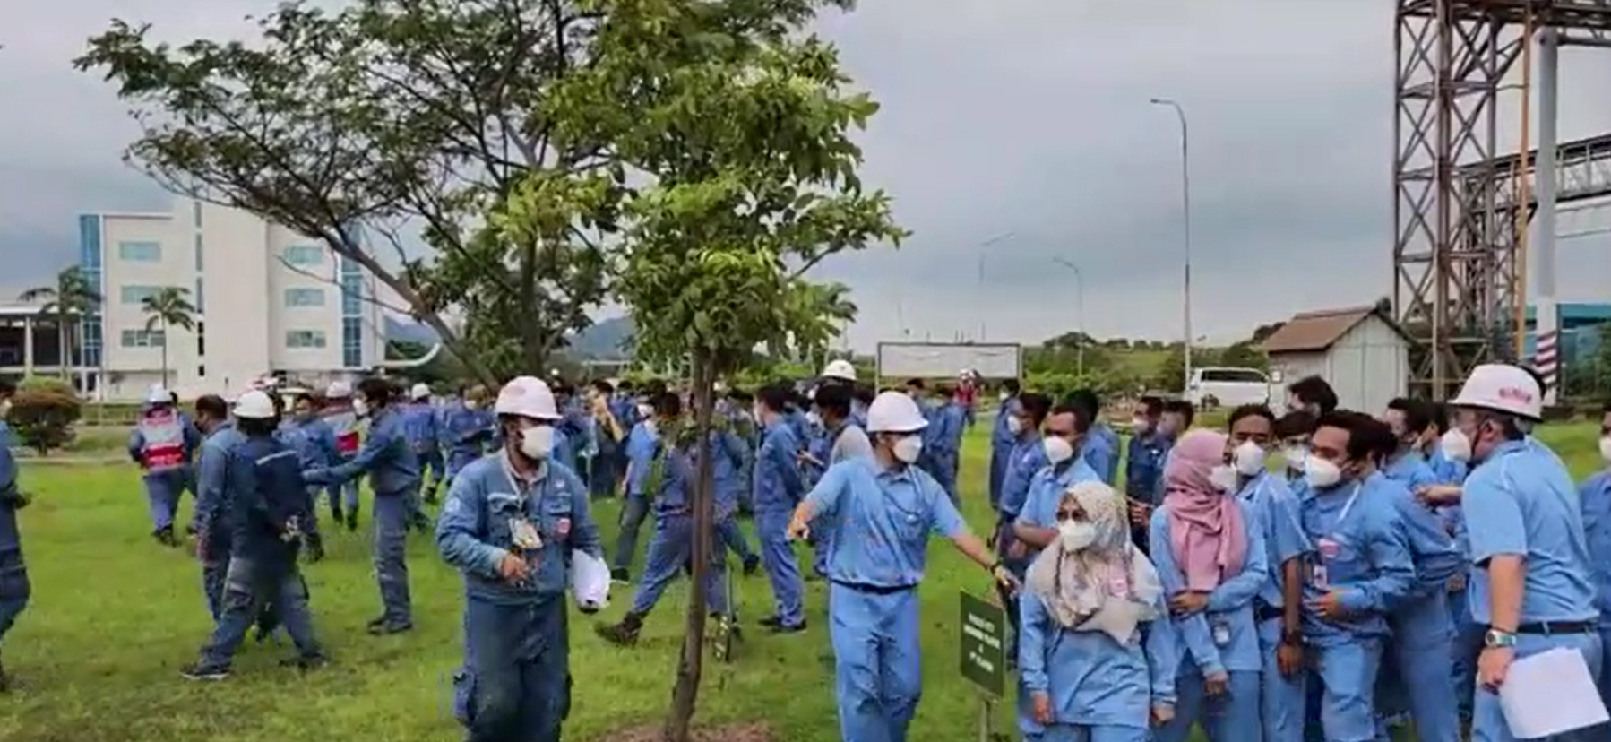
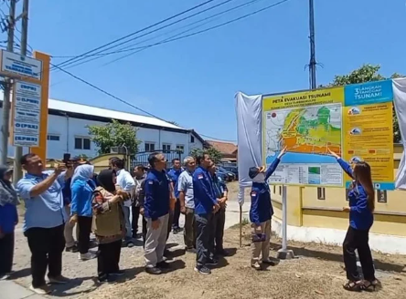
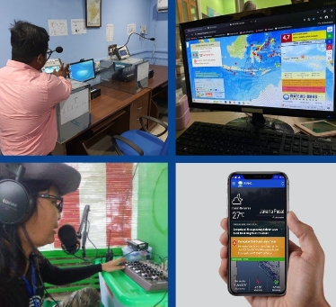
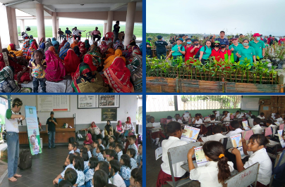
Implementation Plan
Fig 1: Earthquake & Tsunami Emergency response plan drills in I Gusti Ngurah Rai Airport, Bali.
Fig 2: Establishing and capacity building for local disaster preparedness team in a community.
Fig 3: Earthquake& Tsunami evacuation drills in Cilegon Industrial Area, Banten.
Fig 4: Tsunami hazard assessment and evacuation route planning in Central Java.
Fig 5: Alert receiver and dissemination system implemented in local community.
Fig 6: Dissemination and communication of knowledge for every member of communities.

Slide 14
Summary
Comprehensive Guidelines: ISO 22328-3 provides structured guidance for implementing community-based tsunami early warning systems, emphasizing safety management and business continuity for at-risk coastal areas.
Implementation Plan: The framework and guideline provided component by ISO 22328-3 have been implemented in several local communities and business entities in Indonesia, and have proven to increase their readiness to mitigate earthquake and tsunami risk.
Focus on Sustainability: Long-term commitment from both authorities and communities is essential to ensure the usefulness and effectiveness of community-based tsunami early warning systems.

Slide 15
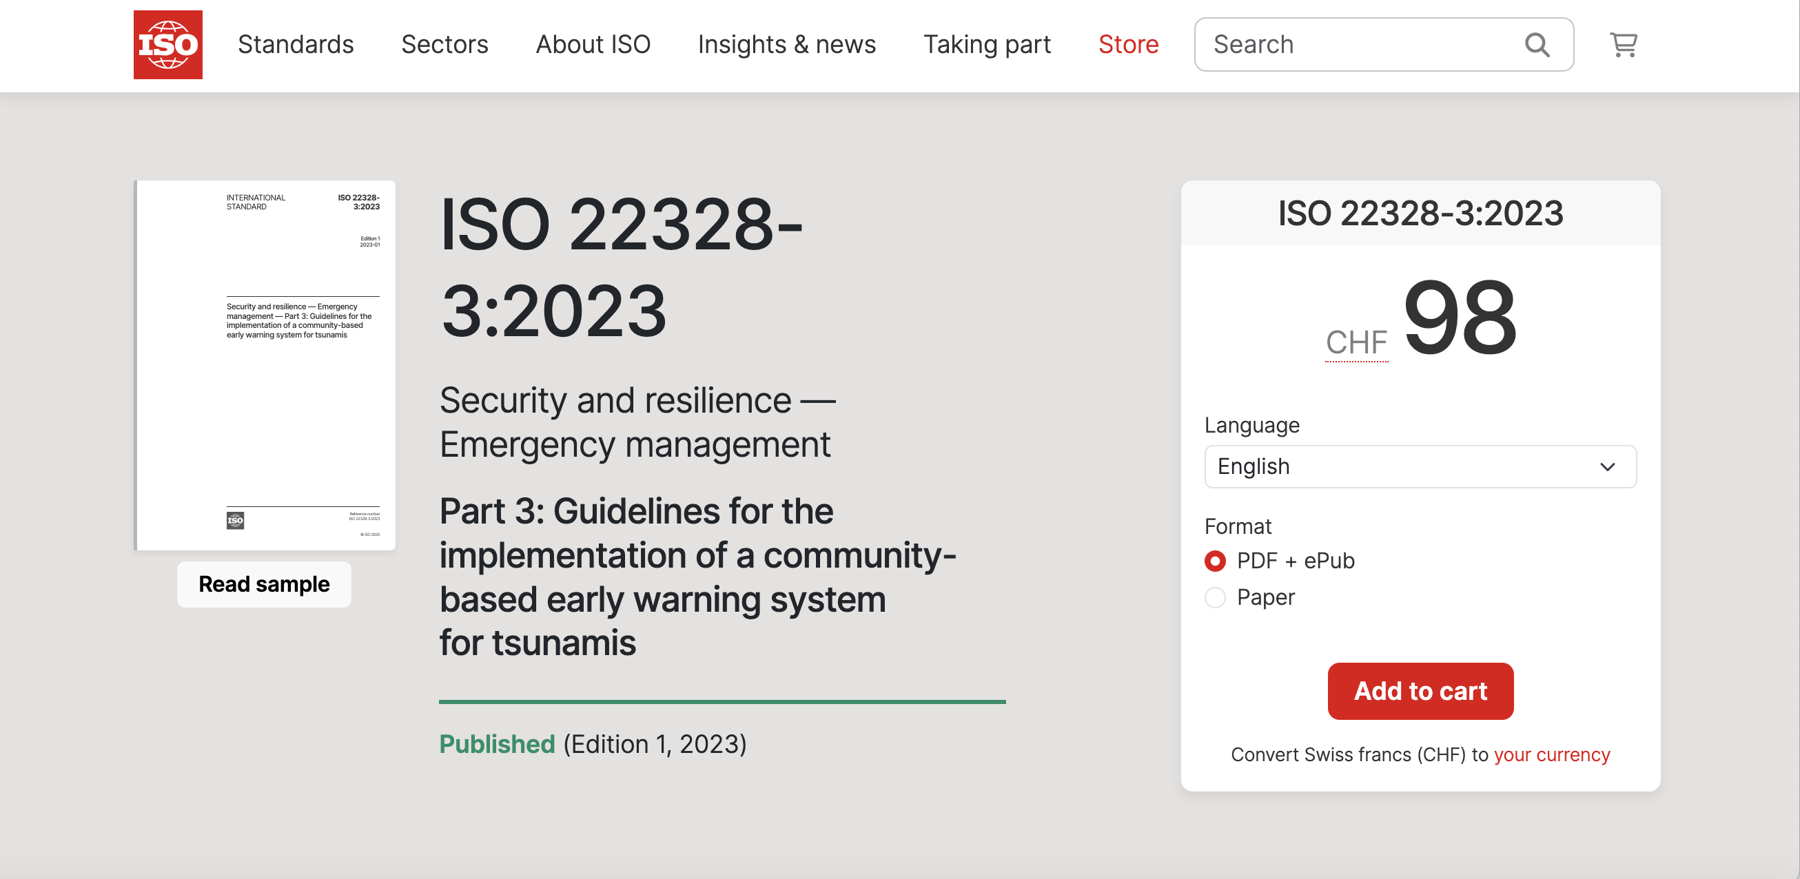
Summary
This ISO document gives guidelines for the implementation of a community-based disaster early warning system (EWS) for tsunamis. It complements the generic guidelines in ISO 22328-1^{[5]}. It describes the methods, procedures, implementation measures and activities specifically related to tsunamis.
This document is applicable to communities vulnerable to tsunamis, without taking secondary/indirect effects into consideration.

Slide 16
THANK YOU weniza@bmkg.go.id

