Slide 1
Joint TT-TWO & TT-DMP
Agenda 3.0
Significant Tsunami Events
in ICG/IOTWMS
Mr. J. Padmanabham(Presenter)
WG-2 Chair, IOTWMS Padmanabham@incois.gov.in
Mr. Nasser Said AL-ISMAILI
n.alismaili@met.gov.om
Thanks to Dr Yuelong Miao, Dr Yedi, Dr Robert for their inputs
TOWS - JOINT SESSION OF TASK TEAM TSUNAMI WATCH OPERATIONS AND
TASK TEAM DISASTER MANAGEMENT AND PREPAREDNESS, 20 Feb 2025

Slide 2
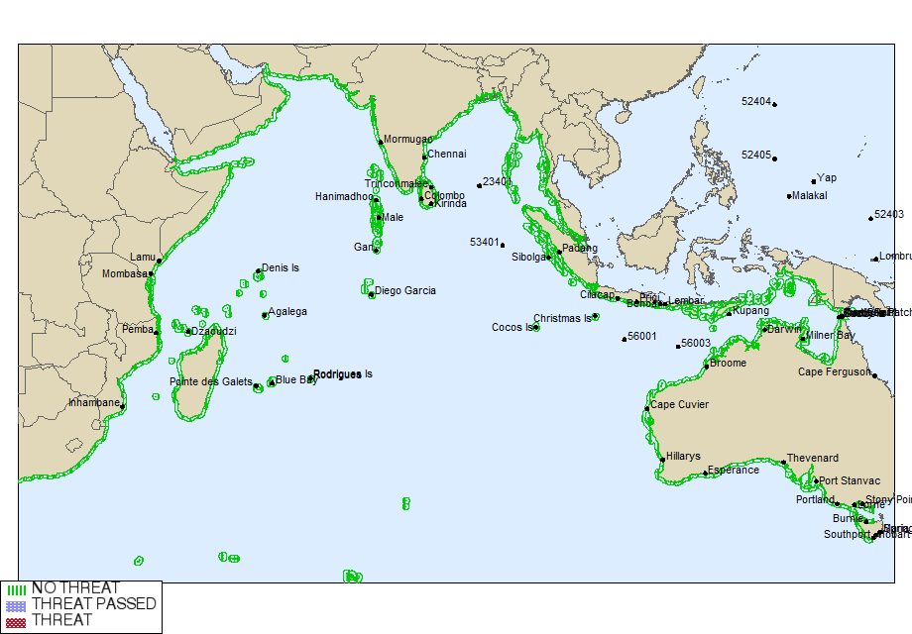
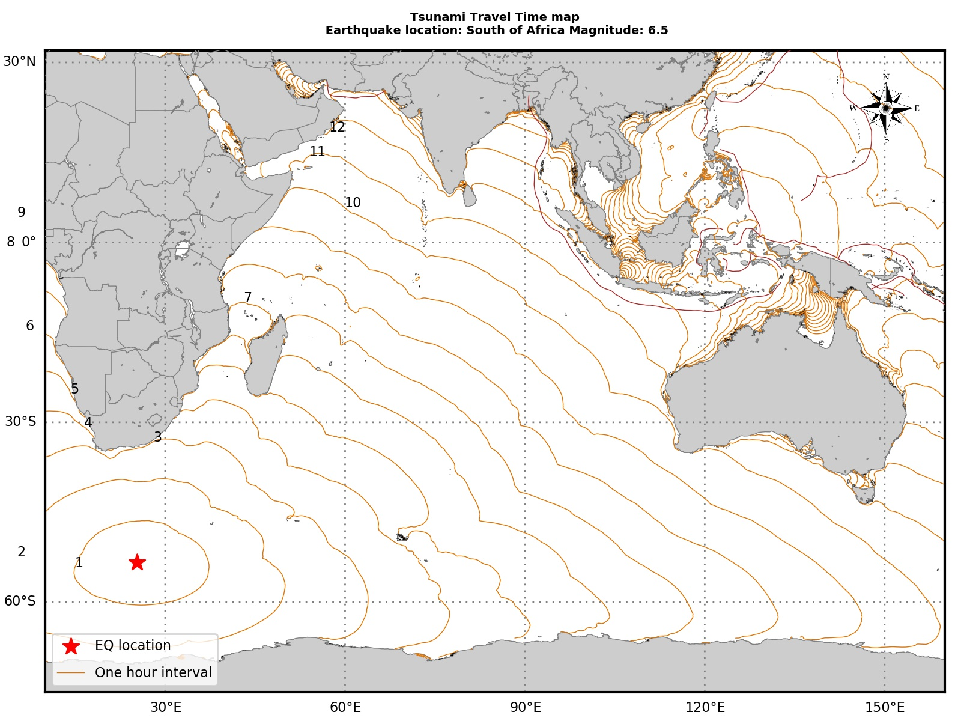
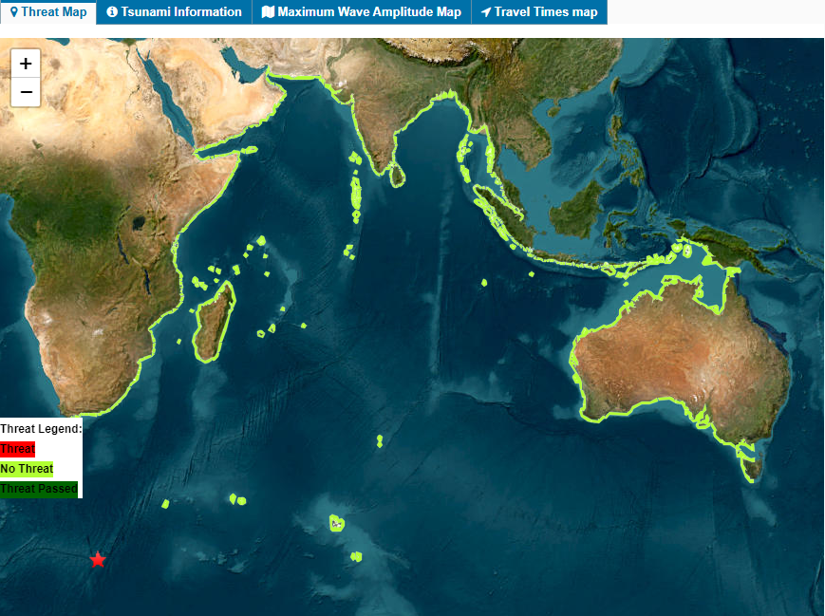
Significant Events in the Indian Ocean
During the reporting period, a total of 22 earthquakes (M≥6.5) were monitored within the ESZ (Indian Ocean, Pacific Ocean, and South Atlantic Ocean), and bulletins were issued to IO member states as per the SOP defined in the Service Definition Document.
One event occurred in the Indian Ocean, as detailed below, for which TSPs issued a "No Threat" bulletin.
M 6.6 - south of Africa
2024-07-10 04:55:41 (UTC)
53.309°S 25.348°E; 4.0 km depth
No threat information from JATWC (TSP-Australia)
Source | Magnitude | No of Bulletins issued by each TSP
USGS (Final Magnitude) | 6.6 MW
TSP – Australia | 6.6 MW | 2
TSP-India | 6.6 MW | 2
TSP-Indonesia has detected this earthquake with magnitude < 6.5
Tsunami Travel Time Map
No threat information from ITEWC-INCOIS (TSP-India)

Slide 3
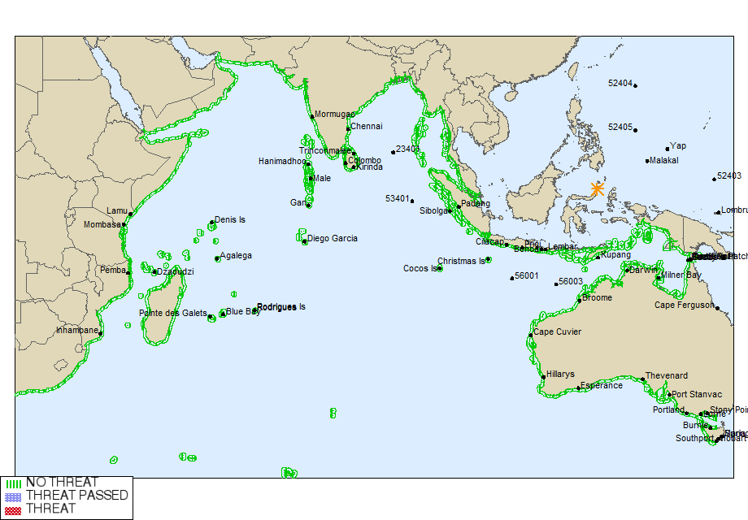
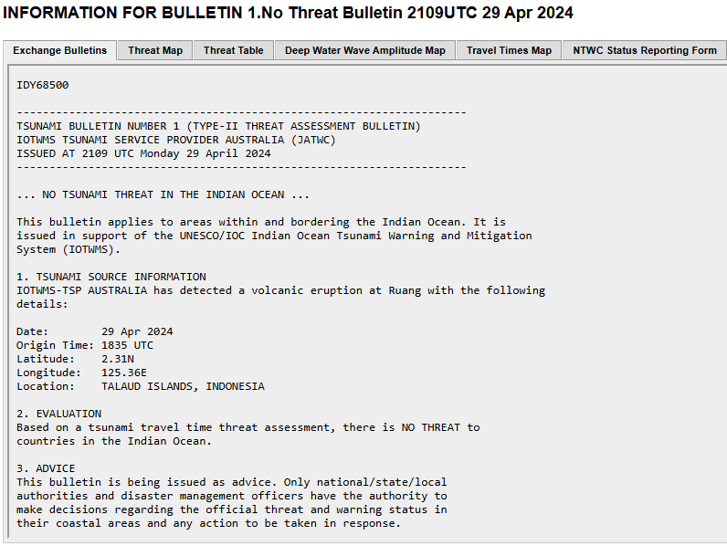
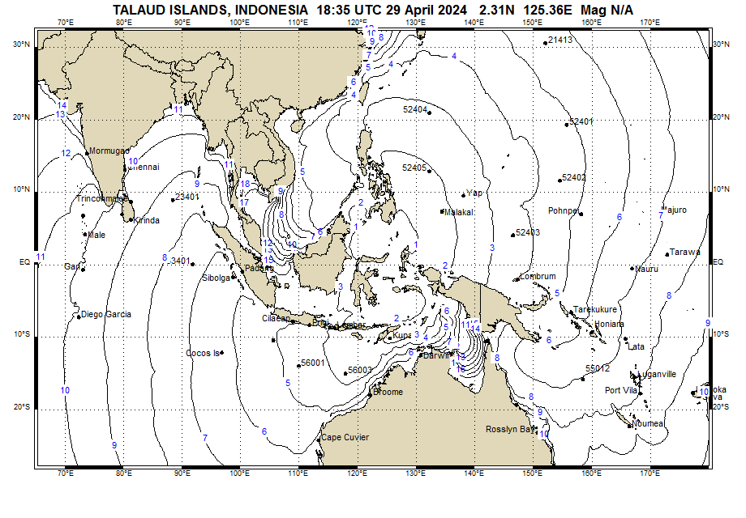
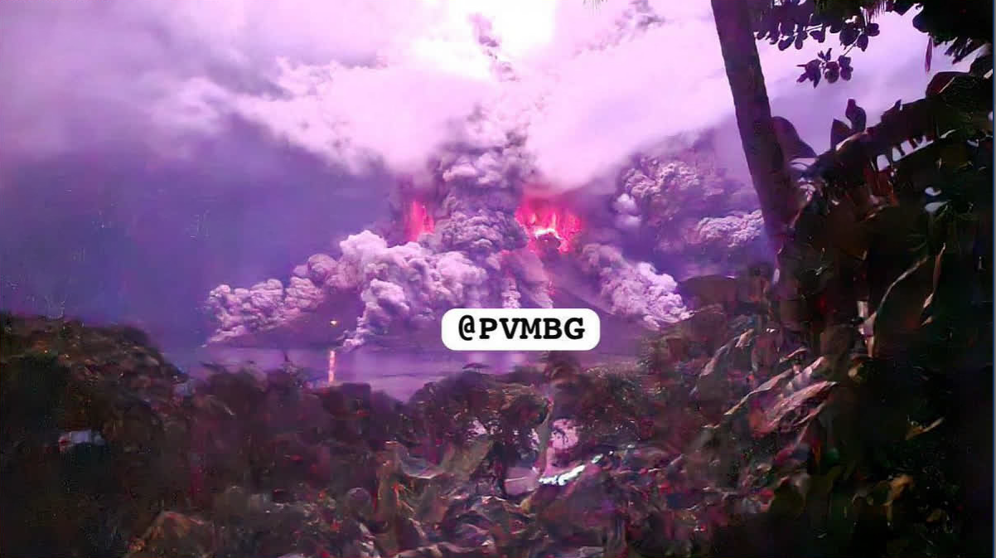
Non-seismic events (with-in ESZ)
April 2024 - Volcanic Eruption MT. Ruang
TSP – Australia has issued a “No Tsunami threat Bulletin” for the Indian Ocean in response to the eruption of Ruang on the 29th of April 2024.
This is the first non-seismic product issued by a TSP for the Indian Ocean.

Slide 4
Thank You
J. Padmanabham (India)
Mr. Nasser Said AL-ISMAILI (Oman)
Padmanabham@incois.gov.in
n.alismaili@met.gov.om

