Slide 1
PTWS-NTWC
Competency Framework - Minimum Levels for Operations Staff
2024-26 ITIC Training Pilot
PROGRESS REPORT
TOWS Joint TT TWO - TT DMP, 20 Feb 2025, Paris, France
Laura Kong, ITIC Director

Slide 2
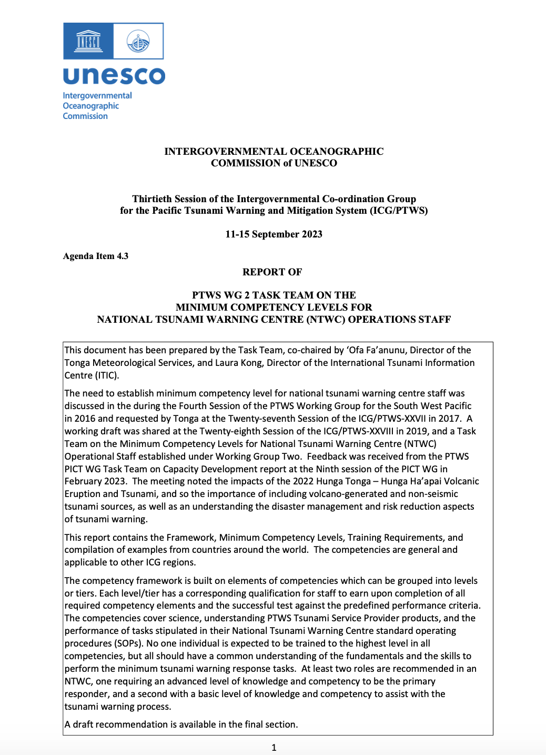
NTWC Minimum Competencies Framework
Minimum Competency Level for National Tsunami Warning Centre (NTWC) Operations Staff
PTWS-XXX (2023) – Approved
Report of the PTWS WG-2 TT to ICG PTWS-XXX. Agenda Item 4.3 (2023)
Built from draft by small group after 2018 PTWS WG mtg in Hawaii.
Content - competency framework is multi-tier system with different levels of knowledge and skills required depending on roles.
PTWS-XXVIII (2019) – Established PICT TT
PTWS-XXVII (2017) – PICT Identified need

Slide 3
Minimum Competencies – 2 Tiers CORE (Basic, Min), ADVANCED (Comprehensive, Max)
KNOWLEDGE Science
CORE : Basic tsunami science / earthquake source knowledge
ADVANCED : Adv tsunami science / earthquake source knowledge, tsunami forecast modelling
OPERATIONS competencies
CORE
Understand / use TSP text / graphical products, core set of decision support tools. Perform all core NTWC SOPs
Identify potential regional, distant, and local source tsunami threats
ADVANCED
Understand and produce tsunami threat maps
Explain relationship of tsunami warning products to evacuation maps and routes
Use a comprehensive set of decision support tools
Advanced practical seismology (locate / characterise EQs), sea-level observations: measure & interpret records
NATIONAL AGENCY competencies - CORE
Provide national threat & impact assessment. Liaise with NDMO & response agencies. Monitor public enquiries, provide guidance. Conduct Post-event activities (e.g., post-tsunami survey)

Slide 4
PTWS-XXX Executive Summary (IOC, June 2024)
The ICG noted recommendations arising from the TT Minimum Competencies, and noting the submission of a Minimum Competency Framework to the IOC for consideration, and in anticipation that conditions around assessment of efficacy have been met, and further noted the instruction of the Working Group on Tsunamis and Other Hazards related to Sea-Level Warning and Mitigation Systems (TOWS-WG) at its 16th meeting in 2023 to the regional ICG, notably the PTWS, and the ITIC to pilot the PTWS National Tsunami Warning Centre (NTWC) Competency Framework for endorsement by ICG/PTWS with the goal to develop a global framework for all ICGs to use.
The ICG approved the PTWS National Tsunami Warning Centre competencies framework, and training requirements, and welcomed the ITIC proposal to pilot the PTWS Minimum NTWC Competency Framework through the development and conduct of a training course during the intersessional period, and report back on its outcome to the ICG/PTWS at its 31st session.

Slide 5
PTWS NTWC Minimum Staff Competencies Training - Pilot
PTWS NTWC Minimum Staff Competencies Training
Competency Framework approved ICG/PTWS-XXX (2023)
ITIC create training, with country partners
Funding: USAID funding, IOC Ocean Training Interns (Q3 2024)
Series of courses - from self-paced to in-person housed under OTGA
In order to take next Lesson, must pass previous Lesson and Course. Start with OTGA UNESCO-IOC Tsunami Awareness and Tsunami Ready
Modules (to be individual OTGA, or US COMET MetEd courses)
Core (multiple Lessons)
Core (multiple Lessons)
Core Agency (multiple Lessons) – National actions
Final training will be in-person (3-4 weeks at ITIC/PTWC)
Finish Training and pilot in early 2026 with 1 small cohort (PIC)

Slide 6
PTWS NTWC Minimum Staff Competencies Training – Project Team
Project Team
Lead – Laura Kong (ITIC)
Project Manager – Tony Elliott (IOTWMS Secr ret)
Tsunami Warning Centre SME – Ken Gledhill (NZ GNS ret)
Budget Administration – Marie Eble (NOAA PMEL ret)
ITIC Interns (Oct–Dec 2024) – Muhammad Harvan (Indonesia), Taniela Takeifanga (Tonga)
Partner Countries: Australia (BOM, GA), New Zealand (GNS), USA (PMEL, PTWC), Others (TBD)
Partner Agency: OTGA (IOC), UCAR COMET (USA)
Consultation with:
PTWS PICT WG TT Capacity Development
PTWS WG 2 on Warning and Dissemination
TOWS WG TT Tsunami Watch Operations
Other countries and experts

Slide 7
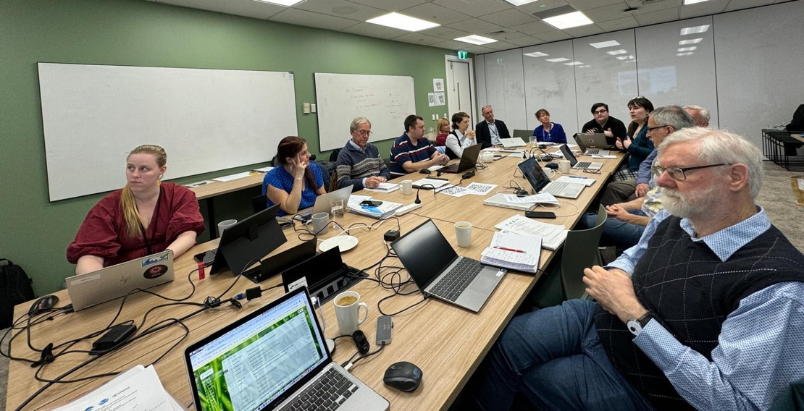
Kick-off Meeting, Wellington, New Zealand
Hosted by NZ National Emergency Management Agency (NEMA), 15-17 July 2024
Attended by project team / reps from BOM, GA, GNS, NEMA, PTWC, and UNESCO-IOC OTGA and TSR Suva
Outcomes:
Reviewed existing schema and training material from Australia, New Zealand, USA
Reviewed NTWC Competency Framework and agreed on modules to include
Obtained agreement from agencies to include their material (formal approval post-mtg)
Agreed to establish Expert Panel comprising nominated representatives from Australia, New Zealand, USA, plus other experienced TWCs, .

Slide 8
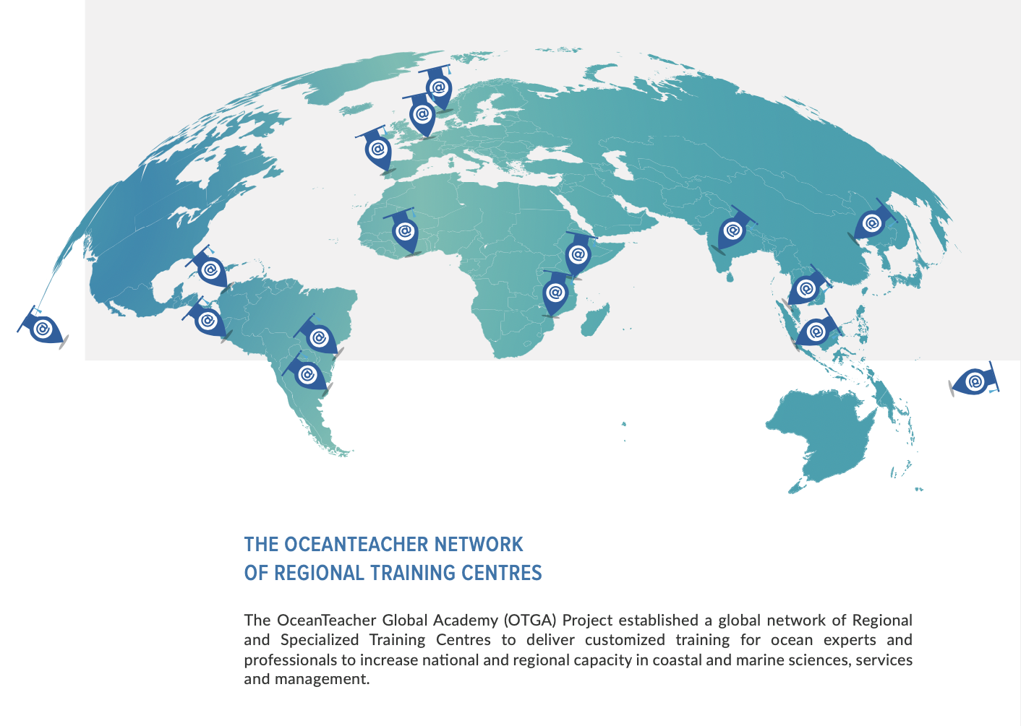
International Tsunami Information Centre (ITIC)

Slide 9
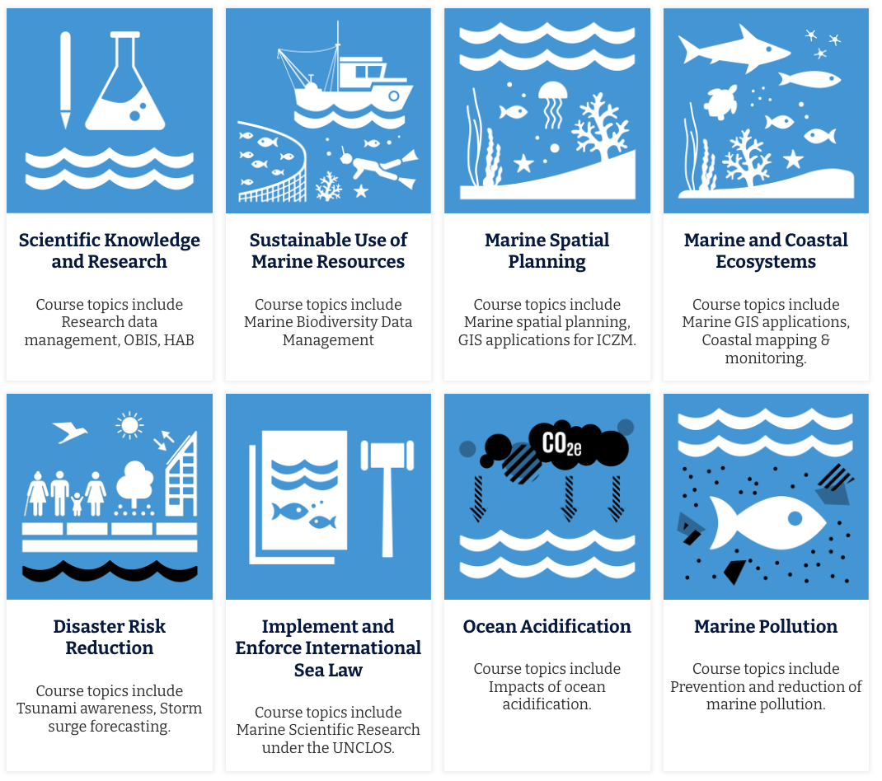
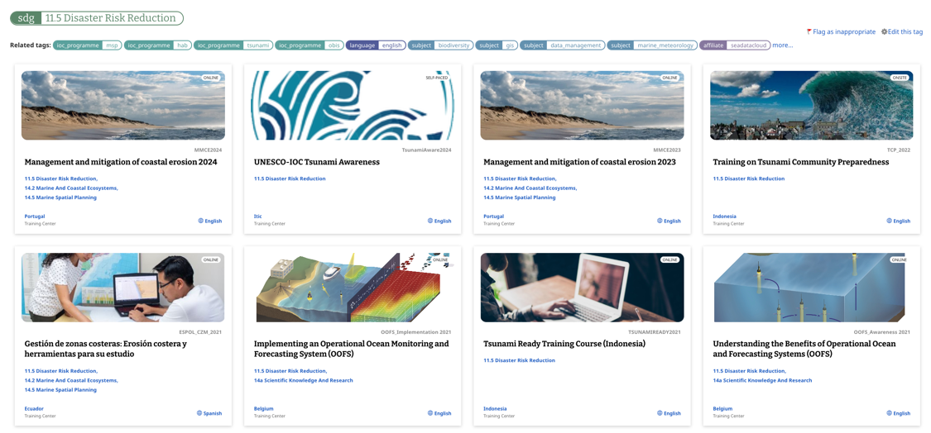
OTGA UNESCO-IOC Tsunami Online Courses
Q1 - 2021
Live 2024
Live 2025
https://classroom.oceanteacher.org/

Slide 10
Overview of Training Programme - OTGA
Prerequisites
Core Science
Hybrid TWC SOP Training
Core Operations
Decision Support Tools
Communicating Threats & Impacts
In Person training
Tsunami Awareness
Tsunami Ready
Tsunami science knowledge
Earthquake science knowledge
Source material:
BOM
COMET module to be updated and modified
PTWC
Understand and use TSP messages and products
Perform NTWC core activities
Source material:
SOP PPTs
IOC M&Gs
PTWC products training videos
SOP Exercise Documents
TEMPP training material
CISN
Tidetool
IOC SLMF
Websites
TTT
TsuCAT
Others
Putting core operational knowledge into practice
Source material:
COMET Module on NTWC Operations to be developed
Using TWC material from SOP training courses
Focus on use of PTWC (TSP) products
Design and conduct exercises
Cohort of 4-6
Must have completed all pre-requisite courses and hybrid training
Lectures and hands-onTWC operations practicums
Observing PTWC duty staff activities
Simulated Event Exercises

Slide 11
Progress to date
OTGA platform – project team lead
Core science competencies training material available from BOM, GA, COMET and OTGA Tsunami Awareness course – Review completed and gaps identified
New module: Basic Tsunami Science knowledge - Development ongoing
New module: Basic Earthquake Source knowledge - Draft completed
COMET platform – project team working with COMET team
Existing module update, COMET: “Tsunamis” - include events since 2017 and ensure materials applicable for US domestic and international - Work ongoing, complete Q2 2025.
New module, COMET: NTWC Decision-making: “Communicating Threats and Impacts during Tsunami Events” – based around COMET’s existing US NTWC, but focus on PTWC Products, with NWPTAC where appropriate (SW Pacific scenario)
Due to US govt / USAID situation, active work paused by most of project team – future not known

Slide 12
OTGA Core Tsunami Science Competencies
Based on BOM training course supplemented by material from GA, OTGA Tsunami Awareness, COMET and other sources as needed.
Focus on job requirements of TWC staff, i.e, on science needed to support operational decision-making.
BOM course is general entry-level covering tsunami science for duty forecasters at the Bureau National Operations Centre (BNOC). It is focused on the Australian AOR
BOM course covers:
Generation – 4 lessons
Propagation – 6 lessons
Impact – 4 lessons

Slide 13
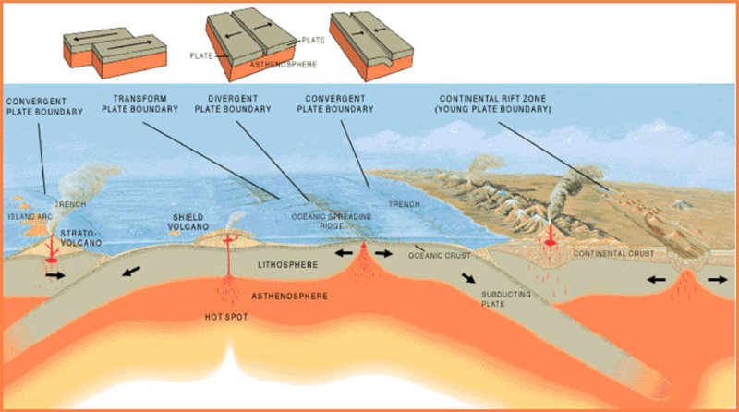
OTGA Core Earthquake Science Knowledge
Draft completed December 2024
Material gathered from COMET, BOM, GA, USGS, IRIS, and OTGA training modules
Covers:
Plate tectonics
Fault types
EQ parameters
EQ magnitude types
EQ intensity
Beachball diagrams
Tsunamigenic EQs
Currently available in MS Word format
Requires editing and review and conversion to HTML5 format, possibly as PPTs

Slide 14
COMET “Tsunamis” course
6 Modules:
Introduction
Generation
Initiation
Propagation
Inundation
Long-term effects
Last updated December 2017
Very good overview of tsunami science but requires general update and inclusion of events such as Palu 2018 tsunami and Hunga Tonga 2022 eruption and tsunami
https://www.meted.ucar.edu/education_training/lessons/831

Slide 15
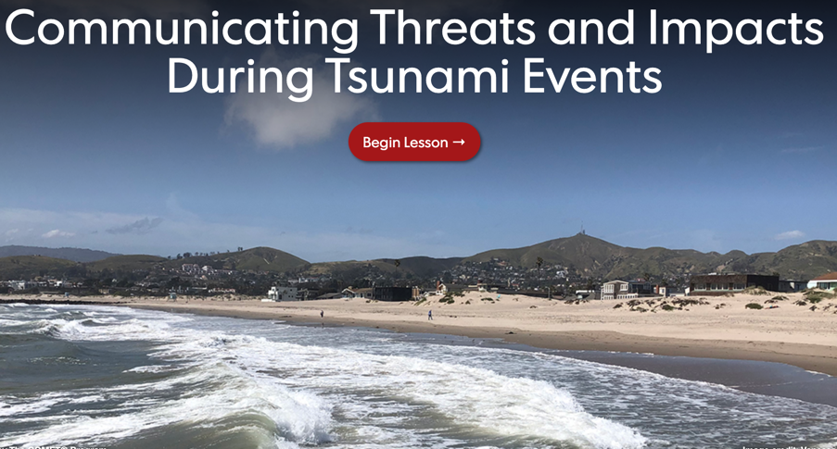
COMET NTWC Operations course
Based on module for US TWC: “Communicating Threats and Impacts During Tsunami Events”
Introduction
TWC product alerts
Local information from WFOs
Tsunami event exercise
Summary of promising practices
Launched in July 2022
Current course is US-centric and requires extensive modification to be suitable for a IOC Pacific regional / international audience (TSP products)
Will focus on NTWC SOPs using PTWC messages and products (NWPTAC if needed)
Tsunami event exercise interactive and will be modified for role play as local, regional and distant tsunami TWC operational staff
https://www.meted.ucar.edu/tsunami/tsunami_dss/index.htm

Slide 16
2025
Work on updating COMET “Tsunamis” module continues - aim to complete by early Q2 2025
Work on OTGA Core Tsunami Science module ongoing - aim to complete by end of Q2 2025
Work on COMET NTWC Operations “Communicating Threats and Impacts during Tsunami Events” module - currently paused.
Hybrid and in-person training planned for late 2025 / early 2026 – dates depending on progress on pre-requisite modules. To be revisited at end of Q2 2025.

Slide 17
PTWS-NTWC
Competency Framework - Minimum Levels for Operations Staff
2024-26 ITIC Training Pilot
THANK YOU!
Laura Kong, ITIC Director

Slide 18
History
PTWS-XXVII (2017, Tahiti) – Identified need
WG-SWP-IV (2016, Honiara). Develop competency guidelines for tsunami operational personnel
Tonga - needs assistance to review its national tsunami warning procedures,… and establish minimum warning competency levels.
Est. TT, PTWS-XXVIII (2019).
Build from draft Framework developed by small group after 2018 PTWS WG mtg in Hawaii.
CONTENT - competency framework proposed is multi-tier system with different levels of knowledge and skills required depending on the roles.
Cont. TT, PTWS-XXIX (2021, virtual).
Draft PTWS NTWC Minimum Competency Framework shared with Global TOWS WG Inter-ICG TT on Tsunami Watch Operations and Disaster Management and Preparedness (2022, 2023)
PTWS-XXX (2023) and PTWS-SC (March 2024) – MS approve Framework
WG 2 recommended approval – ICG/PTWS-XXX Consensus agreement
ITIC proposed to develop training and pilot, report back to PTWS-XXXI – ITIC funded 2024-25
PTWS PICT WG TT on Capacity Development – ITIC to work with and report back to ICG

