Slide 1
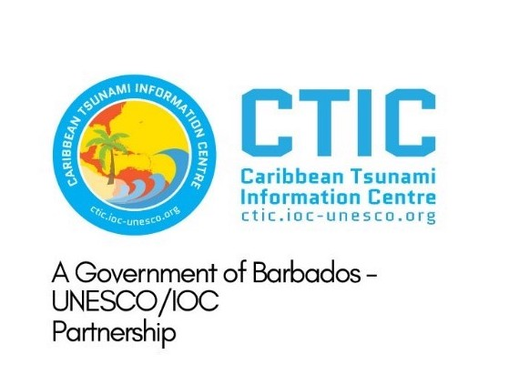
5.1 Updates and Plans in CARIBE-EWS
Dr. Charles McCreery
Director, Pacific Tsunami Warning Center
Dr. Elizabeth Vanacore
Seismologist, Puerto Rico Seismic Network
Joint TOWS TT DMP & TT TOWS Meeting 20 February 2025

Slide 2
PTWC Updates
The US Tsunami Program has embarked on a multi-year effort to better synchronize its two tsunami warning centers (PTWC and US NTWC) to facilitate more seamless backup, more efficient and effective operations, and more efficient enterprise support. The effort also includes ITIC for more coordinated training and decision-support to customers.
This effort includes:
Design, construction and implementation of an enterprise supported Common Analysis System with new features including probabilistic tsunami forecasting.
Design, construction, and implementation of a common product generation and dissemination software
Design, construction and implementation of a new “tsunami.gov” website for posting products and lots of other information regarding US Tsunami Program services
Reorganization of the US Tsunami Program under a common management structure.

Slide 3
PTWC Updates
PTWC has also briefed the ICG/CARIBE-EWS on a variety of changes to its products – mostly a restructuring o make them easier to quickly understand
These changes have been included in a new User’s Guide to PTWC Procedures and Products for the CARIBE-EWS
If accepted at the next ICG/CARIBE-EWS Meeting in May, the changes will be implemented at a designated date.

Slide 4
Seismic Station Status

Slide 5
Impact of “Out” seismic stations

Slide 6
Smart Cables
Conduct a study to demonstrate improvement in tsunami early warning times with two to four variations on SMART Cable designs -Code written to determine improvements in detection time for seismic sources - To Do: EV create a GitHub to share code - Run more test scenarios for optimization

Slide 7
Smart Cables
If All Cables Were Smart
All Seismic: Best Case Current

Slide 8
Sea Level Status: Concerning

Slide 9
Sea Level Training Course
Organize a training course to be taught in English on the general principles of installation and maintenance of sea level stations and the use of tide gauge data
To be hosted in Puerto Rico in July 7-11.
PRSN and CariCOOS assisting with logistics
Circular letter drafted
Some funding available but self funded attendees encouraged

