Slide 1
TOWS-WG 18th Session
Task Team on Tsunami Watch Operation
21 – 22 February 2025
Agenda 9. Optimal Seismic and Sea Level Monitoring Networks
NISHIMAE Yuji
TTTWO Chair

Slide 2
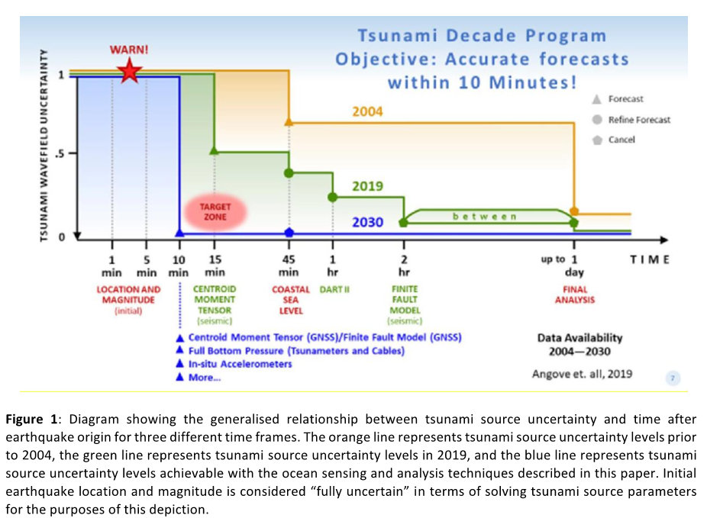
Objectives of the Ocean Decade Tsunami Programme (ODTP) (1)
The first objective of the ODTP is to develop the warning systems’ capability to issue actionable and timely tsunami warnings for tsunamis from all identified sources to 100 percent of coasts at risk. Most urgently, the ODTP will endeavor to provide tsunami confirmation within 10 minutes or less of origin for the most at-risk coastlines.
Research, Development and Implementation Plan for the Ocean Decade Tsunami Programme, IOC Technical Series 180
Notes:
The IOC has developed the UN Ocean Decade Tsunami Program in 2021. There are two objectives described in the UNODTP.
The first objective is to develop the warning systems’ capability to issue actionable and timely tsunami warnings for tsunamis from all identified sources to 100 percent of coasts at risk. Most urgently, the ODTP will endeavor to provide tsunami confirmation within 10 minutes or less of origin.

Slide 3
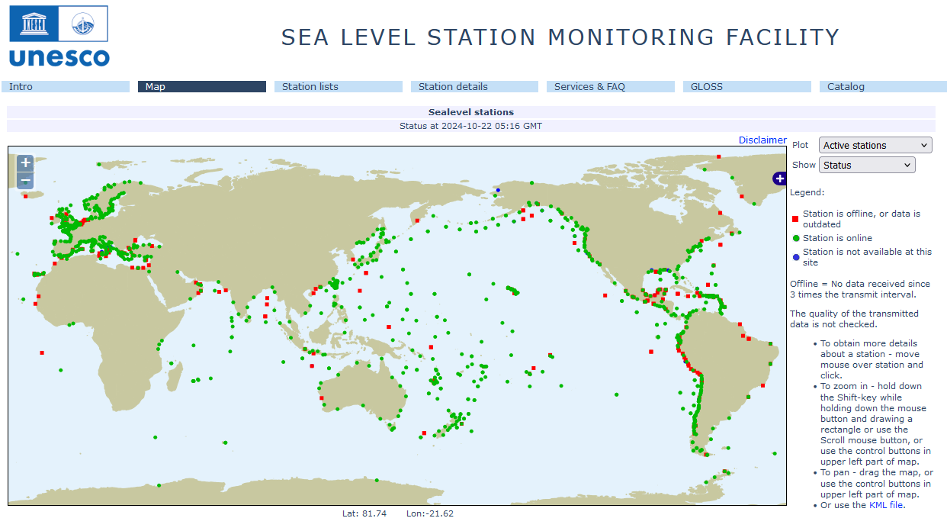
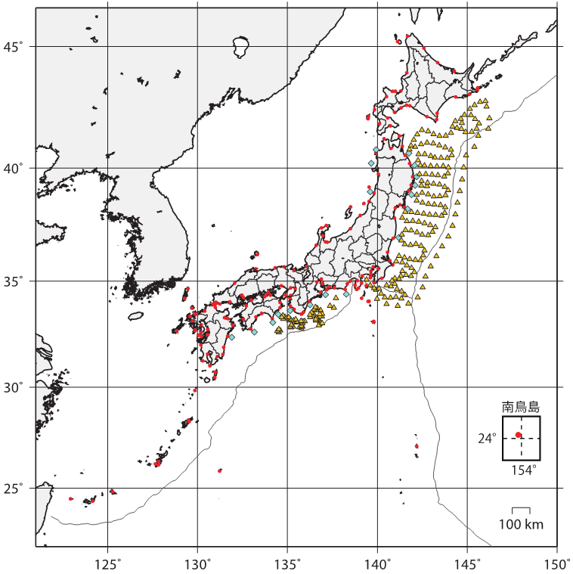
Sea Level Monitoring
Tide Gauge
・JMA
・Japan Coast Guard
・Port & Harbor Bureau
・Geospatial Information Authority of Japan
・Cabinet Office
・Municipality, Private sector
Offshore Tsunami meter
GPS type(PHB)
Pressure sensor
・JMA
・ERI
・NIED
Tide Gauge
・JMA
・Japan Coast Guard
・Port & Harbor Bureau
・Geospatial Information Authority of Japan
・Cabinet Office
・Municipality, Private sector
Offshore Tsunami meter
GPS type(PHB)
Pressure sensor
・JMA
・ERI
・NIED
S-net
DONET
from UNESCO Sea Level Monitoring Station Facility Map
Sea Level Monitoring Facilities monitored by the JMA
Notes:
At first, I will be talking about the observation system.
The observation network of an earthquake and a tsunami is essential for the early tsunami warning system.
The data of the coastal tide gauges are being shared through the IOC web site.
The coastal tide gauges are operated by the various authorities for their own purposes. In the case of Japan, the coastal tide gauge data are shared each other and the gaps of observation are covered.
The data sampling interval and transmission interval are appropriate for respective organizations and they may not be appropriate for tsunami monitoring.
That tsunami is observed at the coast means that tsunami already reaches the coast. In order to detect the tsunami before arriving at the coast, offshore observation is essential.

Slide 4
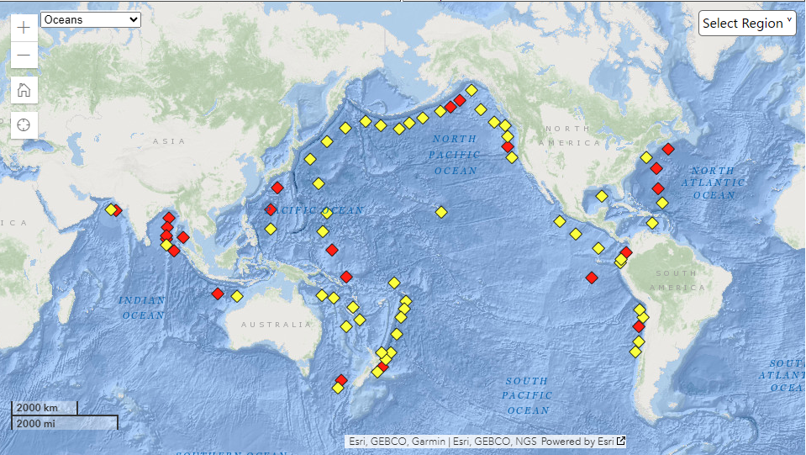
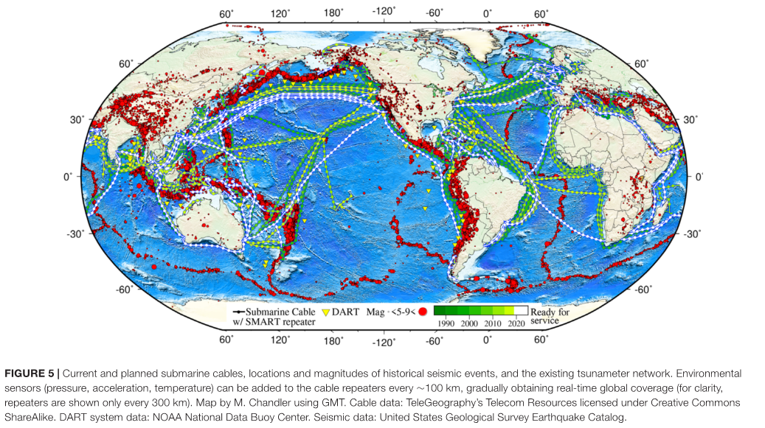
Use of offshore tsunami meters for early tsunami detection
DART® (Deep-ocean Assessment and Reporting of Tsunamis)
NOAA National Data Buoy Center (https://www.ndbc.noaa.gov/)
Offshore cabled networks in Japan (S-net and DONET)
S-net
SMART Cables (Angove et. Al (2019))
DONET
N-net
Notes:
Particularly, in the case of non-seismic tsunamis, it could be crucial to detect a tsunami as close to its source as possible. For this purpose, the offshore tsunami meters are very effective for early detection of tsunami generated by non-seismic events. As of now, some offshore tsunami meter networks have been operated and cabled ocean bottom pressure sensors such as the SMART cables have been deployed and planned. Efforts are in place to develop Standard Operating Procedures (SOP) for tsunamis generated by volcanoes. Relation between the Tsunami Warning Centers and the volcanic authorities such as the Volcano Ash Advisory Canters and the volcano observatories should be deepened and enhanced for an appropriate tsunami warning by volcanoes.

Slide 5
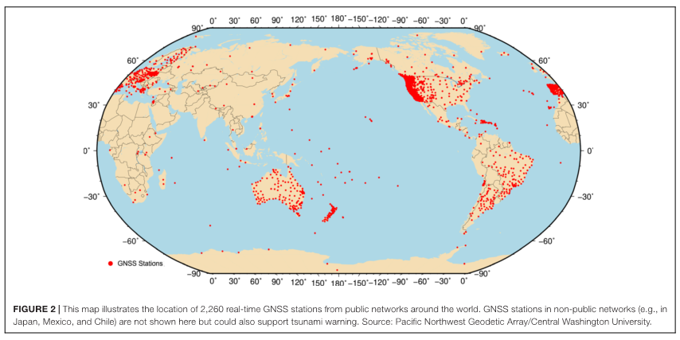
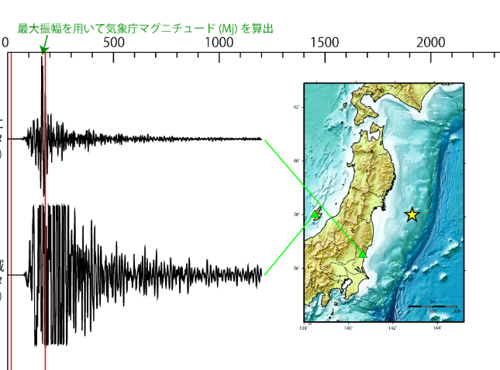
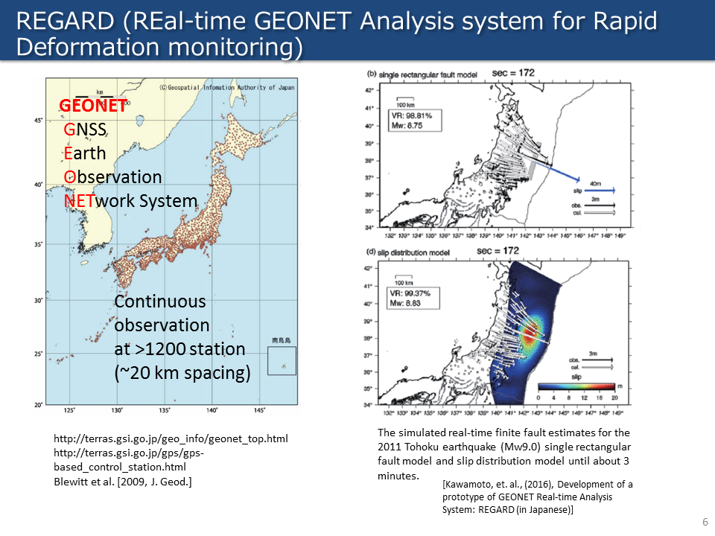
Use of the GNSS for the tsunami warning system
Strong motion data
Example in Japan: REGARD (Real-time GEONET Analysis system for Rapid Deformation monitoring) developed by the Geospatial Information Authority of Japan (GSI).
Broadband data
Data length necessary for Mw calculation
Mw was not calculated due to over-scaled data of broadband seismometers in Japan in 2011 Tohoku Great Earthquake.
Notes:
Regarding local earthquakes, tsunami warning center should issue a tsunami warning as quick as possible. But the determination of the size of megathrust earthquakes, such as 2004 and 2011 earthquakes, is not an easy task. Recently, usefulness of the GNSS has been highlighted to assist quick determination of the size of an earthquake with tsunamigenic potential.

