Slide 1
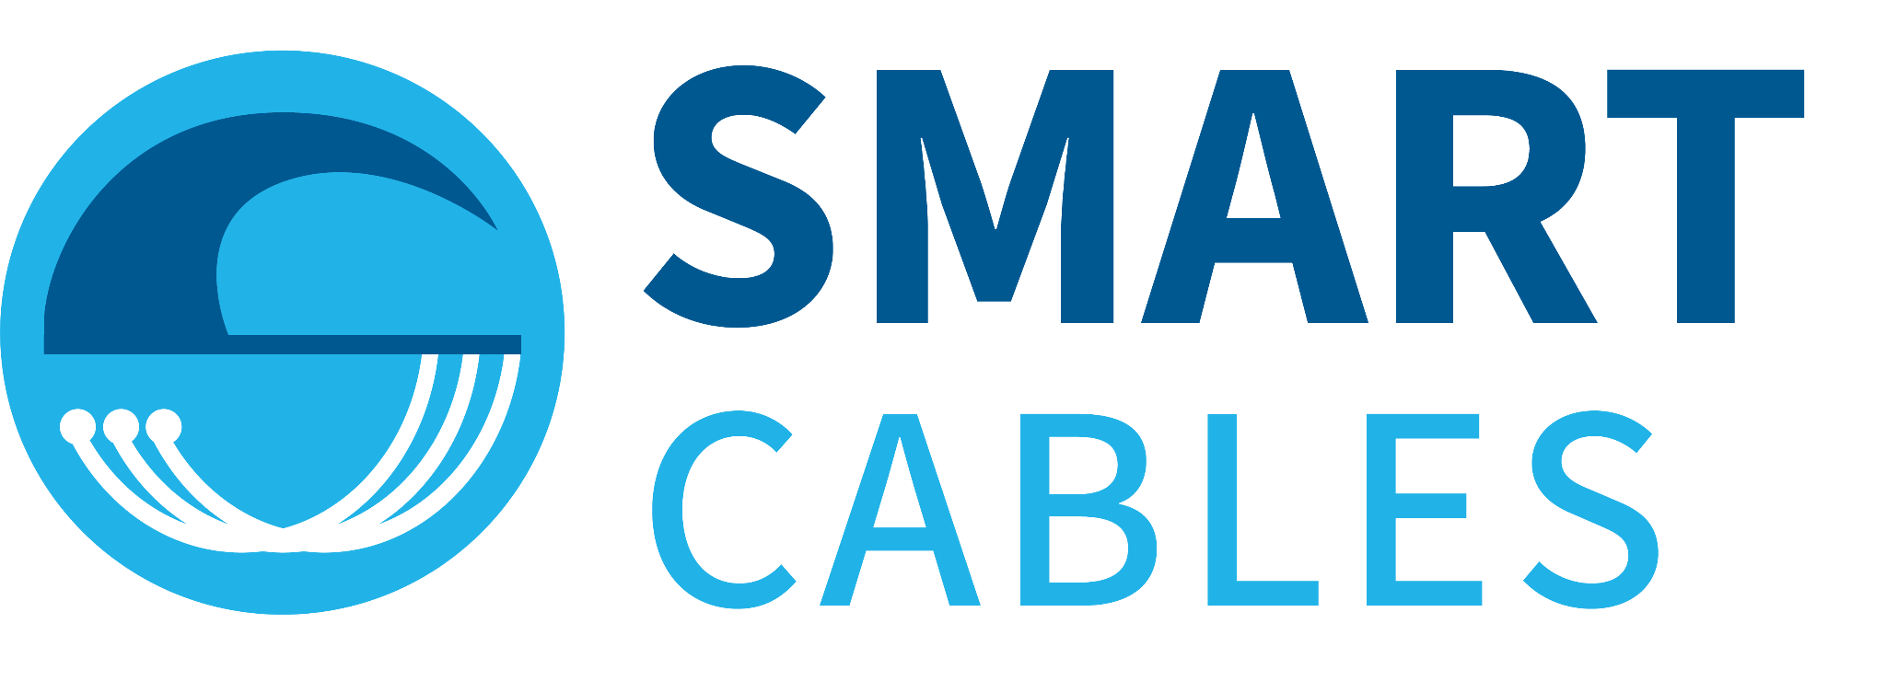
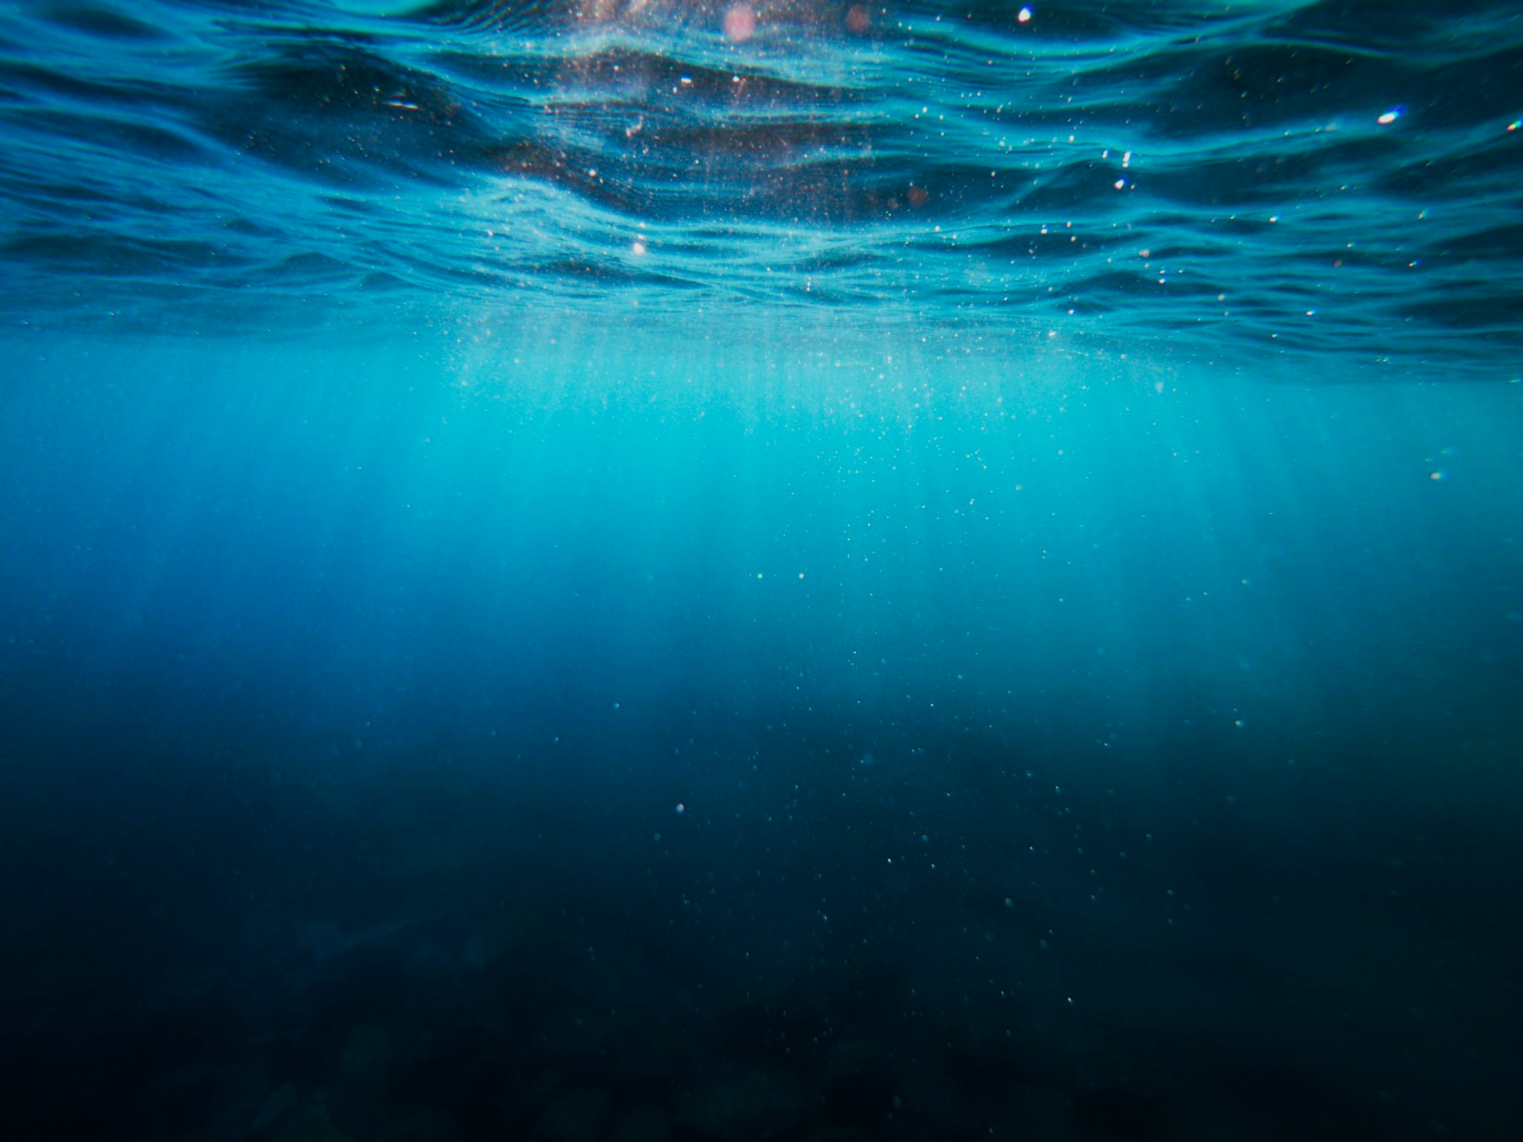
SMART Cables - update
Observing the Ocean and Earth with
Juanjo Dañobeitia,
IOC-UNESCO Liaison JTF SMART Cables
Bruce M. Howe, Ceci Rodríguez and Jose Barros
JTF SMART Cables Initiative International Programme Office
University Hawai'i at Mānoa
18th Tsunamis and Other Hazards related to Sea Level Warning and Mitigation Systems (TOWS-WG)
24-25 February 2025,
UNESCO Headquarters, Paris, France

Slide 2
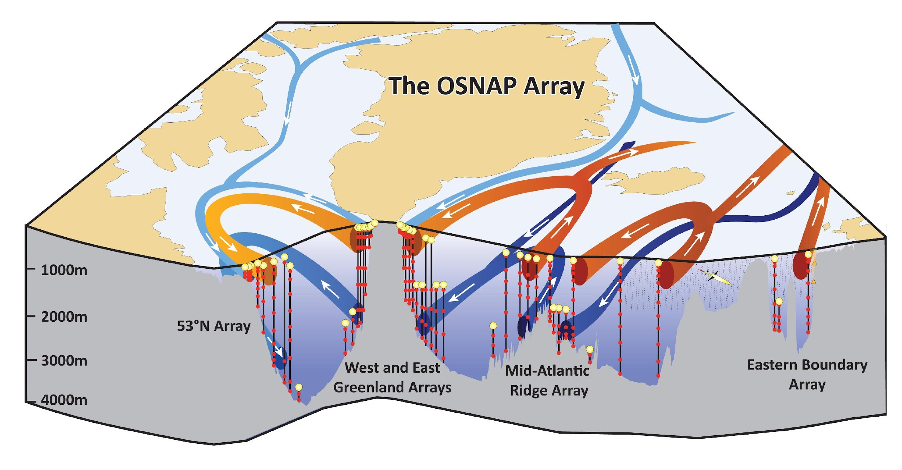
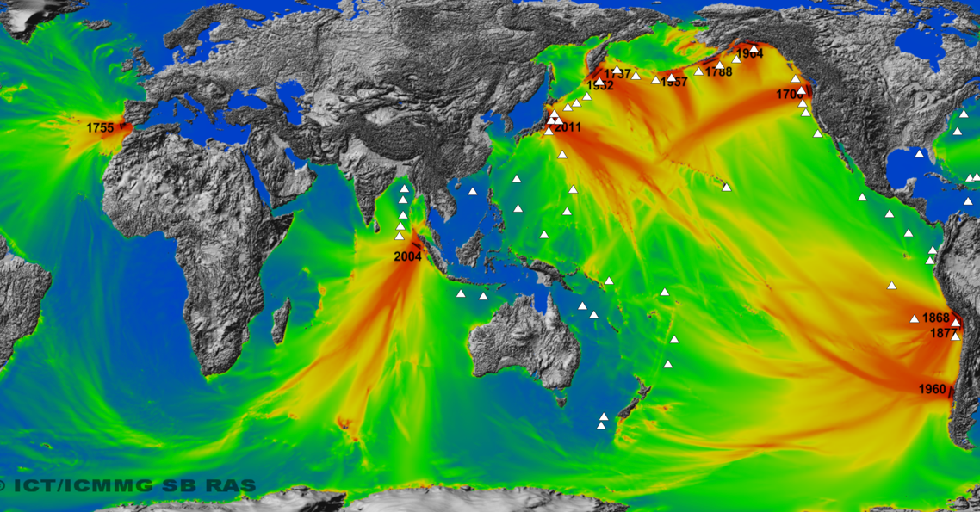
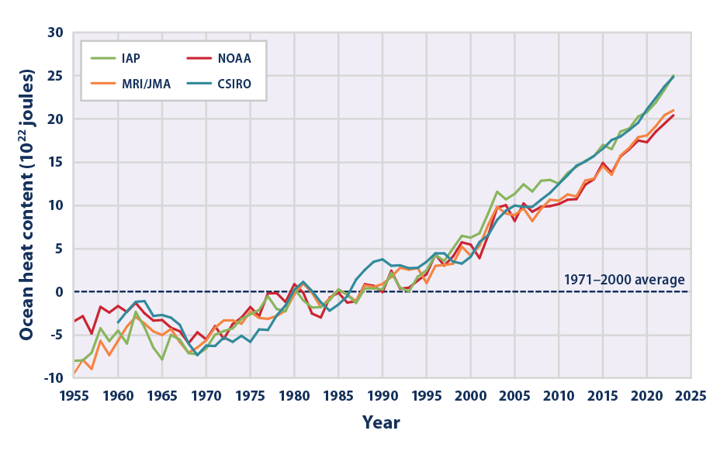
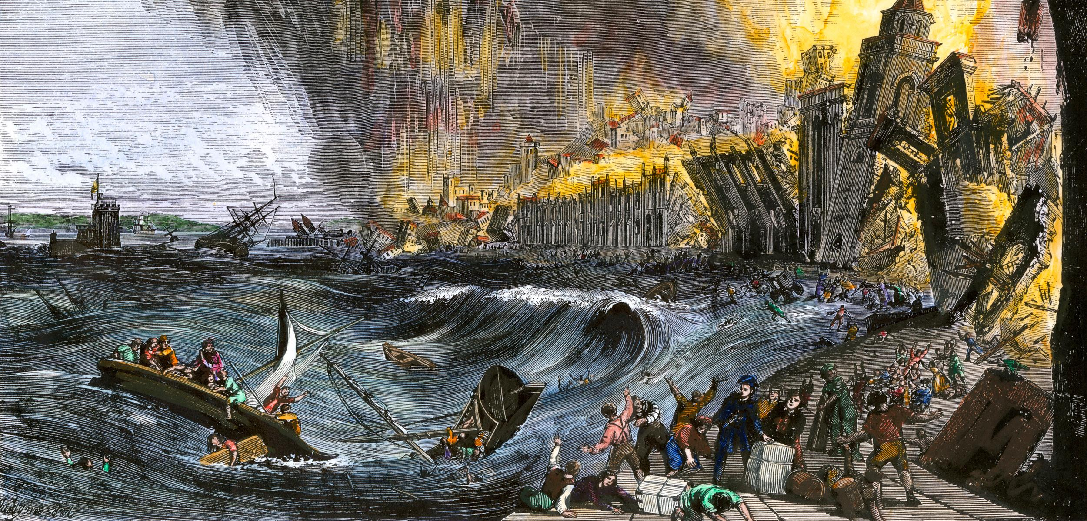
ITU/WMO/UNESCO-IOC JTF SMART Cables
United Nations initiative to bring together science with the telecom industry for Global Ocean and Earth Observation
Ocean general circulation – all scales
Earthquakes and Tsunamis
Climate
Change
Early Warning
Ocean heat and circulation
Disasters Tsunamis Mitigation
Sea Level
Rise
Notes:
These are the main drivers of this initiative, The SMART data will allow a better understanding of the ocean and the earth.
Water flows from high pressure to low pressure allowing us to see changes in heat content and ocean circulation and sea level rise – key for understanding short and long term climate.
Also allows to see the ocean circulation in a global scale for climate change
It will provide real time data to the operational earthquakes and tsunami warning centers
SMART data will provide a better understanding in the seismic component since there are no seismic motion sensors in the deep ocean, only on land.
Providing early information so their SOP can start earlier than now.
It will also allow to observe the propagation of the tsunami in the ocean to give us a better understanding of the potential threat.

Slide 3
SMART Cables Governance
Objective: To explore the feasibility of widespread deployment of scientific instrumentation on ocean telecom fiber-optic cables to enhance capabilities for climate monitoring, tsunami detection, and disaster mitigation. streams as go live
Strategic Objectives and Outcomes
Enhanced Climate Monitoring: Use SMART cables to observe ocean heat content, deep ocean circulation, and sea level rise in remote or data-starved areas to improve understanding and mitigate the impacts of climate change.
Improved Disaster Mitigation: Leverage SMART cables to shorten early warning times for tsunamis and earthquakes in real time, reducing risks to coastal communities.
Global Coordination and Standards: Establish SMART cables as a global standard for ocean observation through collaboration with GOOS and ITU standards.
Capacity Building: Support sustainable development and foster global participation through training, partnerships, and equitable resource distribution.
By integrating strong governance, targeted research and development, and global collaboration, this initiative aims to establish a SMART-enabled submarine cables network to address critical ocean sustainability and resilience challenges. This initiative is supported by coordination with three UN sponsoring agencies: ITU, WMO and UNESCO-IOC.
Notes:
These are the main drivers of this initiative, The SMART data will allow a better understanding of the ocean and the earth.
Water flows from high pressure to low pressure allowing us to see changes in heat content and ocean circulation and sea level rise – key for understanding short and long term climate.
Also allows to see the ocean circulation in a global scale for climate change
It will provide real time data to the operational earthquakes and tsunami warning centers
SMART data will provide a better understanding in the seismic component since there are no seismic motion sensors in the deep ocean, only on land.
Providing early information so their SOP can start earlier than now.
It will also allow to observe the propagation of the tsunami in the ocean to give us a better understanding of the potential threat.

Slide 4
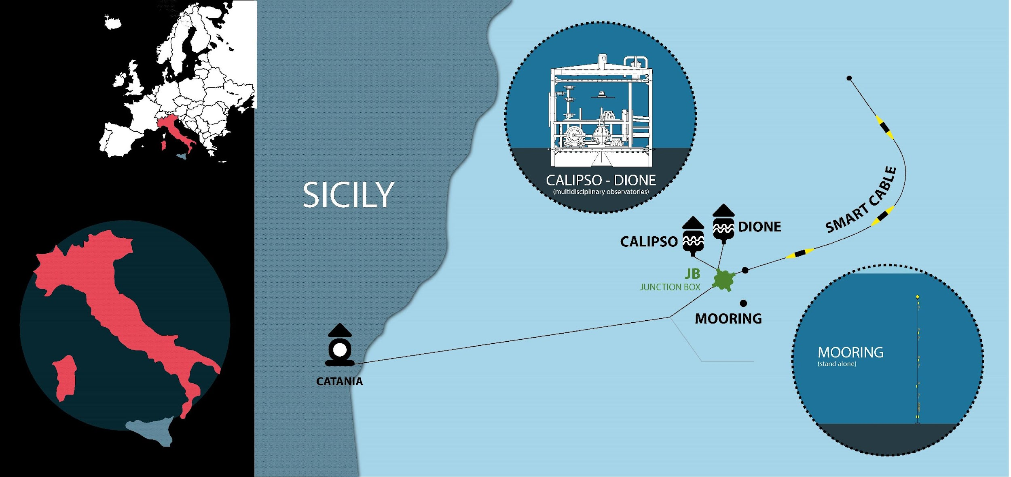
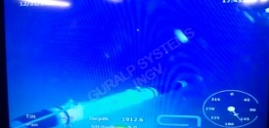
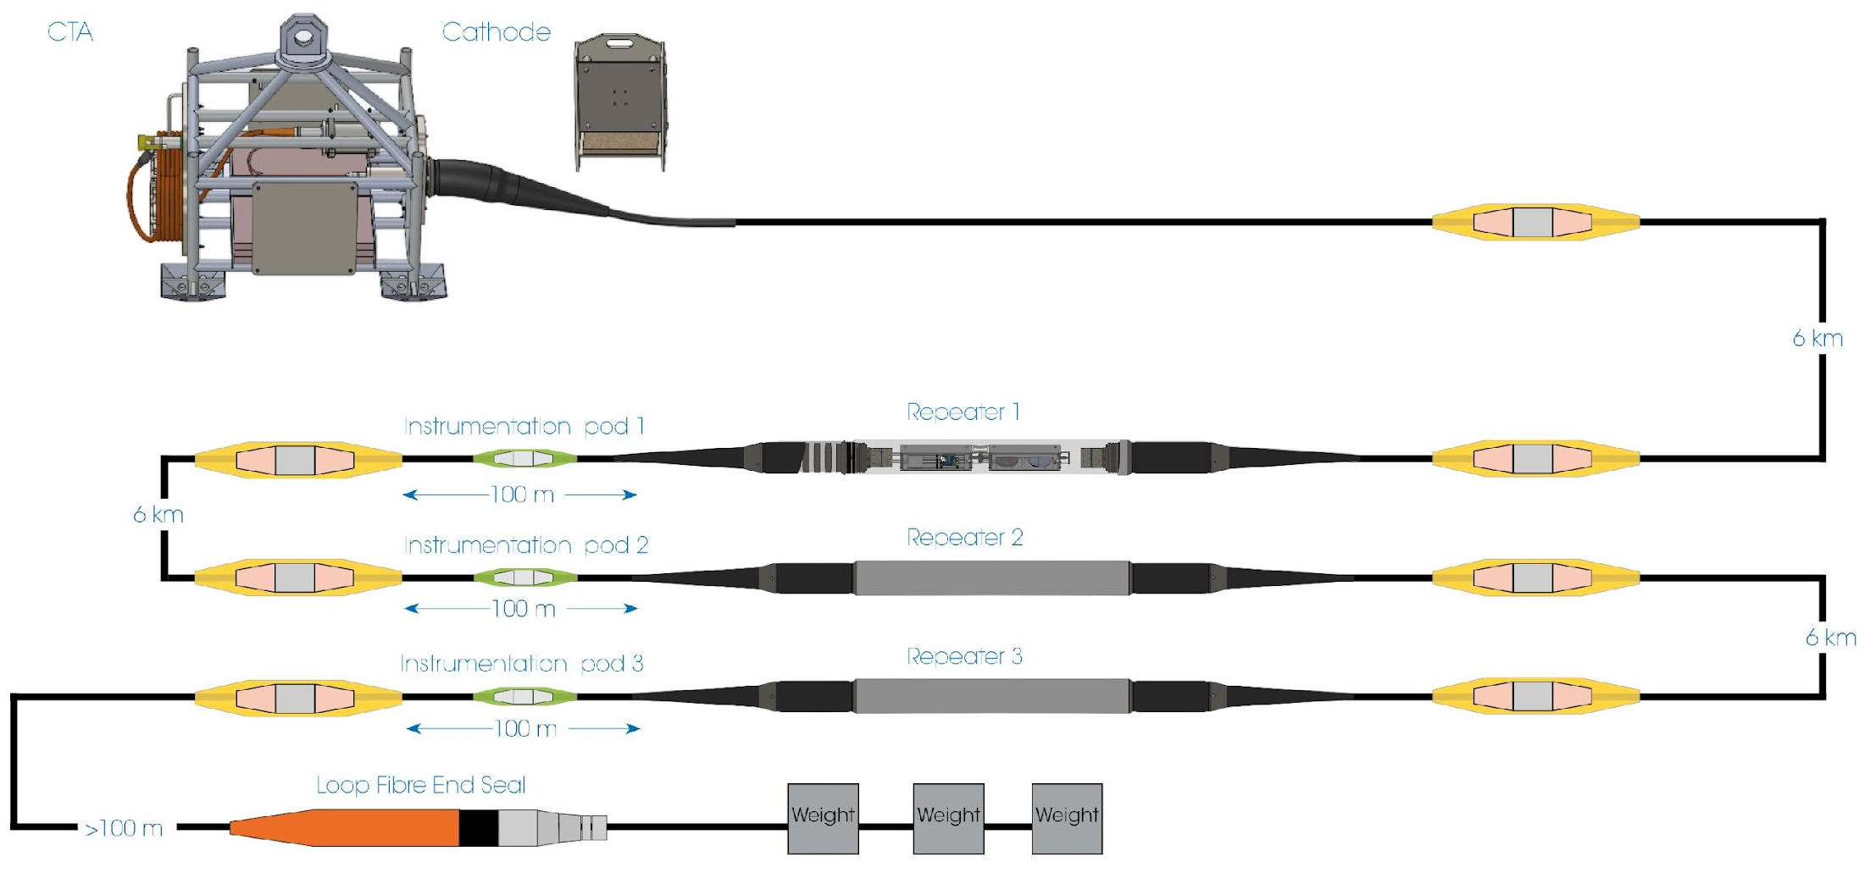
SMART Technical Solution
Shared Cable Infrastructure: Telecom + Science
Sensors:
Temperature
Pressure
Seismic
Key point:
Essential Ocean Variables
SMART Cable location off Catania, Italy
InSea Wet Demo seabed sensor module at Western Ionian Facility (INGV-EMSO)
Sketch of the deployed technological system
Leverage Existing Technology
Guralp and Global Marine
Notes:
These are the main drivers of this initiative, The SMART data will allow a better understanding of the ocean and the earth.
Water flows from high pressure to low pressure allowing us to see changes in heat content and ocean circulation and sea level rise – key for understanding short and long term climate.
Also allows to see the ocean circulation in a global scale for climate change
It will provide real time data to the operational earthquakes and tsunami warning centers
SMART data will provide a better understanding in the seismic component since there are no seismic motion sensors in the deep ocean, only on land.
Providing early information so their SOP can start earlier than now.
It will also allow to observe the propagation of the tsunami in the ocean to give us a better understanding of the potential threat.

Slide 5
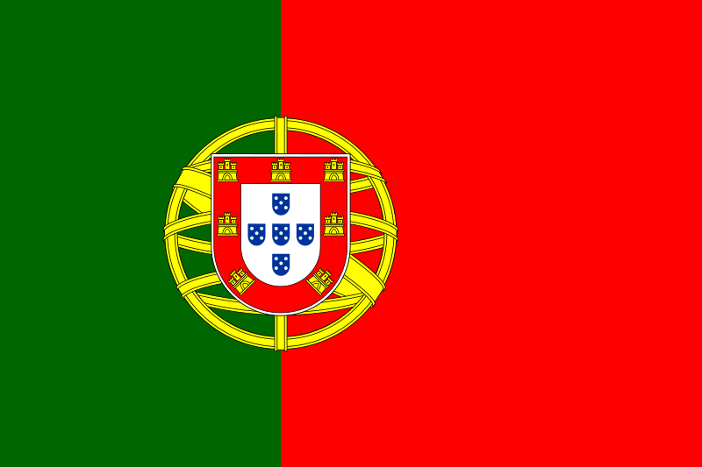
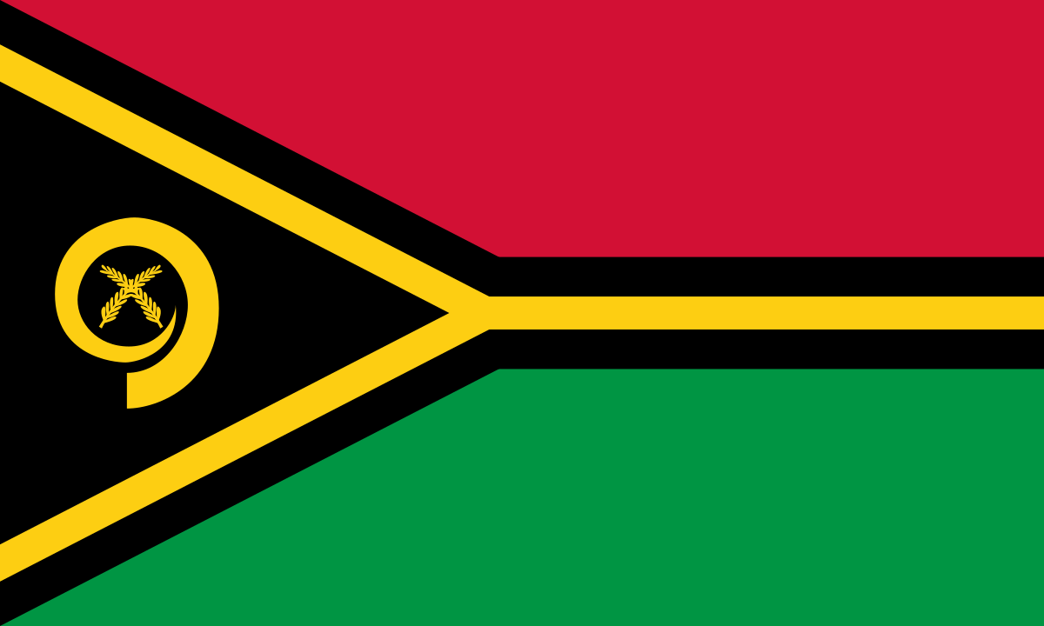
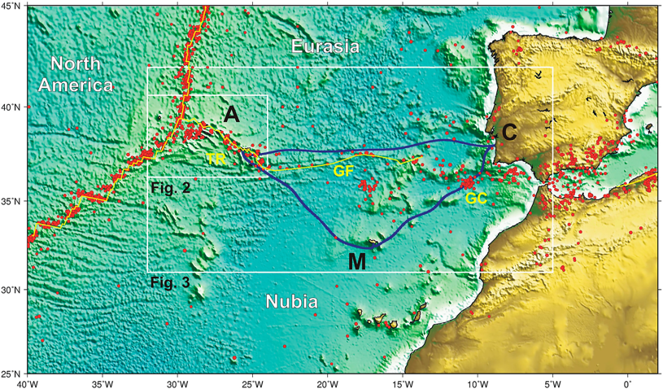
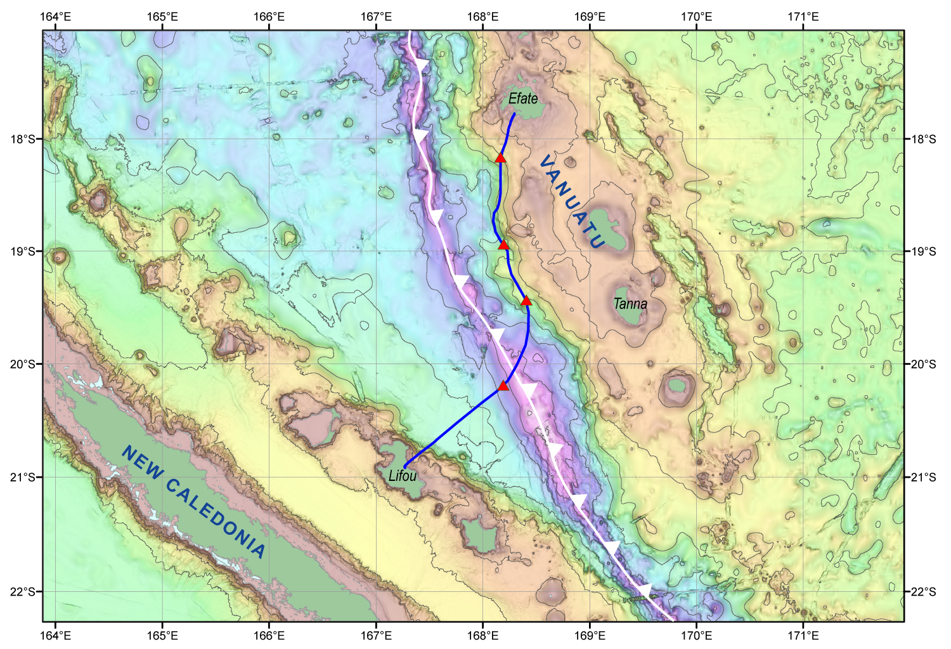
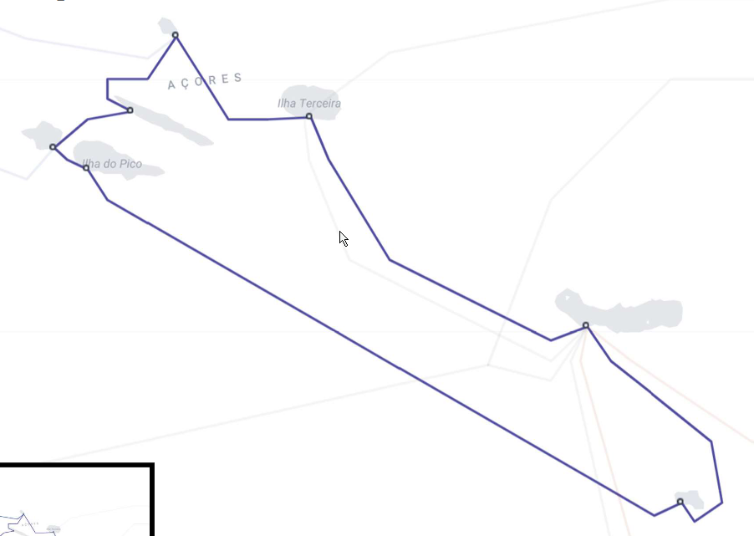
SMART Cable Systems
Portugal SMART Atlantic CAM
TAMTAM SMART Cable System
Lisbon
Azores
Madeira
3700 km, ~20 SMART ASN CC modules +DAS fiber
Gov’t €154M. EU support €56M
SMART 15% ➔ €22M ~ €2/citizen/25 y
~= 2 Tsunami buoys, 25 year (unreliable,
no seismic, not real time)
450 km long, 4 SMART CC nodes, 2 DAS
Data Center, Scientific Research
France funding €18M SMART (telecom: AFD, ADB)
25+ year life, reliable, low lifetime cost
Leverage $5B/y industry, 170 y
Notes:
We do this with the SMART contribution. The Repeaters of the cable systems will have Sensors that will measure ocean bottom temperature, pressure, and seismic acceleration.
Sensors can be mounted in or connected to the repeaters of a telecom cable for power and communications, approximately every 70 km.
Considering a Telecom system lifetime is 25 years with minimal maintenance, adding these sensors can transform the “deaf, dumb, and blind” cables
to environmentally aware systems and thereby improve their integrity and resilience.
Alcatel Submarine Networks, the largest supplier of submarine telecom systems, is very publically committed to supplying SMART capability in the 2025 timeframe as part of its “Climate Change Solution” – a good example of the Blue Economy in action.

Slide 6
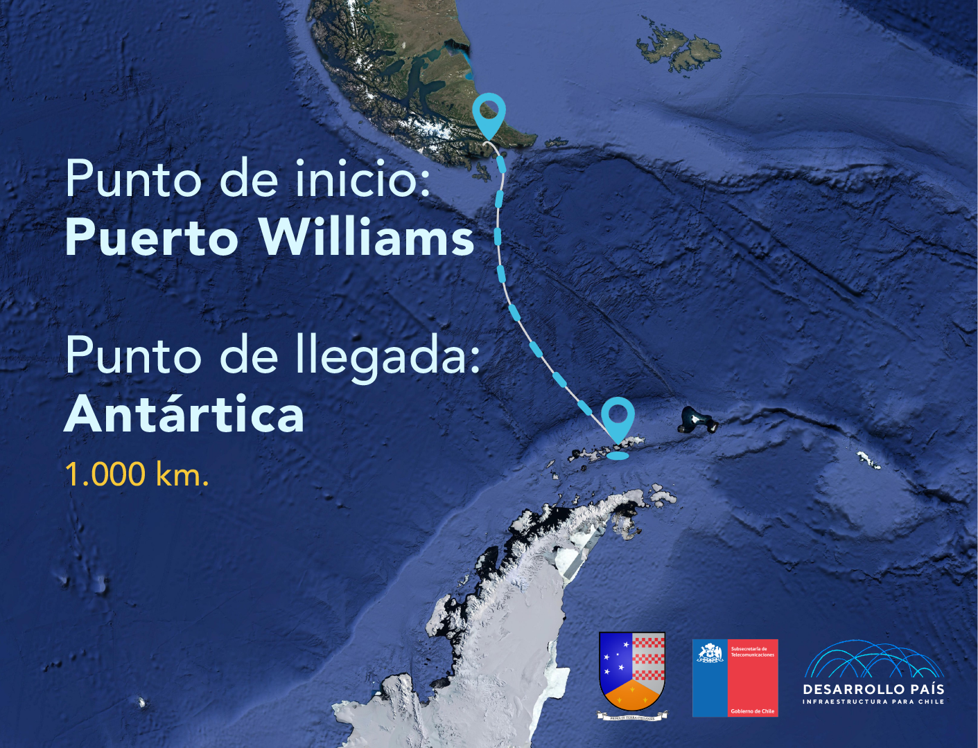
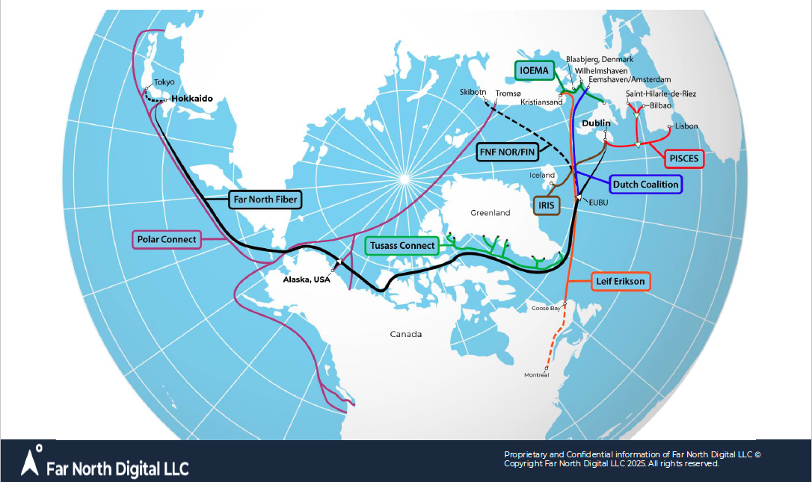
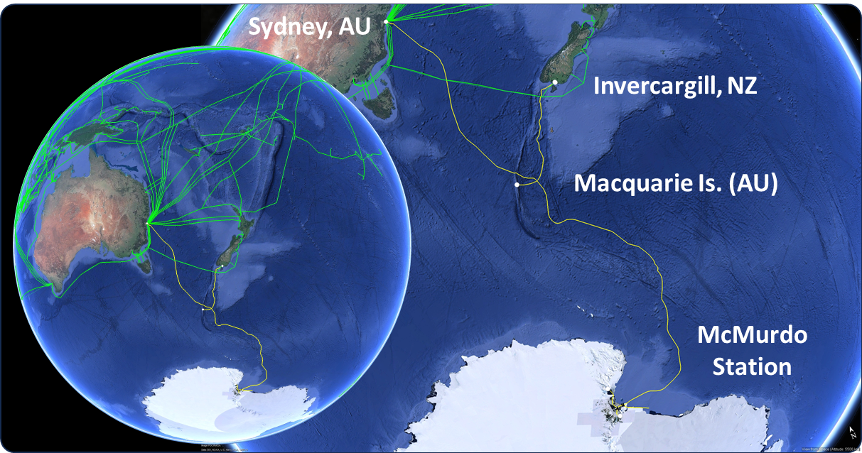
North Atlantic & Polar (Arctic & Antarctica) Systems
Polar Connect Far North Fiber and neighboring Atlantic Projects (Tussas, PISCES, IRIS, IOMEA, etc.
Antarctica Chile
AUS/NZ Antarctica
(NSF MacMurdo)
Notes:
We do this with the SMART contribution. The Repeaters of the cable systems will have Sensors that will measure ocean bottom temperature, pressure, and seismic acceleration.
Sensors can be mounted in or connected to the repeaters of a telecom cable for power and communications, approximately every 70 km.
Considering a Telecom system lifetime is 25 years with minimal maintenance, adding these sensors can transform the “deaf, dumb, and blind” cables
to environmentally aware systems and thereby improve their integrity and resilience.
Alcatel Submarine Networks, the largest supplier of submarine telecom systems, is very publically committed to supplying SMART capability in the 2025 timeframe as part of its “Climate Change Solution” – a good example of the Blue Economy in action.

Slide 7
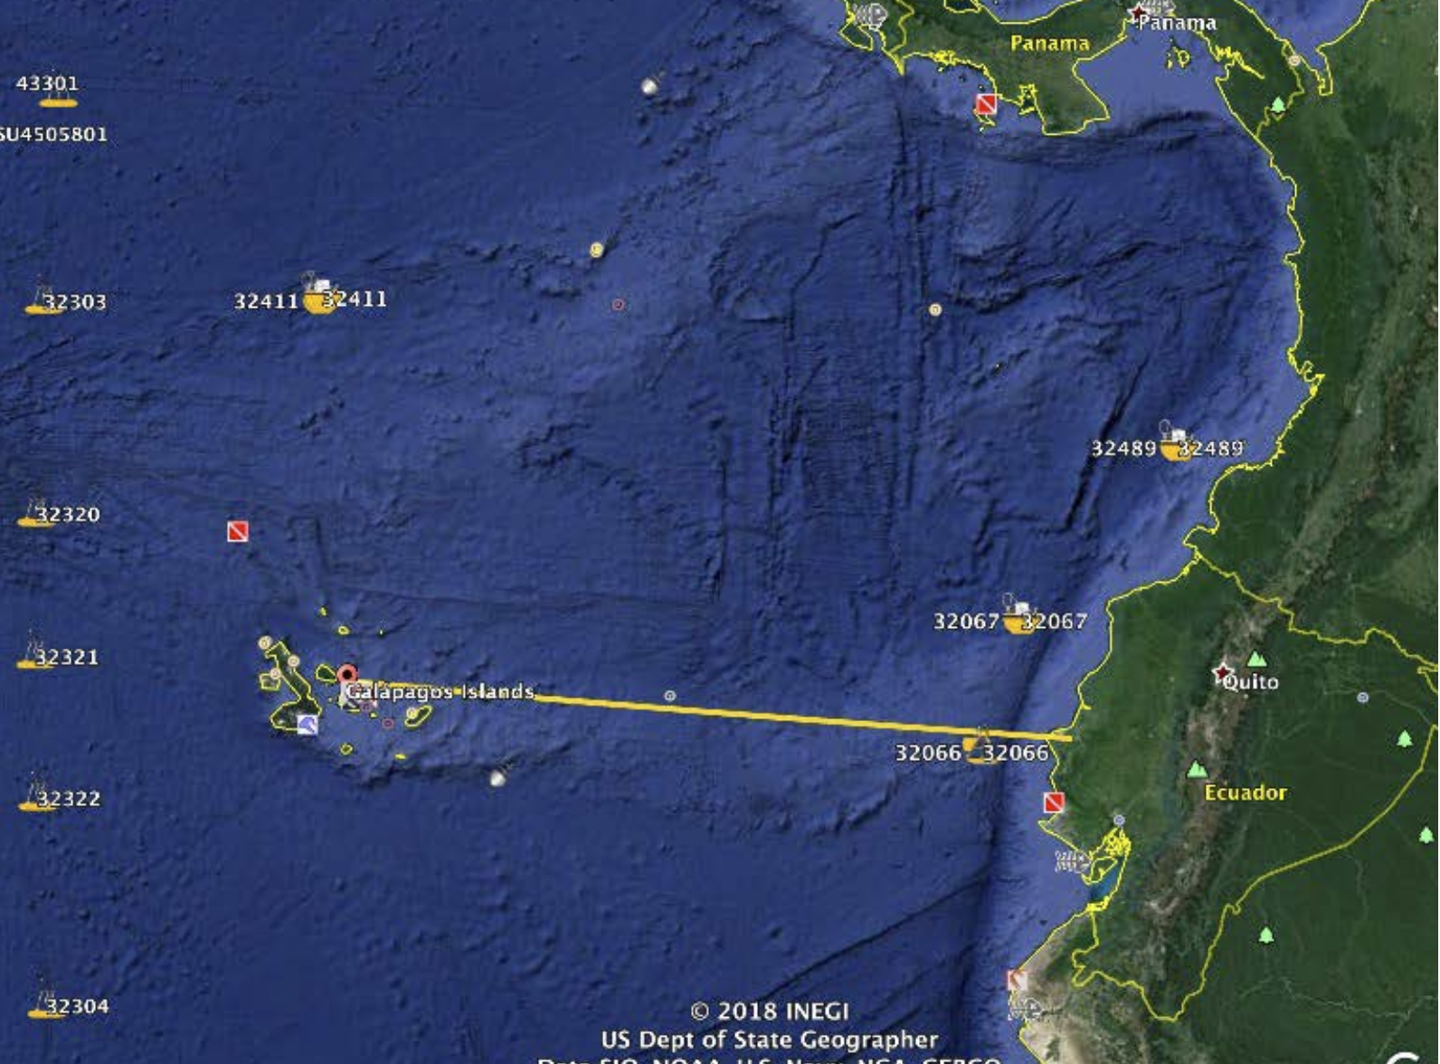
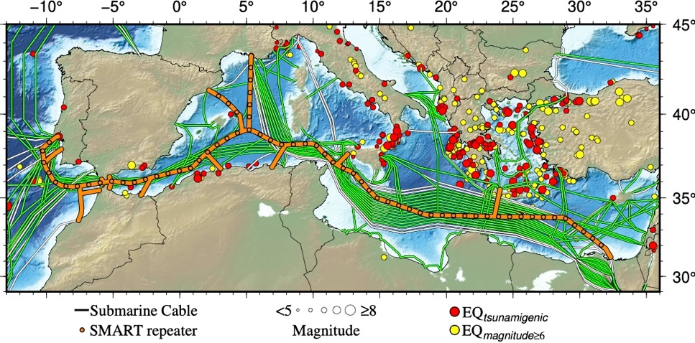
Pacific, Mediterranean, Indian Oceans
Galapagos
NZ - Chathams
Indonesia
50 km, 2 module test system installed off Labuan Bajo
Medusa
MISTS
Barracuda

Slide 8
Scientific benefits
To enhance Ocean Global monitoring by integrating sensors into submarine telecommunications cables
To establish a robust SMART Cable network by strengthening cooperation between research infrastructures, providing its DOOS deep-sea component, and fully integrating into GOOS
To improve Tsunami and Earthquake detection and early warning systems.
Encourage technology innovation and development, enhancing cooperation with telecom, industry, and science
To gain a better knowledge of the complex processes within water column, seafloor and sub-seafloor
To assess the crucial role and evolution that these processes play in the Earth dynamic systems, as global changes, ocean acidification, geological hazards
Global ocean warming and acidification
Impact and sustainability of Marine Resources exploitation
Real-time observations and early warning systems for earthquakes & tsunamis
Marine Ecosystems and Climate Change mitigation
Earth interactions hydrosphere, biosphere,
lithosphere, atmosphere
Global Array: Climate, Oceans, Sea Level, Earthquakes, Tsunamis

Slide 9
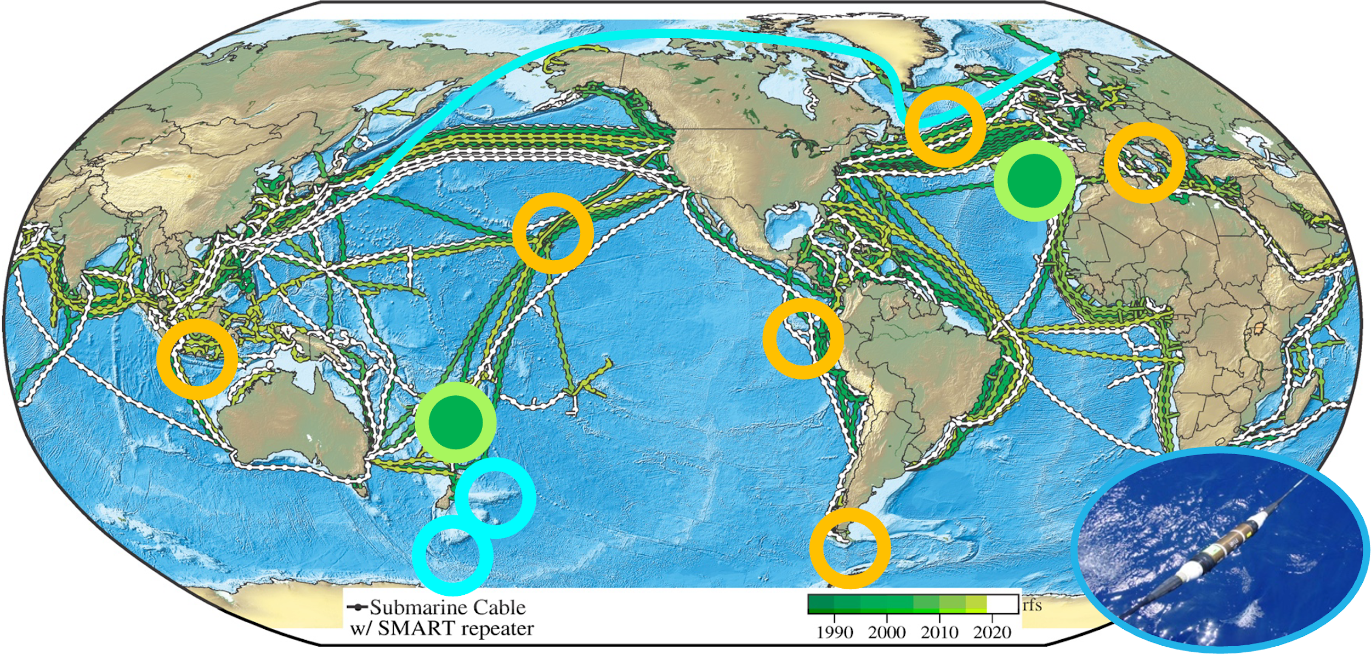
Concluding Remarks
Global Array: Climate, Oceans, Sea Level, Earthquakes, Tsunamis
Create a Planetary sensor, power, Internet network
SMART – coupling with telecom – connectivity, climate, DRR – three for the price of one – saves on all fronts
Anticipated additional 1.3 Gm of cable in water by 2037
Leverage annual investment ~ $ 5 Billion
25+ year life, highly reliable, low lifetime cost
Recent successes – set precedents for future systems
Challenges: $, tech, data, legal, regulatory, security, …
EU Funding: Cables w/ SMART
Working with GOOS, Tsunami, Ocean Decade, DOOS, RENs
SMART Cables was endorsed by ODTP, and TOWS
Think globally, act locally!
Good opportunity for countries to lead!
Saving Lives
Still much to achieve

Slide 10
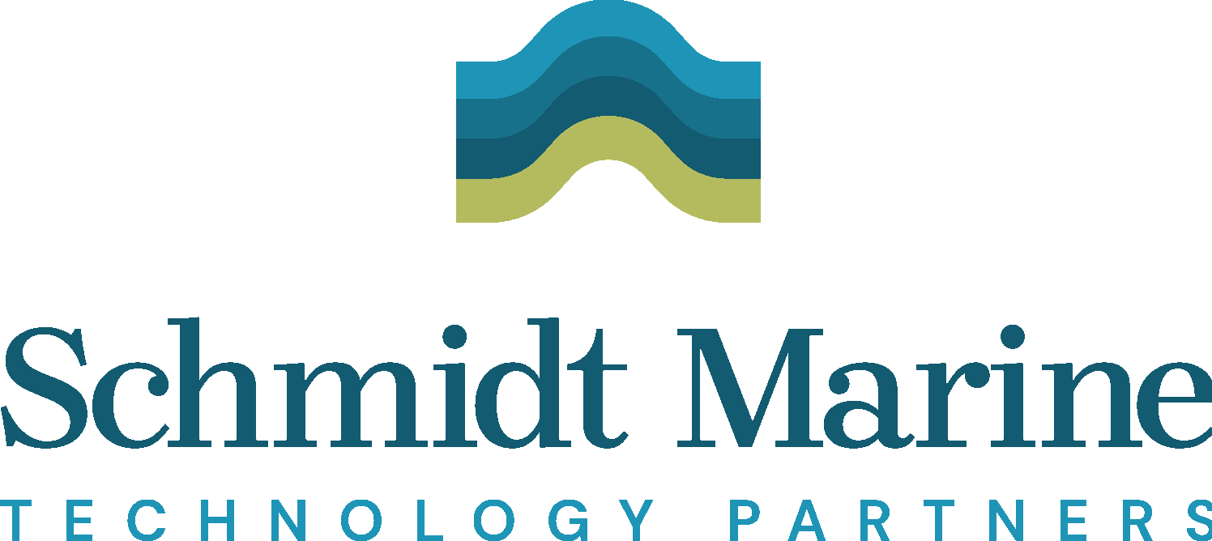
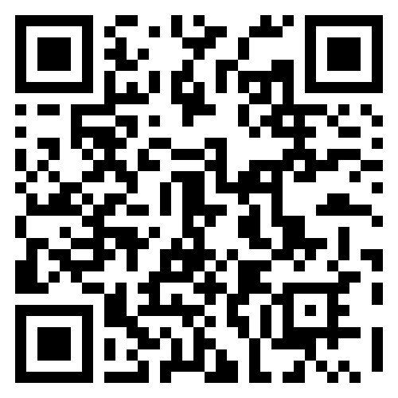
SMARTCables.org
ITU/WMO/UNESCO IOC Joint Task Force
Scan to Join!
18th Tsunamis and Other Hazards related to Sea Level Warning and Mitigation Systems (TOWS-WG)
24-25 February 2025,
UNESCO Headquarters, 75007 Paris, France

