Slide 1
Task Team Disaster Management and Preparedness of TOWS WG
Recommendation and Action
Harkunti P. Rahayu
Chair
IOC of UNESCO Eighteenth Meeting of the Working Group on Tsunamis and Other Hazards related to Sea Level Warning and Mitigation Systems (TOWS-WG-XVIII), Paris 23-24 February 2025

Slide 2
UPDATED TERMS OF REFERENCES FOR INTER ICG TASK TEAM
ON DISASTER MANAGEMENT AND PREPAREDNESS
Facilitate in collaboration with key international stakeholders and organizations (such as UNDRR, IFRC , UNDP, WMO etc ), or initiatives (such as the Tsunami Ready Coalition, Coastal Inundation Forecasting Initiative etc ) the exchange of experiences and information on preparedness and mitigation actions, education/awareness, and other matters related to disaster management and preparedness for tsunamis and other coastal sea level related hazards;
Promote and facilitate the implementation of Tsunami Ready Recognition Programme, and similar initiatives, as well as related capacity development efforts, specifically targeting SIDS and LDCs;
Promote preparedness to build resilient coastal communities through education and awareness products and campaigns;.
Facilitate capacity development and training across ICGs to strengthen emergency response capabilities of Member States and their Disaster Management Offices;
Promote existing and encourage the development of preparedness programmes and assessment tools, and synergies with other initiatives (e.g. resilient cities, safe schools etc) that have been successful in one regional Tsunami Warning and Mitigation Systems as appropriate;
Facilitate the coordination of the TICs of the ICGs and reinforce their ability to serve as a clearinghouse for the development of educational and preparedness products, and capacity development and training;
Report to the TOWS–WG.
The representatives to the Inter-ICG Task Team on Disaster Management and Preparedness shall be nominated by their respective ICG Chairpersons. The membership shall consist of two representatives from each ICG, if formally established one of which should represent the ICG’s Tsunami Information Center. The IOC Chair will appoint the Chair of the Task Team.

Slide 3
TTDMP Members
NAME | COUNTRY | ORGANIZATION | REGION / ROLE IN TTDMP
Harkunti Pertiwi Rahayu | Indonesia | ITB | ICG/IOTWMS / Chair
Denis Chang Seng | France | UNESCO IOC | NEAMTIC, ICG/NEAMTWS / Technical Secretary
Ardito M. Kodijat | Indonesia | UNESCO Jakarta | IOTIC, ICG/IOTWS
Laura Kong | USA | NOAA | ITIC, ICG/PTWS
Ashleigh Fromont | New Zealand | NEMA | ICG/PTWS
Marinos Champalakis | Greece | NOA | ICG/NEAMTWS
Ignacio Aguirre Ayerbe | Spain | IH Cantabria | ICG/NEAMTWS
Alison Brome | Caribbean | CTIC | CTIC, ICG/CARIBE-EWS
Silvia Chacón | Costa Rica | National Tsunami Monitoring System | ICG/CARIBE-EWS
Derya Vennin | France | UNESCO IOC | CoastWave Project
INVITED EXPERT AND OBSERVERS
Alessandro Amato | Italy | INGV | ICG.NEAMTWS Chair
Prof Amr Hamouda | Egypt | NIOF | ICG/NEAMTWS Vice-Chair
Elena Daskalaki | Greece | NOA | ICG/NEAMTWS Co-Chair of Tsunami Ready
Regina Khanbekova | Switzerland | UNDRR | ICG/NEAMTWS

Slide 4
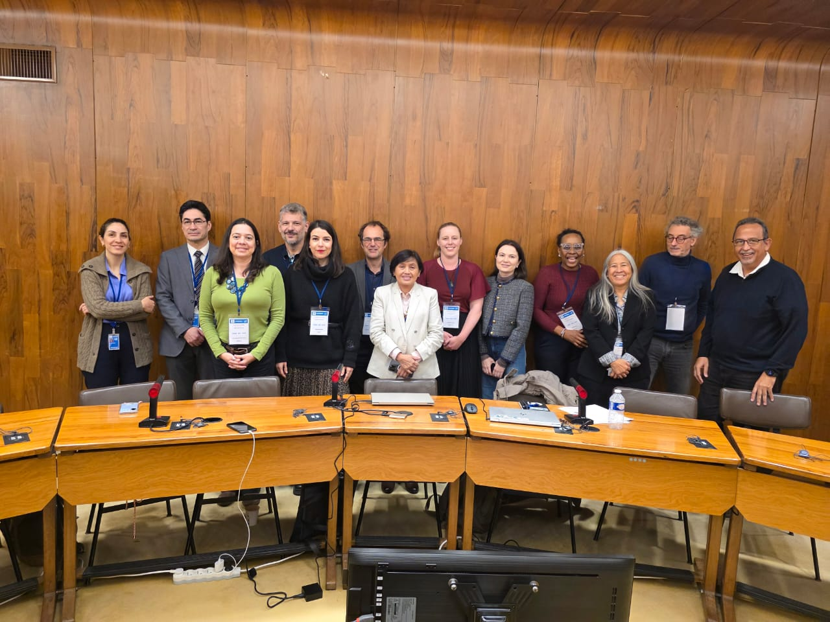
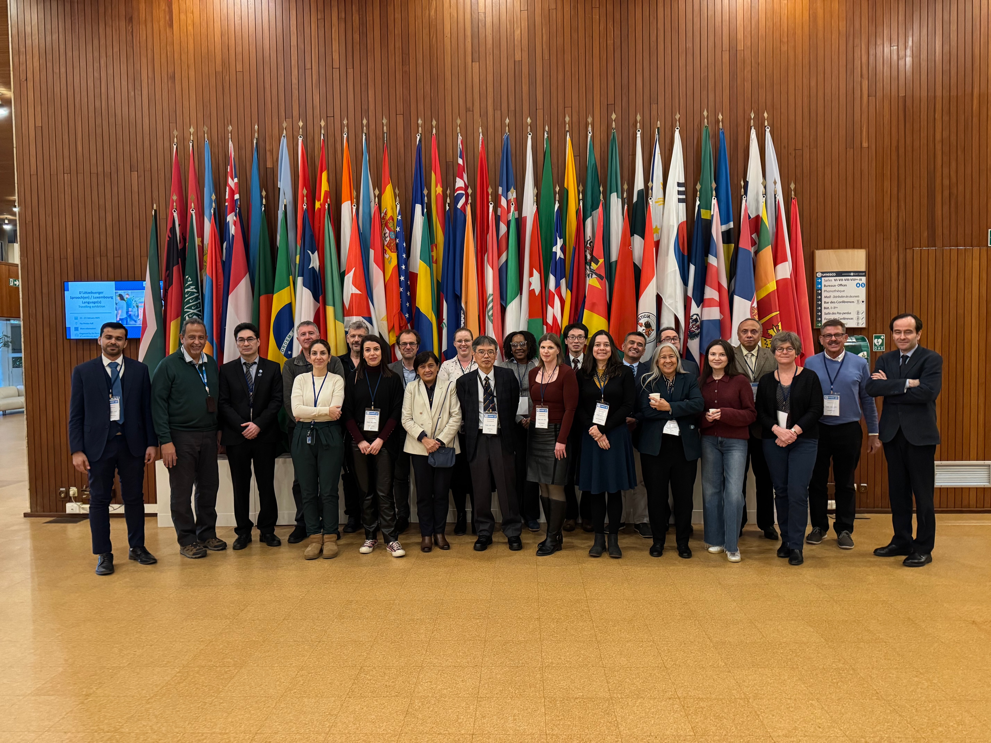
Inter ICG Task Team Meeting on Disaster Management and Preparedness of TOWS WG XVIII, Paris, 20-21February 2025

Slide 5
2.0 OUTCOMES OF THE JOINT MEETING TTDMP and TTTWO
Recommendation to TOWS WG:
Request to perform a scientific peer review on the Methodology for Estimating Eligibility for TRR and Assessment of Tsunami Risk at Community Level to ensure the indices developed are accepted as a scientifically credible methodology and endorsed by ICGs.
Recommend the secretariat, once peer review is completed, to prepare an IOC Technical Series document on the Methodology for Estimating Eligibility for TRR and Assessment of Tsunami Risk at Community Level.

Slide 6
3.0 REVIEW KEY ACTION ITEMS (MAIN ISSUES)
 |  | Lead | Not Started | Started | Ongoing | Completed | Remarks
1 | Tsunami Ready Implementation Status
1.1 | Encourages the completion of the OTGA Tsunami Awareness and Tsunami Ready courses by the ITIC and IOTIC as a key contribution to building capacity for implementation of the Tsunami Ready Recognition Programme globally. | Laura & Ardito |  |  |  |  | Done. To be launched on Friday 17th Jan 2025
1.2 | Recognises the importance of building UNESCO-IOC Tsunami Ready on existing capacities and strengths and encourages ICGs and Member States to explore these synergies. |  |  |  |  |  | PTWS encouragement includes through ‘equivalency’ approach.
1.3 | Recommends the introduction of TR Evaluation Form in the other ICGs, its translation to Spanish and French and its administration by TRS/IOC/UNESCO |  |  |  |  |  | A tsunami ready survey is under investigation by the PTWS TT TR.Pacific Capacity assessment to be run in the first instance.
1.4 | Requests the IOC, led by the TICs, to develop and share a Tsunami Ready Toolkit to assist Member States in implementing the Tsunami Ready Recognition Programme. The toolkit can include a standard and clear procedure, format, and method for submitting the Tsunami Ready application and its supporting documentation, including clarification on the definition of community in the frame ofUNESCO-IOC Tsunami Ready Recognition Programme. | Laura & Ardito |  |  |  |  | To be discussed at TOWS TTs
1.5 | Recommends Secretariat to inform Member States on the Toolkit’s availability via IOC Circular Letter to the Tsunami National Contacts, National Tsunami Ready Board, and widely through the attaching this as an appendix of the Manual and Guide 74 | Laura & Ardito/ Secretariat |  |  |  |  | To be discussed at TOWS TT DMP and IOC CL issued after
MONEV TOOLS
Recommendation to TT DMP
Agrees to conduct an online mid-term evaluation of the new TT DMP actions to assess progress, identify unaddressed actions, propose ways to implement them and define the next TT DMP meeting agenda.

Slide 7
4.1 TSUNAMI READY IMPLEMENTATION STATUS (1)
Recommendation TOWS WG:
Appreciates the the number of Member States and communities joining the UNESCO-IOC Tsunami Ready Recognition Programme, with 100 communities from 34 countries already recognized, of which 10 SIDS.
Recommends
To start reporting TRR communities as soon as effectively possible by percent to get a better idea of how close we are to the Ocean Decade goal of 100% percent of at-risk communities to be TR.
exploring the creation of a global facility to facilitate data and development of inundation and evacuation maps in a more efficient way.
developing a strategy to focus early actions on hazard and risk assessments, to enable the implementation of TR.
producing a short report including reflections on the challenges of TRRP implementation in the NEAM region and beyond,
translating evaluation forms into French and Spanish, making the application submission more efficient, providing tools to facilitate annual reporting, identifying national TR focal points, and consistent reporting mechanisms on better integration of people with disabilities; solutions to vandalism and multi-hazard risks affecting TR recognitions.
organizing a Tsunami Ready Summit in the Caribbean? Or globally? if funds are available in 2025/2026 to strengthen collaboration and strategy.

Slide 8
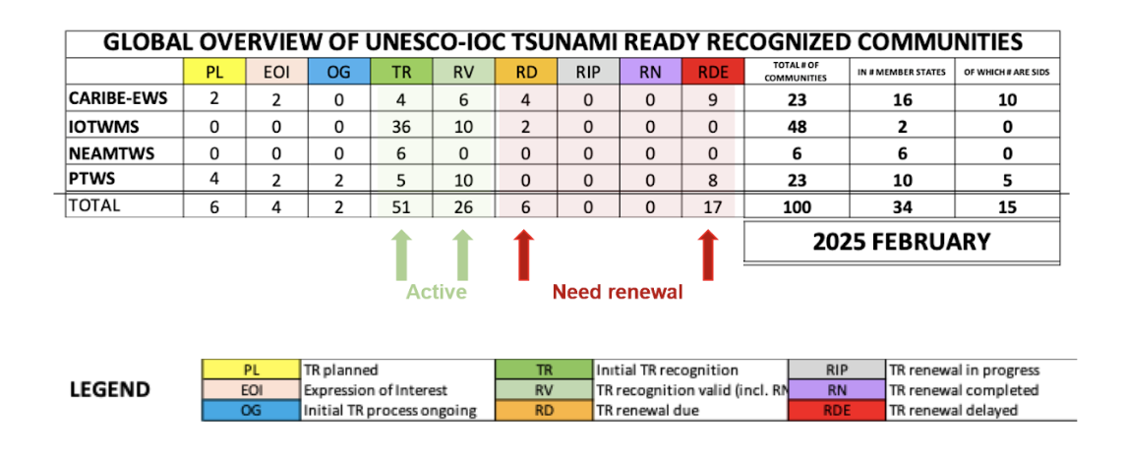
4.1 TSUNAMI READY IMPLEMENTATION STATUS (2)
Recommendation TOWS WG:
Notes the funding and staffing shortages, obstacles and challenges slowing down TR recognitions and renewals.
Further notes that all TICs face resource limitations, causing delays in implementation.
Further notes the importance of securing technical support from social scientists for data analysis.
Also notes the potential critical role of public private partnerships and the need for a high level of scrutiny to ensure the values and integrity of UNESCO are maintained.
Visual Map of UNESCO-IOC Tsunami Ready Recognition Programme Global Status.

Slide 9
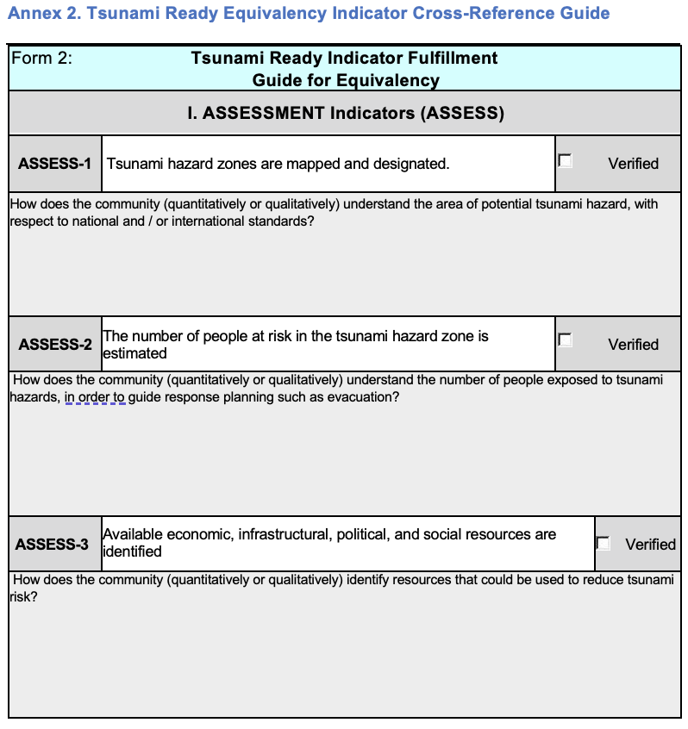
4.2 Synergy with Local and National Resilient
Programmes (Tsunami Parity)
Recommendations to TOWS WG:
Appreciates the progress made for establishing the Tsunami Ready Equivalency for the PTWS by developing a draft guidance using the Tsunami Ready indicators as a foundation.
Notes that the PTWS will explore ways to further recognize and promote the benefits of formal Tsunami Ready Recognition, which remains the preferred approach by TOWS.

Slide 10
4.3 Tsunami Ready Tool Ki
Recommendations to TOWS WG
Requests TOWS WG approval for the Tsunami Ready Toolkit, including an updated application form, workflow and recognition procedures with sample communication templates, folder and file naming conventions certificate and signage samples, renewal procedures, community definition and guidance, to be finalized by TICs and included as appendices to MG74 for submission to the ICGs.
Recommends Secretariat to inform Member States on the Toolkit’s availability via IOC Circular Letter to the Tsunami National Contacts, National Tsunami Ready Board, and widely through the attaching this as an appendix of the Manual and Guide 74
Further Requests that TICs continue developing additional tools, including:
Application Form in official UN languages
More efficient submission procedures
Tsunami Ready Training providing detailed implementation guidance

Slide 11
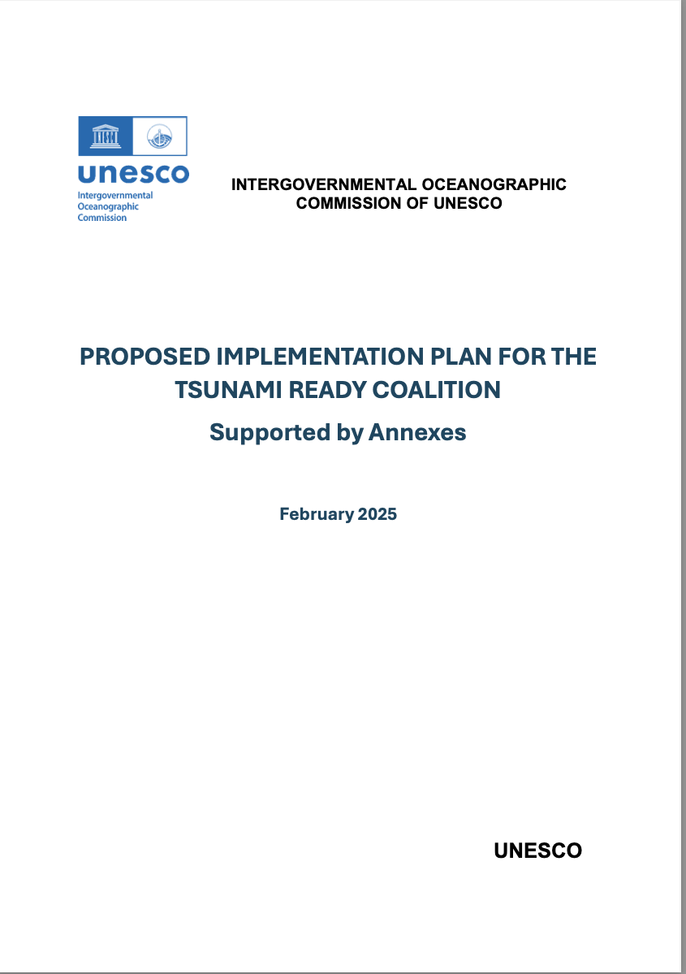
4.4 Tsunami Ready Coalition Implementation Plan (1)
Recommendations to TOWS WG
Notes that TOWS-WG-XVI (2023) requested the Tsunami Ready Coalition Chair to propose a governing structure for the Tsunami Ready Coalition and that TOWS WG approval is essential for advancing the work of the Tsunami Ready Coalition.
Also notes that the Tsunami Ready Implementation Plan was reviewed by the Ocean Decade Scientific Committee (16-17 January 2025) and the TOWS-TT-DMP (21 February 2025), and is included as part of the Coalition Chair’s report to TOWS-WG-XVIII).

Slide 12
4.4 Tsunami Ready Coalition Implementation Plan (2)
Recommendations to TOWS WG
Having considered the Tsunami Ready Coalition Implementation Plan,
Approves the Implementation Plan, including:
The Coalition mandate and terms of reference,
The Coalition structure, and
The identified key Coalition Partners.
Notes that the Plan will remain a dynamic document to allow for updates to the Plan, with updates reflected in the Coalition’s reports to the TOWS-WG.
Recommends the Secretariat to finalize in consultation with the Tsunami Ready Coalition Chair the Coalition Partners, 'Ambassadors' or similar namesake, and Coalition Co-Chair.
Recommends the IOC Executive Secretary to extend invitations to the proposed Coalition Partners and Ambassadors, and a Coalition Co-chair.
Requests ICGs to prioritize regional Tsunami Ready workshops or summits in 2025 and conduct further workshops or summits before 2030.
Notes resource and capacity constraints that will stymie progress of the TRC Coalition Implementation Plan, requests the IOC Executive Secretary to urgently address

Slide 13
4.5 Policy and Future Implementation: Tsunami Ready
Key question 1: How should Tsunami Ready evolve at a policy and national level? How can UNESCO-IOC sustainably engage with both Member States and communities?
Proposed Actions:
Mandating Tsunami Ready by law for schools, public and private companies, and coastal communities within evacuation areas.
Strengthening UNESCO’s role as a recognized global leader in tsunami preparedness.
Leveraging data and statistics to effectively advocate for tsunami risk awareness and preparedness.

Slide 14
4.5 Policy and Future Implementation: Tsunami Ready
Key question 2: How Member States adapt/streamline the programme into their national disaster risk reduction legislative framework?
Recommendations to TOWS-WG
Recommends to TOWS WG and its Task Teams to effectively utilize the Tsunami Early Warning System KPI for reporting and contributing to Sendai Framework Target G, This will support the mid-term review and drive impactful actions at national and local levels.
Further recommends to leverage and integrate comprehensive tsunami risk assessments into policymaking to ensure decision-makers prioritize urgent preparedness measures
Notes that the National Institute of Geophysics and Volcanology (INGV,Italy) will share a guideline on a legal case in Italy and its implications in supporting tsunami-related activities.

Slide 15
Remaining Questions – No time to discuss
The TT DMP meeting ran out of time and could not address the remaining questions, which are important to be discussed. These remaining questions were focusing on reviewing the progress of action which has been discussed and recommended during the Meeting on Disaster Management and Preparedness of TOWS WG XVIII, Sendai Japan, 19 - 20 February 2024 (Key 3, 4 and 5). Meanwhile, there is a new tools that has been developed in Indian Ocean based UNESCO IOC survey after Palu Tsunami event.
The remaining key questions are:
Key Question 3: How to deal with other interests & complex and particular situations (entire coast, schools etc.) - supposed to be presented by Dr. Denis Chang Seng
Key Question 4: How to deal with the interest and needs of critical infrastructure, i.e. airport and port - supposed to be presented by Dr. Harkunti P. Rahayu (Note: the guideline is in progress is planned to be tested using SUSTAIN (tSUnami reSilient criTical INfrastructure) proposal in several Indian Ocean countries).
Key Question 5: How to deal with the interest and needs of hazardous vital infrastructure, i.e. industrial zone, power plan - supposed to be presented by Dr. Harkunti P. Rahayu (Note: it is on going progress).
Key Question 6: TR Evaluation Survey and the Tsunami Event Post Assessment Questionnaire was also proposed - supposed to be presented by Dr. Harkunti P. Rahayu (Note: assessment tools completed based on UNESCO IOC survey after Palu Tsunami event).

Slide 16
5.0 EDUCATION AND WORLD TSUNAMI AWARENESS DAY 2024
AND PLANNING FOR 2025
Recommendations to TOWS WG
Recommends to UNDRR that ‘Tsunami Ready’ becomes a permanent WTAD Theme similar to Safe Schools and others.
Further recommends to link Tsunami Ready theme to collaboration, partnerships, public private partnerships and the proposed TRC Ambassador
UNDRR’s focus on Safe Schools (GP2025 Ministerial Session), the EW4ALL initiative, and Innovative Financing.

Slide 17
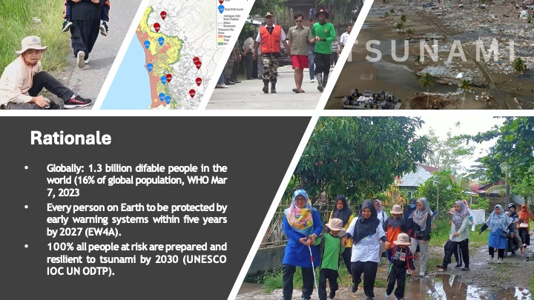
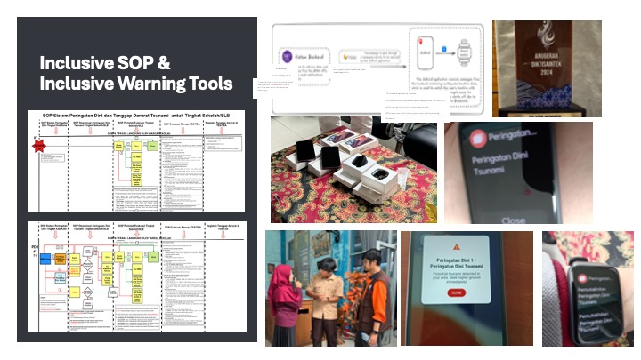
6.0 INCLUSIVE SOPs
Recommendations to TOWS-WG
Appreciates the development of inclusive SOP and Inclusive warning tools for disabled children in Indonesia and the Caribbean.
Recommends the Indonesian inclusive SOPs to be translated to English
Encourages further development of inclusive SOP as official guidelines of UNESCO IOC.
SOP Document format:
Indonesia (Audio-Video with sign language interpreter and hard copy for school)
Caribbean (Braille Documents)

Slide 18
7.0 REVISED TT DMP TOR
Notes through Resolution XXIV-14, the IOC Assembly at its 24th session decided on the establishment of a Working Group on Tsunamis and Other Hazards Related to Sea-Level Warning and Mitigation Systems (TOWS-WG). The group is tasked primarily to advise the IOC Governing Bodies on coordinated development and implementation activities of warning and mitigation systems for tsunamis and other hazards related to sea level of common priority to all Intergovernmental Coordination Groups of Regional Tsunami Warning and Mitigation Systems.
Further notes by its IOC Decision A-31/3.4.1 on Warning Mitigation Systems for Ocean Hazards, the IOC Assembly in 2021 reaffirmed the need for continued inter-ICG coordination through TOWS and the extended tenure of its two inter-ICG Task Teams on:
● Disaster Management and Preparedness (DMP), and
● Tsunami Watch Operations (TWO).
Notes the TOWS TT DMP recommendation in Sendai, Japan, 19 - 20 February 2024 that many advances have been made, and new needs have been identified since TT DMP ToR was prepared and the recommendation to revise TT DMP Terms of Reference.

Slide 19
8.0 DEVELOP TT TMP WORK PLAN
Recommendations to TOWS WG
Agreed to organize a TT DMP meeting ahead of the TOWS TTs and TOWS WG meetings by the end of October 2025 to review actions and define agenda for the February 2026 meeting.
Further agreed to organize short meetings, online or in person to discuss focus topics addressing key agenda items.
Recommends planning the schedule for TOWS-related meetings, preferably holding the TTs meetings from Monday to Wednesday and the TOWS-WG meetings on Thursday and Friday, leaving sufficient time in between meetings for Technical Secretaries to prepare summary report and recommendations.

