Slide 1
UNESCO-IOC Tsunami Ready
Recognition Programme
Global Status
Laura Kong, ITIC
Ardito Kodijat, IOTIC
Ocal Necmioglu, PTWS/CARIBE-EWS Secretariat
TOWS Task Team on Disaster Management , 20-22 February 2025, Paris, France

Slide 2
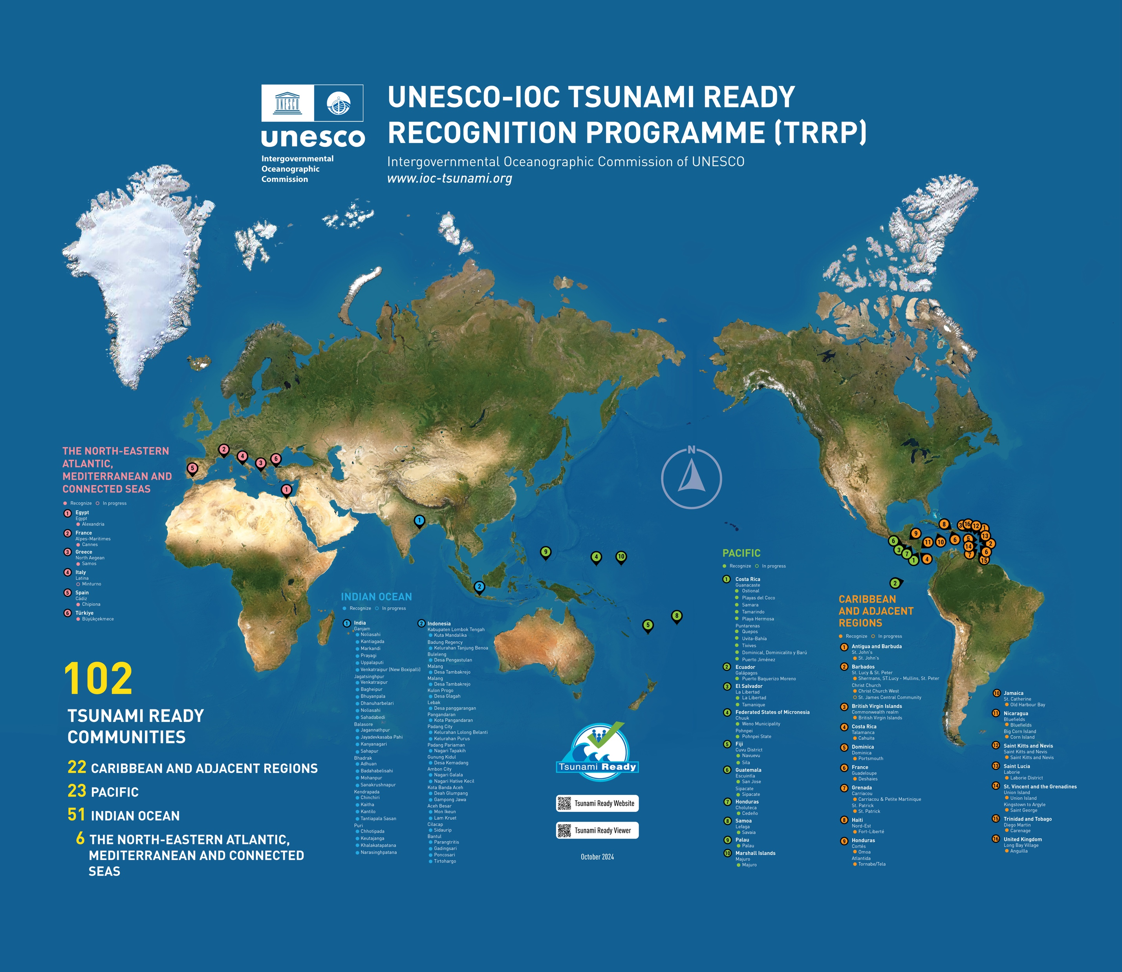
Global Implementation Status
Map, Nov 2024 (IOTIC)
100 (Feb 2025, IOC TSR)
TSUNAMI READY
COMMUNITIES
23 CARIBBEAN AND ADJ REGIONS
48 INDIAN OCEAN
6 NORTH-EASTERN ATLANTIC,
MEDITERRANEAN AND
CONNECTED SEAS
23 PACIFIC OCEAN
100
TSUNAMI READY
COMMUNITIES
23 CARIBBEAN AND ADJ REGIONS
48 INDIAN OCEAN
6 NORTH-EASTERN ATLANTIC,
MEDITERRANEAN AND
CONNECTED SEAS
23 PACIFIC OCEAN

Slide 3
TRRP Implementation Status
Active Need renewal

