Slide 1
Tsunami Ready Toolkit
Ardito Kodijat, IOTIC
Dr. Laura Kong, ITIC
Alison Brome, CTIC
Denis Chang Seng, NEAMTIC
TOWS Task Team on Disaster Management , 20-22 February 2025, Paris, France

Slide 2
TR Toolkit (TOWS-WG XVII recommendation)
Requests the IOC Secretariat to:
(vi) with TICs’ lead, develop and share a Tsunami Ready Toolkit to assist Member States in implementing the TRRP. The toolkit may include a standard and clear procedure, format, and method for submitting the Tsunami Ready application and its supporting documentation, including clarification on the definition of community in the frame of the UNESCO-IOC Tsunami Ready Recognition Programme;
(vii) inform Member States on the Tsunami Ready Toolkit’s availability via IOC Circular Letter to the Tsunami National Contacts, National Tsunami Ready Boards, and widely through attaching this as an appendix of the Standard guidelines for the Tsunami Ready Recognition Programme (IOC/2022/MG/74);
Toolkit Availability – target Qtr 2, 2025

Slide 3
TR Toolkit - contents
TR community – definition and guidance
TR training – OTGA Tsunami Awareness, Tsunami Ready, future plans
TR Application
Updated Application Form
Submission procedures and recognition workflow (workflow SOPs, automated tool)
File naming and file types (file metadata)
Implementation communications (sample letters and templates) – Letter of Intent, NTRB/RTRB, Application submission, IOC acknowledgement, Recognition and Appreciation Certificate names, Community summary for web page
Recognition and Appreciation Certificates – sample
Recognition Ceremony – sample agenda
Recognition Sign – example, accompanying safety message
TR Renewal procedures

Slide 4
TR community – definition and guidance
LEVEL OF IMPLEMENTATION
(village, parish, borough, district, municipality, county, emergency management area, etc.).
Key considerations:
Not too small so that it would be impossible to do all (and many left behind), but not at such a large level that the information and the alerts do not reach the population at risk.
Resources will be needed to reach 100% of tsunami-vulnerable communities, and then also to sustain the Programme (recognition renewals).
The Community must have a government authority that will be recognized, e.g., Mayor, Representative from Parliament, Chief. This is important for national recognition and acceptance.
The Community must have a jurisdiction that will be recognized, e.g., follow already established country divisions/management structure. It is not prudent to reinvent another way to "divide" up the country.
A Level should correspond to an area that has a 24/7 focal point for receiving and disseminating national alerts (e.g., Local DMO office, police or fire station, 24 x 7 clinic, etc)
The Community must have an authority, management structure (e.g., emergency management committee, emergency management office, mayor/chiefs office, etc) to support the development of the evacuation maps, local response plans, provide input on the population, decide on places for signage.

Slide 5
TR community – definition and guidance
As the Programme proceeds, decide which COMMUNITY to target. Key considerations:
There is INTEREST by the "Authority/Structure" to be recognized. It is important to note that the Tsunami Ready Programme is voluntary, and that it is a lot of work (but rewarding).
Level of threat. The higher the threat the more important it is to be Tsunami Ready, and also, probably greater the interest.
Level of vulnerability. There are social/economic/cultural considerations. It may be a good idea to target where there is more vulnerability, and which would not have the resources to implement
Previous work to build upon, especially tsunami or other hazard work.
Existence of volunteer groups, NGOs, e.g., Red Cross or Crescent, GOAL
Opportunity to highlight and potential to socialize project at the national level (such as through traditional media, or social media). This is especially important for the first Tsunami Ready community in the country, since it leads to other communities want to get Tsunami Ready.

Slide 6
TR community – definition and guidance
Clear boundaries: Area has administrative jurisdiction
National ➔ State / Province ➔ District ➔ Sub-District ➔ Village ➔ Neighborhood
Clear boundaries: Natural or Physical boundaries
River, Coastal, Forest, Mangrove, Street, Bridge, Landmarks, etc.
Number of Population
The right number of population would help to understand the scope to be managed when implementing tsunami ready. If the communities are spread out or concentrated, etc.
Characteristic of the community
Urban - Rural; Agriculture – Industrial – Touristic;
Landscape
Flat ground, Hilly, Peninsula, etc.

Slide 7
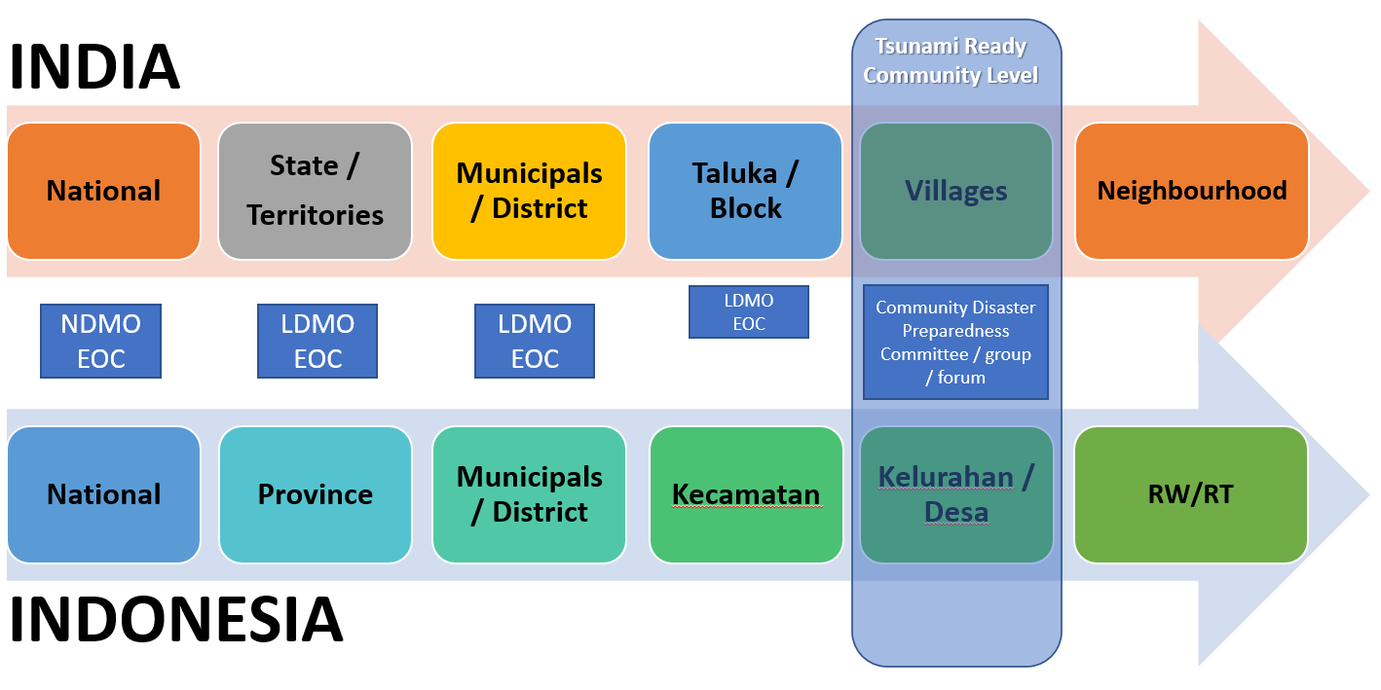
TR community – definition and guidance

Slide 8
TR OTGA Training

Slide 9
TR OTGA Training

Slide 10
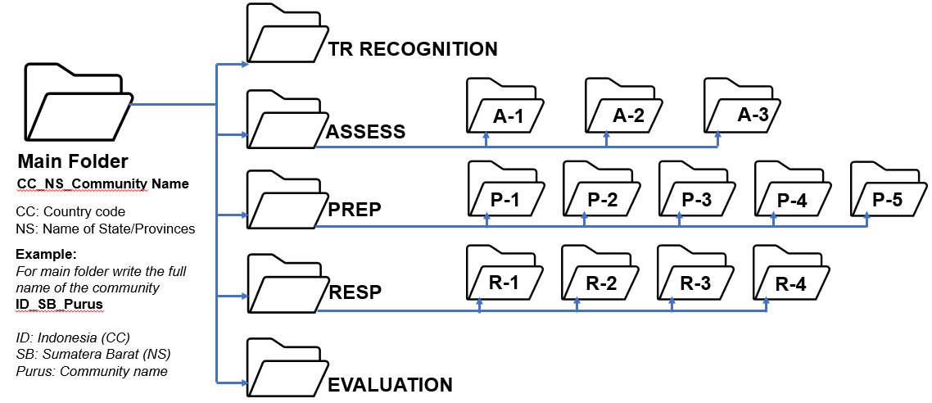
File naming and file types (file metadata)

Slide 11
File naming and file types (file metadata)

Slide 12
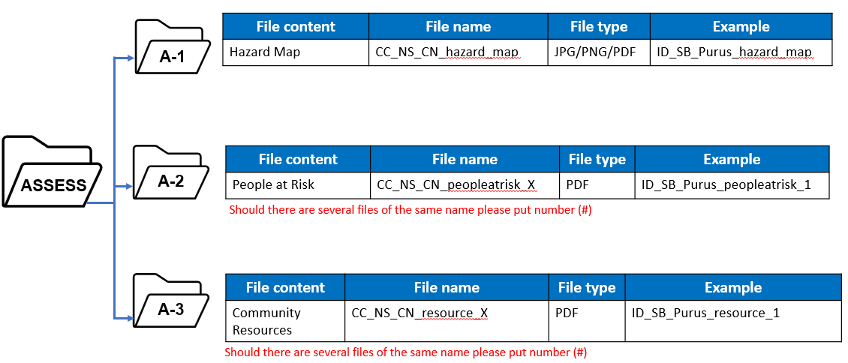
File naming and file types (file metadata)

Slide 13
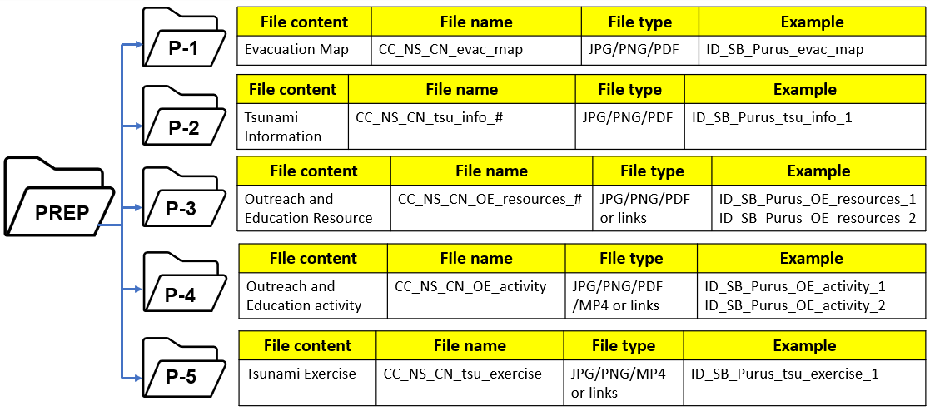
File naming and file types (file metadata)

Slide 14
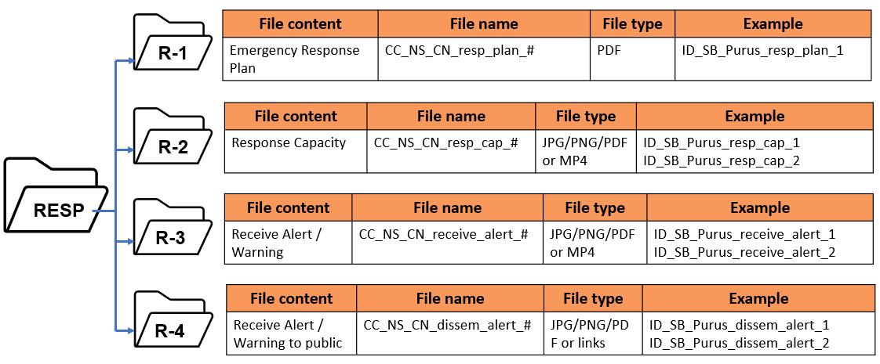
File naming and file types (file metadata)

Slide 15
File naming and file types (file metadata)
Photos:
Limit photos of evidence of each indicator to max. 5 photos.
Make sure the photos are of high quality but not too big size.
Avoid similar photos of the same object or evidence.
Videos:
If the video file is less than 50 MB, the video can be included in the submission, for a bigger file size, upload the video to YouTube, Vimeo, or other social media and provide the link to the video.

Slide 16
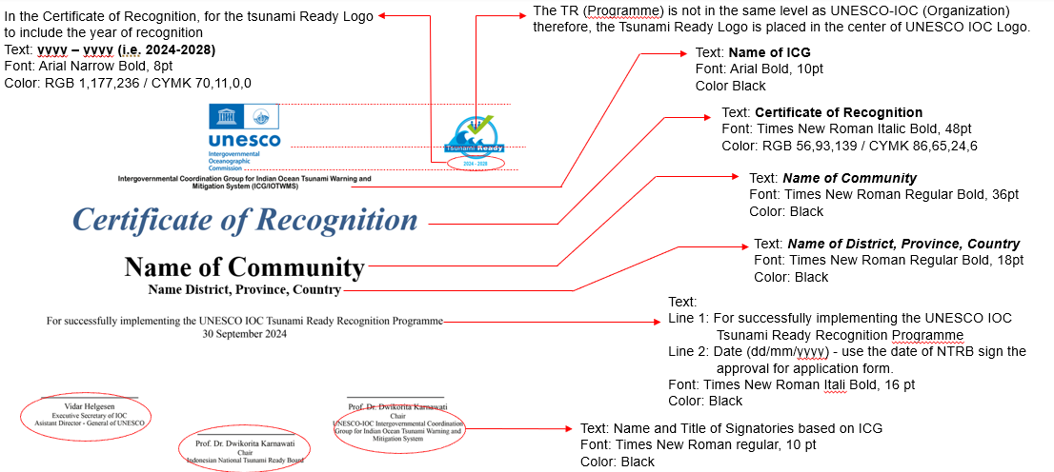
Recognition and Appreciation Certificates

Slide 17
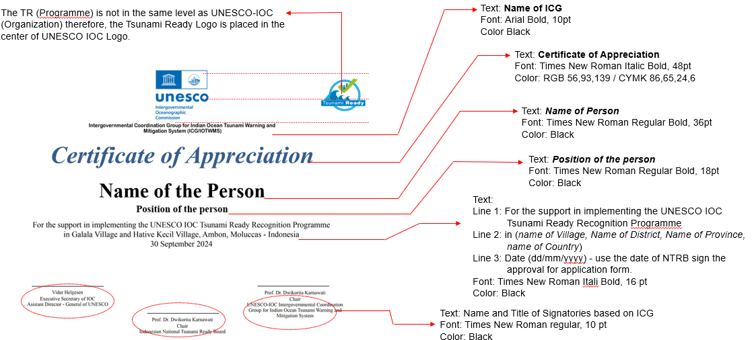
Recognition and Appreciation Certificates

Slide 18
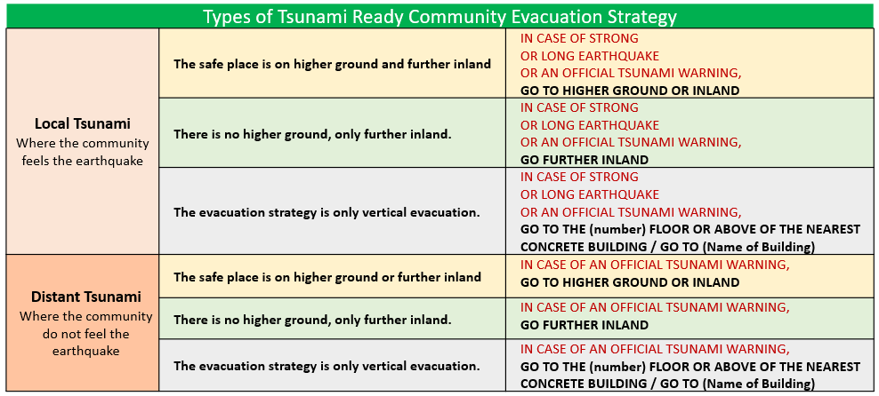
Recognition Sign

Slide 19
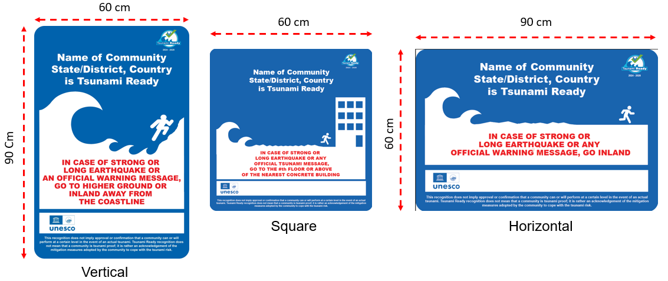
Recognition Sign

Slide 20
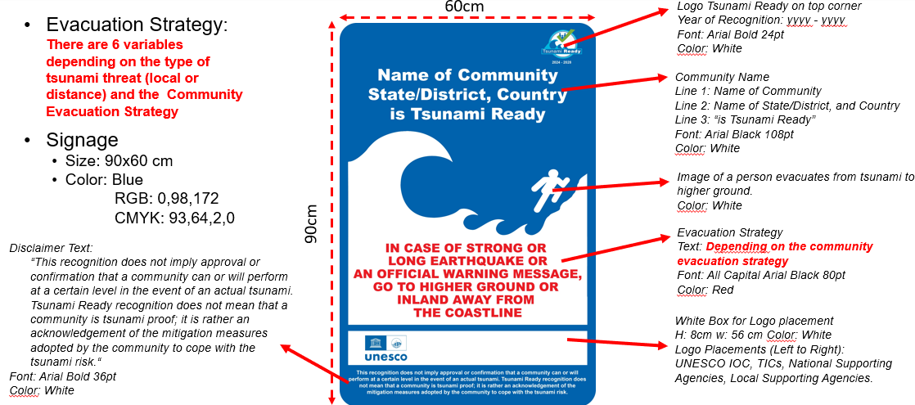
Recognition Sign

Slide 21
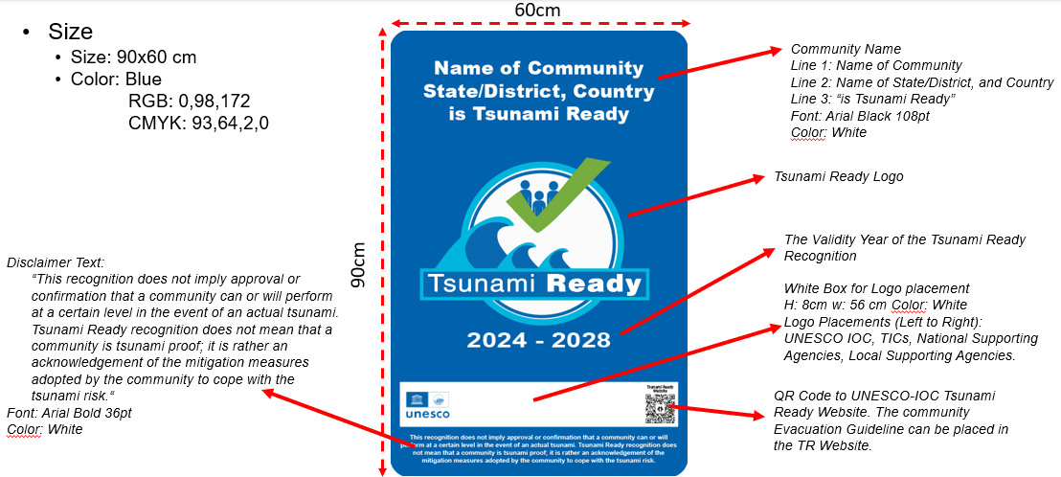
Recognition Sign (Proposed option)

Slide 22
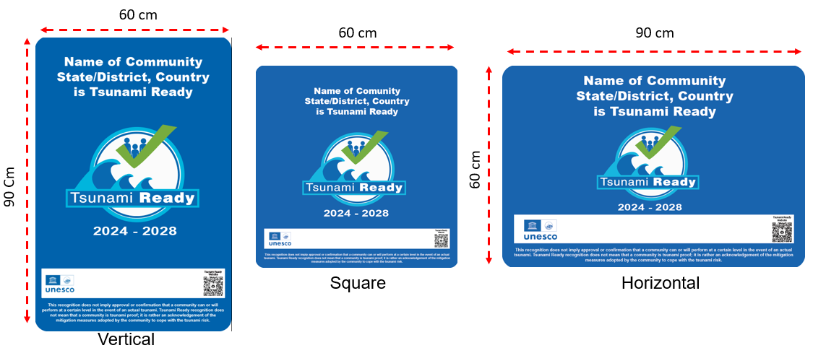
Recognition Sign (Proposed option)

Slide 23
Thank you

