Slide 1
Draft Toolkit for
UNESCO-IOC Tsunami Ready
Community

Slide 2
Tsunami Ready community
A group of people who live in the same area, such as a city, town, village or neighbourhood. An interacting population of various kinds of individuals in a common location
Community includes its social and economic dimensions, its infrastructure, life-lines and supporting environmental systems
Scale of community is important. Its size, leadership structure, national political setting as well as its vulnerability and exposure will determine how it implements Tsunami Ready and the resources and capacity required
Essentially, all sectors and sub-communities of a community will need to be Tsunami Ready for the whole community to be Tsunami Ready
For large communities, this requires careful planning, coordination and promotion to ensure that all sectors “buy in” to the concept of Tsunami Ready and commit to implementing it
Notes:
Point 3 from risk assessment guidelines

Slide 3
Community ➔ an ecosystem of society
Tsunami Ready
Neighborhood
(People)
Tsunami Ready
Hotels
Tsunami Ready Government
(Agencies)
Tsunami Ready Shops, Markets & Vendors
Tsunami Ready Businesses
(+Tourism)
Tsunami Ready
Family
Tsunami Ready Industries
UNESCO Sites
Safe
Schools
Safe
Hospitals
Tsunami Ready
Harbors &
Airports
Tsunami
Ready
critical
Infrastructures
Notes:
Lingkup: Ekosistem dari semua komponen yang tinggal diwilayah tersebut. Manusia, Usaha, Industri, Fasilitas, Kegiatan yang berada di wilayah tersebut.
Sekolah, Hotel, Rumah Sakit, Fasilitas kritis, Perkantoran, Pedagang kaki lima, Pengunjung (turis) dsbg.
Batas wilayah: Batas administrati atau batas alami.
Perhatikan karakteristik: Perkotaan atau Pedesaan.
Kepadatan penduduk
Kegiatan, industry, agrikultur, dsbg.

Slide 4
Tsunami Ready Community Selection
It is important to define the scope of the community to be able to measure the scope of work and to strategize for the capacity building of the community
Clear boundaries: Area has administrative jurisdiction
National ➔ State / Province ➔ District ➔ Sub-District ➔ Village ➔ Neighborhood
Clear boundaries: Natural or Physical boundaries
River, Coastal, Forest, Mangrove, Street, Bridge, Landmarks, etc.
Number of Population
The right number of population would help to understand the scope to be managed when implementing tsunami ready. If the communities are spread out or concentrated, etc.
Characteristic of the community
Urban - Rural; Agriculture – Industrial – Touristic;
Landscape
Flat ground, Hilly, Peninsula, etc.
Notes:
Lingkup: Ekosistem dari semua komponen yang tinggal diwilayah tersebut. Manusia, Usaha, Industri, Fasilitas, Kegiatan yang berada di wilayah tersebut.
Sekolah, Hotel, Rumah Sakit, Fasilitas kritis, Perkantoran, Pedagang kaki lima, Pengunjung (turis) dsbg.

Slide 5
Who selects the community
Initially, selection of communities eligible to apply for Tsunami Ready recognition in a country is likely to be undertaken by national authorities i.e. NTRB. The national authorities must however obtain the approval and commitment from the selected community and the local authorities to undertake and complete the programme
Subsequently, as the programme expands in a country, communities may self-nominate themselves to the NTRB
In any case, it is important that the community takes ownership of the programme and that implementation should be community-led with support from national and local authorities with other external agencies/institutions providing technical support

Slide 6
Reminder of criteria for Tsunami Ready community selection
The community should have the capacity and authority to undertake the Tsunami Ready programme. It should not be too big or too small.
Voluntary – the community should demonstrate its interest and commitment to complete the programme
The community should have the ability to receive and disseminate warnings according to national Standard Operating Procedures
The community should have or commit to establishing an Emergency Response Centre or equivalent place to deal with emergencies
The community should ensure that it has the requisite government authority to apply for recognition
The community should have a “champion” prepared to advocate the programme, address problems and challenges as they arise and keep the process moving forward

Slide 7
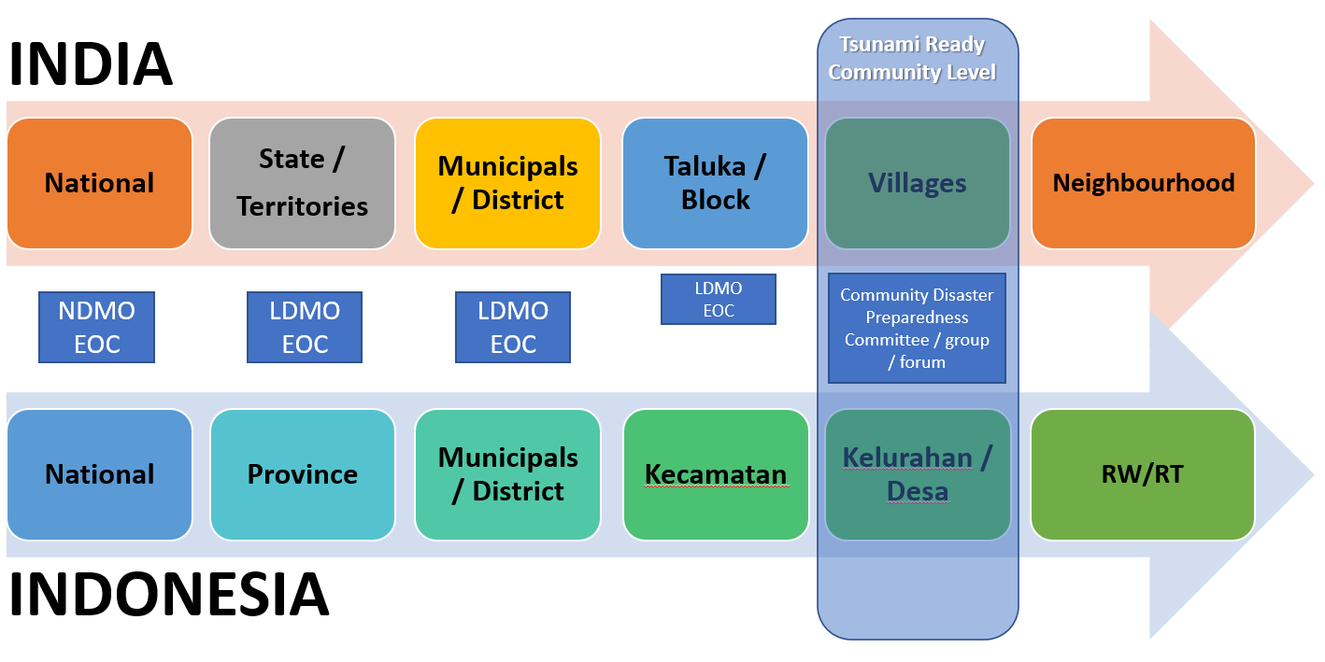
Example of Community Definition by NTRB

