Slide 1
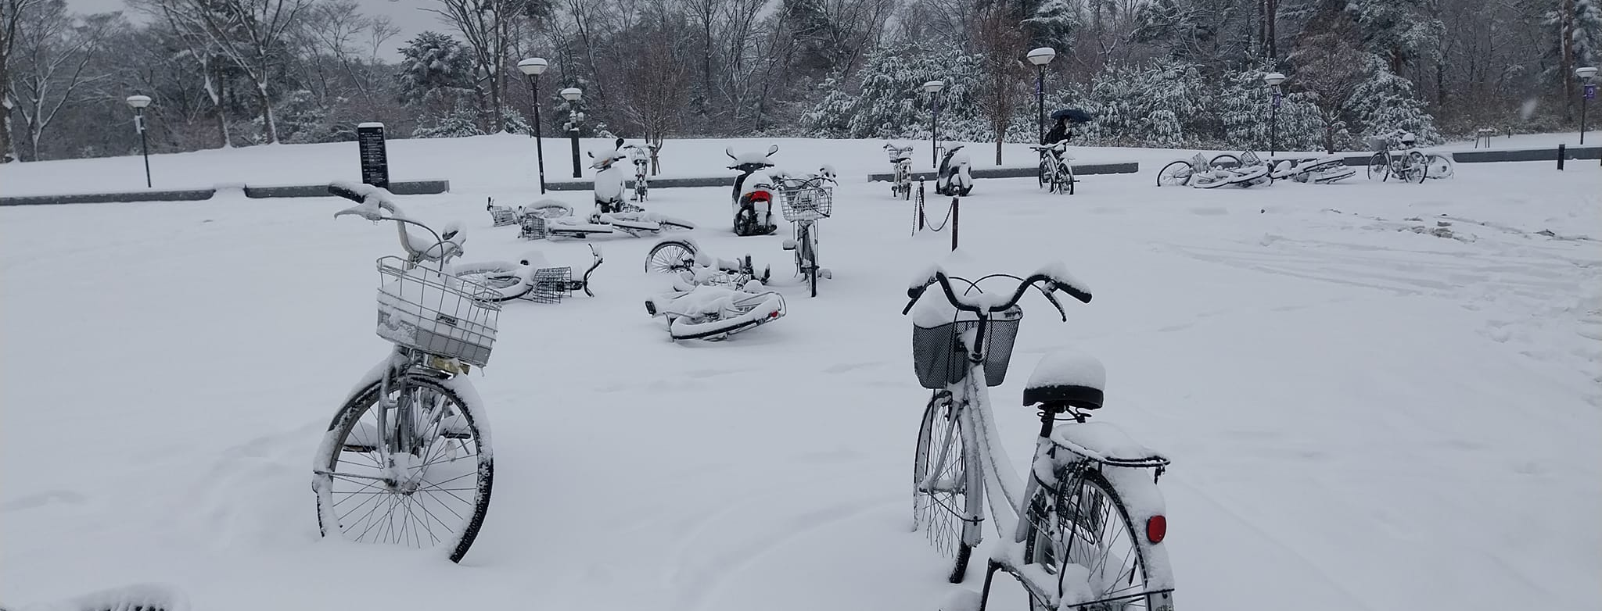
5th ODTP –SC TOWS Task Team Disaster Management and Preparedness 16-17 January 2025, UNESCO, Paris France
PROGRESS IN IMPLEMENTATING TT DMP DECISIONS AND RECOMMENDATIONS (2024)
Prepared by Denis Chang Seng, PhD Programme Specialist Technical Secretary (ICG-NEAMTWS and TOWS TT DMP) Focal Point TSR ODTP-ODTP-SC-OD CoastWAVE Project UNESCO -IOC
Inputs from TT DMP Members

Slide 2
 |  | Lead | Not Started | Started | Ongoing | Completed | Remarks
1 | Tsunami Ready Implementation Status
1.1 | Encourages the completion of the OTGA Tsunami Awareness and Tsunami Ready courses by the ITIC and IOTIC as a key contribution to building capacity for implementation of the Tsunami Ready Recognition Programme globally. | Laura & Ardito |  |  |  |  | Done. To be launched on Friday 17th Jan 2025
1.2 | Recognises the importance of building UNESCO-IOC Tsunami Ready on existing capacities and strengths and encourages ICGs and Member States to explore these synergies. |  |  |  |  |  | PTWS encouragement includes through ‘equivalency’ approach.
1.3 | Recommends the introduction of TR Evaluation Form in the other ICGs, its translation to Spanish and French and its administration by TRS/IOC/UNESCO |  |  |  |  |  | A tsunami ready survey is under investigation by the PTWS TT TR.Pacific Capacity assessment to be run in the first instance.
1.4 | Requests the IOC, led by the TICs, to develop and share a Tsunami Ready Toolkit to assist Member States in implementing the Tsunami Ready Recognition Programme. The toolkit can include a standard and clear procedure, format, and method for submitting the Tsunami Ready application and its supporting documentation, including clarification on the definition of community in the frame ofUNESCO-IOC Tsunami Ready Recognition Programme. | Laura & Ardito |  |  |  |  | To be discussed at TOWS TTs
1.5 | Recommends Secretariat to inform Member States on the Toolkit’s availability via IOC Circular Letter to the Tsunami National Contacts, National Tsunami Ready Board, and widely through the attaching this as an appendix of the Manual and Guide 74 | Laura & Ardito/ Secretariat |  |  |  |  | To be discussed at TOWS TT DMP and IOC CL issued after

Slide 3
2.0 Synergy with Local and National Resilient Programmes, including Tsunami and Critical Infrastructures, and ISO 22328-3 (Community-based Early Warning Systems for Tsunamis)
2.1 Requests ICG/PTWS Task Team Tsunami Ready to share the development of formal ICG/PTWS guidance on “Tsunami Ready Parity” with TT-DMP, as a potential mechanism for reporting toward this goal | Secretariat-ICG/PTWS TT TR |  |  |  |  | Draft guidance has been developed by TT TR with some input from other oceans. Final draft will be presented at TT-DMP & ICG/PTWS in 2025.
3.0 Tsunami Ready Recognition Sign Guidance
3.1 Recommends that Member States adopt a standard for their Tsunami Ready Recognition signage. | Respect Rep |  |  |  |  | Ongoing
3.2 Further recommends that Tsunami Ready Recognition Sign, and other sign guidance, including for text content, sign shape and size and color, will be included in the Tsunami Ready Implementation Toolkit to be developed under the guidance of the IOC TICs. |  |  |  |  |  | Ongoing
3.3 Requests the Tsunami Information Centres to continue to do their work in coordination with the ICGs’ working groups in the region. | TOWS-TT DMP |  |  |  |  | Ongoing. New webiste a challenge

Slide 4
4.0 Tsunami Ready and Making Cities Resilient
4.1 Request Secretariat to follow up on the MCR ISO requirements. | Secretariat
4.2 Recommends ICGs and TICs to advocate Member States implementing Tsunami Ready to link with MCR. | TOWS-TT DMP/ Secretriat |  |  |  |  | Portugal and Spain started
4.3 Encourages the National Tsunami Ready Board of Member States to include national agency work on MCR to be member of the NTRB meeting, and to see the possibilities for ICGs and TICs to promote Tsunami Ready in MCR events i.e. hold Tsunami Ready workshop as MCR events in the MCR regions. | TOWS -TT DMP |  |  |  |  | Portugal started
5.0 Education and World Tsunami Awareness Day 2023 and Planning for 2024
5.1. (a) Continued collaboration on scaling up the #GetToHighGround Campaign mobilizing action globally, (b) Further notes the planned collaboration between IOC-UNESCO and UNDRR on Eyewitness and Survivors Project and the Indian Ocean Youth Tsunami Conversation and Campaign of IOTIC | TOWS -TT DMP |  |  |  |  | Included in WTAD 2024 strategy/activities. First special event at IOC EC -57
6.0 Tunami Ready Critical Infrastructure
6.1 Recommends the development of guideline for Tsunami Ready Critical Infrastructure as an effort to achieve goal no 2 of UN ODTP on achieving 100% people at risk to be ready and resilience to tsunami by 2030. | TOWS- TT DMP Chair |  |  |  |  | Secretariat exchanged with TT DMP Chair. TT DMP Agenda for discussion
7.0 ISO 22328-3 (Community-based Early Warning Systems for Tsunamis) | TOWS-TT DMP |  |  |  |  | No significant progress reported. Email exchange last February with Greece

Slide 5
8 | TT-DMP organization
8.1 | Recommends to extend the TTs meeting to a 3-days meeting, including the Joint meeting with TT-TWO, in order to cover all the subjects and allow enough time to discuss. | TOWS -TT DMP/Secretariat |  |  |  |  | TTs meeting extended by half day plus opportunity provided to work in smaller group on D &R
8.2 | Recommends revising the TT DMP Terms of Reference | TOWS -TT DMP/ Secretriat |  |  |  |  | Revision initiated at TOWS, but not completed. TT DMP Secretariat re-initiated revision via online input in Google Doc
Progress | Not Started | Started | Ongoing | Completed
Task | 4 | 3 | 8 | 2
% | 24 | 18 | 47 | 12

