Slide 1











Tsunami Evacuation Planning & The Development of Inclusive SOP for Tsunami Warning System for Difable at Special Need School
Harkunti Pertiwi Rahayu
Inter ICG Task Team Meeting on Disaster Management and Preparedness of TOWS WG XVIII, Paris, 20-21February 2025

Slide 2
Research Project Team
ITB
Prof. Harkunti Pertiwi Rahayu (PI)
Dr. Retno Gumilang Dewi (ITB Faculty – a parent with total hearing impairment daughter)
Nisa Farhana - BMKG Officials (partial hearing impairment)
In In Wahdiny
Dewi Nurhasanah
Trysnawandi Warisman (total hearing impairment)
Postgraduates Students:
Andina Fathiyaturrahma
Difa Ayu Balqist
ITB Undergraduate Students:
M. Farid Rizqi
Yusuf Ridhan Muhammad
Camilla Rosanti Budimansyah
Irda Naila Eliska
Ahmalia Firdausa
University of Huddersfield
Prof. Dilanthi Amaratunga (PI)
Prof. Richard Haigh
PhD Students:
Anuradha Senanayake

Slide 3
Background

Slide 4
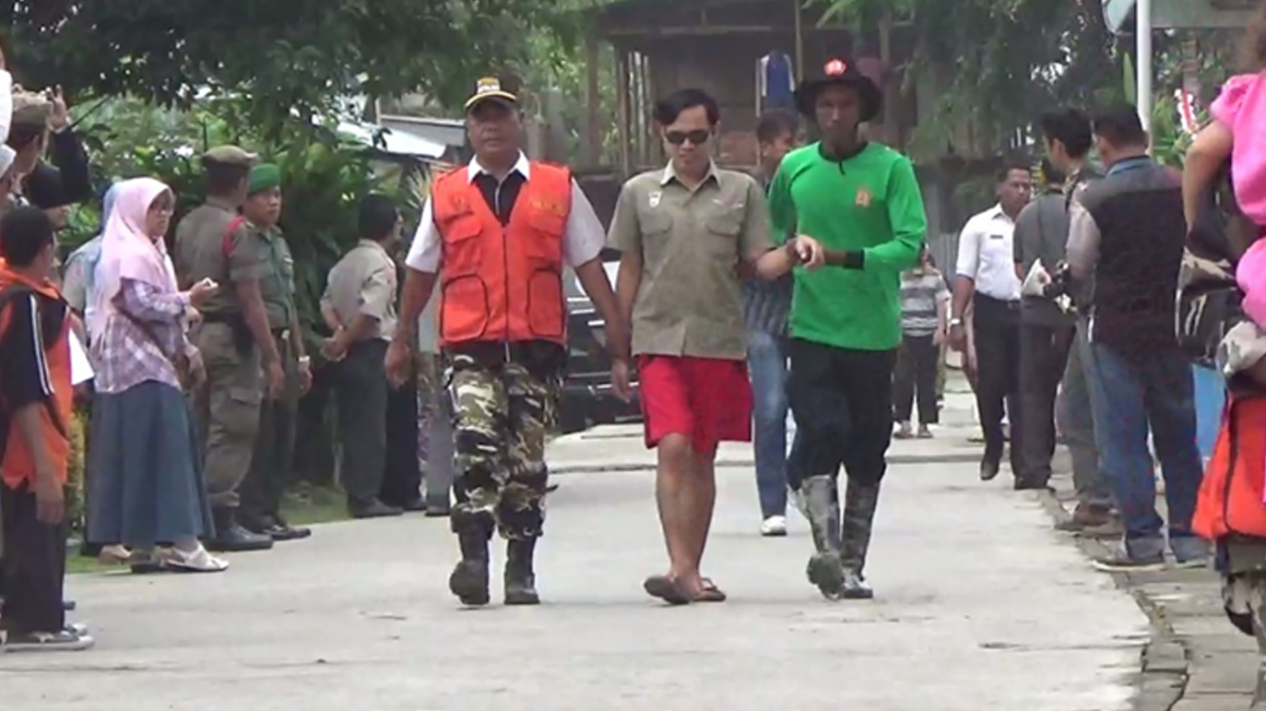
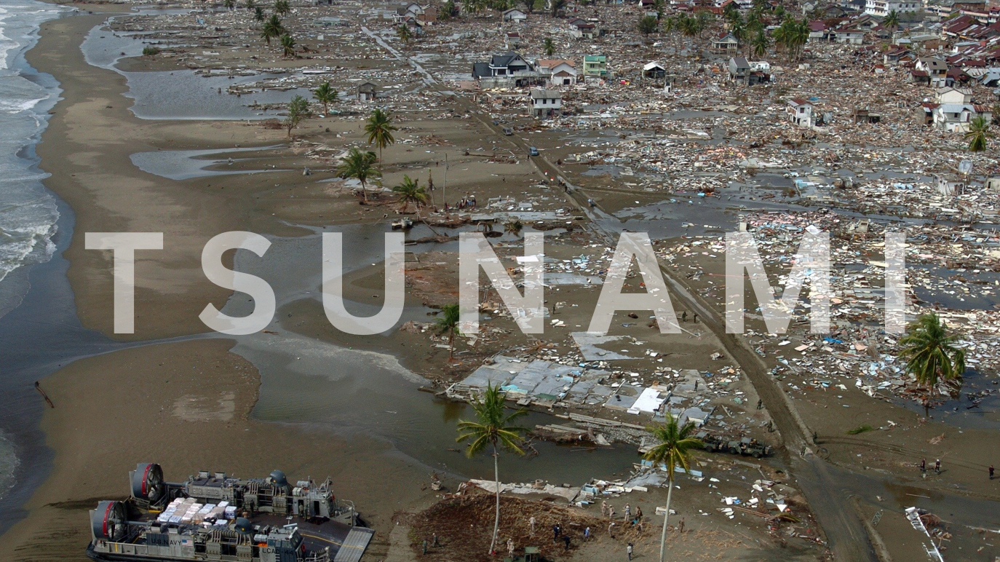
People with Disability – the most vulnerable group in any disaster (tsunami)

Slide 5
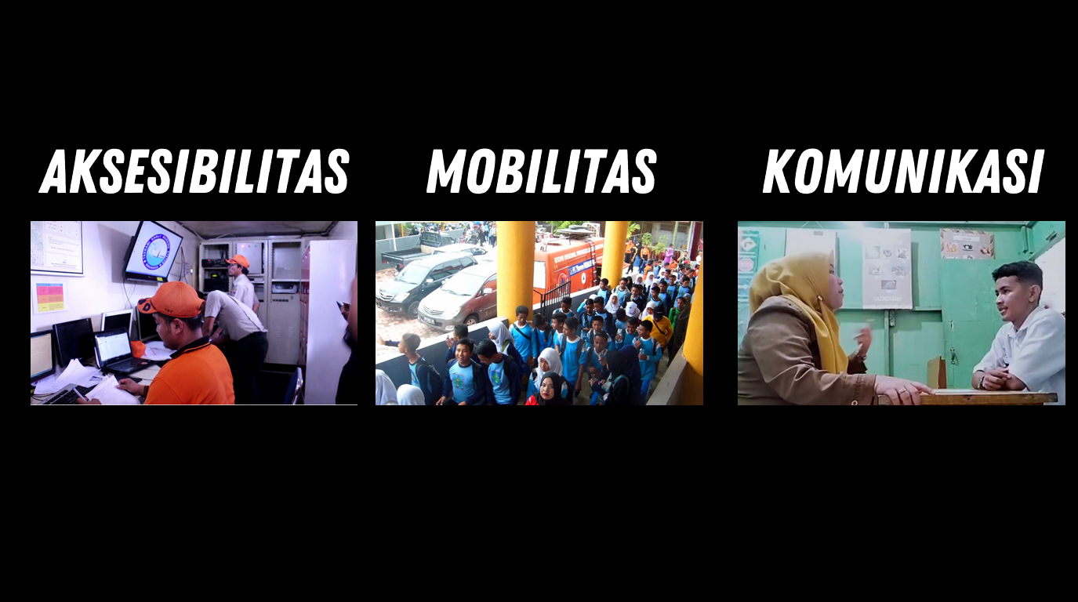
Different Functional Ability – Difable People
Facing Challenges in:
Accessibility
Mobility
Communication

Slide 6
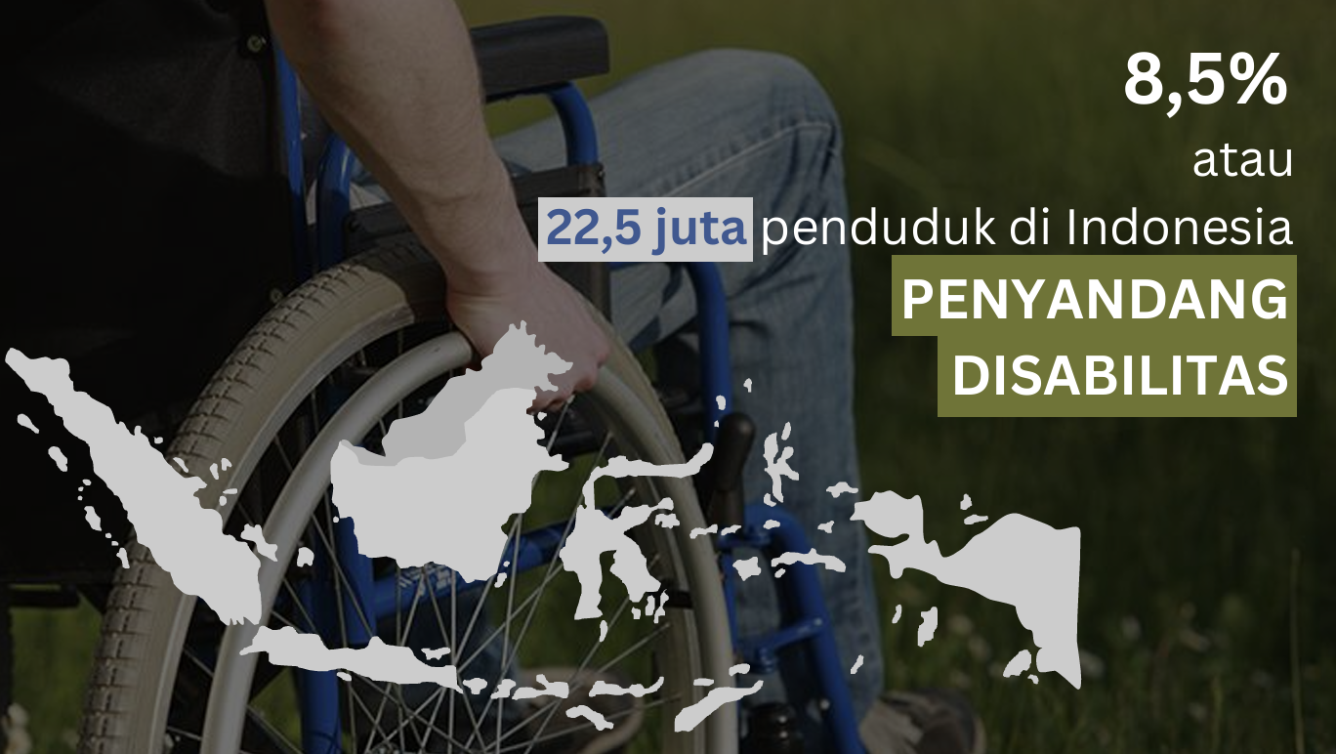
or
22.5 millions of Indonesian population
People with Disability
(Difable)

Slide 7


SDGs - Disabilities - Tsunami Warning and Mitigation
Globally: 1.3 billion difable people in the world (16% of global population, WHO Mar 7, 2023)
Disability characterized by:
Barriers to full social and economic inclusion, inaccessible physical environments and transportation, unavailability of assistive devices and technologies, non-adapted means of communication, gaps in service delivery, and discriminatory prejudice and stigma in society.
Limited access to Tsunami Warning Information → time is very critical for disabilities at the tsunami prone area
2030 Agenda for Sustainable Development and its 17 SDGs pledge to leave no one behind and
recognize disability as an issue that cuts across all SDGs.

Slide 8
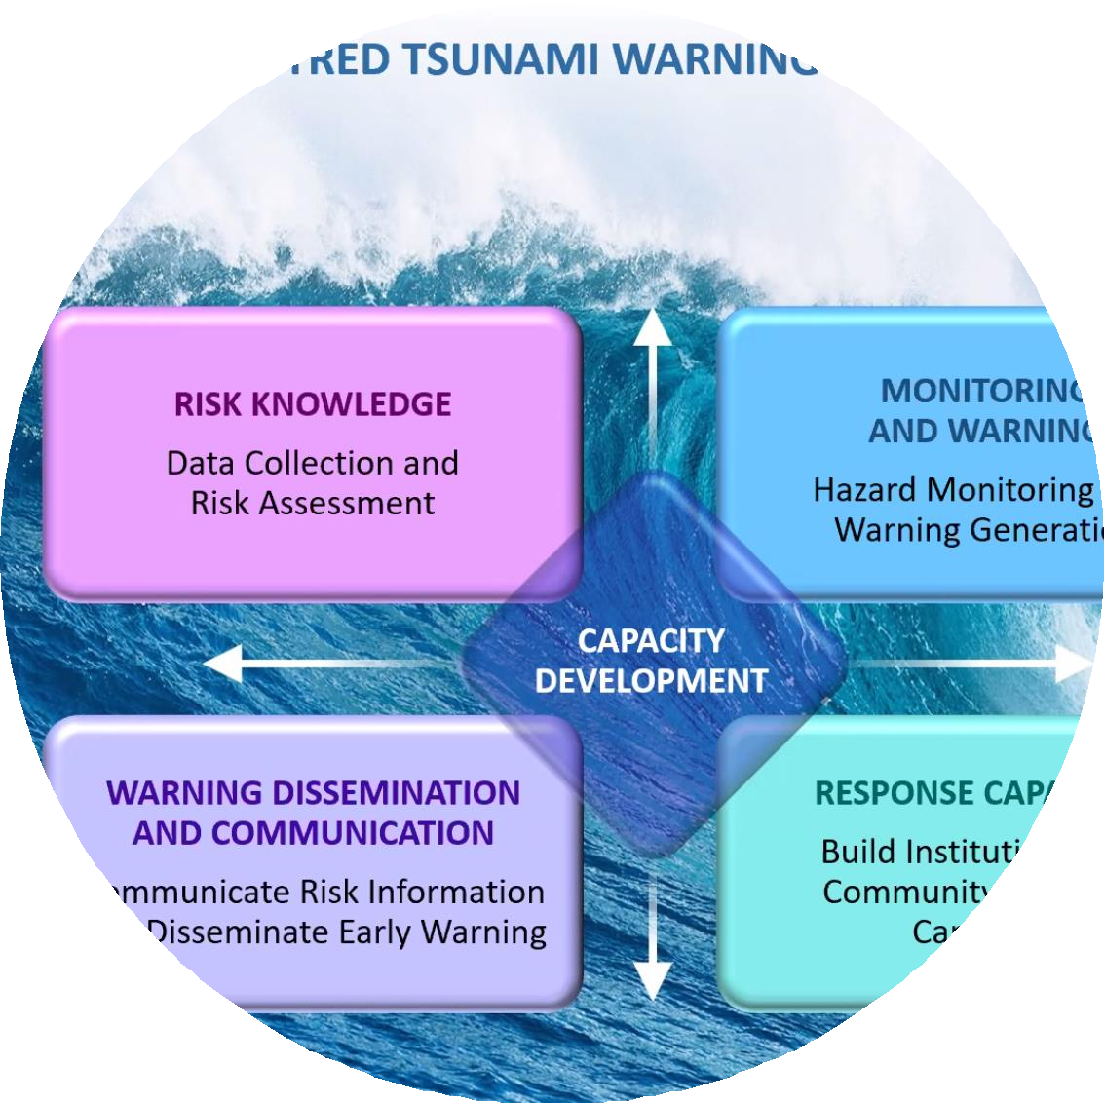
Early Warning for ALL & UNESCO IOC ODTP
The UN Secretary-General has called:
Every person on Earth to be protected by early warning systems within five years by 2027 (EW4A).
100% all people at risk are prepared and resilient to tsunami by 2030 (UNESCO IOC UN ODTP).
People-Centered early warning and mitigation system → how to reach the last miles and the very last miles (disabilities)

Slide 9

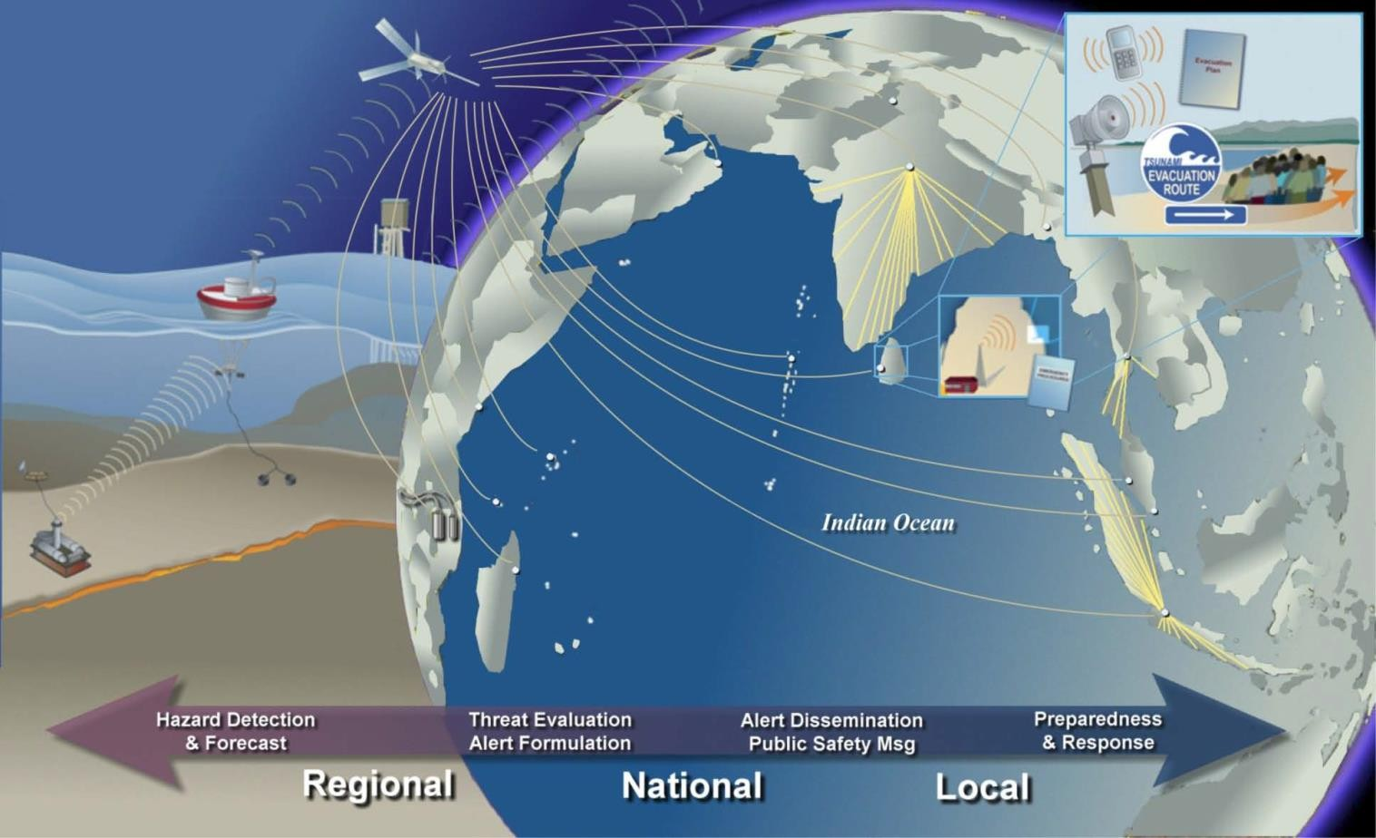
2004 Indian Ocean Tsunami:
a Wake-up Call for Ina TEWS and ICG IOTWMS
“End To End System”
From 0.0 to 4.0
Has it considered reaching the Difable People ??
?
?
Has it considered the response of Difable People to the warning message??
4.0
4.0

Slide 10



Lesson Learned
learned from IABI member The Unspoken Ministry (TUM) Indonesia, a non- profit organization dedicated to Deaf community services by providing some affirmative actions.
needs for development of Sound Based Early Warning System (SBEWS) for the hearing impairment (Teman Tuli).

Slide 11
Through Matching Fund from Government of Indonesia Kedaireka able to Develop Inclusive Tsunami Evacuation Plan & Inclusive SOP TEWS and Devices for Difable Students at Special Need School

Slide 12






My RESEARCH FOOTPRINT IN PADANG CITY
NSF (University of Pittsburgh, ITB): “Hazards SEES Type 2: From Sensors to Tweeters: A Sustainable Sociotechnical Approach for Detecting, Mitigating, and Building Resilience to Hazards”
NAS and USAID: PEER Science Cycle 6: Converging CCA and DRR Strategies into Agglomeration Policy for Coastal Metropolitan Planning (Kota Padang menjadi salah satu Lokasi studi selain Padang Pariaman dan Pariaman)
Inclusive SOP TEWS and warning tools for Difable at Special Need School
Baseline study:
2009 earthquake damage assessment
Logic Model of stakeholders’ perceptions about tsunami preparedness and TEWS i
2017-2022
2024
2017-2020
2015-2017
Swiss Re Foundation (University of Pittsburgh, ITB and Unand☺ “Deploy, Test Prototype Early Tsunami Detection Warning System”
Brtish Council and Kedaireka MOE Dikti Sainstek: Development of Inclusive Tsunami Evacuation Plan,Inclusive SOP TEWS and tools
2013-2016
2009-2010
NAS and USAID: PEER Science Cycle 3: Integrated Local Emergency Operation & Response Policy Improvement and Capacity Building for Advance-Early Warning System in the Face of Near-Field Tsunami Risk (Termasuk Pengembangan SOP Sistem Peringatan Dini Tsunami dan Uji Coba dalam IOWave 2016 di Kota Padang - Indonesia Reaching the Very Last Miles)
UN Scientific Committee on development of RDI (Research, Development and Implementation) of Ocean Decade for Tsunami Program, which is part of UN Ocean Decade for Science – 2022 to 2025
Chair of WG1 UNESCO IOC/ICG-IOTWMS – 2015-2024
Chair of TTDMP-UNESCO IOC TOWS WG– 2022-2025

Slide 13
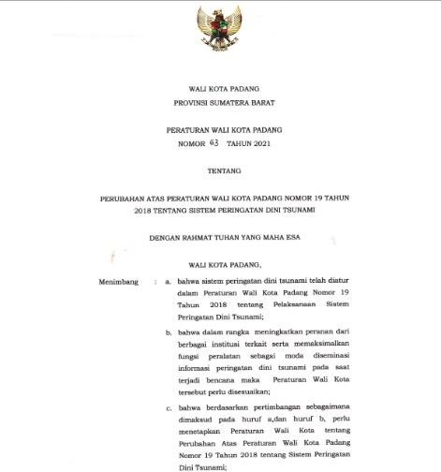
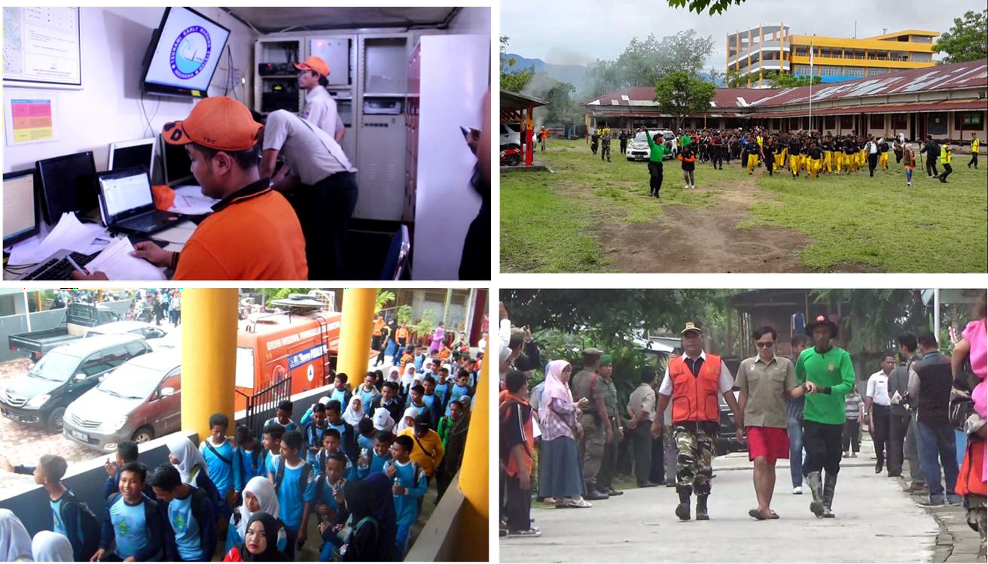

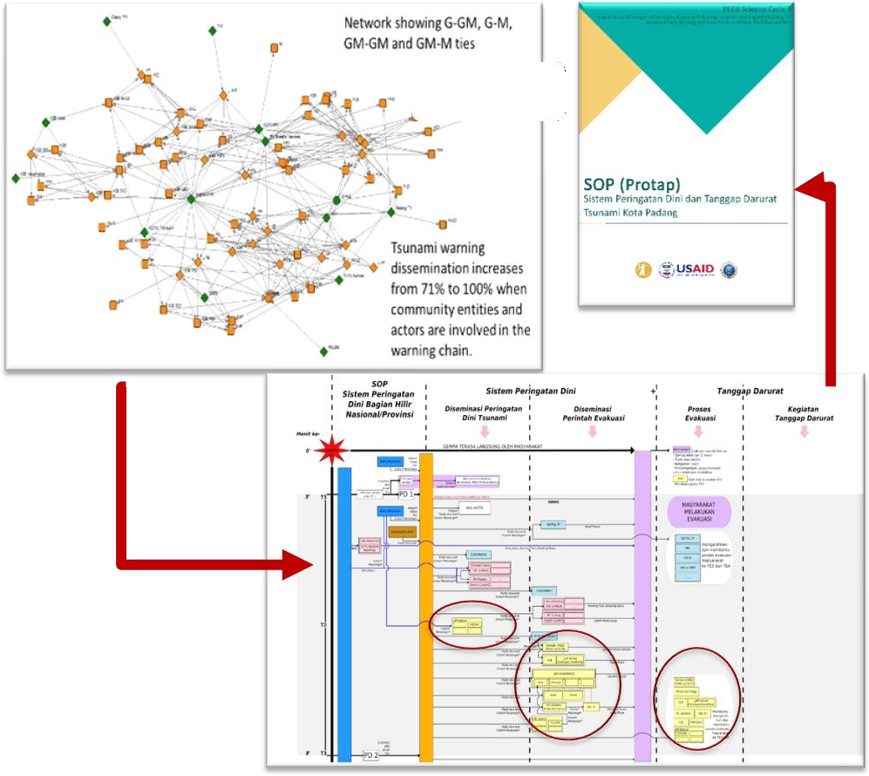
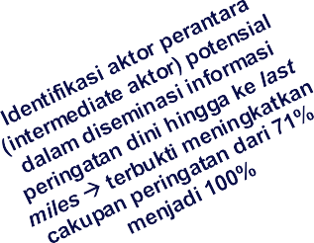
People Center Early Warning System SOP for Padang City Mayor Decree No. 63 Year 2021
Tested the SOP in
IOWave 2016

Slide 14
Research Project
Funded by British Council
Funded by Kedaireka – Govt of Indonesia
Enhance existing institutional
Share practices learners
knowledge and best among
Develop inclusive Open Educational
partnership to promote and share inclusive policies and practices for greater accessibility in community
educators,
Resources (OERs) and practical
Strengthen capacity among
and disabilities on
recommendations to help HE
educators, administrators for
principles for inclusivity in disaster
institutions and educators adopt
inclusive teaching & learning and research in DRR related HE programmes
for DRR learners, educators and
disabilities.
preparedness, discrimination, participation.
including non-
accessibility and
inclusive practices in their curriculum
design for DRR related taught
programmes and research
Develop Inclusive Standard
Identify of need, issue and challenges of Inclusivity and Accessibility to Early Warning Systems
Strengthen capacity of disabilities to understand the inclusive SOP
Operating Evacuation respond Warning.
Procedure (SOP) for disabilities to Tsunami Early
April to August
February to December
July to November
April to November
July 2024
July to August 2024
August to October 2024
December 2024

Slide 15
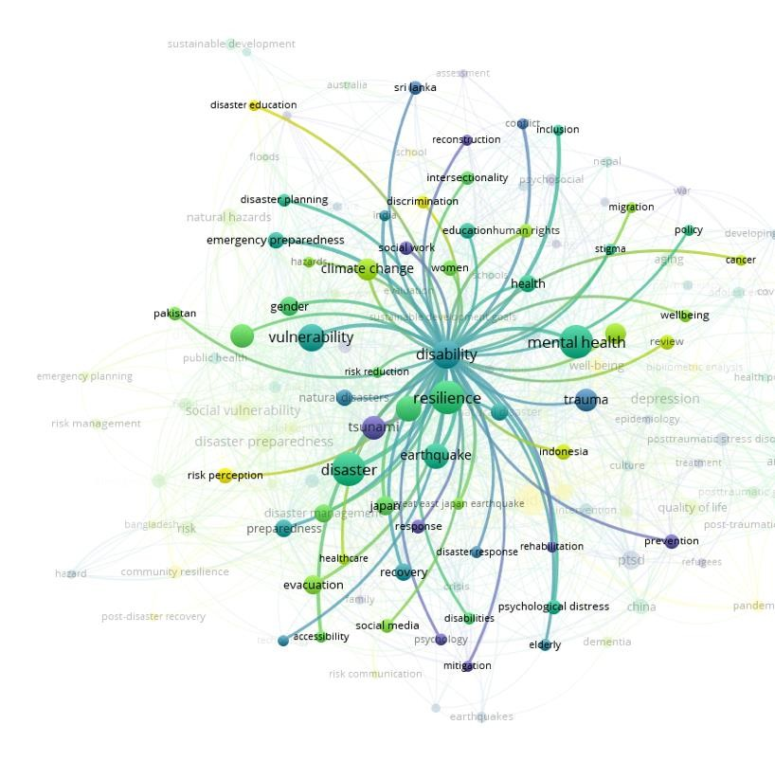
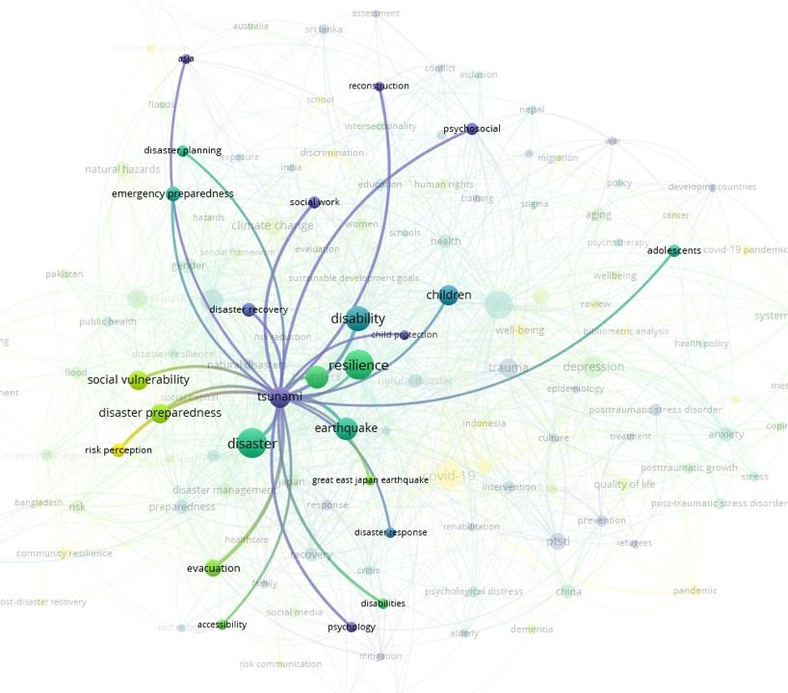
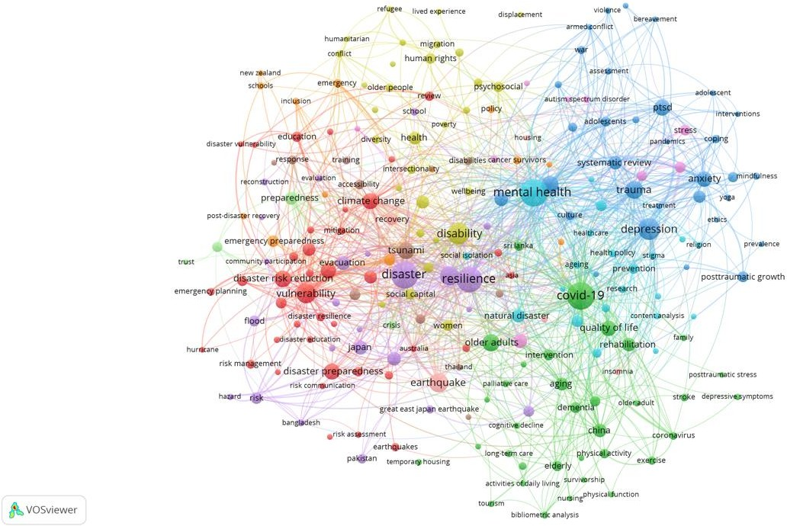
Systematic Literature Review
Disability AND Tsunami – Network Map
Disability AND Tsunami – Disability Cluster
Disability AND Tsunami – Tsunami Cluster

Slide 16
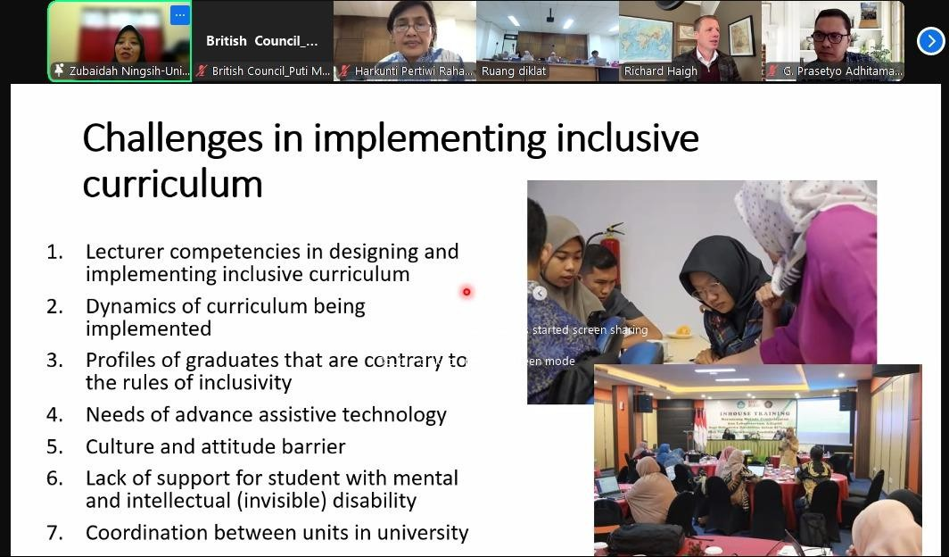
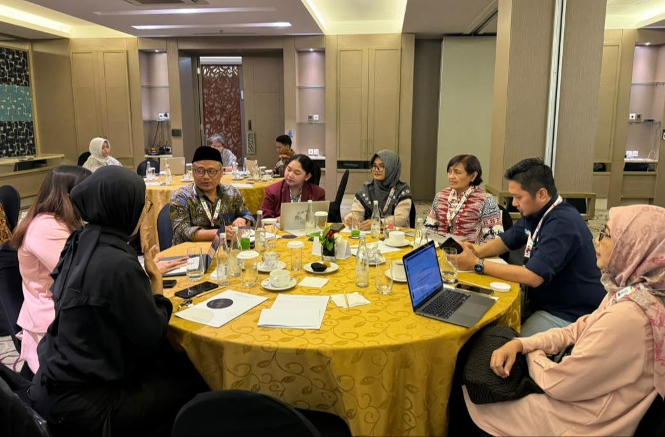
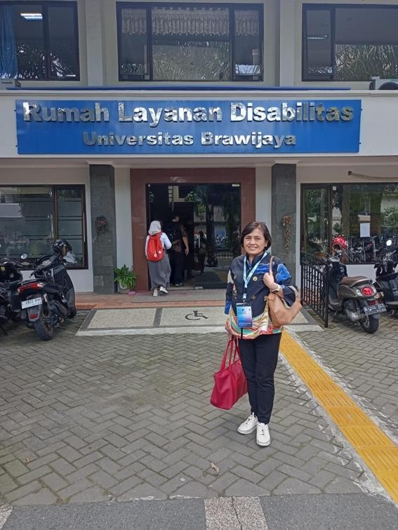
Activity 1: Workshop/FGD on Challenges and Opportunities for Using Technology in the Formulation and Implementation of Inclusive SOPs for Tsunami Early Warning Systems for Disabled People in Indonesia

Slide 17
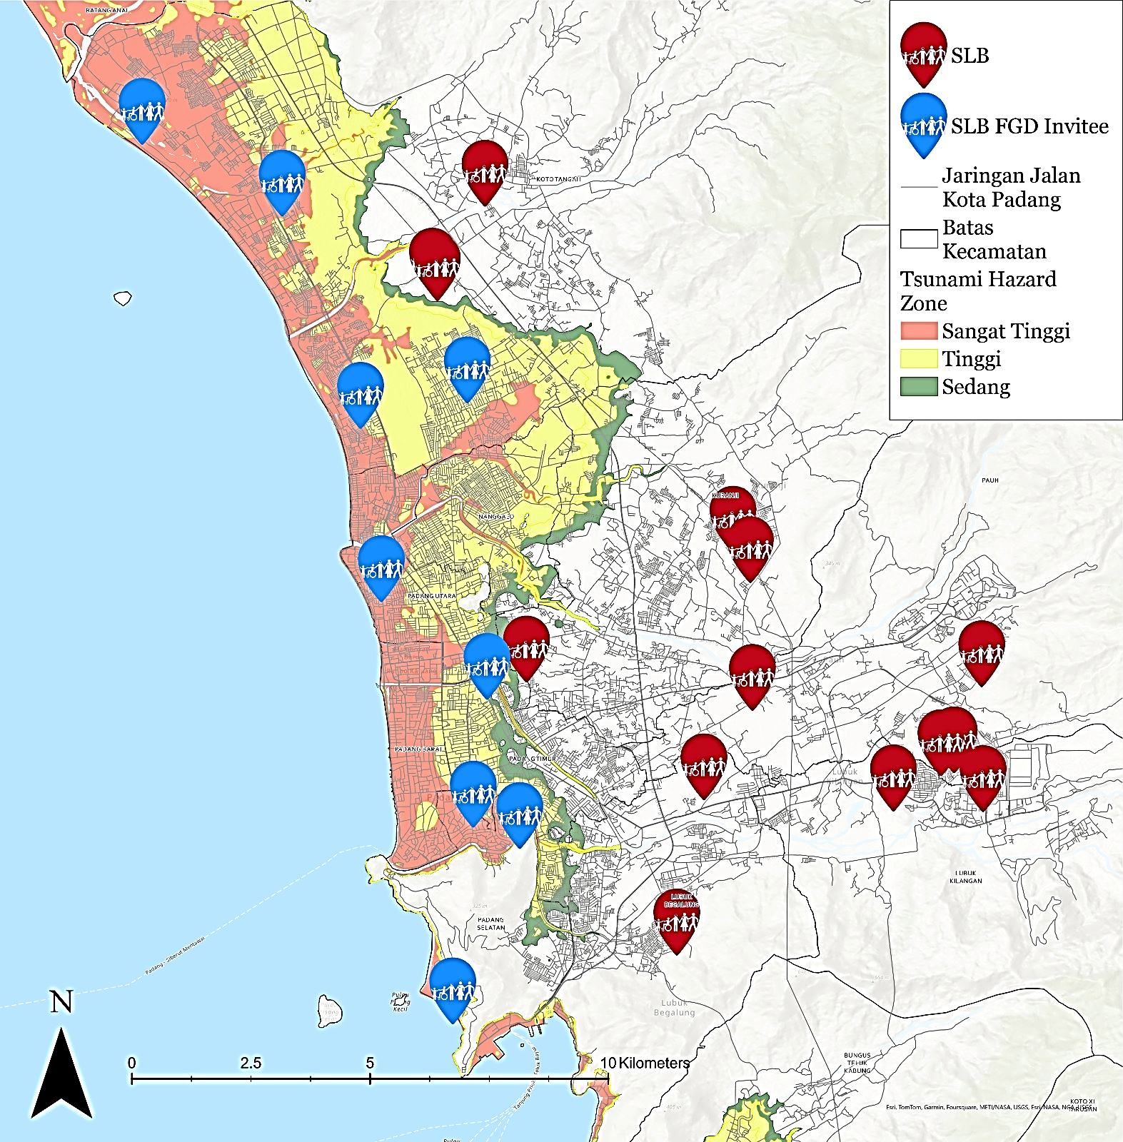
Situation of Special Schools for Disabilities in Padang City at Tsunami Prone Area
No | Special Schools | Number of Teachers | Number of Students
1 | SLBN 2 Padang​ | 44 | 134
2 | SLB Bakti​ | 7 | 22
3 | SLB MGF Lubuk Buaya Padang | 5 | 22
4 | SLB Karya Padang​ | 7 | 25
5 | SLB Perwari (Padang Utara)​ | 10 | 32
6 | SLB YPAC SUMBAR (Padang Utara)​ | 8 | 35
7 | SLB Wacana Asih (Padang Selatan)​ | 18 | 78
8 | SLB Al-Ishlaah Padang (Padang Selatan)​ | 12 | 26
9 | SLB Etnik Kreatif (Padang Selatan)​ | 5 | 19
10 | SLB Samudera Biru​ | 3 | 39
 | TOTAL | 119 | 432
SLB 2 Padang
SLB Bakti Padang
SLB MGF Lubuk Buaya Padang
SLB Karya Padang
SLB PERWARI Padang
SLB YPAC Sumatera Barat
SLB Wacana Asih Padang
SLB Al-Ishlaah Padang
SLB Etnik Kreatif Padang
SLB Samudera Biru

Slide 18
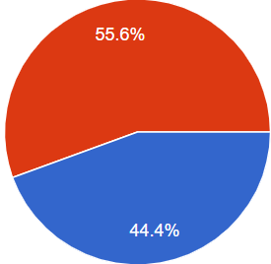
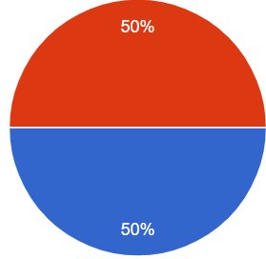
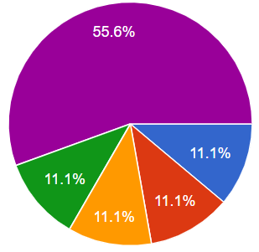
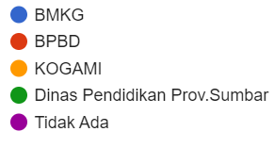
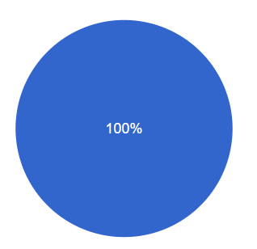
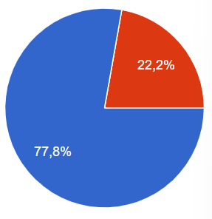
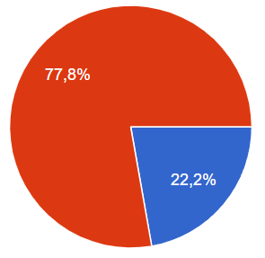
Challenges in tsunami warning dissemination and response for disability
Difficulties in accessing warning information
Lack of reachable Tsunami Vertical Evacuation Shelter
Evacuation route road condition (small, steep road, poor pavement, no sidewalk, side by side with open drainage channel )
Need for Evacuation
Need supporting help in evacuation: deaf (no need), blind (1 helper) and physical disability (min 1)
Availability of Early Warning Dissemination Tools
EWS Condition
Early Warning Information Dissemination Cooperation
Ya
Tidak
Berfungsi
Tidak berfungsi
Existing
Evacuation Route
Tsunami drill
Tsunami Shelter near School
Pernah
Tidak Pernah
Ada
Ya
Tidak
Tidak Ada

Slide 19
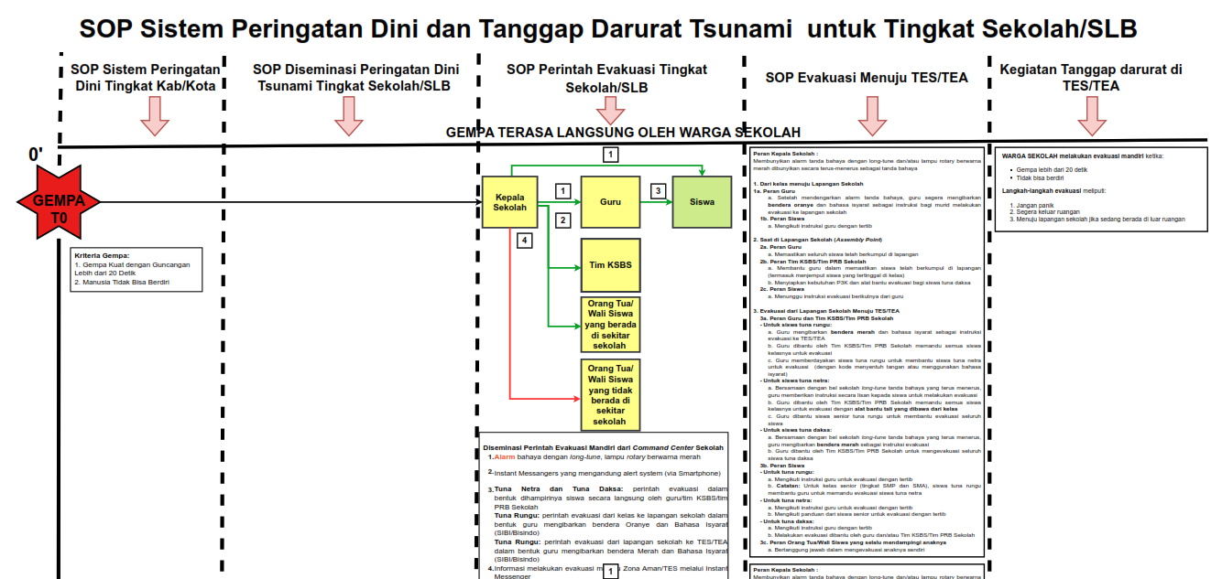
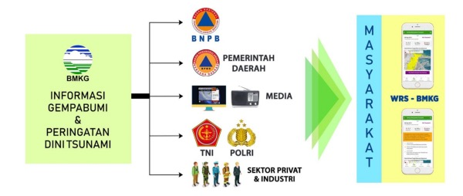
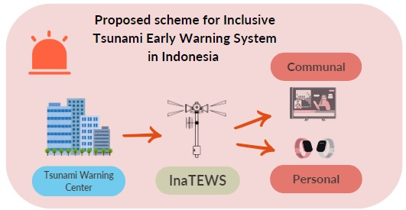
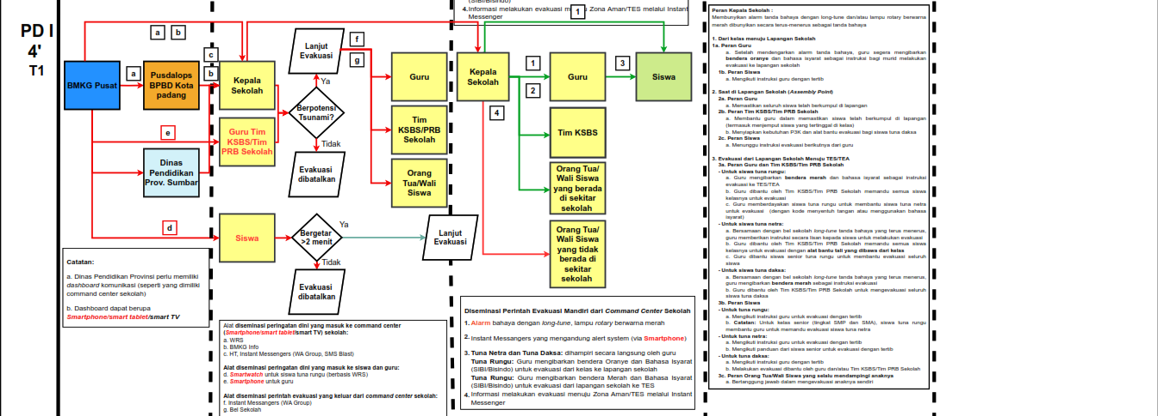
Inclusive SOP for Disability
Tsunami EWS Dissemination
Development of inclusive tsunami EWS for people with disability: deaf/hearing impairment & blind using inclusive communal and personal warning chain tools.

Slide 20
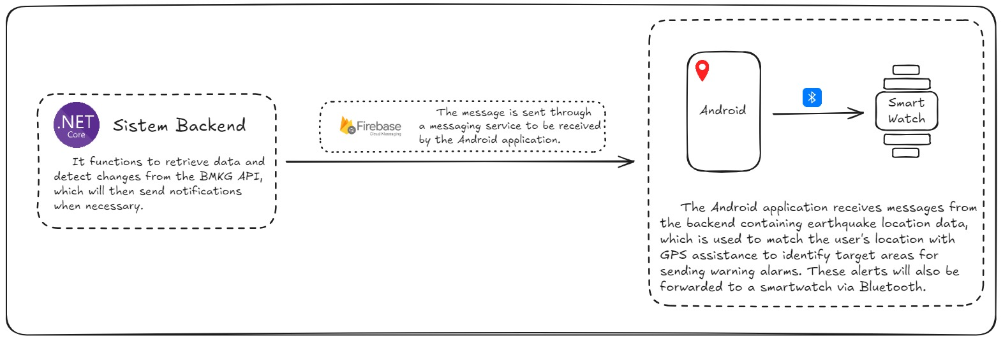
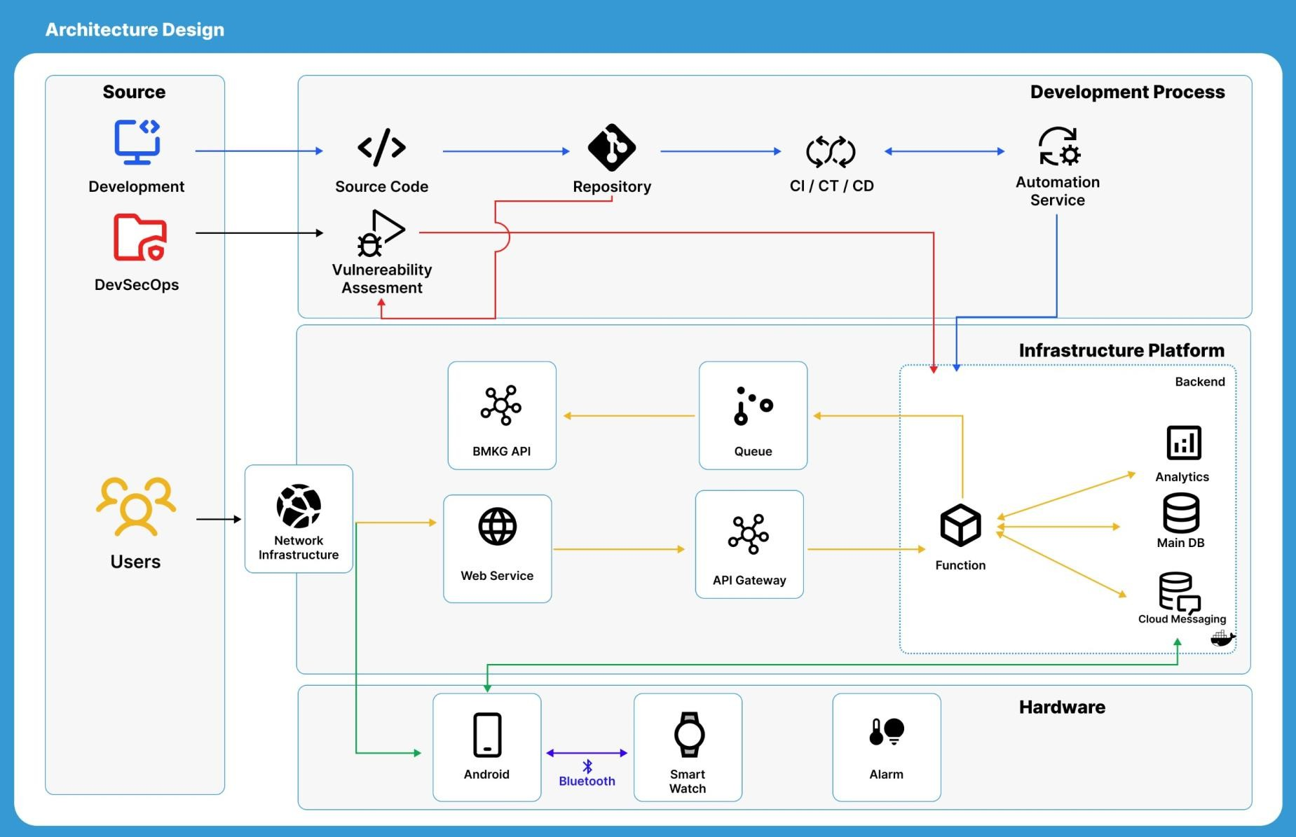
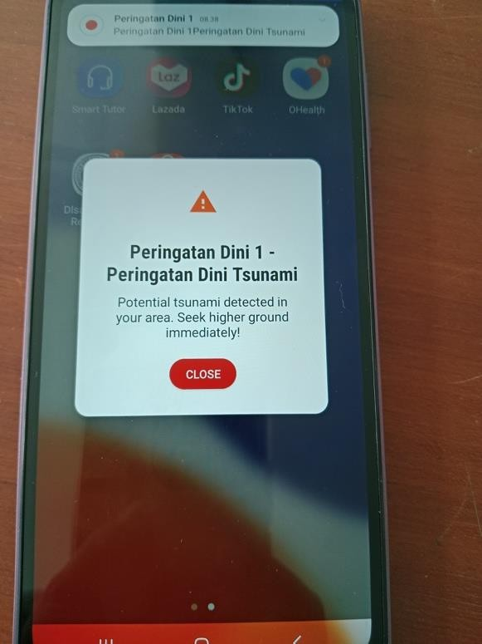
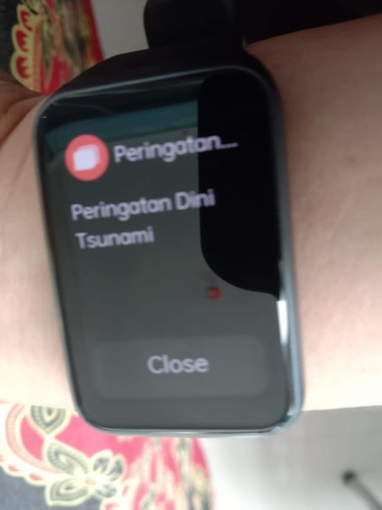
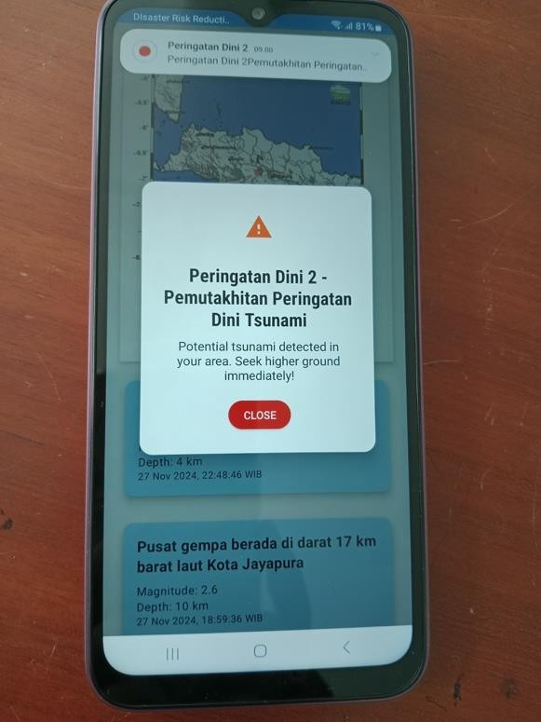
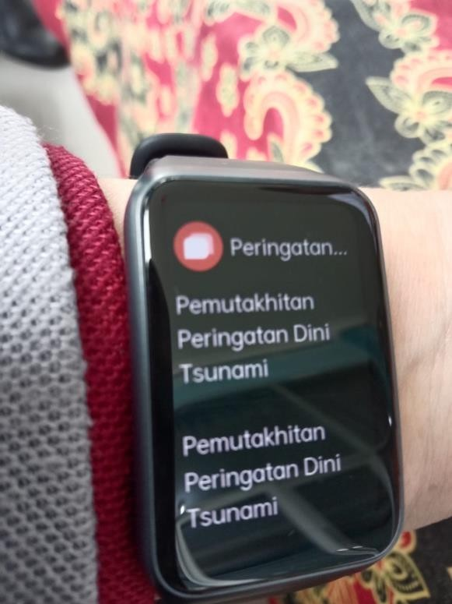
Inclusive Tools for supporting Tsunami Early Warning System
Develop
Backend System
The message is sent through a messaging service to be received by the Android application.
It functions to retrieve data and detect changes from the BMKG API, which will then send notifications when necessary.
Fire Base: cross platform messaging
The Android application receives messages from
the backend containing earthquake location data,
which is used to match the user's location with
GPS assistance to identify target areas for sending warning alarms. These alerts will also be forwarded to a smartwatch via Bluetooth.
Using Net Core Programming
Notes:
Diagram alir dari tim pengembang alat
Net Core Programming language
Fire Base – cross platform messaging

Slide 22
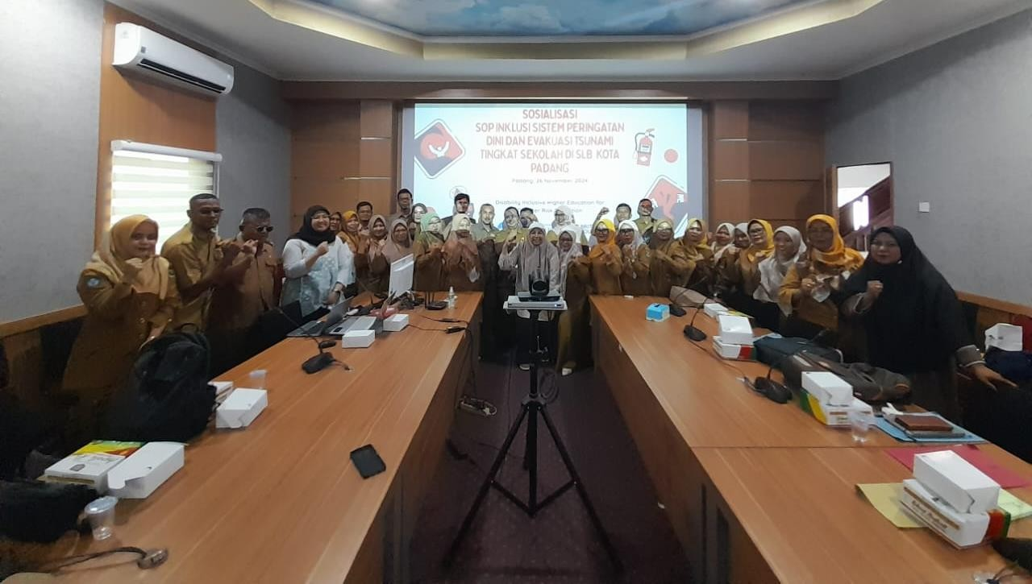
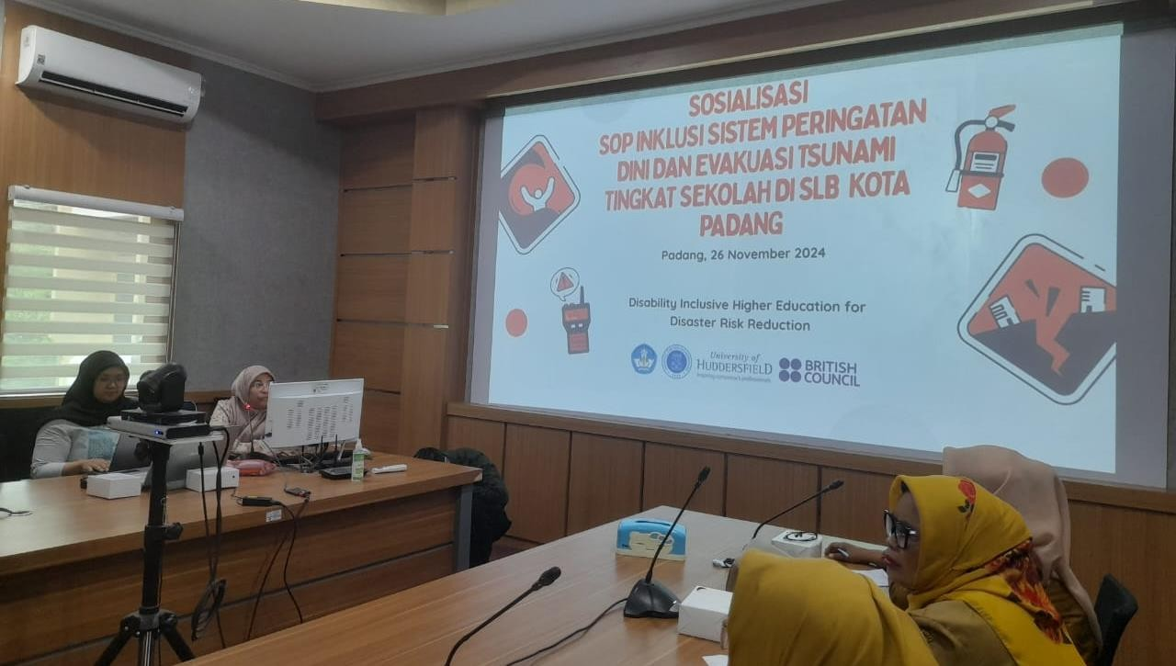
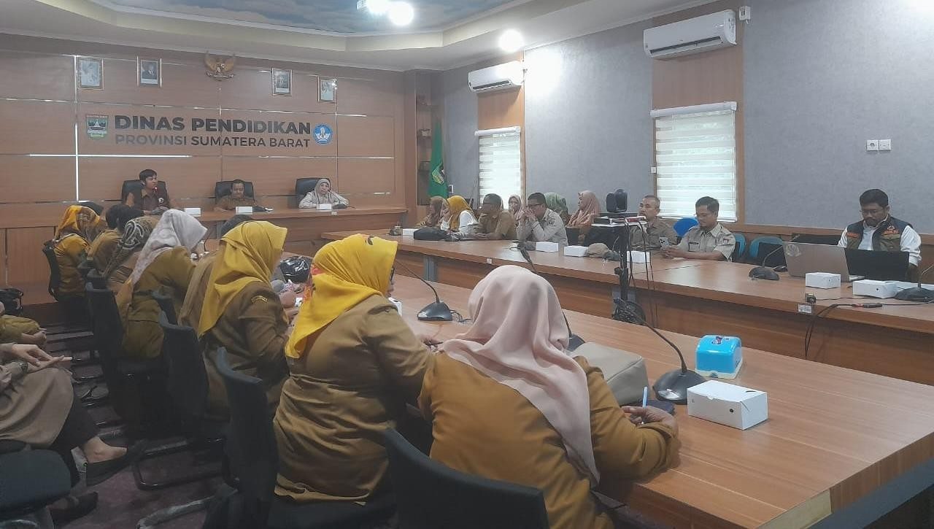
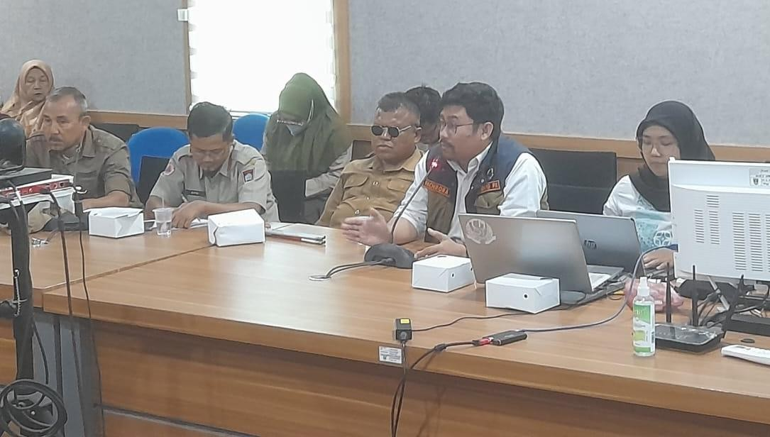
Preparation for testing the Iclusive SOPin Padang City
Kantor Dinas Pendidikan Provinsi Sumbar, 26 November 2024

Slide 23
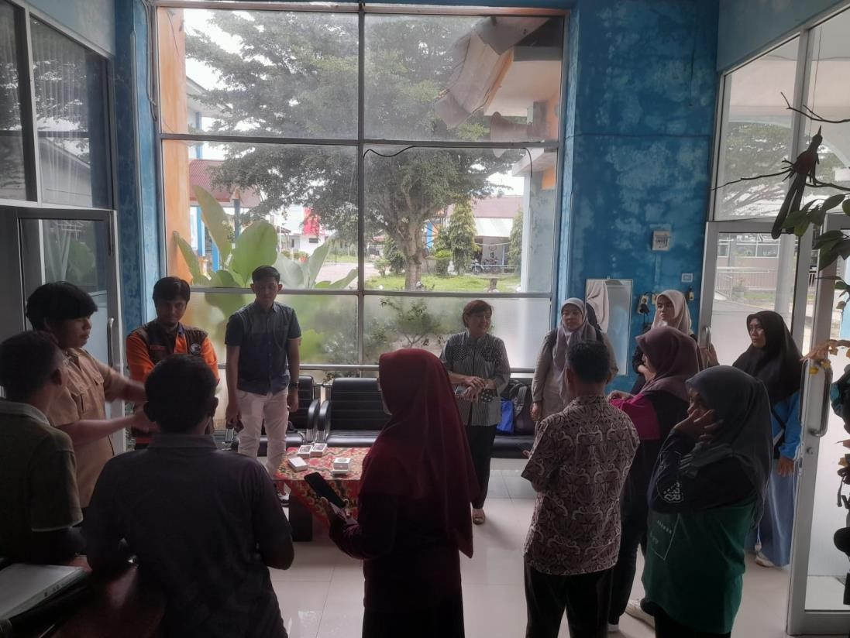
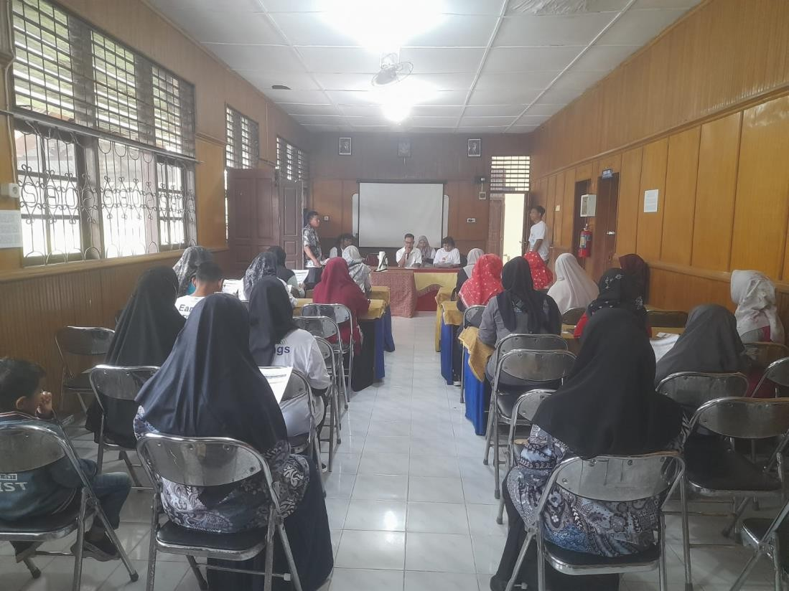
Briefing Gladi Simulasi Pengujian SOP Sistem Peringatan Dini dan Perintah Evakuasi Tsunami Inklusif untuk SLB di Kota Padang: SLBN 2 Padang Padang, 28 November 2024
Penjelasan rundown simulasi dan briefing mengenai cara kerja alat peringatan dini inklusif (smartphone dan smartwatch hasil pengembangan Tim ITB

Slide 24
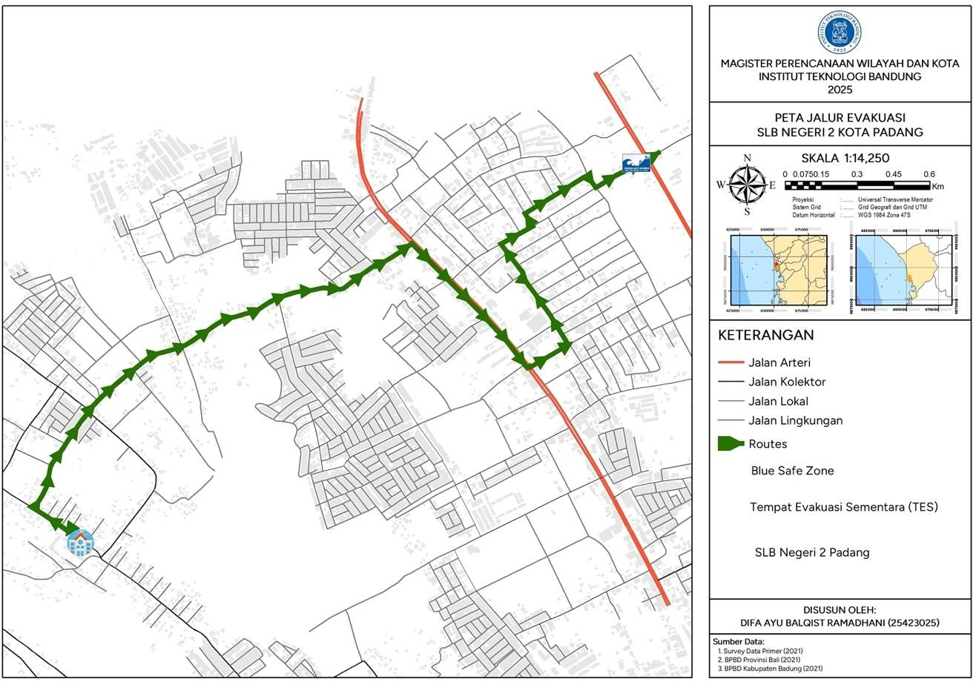
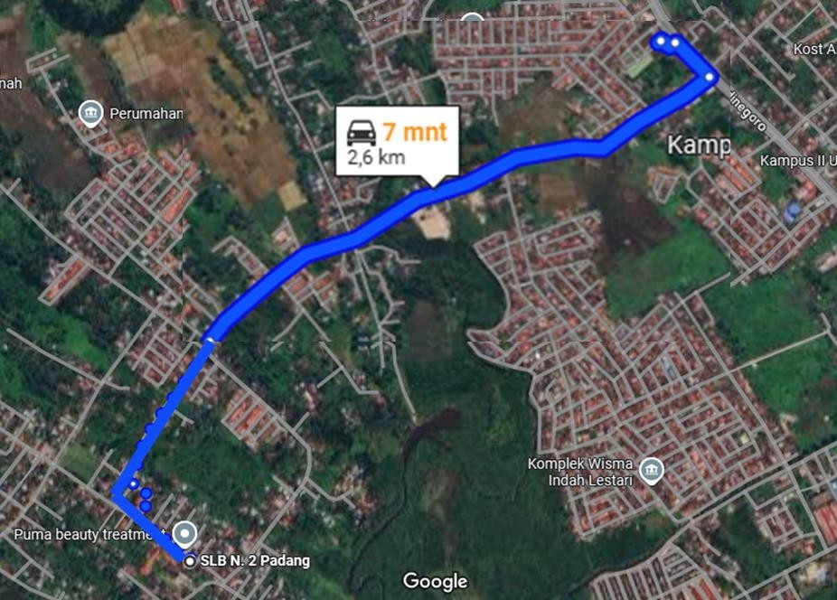
Peta Rute Evakuasi – SLBN 2
Hasil Network Analysis
Hasil Diskusi dengan Sekolah, Dinas, dan Komunitas

Slide 25
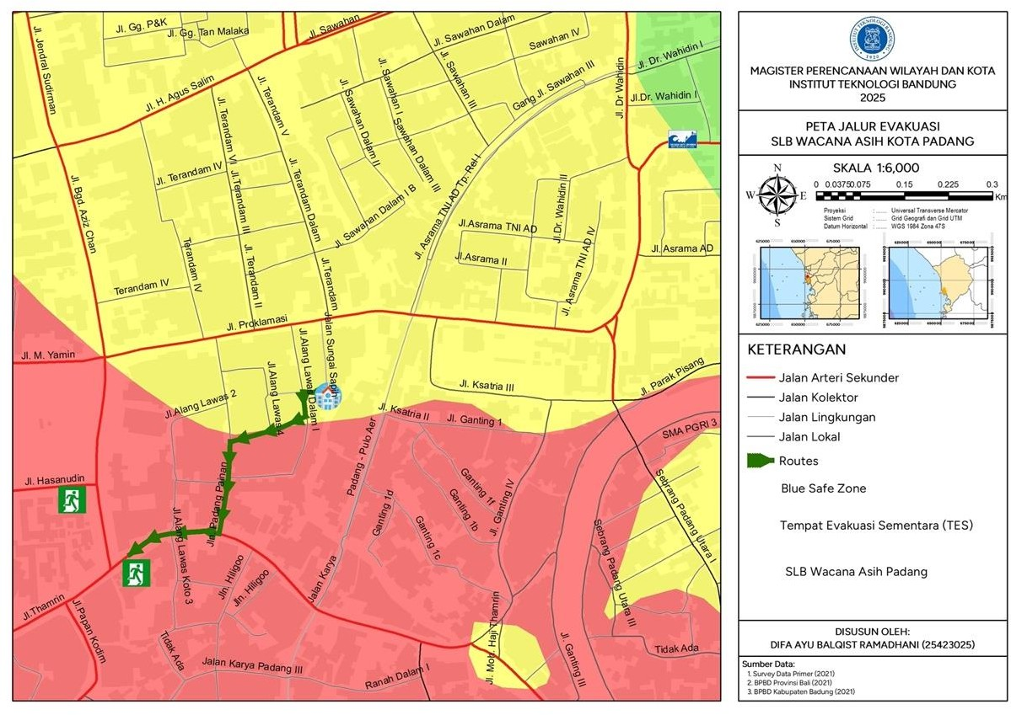
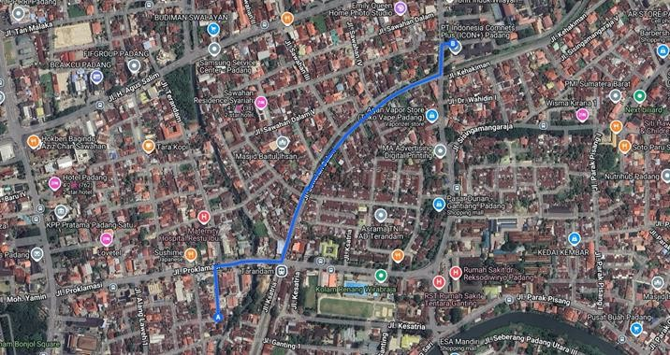
Peta Rute Evakuasi – SLB Wacana Asih
Hasil Network Analysis
Hasil Diskusi dengan Sekolah, Dinas, dan Komunitas

Slide 26
Simulation for Inclusive SOP and Testing Inclusive Warning Tools
Focus on two location: SLBN2 dan SLB Wacana Asih

Slide 27
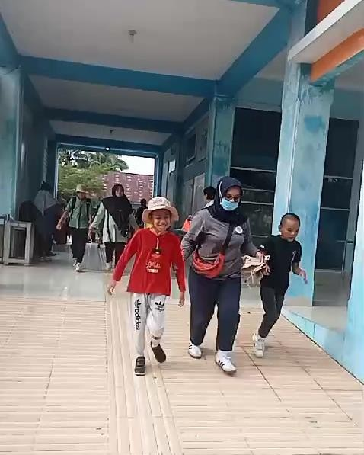
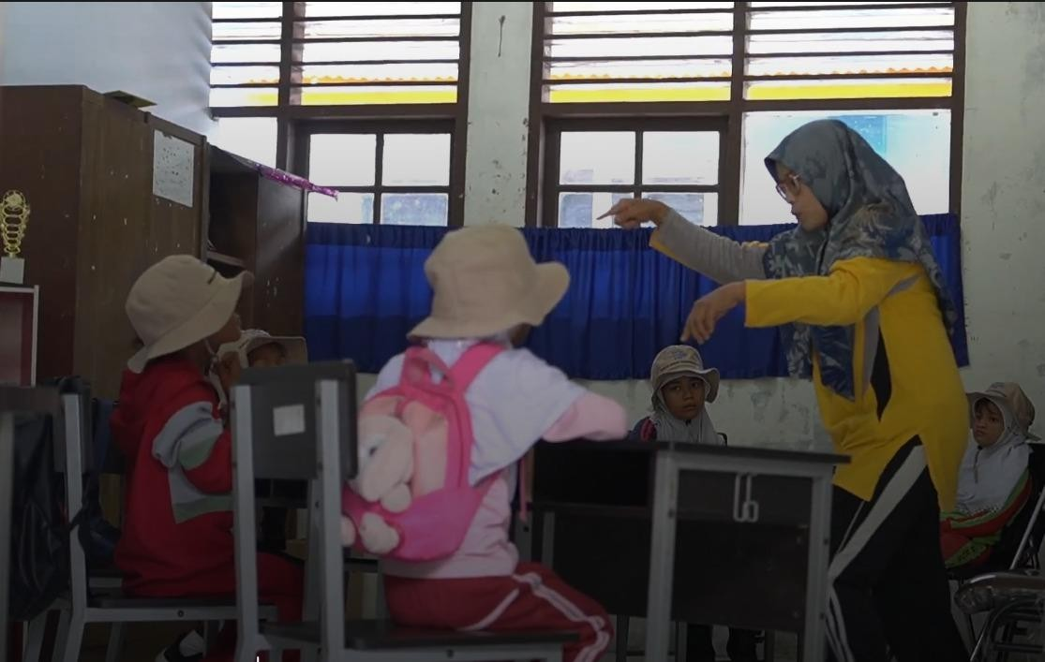
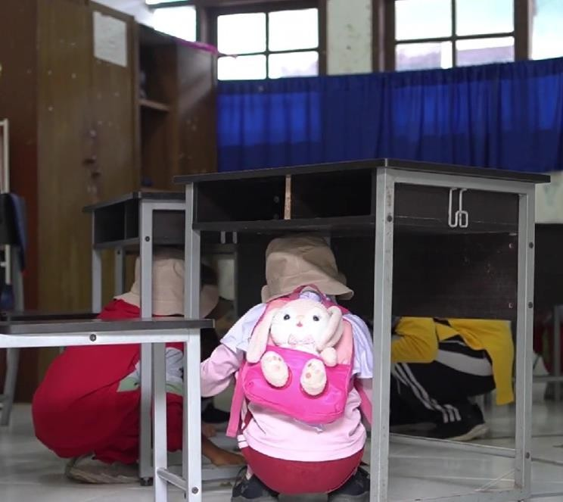
1. Simulasi Pengujian SOP Sistem Peringatan Dini dan Perintah Evakuasi
Tsunami Inklusif untuk SLBN2 Padang
Padang, 29 November 2024
Simulasi dilaksanakan di:
1. SLBN 2 Padang menuju Simpang Adinegoro

Slide 28
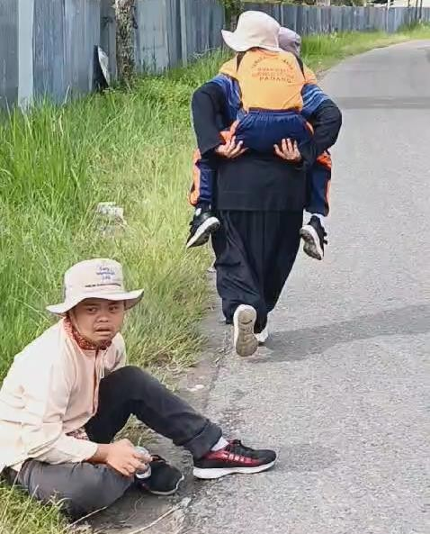
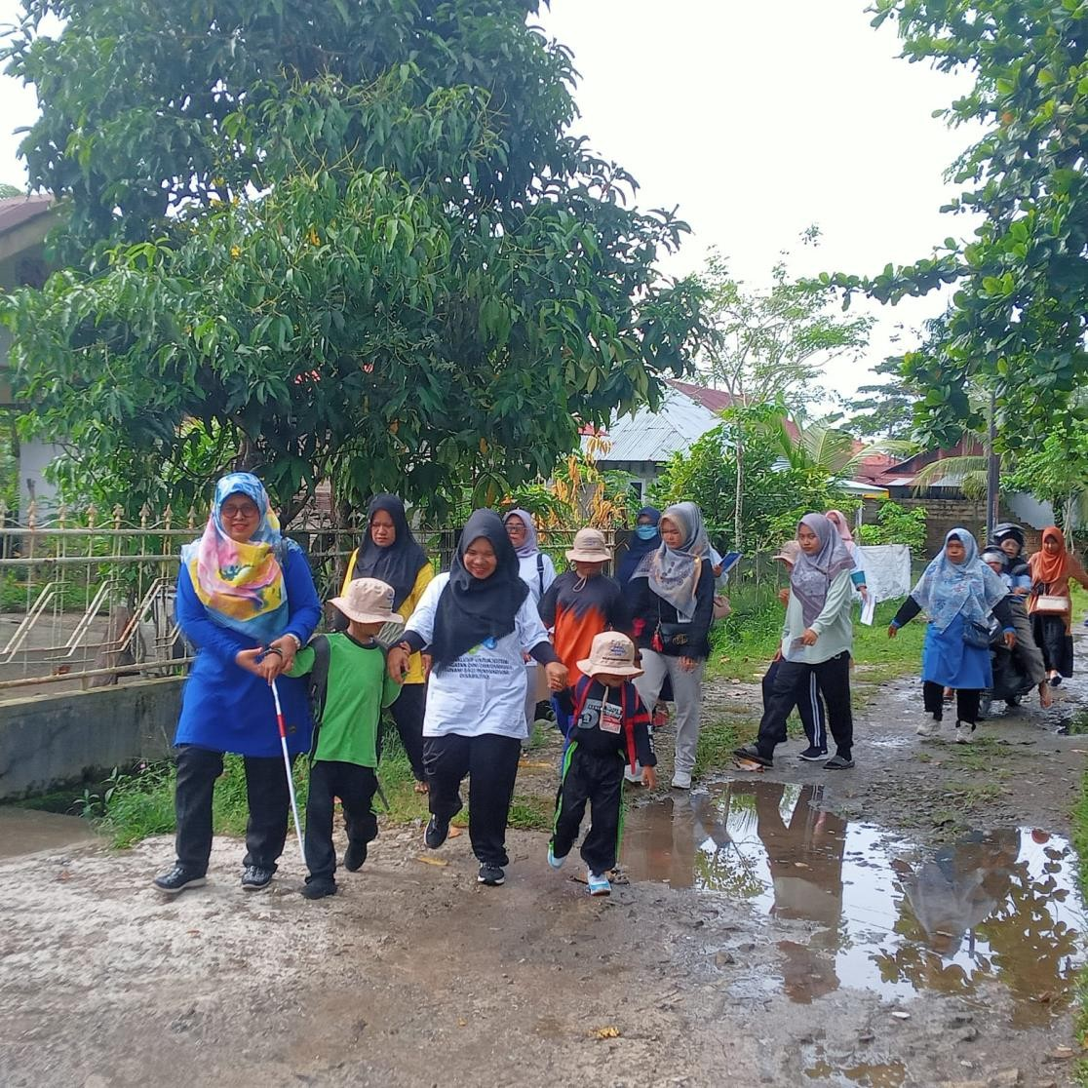
Simulasi Pengujian SOP Sistem Peringatan Dini dan
Perintah Evakuasi Tsunami Inklusif untuk SLB

Slide 29
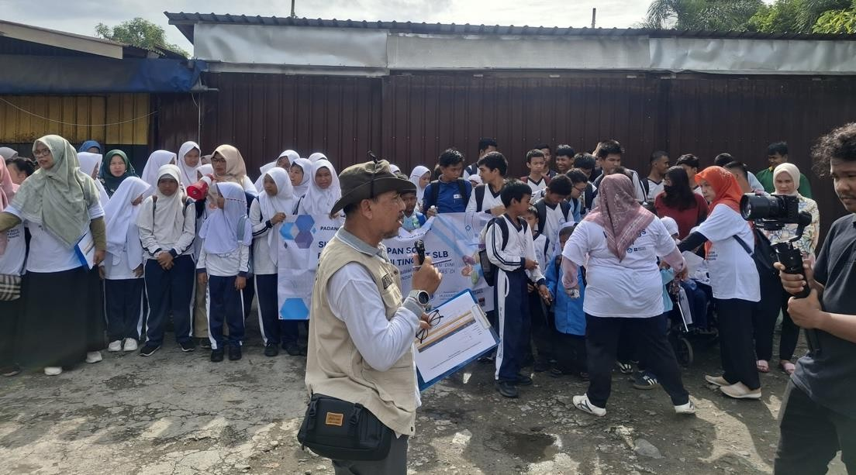



2. Simulasi Pengujian SOP Sistem Peringatan Dini dan Perintah Evakuasi
Tsunami Inklusif untuk SLB Wacana Asih di Kota Padang
Padang, 29 November 2024
Simulasi dilaksanakan di:
1. SLB Wacana Asih menuju PLN Sawahan

Slide 30


Briefing Simulasi Pengujian SOP Sistem
Peringatan Dini dan Perintah Evakuasi Tsunami Inklusif untuk SLB di Kota Padang

Slide 31


Siswa yang saling membantu saat evakuasi maupun di TES

Slide 32
1. Simulasi Pengujian Alat Peringatan Dini dan Perintah Evakuasi Tsunami
Inklusif untuk SLB – PD 1 dan PD 2
Padang, 29 November 2024
Peringatan Dini 1
Peringatan Dini 2
Dilakukan pengujian alat peringatan dini inklusif (smartphone dan smartwatch). Alat akan bergetar dan berdering panjang jika terdapat peringatan dini potensi tsunami dari BMKG

Slide 33



2. Simulasi Pengujian Alat Peringatan Dini dan Perintah Evakuasi Tsunami
Inklusif untuk SLB – PD 3 dan PD 4
Padang, 29 November 2024
3. Simulasi Pengujian Alat Peringatan Dini dan Perintah Evakuasi Tsunami Inklusif untuk SLB – PD 3 dan PD 4
Padang, 29 November 2024
Peringatan Dini 3
Peringatan Dini 4
Dilakukan pengujian alat peringatan dini inklusif (smartphone dan smartwatch). Alat akan bergetar dan berdering panjang jika terdapat peringatan dini potensi tsunami dari BMKG

Slide 34

3. Simulasi Pengujian Alat Peringatan Dini
dan Perintah Evakuasi Tsunami Inklusif
untuk SLB – KS SLBN2 dengan HP (Dashboard – Peringatan Dini Tsunami)
Padang, 29 November 2024

Slide 35
6. Hot Wash: Evaluasi hasil
observasi Simulasi SOP Inklusif

Slide 36



Hotwash/Evaluasi Simulasi Pengujian SOP Sistem Peringatan Dini dan Perintah Evakuasi Tsunami Inklusif untuk SLB di Kota Padang
Hotel Truntum Padang, 29 November 2024
Evaluasi dilakukan setelah kegiatan simulasi dengan melibatkan perwakilan guru pelaksana dan observer (perwakilan guru SLB, Dinas Pendidikan Prov. Sumbar, BPBD Prov Sumbar, BPBD Kota Padang, BMKG Padang Panjang, dan KOGAMI)

Slide 37
Terima Kasih

