Slide 1
Permanent Service for Mean Sea Level and British Oceanographic Data Centre
Report to GLOSS Group of Experts XVIII
Panama, March 2025
Elizabeth Bradshaw, Andrew Matthews, Chanmi Kim

Slide 2
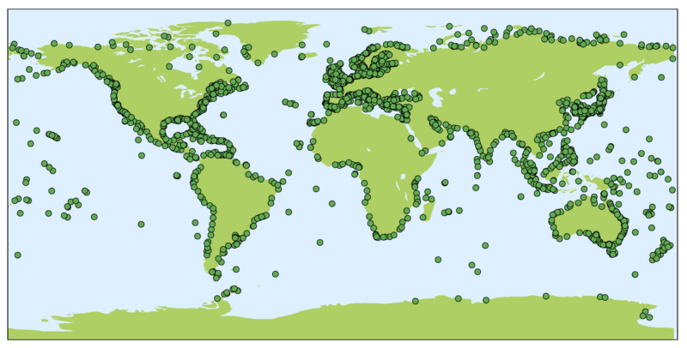
Current status of the PSMSL data centre
Global data centre for long term mean sea level data, with history dating back to 1933
Hosted and funded by the UK’s National Oceanography Centre (NOC) and is one of the key data centres for the Global Sea Level Observing System (GLOSS)
Service for both IAG and IAPSO
Member of GGOS Bureaus of Networks & Observations, and Products & Standards​
Data are used to develop and validate ocean circulation, tidal and storm surge models; monitor tsunamis, storm surges, and long-term sea-level changes; and help validate satellite ocean surface altimeters
All stations in the PSMSL databank

Slide 3
Staff members
NOC staff
Angela Hibbert, capacity building
Chris Hughes, scientific advisor
Svetlana Jevrejeva, projections, impact and adaptation
Joanne Williams, surges, extremes and tides
Simon Williams, GNSS and VLM
Chris Wilson, ocean circulation and modelling
Philip Woodworth, scientific advisor
Lesley Richards, former director
PSMSL Staff
Elizabeth Bradshaw*, Head of the PSMSL
Andrew Matthews, Technical lead, PSMSL
Chanmi Kim, PSMSL data manager
* British Oceanographic Data Centre’s (BODC) lead for sea level data management, including GLOSS and UK’s tide gauge network

Slide 4
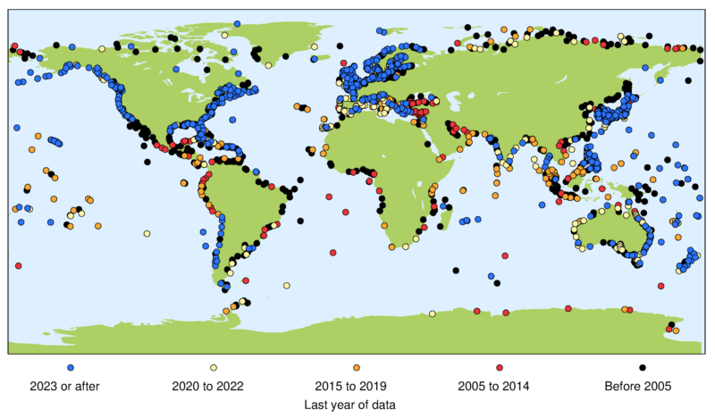
Mean sea level dataset
Acquire, quality control and make available mean sea level data
The PSMSL MSL dataset has continued to grow from 2020 to 2024
Some sites have not contributed data for over 20 years, and it may be that these stations have ceased to function
Many of older stations are in the Arctic and Antarctic and are key gaps in the dataset
Produce and distribute sea level related products (e.g. estimates of trends, land movement)
Year of most recent data received by PSMSL
Data added to the PSMSL databank

Slide 5
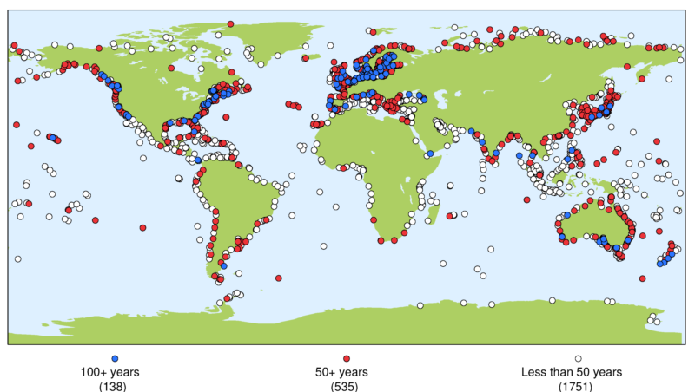
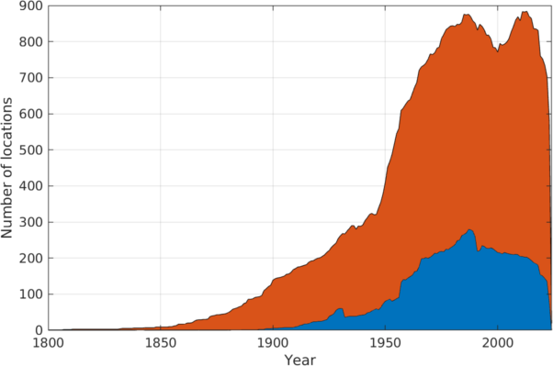
Mean sea level dataset
Distribution of long tide gauge records
North-South hemisphere distribution of data received by PSMSL
No datum-controlled records at PSMSL longer than 100 years for the Arctic, Africa, South America or Antarctica
In 2022, the head of the PSMSL wrote a letter of support for the Southern Ocean Sea Level Monitoring Network as part of Australian Antarctic Division Decadal planning activities to highlight the need for data in the Southern Ocean

Slide 6
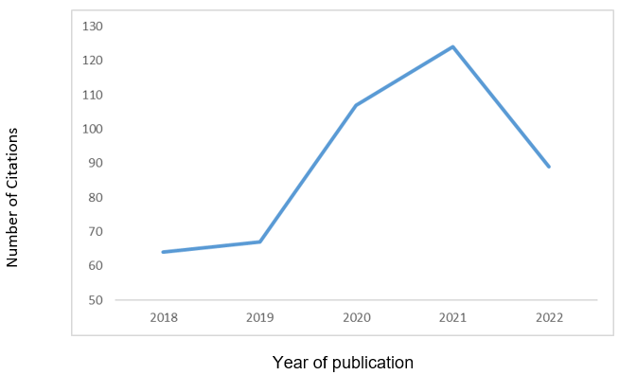
Citations of PSMSL data
451 papers published in 182 journals (2018–2022)
14 journals had an Impact Factor > 10, with 38 papers published in these
Top 3 journals by Impact Factor:
Nature
Reviews of Geophysics
Nature Climate Change
Top 3 journals by number of publications:
Advances in Space Research (21)
Remote Sensing (18)
Geophysical Research Letters (16)
Wide-ranging subject areas: climate studies, satellite altimetry, marine engineering, environmental assessment, geology
Number of dataset citations from 2018-2022

Slide 7
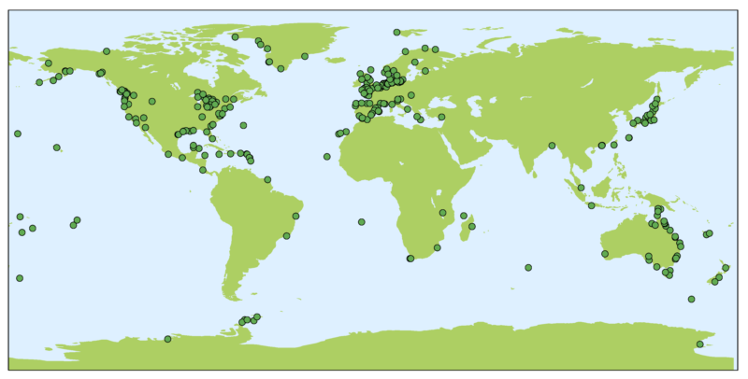
GNSS Interferometric Reflectometry (GNSS-IR)
As well as a receiving a direct signal from a GNSS satellite, the GNSS receiver detects a reflected signal off the surface of the water. Noise changes as sea rises and falls and sea level data can be extracted from signal‐to‐noise ratio
The PSMSL continues to host a repository of sea level data extracted from GNSS receivers using interferometric reflectometry (GNSS-IR)
GNSS-IR sea level records available from PSMSL

Slide 8
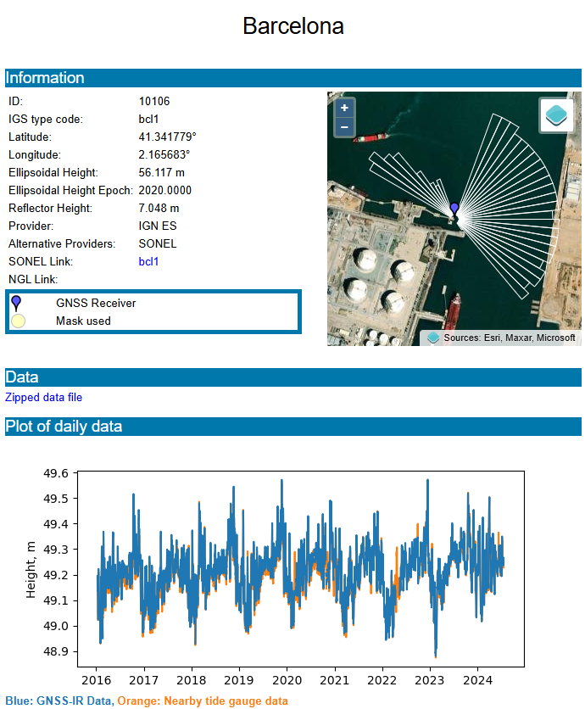
Data portal at https://psmsl.org/data/gnssir​
The PSMSL initially created the portal with funding from the European Union Horizon 2020 EuroSea project, and are now maintaining it using core NOC funding.
Over the past two years, we have expanded the portal from about 250 sites to nearly 350
Improved the documentation on the website, including adding Python notebooks illustrating the available parameters in the data files, and details of metadata files that will help those wishing to access data programmatically

Slide 9
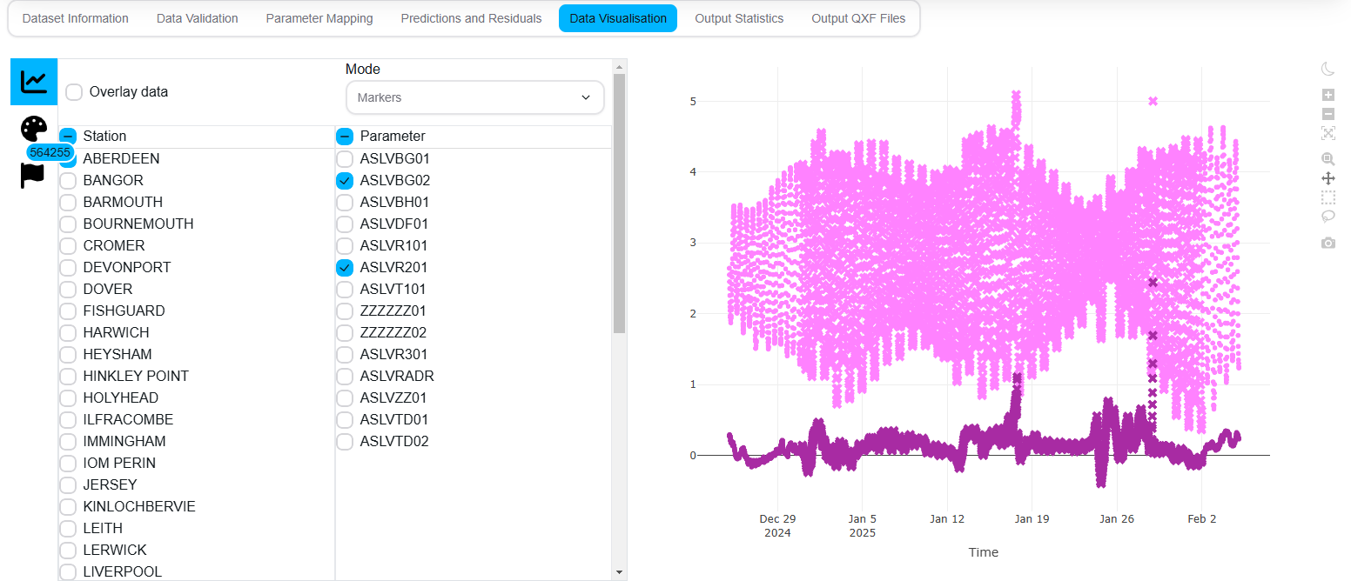
BODC developments
BODC’s new quality control software
The previous package for quality controlling sea level data become difficult to maintain due do its complexity and the current IT team’s relative unfamiliarity
With help from PSMSL scientists, BODC developers modernized the package using common libraries and best practices
Now being used to quality control sea level data from the UK’s national tide gauge network

Slide 10
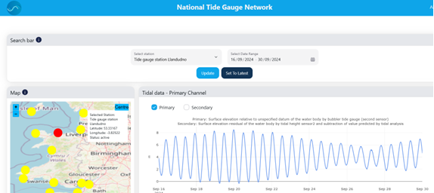
BODC developments
The prototype BODC dashboard
Tide gauge data from two UK sites were added to BODC’s ERDDAP server under the CreamT project, which developed a dashboard for coastal flood monitoring
Expanded to include the entire UK tide gauge network, with another prototype dashboard

Slide 11
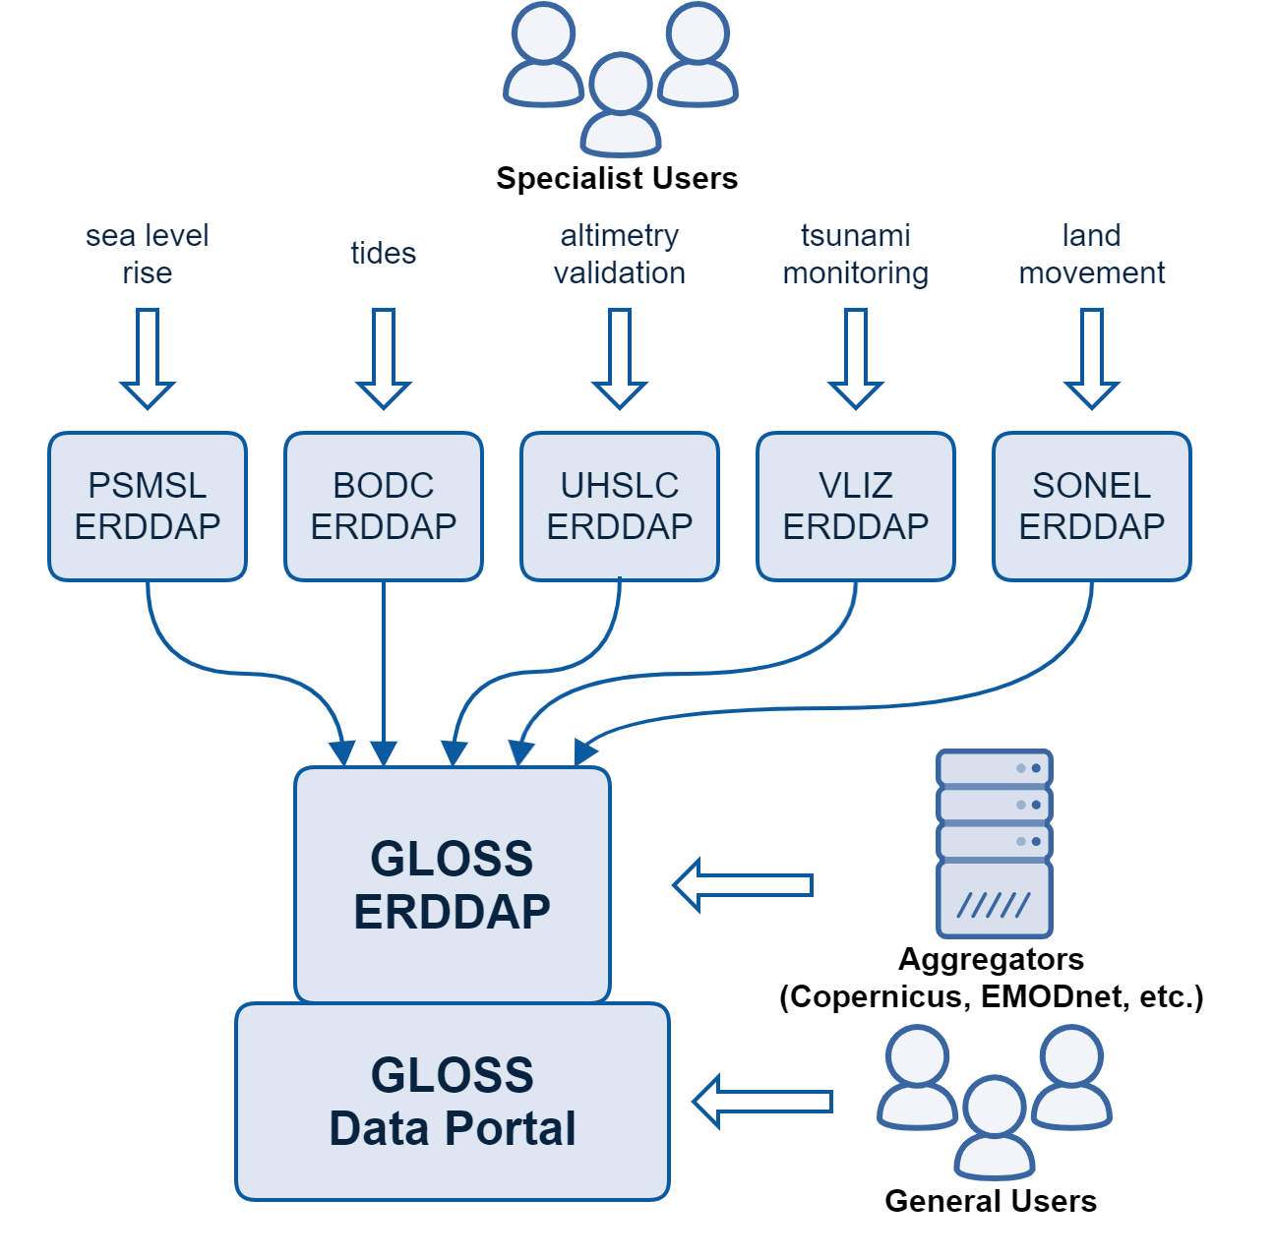
BODC developments
PSMSL is exploring ways to deliver data through ERDDAP for the upcoming GLOSS ERDDAP server
Initial test netCDF files are ready, but metadata may need updates to align with the final GLOSS data model
Schematic of the proposed unified GLOSS data portal, and how different users might interact with our data

Slide 12
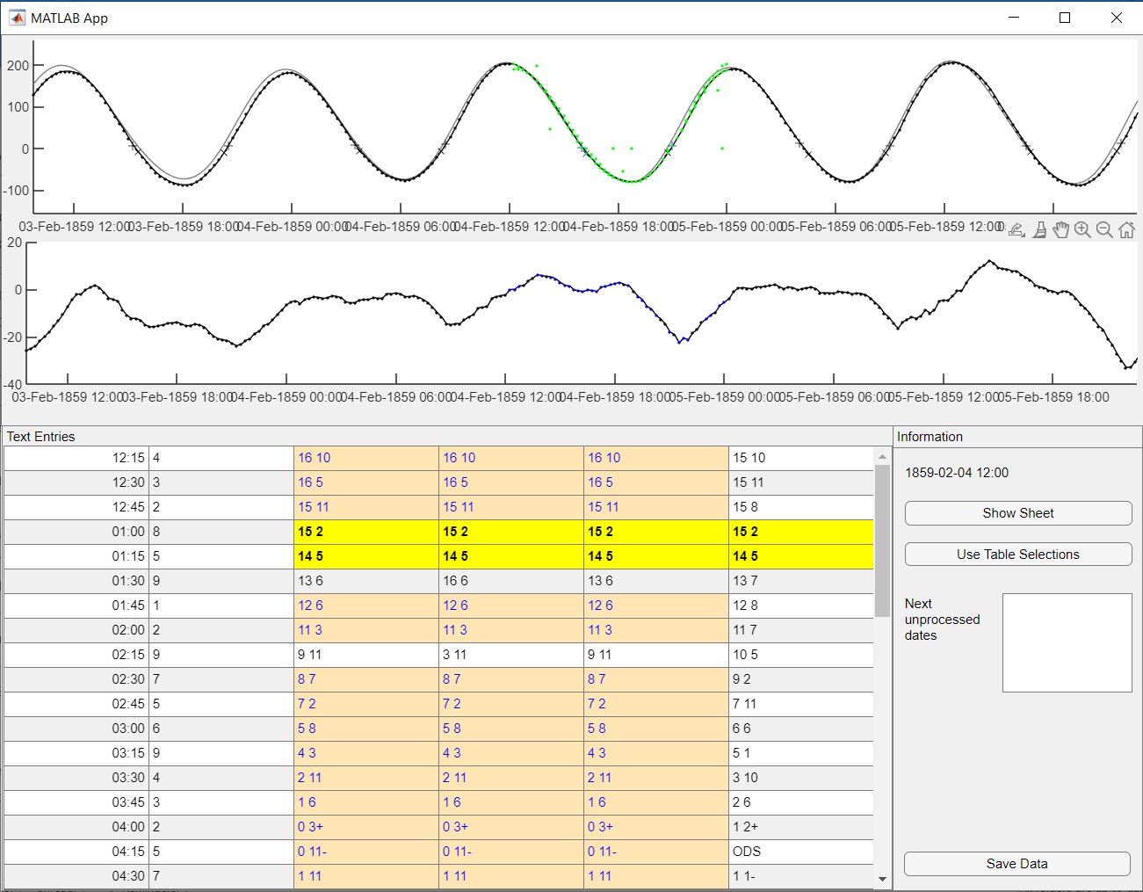
Other activities
Data rescue
Finished quality control of data from two sites in Liverpool Bay (1853–1903) recovered using volunteers on citizen science platform Zooniverse.org
Final data submitted to BODC for ingestion and used to validate a reanalysis of a storm surge in 1902 (Hawkins et al., 2023)
An example of quality controlling data recovered from ledgers in the UK Tides Zooniverse project

Slide 13
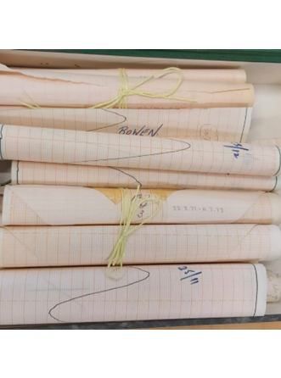
Other activities
Meetings and Trainings
Reorganisation of PSMSL archives
Trainings:
Providing training in sea level monitoring and science to remote sensing PhD students in the UK (January 2023)
Delivering training in tidal analysis and sea level variability to Madagascan stakeholders (January 2024)
Visiting Anguilla to support their project to obtain tsunami ready accreditation from the IOC, including sessions on tide gauge maintenance and sea level science (March 2024)
Meetings:
Members of the PSMSL helped organise a tide gauge workshop alongside the EuroGOOS Tide Gauge Task Team as part of the EuroSea programme (May 2023)
Held a workshop on best practices in tidal analysis as part of an ongoing IAPSO study group
A selection of mareograms from Australia contained in the PSMSL archives
In 2024, NOC refurbished its Liverpool office, prompting the relocation of PSMSL's paper archives. We used this opportunity to review, reorganise, catalogue, and dispose of outdated content.

Slide 14
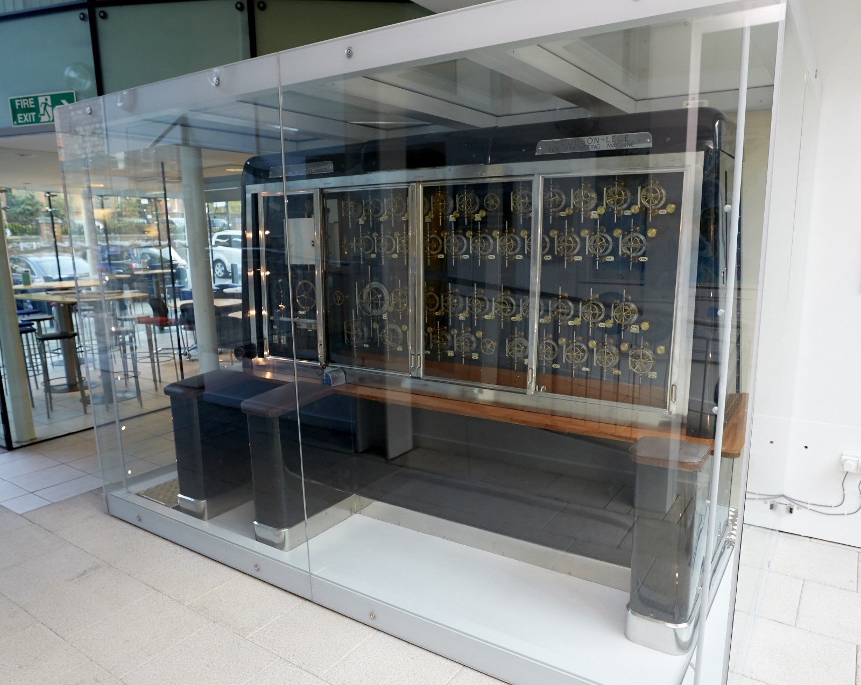
Other activities
Refurbishment of the Doodson-Légé tidal prediction machine
The NOC Liverpool site still hosts two analogue tidal prediction machines, on loan from National Museums Liverpool
In July 2024, a metals conservator performed routine maintenance on the newer Doodson-Légé machine
In the 1950s, a team of assistants known as “computers” operated these machines. As they retired, the knowledge was passed down, but only a few staff members knew how to operate them. We took the opportunity to train four more “computers” and document the process to preserve this important history
The Doodson-Légé Machine, and a close up of the mechanisms used to adjust the parameters for an individual constituent.

Slide 15
Future plans
Finalising the delivery of PSMSL and BODC data through ERDDAP servers
Improving PSMSL metadata, particularly lineage metadata, so our data suppliers are properly credited
Continuing investigation of the use of permanent identifiers to improve tide gauge metadata
Further developing the use of GNSS-IR, in particular near real time delivery and significant wave height data.
Continuing to explore methods of recovering historical sea level data

Slide 16
Thank you for your attention!

