Slide 1
UPDATE:
IAPSO best practice study group on tidal analysis
Andrew Matthews
GLOSS GE XVIII 11-14 March 2025

Slide 2
IAPSO best practice study groups
Calls issued every two years
Provides funding for a several day meeting
Consensus should be sought regarding the pros and cons of different techniques
Ideally this will result in a short technical guideline that will assist researchers in making the best choices in e.g. analysing data
Recommend https://www.oceanbestpractices.org/

Slide 3
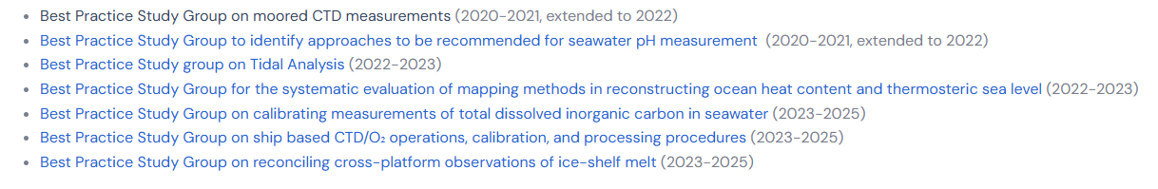
Iapso best practice study groups
See https://iapso-ocean.org/activities/best-practice-study-groups.html

Slide 4
OVERVIEW
An attempt to write a best practice document for tidal analysis
Not a comprehensive study of the science
More a practical guide
IAPSO funded meeting at the end of 2023
Will be submitted to www.oceanbestpractices.org
Plans for translations with support of IOC

Slide 5
Where are we now?
Google drive with several documents – email antt@noc.ac.uk
Meeting report – IAPSO deliverable
First draft (“Chapter 1”)
Example constituent sets
List of tidal software

Slide 6
Example constituent sets
Duration of data (not inc. gaps) | Number of Constituents | Comments
1 – 10 days | 1 | M₂ only
15 days | 4 | M₂, S₂, O₁, K₁ only can potentially generate more however it would involve missing out some of the key constituents (such as N₂ and K₂) and therefore probably of little value. May be of value in quality controlling data but not for future tide table production.
15 days | 15 14 if Msf excluded | Msf, 2Q₁, O₁, K₁, OO₁, Mu₂, M₂, S₂, M₃, M₄, MS₄, S₄, M₆, 2MS₆, 2SM₆ Use with caution for tidal prediction as N₂ can't be separated from M₂ with only 15 days of data.
30 days | 26 24 if Mm and Msf excluded. | Mm, Msf, Q₁, O₁, M₁, K₁, J₁, OO₁, Mu₂, N₂, M₂, L₂, S₂, 2SM₂, MO₃, M₃, MK₃, MN₄, M₄, SN₄, MS₄, 2MN₆, M₆, MSN₆, 2MS₆, 2SM₆ Use with caution for tidal predictions as K₂ is not included. It is better to infer K₂ from S₂, than leave it out altogether.

Slide 7
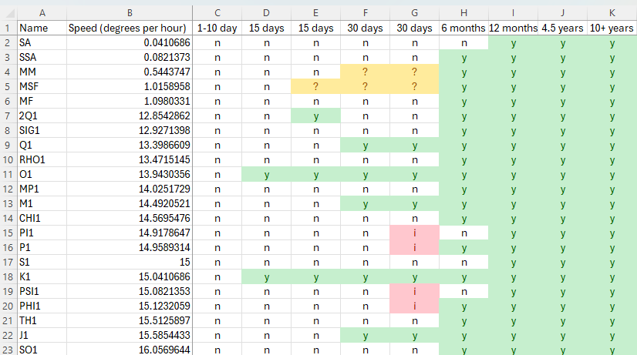
Example constituent sets – excel summary

Slide 8
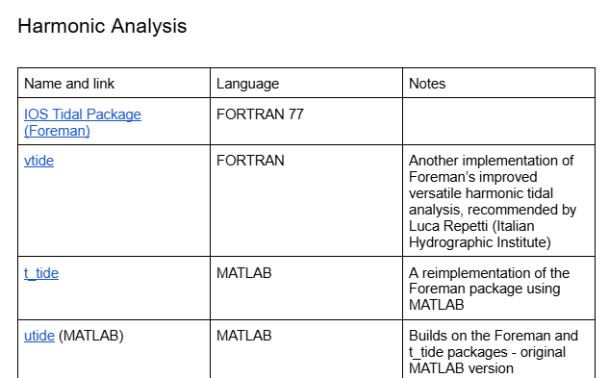
Software list

Slide 9
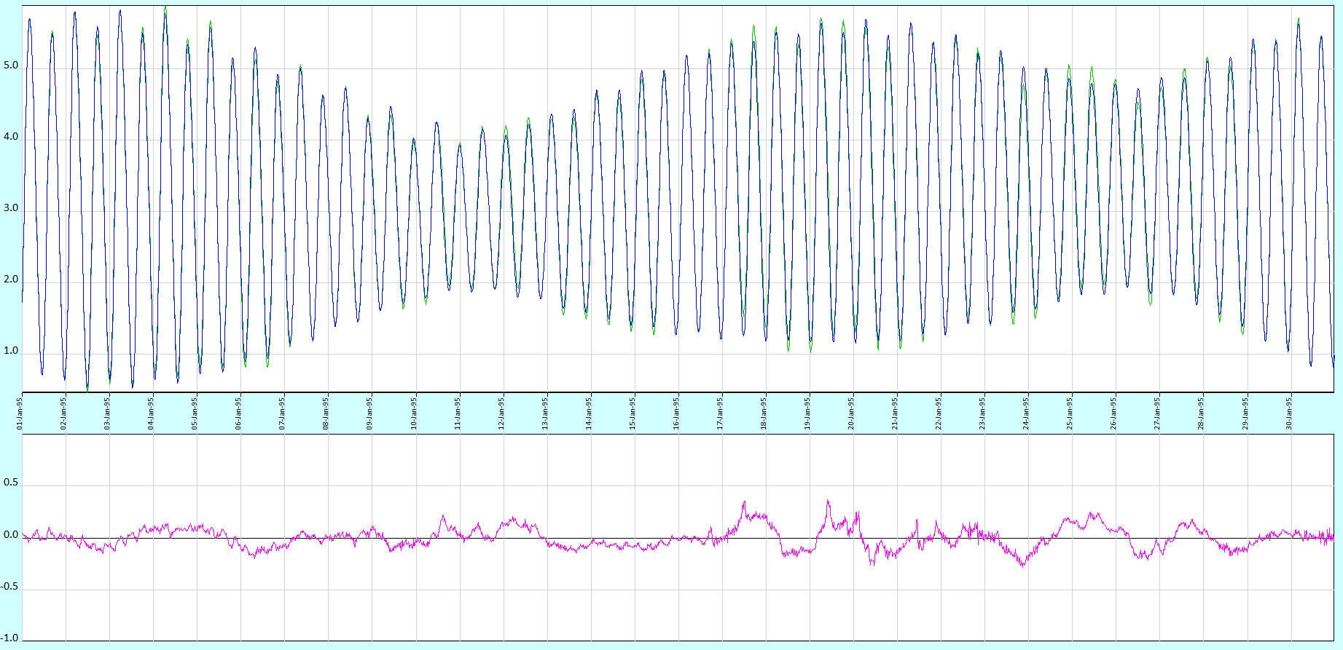
Examples – using too many constituents #1
Fitting 54 constituents
to 1 month of data
Rayleigh criteria suggests you
need 6 months

Slide 10
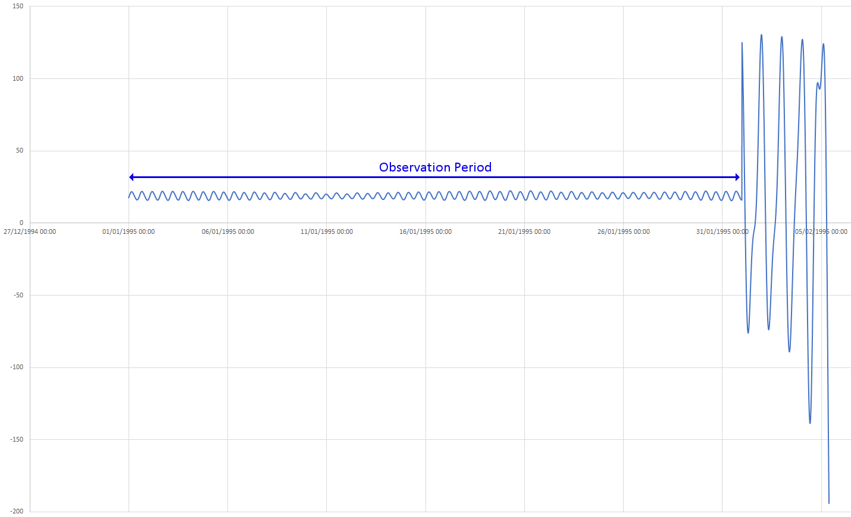
Examples – using too many constituents #2
But look at the next month…

Slide 11
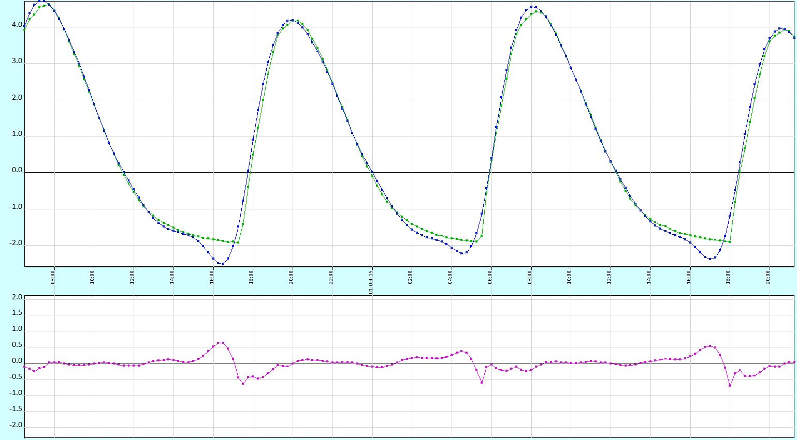
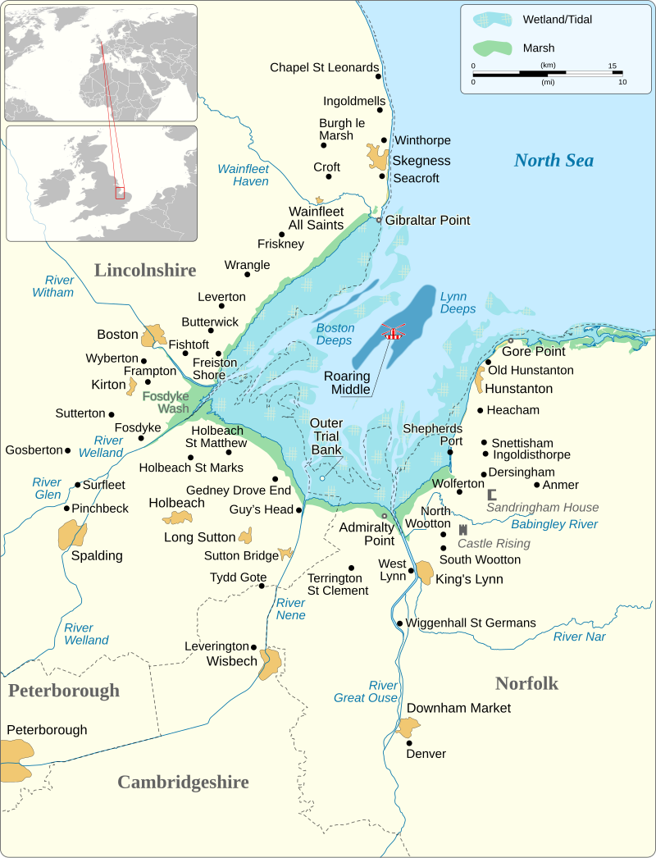
Difficult coastlines to model with classical harmonics
King’s Lynn South Quay
Tide Gauge in Green, Predictions in Blue
By Goran_tek-en, CC BY-SA 4.0,
https://commons.wikimedia.org/w/index.php?curid=145917154

Slide 12
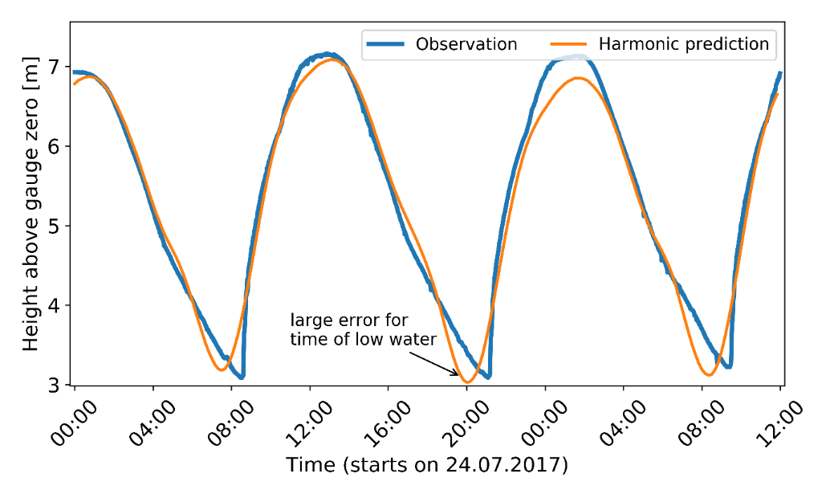
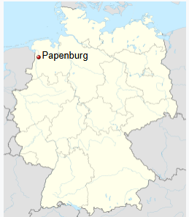
Difficult coastlines to model with classical harmonics
Papenburg, Germany
Notes:
Papenburg, Germany
On Ems river
Known for a large shipyard that builds cruise liners
BSH don’t use classical harmonics, but Harmonic Representation of Inequalities technique

Slide 13
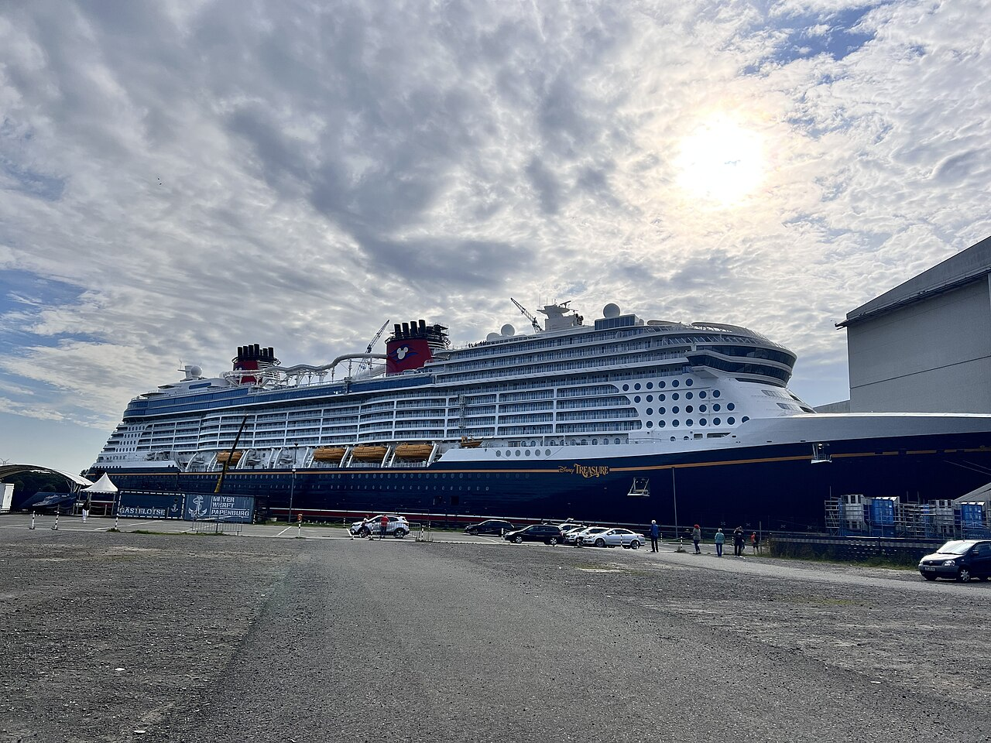
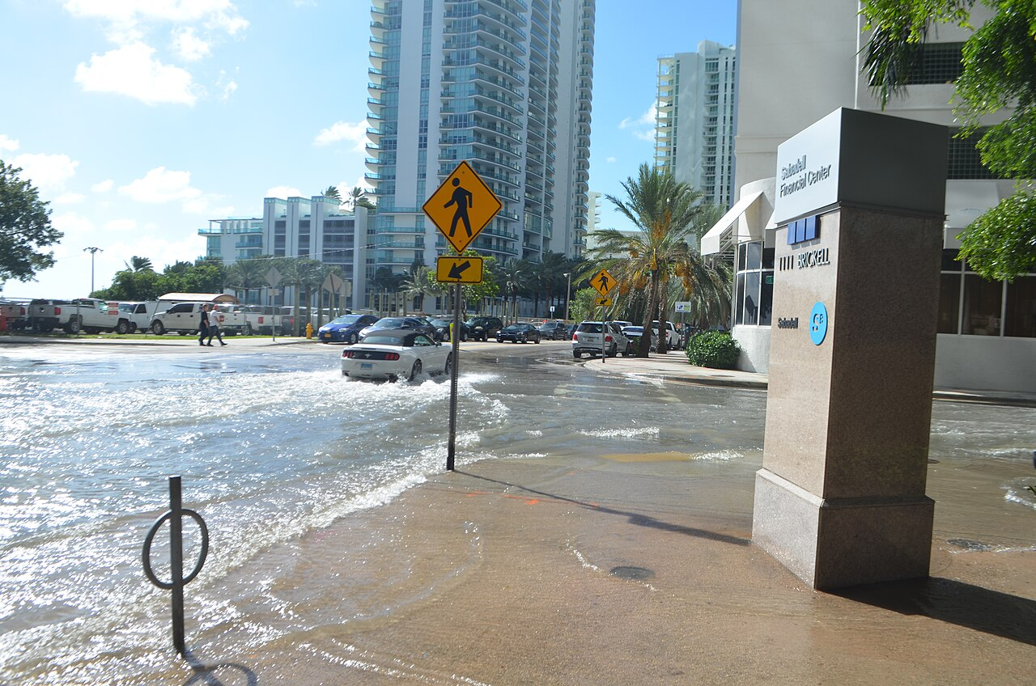
Why are you doing the tidal analysis?
October 17, 2016 tidal flooding on a sunny day, during the "king tides" in Brickell, Miami that peaked at 4 ft MLLW
By B137 - Own work, CC BY-SA 4.0,
https://commons.wikimedia.org/w/index.php?curid=52334453
The Disney Treasure at the Meyer Werft shipyard in Papenburg
By HIHIMOINMOIN1 - Own work, CC BY-SA 4.0,
https://commons.wikimedia.org/w/index.php?curid=155118411
Notes:
This gets in to why you’re doing the tidal analysis
If you’re wanting to study flooding, you’re more interesting in the top of the curve
But for navigation, the bottom is more important, and probably time rather than height
For quality control, less need to precision

Slide 14
Things we need to add
Needs sections on:
Satellite data
Model data
Analysis of currents
Techniques other than harmonic analysis
Third-degree tides
Tidal analysis metadata

Slide 15
Tidal analysis of satellite data in sun-synchronous orbit
Image courtesy of Michael Hart-Davis, DGFI-TUM
Notes:
We’re going to discuss satellite data – as observations are way less frequent, you need longer records with less constituents
Particular issue with sun synchronous orbits – you can’t extract S2 due to aliasing

Slide 16
Better explanation of long term cycles
M2 constituent
Annual fits to Newlyn, UK without accounting for nodal cycle

Slide 17
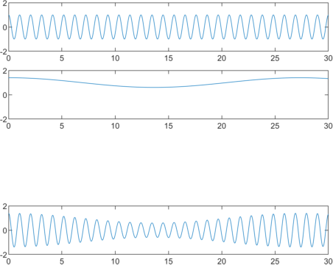
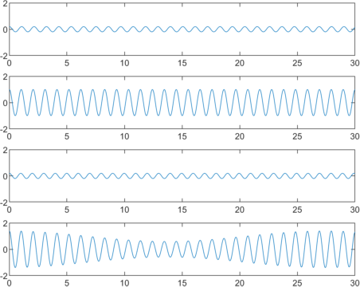
Background on where the constituents come from
Lunar Day
O1
x
+
Sidereal
Month
M1
+
=
K1
=
How do we get from 6 astronomical cycles to 115+ constituents?
Notes:
More theoretical stuff explaining how we got from 6 astronomical cycles to loads of constituents of different frequencies
e.g. Jupyter notebook examples illustrating
Lunar day modulated by sidereal month is equivalent
O1 + M1 + K1
Where O1 & K1 are just the frequency of the lunar day +/- frequency of sidereal month

Slide 18
HOW CAN YOU HELP?
Examples:
Different software
Different difficult scenarios
Any other good ideas you’ve got!

Slide 19
Thank you

