Slide 1
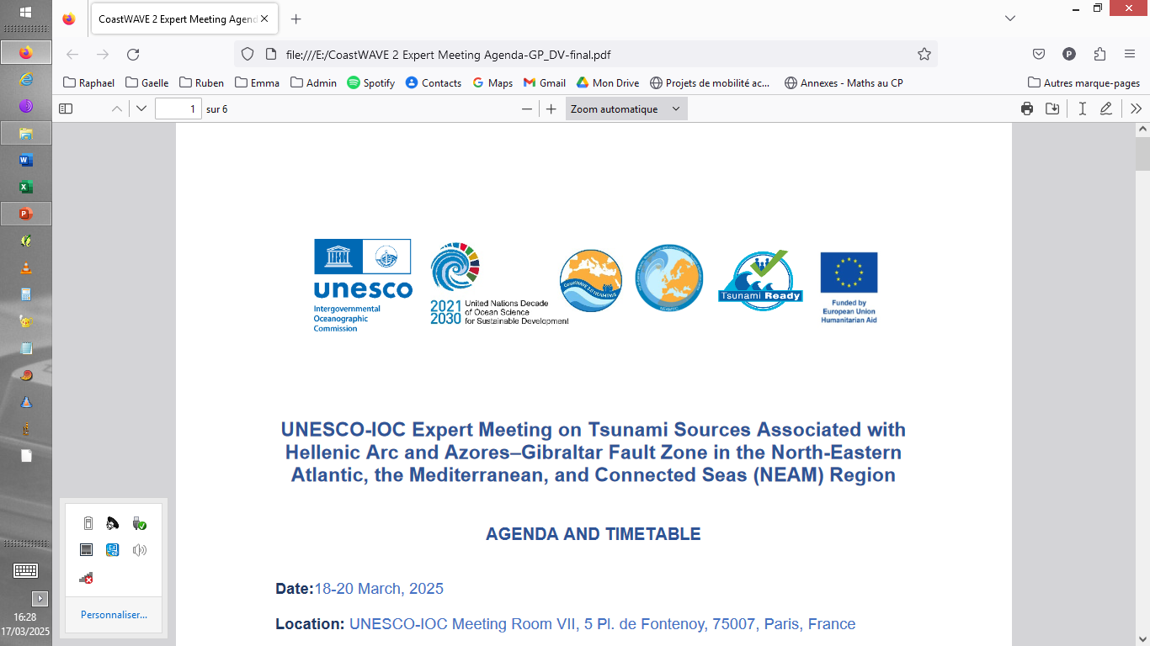



Volcanic and landslide tsunami sources in the NEAM region – An overview
Raphaël Paris
Laboratoire Magmas & Volcans
CNRS - Université Clermont Auvergne
FRANCE

Slide 2
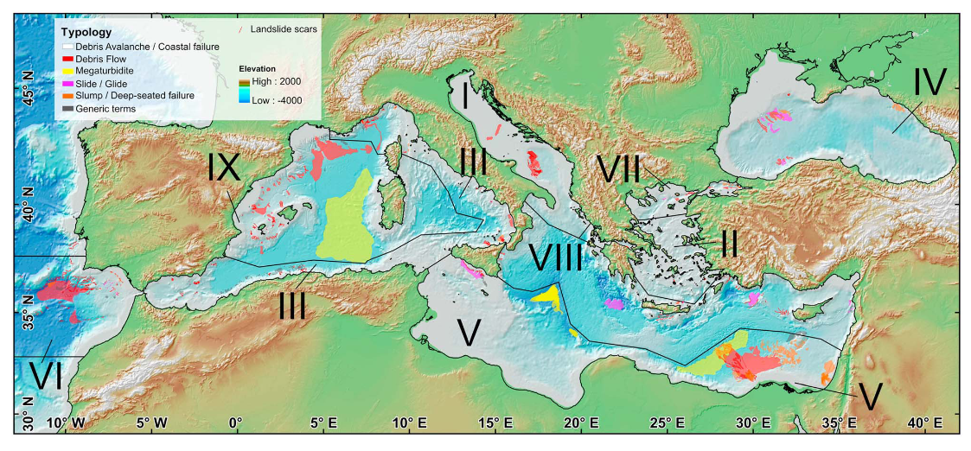
GIS database of submarine landslides in the Mediterranean
Urgeles and Camerlenghi 2013
Dataset available on the EPOS data portal (Tsunami TCS)

Slide 3
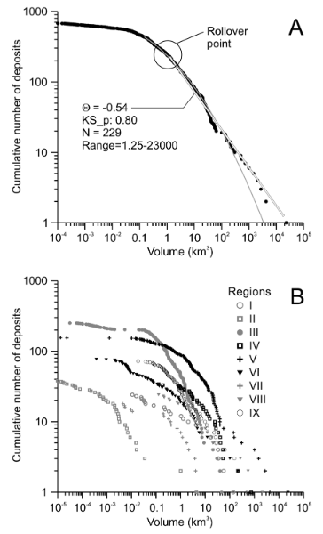
Landslide volume: the main parameter, but not the only one…
Wide range of volumes, from millions of m³ to thousands of km³
Volume distributions display
power law scaling for landslides > 1 km³
-> 3.5 times more landslides of 1 km³ than landslides of 10 km³
But different distribution of landslide volumes from one area to another
A volume vs frequency relationship is expected but only 10% of the landslide deposits are accurately dated.
Urgeles and Camerlenghi 2013

Slide 4
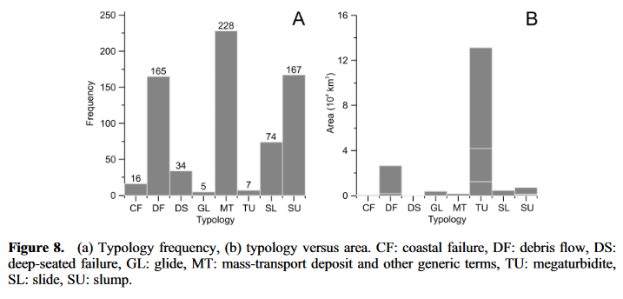
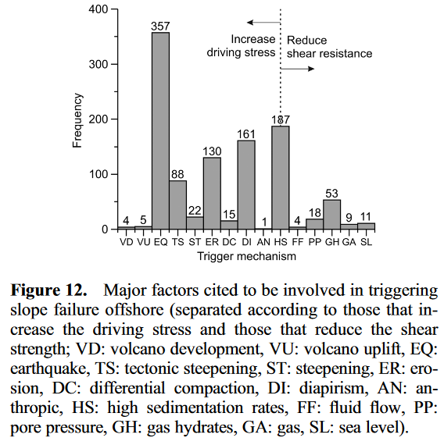
Landslide typology and triggering mechanisms
Urgeles and Camerlenghi 2013
Dominant types of landslides inferred from the morphology of the scars and deposits: mass-transport, debris flows and slump deposits.
-> How to relate the landslide type with the landslide dynamics and its coupling with the tsunami generation?
Dominant triggering: earthquake + aggravating factors such as high sedimentation rates fed by high erosion inland (link with global change?)

Slide 5
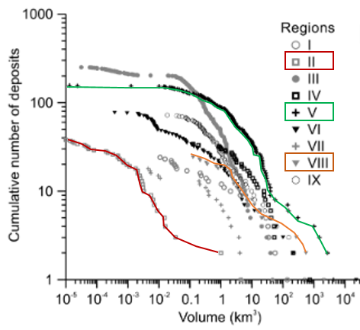
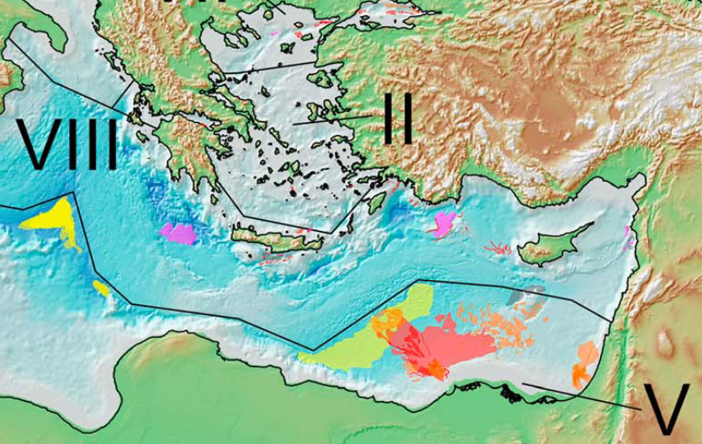
Submarine landslides impacting the Hellenic Arc
Urgeles and Camerlenghi 2013
No evidence of landslide deposits along the Hellenic subduction trench?

Slide 6
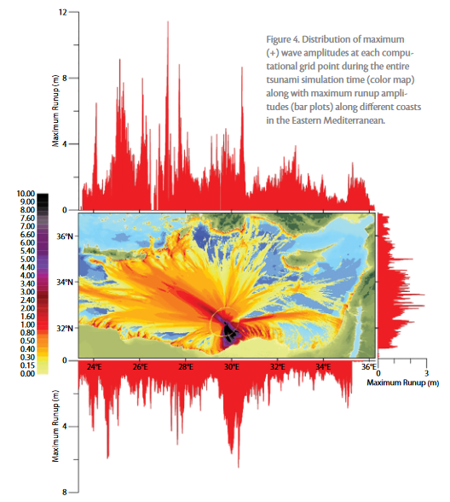
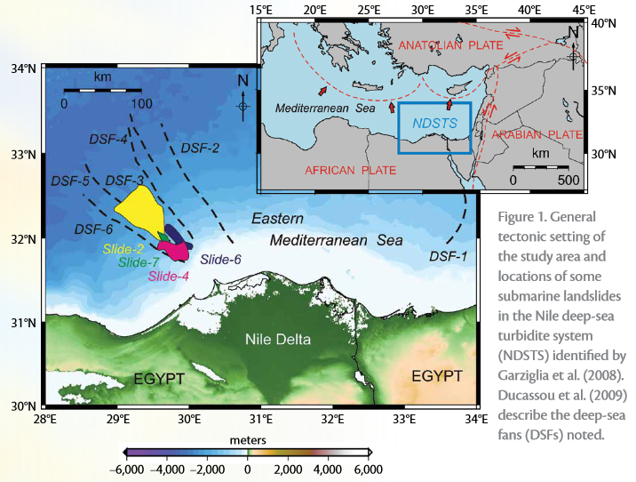
Submarine landslides in the Nile Delta
A ~40 km³ landslide generates waves >1 m (up to 12 m locally) in all the eastern Mediterranean basin
Yalciner et al 2014

Slide 7
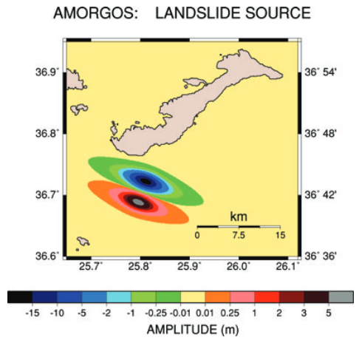
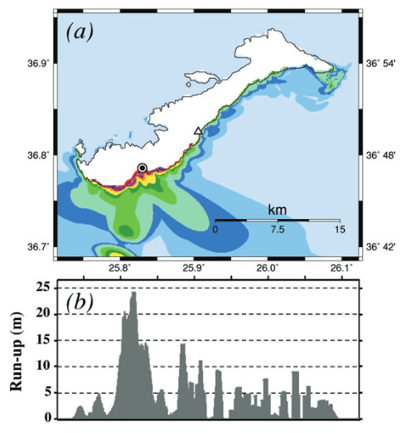
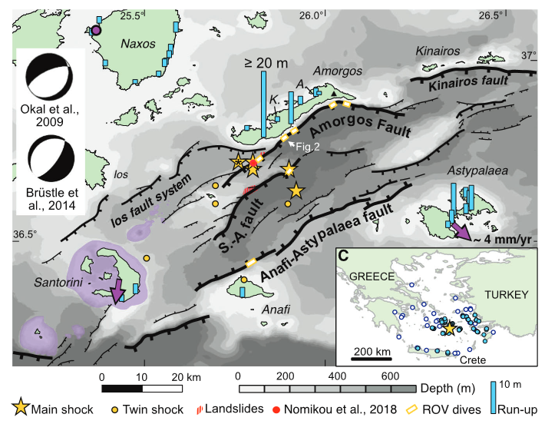
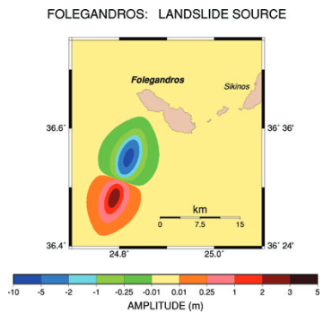
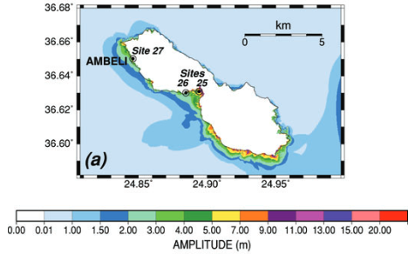
Landslides triggered by earthquakes in the Aegean Sea
The July 9, 1956 earthquake
debate on the source of the tsunami
Leclerc et al 2024
Okal et al 2009

Slide 8
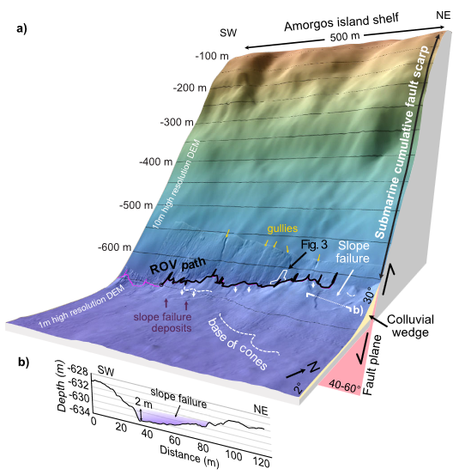
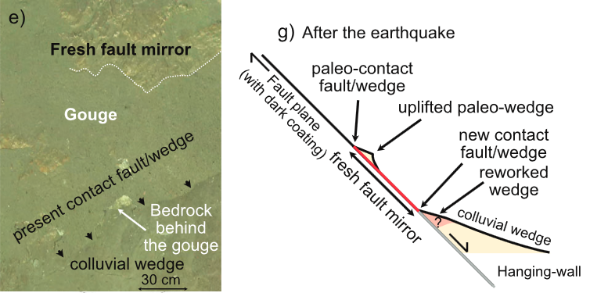
Recent work offshore -> 9.8-16.8-m (9 m average) large seafloor offset is compatible with a Mw 7.5 event. No evidence of landslide deposits.
Reassessment of the source of the large tsunami wave, previously attributed to earthquake-triggered submarine landslides.
ANR project AMORGOS starting January 2025
Leclerc et al 2024

Slide 9
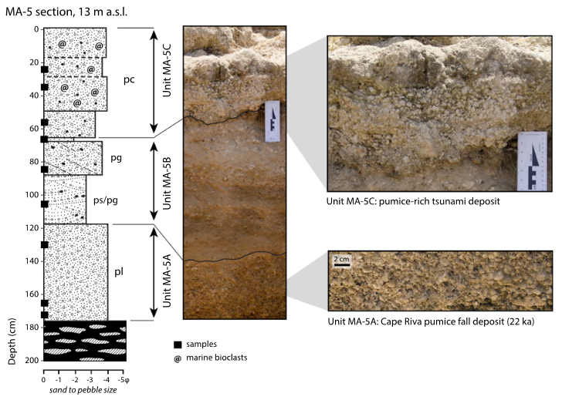
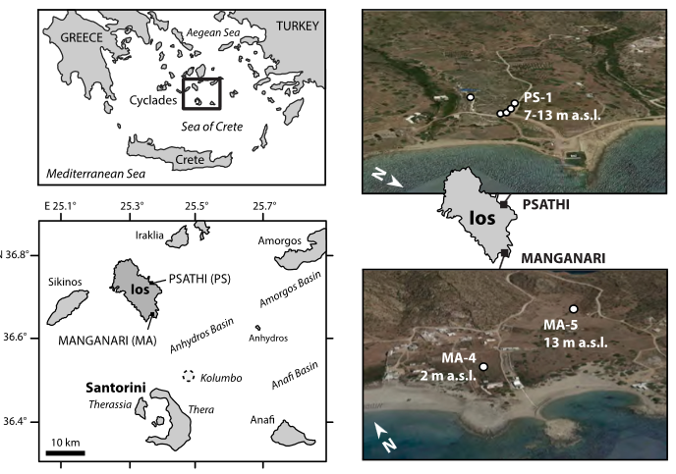
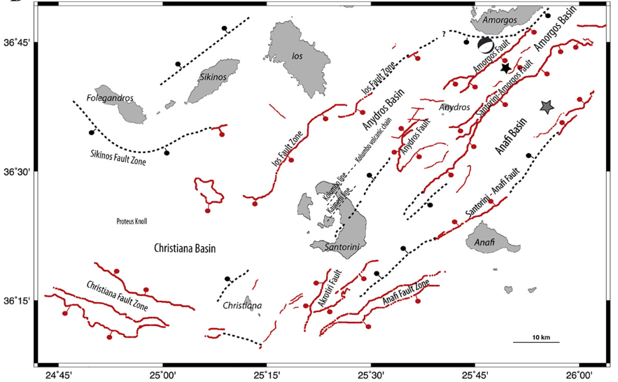
Paleotsunami evidence in Ios Island
Paris et al 2022
Age of the paleotsunami between Cape Riva (22 ka) and the Minoan (3.5 ka) eruptions of Santorini, but < 10 ka (for eustatic reasons).
No volcanic eruptions at Santorini or Kolumbo volcanoes during this period
-> large tsunami of tectonic and/or landslide origin, related t the faults nearby

Slide 10
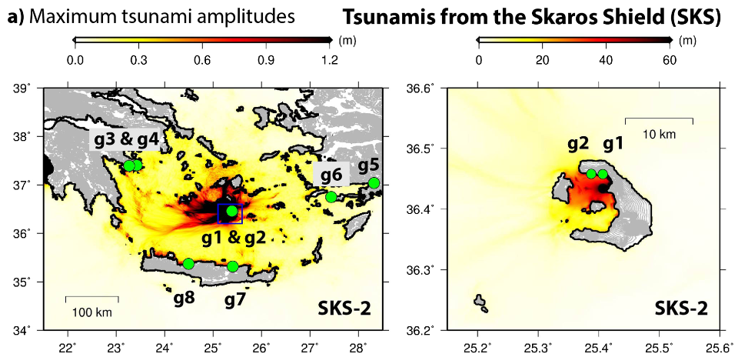
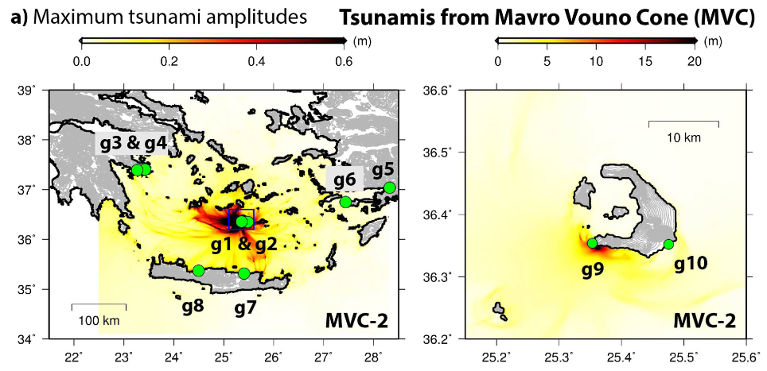
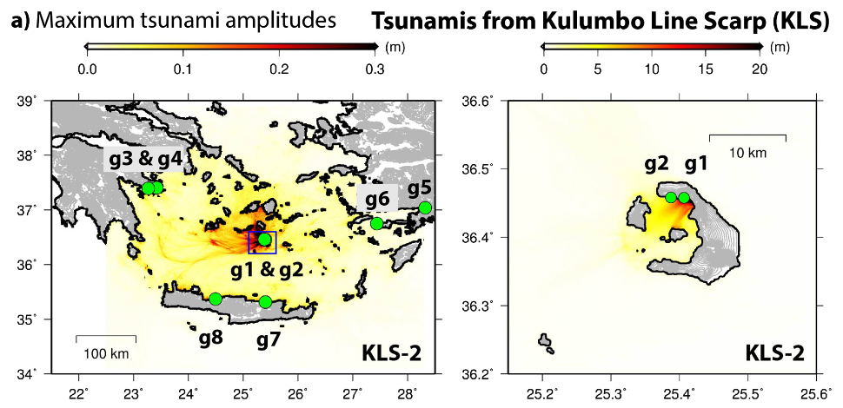
Necmioglu et al 2023
Landslides in the Aegean Sea
Subaerial landslides on the walls of Santorini caldera
High impact in the near-field (Santorini coasts)
Moderate-low impact on the islands nearby
-> Credible scenarios of tsunami
On-going seismic crisis around Anhydros -> rockfalls on the caldera walls.

Slide 11
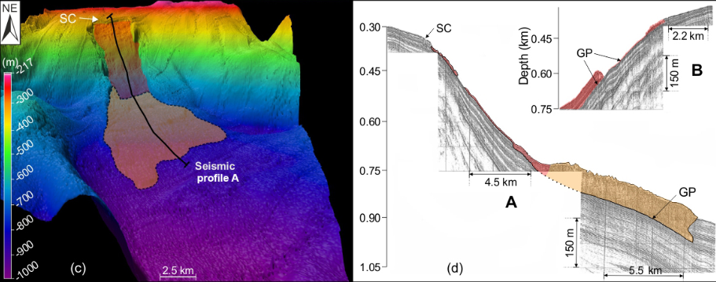
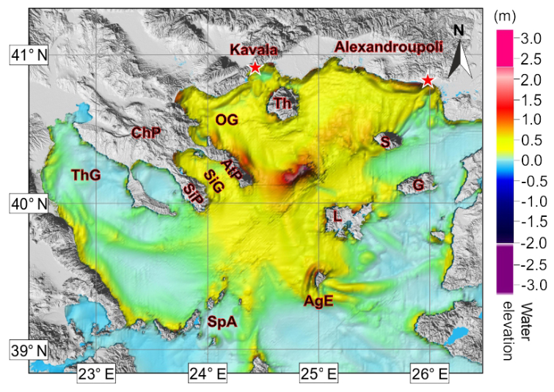
Landslides in the northern Aegean
Few published work -> no impact in the Southern Aegean?
Janin et al 2019

Slide 12
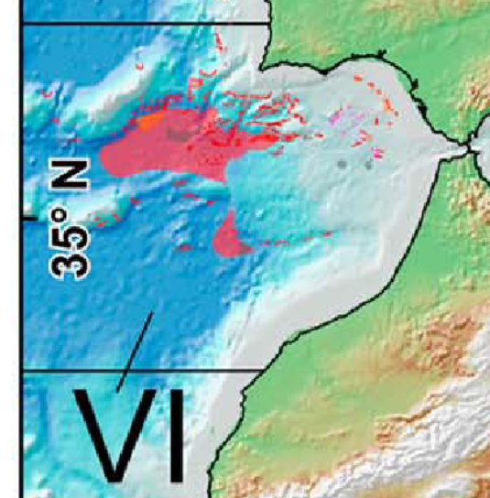
Submarine landslides in the Azores – Gibraltar Fault Zone
Evidence of submarine landslide deposits in all the area with a very large diversity of volumes
Urgeles and Camerlenghi 2013

Slide 13
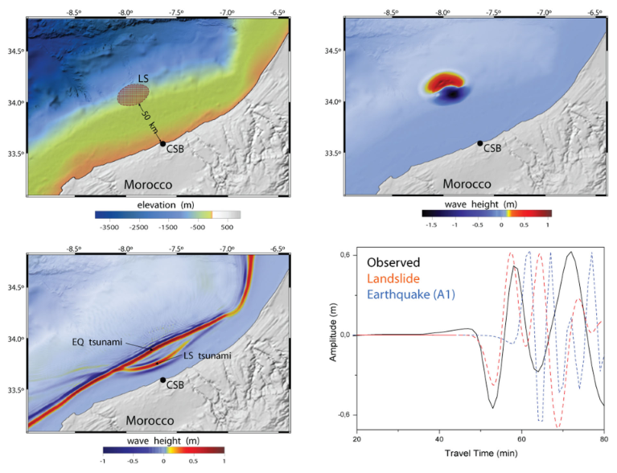
Submarine landslides in the AGFZ: the February 28, 1969 earthquake as a case-study
A submarine landslide with a volume of 3 km³ occuring 15 minutes after the earthquake is proposed to account for the observed sea level variations in Casablanca.
Baptista et al 2025

Slide 14
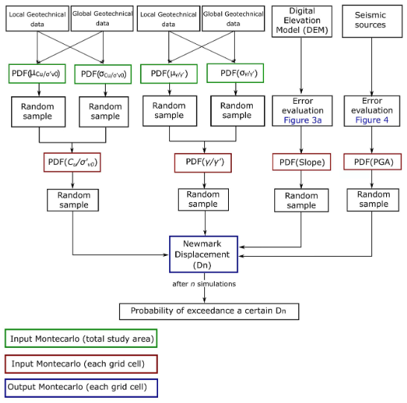
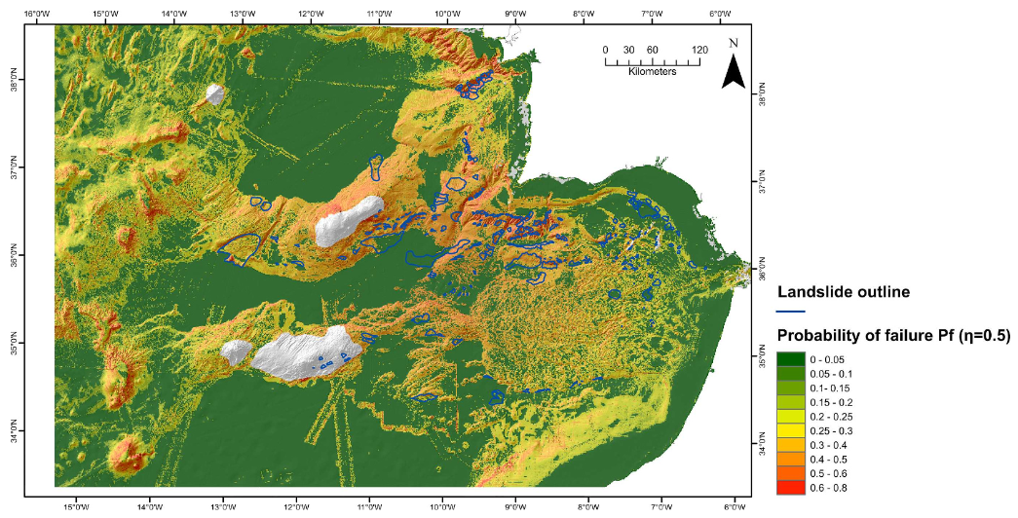
Geotechnical (slope stability) model of landslide susceptibility of the SW Iberian margin
-> mandatory step towards a landslide PTHA?
Collico et al 2020

Slide 15
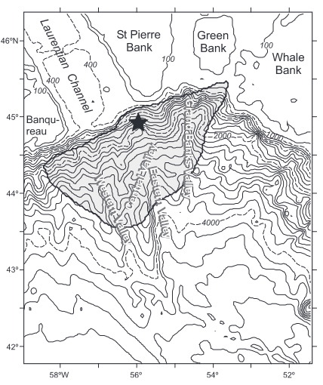
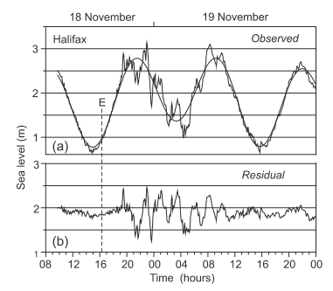
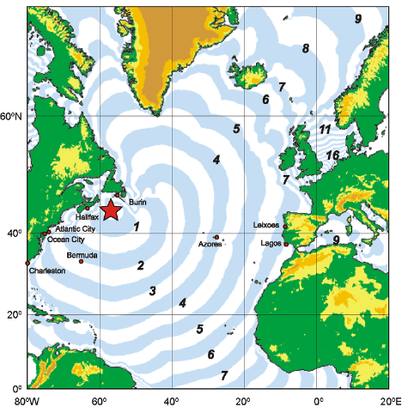
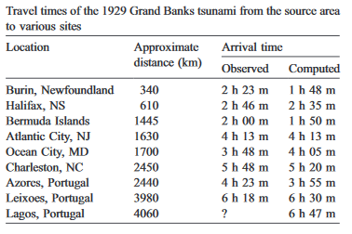
November 18, 1929 Grand Banks (Newfoundland) M=7.2 earthquake and landslide tsunami
Fine et al 2005
Very low impact in Portugal but observed on tide gauge records

Slide 16
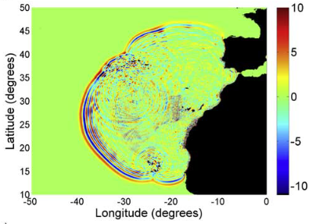
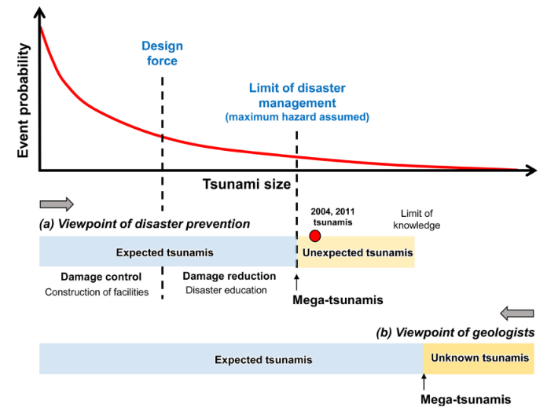
Tsunami produced by giant landslides in the Canary and Azores islands (island flank collapses 10² to 10³ km³)
La Palma
Lovholt et al 2008
HILP category
High Impact Low Probability events
Poorly-constrained recurrence in the order of 10s to 100s thousands years
Paris et al 2021

Slide 17
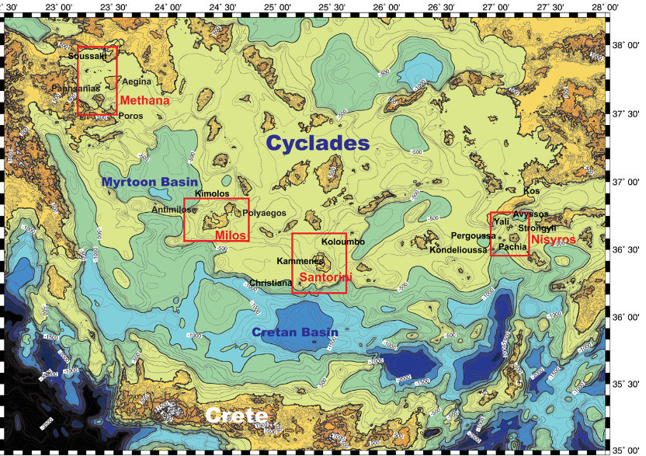
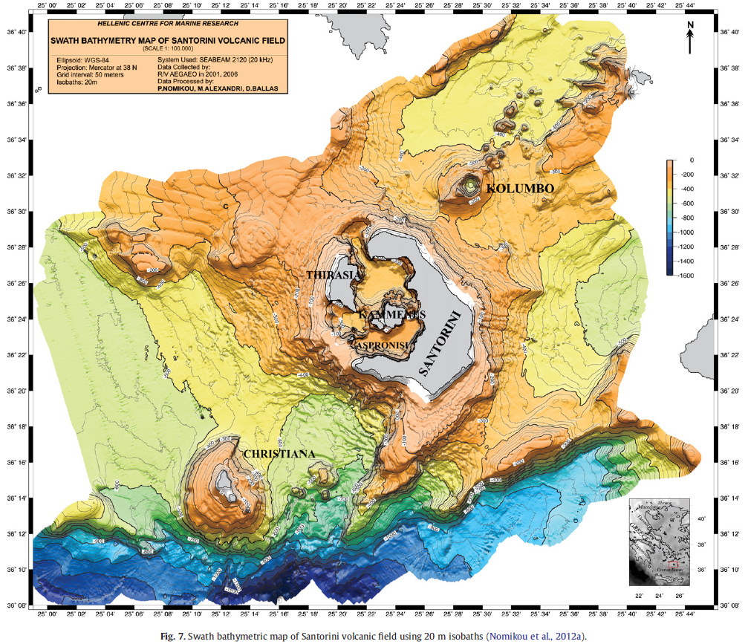
Tsunamis generated by the Hellenic Arc volcanoes
Nomikou et al 2012
Two major explosive eruptions during the Holocene were associated with tsunamis.
Santorini : Minoan eruption -> tsunami whose source is still poorly-constrained despite abundant literature.
Kolumbo : 1650 eruption -> tsunami observed in all the southern Aegean Sea.

Slide 18
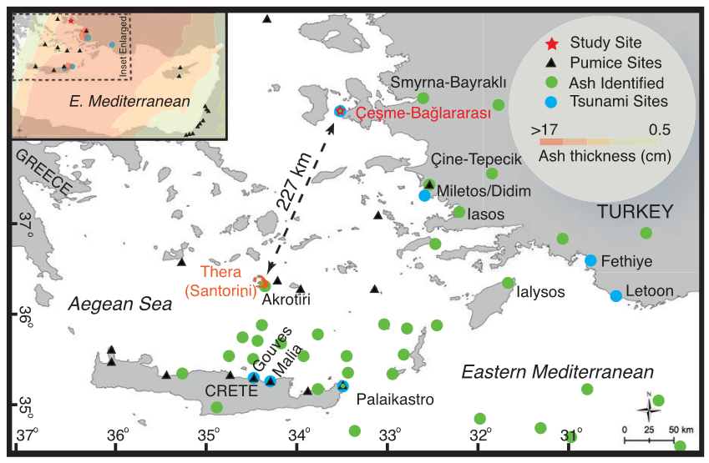
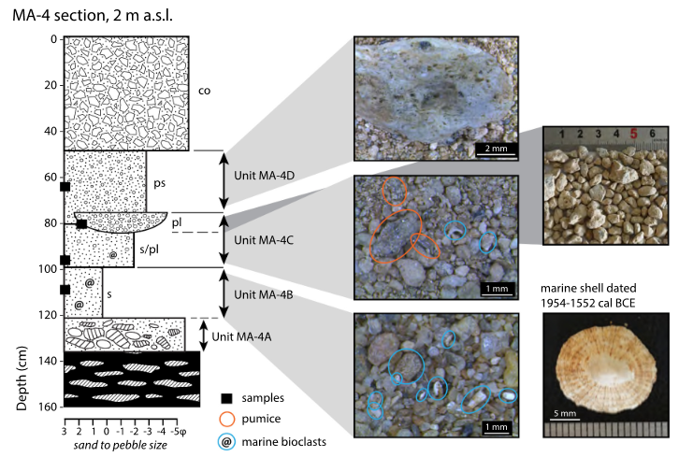
Geological evidence of the Minoan tsunami on the coasts of Turkey and northern coast of Crete -> far-field (e.g. Minoura et al 1992, Bruins et al 2008, Lespez et al 2021, Sahoglu et al 2022)
Sahoglu et al (2022) found multiple tsunami events, including a first (and deadly) tsunami preceding the main tepha falls.
Paris et al 2022
New evidence of the Minoan tsunami on the southern coast of Ios Island = near-field
2 tsunami deposits:
First one with very few pumice lapilli but abundant marine bioclasts (dated shell)
Second one with abundant pumice lapilli from the first Plinian phase.
> 2 m asl and > 200 m

Slide 19
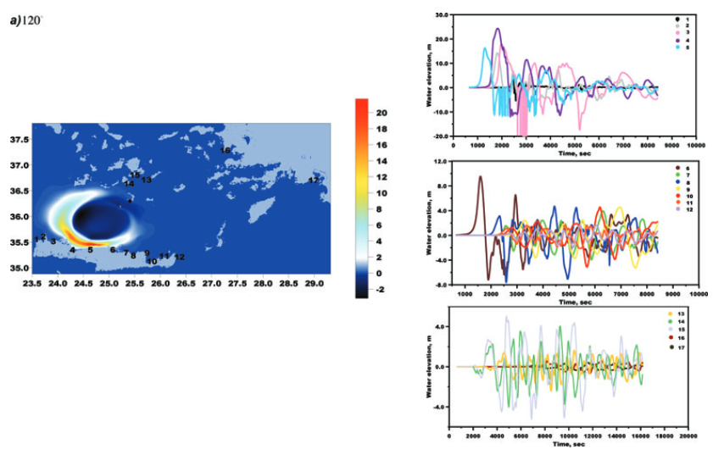
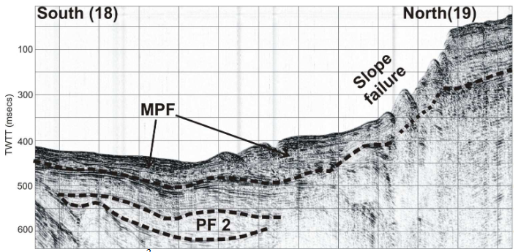
The source of the first Minoan tsunami is unknow.
For the second one, a pyroclastic flow origin is likely
Novikova et al 2011
Sakellariou et al 2012

Slide 20
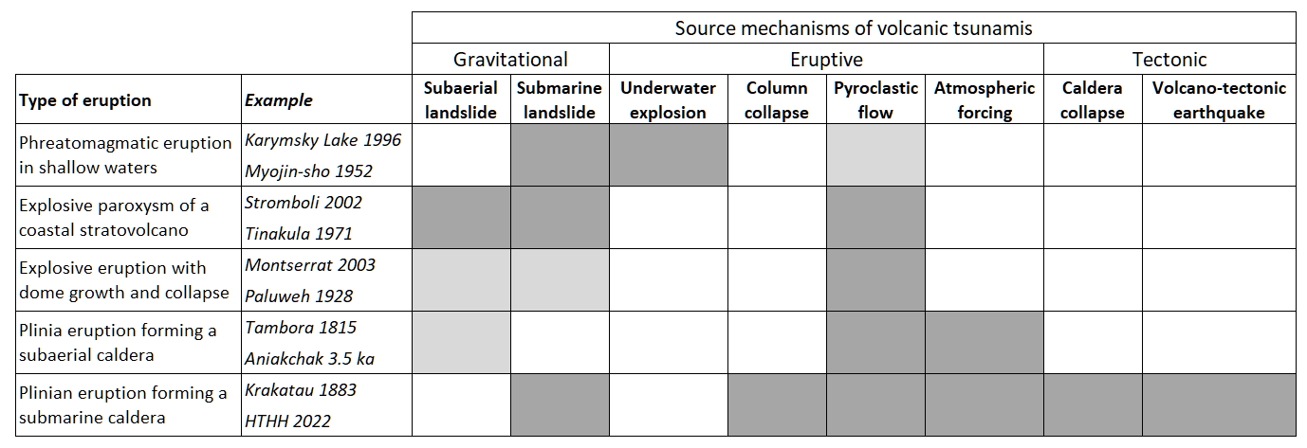
Learning from past examples of volcanic tsunamis
Possible sources of tsunamis differ from one type of eruption to another
Santorinni (Minoan)
Kolumbo (1650)

Slide 21
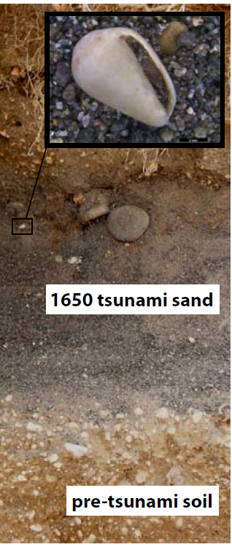
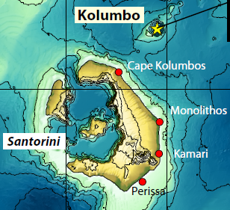
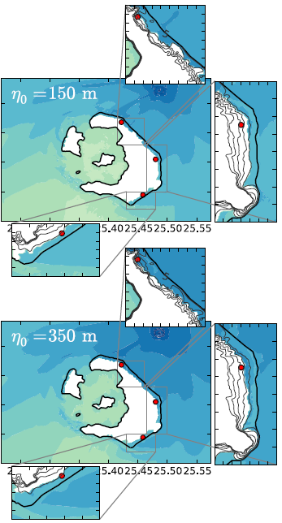
Numerical simulations compared with field evidence of the 1650 Kolumbo tsunami
Map tsunami deposits on Santorini coasts
Ulvrova et al 2016
190m inland
14 m asl
20 m asl
630 m inland
360 m inland
3.5 m asl

Slide 22
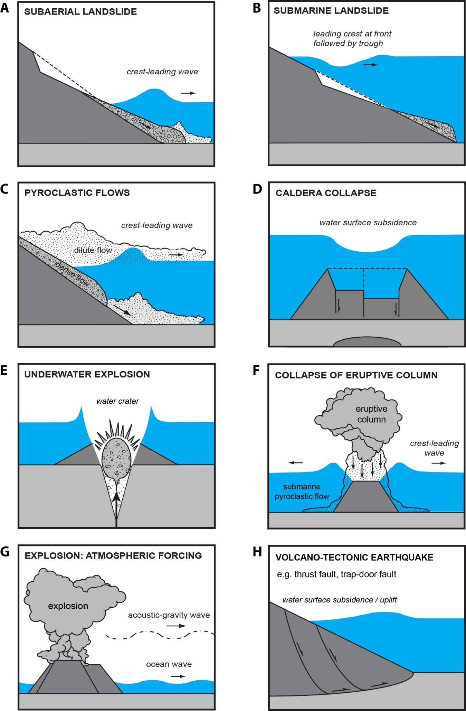

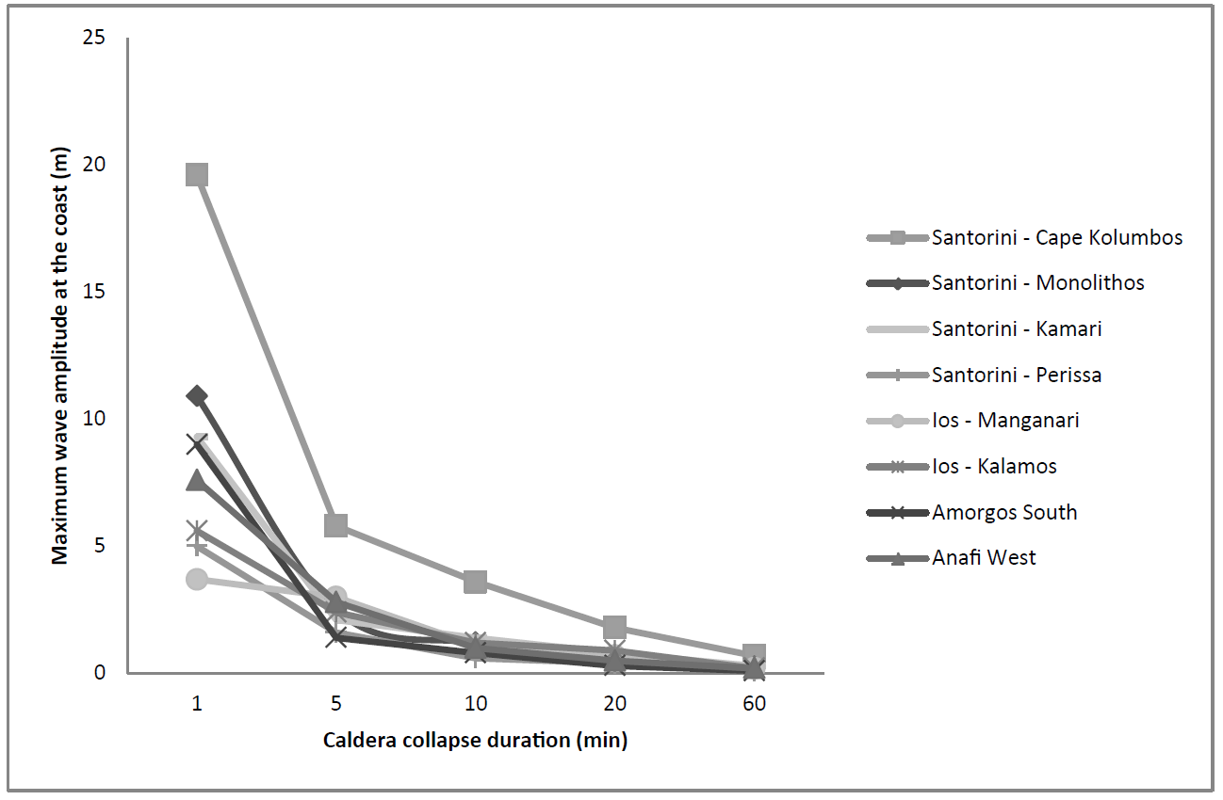
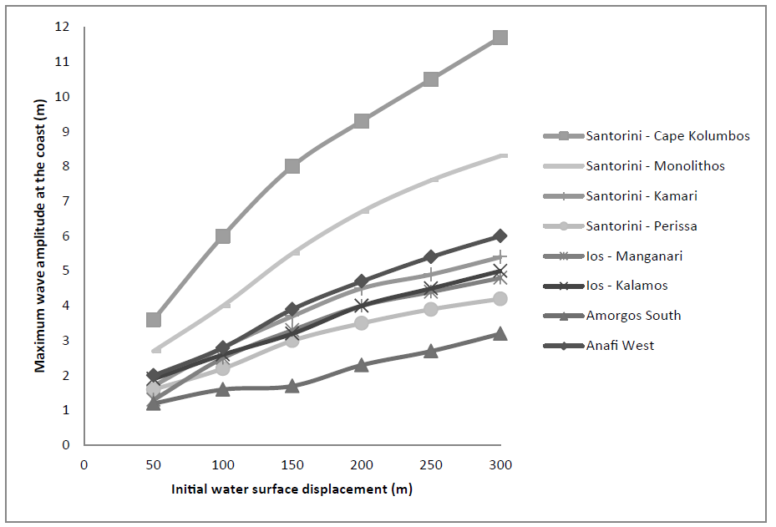
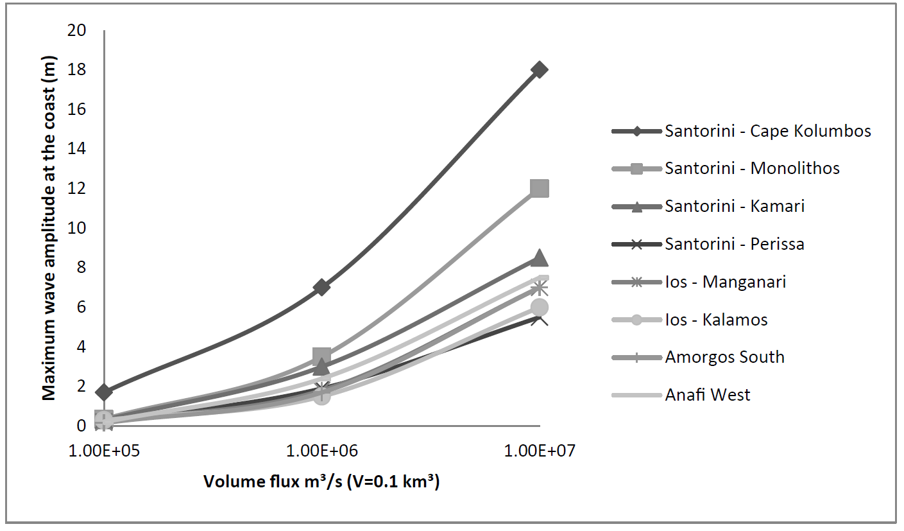
Three different source mechanisms tested to explain the 1650 Kolumbo tsunami
Not physically realistic 1650 ? 1650 ?

Slide 23
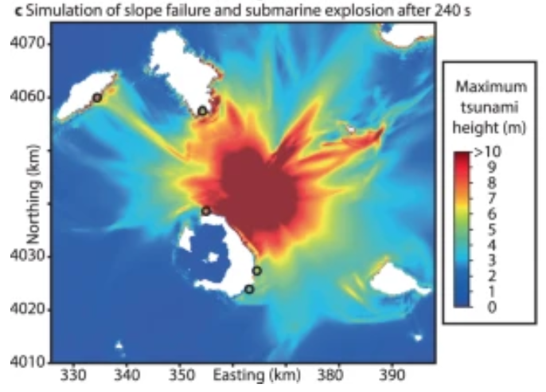
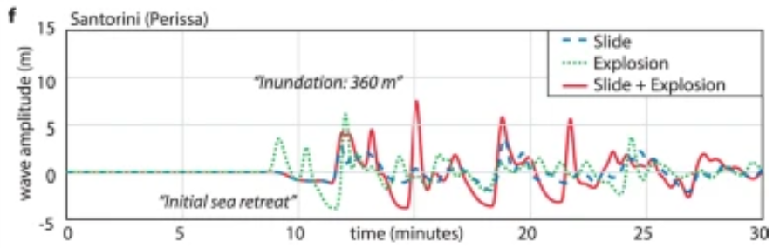
Evidence of slope instability on the NW flank
A hybrid landslide/explosion scenario to explain the observed tsunami
The landslide accelerates the depressurization of the magmatic system and thus triggers the explosive paroxysm.
Karstens et al. 2023

Slide 24



New scenarios recently added
Tadini et al, submitted
150-300 Mm³
Ulvrova et al 2016

Slide 25

What would be the probability to have a tsunami and which magnitude of tsunami in the case of a future eruptions at Kolumbo submarine volcano?
Expert elicitation organized in 2023
Tadini et al, submitted
Moving from a deterministic to a probabilistic approach
Database of numerical simulations

Slide 26

In this context, the probabilistic approach is promising but it is also challenging
A bayesian Event Tree for Volcanic Tsunami Hazard Assessment (PVTHA)
Arrows indicate potential paths which involve different volcanic states (node 1), phenomena (node 2), source position and size (nodes 3 and 4), and tsunami generation (node 5).
Blue arrows indicate a possible scenario (among others) generating a tsunami (node 5) and leading to the evaluation of hazard at a given location (nodes 6) and exceeding a certain threshold of wave height at the shoreline (7).

Slide 27



GEOLOGY MODELING
Paris et al. 2019a (Campi Flegrei)
Ulvrova et al. 2016 (Kolumbo)
Paris et al. 2019b (Lake Taal)

Slide 28








Laboratory experiments on tsunami generation by pyroclastic flows
Understanding the physics behind a complex phenomenon

Slide 29


Non-fluidized
Fluidized
Highly mobile flow
E.g. pyroclastic flow
-> higher flow velocity and mass flux
-> very efficient energy transfer from flow to water
-> steeper and higher wave
Bougouin et al. (2020)

