Slide 1
Probabilistic Tsunami Hazard and Risk Assessment Best practices towards a Global Tsunami Model approach
29.03.2025
Jörn Behrens

Slide 2
Background
Foto: JB

Slide 3
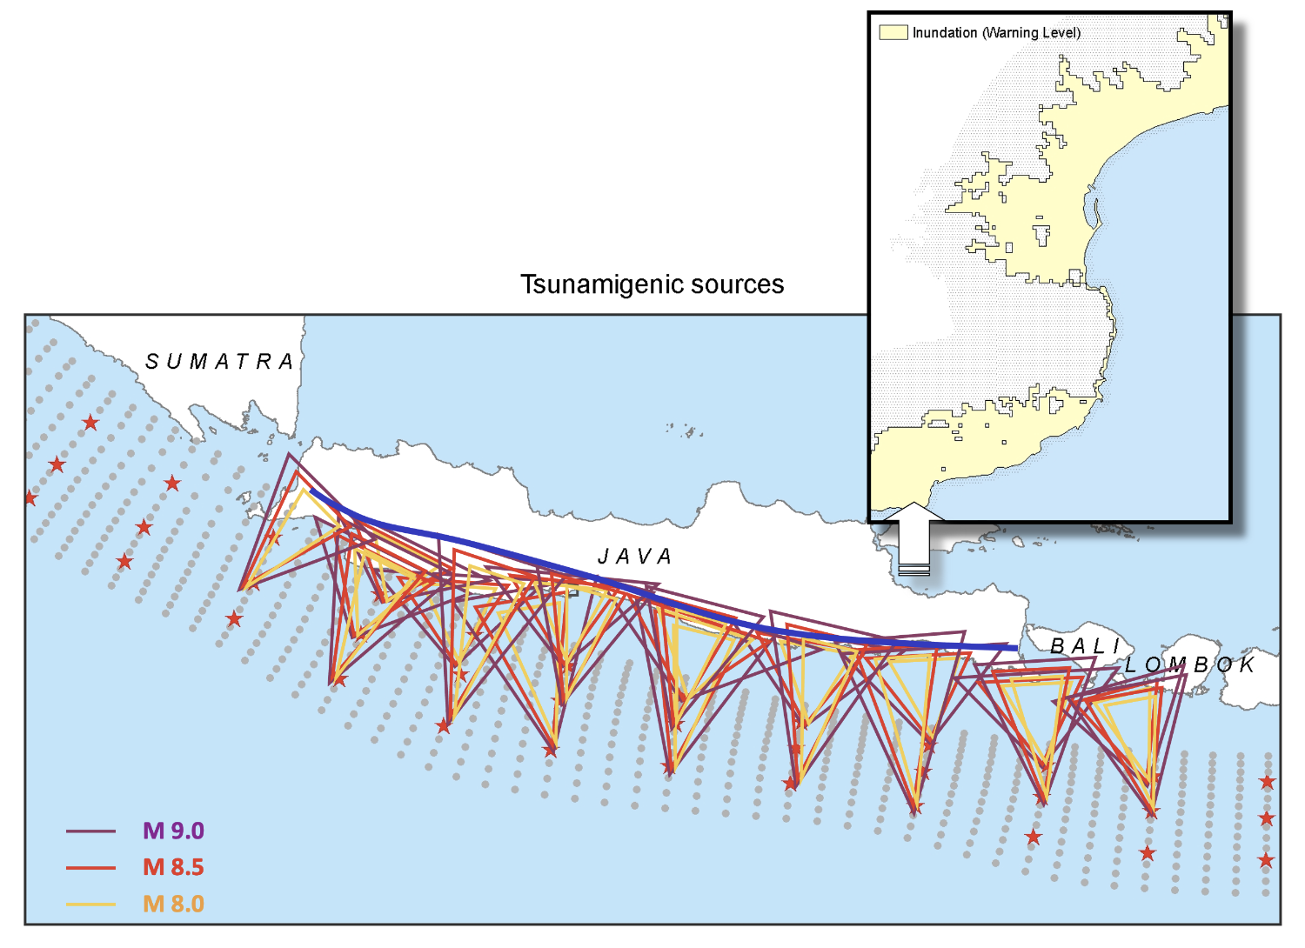
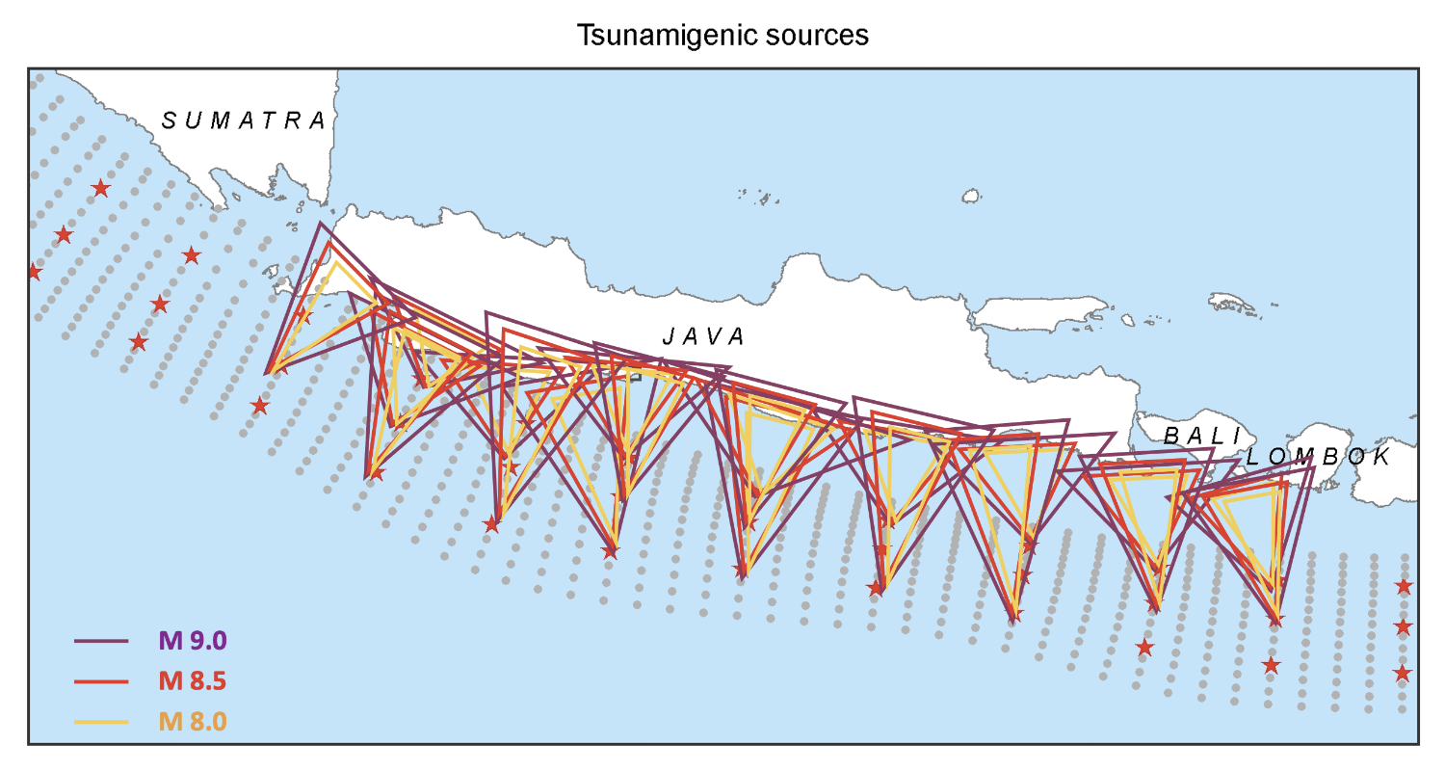
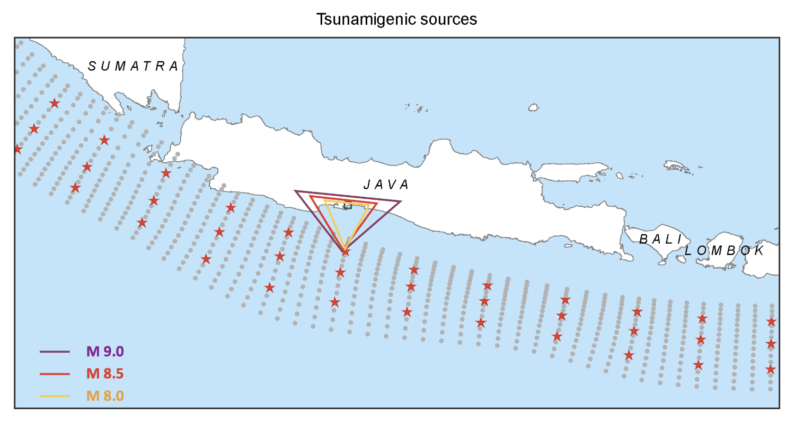
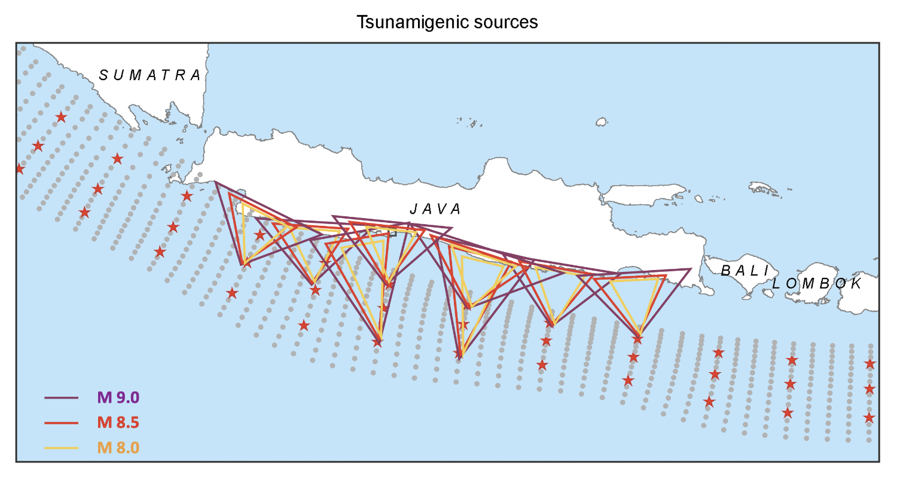
Probabilistic Approach
Use collection of sources
Assign source probability
Simulate variability of sources
Aggregate hazard index and probability density

Slide 4
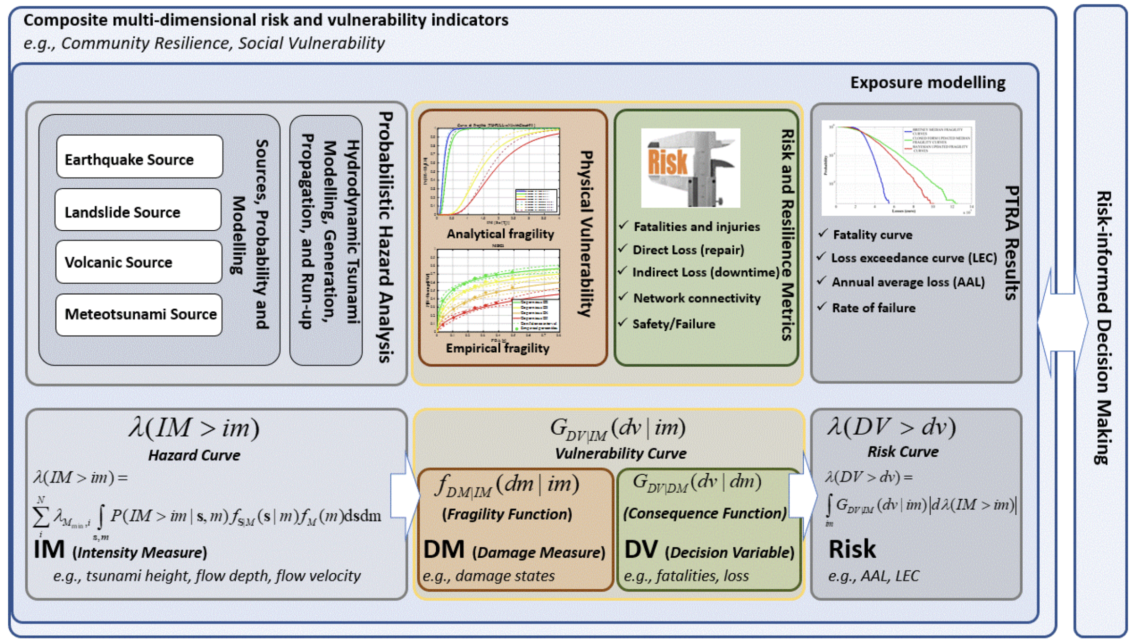
PTHA/PTRA Framework
Behrens et al., 2021

Slide 5
Uncertainty
Think: Input-Map-Output
Each Step maps uncertain input to more uncertain output
Consecutive Steps amplify uncertainty
Goal: Uncertainty reduction
Use “orthogonal“ information
Input Output
Source Parameters Uplift
Source Uplift Wave Height

Slide 6
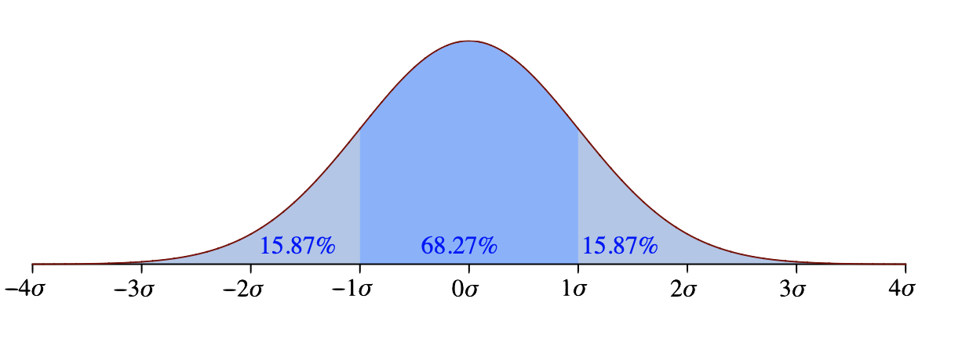
Uncertainty
Use Probability Density
Define acceptable levels
Often binned
By Jhguch at en.wikipedia, CC BY-SA 2.5, https://commons.wikimedia.org/w/index.php?curid=14524285
Input Probability Output Probability

Slide 7
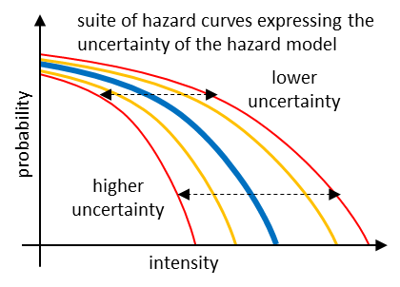
Probabilistic Workflow
Information flux
Hazard Curve
Step-1: Probabilistic earthquake model
Step-2: Tsunami generation & modeling in deep water
Step-3: Shoaling and inundation
Step-4: Hazard aggregation & uncertainty quantification
Lorito, pers. comm.

Slide 8
Available
Foto: JB

Slide 9
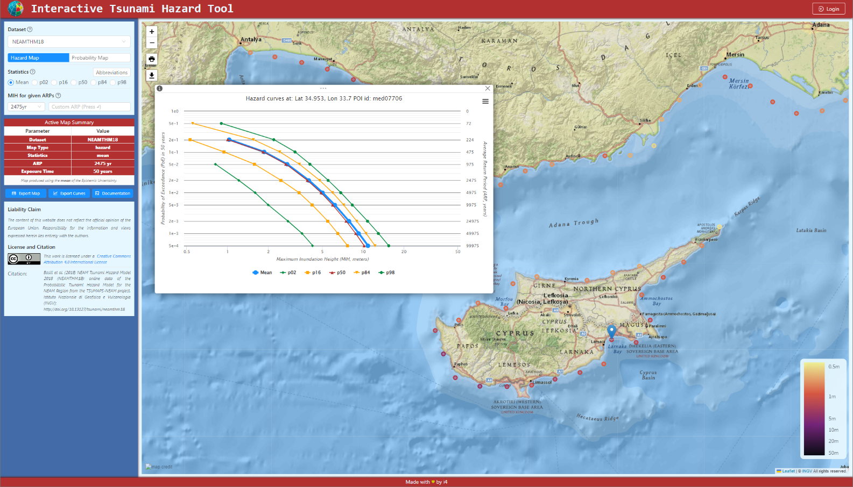
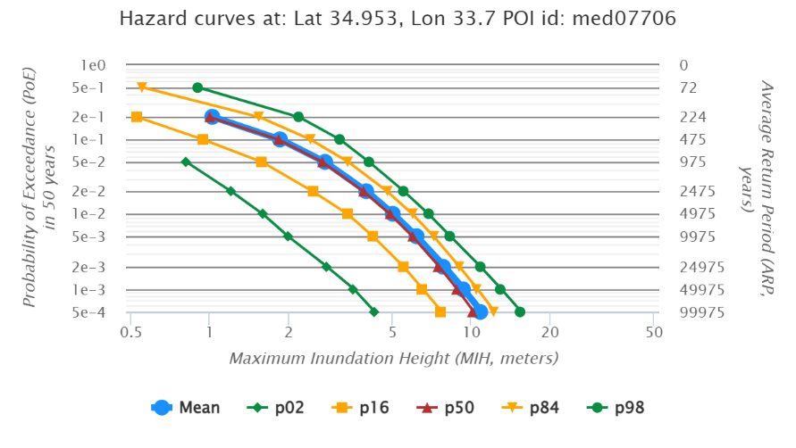
NEAMTHM18
TCS Tsunami
ics-c.epos-eu.org
Lorito, pers. comm.

Slide 10
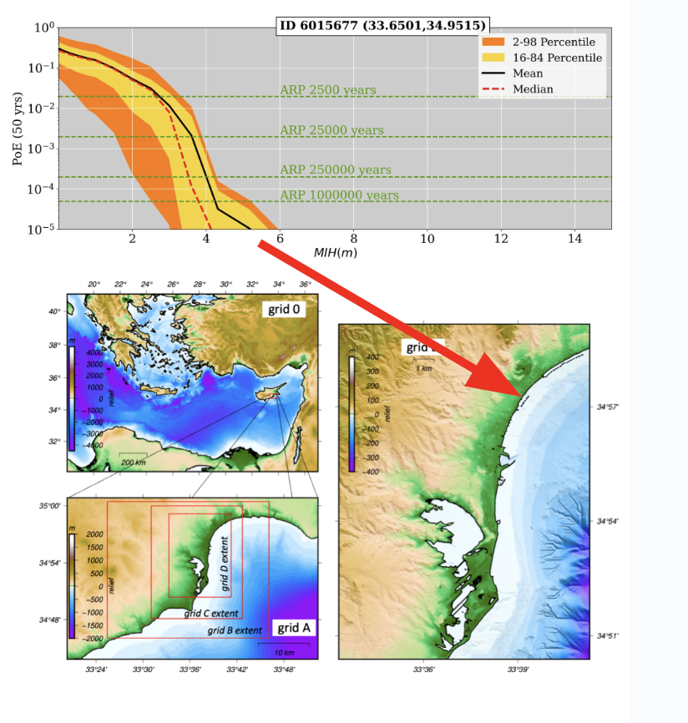
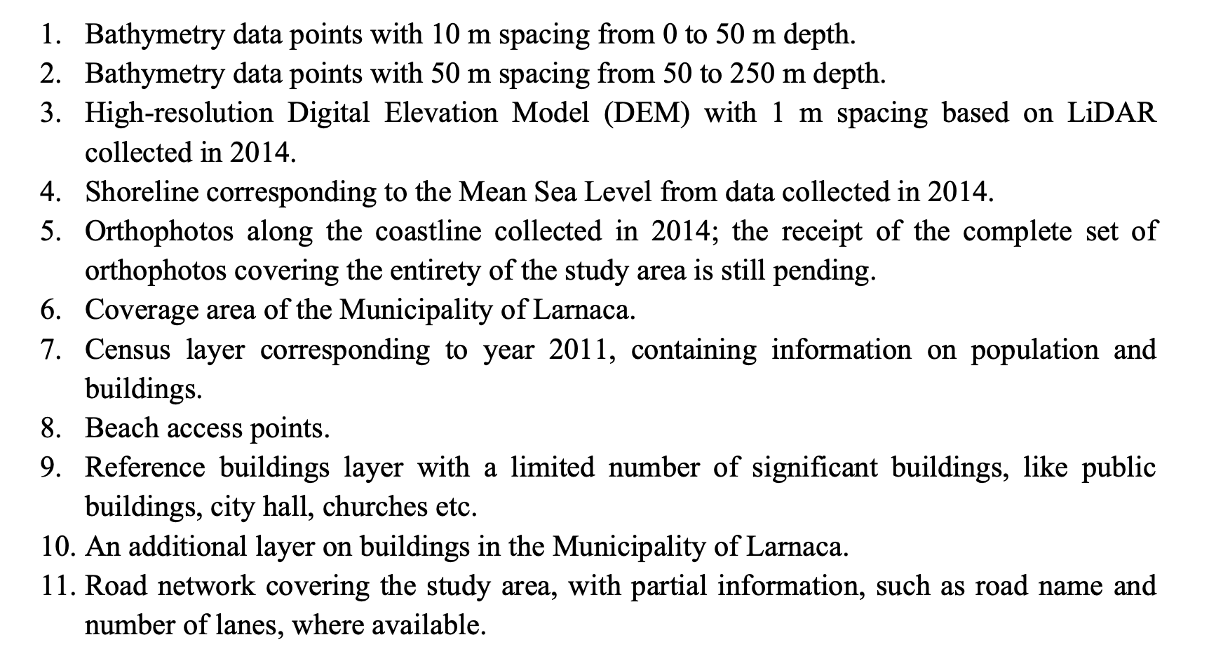
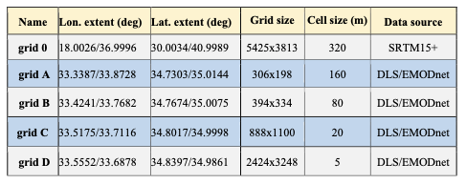
Hazard Mapping Features
Lorito, pers. comm.

Slide 11
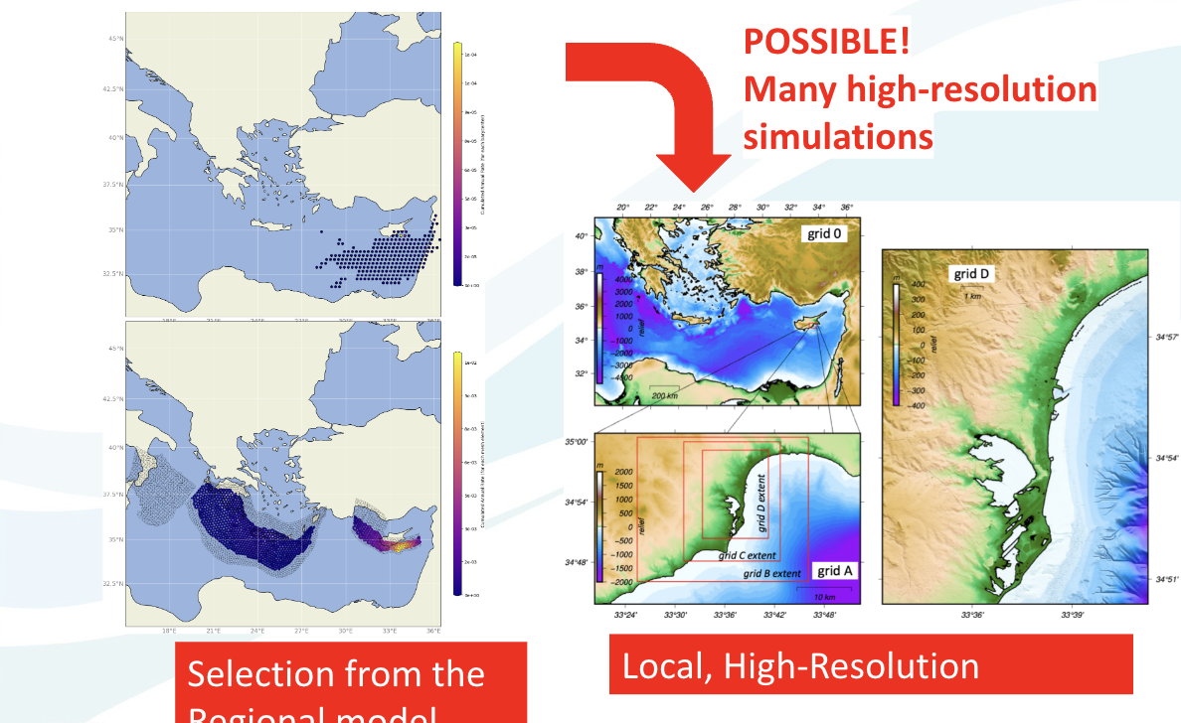
Example Larnaca
Selection from the Regional model
Lorito, pers. comm.

Slide 12
Example Larnaca
Lorito, pers. comm.

Slide 13
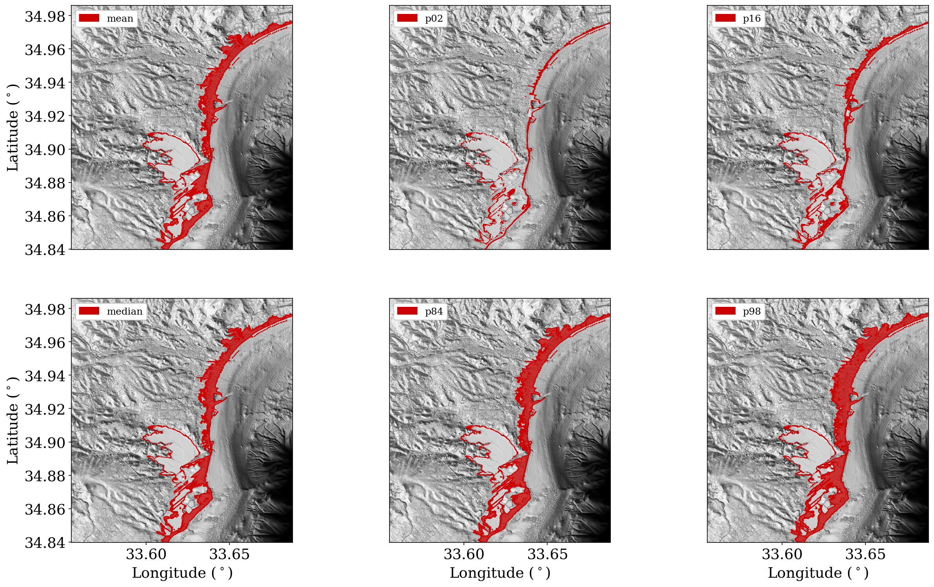
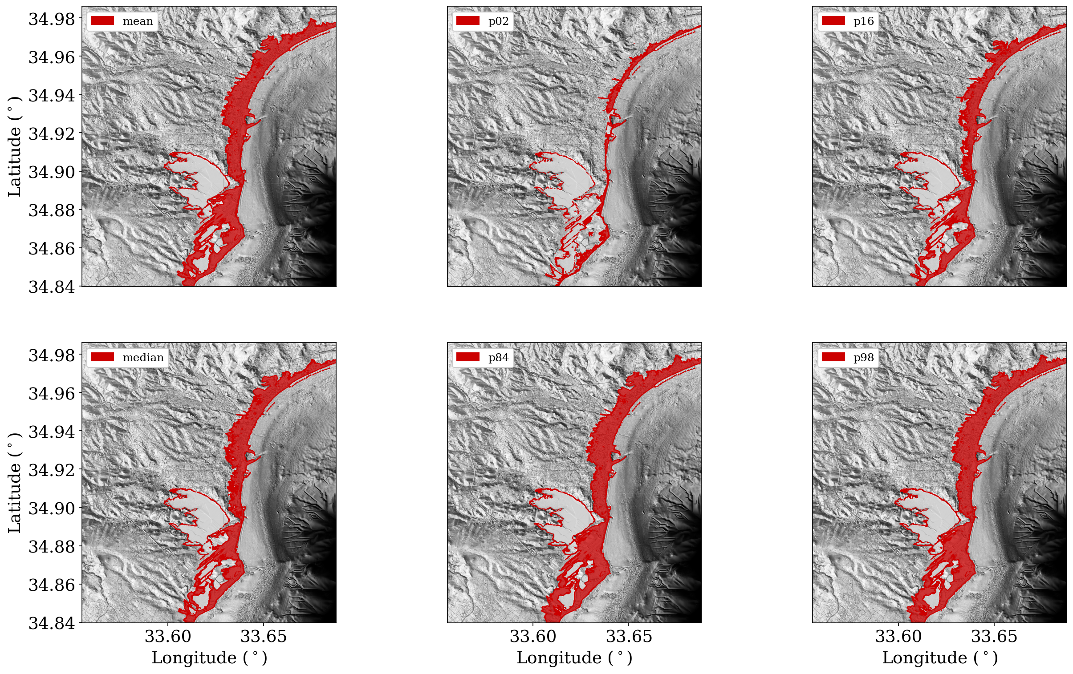
Inundation Modeling
25,000 year ARP
vs. 2,500 year ARP
Lorito, pers. comm.

Slide 14
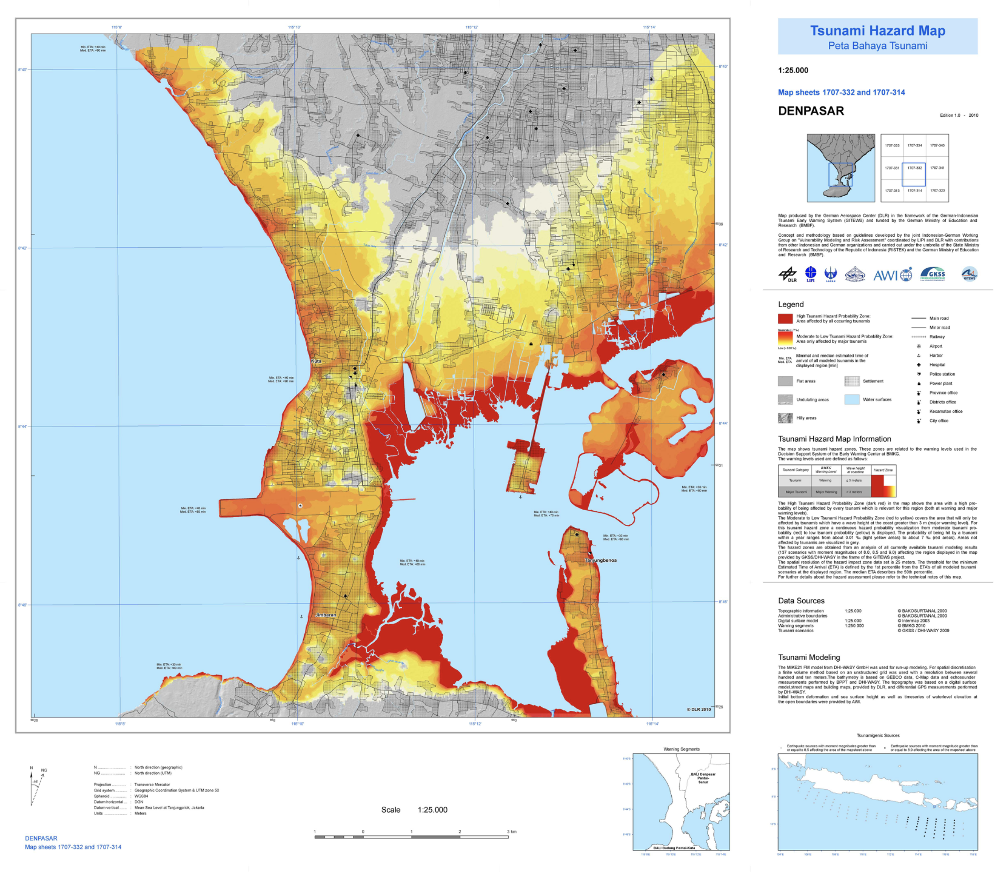
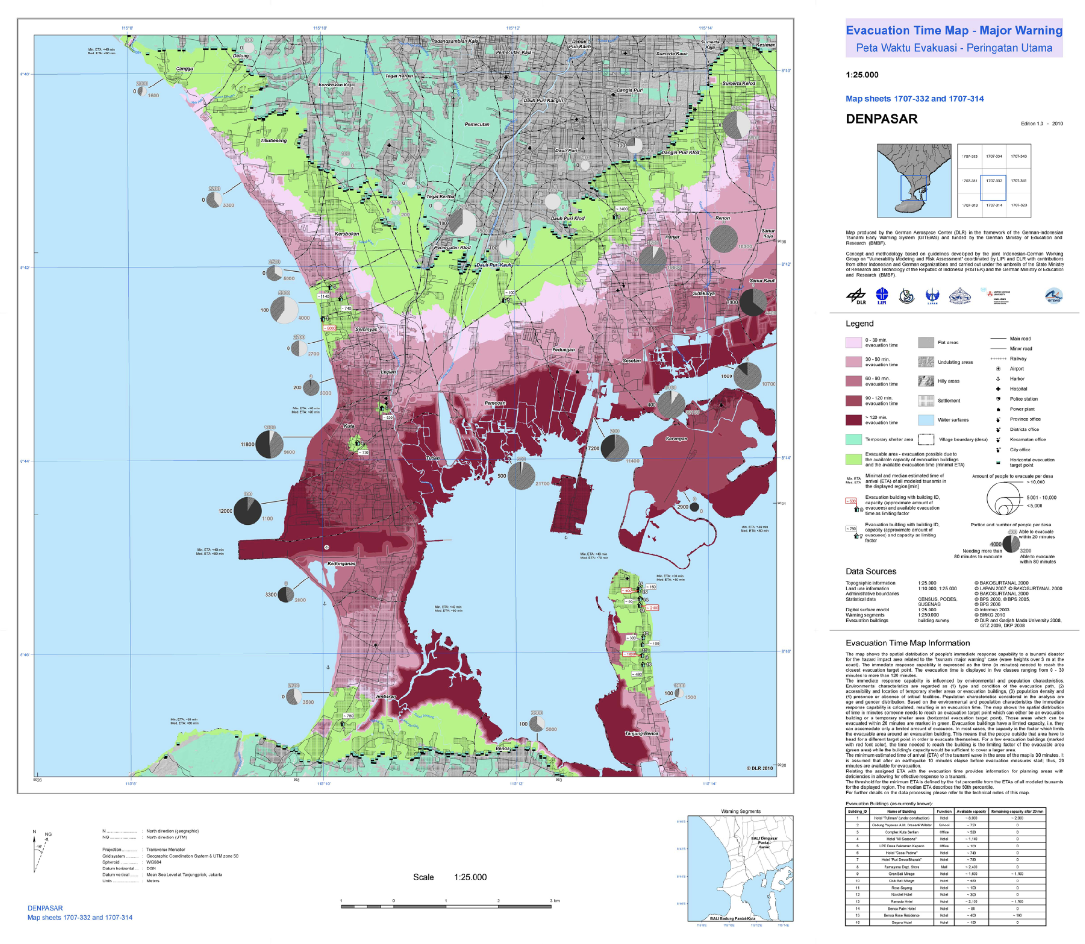
From Inundation to Evacuation
Strunz et al., 2010

Slide 15
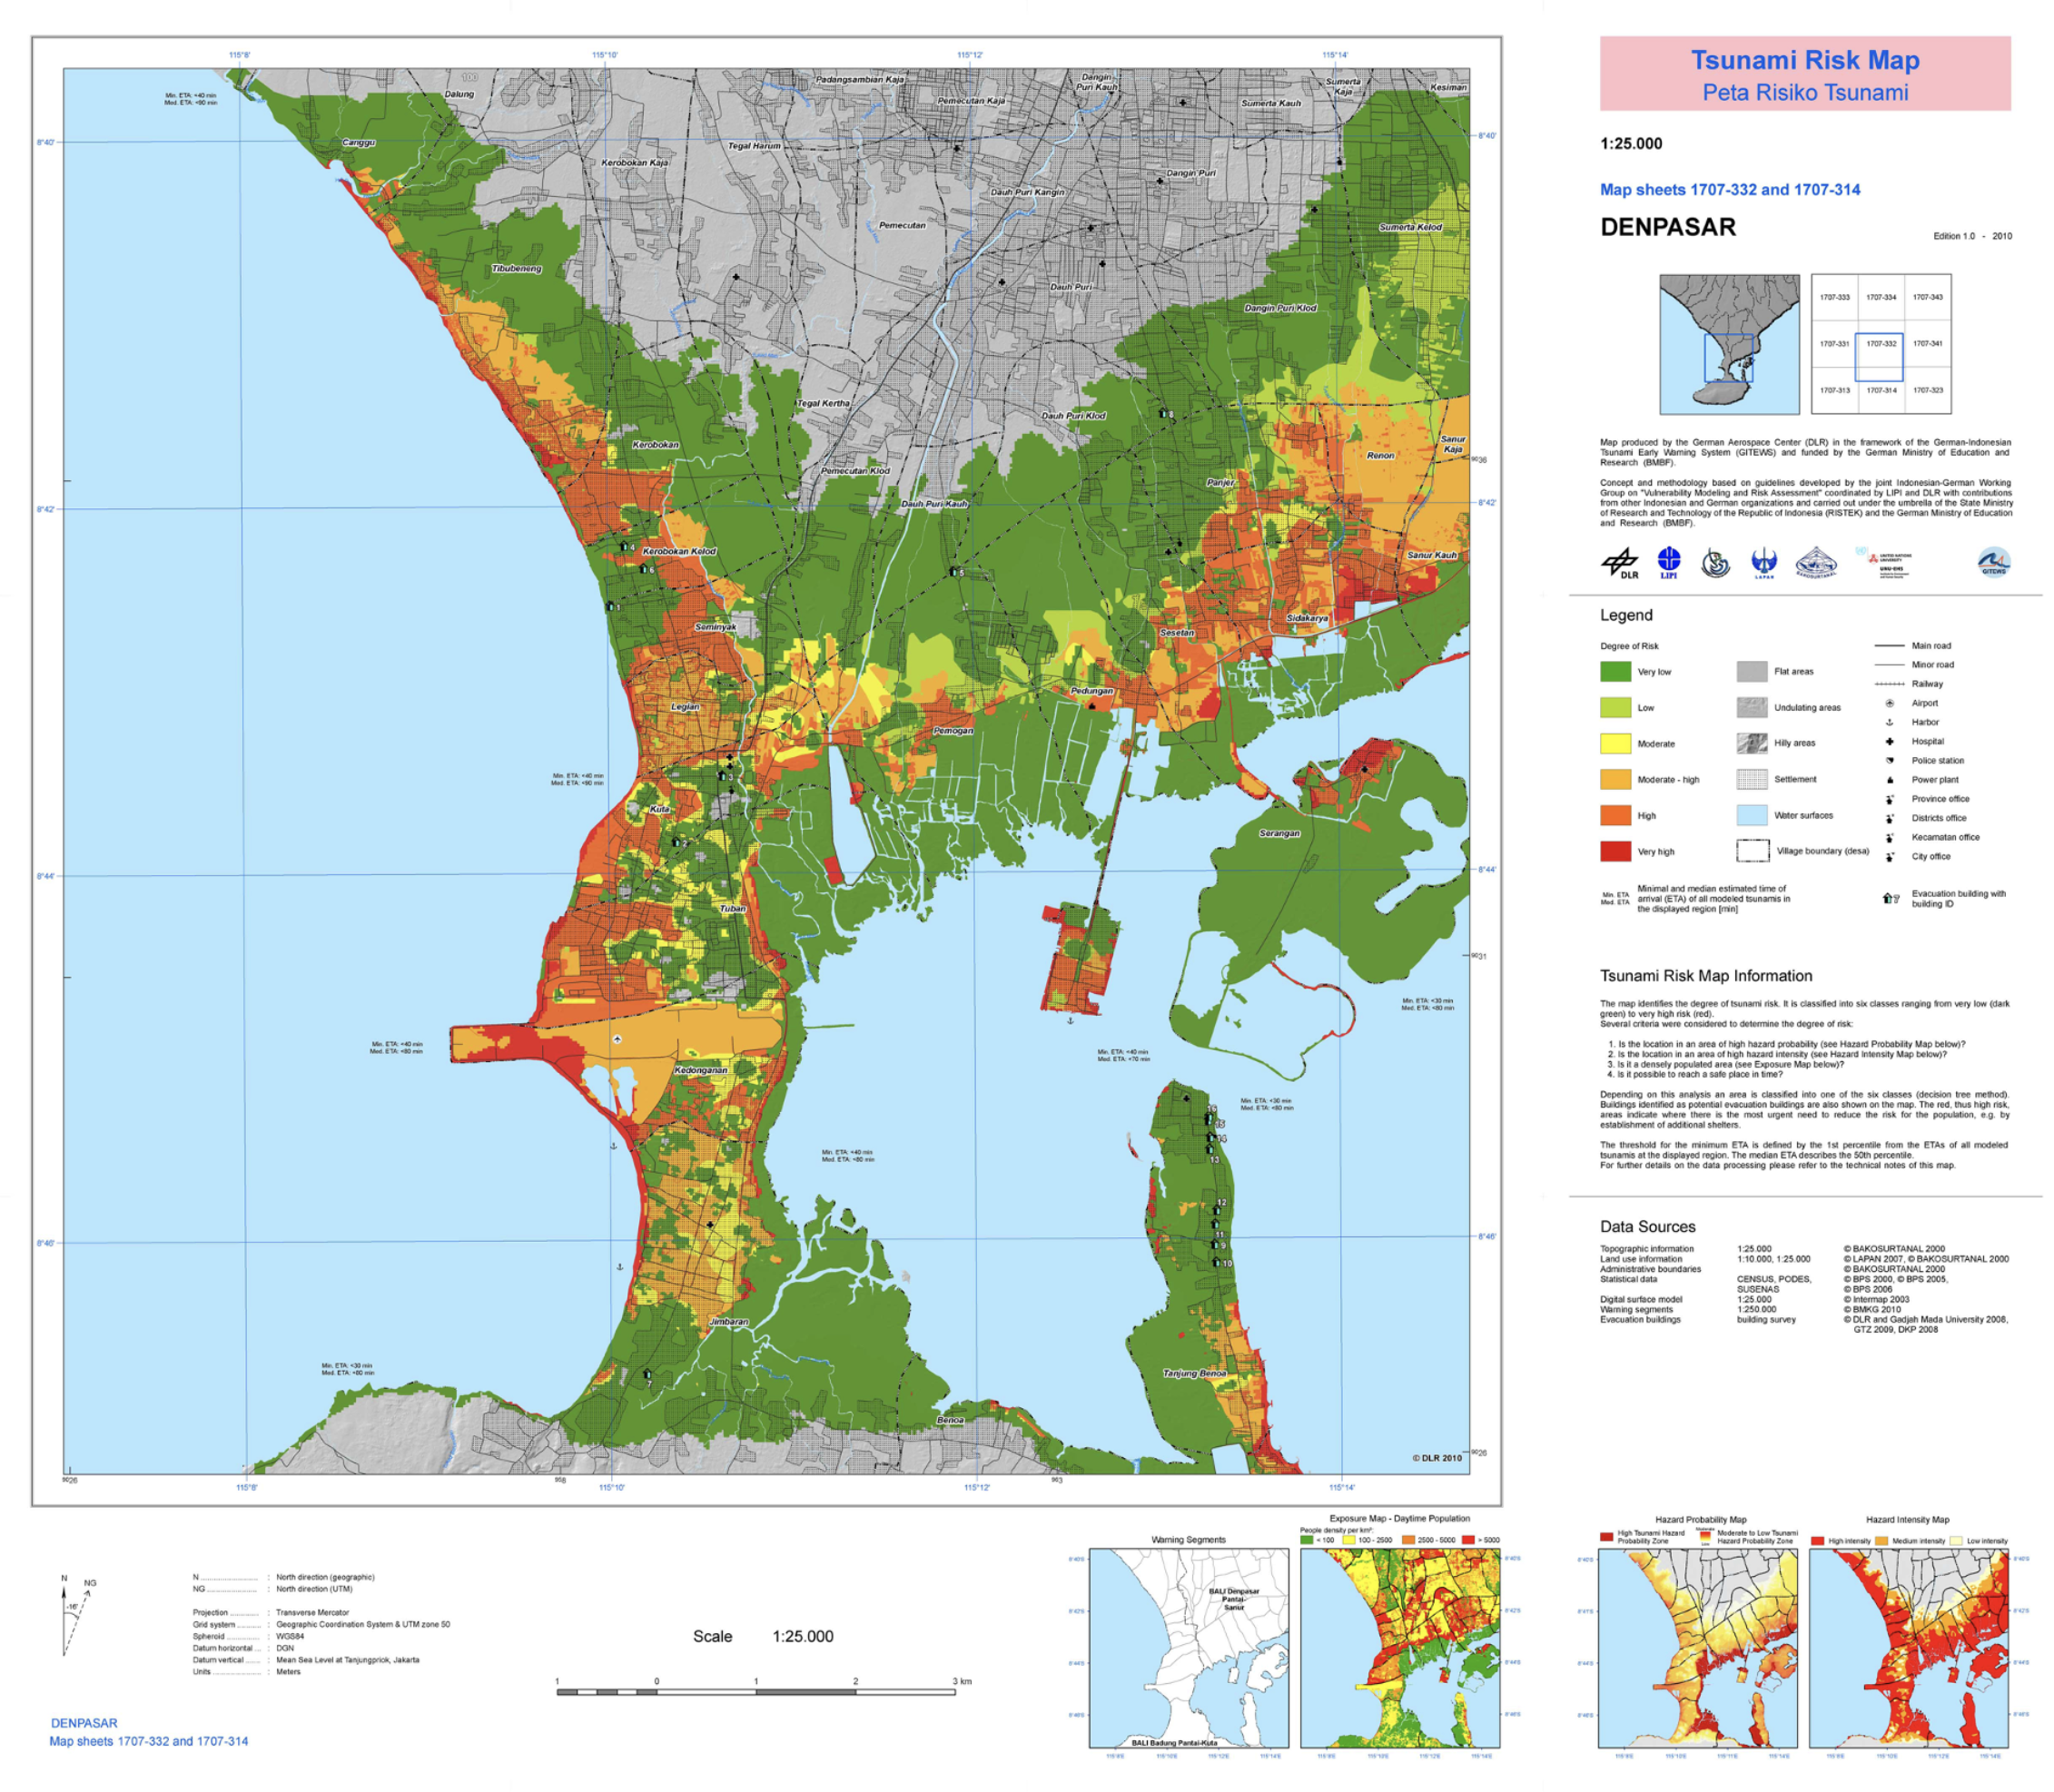
Risk Mapping
Strunz et al., 2010

Slide 16
Next Steps
GTM
Foto: JB

Slide 17
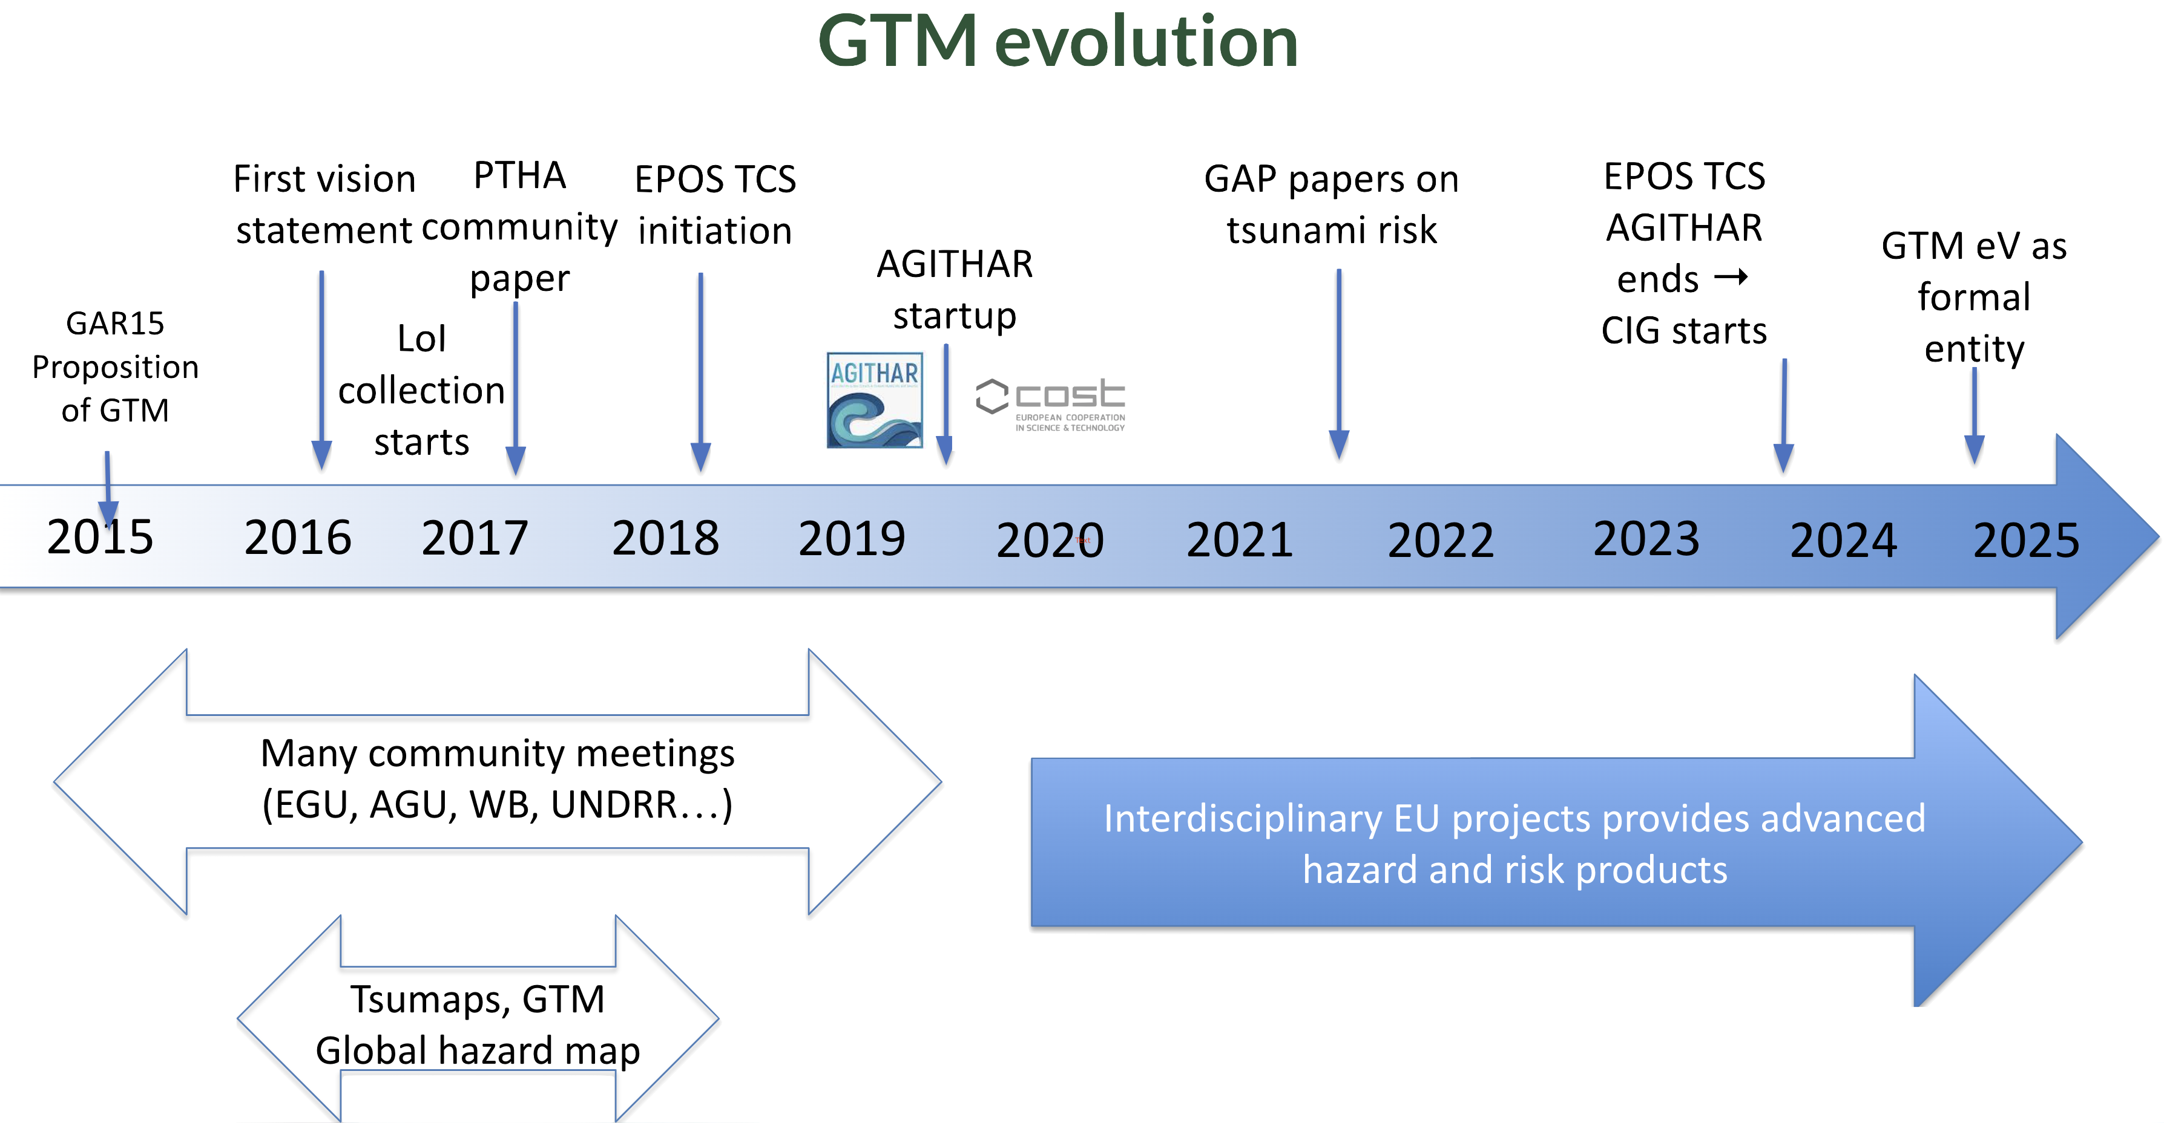
GTM‘s History
Løvholt, pers. comm.

Slide 18
Recent Development – GTM Association (e.V.)
Løvholt, pers. comm.

Slide 19
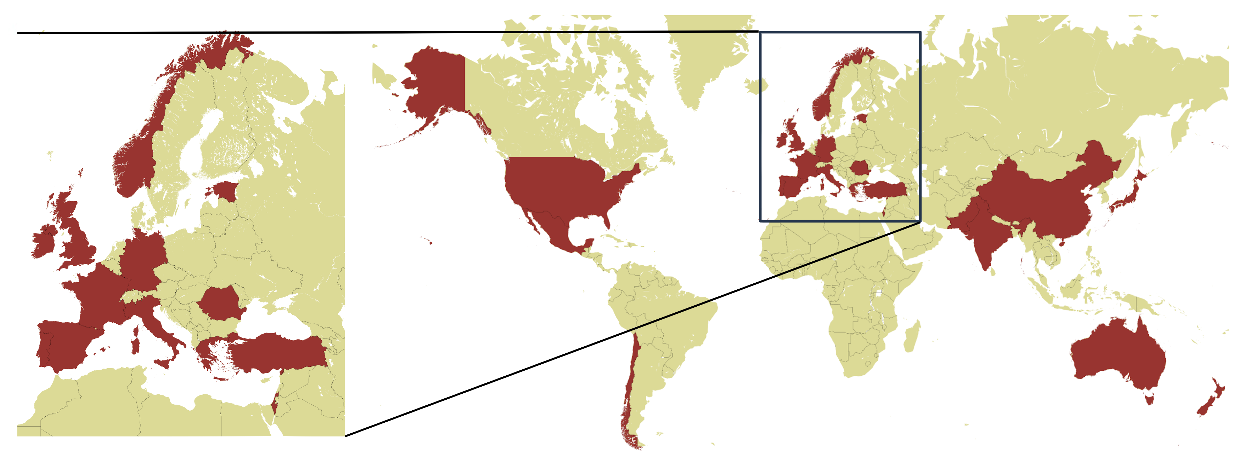
An International Network – GTM LoI Subscriptions
Løvholt, pers. comm.

Slide 20
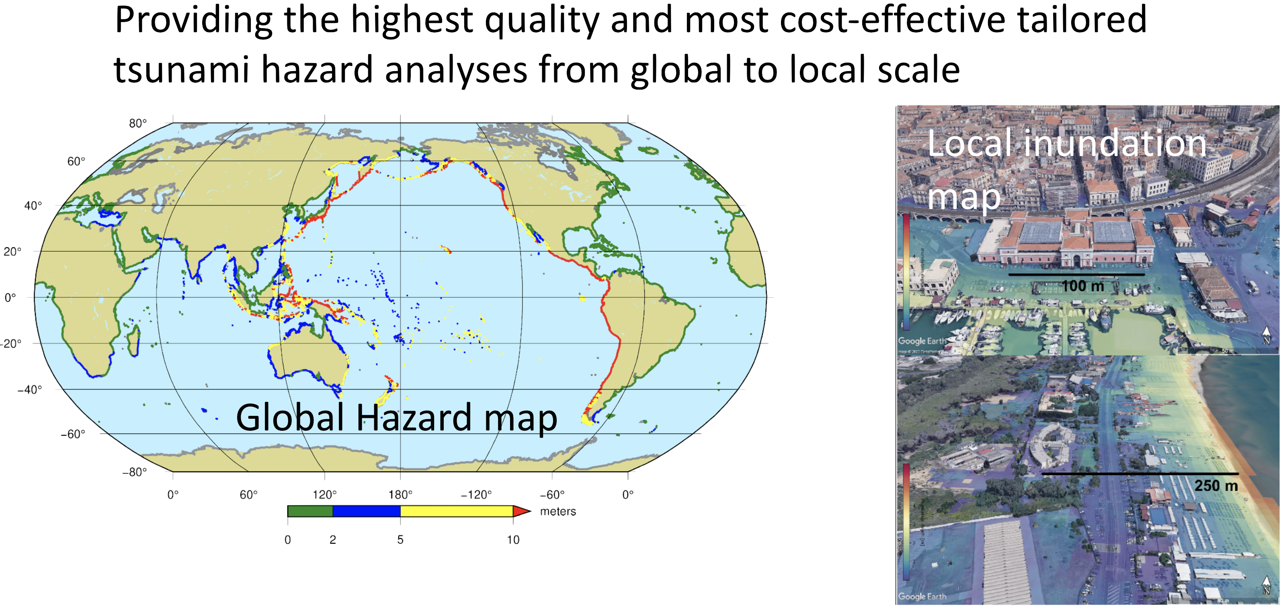
GTM Products
Løvholt, pers. comm.

Slide 21
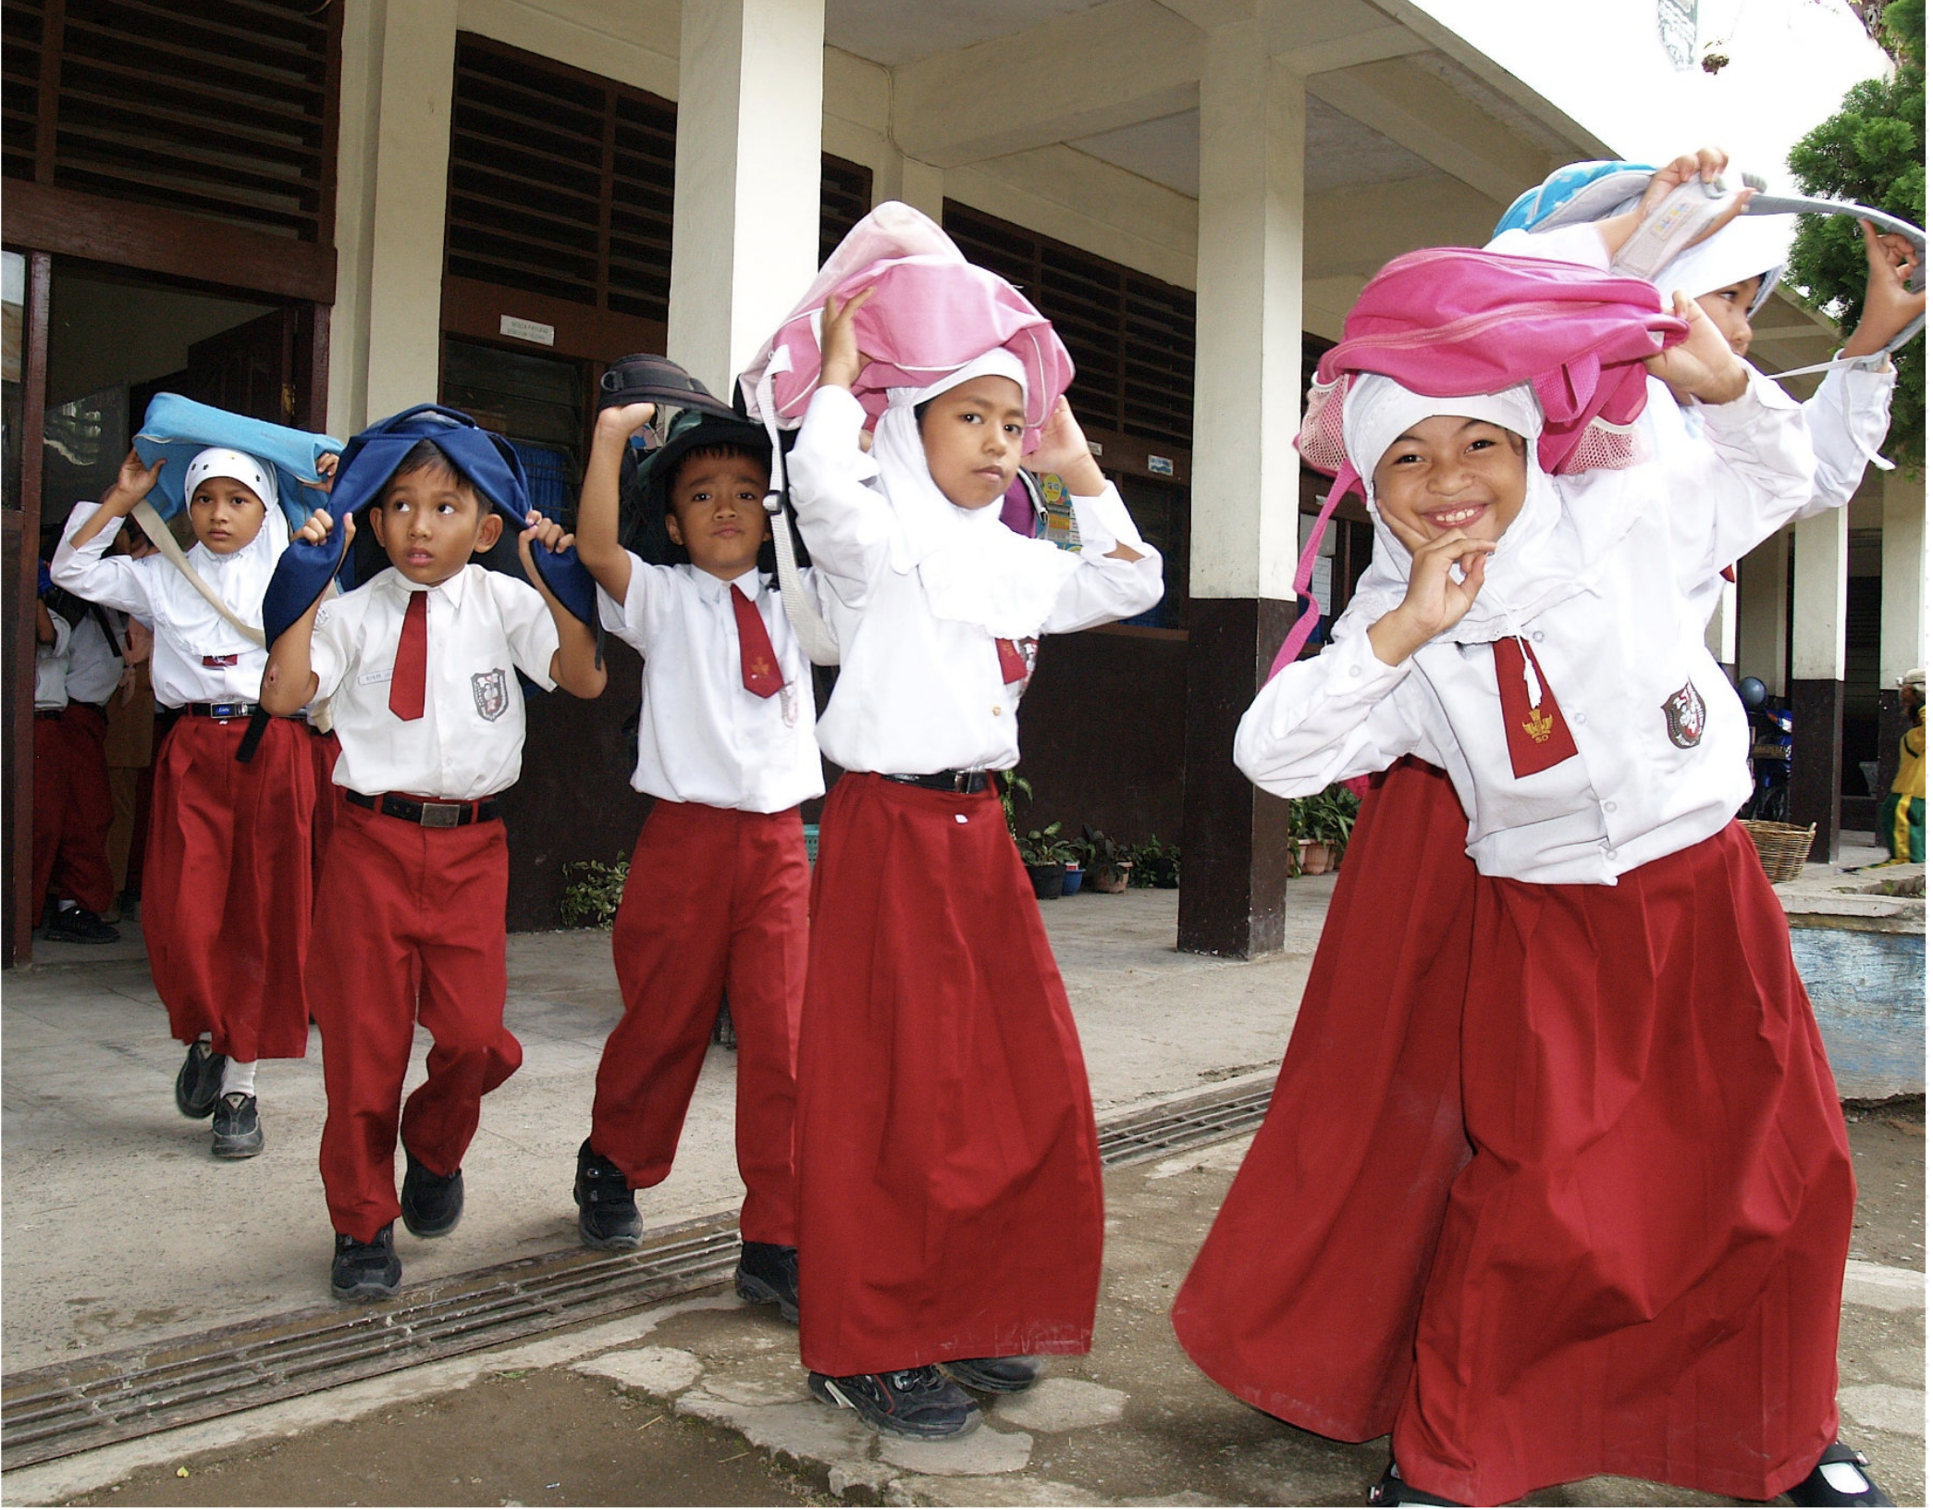
GTM Vision
Saving lives, reducing losses, and enhancing resilience, through the advancement of tsunami science, provision of expert information, and promoting dialog about tsunami hazard and risk.

Slide 22
Questions?
Foto: JB

