Slide 1
Seismotectonics of the Hellenic Subduction System and Tsunami Sources
Gian Maria Bocchini*
*Institute of Geology, Mineralogy and Geophysics, Ruhr University of Bochum, Germany.
This talk benefitted from discussions and collaborations with colleagues from the National Observatory of Athens, University of Kiel, and University of Bochum
UNESCO-IOC Expert Meeting on Tsunami sources in NEAM
Notes:
Currently Postdoc at the University of Bochum
Today I am presenting mostly work carried out during my PhD at the National Observatory of Athens in collaboration with the University of Kiel in

Slide 2
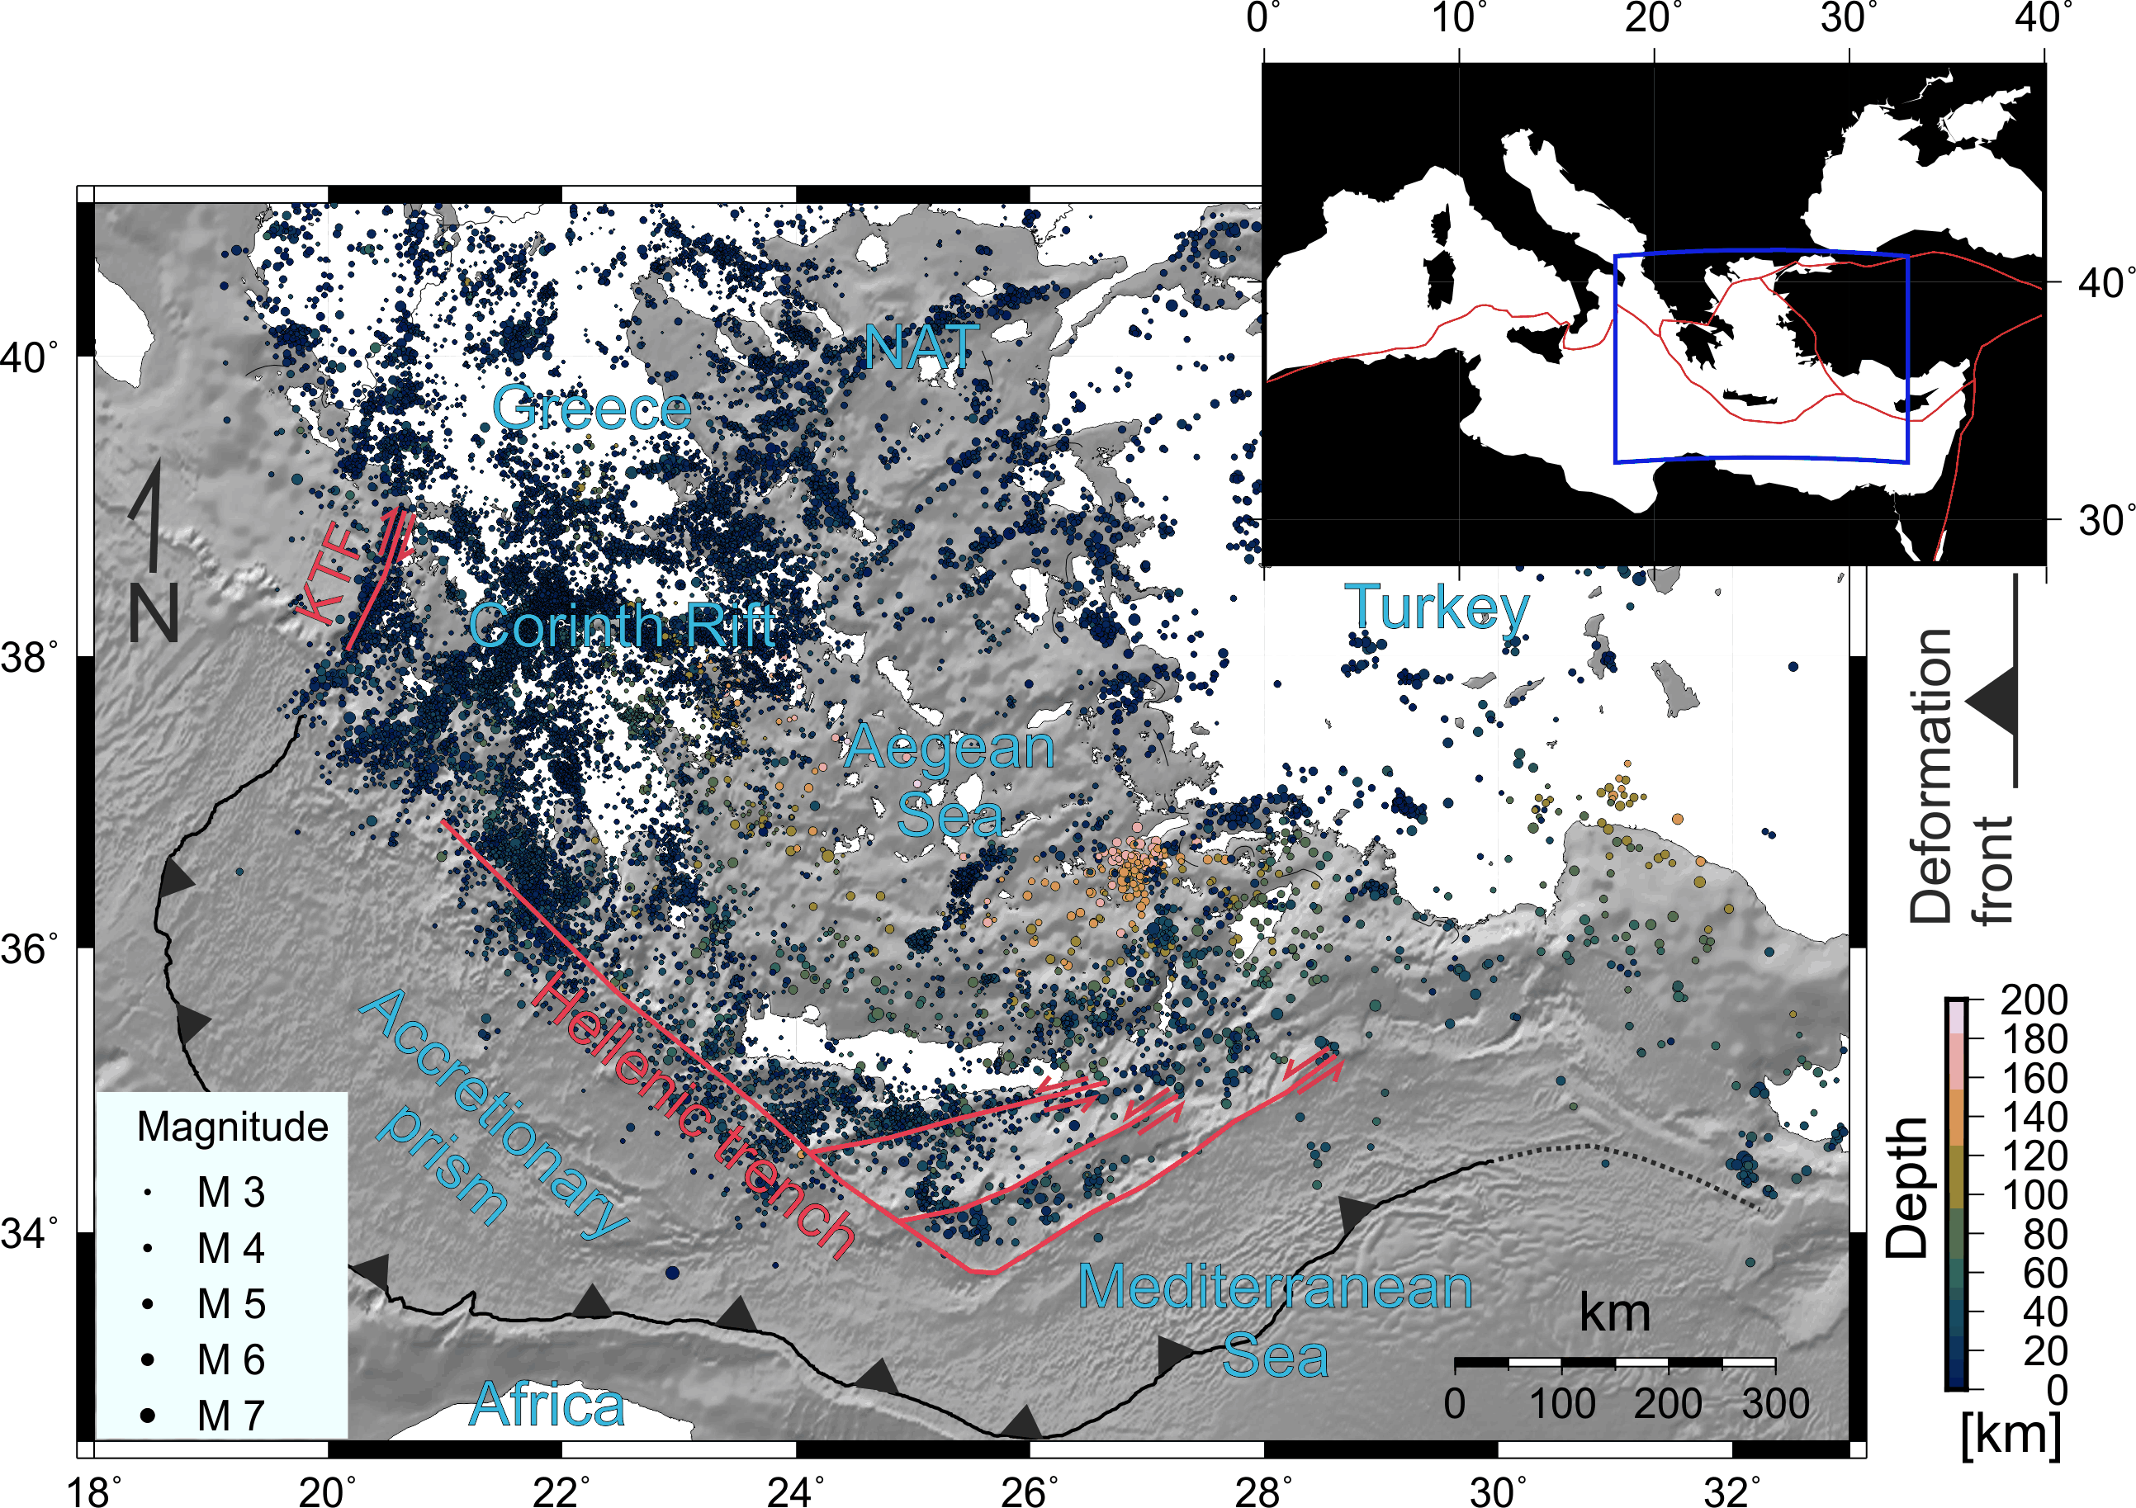
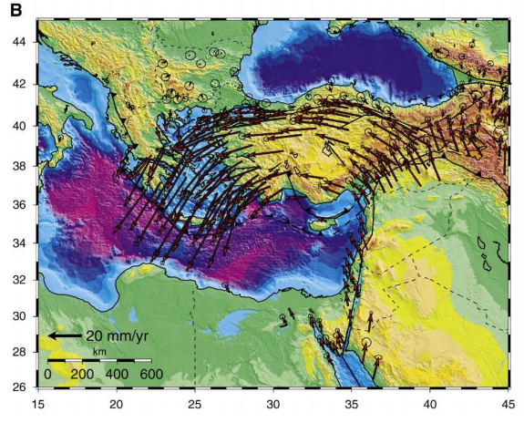
The Hellenic Subduction System (HSS)
Eurasia
Arabia
Africa
GPS-velocity vectors with respect to stable Eurasian Plate (Reilinger et al., 2010)
Seismicity from the reviewed ISC catalog 1964-2014 (vertical and horizontal errors ≤10 km)
Notes:
The term Hellenic Arc is often used to refer to the arcuate shape of the subduction system, visible in the subducting slab and therefore in the distribution of seismicity, in the volcanic arc and in the subduction related orogen, namely the Hellenides.
The HSS is located in the eastern Mediterranean sea, at the boundary between the African and Eurasian plate, a region characterized by intense deformation and seismicity.
The convergence rate at the Hellenic margin of 35-40 mm/yr exceed the relative convergence betweeen Africa and Eurasia (less than 1 cm/yr), due to the counterclockwise rotation of the Arabian, Anatolia and of the Aegean region, with respect to Eurasia, with velocities increasing towards the Hellenic margin due to slab rollback.
The spectacular velocity filed image by GPS is reflected in intense seismicity. The most seismically active region in the Aegean are:
The north Aegean trough
The Gulf of Corinth
The Kefalonia Transform Fault,
- All the offshore region in the outer Hellenic forearc from the KTF to SW Turkey. This is the region hosting the interplate seismogenic zone where largest earthquake on earth occur.
- Seismicity in the outer forearc shows lateral heterogeneities in the distribution of seismicity.
Here I want to spend a few words on the presence of the Hellenic trench, a very distinct feature of the HSS, initially erroneously interpreted as the subduction trench and now interpreted as morphotectonic features of the upper-plate although thier origin remains debated.
Finally the SE Aegean sea region exibits higher seismicity rates of the rest of the Aegean both at shallow and intermediate depths.
2

Slide 3
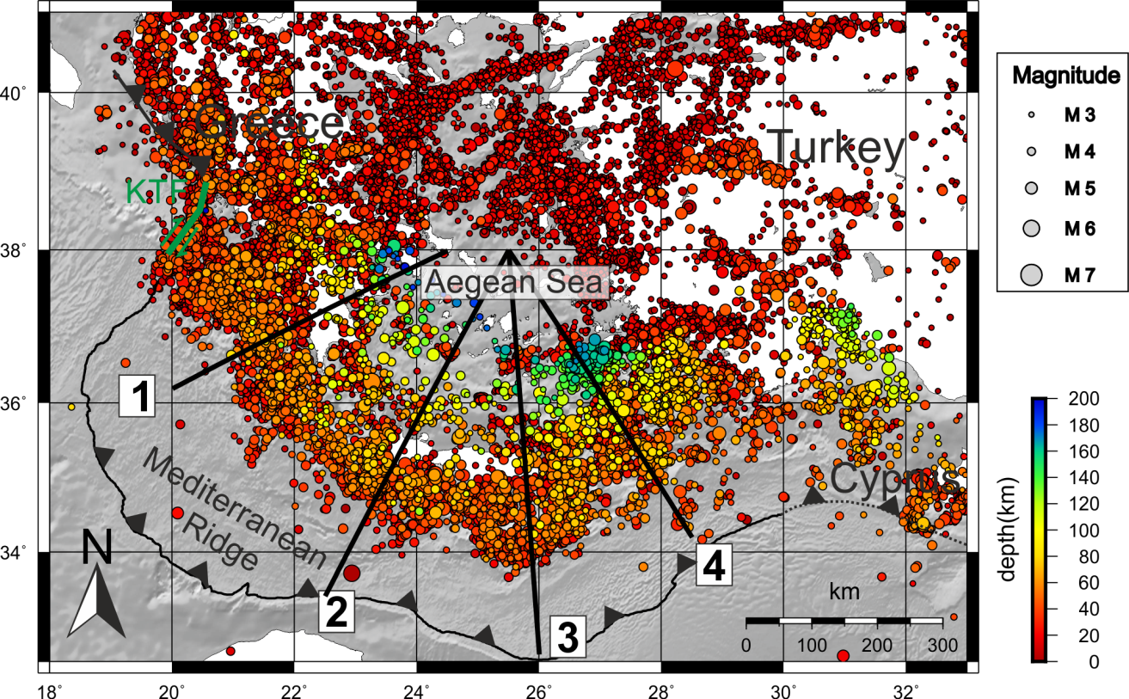
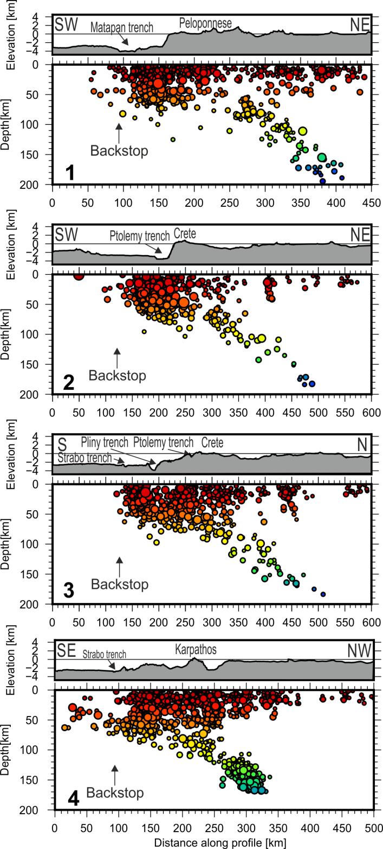
Wadati-Benioff Zone and Slab Geometry
Well-defined WBZ down to ~180 km.
Steeper slab in the area of Rhodes -Nisyros (cross-section 4) with respect to the area of Crete and Peloponnese (cross-sections 1, 2, 3).
More intense intermediate-depth seismicity in the area of Rhodes-Nisyros (cross-section 4).
W
Bocchini et al. (2018)
E
W: 100 km
Notes:
In addition, based on the properties of intermediate depth seismicity, more intense in the SE Aegean than west of it, and on the increasing dipping angle of the slab from west to east visible in the distribution of intermediate depth seismicity and regional tomography models and receiver functions, several authors proposed that the slab could be segmented somewhere between Crete and Rhodes. The geometry and location of this possible feature were not described.
An other interesting aspect of the intra-slab seismicity is its downdip extent down to 180 km, much shallower than the downdip extent of the slab and of intra slab seismicity observed elsewhere in the world.

Slide 4
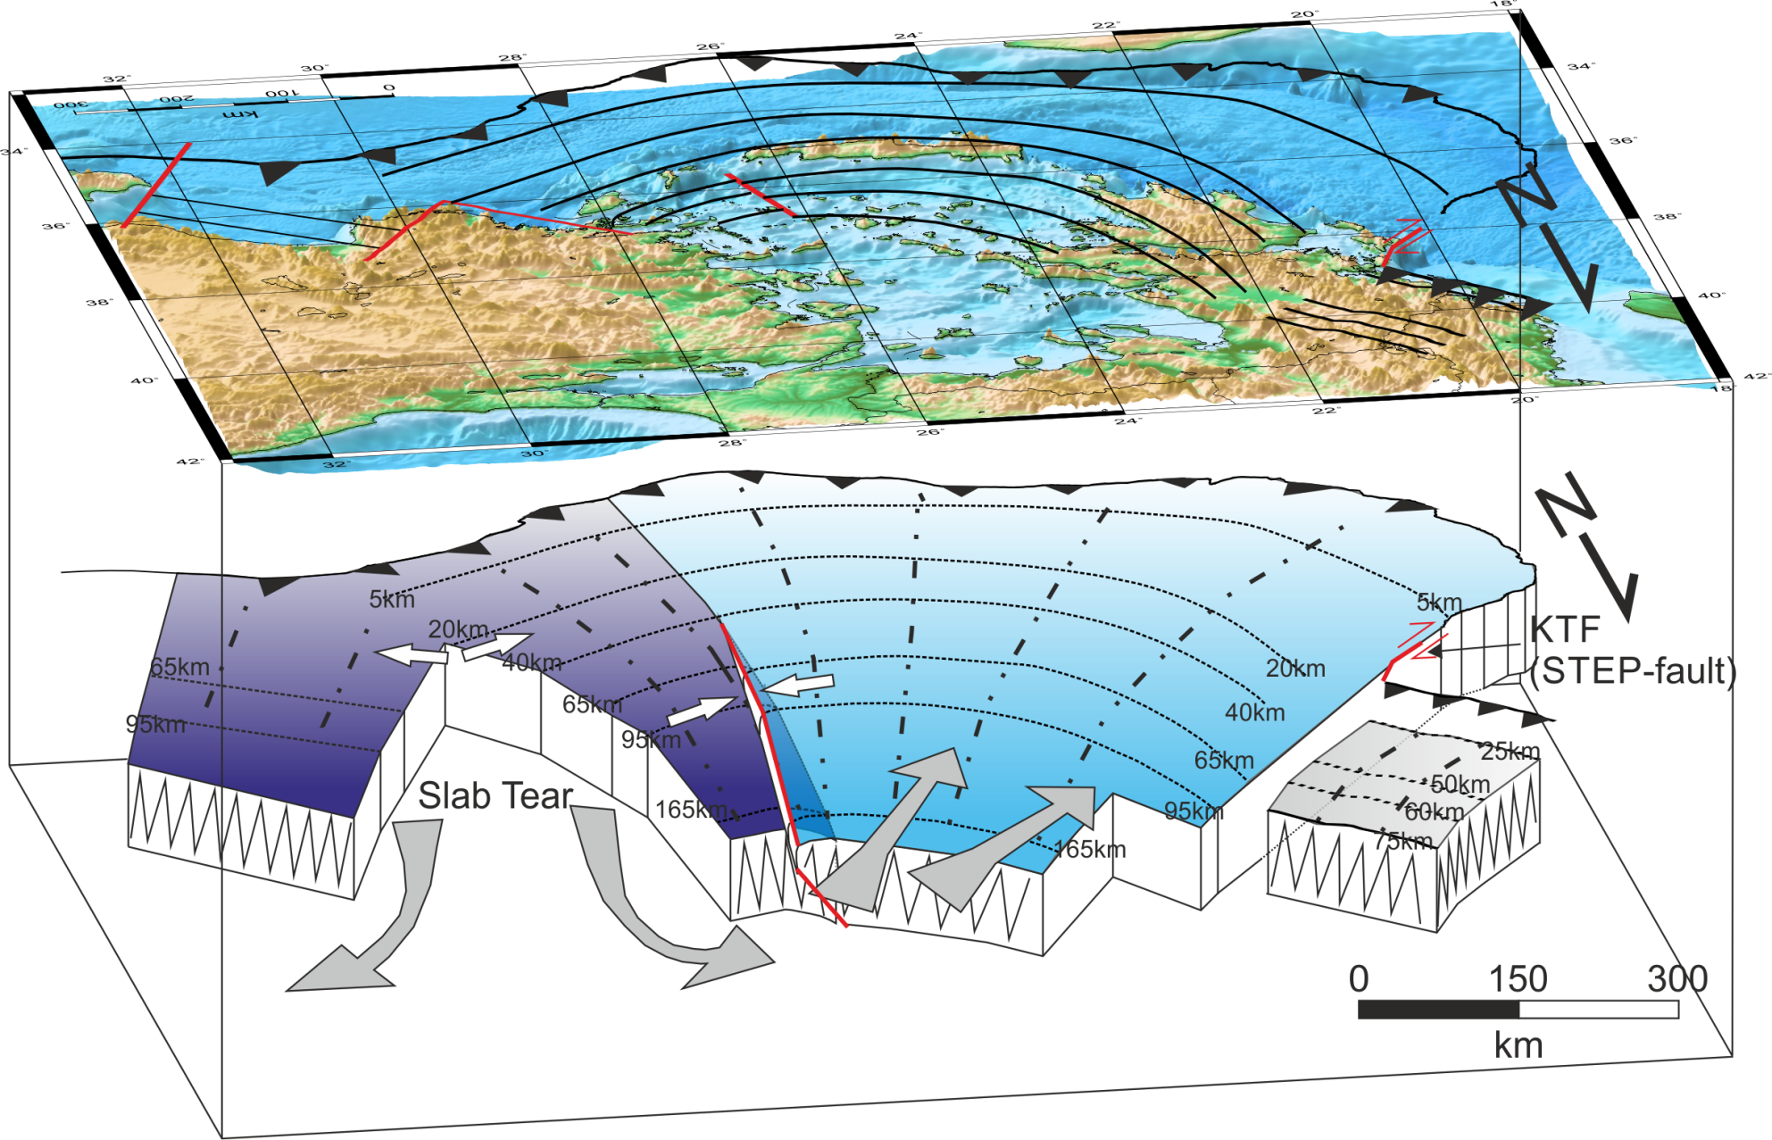
Refined Seismically Active Slab Geometry
Amphitheater-like shape of the slab;
Discontinuities (tear) in the slab between Rhodes and SW Türkiye and beneath Northern Greece (along the KTF);
Steeper slab in the area of Rhodes-Nisyros then to the west.
Slab geometry affects shallow and intermediate depth seismicity distribution.
Vertical exaggeration by a factor of about 2
Bocchini et al. (2018)
Notes:
Combining all the information that I’ve showed we came out with a refined geometry that we see in map and 3-D view. Let’s now explore the main features of the model from west to east:
The KTF above the edge of the seismically active slab – STEP fault
Possible discontinuity between the continental and oceanic slab beneath northern Greece
Shallower hypocentres north of Corinth then to the south
First order segmentation of the subducting slab occurring between Crete and Karpathos
NW-dipping slab in the area of Rhodes-Nisyros – not compatible with a NE-SW STEP fault in the Pliny Strabo trench region
Eastern slab edge beneath the SW coastline of Turkey
V-shaped tear between the Hellenic and Antalya slab
4

Slide 5
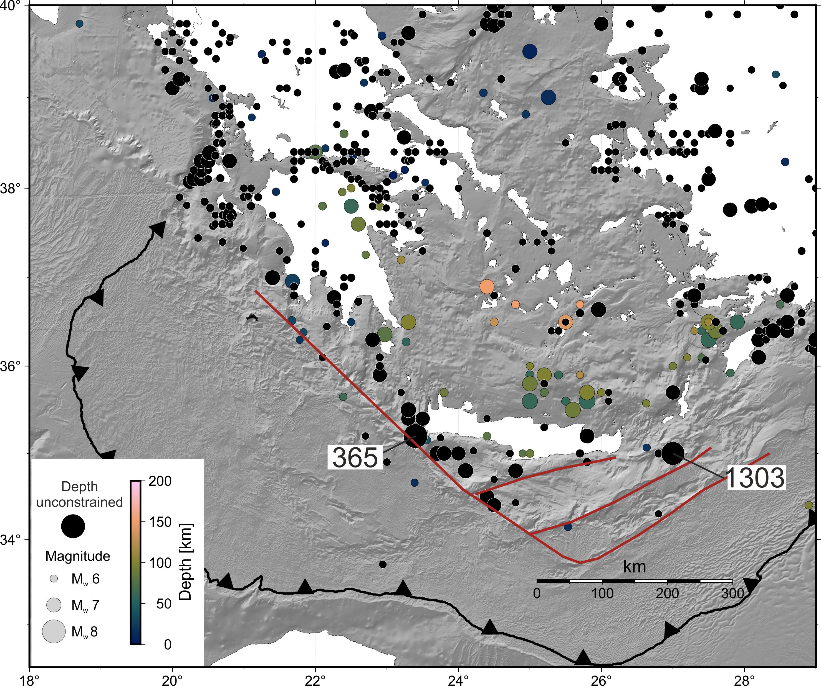
Historical Earthquakes in the HSS
550 BCE – 2010
M 6+
*1303 earthquake epicentral location according to Guidoboni & Comastri (1997)
Papazachos et al. (2000; 2010)

Slide 6
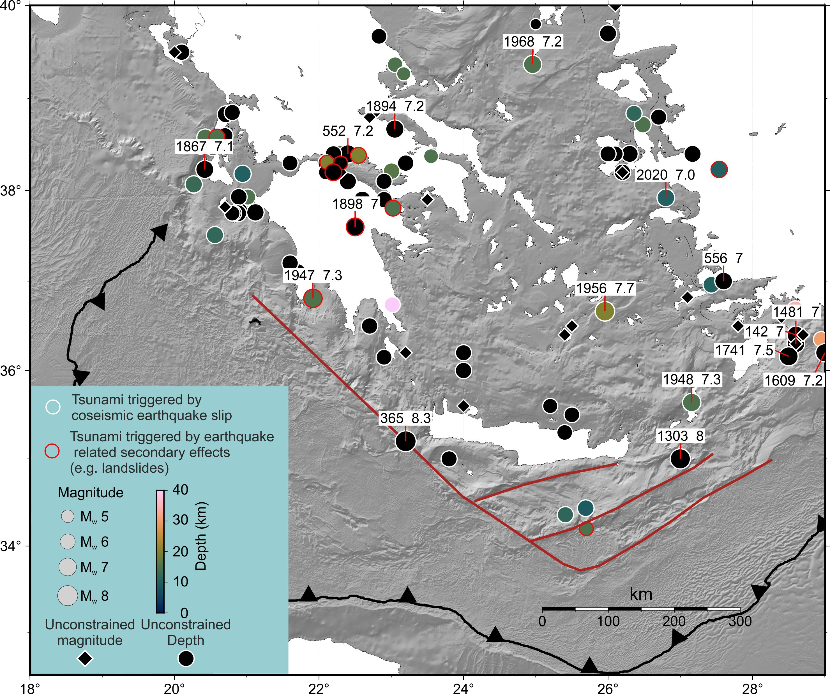
Tsunamigenic Earthquakes in the HSS
Modified after Papadopoulos (2000, 2011)

Slide 7
Tsunamigenic Earthquakes
The Outer Hellenic Arc
Modified after Papadopoulos (2000, 2011)

Slide 8
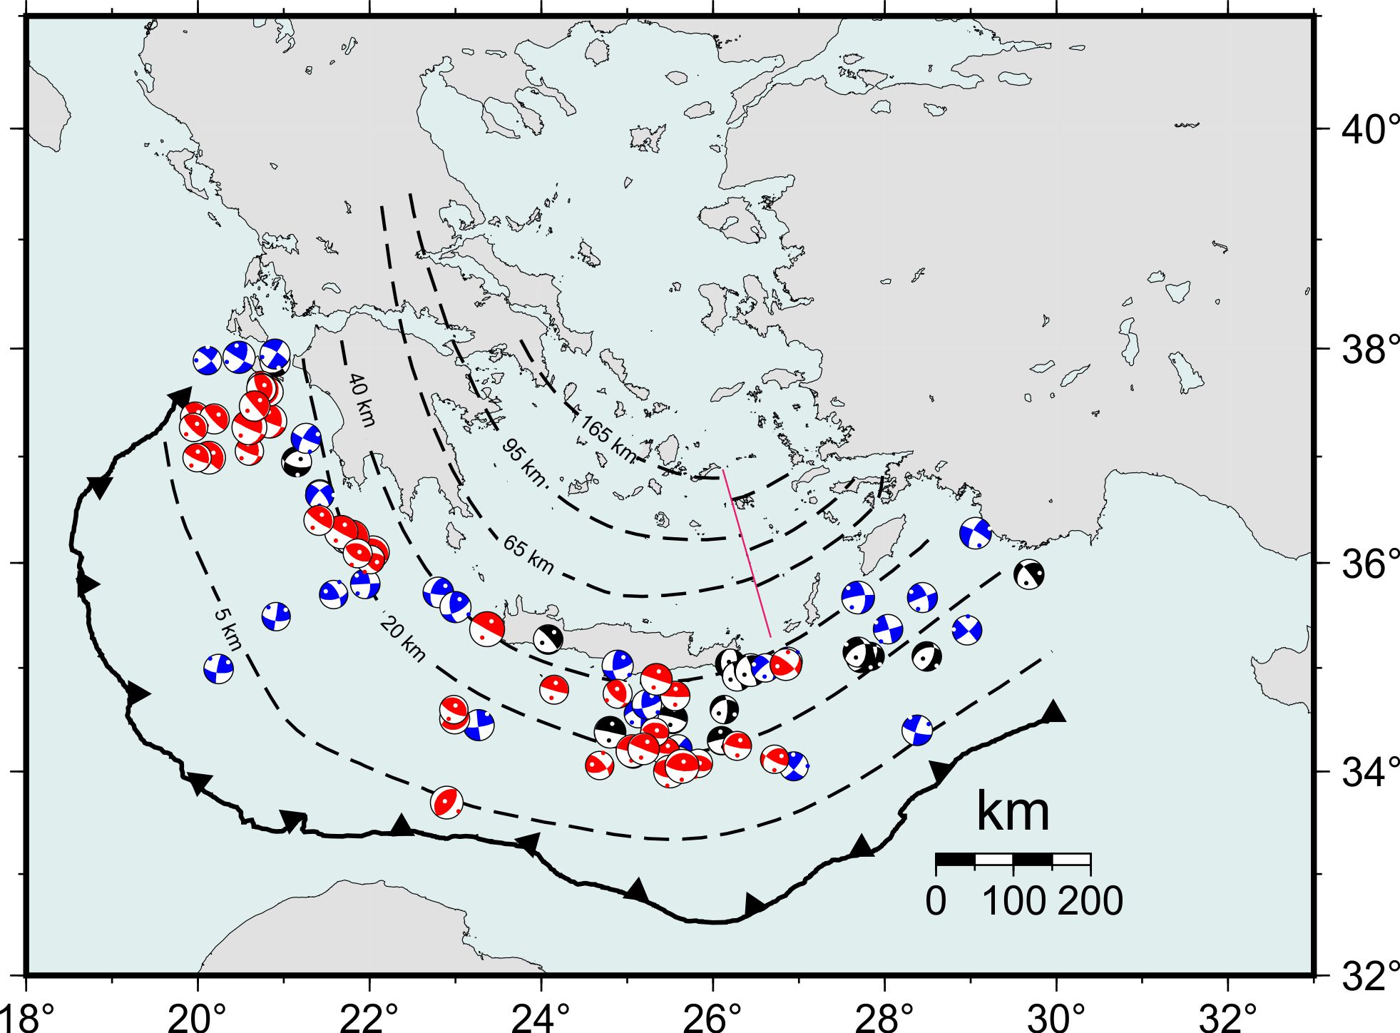
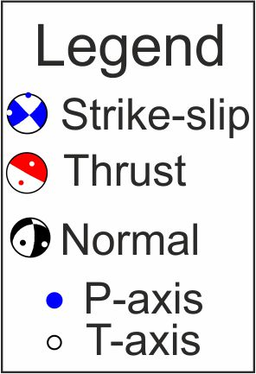
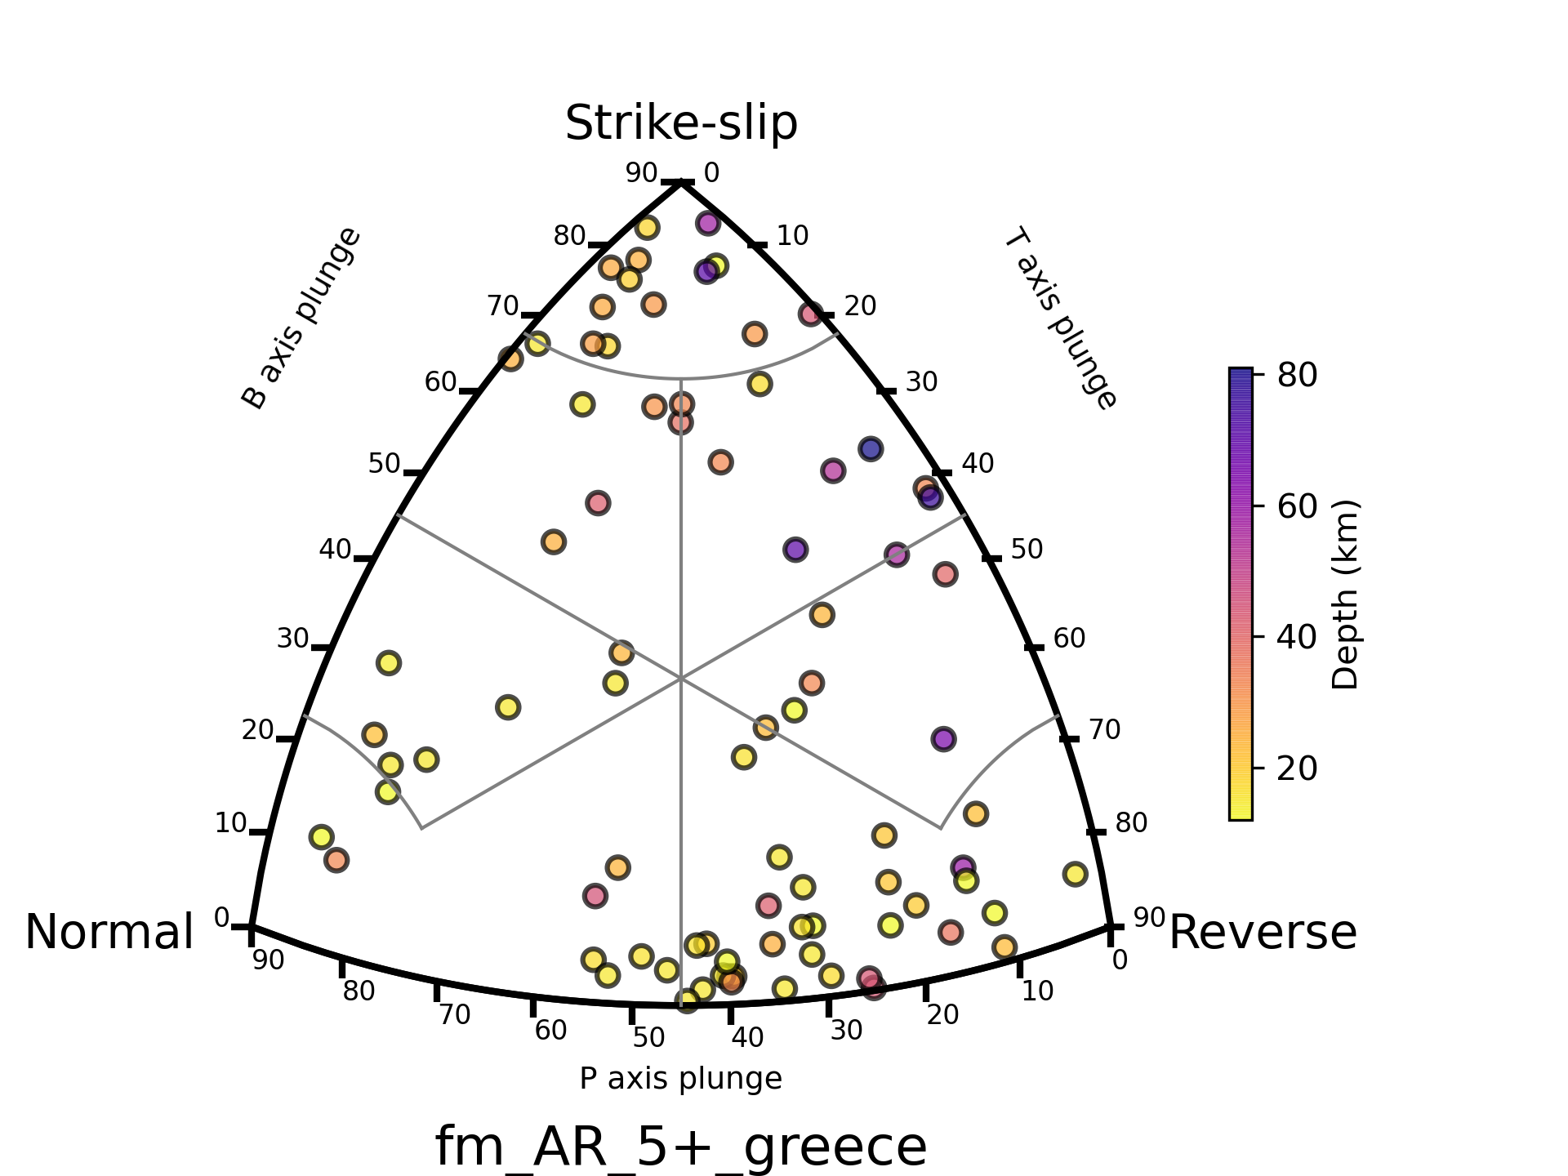
Active Deformation in the Outer Hellenic Arc
The Outer Hellenic Arc hosts a mixture of thrust, strike-slip, and normal faults highlighting its tectonic complexity.
Global CMT catalog
1976-present
M 5+

Slide 9
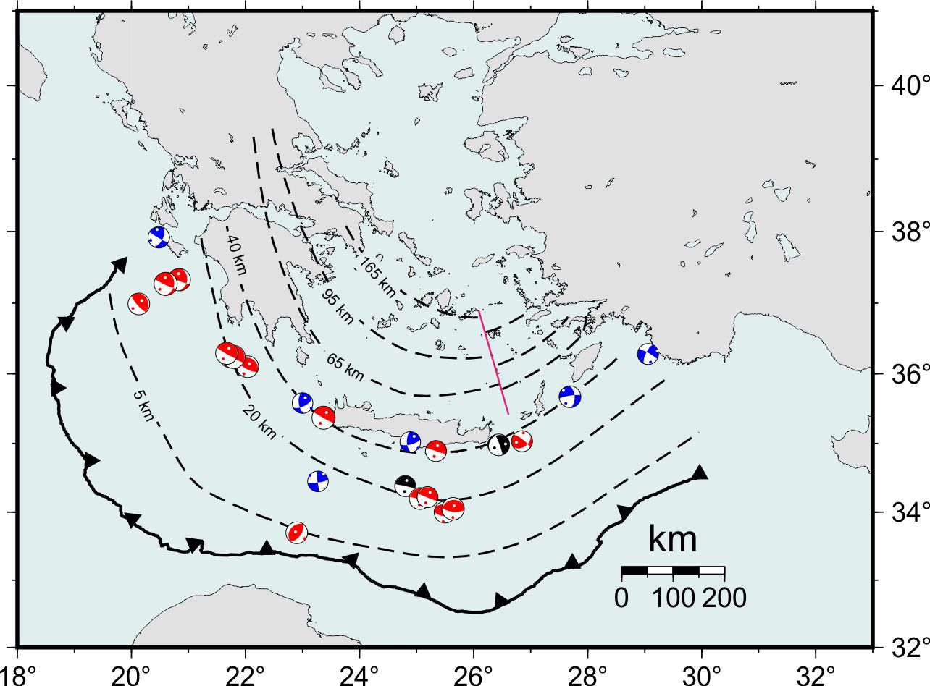
Active Deformation in the Outer Hellenic Arc
The Outer Hellenic Arc hosts a mixture of thrust, strike-slip, and normal faults highlighting its tectonic complexity.
Dominance of thrust and strike-slip mechanisms for M > 6 earthquakes.
Global CMT catalog
1976-present
M 6+

Slide 10
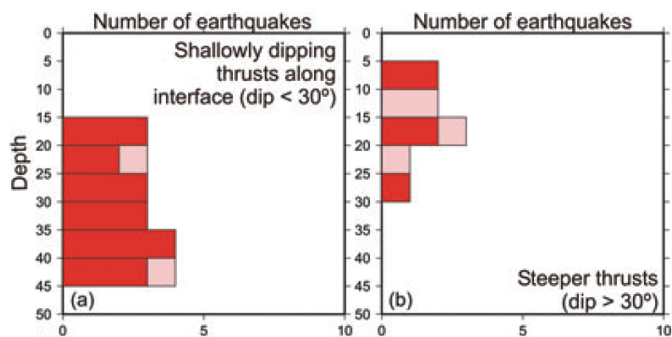
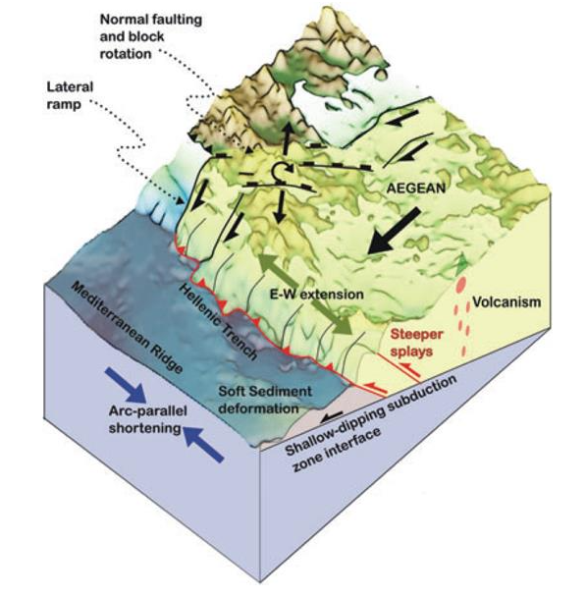
Thurst Earthquakes in the Outer Hellenic Arc
Thurst fault earthquakes in the outer Hellenic arc can be subdivided into:
Steeper thrusts (dip ~30-40°) in the overriding plate;
Shallowly dipping thrusts (dip <20-30°) along the plate interface;
Intraslab earthquakes with P-axis parallel to the slab isodepths.
Increasing average
depth
Shaw and Jackson (2010)

Slide 11
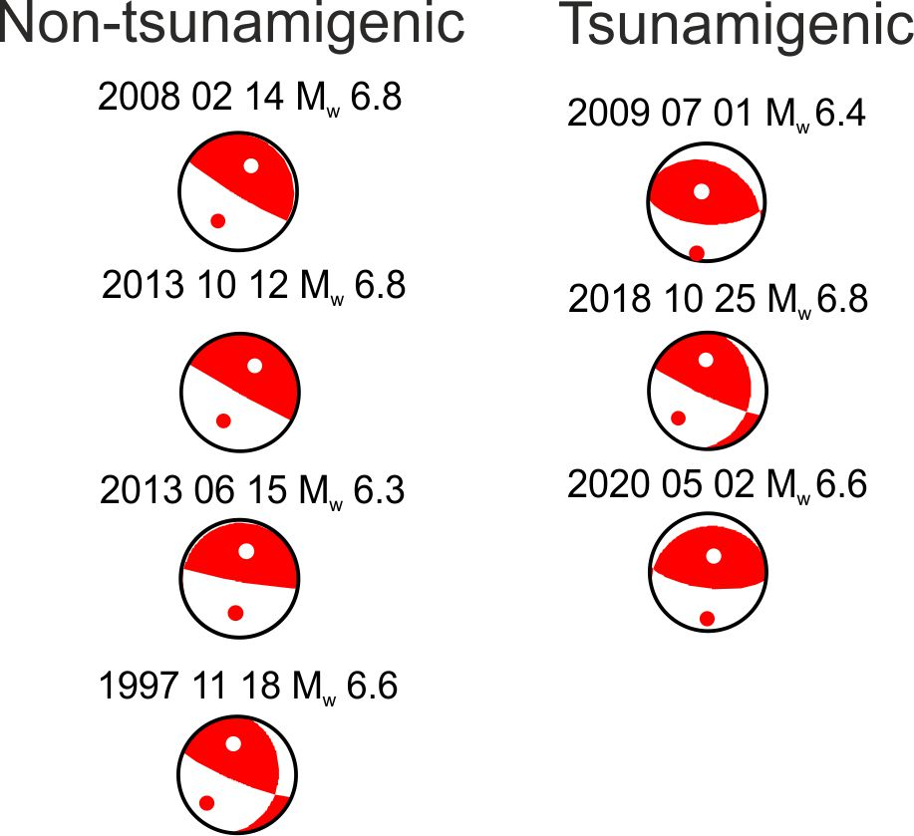
Recent M6+ Earthquakes (Tsunamigenic and not)
1997
2018
2013 10
2008
Tsunamigenic earthquakes have steeper dip angles than non-tsunamigenic earthquakes.
2013 06
2009
2020
Sources: Bocchini et al. (2020) , Cirella et al. (2020), Howell et al. (2017), Kalligeris et al. (2022), Triantafyllou et al. (2024)
Focal mechanisms from GCMT catalog.

Slide 12
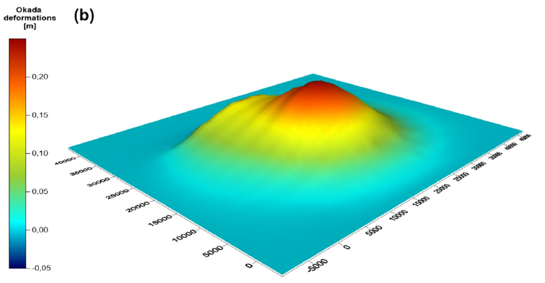
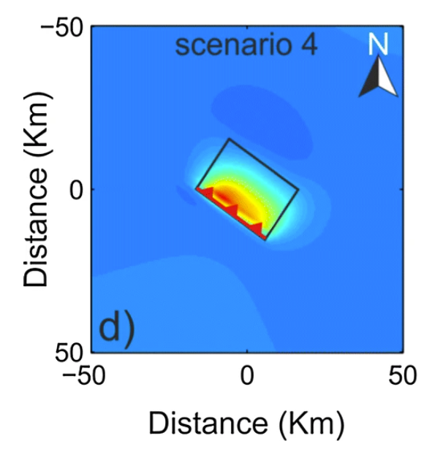
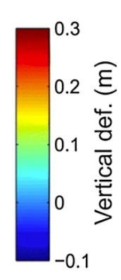
The 2009 and 2020 Tsunamigenic Earthquakes
Hypocentral depth < 15 km.
Fault dip angle > 30°.
Similar maximum vertical deformation of the seafloor of ~25-30 cm.
~0.3 m high tsunami waves along the southern coast of Crete (Bocchini et al., 2020, Kalligeris et al., 2022; Triantafyllou et al., 2024).
Triantafyllou et al. (2024)
Bocchini et al. (2020)

Slide 13
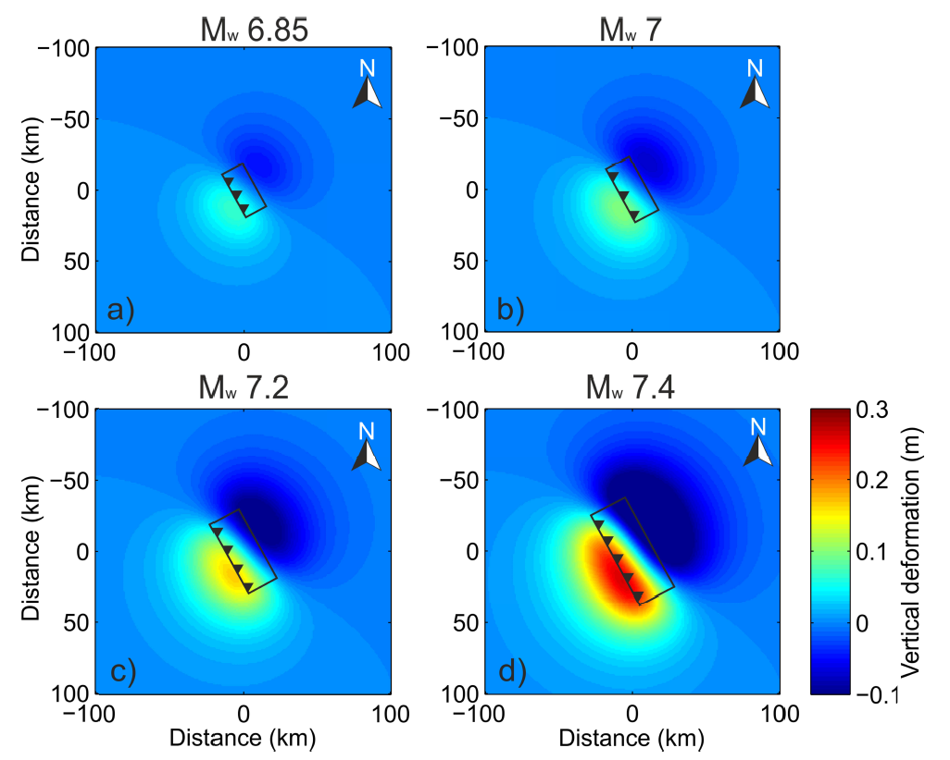
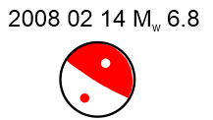
Non-Tsunamigenic Earthquakes (Methoni Earthquake)
One of the largest well-recorded interplate earthquake in the HSS (Howell et al., 2017)
Hypocentral depth of the Methoni earthquake ranges between 15-37 km.
Fault dip angle < 10-15°.
For a “Methoni-like” earthquake, the maximum vertical displacement is comparable to that caused by the 2009 and 2020 earthquakes for M ~7.3-7.4 (but spread across a much larger area).
(Bocchini, 2018, PhD thesis)

Slide 14
Concluding Remarks
The record of instrumentally observed tsunamigenic earthquakes is limited.
Upper-plate thrust fault earthquakes exhibit a higher potential for generating tsunamis compared to similar or slightly larger magnitude thrust earthquakes occurring along the plate interface.
A greater focus on studying non-tsunamigenic earthquakes is essential for understanding the mechanisms behind tsunamigenic events (e.g., Triantafyllou et al., 2024; Bocchini, 2018).
Higher-quality hypocentral location (and of the slab geometry) in the outer Hellenic Arc are crucial for a better characterization of seismogenic and tsunamigenic sources.

Slide 15
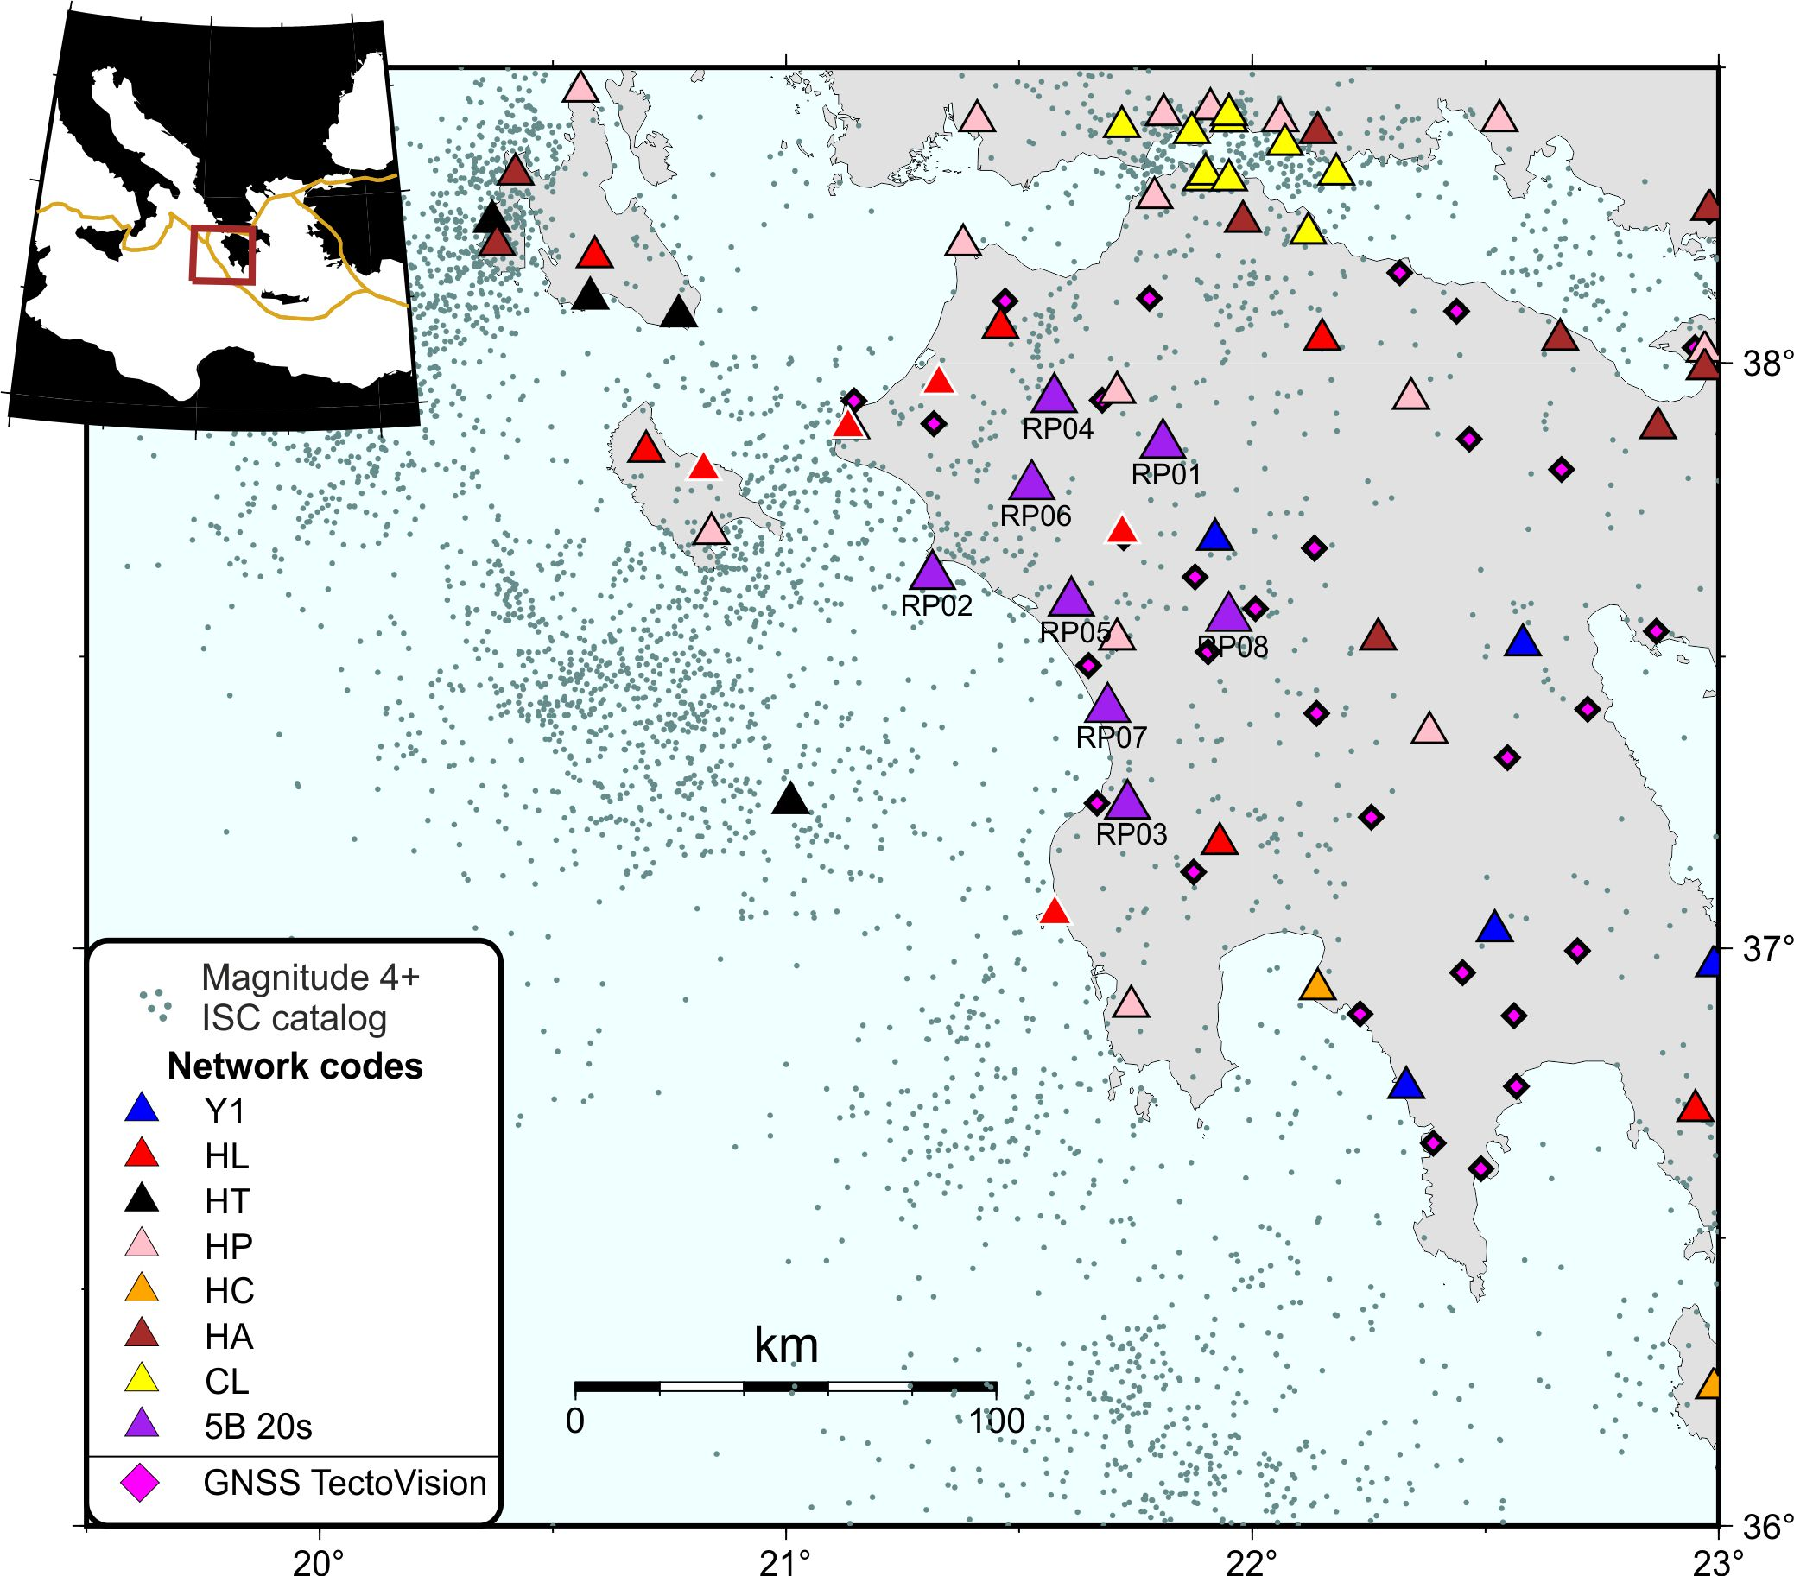
Ongoing Initiatives in HSS
TectoVision (P.I. Bedford) – GNSS stations
Pelops (Harrington research’s group) – temporary seismic network
Aims: study of active structures, preferential fault slip modes (seismic vs. aseismic), and fault slip interactions.
University of Bochum
University of Patras
National Observatory of Athens

Slide 16
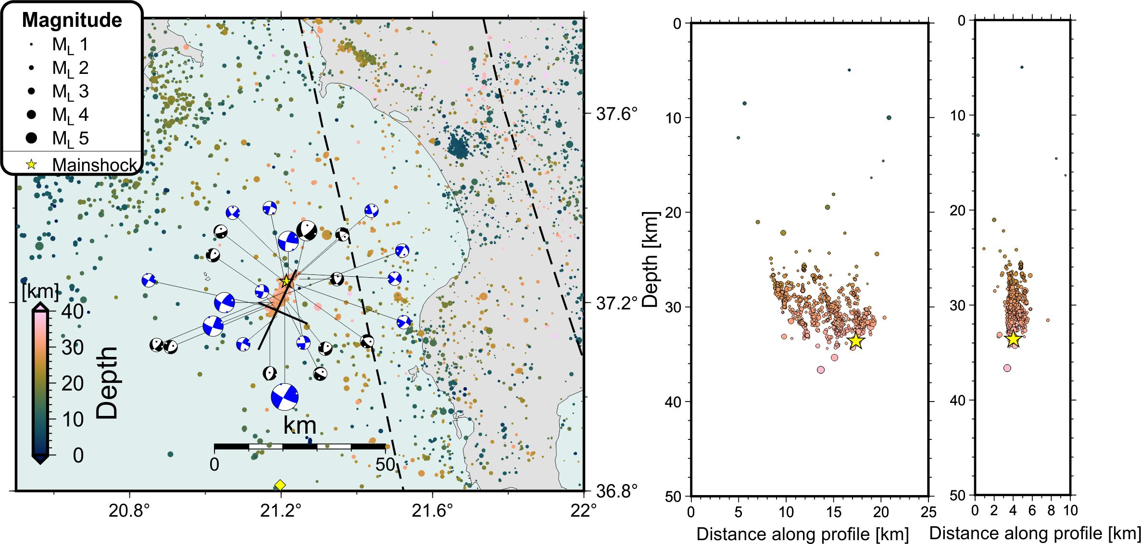
29 March 2024 M 5.9 (Gulf of Kyparissia)
Bocchini et al. (in prep)

Slide 17
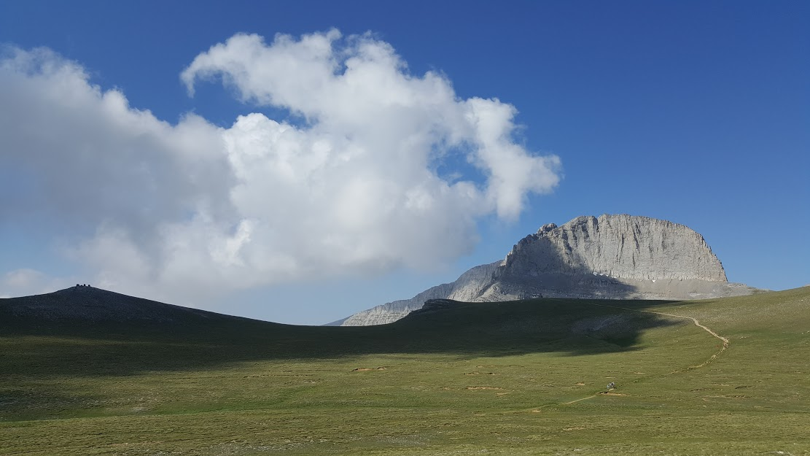
Thanks for your attention!
Contact: gian.bocchini@rub.de
Olympus Mt. - July 2017

Slide 18
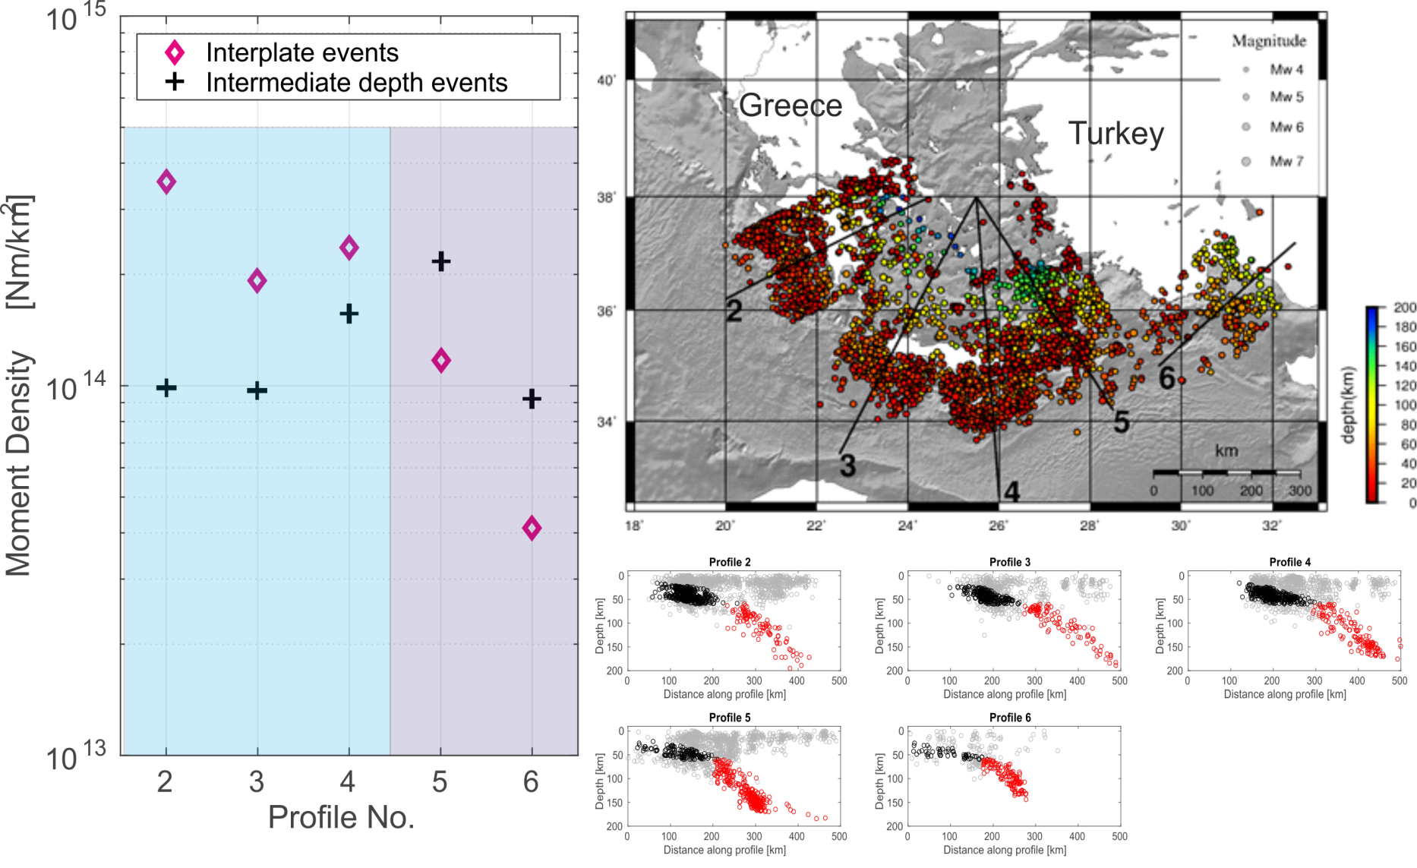
Slab segmentation & seismicity distribution
Reviewed ISC catalogue (1964-2014) location errors ≤10 km and Mw≥4
Larger seismic moment release along the plate interface of the western slab segment
Larger seismic moment release of intermediate depth seismicity along the eastern slab segment
Slab segmentation affects seismic moment release of interplate and intermediate depth seismicity in the HSS!
W
E
Cross-sections
width 200 km
Bocchini et al. (2018)
Notes:
As last step we went to check for possible relations between the geometry of the subducting slab and the distribution of seismicity.
In this slide I am showing the seismic moment released from interplate (black dots in the cross-sections ) and intermediate depth seismicity (red dots in the cross-sections) along strike in the HSS.
The statistics rely on the ISC seismicity catalog covering about 50 years.
The main result is a sharp change in the seismic moment released above the western slab segment and above the eastern slab segment, with interplate earthquakes releasing higher seismic moment above the western slab segment and intermediate depth events releasing higher moment above the eastern slab segment. The pattern is compatible with the presence of a first-order segmentation in the slab between Crete and Karpathos,
18

Slide 19
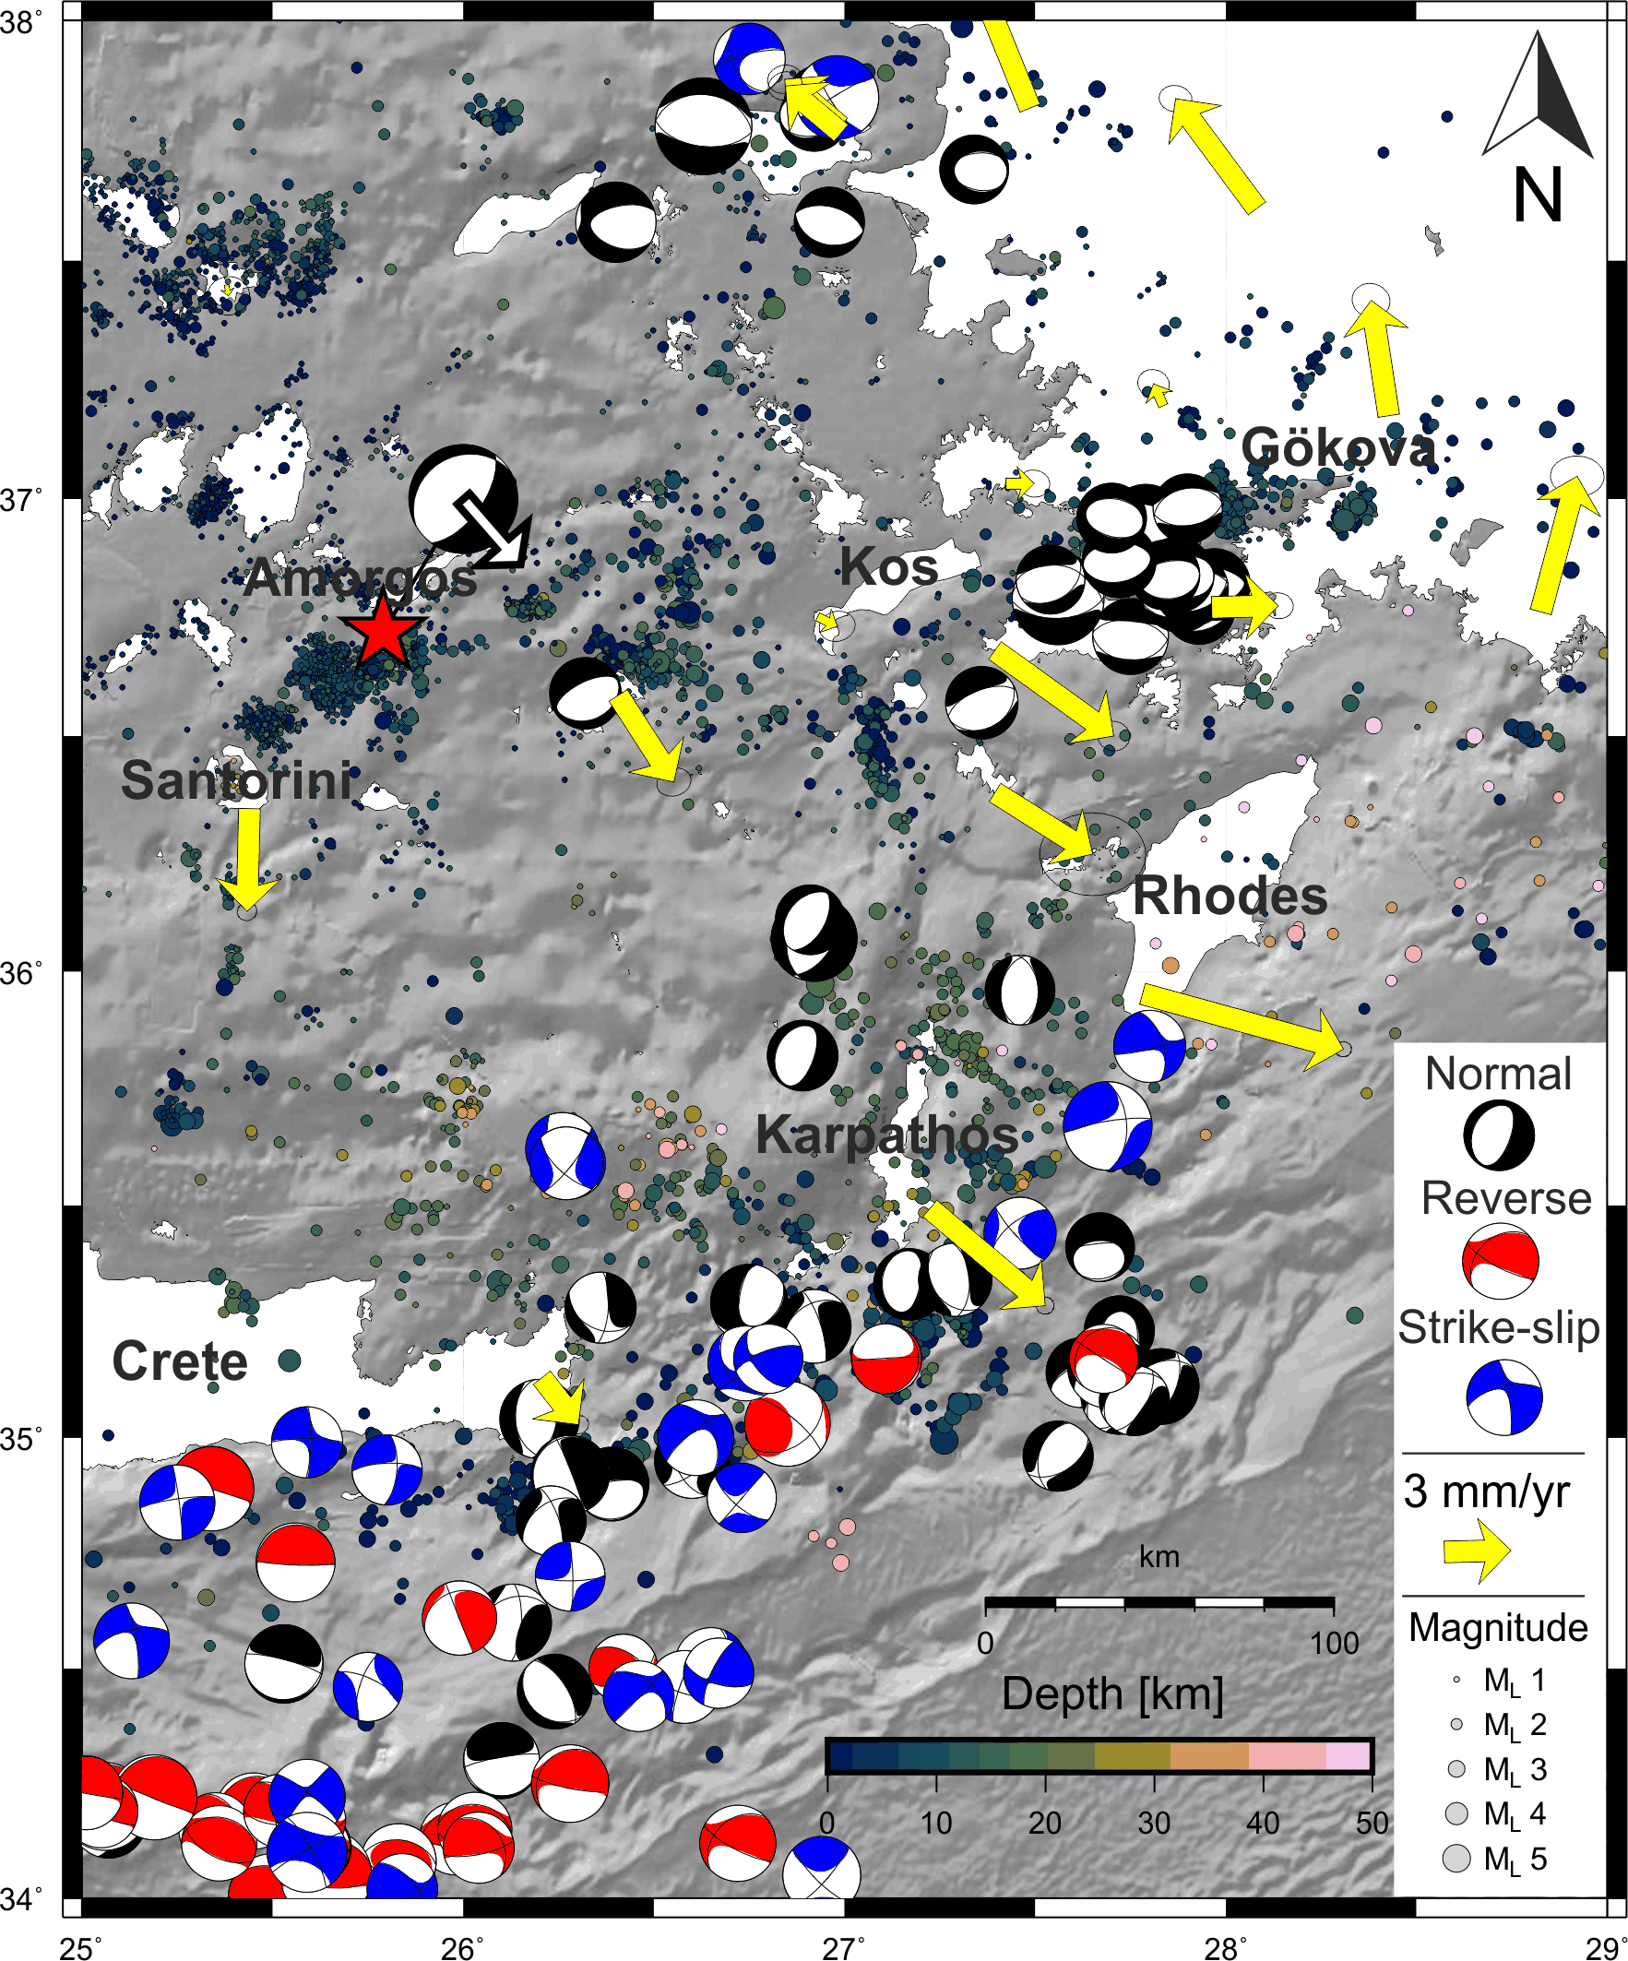
Slab segmentation & upper-plate deformation
Upper-plate deformation reconstructed from:
Seismicity from EGELADOS and CYCNET catalogues (depth ≤ 50 km, err<20km).
Harvard GCMT (Mw≥5, period 1976-2020).
GPS velocity vectors with respect to stable Aegean-Peloponnese (Reilinger et al., 2010).
Slab segmentation affects upper-plate deformation!
Adapted from Bocchini et al. (2018)
Notes:
To conclude, we investigated also possible relations between the upper-plate deformation and the slab geometry.
We reconstructed the deformation pattern in SE Aegean by combining shallow seismicity from local networks, focal mechanicsms from Global CMT and GPS derived velocity vectors.
All these detasets together indicate more intense deformation taking place in the SE Aegean with respect to central Aegean, and seem to indicate the fragmentation of the SE-most part of the Aegean with respect to central Aegean.
See normal faultin distribution and velocity vectors with velocities increasing trenchward. The deformation pattern is consistent with the presence of a steeper slab with enhanced rollback with respect to adjacent slab segments.

Slide 20
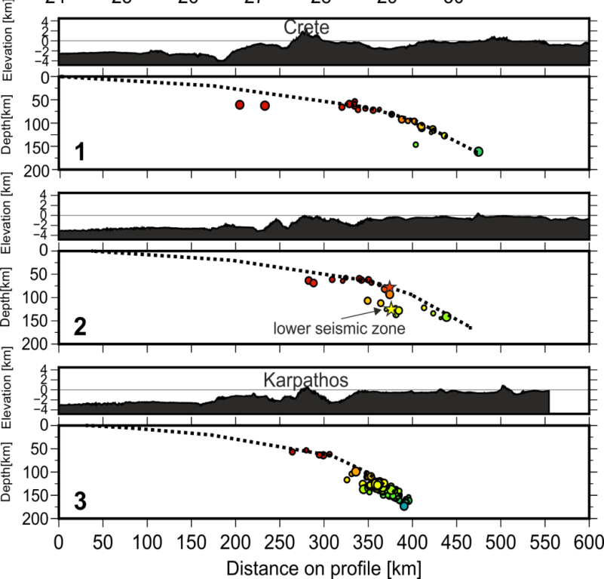
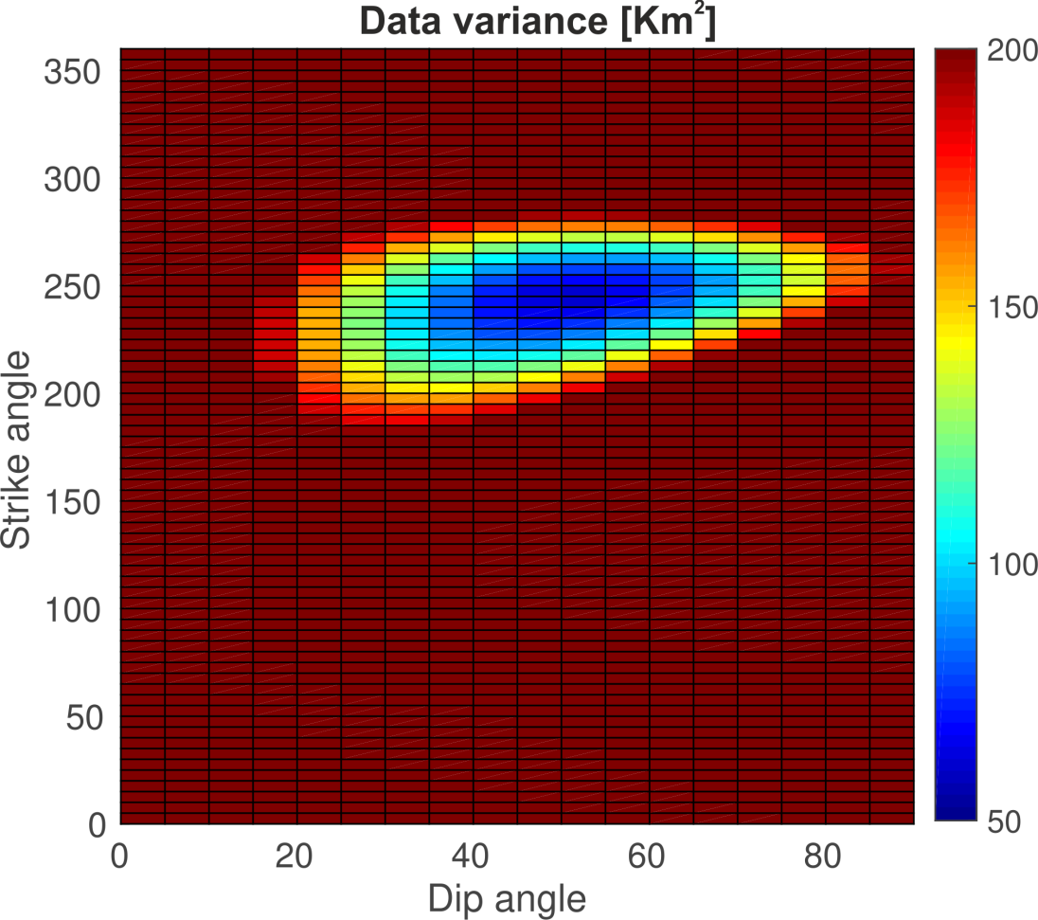
SEISMICITY AT THE EASTERN TERMINATION
The best fit solution, obtained from the least square method, provided a strike N240° and a dipping angle of 50°.

