Slide 1

Seismicity patterns and tsunami potential in the Azores-Gibraltar fault zone
Arantza Ugalde and Beatriz Gaite

Slide 2
Background

Slide 3
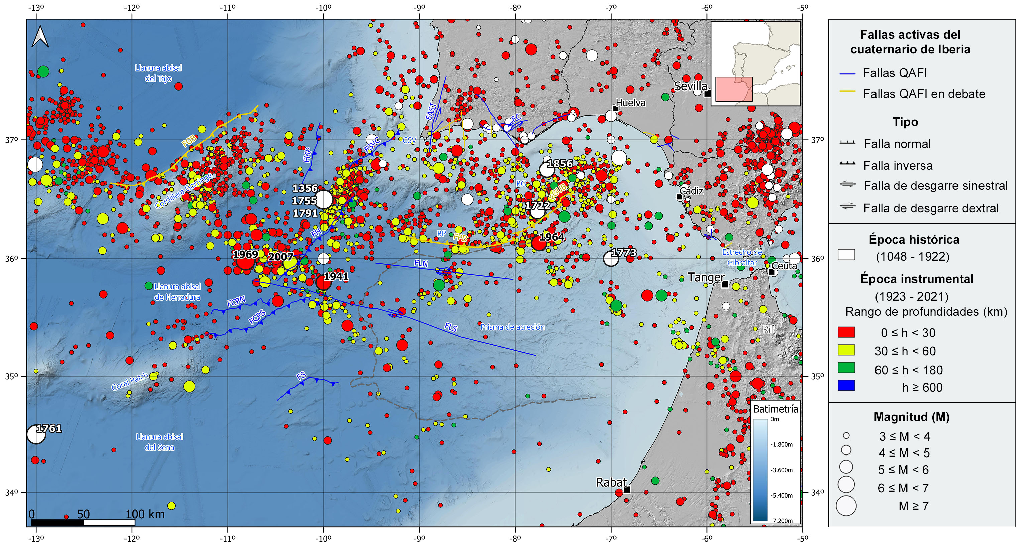
Seismotectonics Gulf of Cadiz-Gorringe
Source: IGN
Notes:
Seismic information source from the National Geographic Institute (IGN) (https://doi.org/10.7419/162.03.2022). Raster cartography of Spain from the IGN CC BY 4.0 ign.es. Bathymetry data from the IGN and EMODnet Bathymetry (European Marina Observation and Data Network). (https://tiles.emodnet-bathymetry.eu). Main Quaternary active faults compiled from the QAFI data base (García-Mayordomo et al., 2012; IGME, 2022). FAST: Aljezur-S. Teotónio Fault System, FC: Carcavai Fault, FCPN: Coral Patch North Fault, FCPS: Coral Patch South Fault, FGB: Gorringe Bank Fault, FGUB: Guadalquivir Bank Fault, FH: Horseshoe Fault, FLN: Lineament North Fault, FLS: Lineament South Fault, FMP: Marqués de Pombal Fault, FPB: Portimao Bank Fault, FS: Seine Fault, FSVC: San Vicente Canyon Fault. CSV: San Vicente Cape. BG: Gorringe Bank, BP: Portimao Bank.

Slide 4
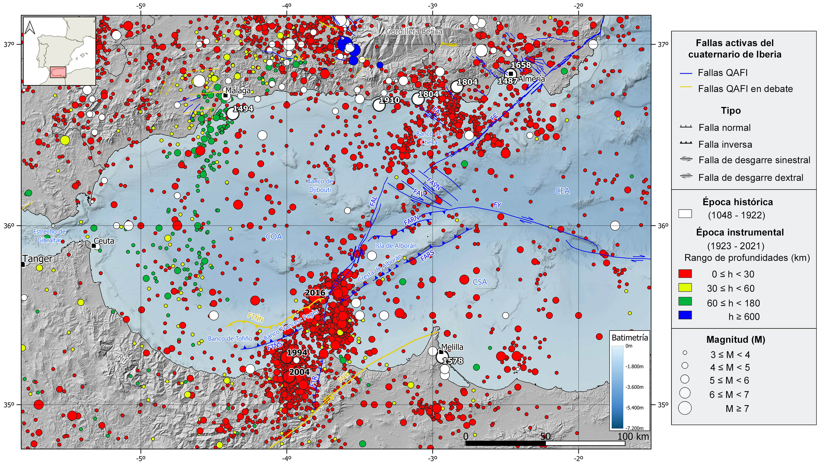
Seismotectonics Alboran
Source: IGN
Notes:
Seismic information source from the National Geographic Institute (IGN) (https://doi.org/10.7419/162.03.2022). Raster cartography of Spain from the IGN CC BY 4.0 ign.es. Bathymetry data from the IGN and EMODnet Bathymetry (European Marina Observation and Data Network). (https://tiles.emodnet-bathymetry.eu). Main active faults during the Quaternary extracted from the QAFI database(García-Mayordomo et al., 2012; IGME, 2022). FA: Adra Fault, FC: Carboneras Fault, FAV: Averroes Fault, FAVN: Averroes North Fault, FARN: Alboran Ridge North Fault, FARS: Alboran Ridge South Fault, FY: Yusuf Fault, FAL: Al-Idrisi Fault, FTÑS: Tofiño South Fault, FTÑN: Tofiño North Fault. COA: West Alboran Basin, CEA: East Alboran Basin, CSA: South Alboran Basin.

Slide 5
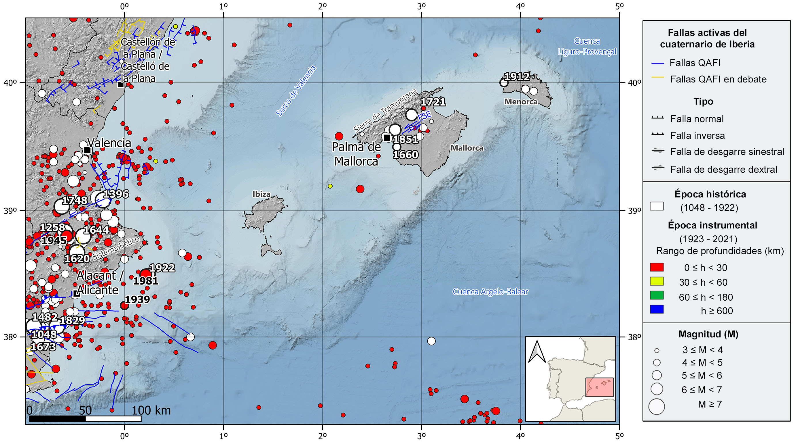
Seismotectonics Betic-Balearic
Source: IGN
Notes:
Seismic information source from the National Geographic Institute (IGN) (https://doi.org/10.7419/162.03.2022). Raster cartography of Spain from the IGN CC BY 4.0 ign.es. Geological data source: Thematic map of the National Atlas of Spain (ANE) CC BY 4.0 ign.es (2020), synthesis based on the IGME-SGE Geological Map of Spain 2M (2004) and the IGME-LNEG Geological Map of Spain and Portugal 1M (2015). 50% transparency. Main Quaternary active faults compiled from the QAFI data base (García-Mayordomo et al., 2012; ( IGME, 2022).FSE: Sencelles Fault.

Slide 6
Tsunami hazards

Slide 7
Catalogue of tsunamis on the Spanish coast
Day | Subregion | Cause | Depth (km) | Mag. (Mw) | Validity | Max. height (m) in Spain
21/05/2003 | North Algeria | TS | 12 | 6.8 | 4 | 1.00
10/10/1980 | North Algeria | TT | 5 | 7.1 | 4 | 0.35
26/05/1975 | Gloria Fault | TS | 15 | 7.8 | 4 | 0.10
17/07/1969 | Atlantic (recorded in Tenerife) | ? |  |  | 2 | 0.19
28/02/1969 | Azores-Gibraltar | TS | 31 | 7.8 | 4 | 0.48
09/09/1954 | North Algeria | DST/TT |  | 6.7 | 4 | 0.2
21/08/1856 | North Algeria | TS |  | 6.6 | 4
13/01/1804 | Alboran Sea | TS |  | 6.1 | 2
09/10/1790 | North Algeria | TT |  | 6.7 | 2 | 1.8
31/03/1761 | Azores-Gibraltar | TS |  | 8.5 | 2
01/11/1755 | Azores-Gibraltar | TS |  | 8.5 | 4 | 13
09/10/1680 | Málaga | TT | 40 | VIII-IX Imax | 2 | 5
22/09/1522 | Almería | TT |  | VIII-IX Imax | 2
Cause of the tsunami:
TT Earthquake in land
TS Submarine earthquake
DST Submarine landslide triggered by an earthquake
? Unknown cause
Validity:
0 Very improbable tsunami
1 Improbable tsunami
2 Questionable tsunami
3 Probable tsunami
4 Definite tsunami
Source: IGN https://doi.org/10.7419/162.04.2023

Slide 8
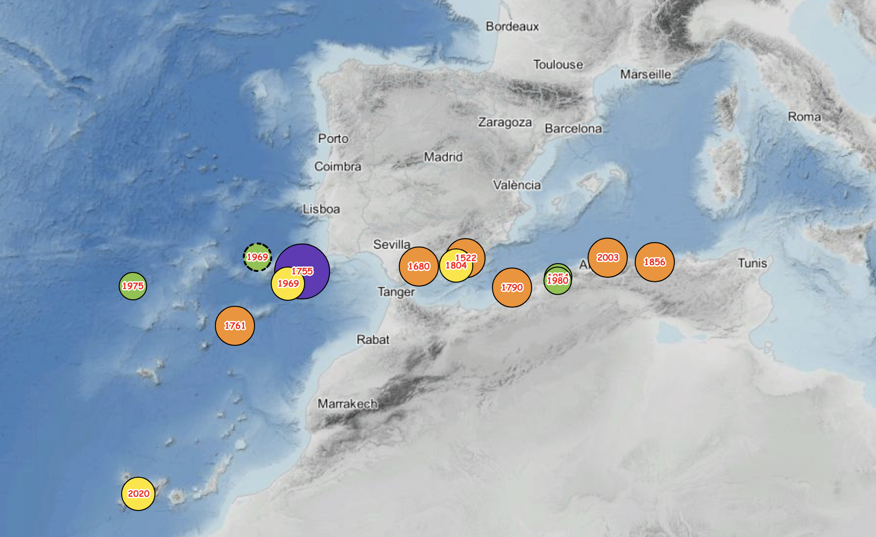
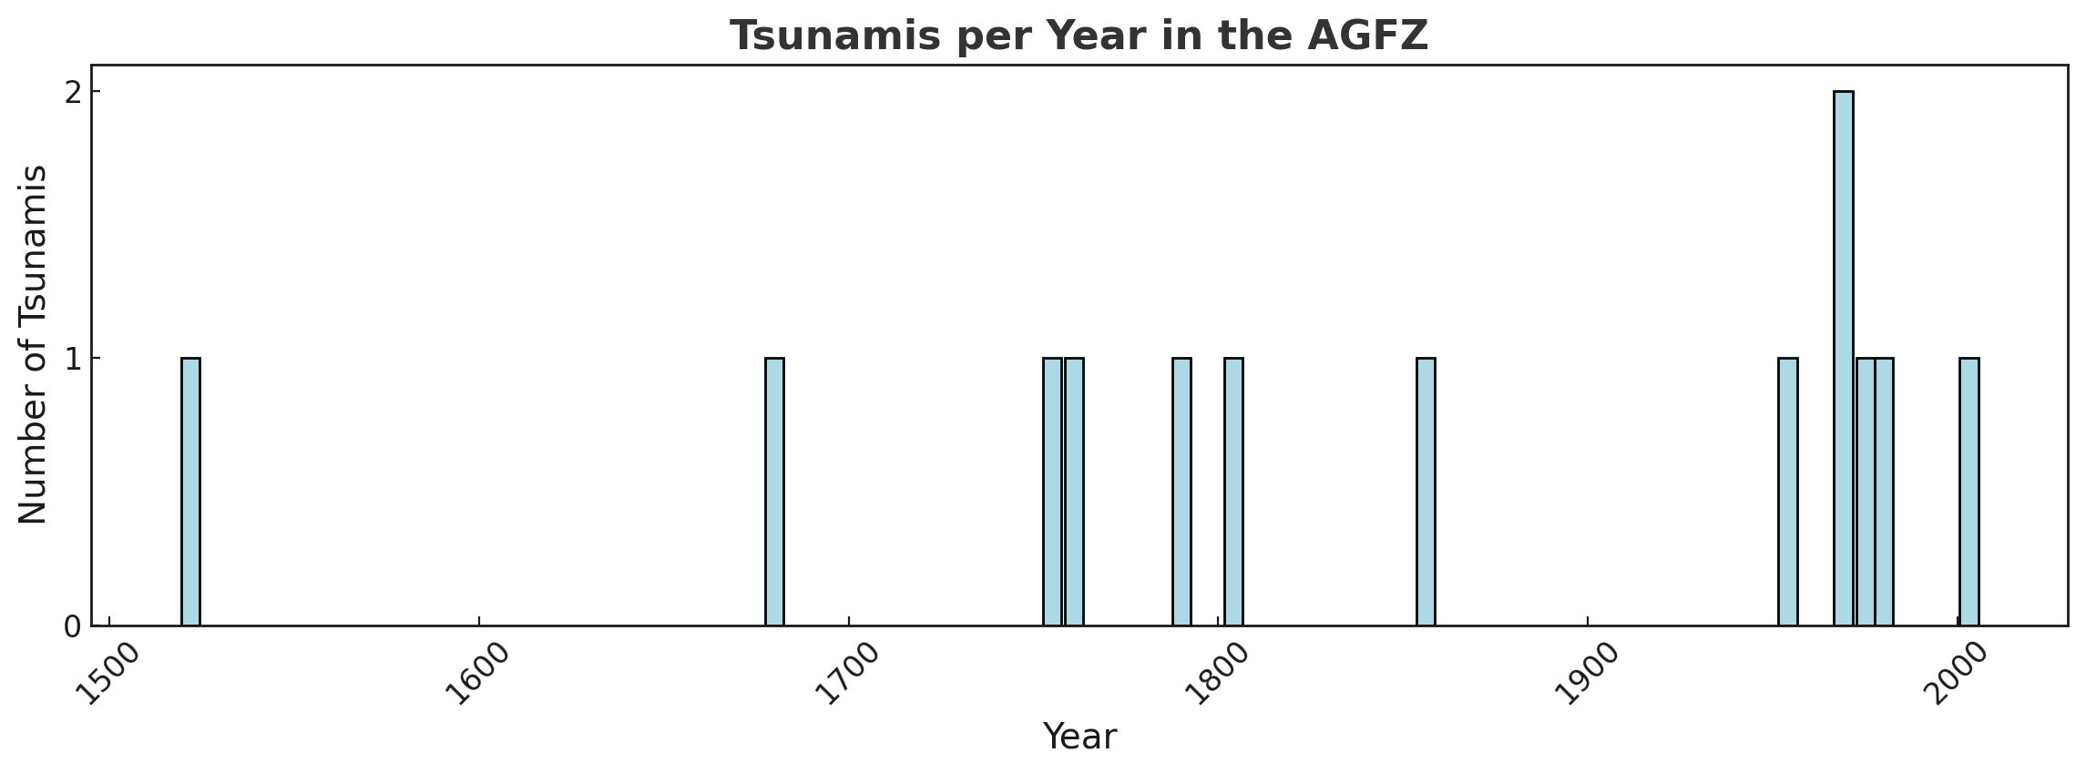
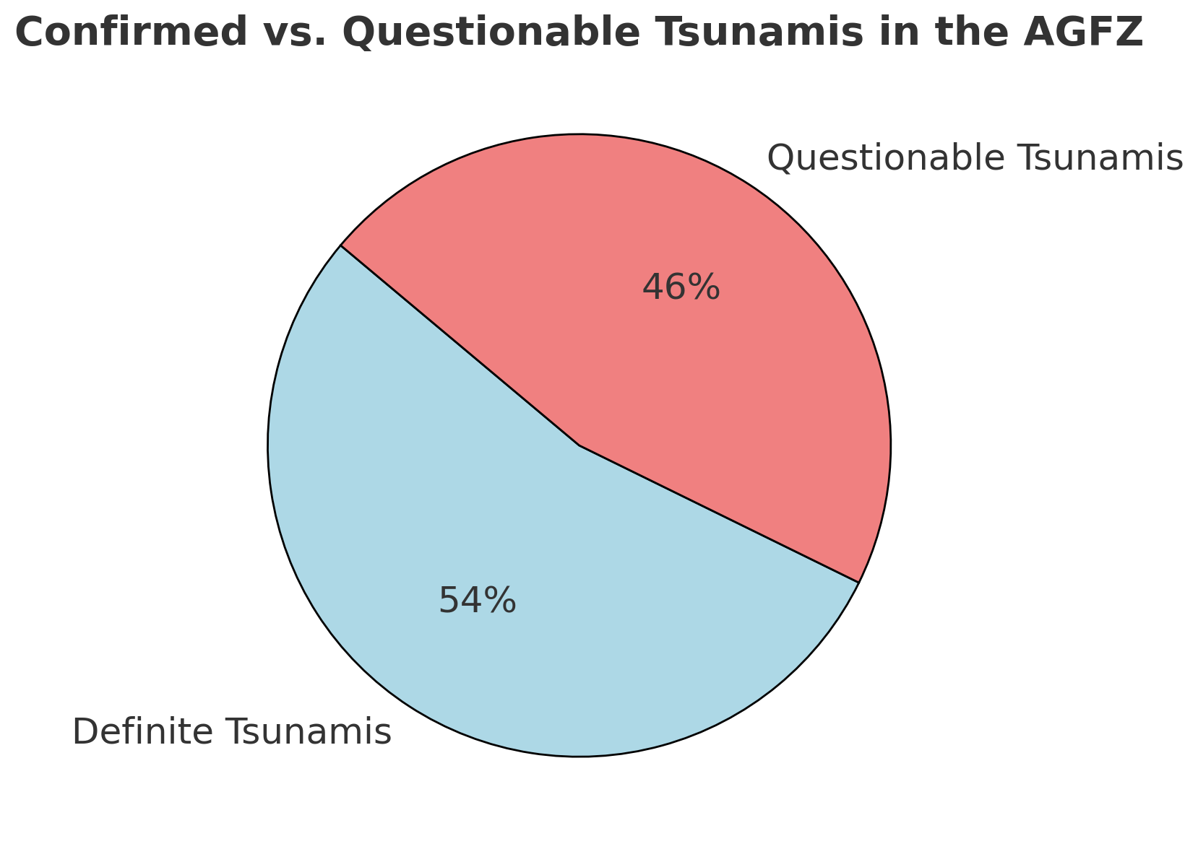
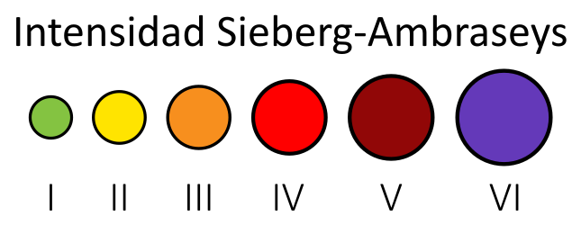
Catalogue of tsunamis on the Spanish coast

Slide 9
Faults

Slide 10
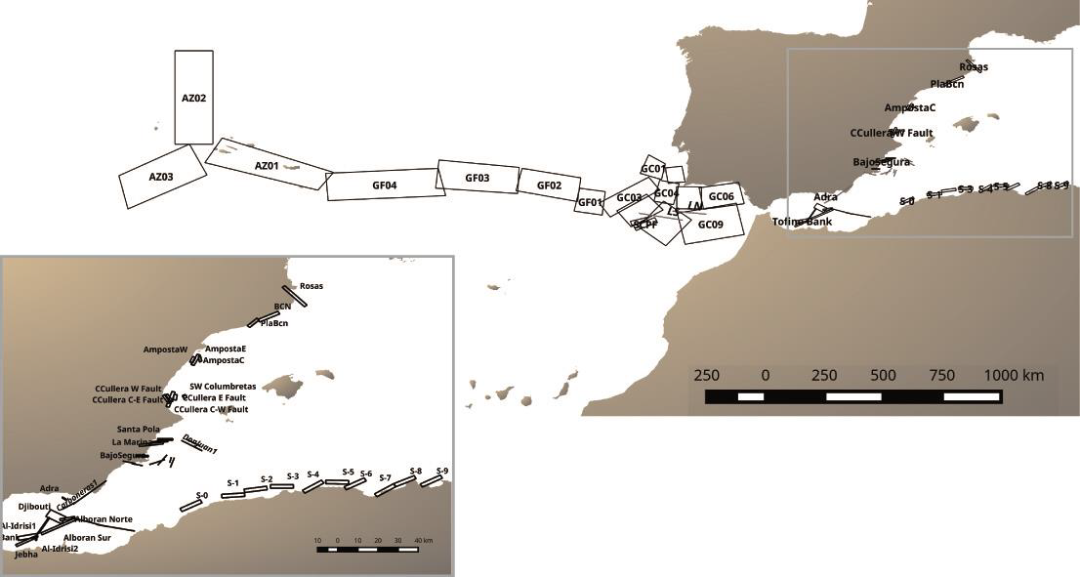
Marine-fault database
Surface projection of the 66 fault planes collected on the database
Gaite et al. (2018)

Slide 11
Marine-fault database
Surface projection of the 66 fault planes collected on the database
Gaite et al. (2018)
Notes:
B. Gaite, J.V. Cantavella, C. González, B. Rodríguez, A. Robledano and E. Carreño . Marine-fault and magnitude-scaling law database as input for real-time tsunami propagation computation. Resúmenes de la 2a Reunión Ibérica sobre Fallas Activas y Paleosismología, Alicante, España (2018)

Slide 12
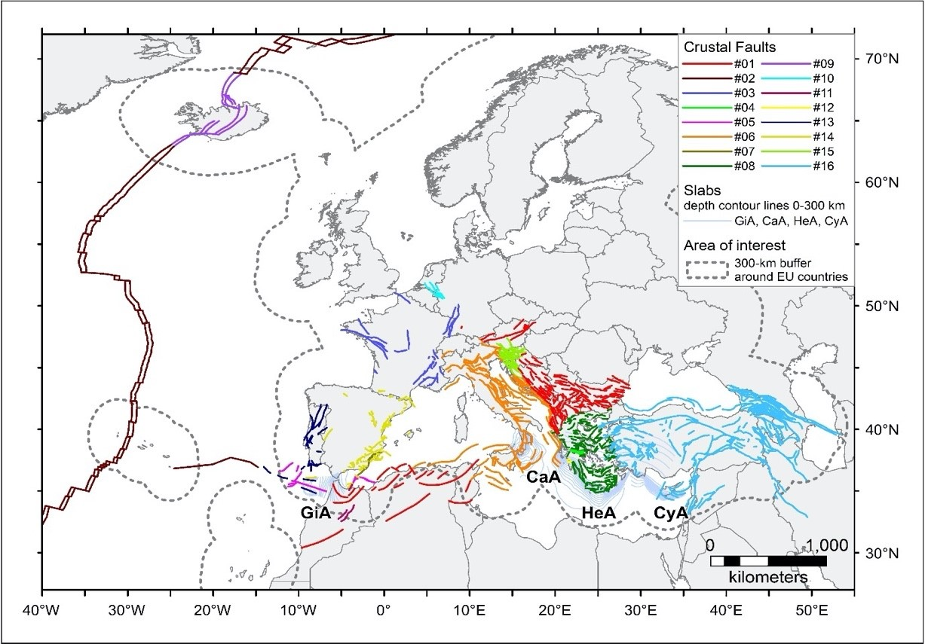
ESHM20 – Active Faults and Subduction Sources
Notes:
Map of collated fault datasets for developing the European Fault-Source Model 2020 (EFSM20). See text for the descriptions of the various datasets. From west to east, the subduction systems are: Gibraltar Arc (GiA); Calabrian Arc (CaA); Hellenic Arc (HeA); and Cyprus Arc (CyA). Citation: Basili R., Danciu L., Beauval C., Sesetyan K., Vilanova S., Adamia S., Arroucau P., Atanackov J., Baize S., Canora C., Caputo R., Carafa M., Cushing M., Custódio S., Demircioglu Tumsa M., Duarte J., Ganas A., García-Mayordomo J., Gómez de la Peña L., Gràcia E., Jamšek Rupnik P., Jomard H., Kastelic V., Maesano F. E., Martín-Banda R., Martínez-Loriente S., Neres M., Perea H., Sket-Motnikar B., Tiberti M. M., Tsereteli N., Tsironi V., Vallone R., Vanneste K., Zupančič P. (2022). European Fault-Source Model 2020 (EFSM20): online data on fault geometry and activity parameters [Data set]. Istituto Nazionale di Geofisica e Vulcanologia (INGV). https://doi.org/10.13127/efsm20

Slide 13
Data quality

Slide 14
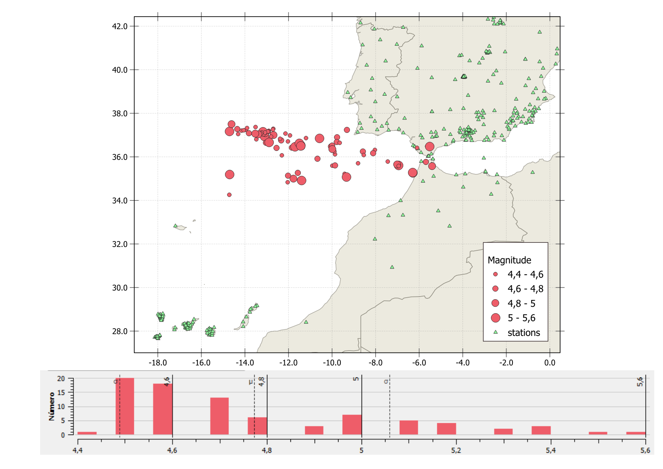
Seismicity Gulf of Cadiz-Gorringe (2010-2024 M_{bLg}≥4.5)
Number
Magnitude

Slide 15
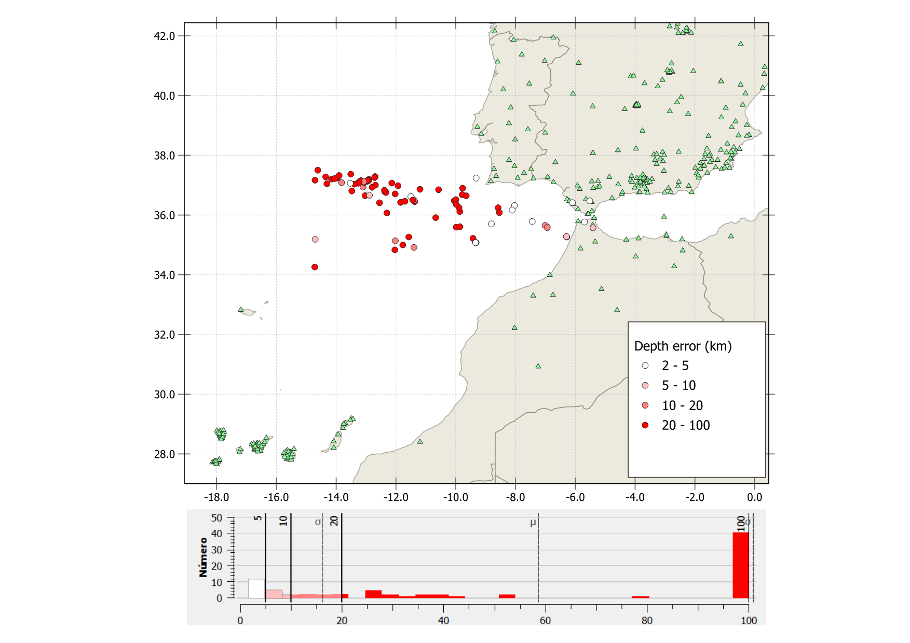
Depth error
Number
Error

Slide 16
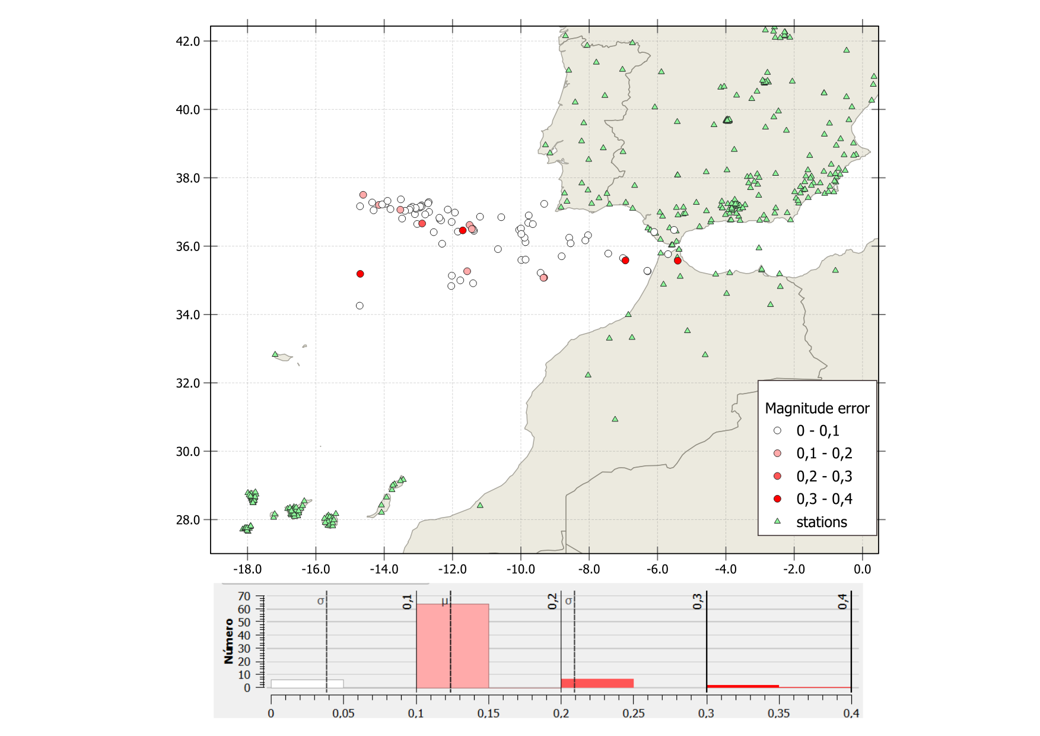
Magnitude error
Number
Error

Slide 17
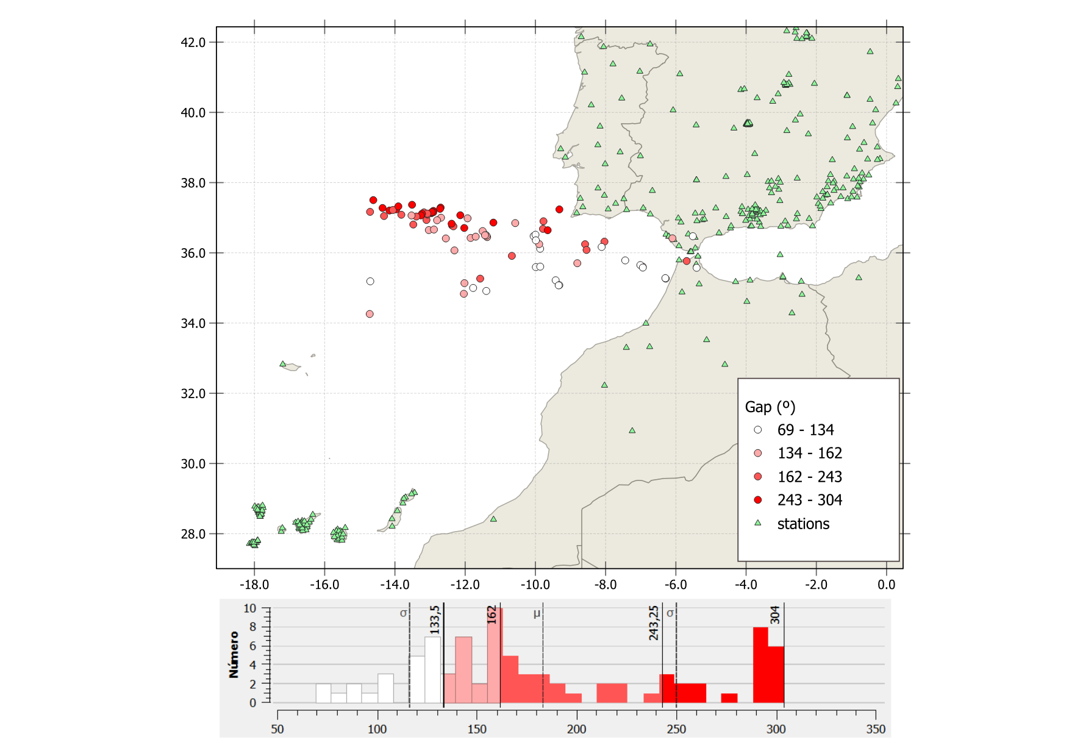
Station gap
Number
Gap

Slide 18
Earthquake relocations

Slide 19
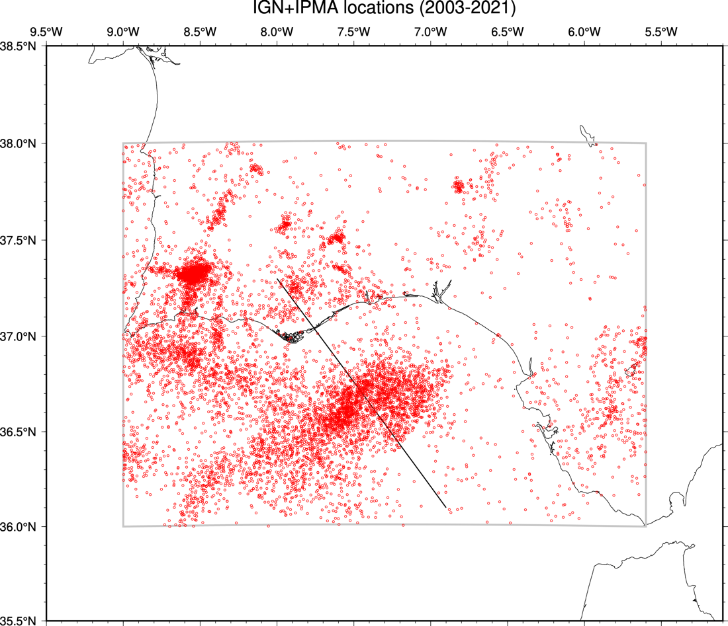
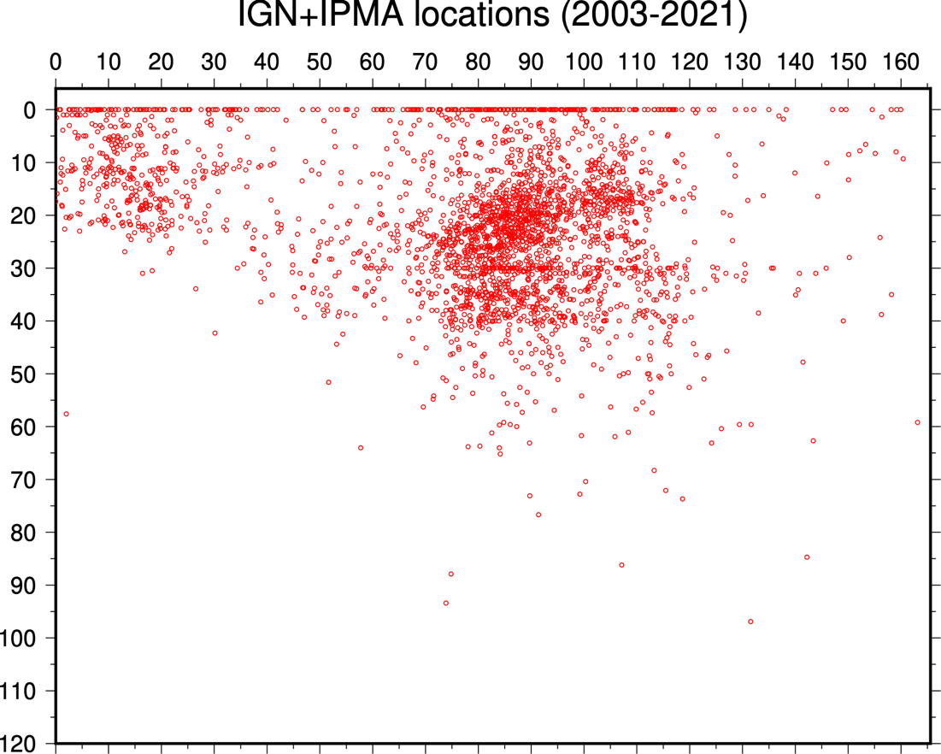
Combined IGN-IPMA catalog (2003-2021)
Latitude
Depth (km)
Longitude
Distance (km)

Slide 20
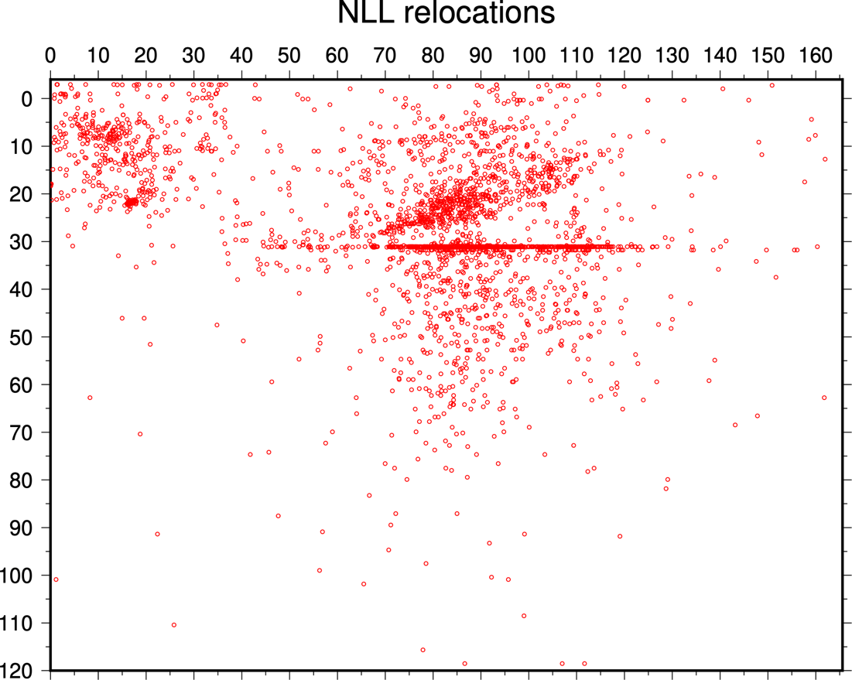
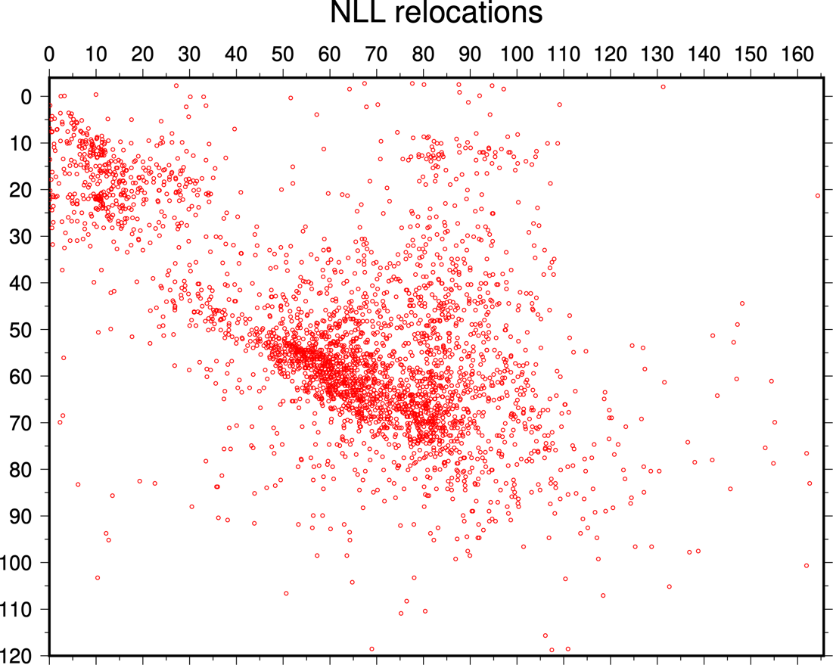
NonLinLoc relocations
Depth (km)
Distance (km)
Distance (km)
1D velocity model
Constant-gradient 1D velocity model

Slide 21
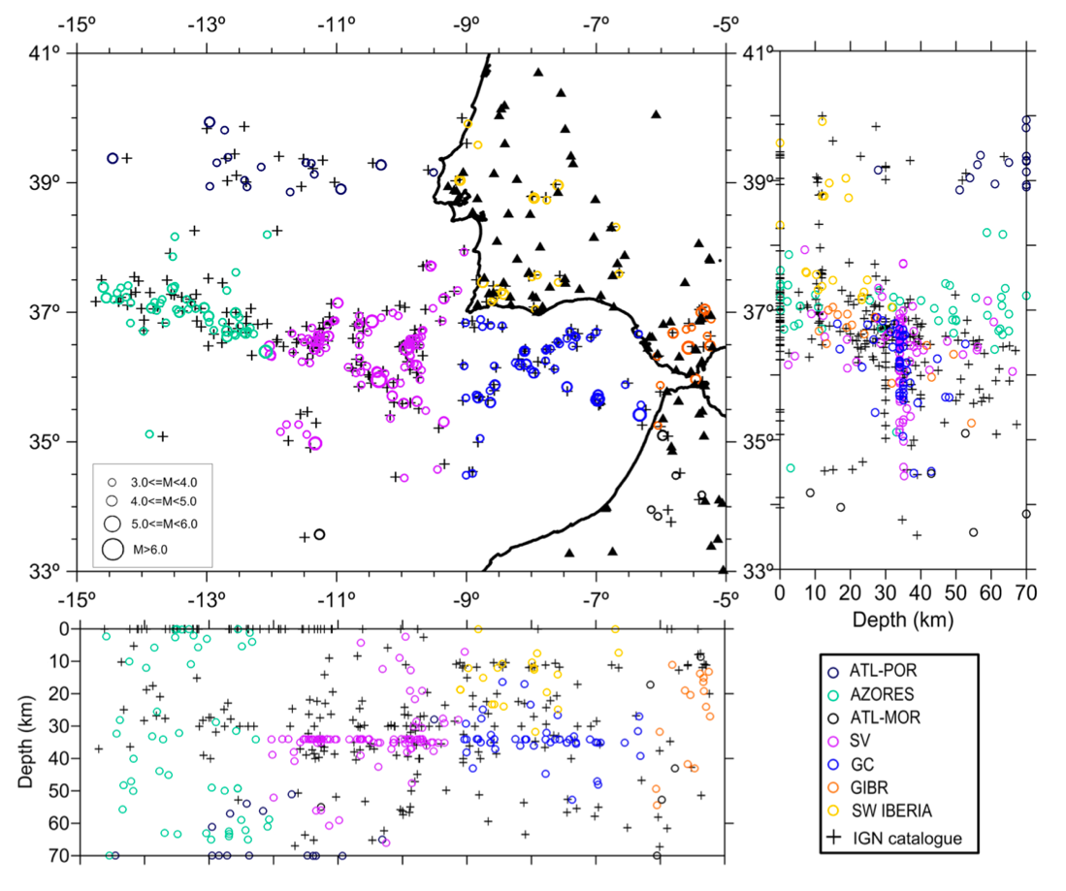
NonLinLoc relocations
3D velocity model (Lozano et al., 2020)
Notes:
Lozano, L.; Cantavella, J. V.; Barco, J. (2020). A New 3-D P-Wave Velocity Model for the Gulf of Cadiz and Adjacent Areas Derived from Controlled-Source Seismic Data: Application to Nonlinear Probabilistic Relocation of Moderate Earthquakes. Geophysical Journal International, 221, 1–19. https://doi.org/10.1093/gji/ggz562.

Slide 22
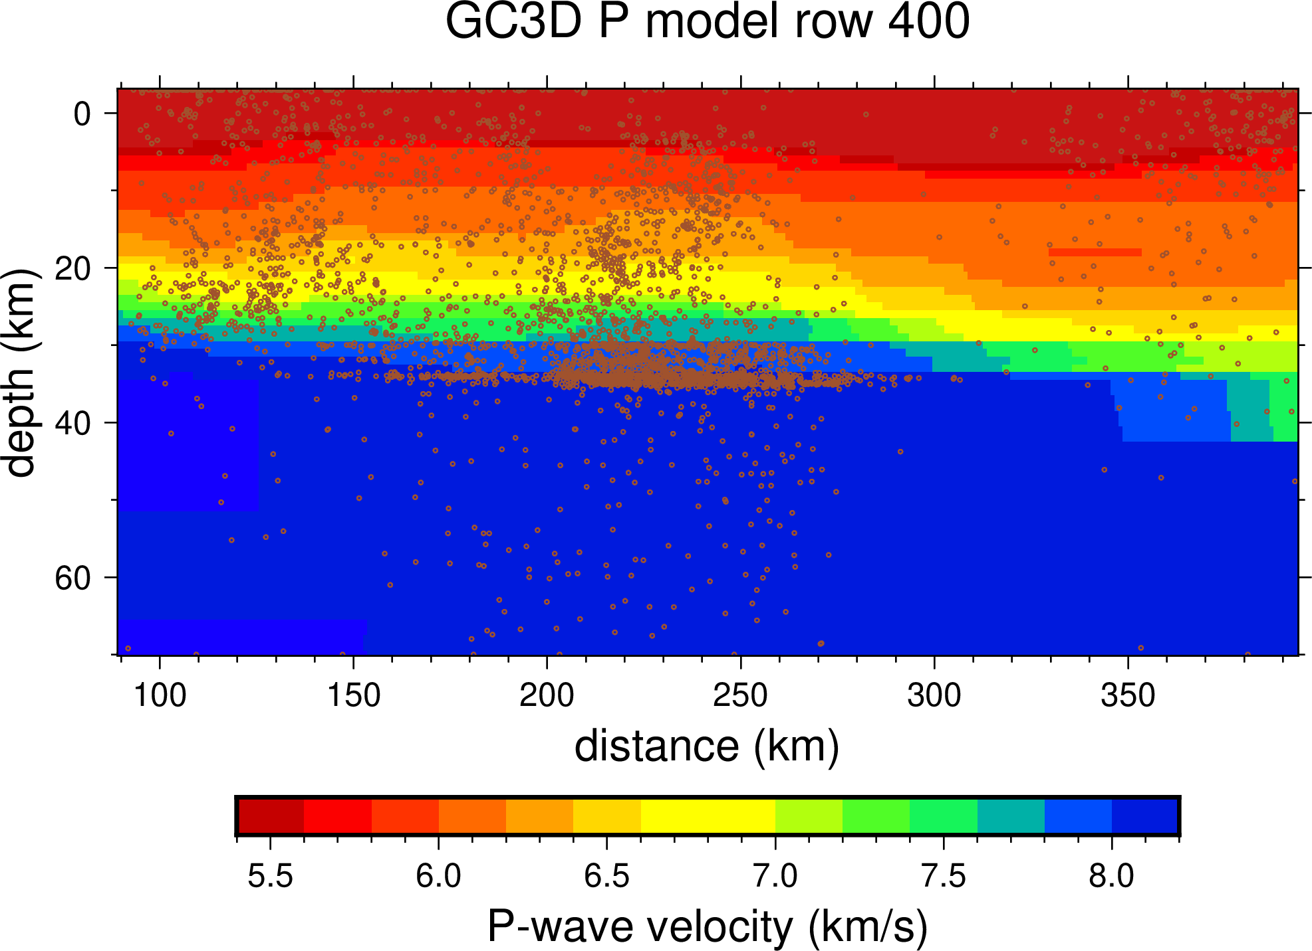
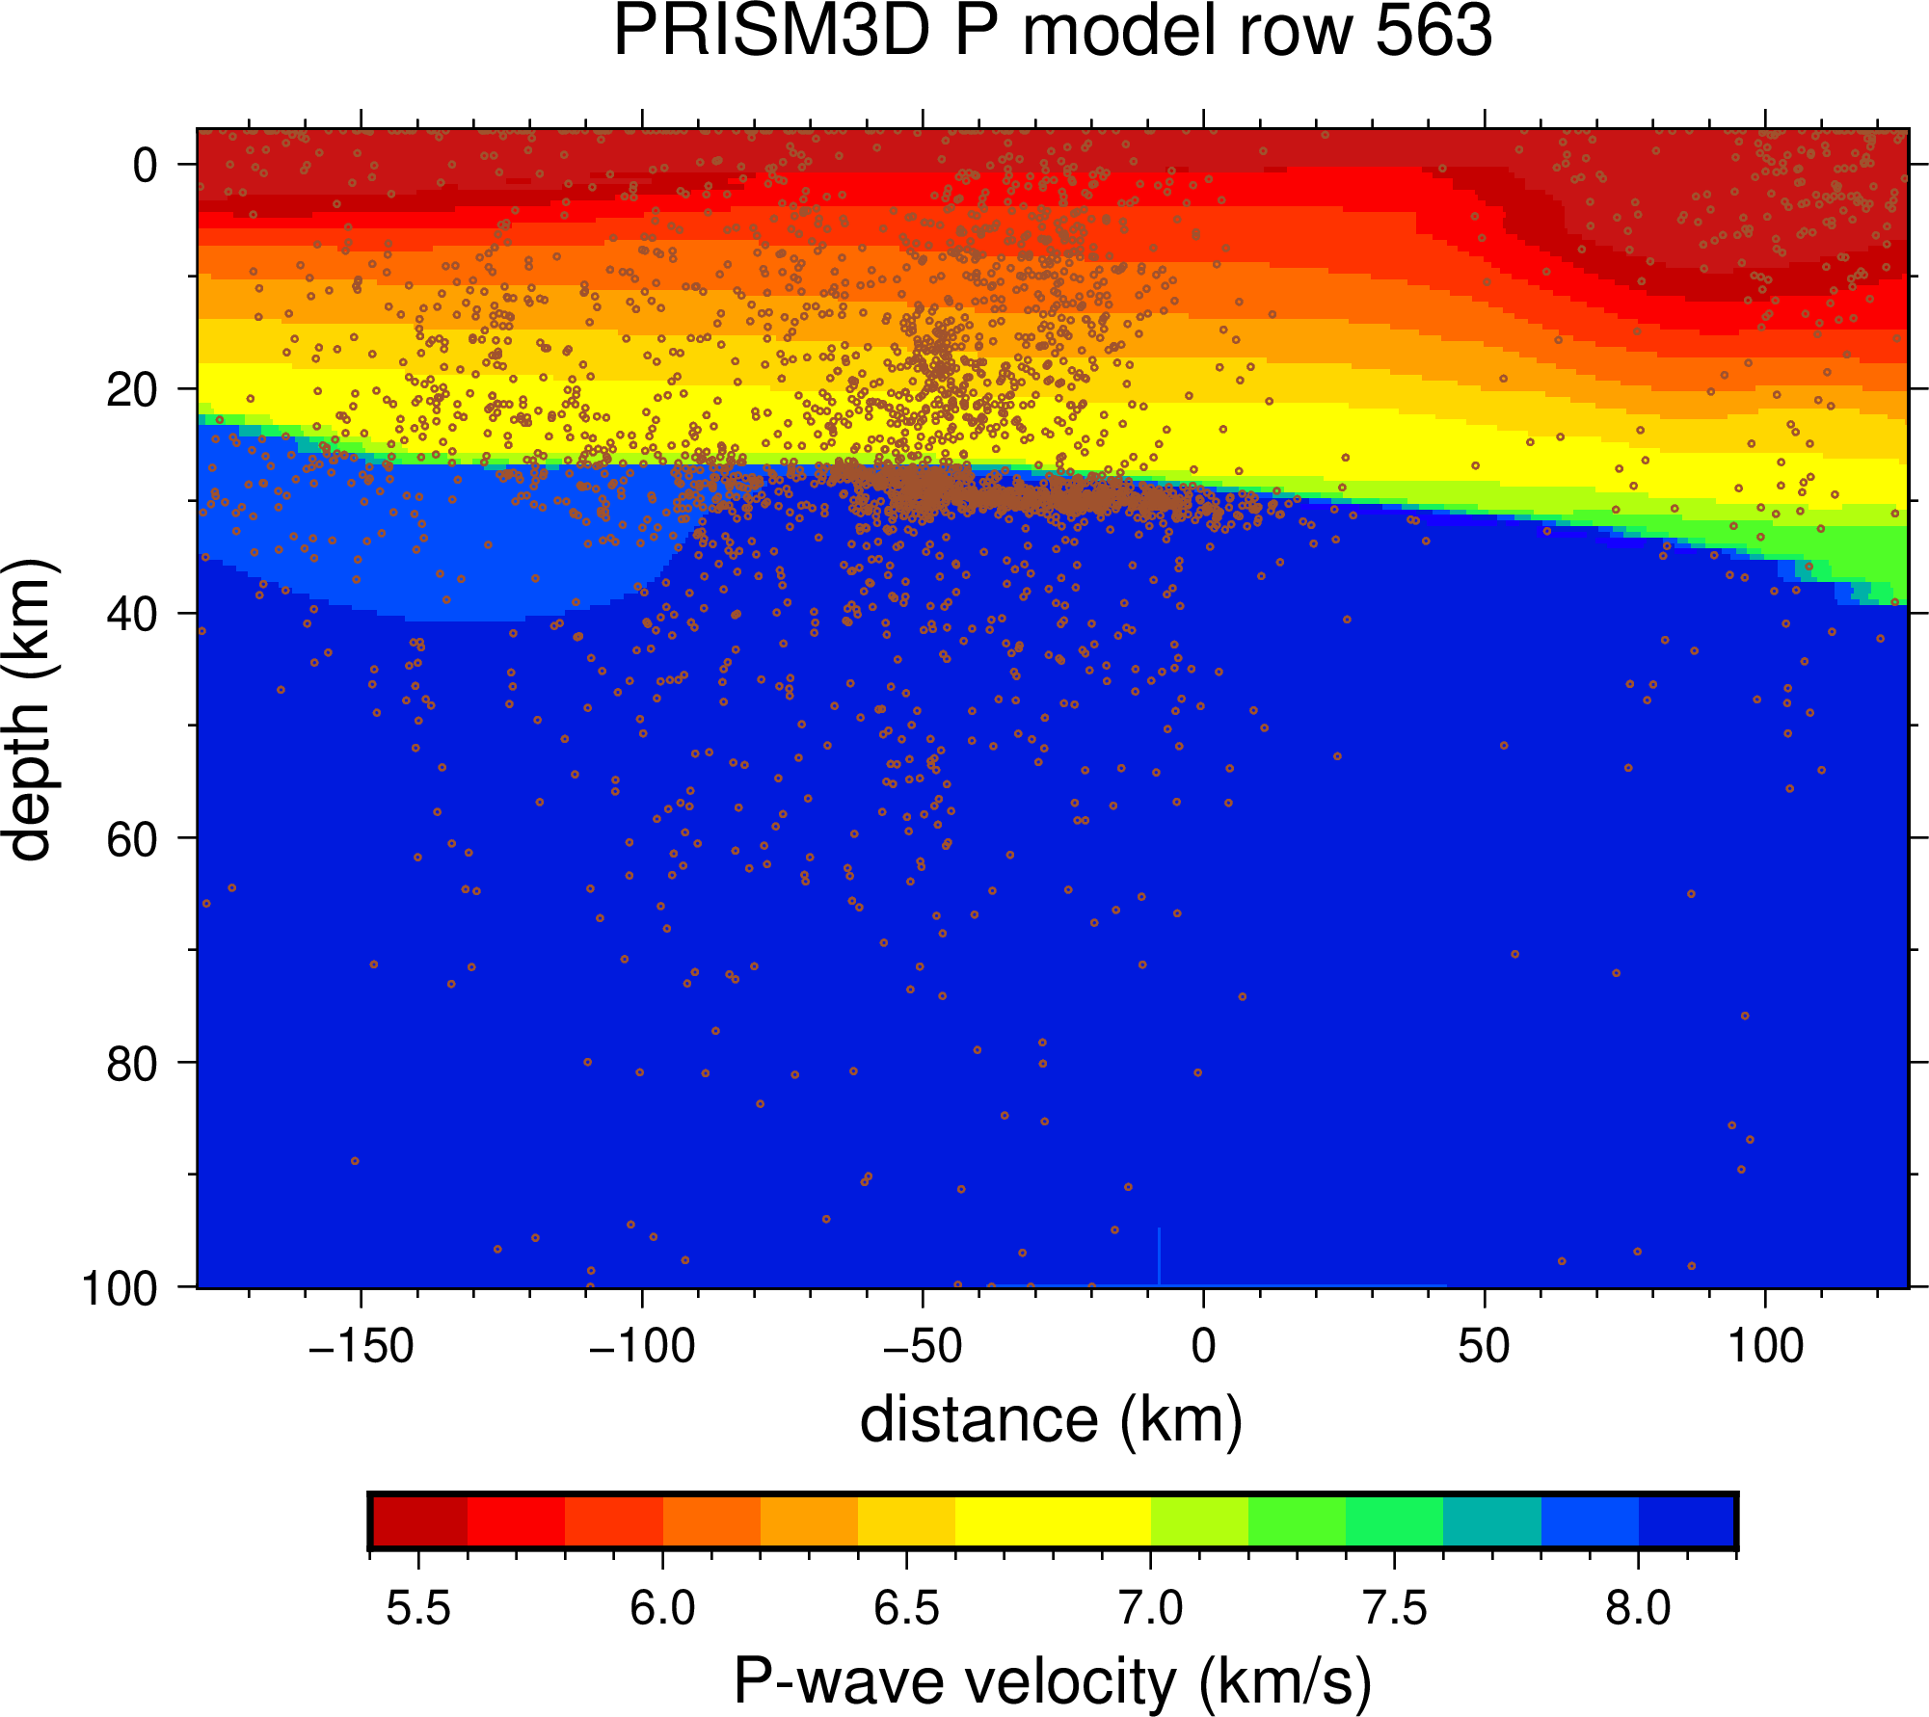
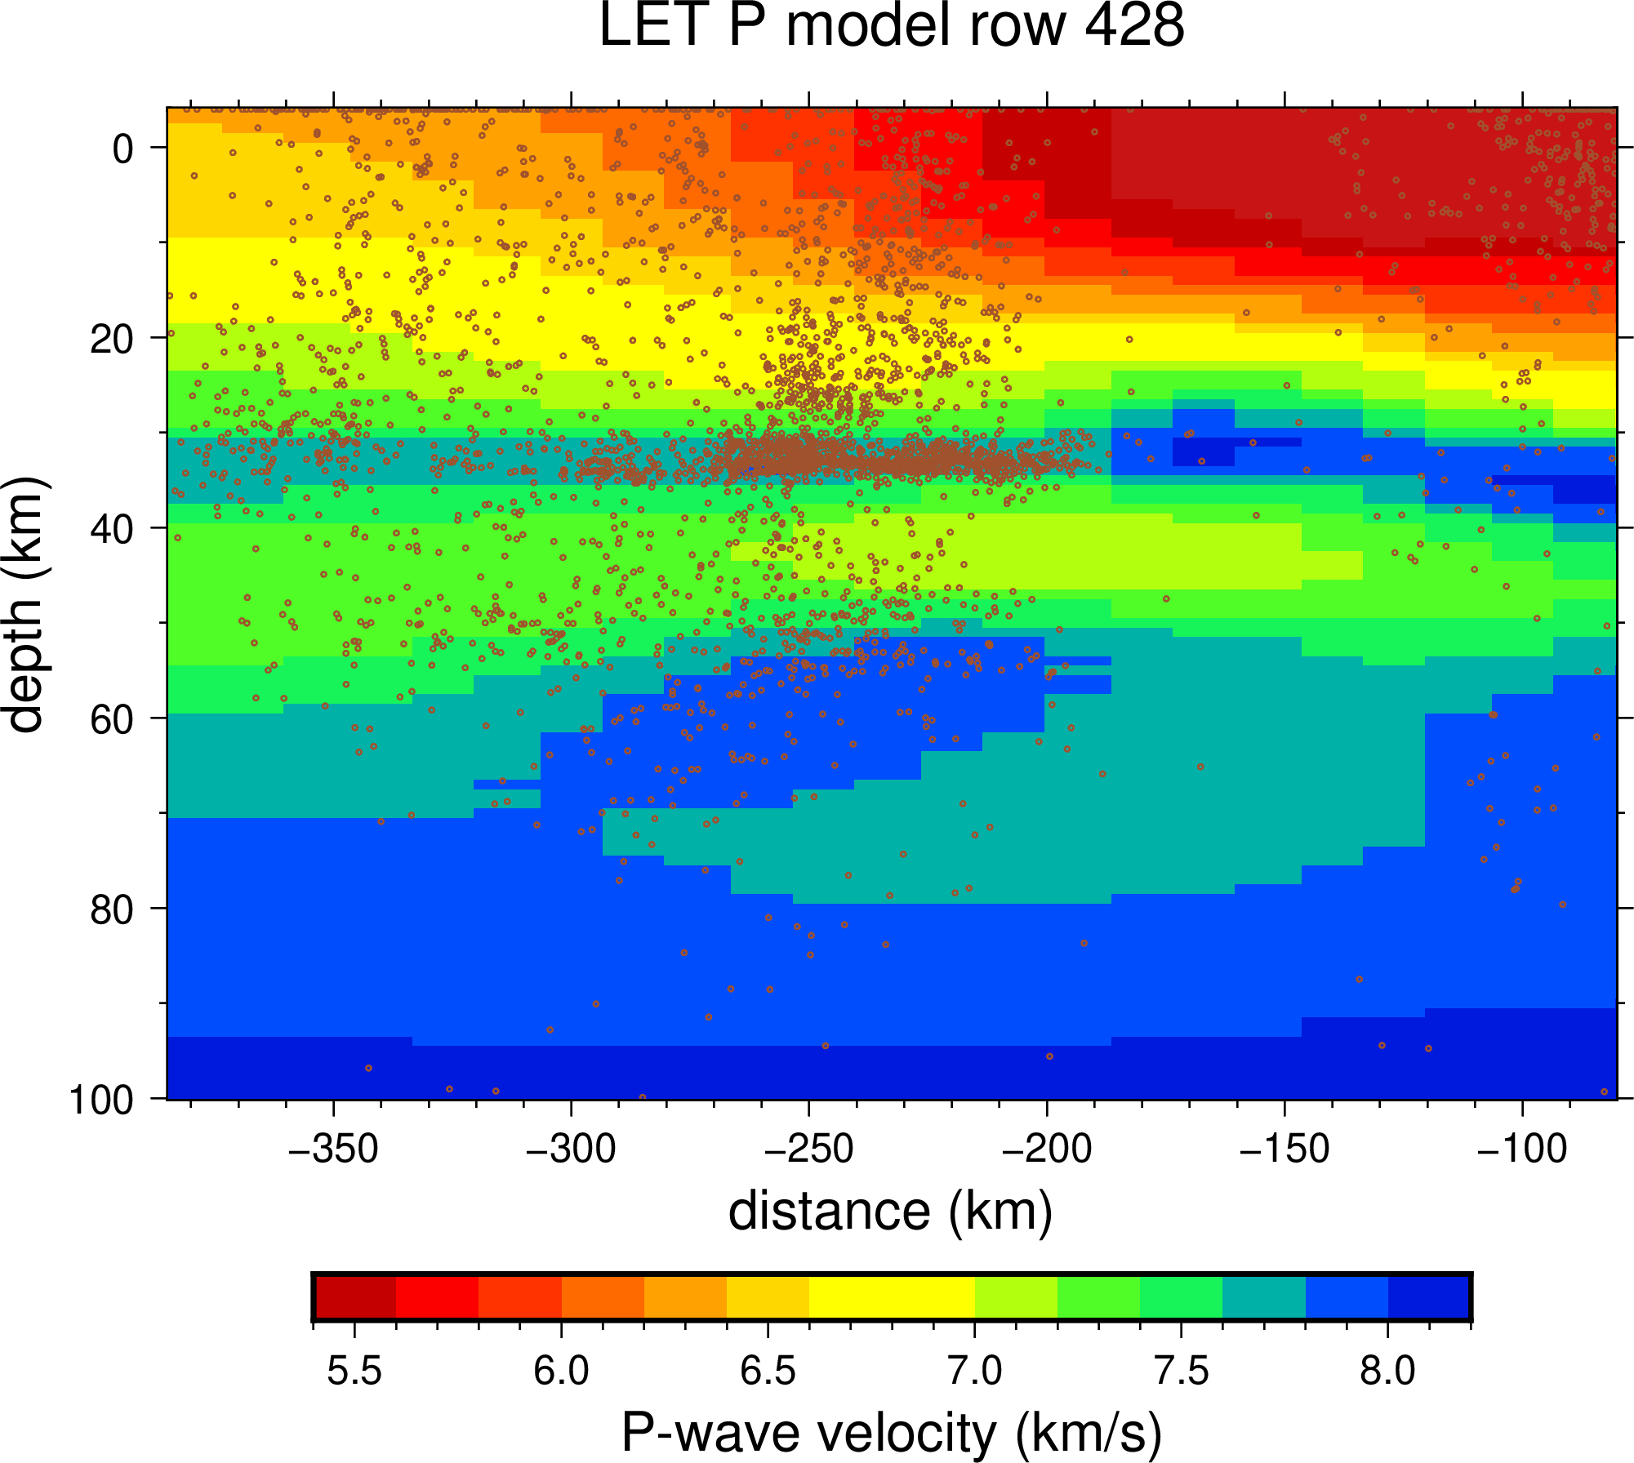
Influence of the velocity models on earthquake depth
Notes:
GC3D: Lozano, L.; Cantavella, J. V.; Barco, J. (2020). A New 3-D P-Wave Velocity Model for the Gulf of Cadiz and Adjacent Areas Derived from Controlled-Source Seismic Data: Application to Nonlinear Probabilistic Relocation of Moderate Earthquakes. Geophysical Journal International, 221, 1–19. https://doi.org/10.1093/gji/ggz562.
PRISM3D: Arroucau, P, S Custódio, C Civiero, G Silveira, N Dias, J Díaz, Antonio Villaseñor, and T Bodin. (2021). PRISM3D: A 3-D Reference Seismic Model for Iberia and Adjacent Areas. Geophysical Journal International, 225, 789–810. https://doi.org/10.1093/gji/ggab005.

Slide 23
Tsunami simulation

Slide 24
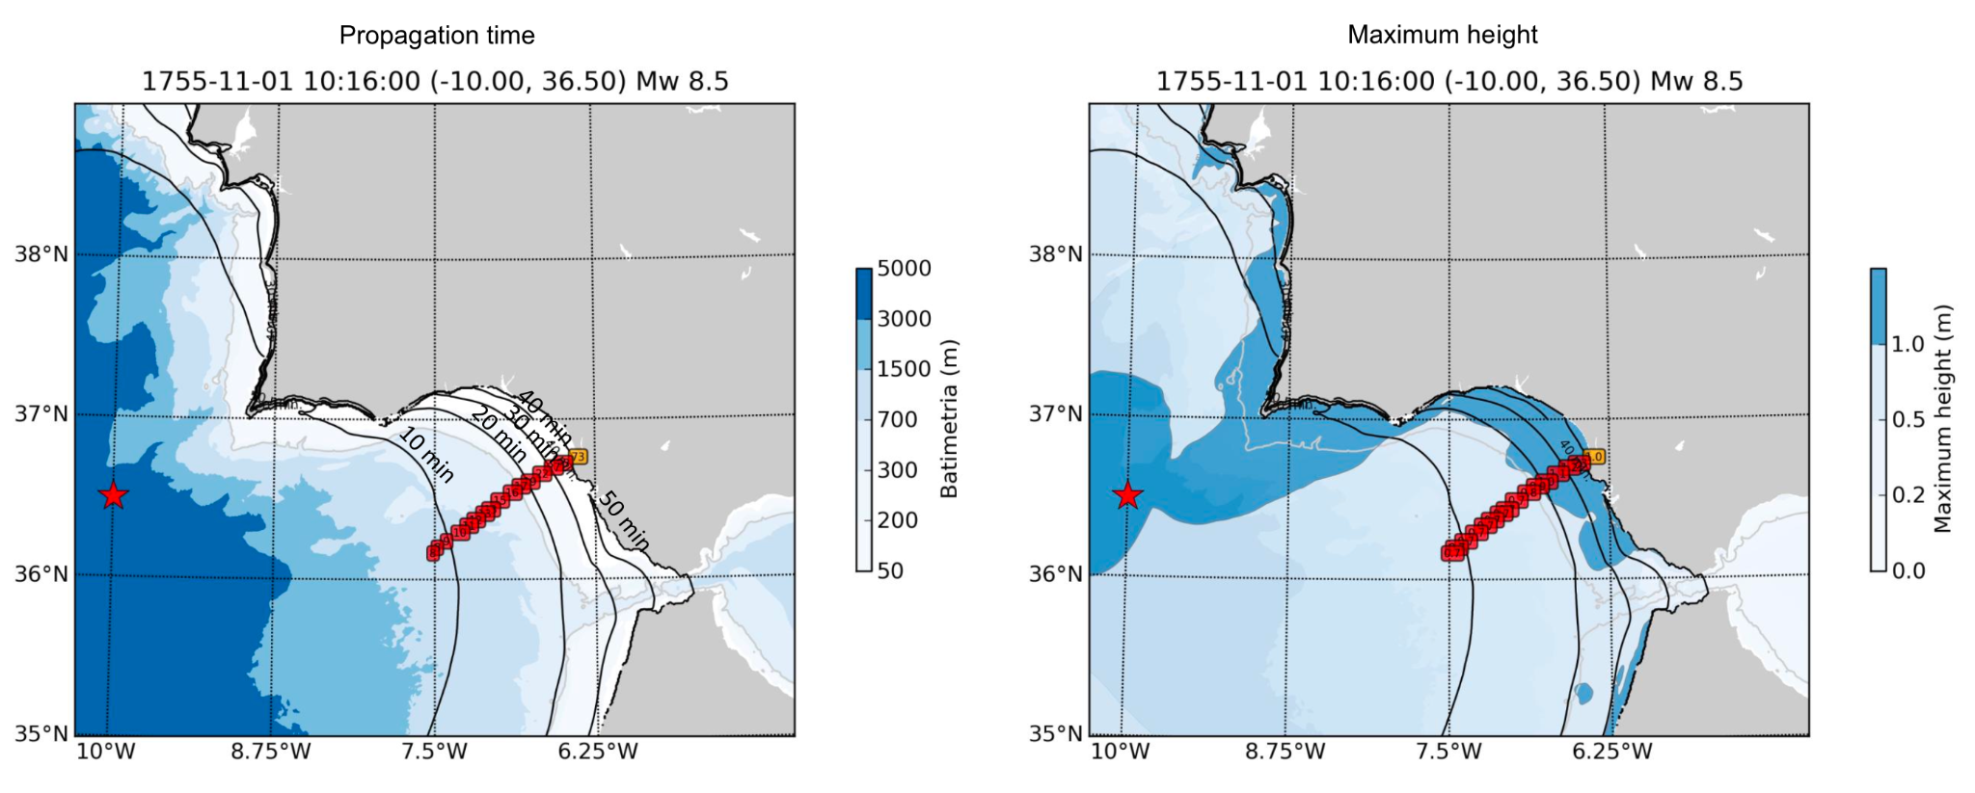
Simulation of the 1755 tsunami event

Slide 25
Conclusions & take-aways
🌊 Tsunami Hazard is Significant
AGFZ and Alboran Sea are active regions with potential tsunami sources.
📜 Historical Tsunamis Show Recurring Risk
Spanish coasts have been affected by both Atlantic and Mediterranean tsunamis.
📍 Seismic Data Has Limitations
Depth uncertainties impact tsunami hazard models and real-time warnings.
📡 Better Monitoring is Needed
Offshore seismic stations would improve tsunami early warning.

