Slide 1
WG2: Tsunami Detection, Analysis and Forecasting
E.A. Vanacore

Slide 2
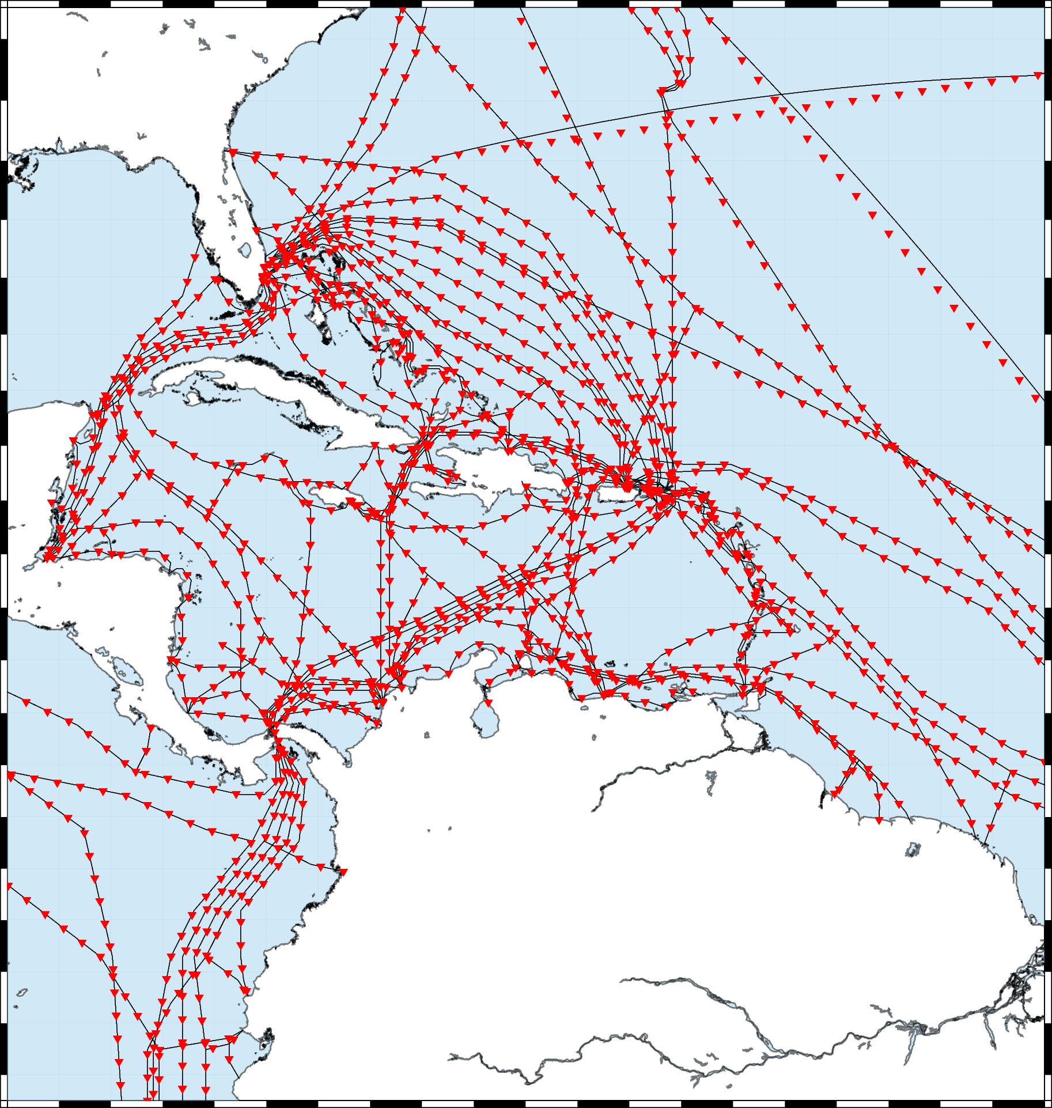
Smart Cables
Conduct a study to demonstrate improvement in tsunami early warning times with two to four variations on SMART Cable designs -Code written to determine improvements in detection time for seismic sources - To Do: EV create a GitHub to share code - Run more test scenarios for optimization

Slide 3
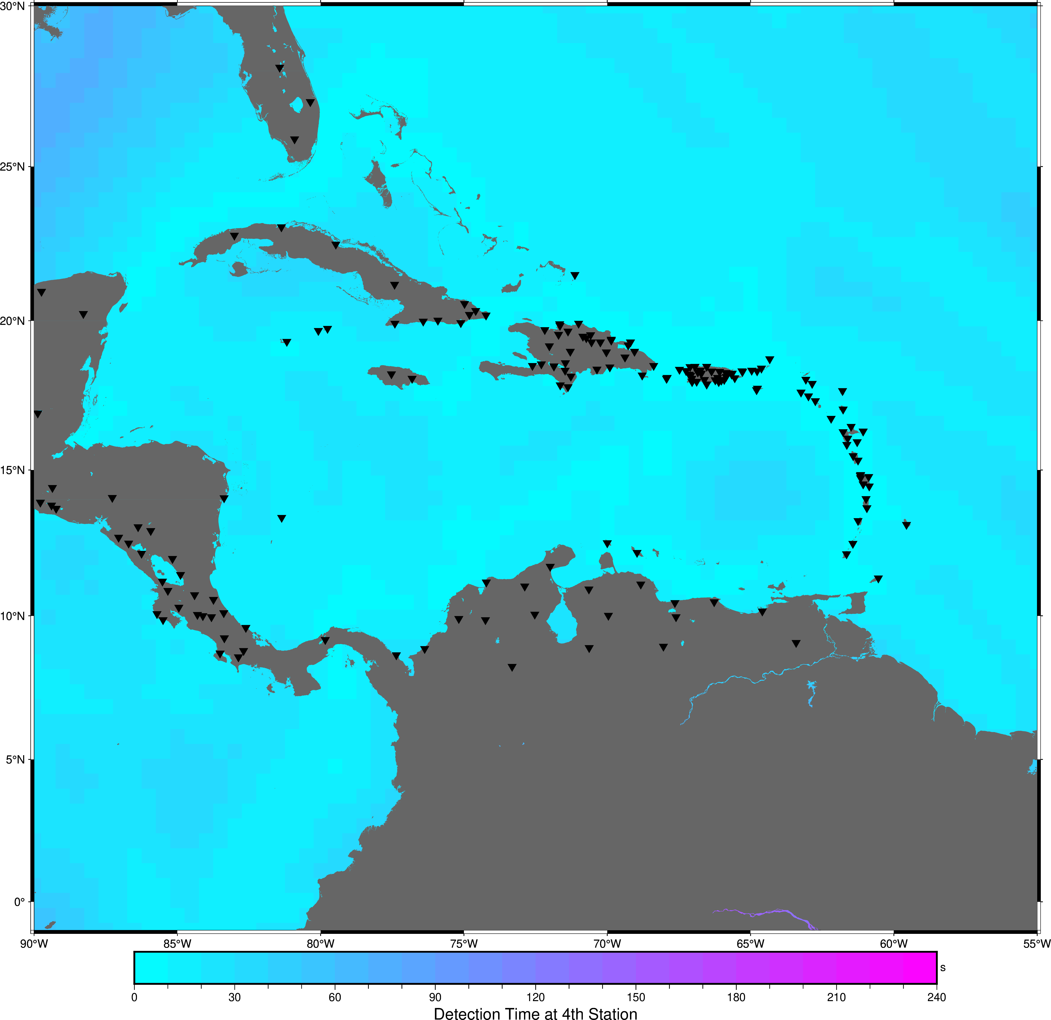
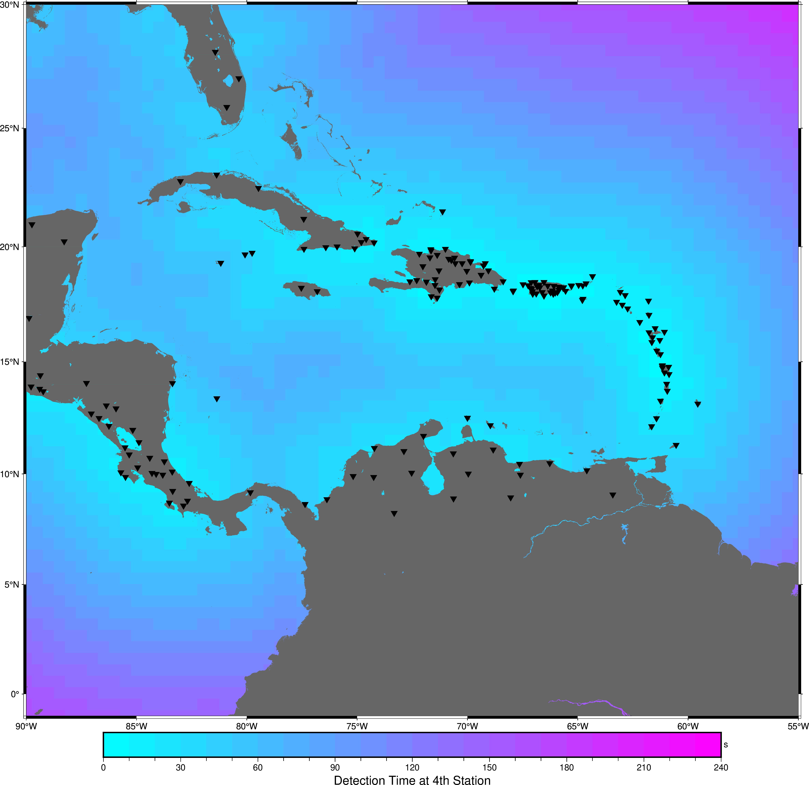
Smart Cables
If All Cables Were Smart
All Seismic: Best Case Current

Slide 4
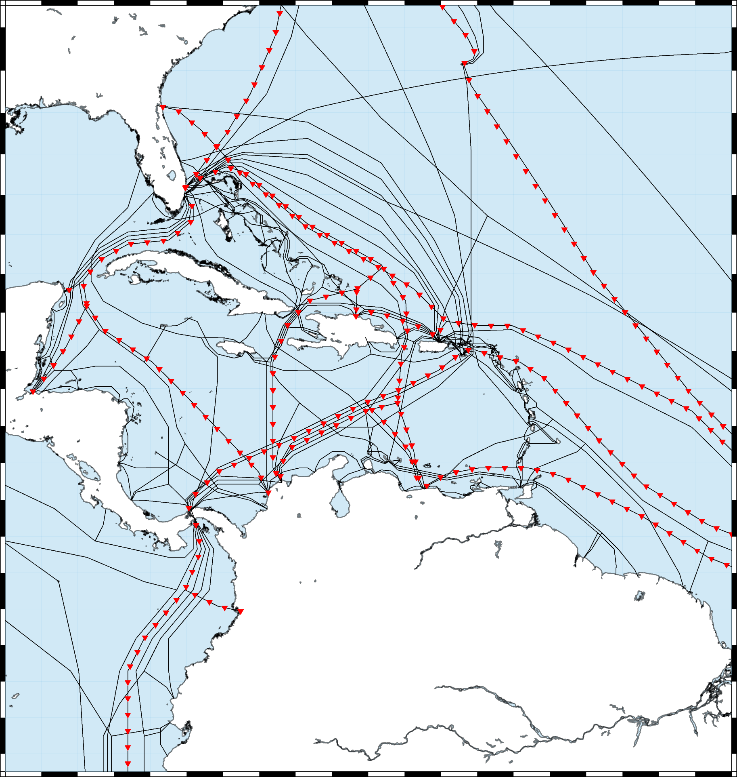
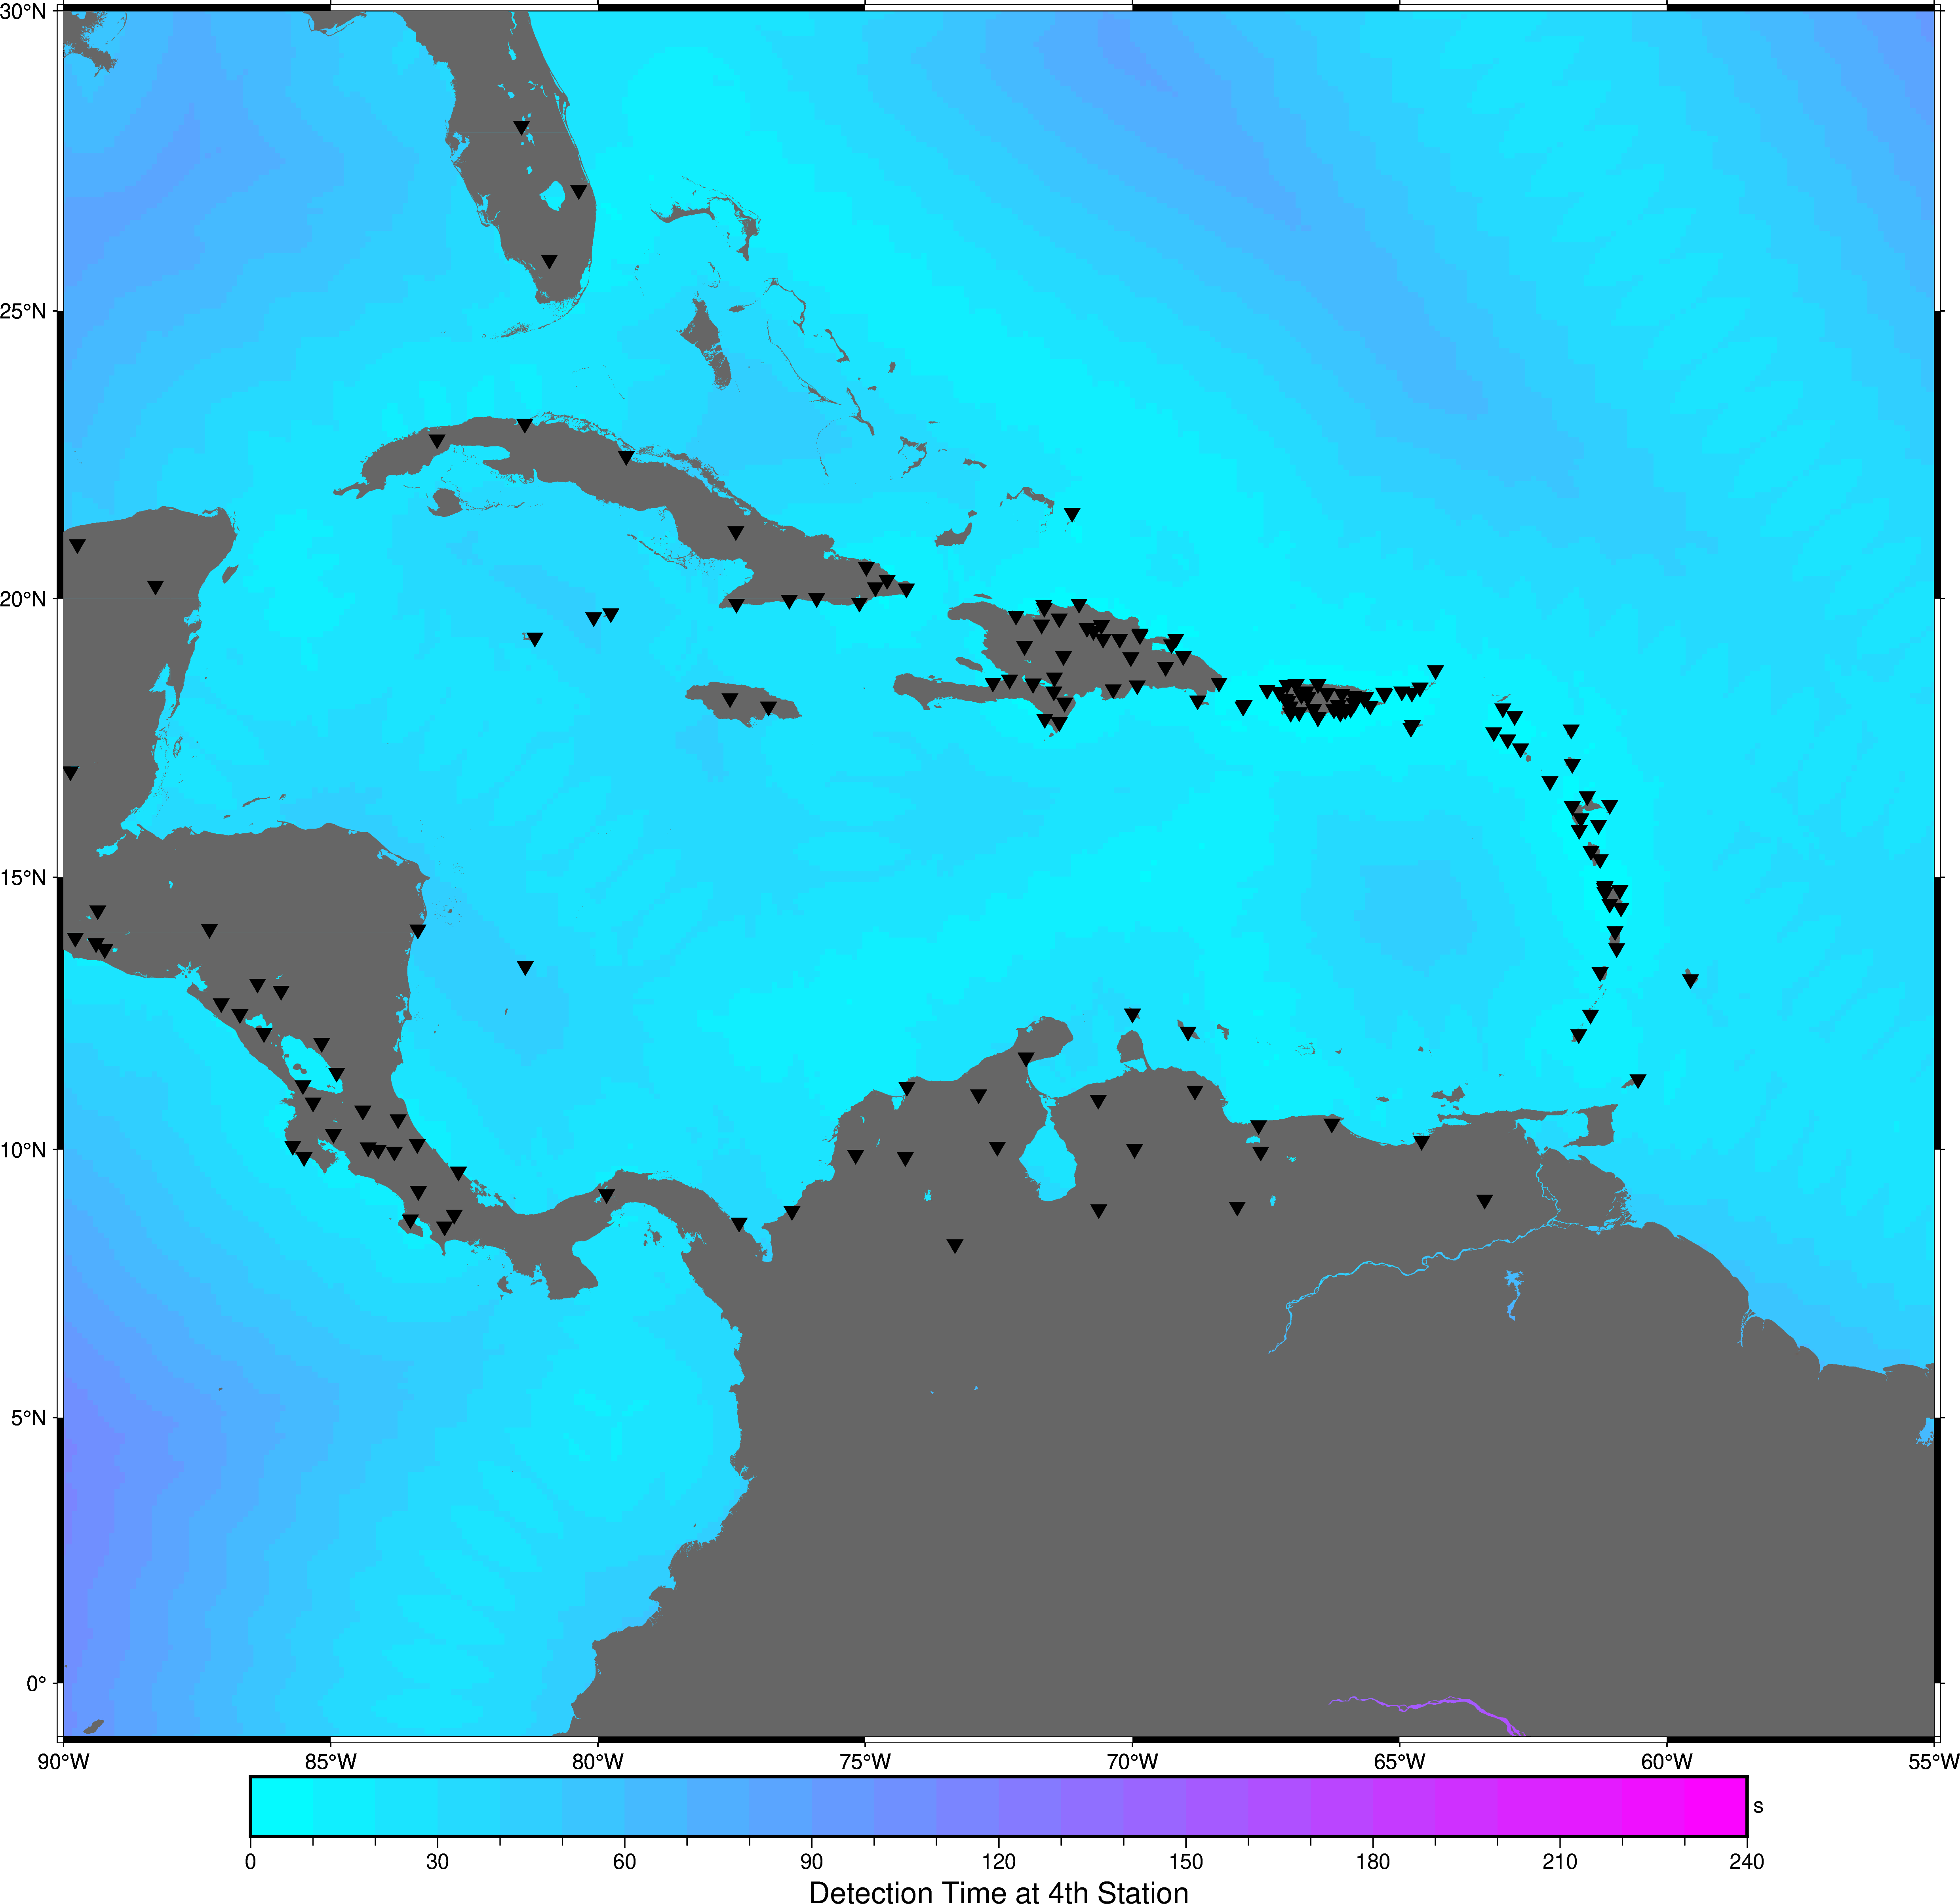
Test Geometry 1

Slide 5
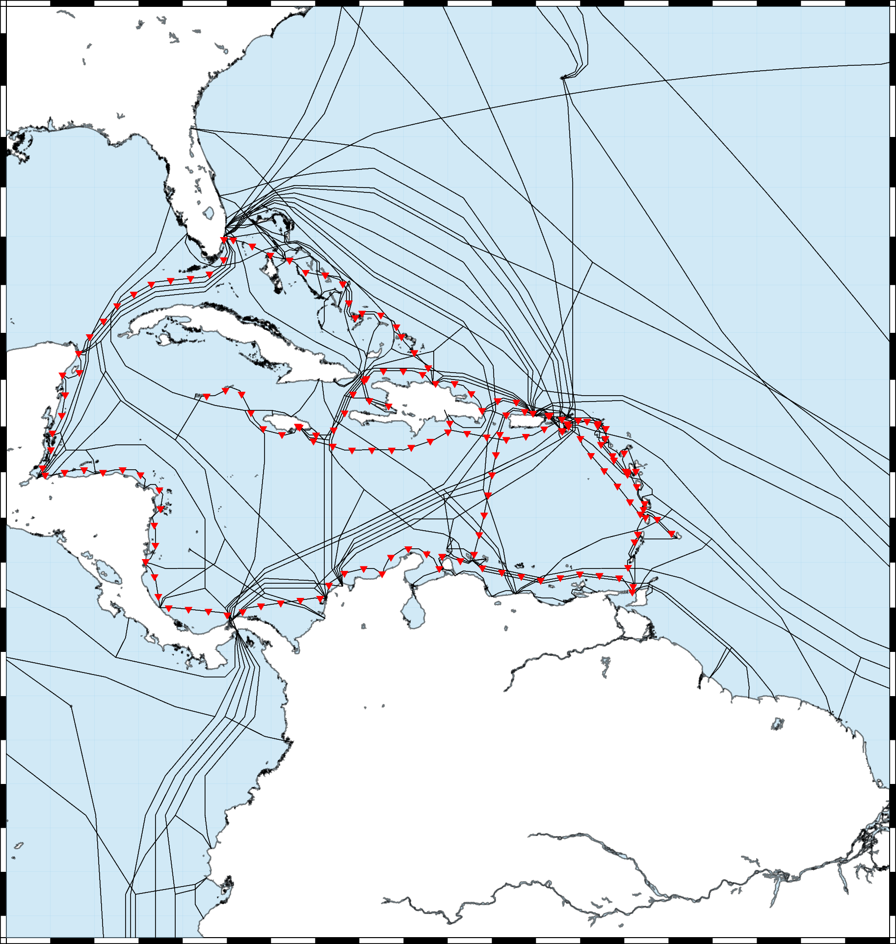
Test Geometry 2 (with Antilles)
Currently Calculating….

Slide 6
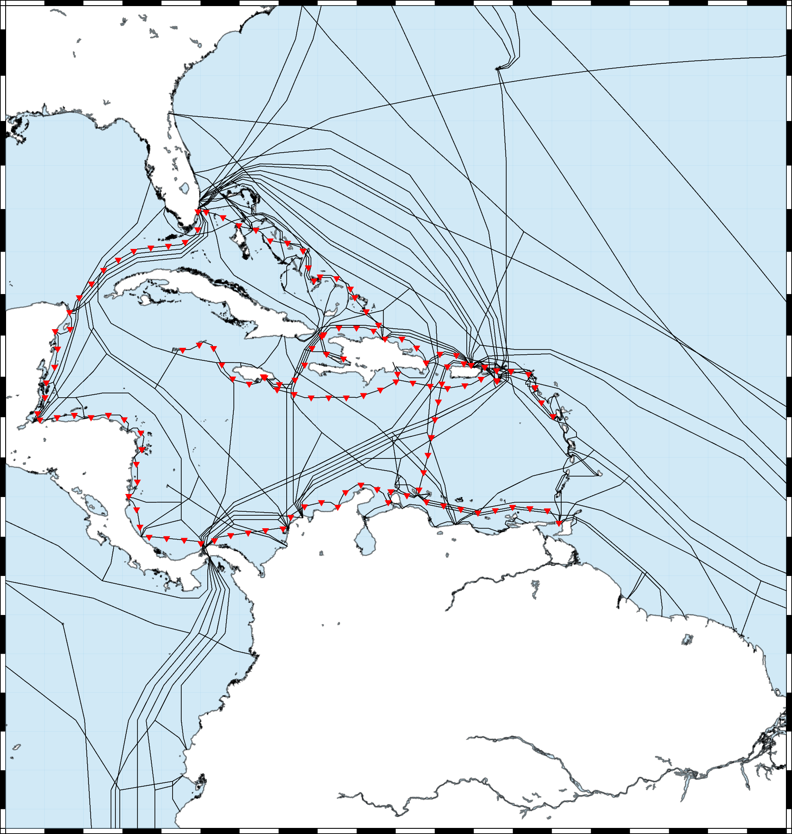
Test Geometry 2 (without Antilles)
See cost benefit of smart vs on-island
Next in queue

Slide 7
Smart Cables
Organize a SMART Cable webinar targeting the Caribbean Region - Two or so possible speakers→ Before or after Caribe Wave?
Formation of a sub-group under Working Group 2 to specifically address the implementation of such technology in the CARIBE-EWS. - Need more Volunteers (right now essentially Chris Moore and Elizabeth Vanacore)

Slide 8
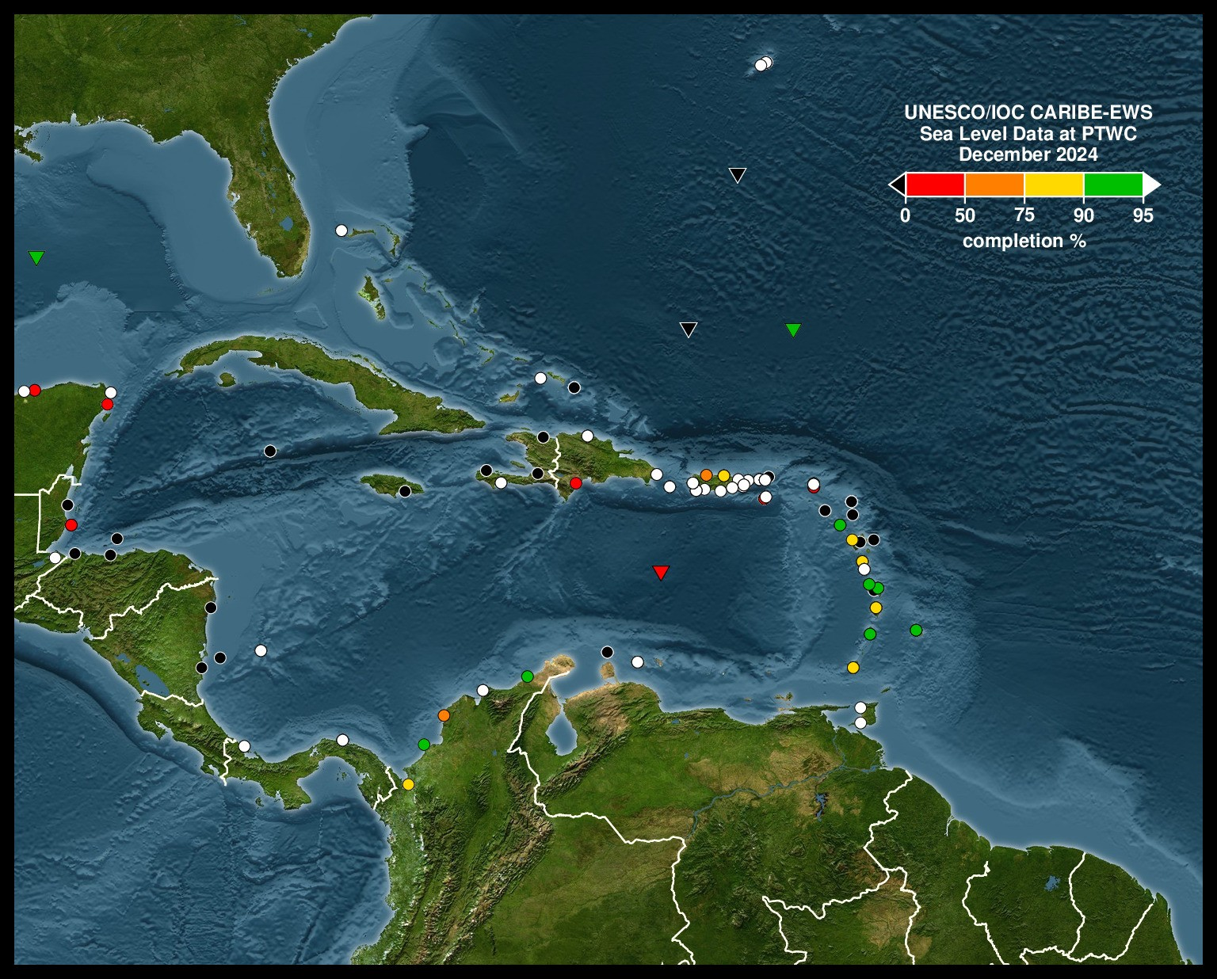
Sea Level Status: Concerning

Slide 9
Sea Level Training Course
Organize a training course to be taught in English on the general principles of installation and maintenance of sea level stations and the use of tide gauge data
To be hosted in Puerto Rico in July 7-11.
PRSN and CariCOOS assisting with logistics
Circular letter soon
Some funding available but self funded attendees encouraged

