Slide 1
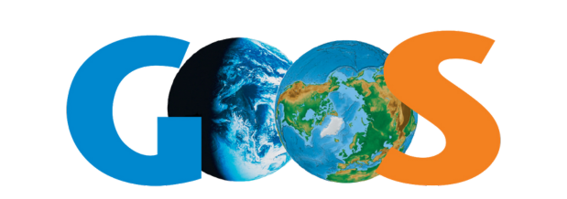
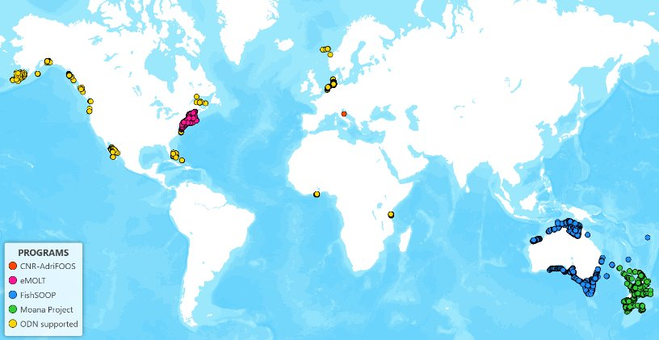
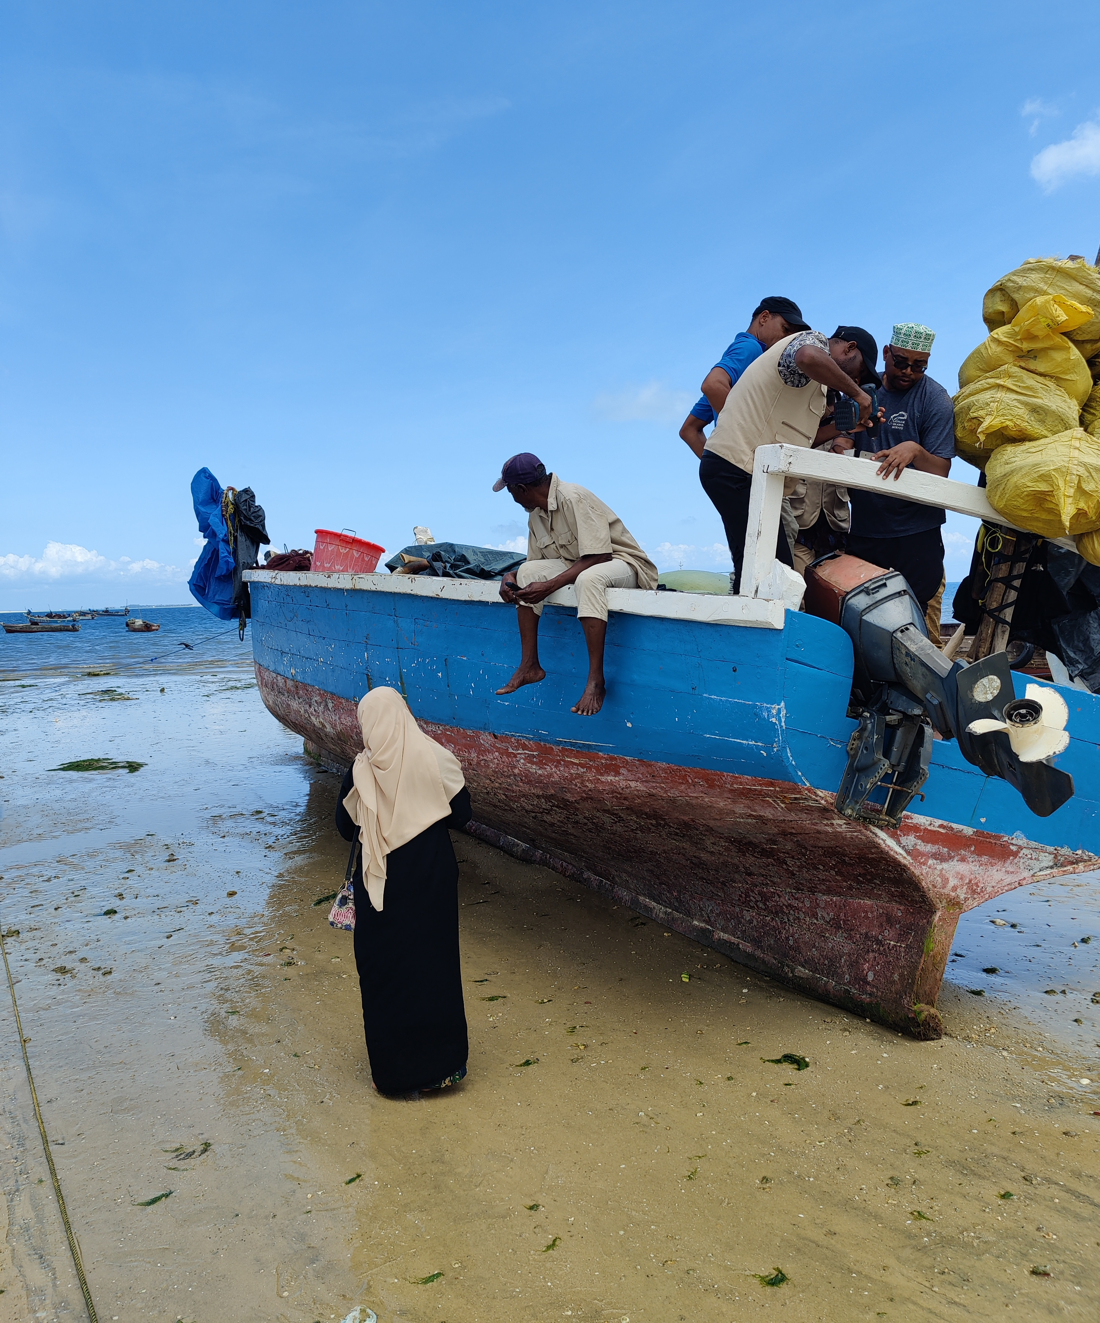
Observations Coordination Group (OCG) - 16
Fishing Vessel Ocean Observing Network
ILLUMINATING THE COASTAL SEAS
Cooper Van Vranken¹ (cooper@oceandata.net); A. Miguel Santos² (amsantos@ipma.pt)
¹Ocean Data Network (ODN) | ²Portuguese Institute for the Sea and the Atmosphere (IPMA)
STATUS
600+ fishing vessels (not all open)
36792 complete profiles in 2024
Goal: 10s of thousands of vessels
CoastPredict UNDOS Project
Today, mostly temperature profiling
CHALLENGES
Financial Innovation Subcommittee to achieve economies of scale
Challenges and opportunities with primarily EEZ network
Aim for FVON to be more fisheries centric: both industry tools, and for FAO
Above: Tropical Cyclone intensification forecasting improvement network in The Bahamas. Threshold temperature = 26 °C.
Right, Pilots in under-observed regions: Papua New Guinea, Fiji, Norfolk Island, Southern Ocean, Ghana, Bahamas, and Tanzania (Installation shown on Zanzibar).
QUESTIONS
Requirements: GCOS great for showing how far we all need to go. But we have not been able to link financing to meet requirements.
Data access: working on federated FVON access point. Today available from programs and subsets on GTS, EMODnet, and CMEMS.
EMOLT: https://erddap.emolt.net/erddap/index.html
Fish-SOOP: https://imos.org.au/facility/ships-of-opportunity/fishing-vessels-as-ships-of-opportunity
Adri-FOOS: https://essd.copernicus.org/articles/15/3513/2023/
Visit our website for a full list of publications:
Newsletter signup:
https://fvon.org/

