Slide 1
ICG/PTWS– XXXI
April, 2025
Report from Northwest Pacific Tsunami Advisory Center (NWPTAC)
Northwest Pacific Tsunami Advisory Center (NWPTAC)
Japan Meteorological Agency (JMA)
Notes:
Thank you for chairman. Good morning, everyone.
I am Takeshi Sato in Northwest Pacific Tsunami Advisory Center (NWPTAC), Japan Meteorological Agency (JMA).
I'm very glad to see all of you today
I would like to talk about the report from Northwest Pacific Tsunami Advisory Center (NWPTAC) between September 2023 and February 2025.

Slide 2

NWPTA Issuance 1 (Sep. 2023 – Feb. 2025)
Origin Time(UTC) | Lat. | Lon. | Location | Mag. | Elapsed Time(min)* | Tsunami Potential
01:59Z 05 OCT 2023 | 29.8N | 139.8E | SOUTHEAST OF HONSHU, JAPAN | 6.6 | 11 | A VERY SMALL POSSIBILITY OF A DESTRUCTIVE LOCAL TSUNAMI
08:34Z 07 OCT 2023 | 5.7S | 146.1E | EASTERN NEW GUINEA REG., P.N.G. | 7.0 | 19 | A VERY SMALL POSSIBILITY OF A DESTRUCTIVE LOCAL TSUNAMI
08:14Z 17 NOV 2023 | 5.6N | 125.3E | MINDANAO, PHILIPPINES | 7.2 | 23 | A POSSIBILITY OF A DESTRUCTIVE LOCAL TSUNAMI NEAR THE EPICENTER
04:48Z 22 NOV 2023 | 15.0S | 168.0E | VANUATU ISLANDS | 7.0 | 17 | A VERY SMALL POSSIBILITY OF A DESTRUCTIVE LOCAL TSUNAMI
09:05Z 24 NOV 2023 | 20.3N | 146.3E | MARIANA ISLANDS REGION | 6.9 | 27 | A VERY SMALL POSSIBILITY OF A DESTRUCTIVE LOCAL TSUNAMI
21:47Z 27 NOV 2023 | 3.3S | 144.0E | NEAR N COAST OF NEW GUINEA, P.N.G. | 6.6 | 16 | A VERY SMALL POSSIBILITY OF A DESTRUCTIVE LOCAL TSUNAMI
14:37Z 02 DEC 2023 | 8.6N | 126.4E | MINDANAO, PHILIPPINES | 7.7 | 24 | A POSSIBILITY OF A DESTRUCTIVE REGIONAL TSUNAMI
10:36Z 03 DEC 2023 | 8.3N | 126.9E | MINDANAO, PHILIPPINES | 7.0 | 19 | A VERY SMALL POSSIBILITY OF A DESTRUCTIVE LOCAL TSUNAMI
19:50Z 03 DEC 2023 | 8.9N | 127.1E | PHILIPPINE ISLANDS REGION | 7.0 | 23 | A VERY SMALL POSSIBILITY OF A DESTRUCTIVE LOCAL TSUNAMI
17:16Z 30 DEC 2023 | 3.2S | 139.3E | IRIAN JAYA, INDONESIA | 6.5 | 25 | NO POSSIBILITY OF A TSUNAMI
20:49Z 08 JAN 2024 | 4.9N | 126.3E | TALAUD ISLANDS, INDONESIA | 7.0 | 24 | A VERY SMALL POSSIBILITY OF A DESTRUCTIVE LOCAL TSUNAMI
20:22Z 23 MAR 2024 | 4.1S | 143.0E | NEW GUINEA, PAPUA NEW GUINEA | 7.0 | 23 | NO POSSIBILITY OF A TSUNAMI
23:58Z 02 APR 2024 | 23.8N | 121.7E | TAIWAN | 7.5 | 8 | A POSSIBILITY OF A DESTRUCTIVE LOCAL TSUNAMI NEAR THE EPICENTER
Yellow and bold characters shows events that provided Graphical products.
*) Elapsed time from Eq. origin time to Issuance the first NWPTA Products (minutes)
Notes:
Firstly, I introduce the issues of the Northwest Pacific Tsunami Advisory (NWPTA) from September 2023 to February 2025, as the NWPTAC Major Activities.
This and next slides show the have issued bulletins of NWPTA from September 2023 to February 2025.
NWPTAC have issued NWPTA when NWPTAC detects an earthquake of magnitude 6.5 or more in the area of the service of the northwestern Pacific Region.
Since the last PTWS meeting in September 2023, NWPTAC have issued bulletins for 26 events.
In this table, Origin Time on UTC with Yellow color and bold characters indicates the earthquakes that provided Graphical products.
In this term (between September 2023 and February 2025), although there is a lot of tsunami events issued NWPTA, there is no destructive tsunami event.

Slide 3
NWPTA Issuance 2 (Sep. 2023 – Feb. 2025)
Origin Time(UTC) | Lat. | Lon. | Location | Mag. | Elapsed Time(min)* | Tsunami Potential
11:03Z 05 APR 2024 | 19.3N | 145.6E | MARIANA ISLANDS | 6.6 | 12 | NO POSSIBILITY OF A TSUNAMI
09:48Z 09 APR 2024 | 2.7N | 127.1E | NORTHERN MOLUCCA SEA | 6.6 | 22 | A VERY SMALL POSSIBILITY OF A DESTRUCTIVE LOCAL TSUNAMI
20:57Z 14 APR 2024 | 5.9S | 151.1E | NEW BRITAIN REGION, P.N.G. | 6.5 | 20 | A VERY SMALL POSSIBILITY OF A DESTRUCTIVE LOCAL TSUNAMI
18:26Z 22 APR 2024 | 23.8N | 121.6E | TAIWAN | 6.6 | 11 | A VERY SMALL POSSIBILITY OF A DESTRUCTIVE LOCAL TSUNAMI
08:35Z 27 APR 2024 | 27.9N | 140.0E | BONIN ISLANDS, JAPAN REGION | 6.9 | 9 | NO POSSIBILITY OF A TSUNAMI
02:13Z 11 JUL 2024 | 6.0N | 123.3E | MINDANAO, PHILIPPINES | 6.9 | 15 | NO POSSIBILITY OF A TSUNAMI
22:23Z 02 AUG 2024 | 8.3N | 127.1E | PHILIPPINE ISLANDS REGION | 7.0 | 19 | A VERY SMALL POSSIBILITY OF A DESTRUCTIVE LOCAL TSUNAMI
07:42Z 08 AUG 2024 | 31.8N | 131.7E | KYUSHU, JAPAN | 6.9 | 6 | A VERY SMALL POSSIBILITY OF A DESTRUCTIVE LOCAL TSUNAMI
19:10Z 17 AUG 2024 | 52.7N | 160.1E | OFF EAST COAST OF KAMCHATKA | 7.4 | 21 | A POSSIBILITY OF A DESTRUCTIVE LOCAL TSUNAMI NEAR THE EPICENTER
20:14Z 01 SEP 2024 | 6.7S | 155.5E | SOLOMON ISLANDS | 6.6 | 23 | A VERY SMALL POSSIBILITY OF A DESTRUCTIVE LOCAL TSUNAM
05:29Z 15 NOV 2024 | 4.7S | 153.2E | NEW IRELAND REGION, P.N.G. | 6.7 | 19 | A VERY SMALL POSSIBILITY OF A DESTRUCTIVE LOCAL TSUNAM
12:47Z 27 DEC 2024 | 46.8N | 151.7E | KURIL ISLANDS | 6.7 | 10 | NO POSSIBILITY OF A TSUNAMI
12:19Z 13 JAN 2025 | 31.8N | 131.6E | KYUSHU, JAPAN | 6.9 | 14 | A VERY SMALL POSSIBILITY OF A DESTRUCTIVE LOCAL TSUNAMI
Yellow and bold characters shows events that provided Graphical products.
*) Elapsed time from Eq. origin time to Issuance the first NWPTA Products (minutes)
Notes:
In this term (between September 2023 and March 2025), although there is a lot of tsunami events issued NWPTA, there is no destructive tsunami event.

Slide 4
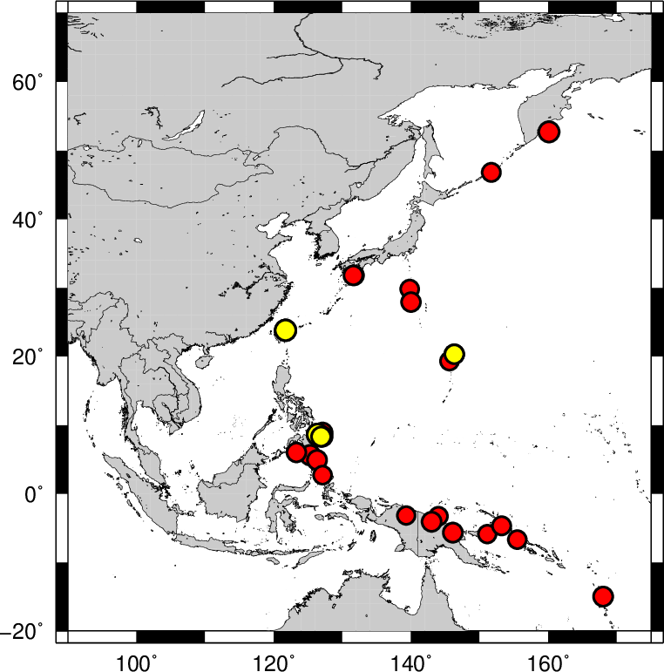
Earthquake locations of NWPTA Issuance
(Sep. 2023 – Feb. 2025)
NWPTA was issued for 26 events between September 2023 and February 2025.
●: NWPTA was issued.
●: Graphical products was issued in the NWPTA second bulletin.
Notes:
This slide shows epicenters of the 26 earthquakes issued NWPTA.
Yellow circles show events that provided Graphical products.
The issuances of NWPTA from our center were nothing wrong.
We had no problems with the issuance of the NWPTA from our center.

Slide 5
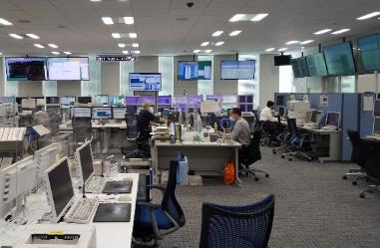
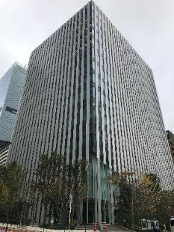
NWPTAC Major Activities (Sep. 2023 – Feb. 2025)
Dec. 05, 2023 Communication Test
May. 28, 2024 Communication Test
Nov. 05, 2024 Live Communication Test, and Trial Transmission to NAVAREA Coordinators for the PacWave24
Dec. 17, 2024 Communication Test
Apr. 01, 2025 Cessation of the fax transmission from NWPTAC
Japan Meteorological Agency
Operation Room of NWPTAC (JMA)
Notes:
Secondly, I introduce to the other major activities of NWPTAC.
This slide shows events without the issuance of NWPTA between September 2023 and February 2025.
NWPTAC conducted 3 communication tests on December 5, 2023, May 28, and December 17, 2024 in JST.
Then, for PacWave24, NWPTAC conducted the live communication test on November 5, 2024.
In PacWave24, our center conducted the trial transmission to NAVAREA Coordinator (Japan Coast Guard).
Outside of this term, at 00:00 UTC on 1 April 2025, NWPTAC discontinued the dissemination of our tsunami bulletins (NWPTA) via fax effectively.
(the dissemination of our tsunami bulletins via fax will be discontinued effective at 00:00 UTC on 1 April 2025.)

Slide 6
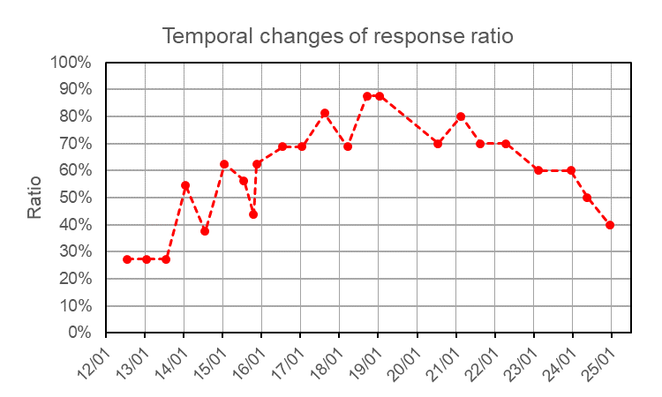
Responses of Communication Tests
NWPTAC conducts communication tests basically twice a year since 2012.
Thanks to the coordination of the secretariat and the member states, the situation is maintained.
Some countries (same countries) have not responded to communication tests recently.
Notes:
This slide shows the response about communication tests of NWPTAC.
NWPTAC conducts communication tests basically twice a year since 2012.
Thanks to the coordination of the secretariat and the member states, the situation is maintained.
Last 3 times, the response ratio about communication tests has decreased.
Some countries (same countries) have not responded to communication tests recently.

Slide 7
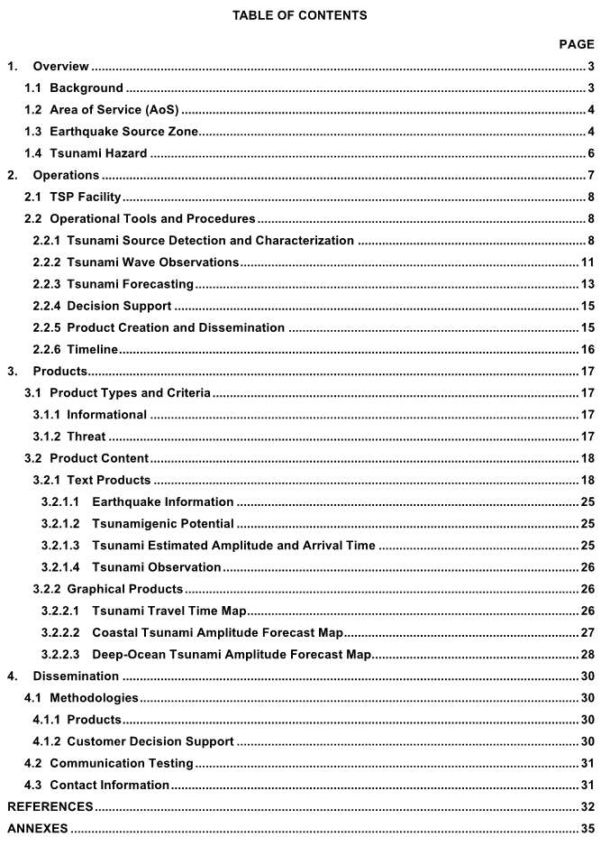
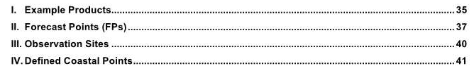
Revised NWPTAC User’s Guide
Draft of Revised NWPTAC Users’ Guide
NWPTAC prepared a draft of the revised NWPTAC user’s guide based on the proposed common Table of Contents for PTWS.
The draft of the revised NWPTAC user’s guide was sent by e-mail to TNC for the request of the confirmation about its contents.
NWPTAC has incorporated comments from TNC into the revised user’s guide.
* The revised user’s guide do not affect NWPTAC products or NWPTAC operations in any way.
Notes:
Thirdly, I would like to report on the current progress of the revised NWPTAC User’s Guide.
Left figure shows the table of contents on a draft of the revised NWPTAC user’s guide.
NWPTAC prepared a draft of the revised NWPTAC user’s guide based on the proposed common Table of Contents for PTWS.
The draft of the revised NWPTAC user’s guide was sent by e-mail to TNC for the request of the confirmation about its contents.
NWPTAC has incorporated comments from TNC into the revised NWPTAC user’s guide.
The revised user’s guide do not affect NWPTAC products or NWPTAC operations in any way.

Slide 8

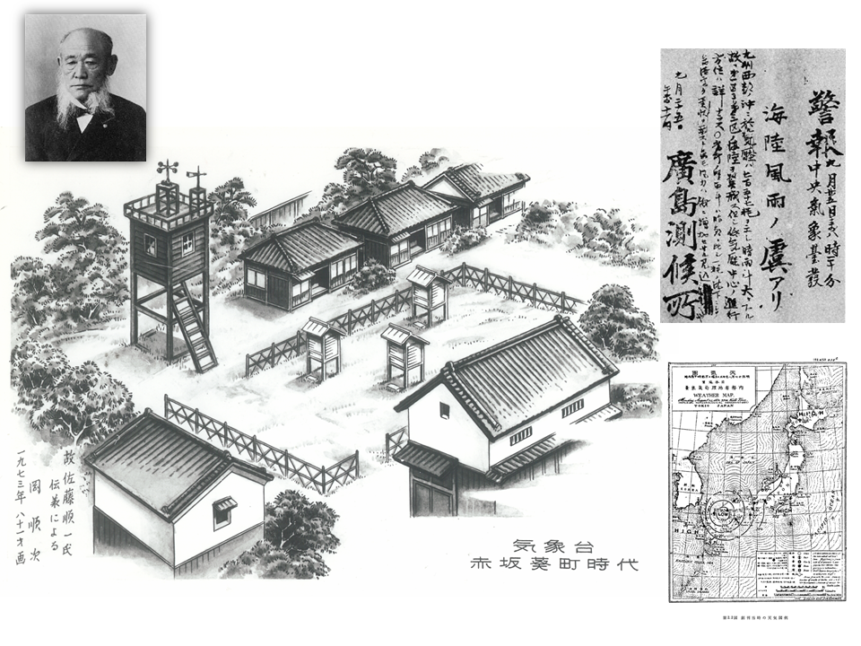
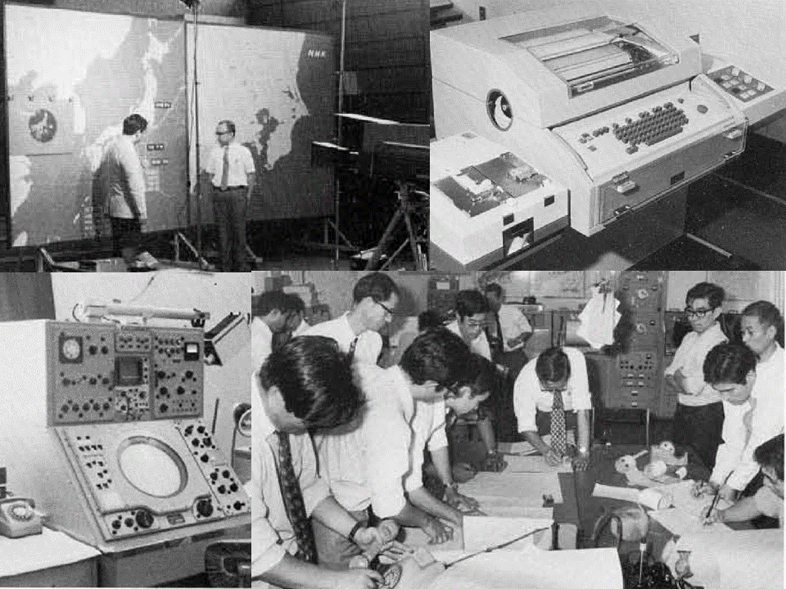
150th Anniversary of Meteorological Services in JMA
This year marks 150th anniversary of JMA of starting of meteorological services since 1st July, 1875.
(https://www.jma.go.jp/jma/kishou/info/150th/index.html)
Notes:
Lastly, I would like to inform you that Japan Meteorological Agency (JMA) will mark the 150th anniversary from starting of meteorological services in this year.
JMA started meteorological services since 1st July, 1875.
This year marks 150th year anniversary in JMA.
JMA including NWPTAC will continue its relentless efforts to protect people's lives and property from disasters.

Slide 9
Thank you very much for your kind attention.
Notes:
That concludes my report.
Thank you very much for your kind attention.

