Slide 1
Session 4: Requirements implementation
Ana Lara-Lopez, GOOS BioEco Panel IPO
Sixteenth Observations Coordination Group Meeting (OCG-16)
7-10 April 2025, IFREMER, Brest, France.

Slide 2
BioEco Panel update

Slide 3
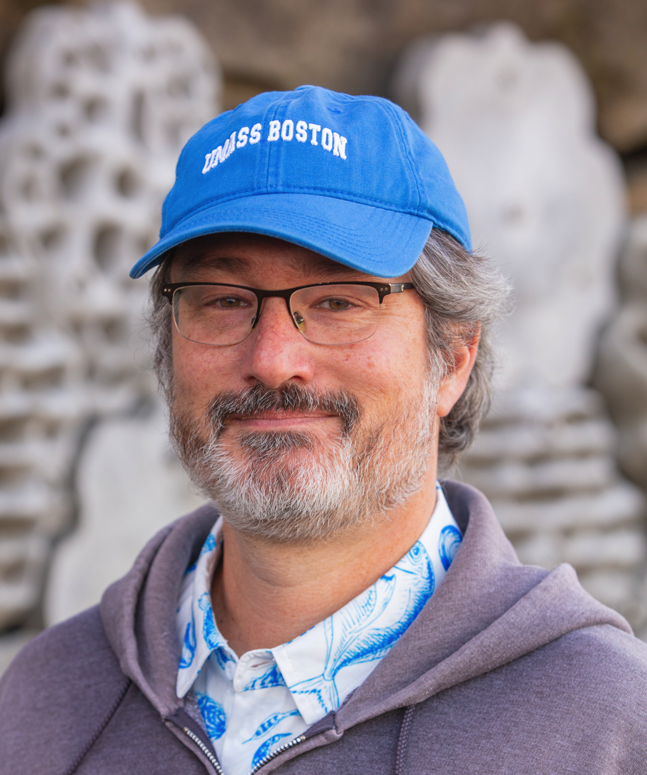
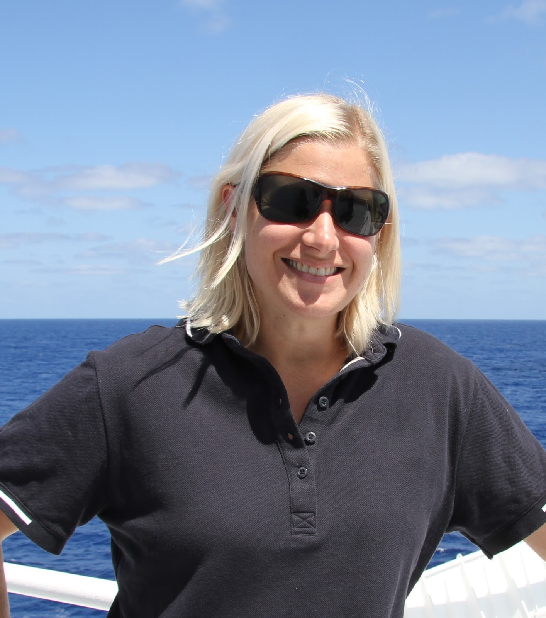
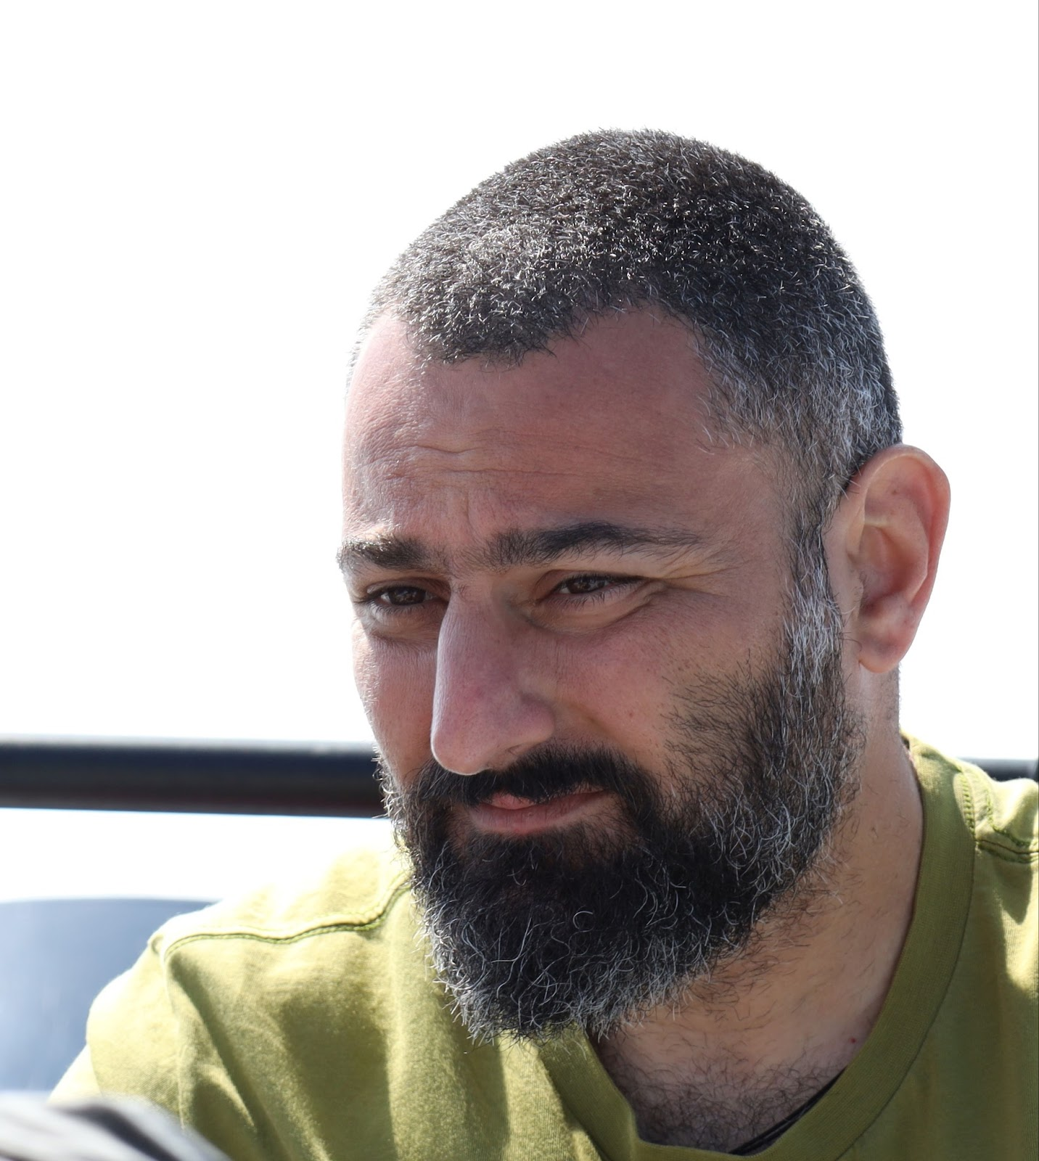
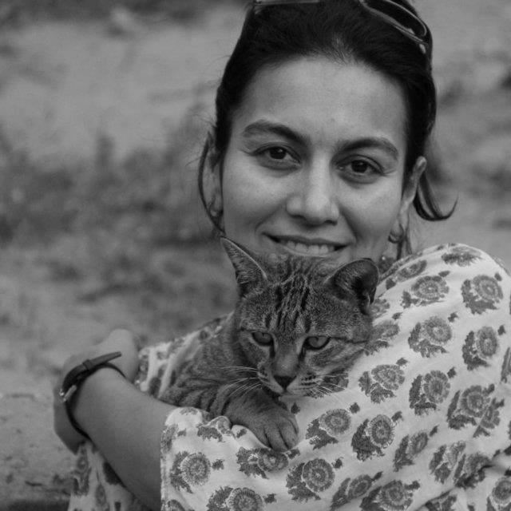
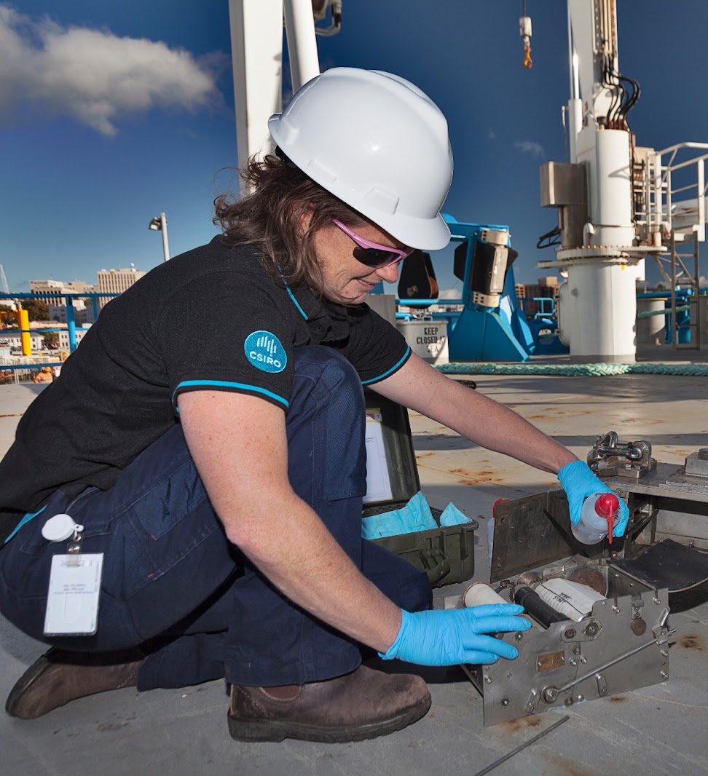
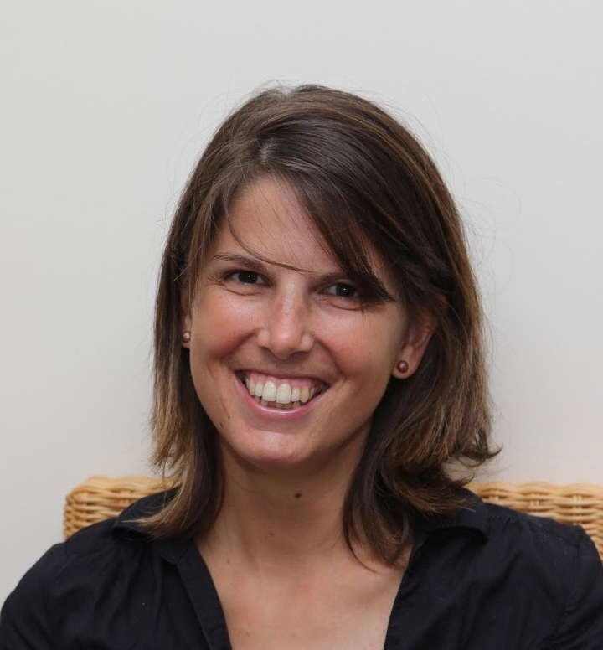
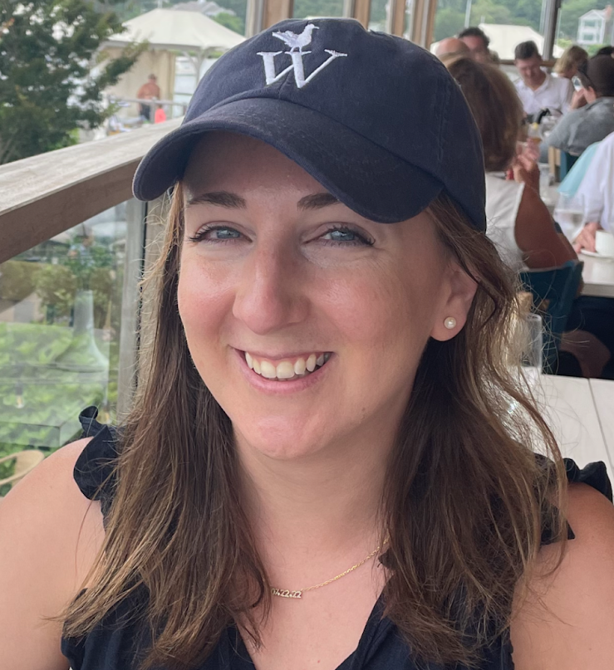
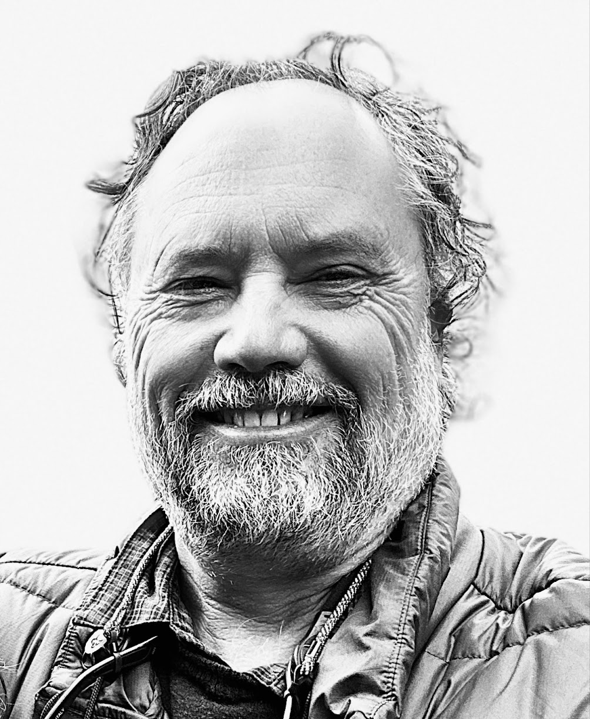
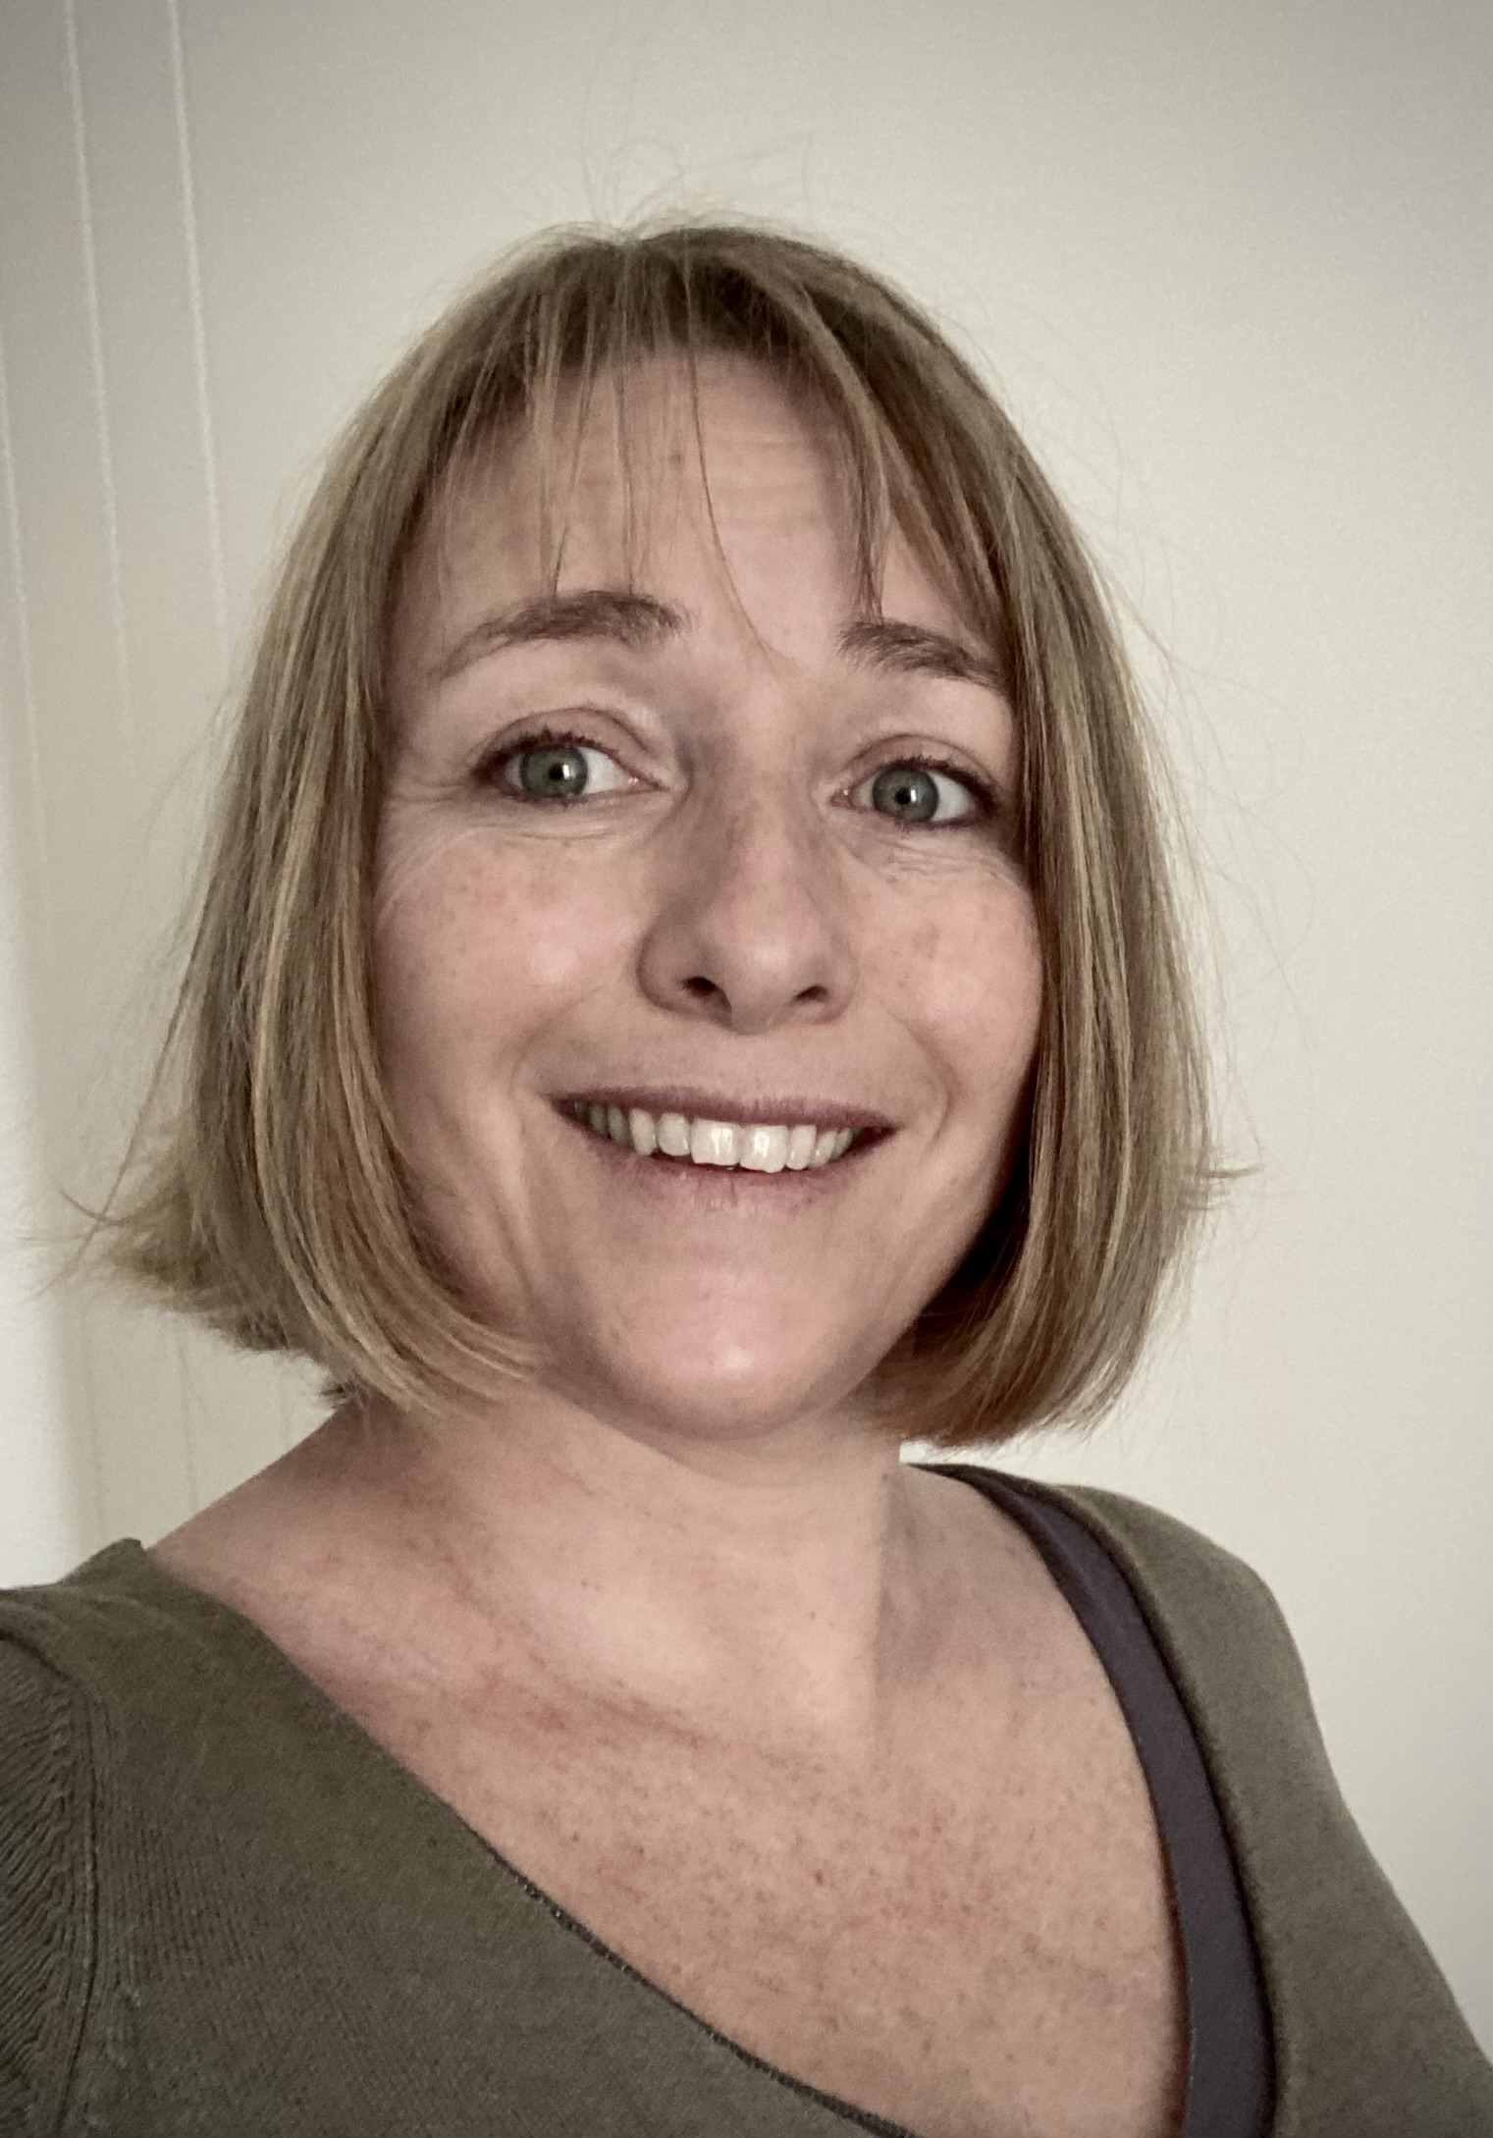
Expanded BioEco Panel - new members and new co-chairs
Eduardo Cuevas
Sea turtles EOV
Jarrett Byrnes
Macroalgae EOV
Julie Robidart
Microbes EOV
Rachel Przelawski
Benthic inverts EOV
Dimitris Poursanidis
Seagrass EOV
Svenja Halfter
Zooplankton EOV
Dipani Sutaria
Marine mammals EOV
Claire Davies
Phytoplankton EOV
Lucille Chapuis
Ocean Sound EOV
Erika Towle
Corals EOV
Clive McMahon
Co-chair
Audrey Darnaude
Co-chair

Slide 4
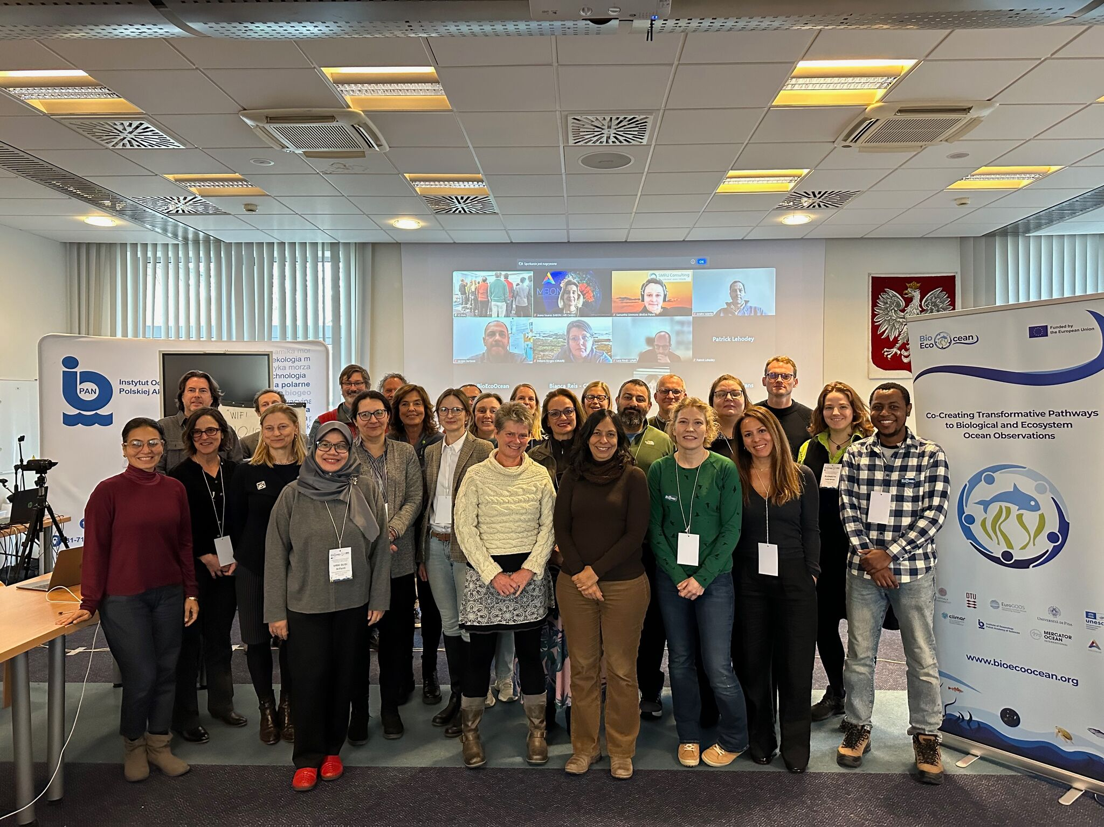
BioEco Panel updates
Meeting in Sopot, Poland on 3-6 February 2025 with BioEcoOcean project
-EOV specification sheets
-Data workshop
-TRL assessment and BP discussions

Slide 5
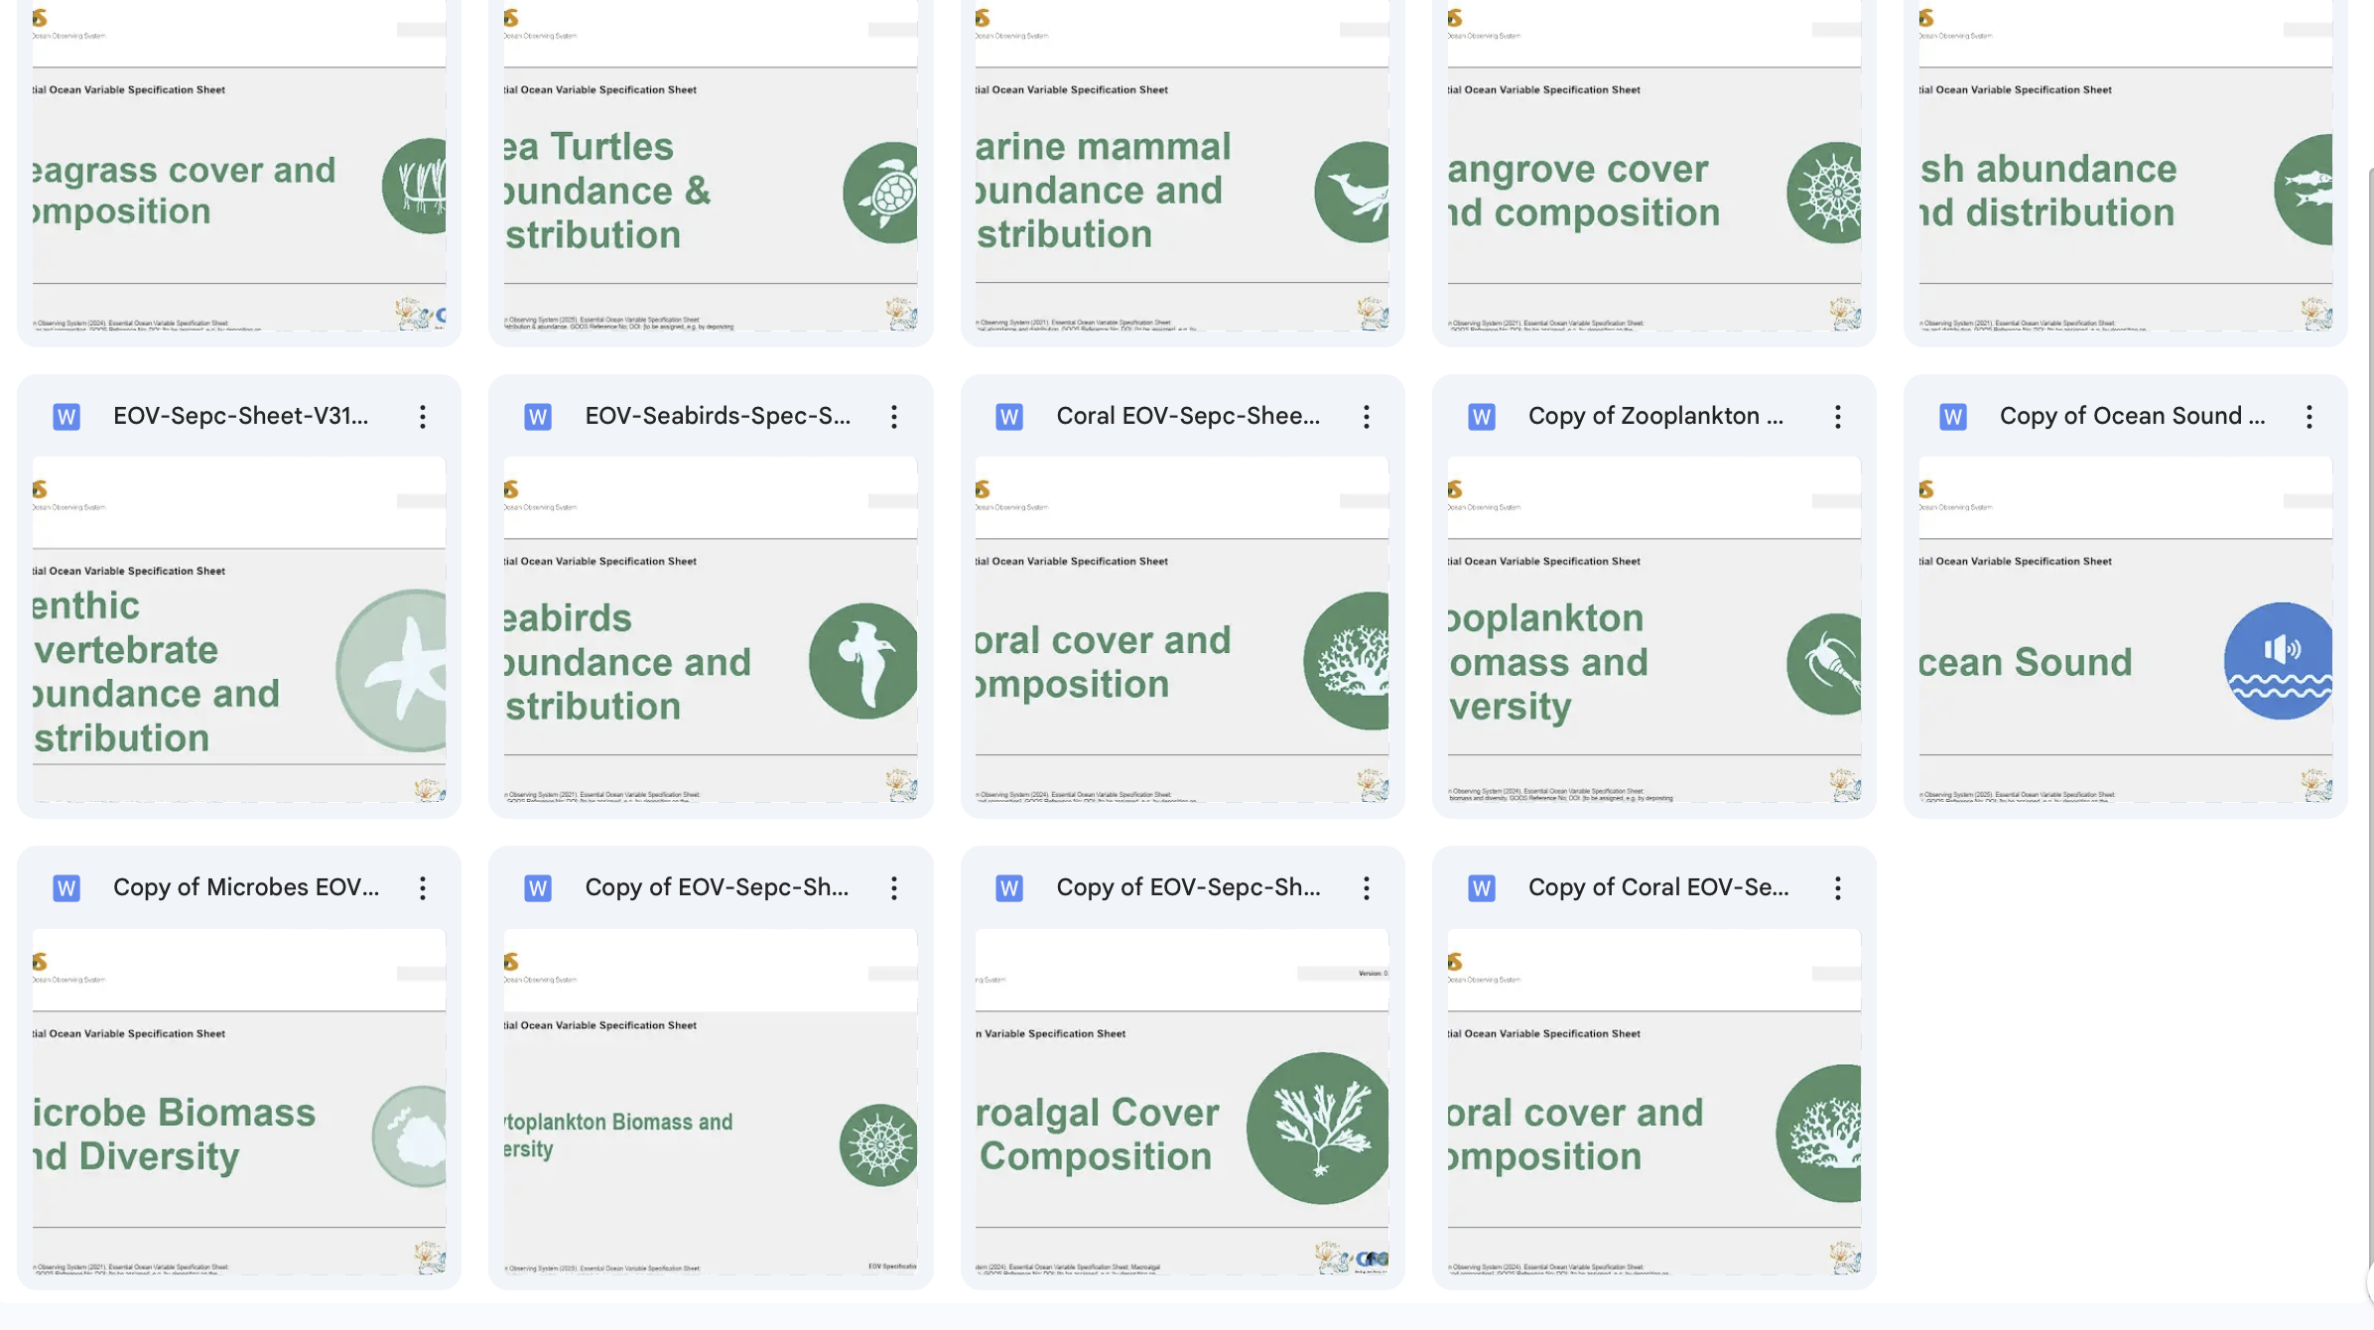
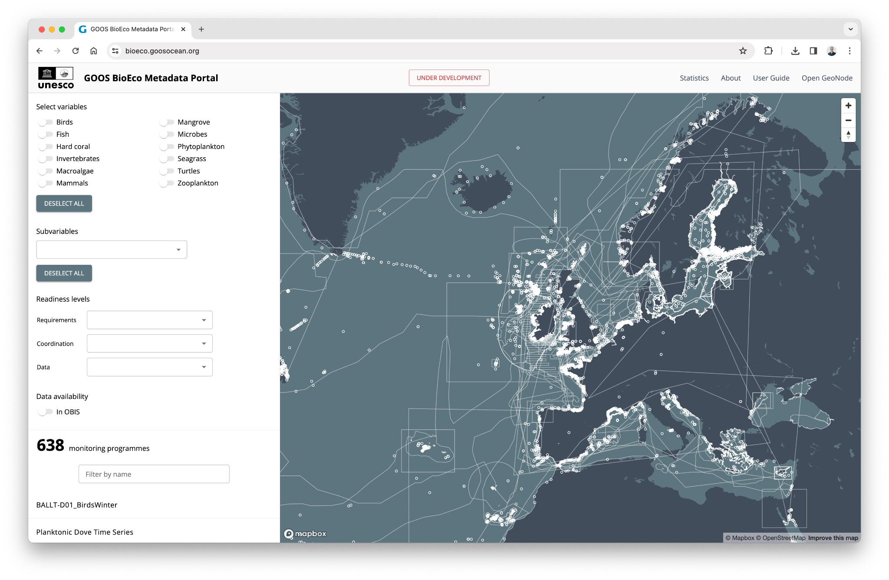
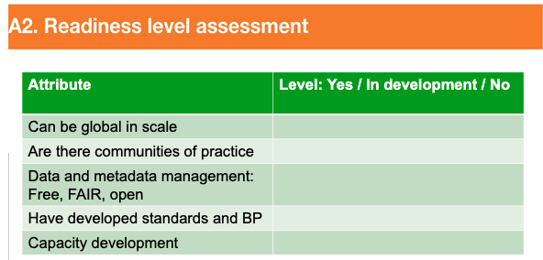
Review of BioEco EOV specification sheets:
Refine Q1/Q2
Consult Q2-Q3
Finalise Q4
Data and metadata
minimum metadata standards - consistent with OCG
Biological dataflows - ID other OCG networks (Bio-GO SHIP)
platforms that observe several EOV - case study - OCG network?
TRL assessment
Baseline assessment of biological EOV communities
Consistent with OCG - metrics task team

Slide 6
OCG-15 decisions

Slide 7
AniBOS biological data
Ian Jonsen, Jon Pye, Ward Appeltans, Clive McMahon
Pilot project using IMOS-ATF southern elephant seal satellite tracking data - SMRU SRDL-CTD tags
Runs the IMOS-ATF satellite location data Quality Control process
Pulls the locations and associated metadata from the QC process: merges locations with metadata, translates into DwC, pushes to OTN IPT for publication in OBIS

Slide 8
Next steps
Handle QC’d Wildlife Computers tag data and publish DwC Event Core data to OBIS.
Provide the ability to summarize and publish other biological (diving & surface behaviour) and (possibly) physical (salinity - temperature) data will be added.
Automate process for A and B
By October 2025, a fully automated data QC and OBIS publication processes available on a near-real time basis.

Slide 9
Real-time biological data
Potential to inform location of endangered wildlife - avoid vessel strikes or fishing activities
Provide valuable biological information (hotspots) and foster engagement with new communities, e.g. Convention on the Conservation of Antarctic Marine Living Resources (CCAMLR), and other.
Delivering both biological and physical data in near-real-time (NRT) demonstrating effective system integration and multi-disciplinary operational capacity
A future-looking blueprint for establishing systems capable of delivering comprehensive information across disciplines.

Slide 10
GOOS Biodiversity Plan
GOOS SC -13
“Action 4.3 - Lead cross-panel/ community effort to co-design and coordinate an integrated and responsive marine biodiversity observing implementation plan to meet current and future assessment, reporting and conservation requirements (GOOS SC and BioEco Panel). “
Objective 1: Mature BioEco EOVs by establishing a robust, interoperable observing and data framework
Objective 2: Simplify data submission processes and support capacity building to encourage greater participation and data contributions from ocean observing networks to the global system
Objective 3: Increase awareness of BioEco EOVs and GOOS activities and services by developing clear targeted communication about the value of a global ocean observing system and the EOV framework.
Objective 4: Engage with marine stakeholders and rights holders worldwide to co-design data products and use cases that demonstrate the applied value of BioEco data delivery at different scales.
Objective 5: Strengthen global marine biodiversity monitoring by building capacity to expand participation across communities and across borders.
Objective 6: Establish a framework to regularly assess the maturity of BioEco observing networks and programmes and the quality of BioEco EOV data against agreed attributes, consistent with OCG.

Slide 11
GOOS Biodiversity Plan - ACTIONS
Objective 1: Mature BioEco EOVs by establishing a robust, interoperable observing and data framework
Minimum metadata standards
Objective 2: Simplify data submission processes and support capacity building to encourage greater participation and data contributions from ocean observing networks to the global system
BioEco Portal links with ODIS and OceanOPS - IOC Data Architecture
Objective 5: Strengthen global marine biodiversity monitoring by building capacity to expand participation across communities and across borders.
BioEco data pipelines from OCG networks with biological data (Bio GO-SHIP, OceanSITES?)
Objective 6: Establish a framework to regularly assess the maturity of BioEco observing networks and programmes and the quality of BioEco EOV data against agreed attributes, consistent with OCG.
Metrics to assess maturity consistent with OCG

Slide 12
Timeline
Draft annotated outline -end of January 2025
Writing session with the BioEco Panel - February 2025 Panel meeting
Discuss plan with Cross-Panel leadership and report on draft plan and timeline to GOOS SC
Input from Panels and OCG to the draft plan - End of May
Who: GOOS components + GOOS SC and sponsors + relevant parts of IOC + OTHERS
Adjudicate comments and finalise draft - June
Who: Drafting team (BioEco Exec + others)
Draft out for comments - July - Sep
Who: GOOS components, GRAs, relevant organisations, relevant IOC programs, bioeco observing community
Finalise GOOS Biodiversity Plan - Nov-Dec

Slide 13
Summary - Interaction with OCG
Biological dataflows from other OCG networks - case studies
Consistent metrics for maturity assessment
Consistent minimum metadata standards
BioEco Portal and OceanOPS connection - IOC data architecture?
Other:
Unique identifiers
Notes:
there is a bit of funding from Marco-Bolo and BioEcoOcean for this, but IODE and GOOS will need to find a way to co-fund this from core funds. For this biennium 2024-2025 all budgets are allocated.

Slide 14
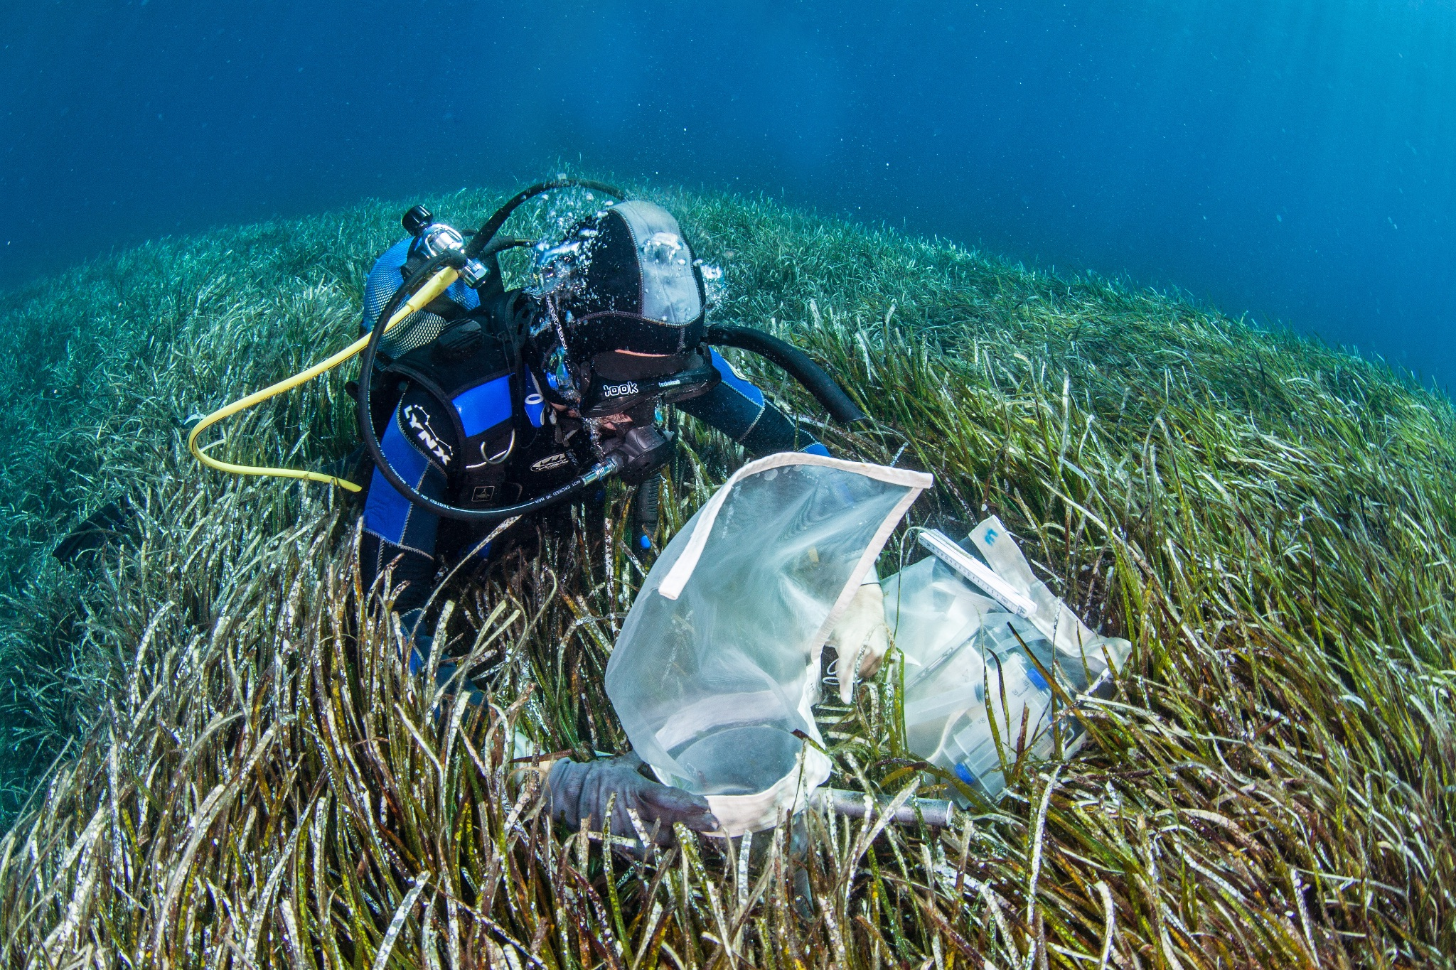
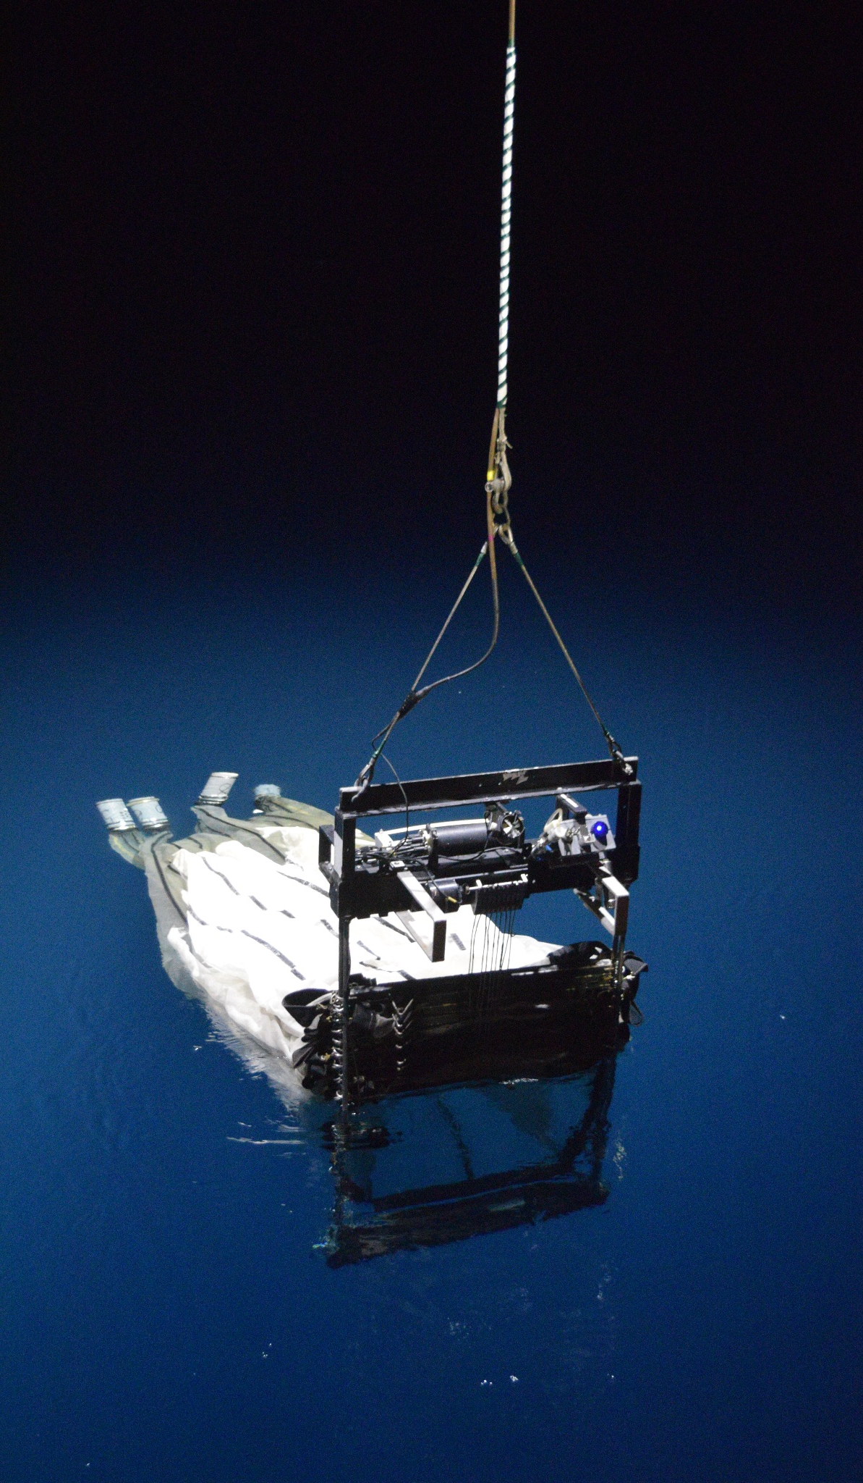
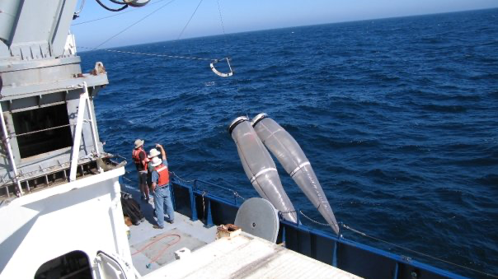
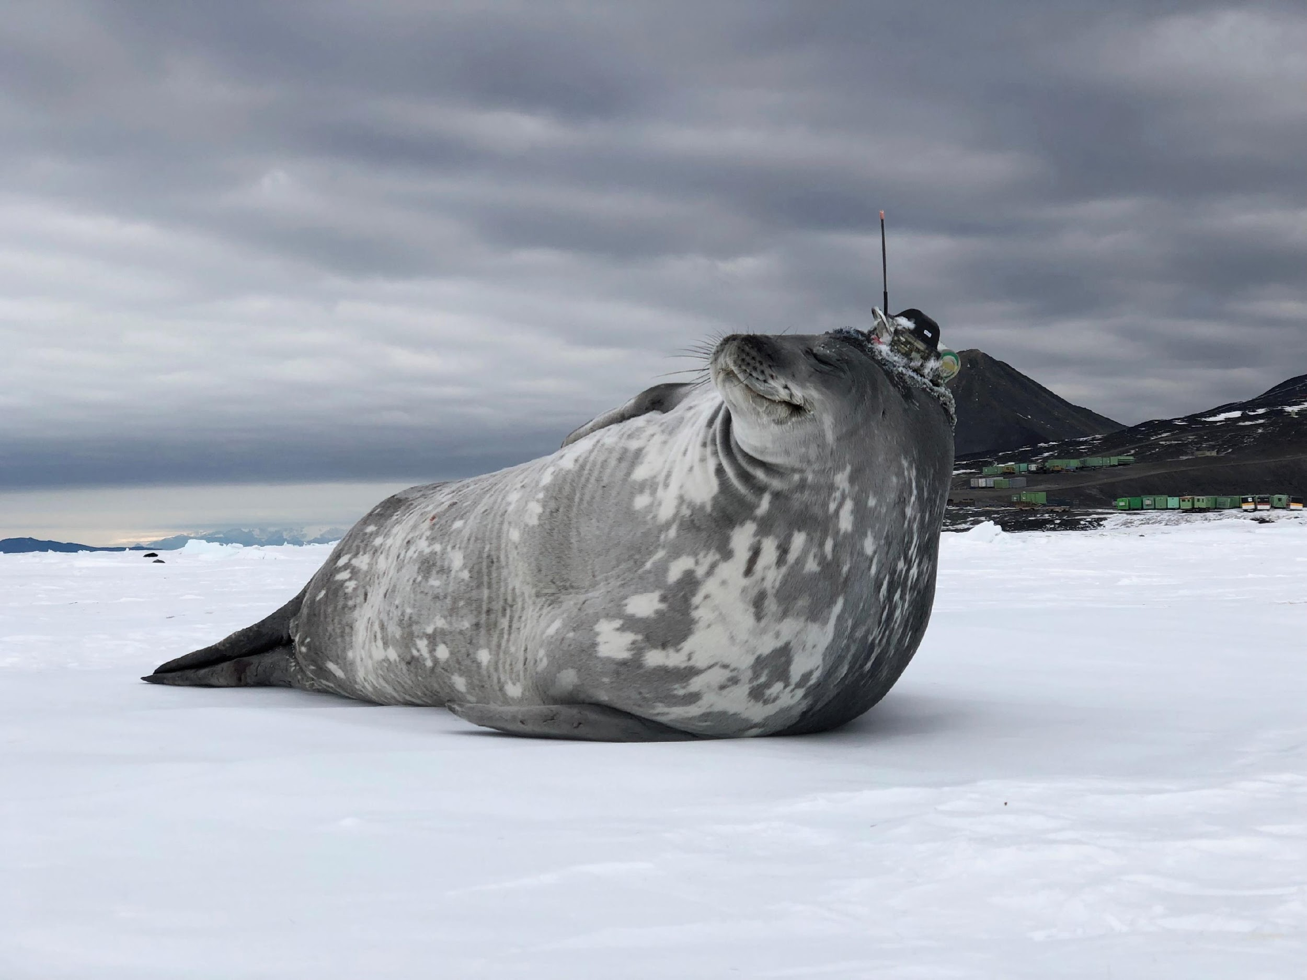
Thank you
goosocean.org
Dimitris Poursanidis / Ocean Image Bank
Giiulia Wood

