Slide 1
9th Joint ICG/PTWS–IUGG/JTC Workshop
60th Anniversary of the ICG/PTWS – Past and Future
Yuichiro Tanioka
Center for Natural Hazards Research
Hokkaido University

Slide 2
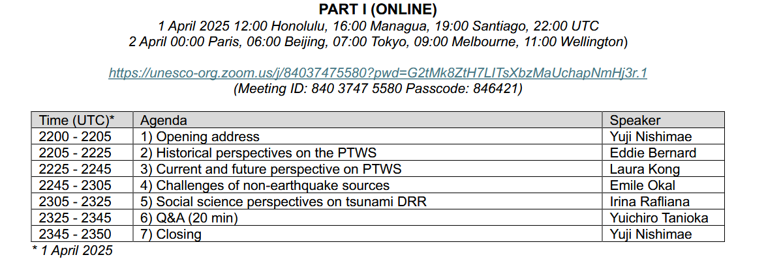

Slide 3
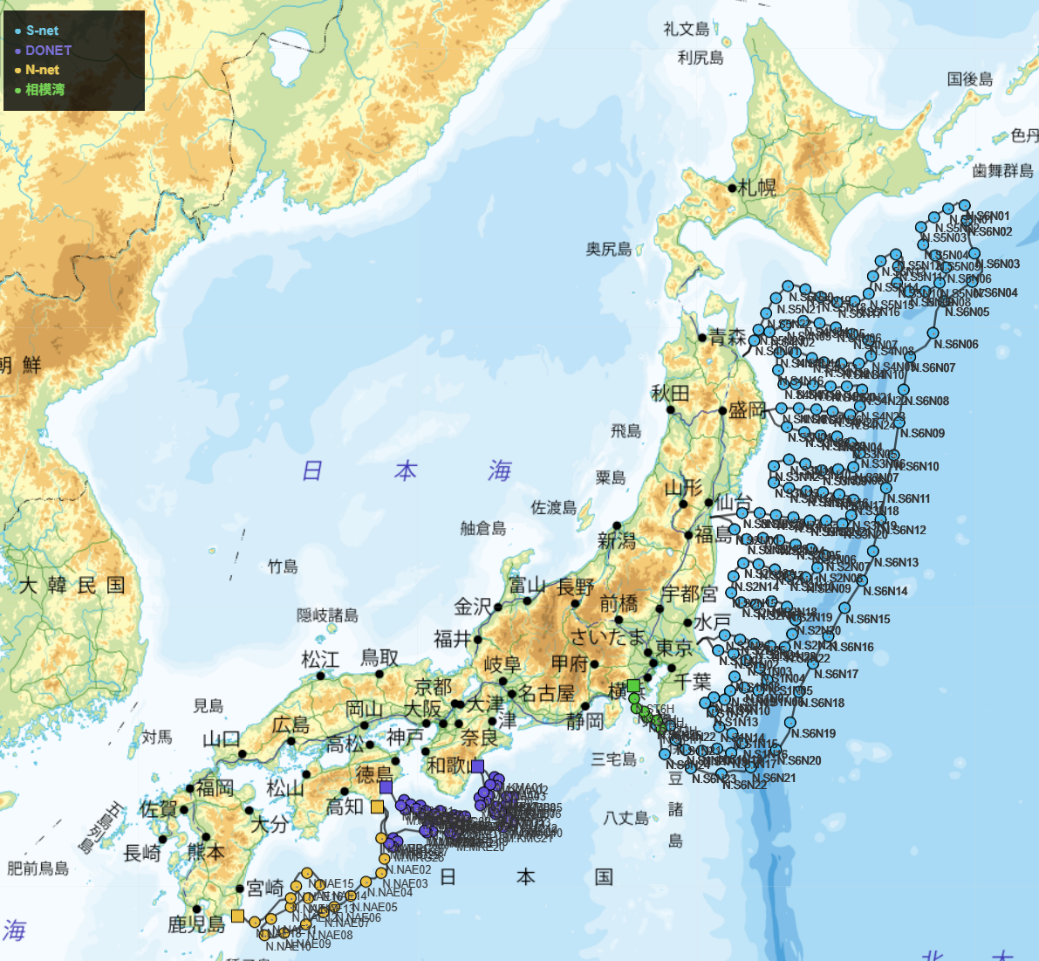
New observations
S-NET
DONET
N-NET
SMART cable

Slide 4
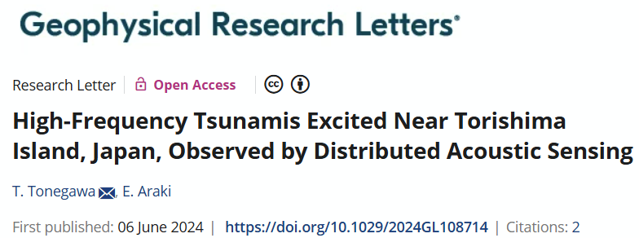
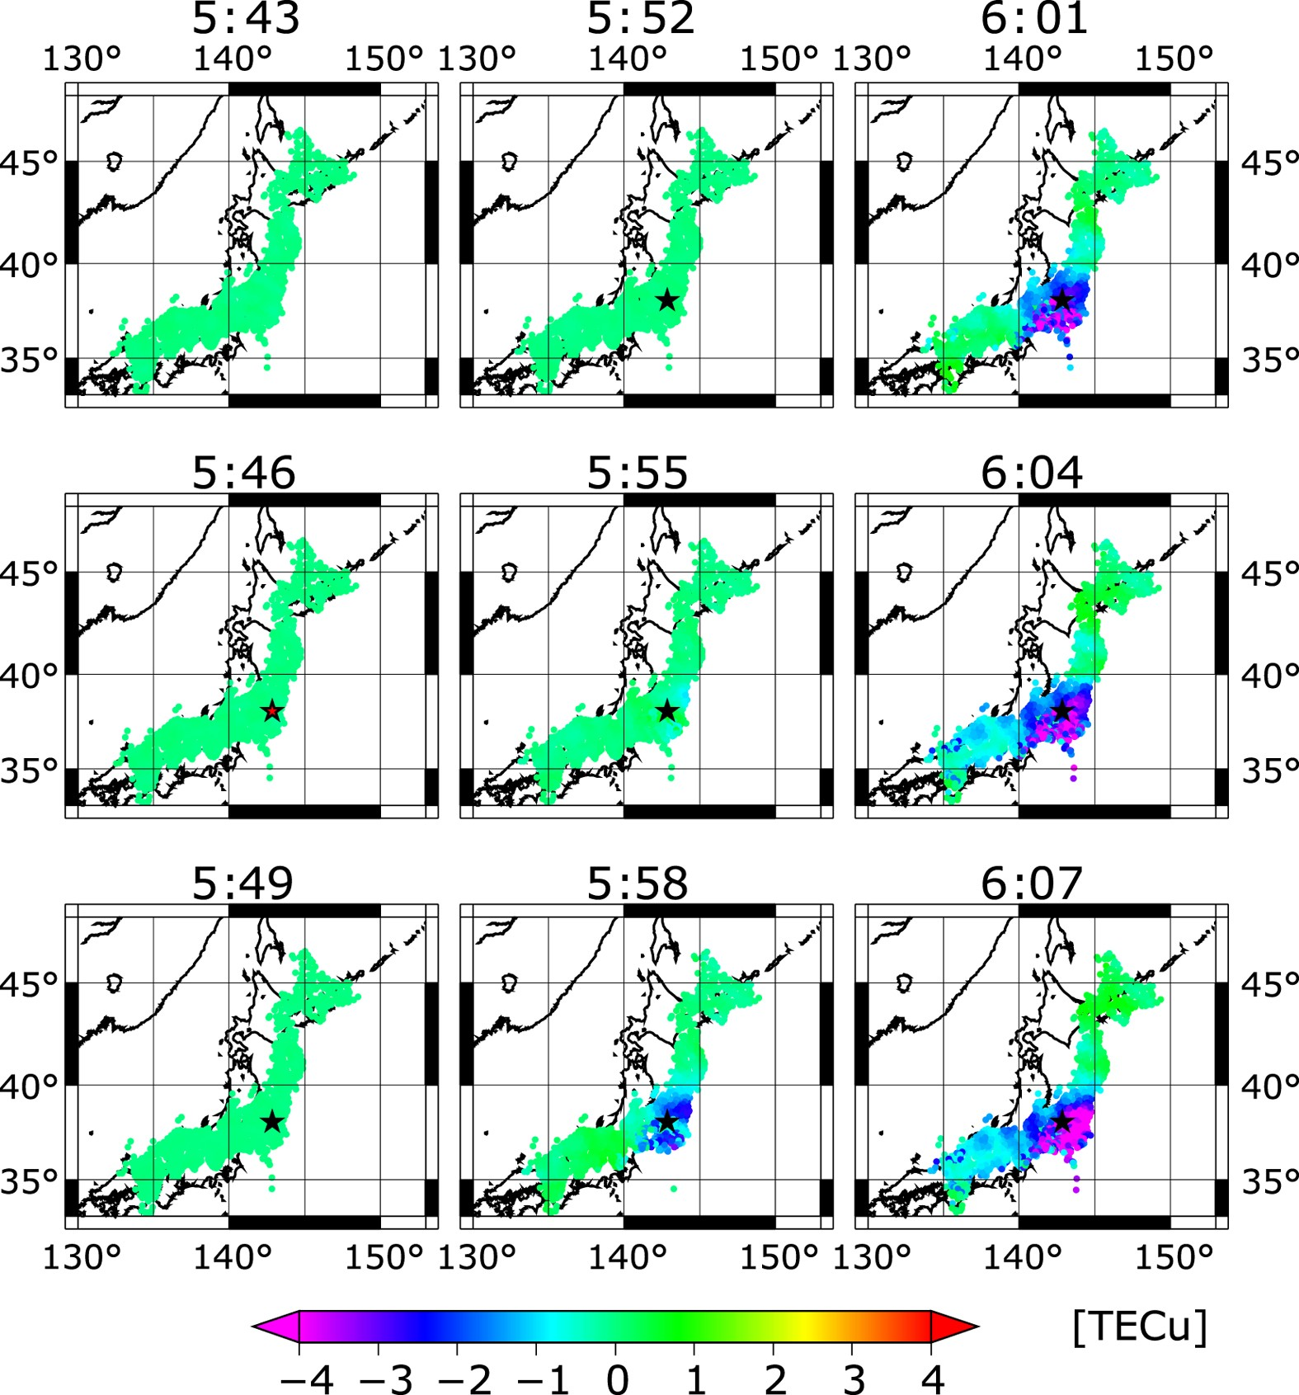
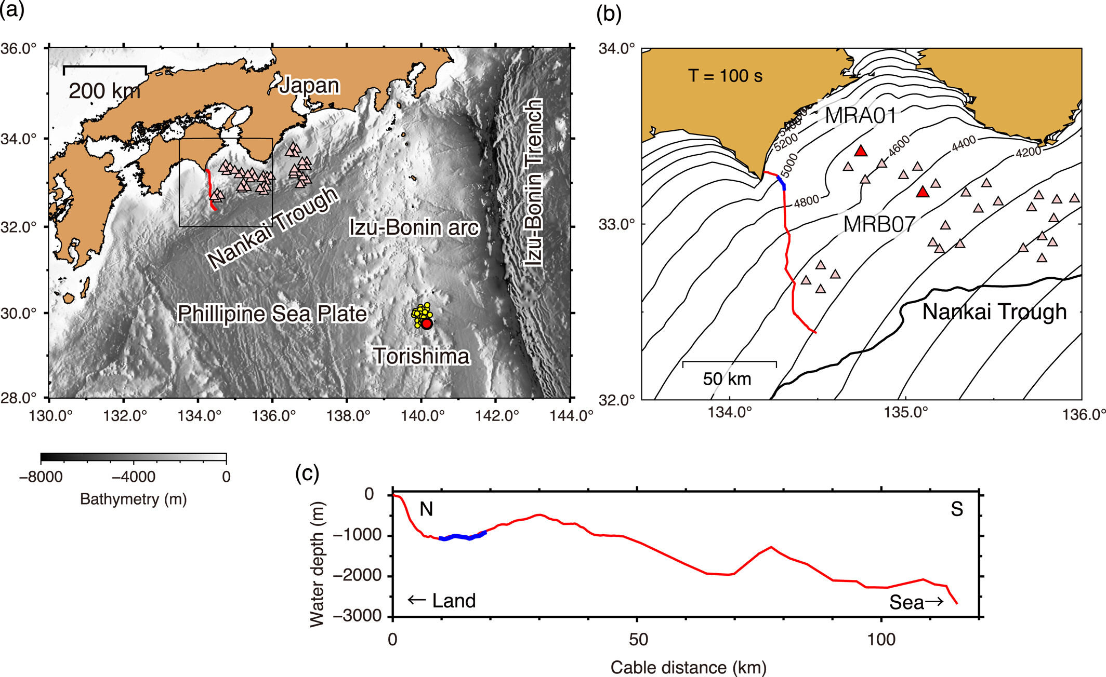
GNSS TEC (Kamorawa et al., 2016)

Slide 5
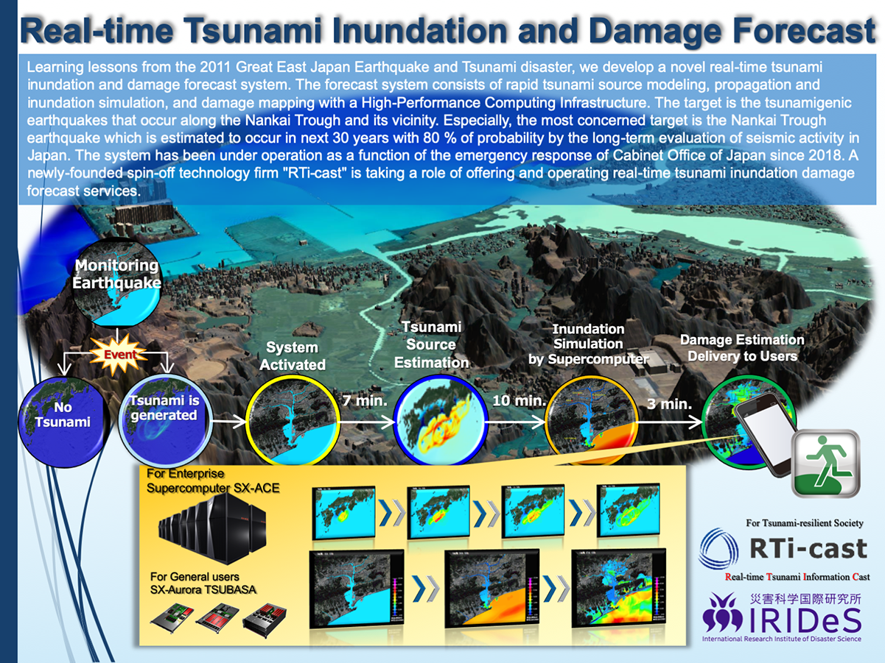
Koshimura Web site

Slide 6
April 1-2 (PART 1)
Non-earthquake sources (Presentation by Prof. Emile Okal)
Deep Ocean Landslide
1946 Aleutian Tsunami (also presented by Dr. Laura Kong)
1929 Grand Banks Tsunami

Slide 7
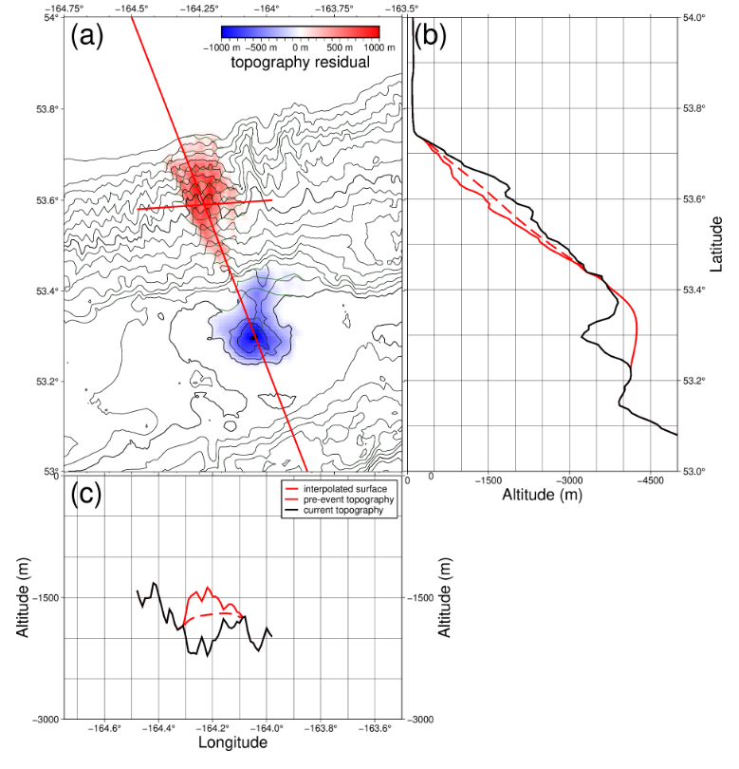
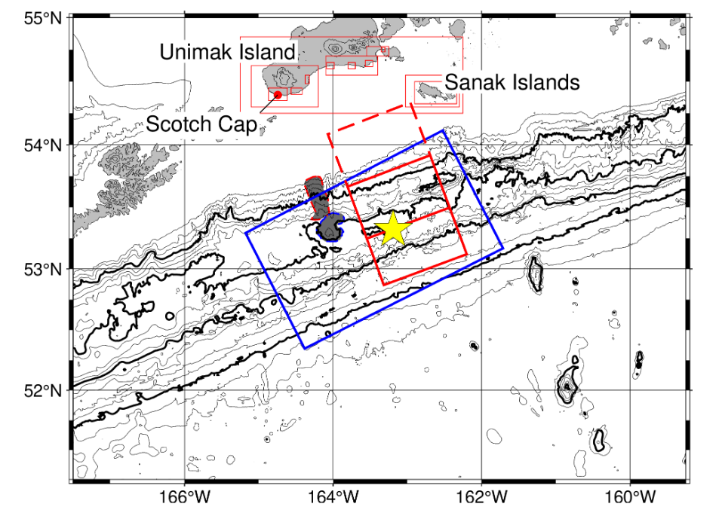
1946 Aleutian Tsunami
Blue fault model (López and Okal, 2006)

Slide 8
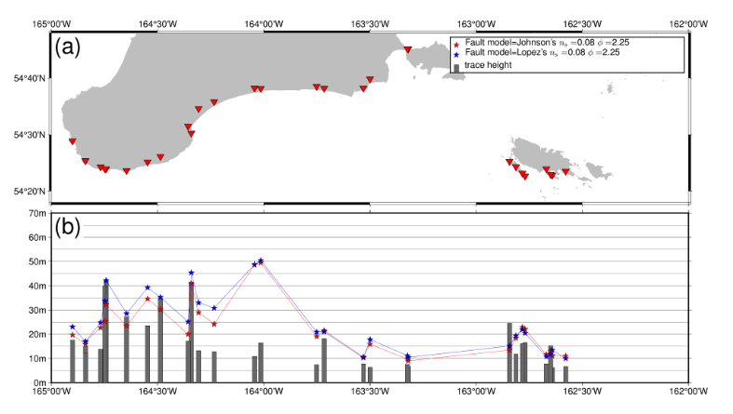

Slide 9
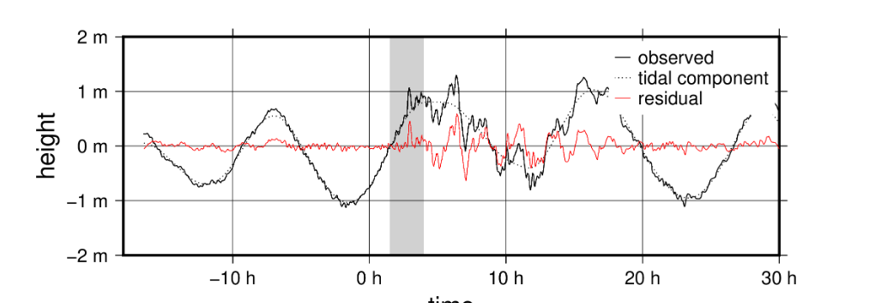
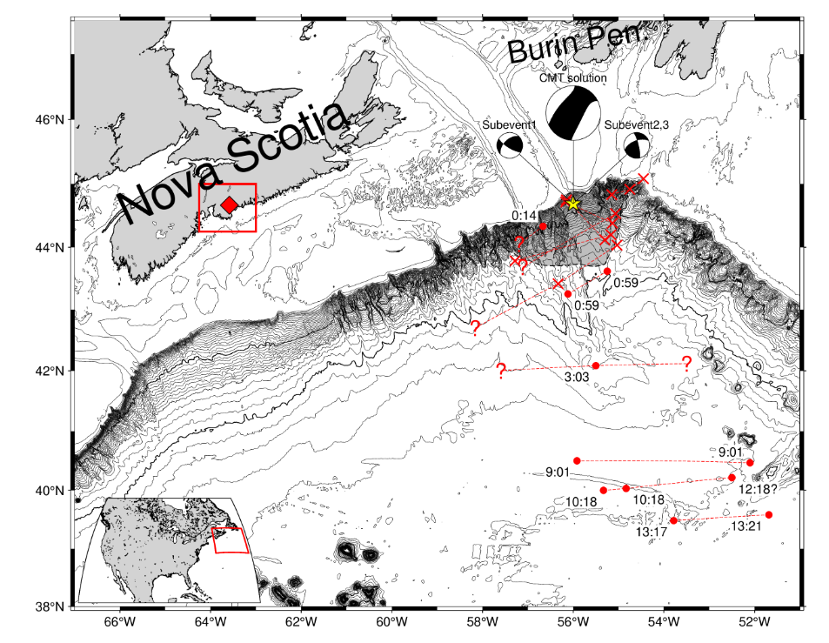
1929 Grand Banks Tsunami
Nakagaki and Tanioka (2025)
Geophysical Journal International

Slide 10
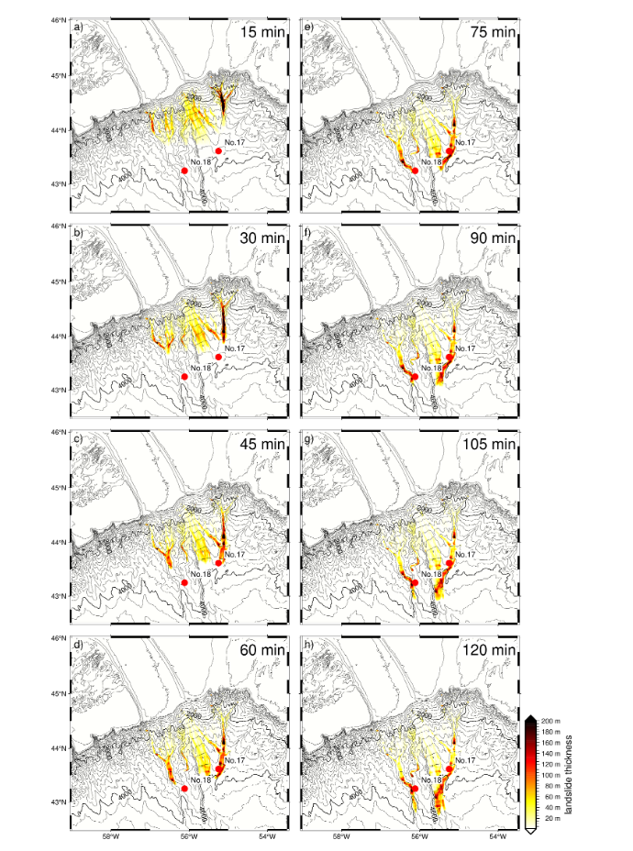
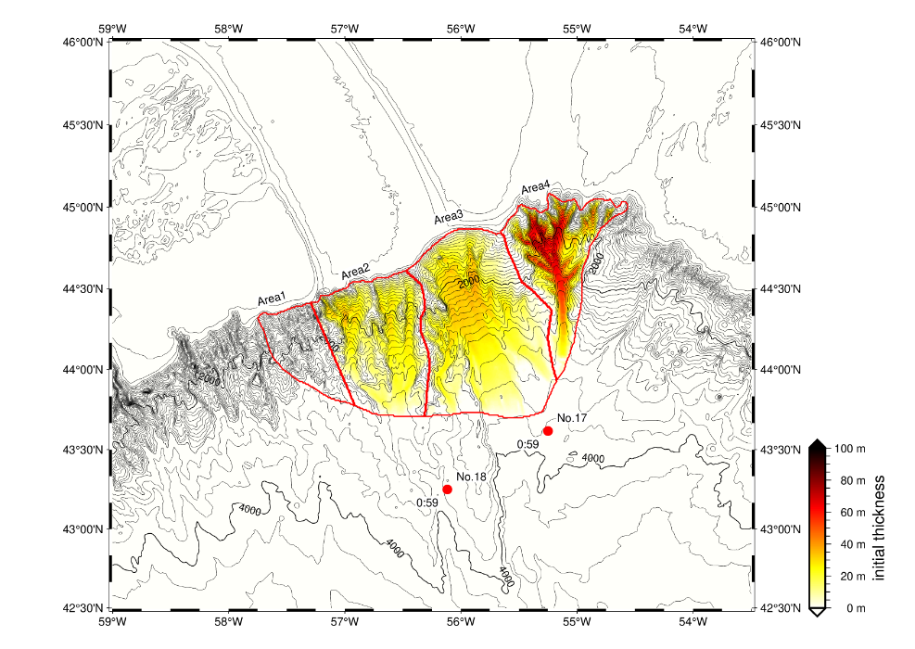
Total volume of 450 km3

Slide 11
● First Session
Three Keynote Speeches
Perspectives on the 60th Anniversary of ICG/PTWS
Eddie Bernard
60th Anniversary of ICG/PTWS
– Perspectives of the Workshop Host Country
Dakui Wang
New Challenges and opportunities in enhancing tsunami early
warning and mitigation services in the South China Sea region
Peitao Wang

