Slide 1
Advances in GNSS TEC
for monitoring applications
Michela Ravanelli
Geodesy and Geomatics Division
Sapienza University of Rome
9th Joint ICG/PTWS – IUGG/JTC Workshop
60th Anniversary of the ICG/PTWS – Past and Future
Hybrid meeting
April 7th, 2025

Slide 2
Background Where are we now? Future directions & challenges
Outline
Background
Where are we now?
Futures directions & challenges
Michela Ravanelli – Joint ICG/PTWS–IUGG/JTC Workshop 07/04/2025

Slide 3
Background Where are we now? Future directions & challenges
Outline
Background
Where are we now?
Futures directions & challenges
Michela Ravanelli – Joint ICG/PTWS–IUGG/JTC Workshop 07/04/2025

Slide 4
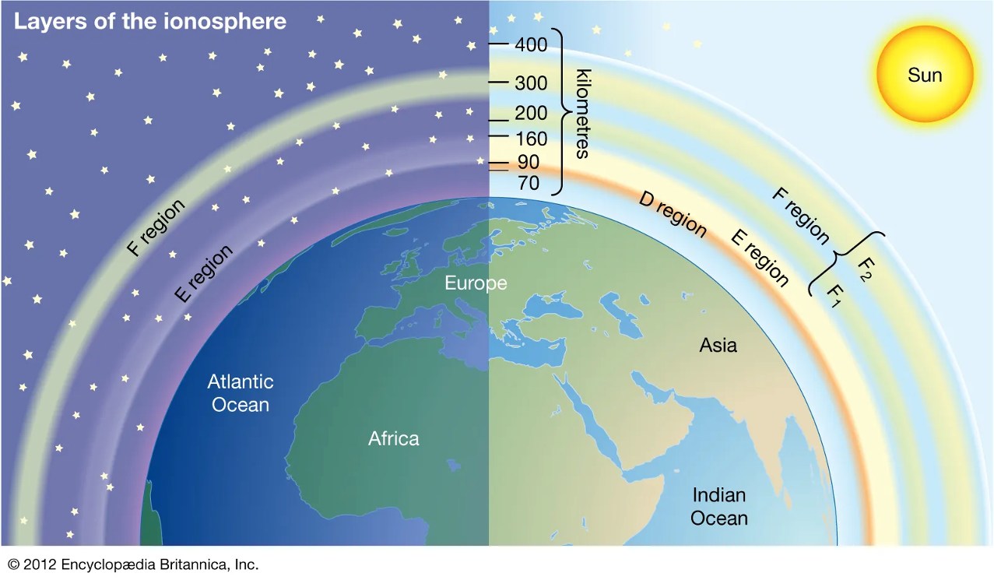
Background Where are we now? Future directions & challenges
The ionosphere
Features
s
50-1000 km of altitude
Ionopheric gas ionized from solar radiation (UV, X-rays)
Shell of electrons and ions
It is a plasma
The Ionosphere is a natural sensor for geophysical phenomena
Michela Ravanelli – Joint ICG/PTWS–IUGG/JTC Workshop 07/04/2025
Notes:
We live on a dynamic planet in constant motion that requires long-term continuous quantification of its changes in a truly stable frame of reference

Slide 5
Background Where are we now? Future directions & challenges
The ionosphere
It varies according to
the level of solar activity
the day/night conditions,
the season and latitudes
the altitude, defining the
ionospheric layers: D
(60-90 km), E (90-120
km), F (120-800 km)
the geomagnetic field
The Ionosphere is a natural sensor for geophysical phenomena
Michela Ravanelli – Joint ICG/PTWS–IUGG/JTC Workshop 07/04/2025
Notes:
We live on a dynamic planet in constant motion that requires long-term continuous quantification of its changes in a truly stable frame of reference

Slide 6
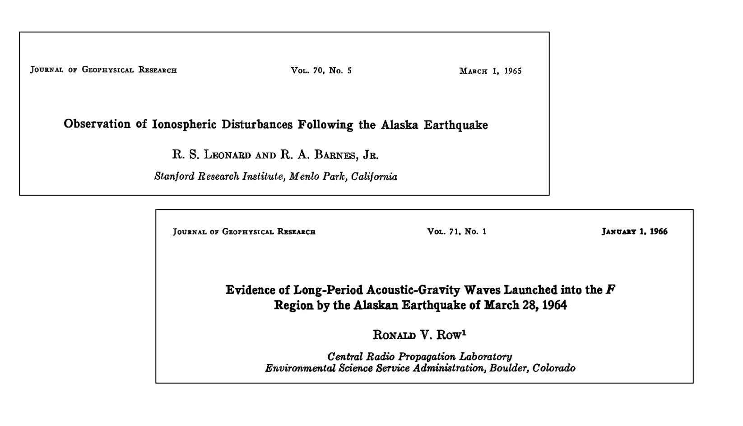
Background Where are we now? Future directions & challenges
First observations
The first NH-related ionospheric disturbances were detected after the great 1964 Alaskan earthquake by ionosondes and doppler sounders
Michela Ravanelli – Joint ICG/PTWS–IUGG/JTC Workshop 07/04/2025
Notes:
We live on a dynamic planet in constant motion that requires long-term continuous quantification of its changes in a truly stable frame of reference

Slide 7
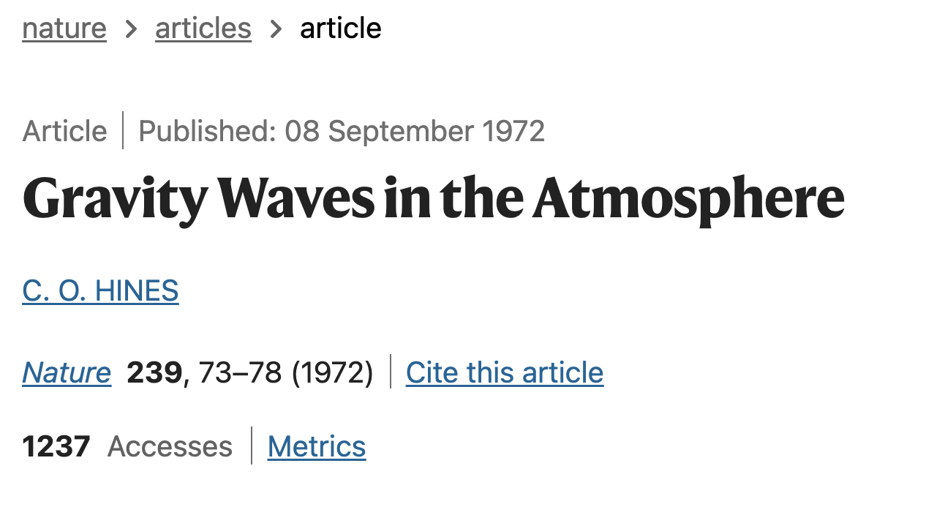
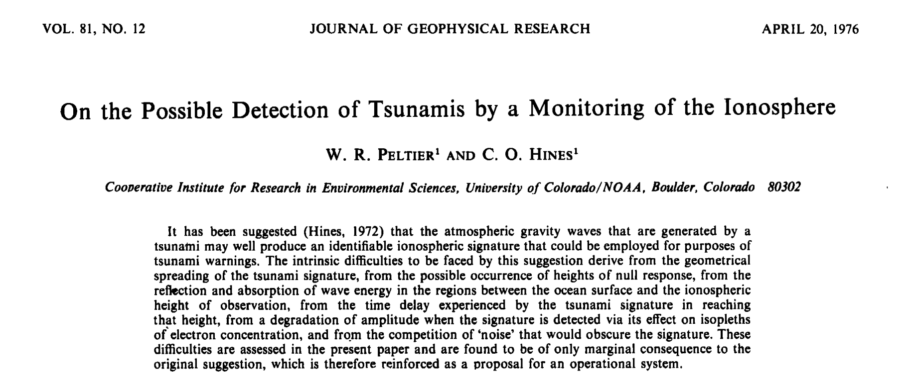
Background Where are we now? Future directions & challenges
First observations
The theoretical possibility of detecting ionospheric perturbations due to
tsunamis was first proposed by Hines (1972) and Peltier and Hines (1976)
Michela Ravanelli – Joint ICG/PTWS–IUGG/JTC Workshop 07/04/2025
Notes:
We live on a dynamic planet in constant motion that requires long-term continuous quantification of its changes in a truly stable frame of reference

Slide 8
Background Where are we now? Future directions & challenges
First observations
The deployment of GPS satellite constellations in the 1990s introduced a transformative observational technique for measuring ionospheric Total Electron Content (TEC), offering new insights into ionospheric perturbations associated with natural hazards
Michela Ravanelli – Joint ICG/PTWS–IUGG/JTC Workshop 07/04/2025
Notes:
We live on a dynamic planet in constant motion that requires long-term continuous quantification of its changes in a truly stable frame of reference

Slide 9
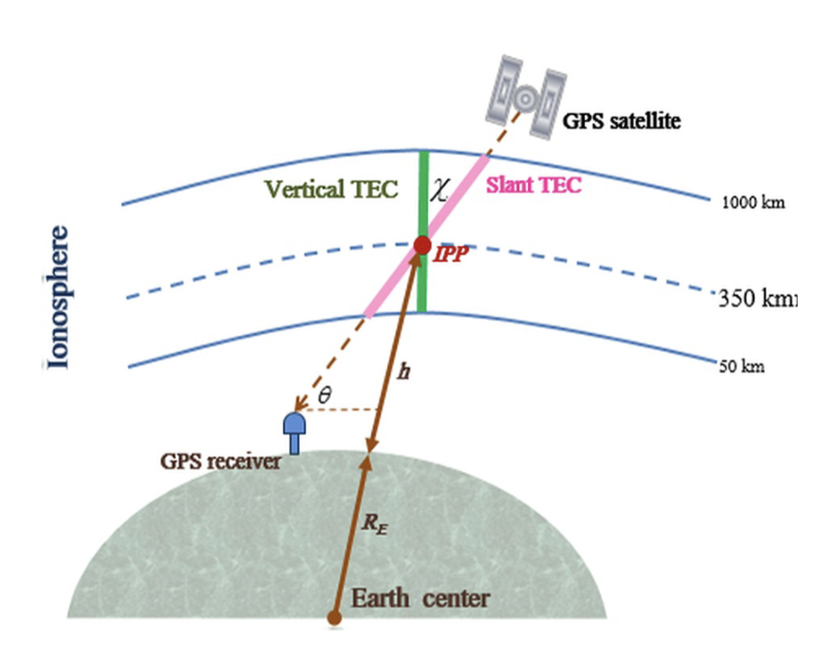
Background Where are we now? Future directions & challenges
GNSS Ionospheric Sounding
Ground-based dual-frequency GNSS receivers allows to compute TEC
Slant Total Electron Content
Slant TEC
is the total electron content along the
straight line between the satellite
and the receiver
Siwal et al. (2021)
Michela Ravanelli – Joint ICG/PTWS–IUGG/JTC Workshop 07/04/2025
Notes:
We live on a dynamic planet in constant motion that requires long-term continuous quantification of its changes in a truly stable frame of reference

Slide 10
Background Where are we now? Future directions & challenges
GNSS Ionospheric Sounding
Ground-based dual-frequency GNSS receivers allows to compute TEC
Vertical Total Electron Content
where Rz is the Earth’s radius, Hion is the
altitude of the ionospheric thin shell, θs is the
elevation angle
Siwal et al. (2021)
Michela Ravanelli – Joint ICG/PTWS–IUGG/JTC Workshop 07/04/2025
Notes:
We live on a dynamic planet in constant motion that requires long-term continuous quantification of its changes in a truly stable frame of reference

Slide 11
Background Where are we now? Future directions & challenges
GNSS Ionospheric Sounding
Ground-based dual-frequency GNSS receivers allows to compute TEC
Ionospheric Pierce Point
It is the intersection of the line of sight satellite - receiver with the single thin layer used to approximate the ionosphere
Its projection onto the ellipsoid is the sub-ionospheric pierce point (SIP)
Siwal et al. (2021)
Michela Ravanelli – Joint ICG/PTWS–IUGG/JTC Workshop 07/04/2025
Notes:
We live on a dynamic planet in constant motion that requires long-term continuous quantification of its changes in a truly stable frame of reference

Slide 12
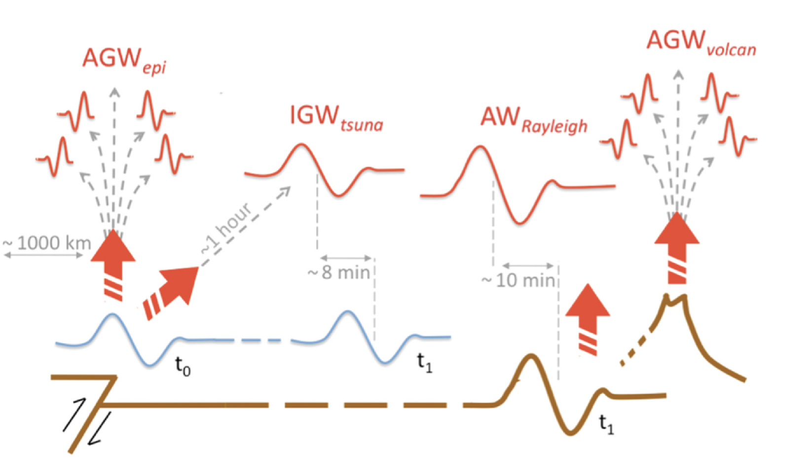
Background Where are we now? Future directions & challenges
The physical phenomenon
Adapted from Occhipinti, 2005
Michela Ravanelli – Joint ICG/PTWS–IUGG/JTC Workshop 07/04/2025
Notes:
We live on a dynamic planet in constant motion that requires long-term continuous quantification of its changes in a truly stable frame of reference

Slide 13
Background Where are we now? Future directions & challenges
Outline
Background
Where are we now?
Futures directions & challenges
Michela Ravanelli – Joint ICG/PTWS–IUGG/JTC Workshop 07/04/2025

Slide 14
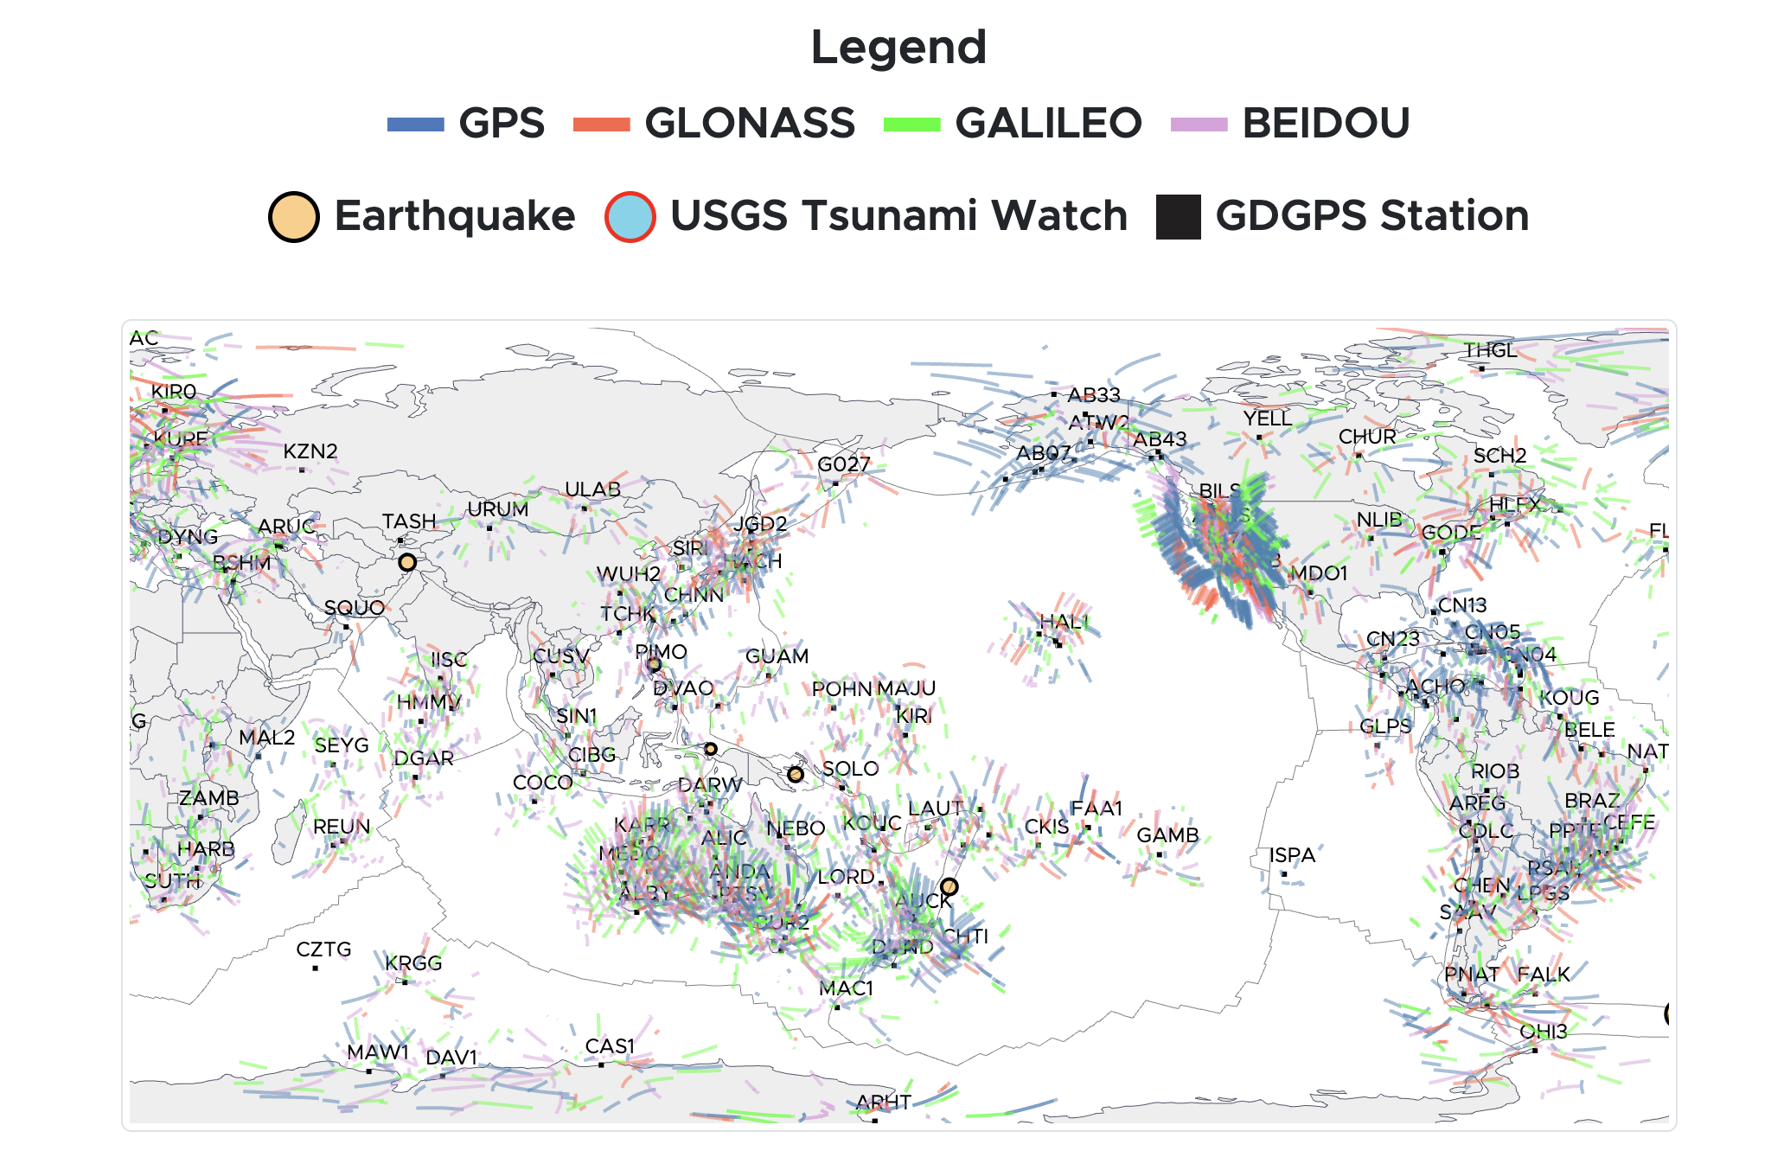
Background Where are we now? Future directions & challenges
Near Real-time TEC monitoring
GUARDIAN system
TEC time-series and analysis are readily available for the public with approximately 3-minutes latency for over 90 stations worldwide across four different constellations
82% global coverage
GUARDIAN’s near-real-time data streams are available for analysis through CDDIS (updated every 5 minutes)
Martire et al., 2023
Michela Ravanelli – Joint ICG/PTWS–IUGG/JTC Workshop 07/04/2025
Notes:
We live on a dynamic planet in constant motion that requires long-term continuous quantification of its changes in a truly stable frame of reference

Slide 15
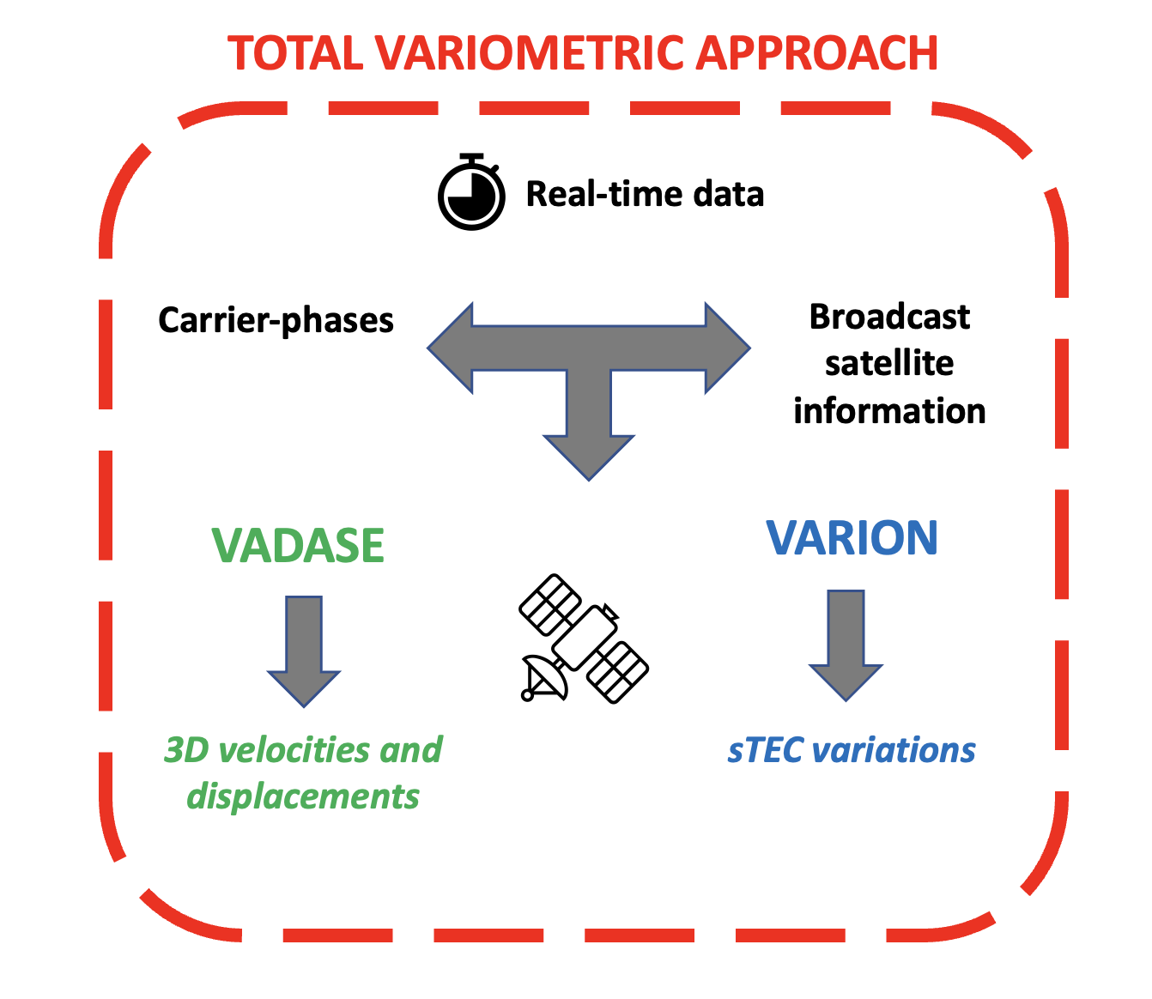
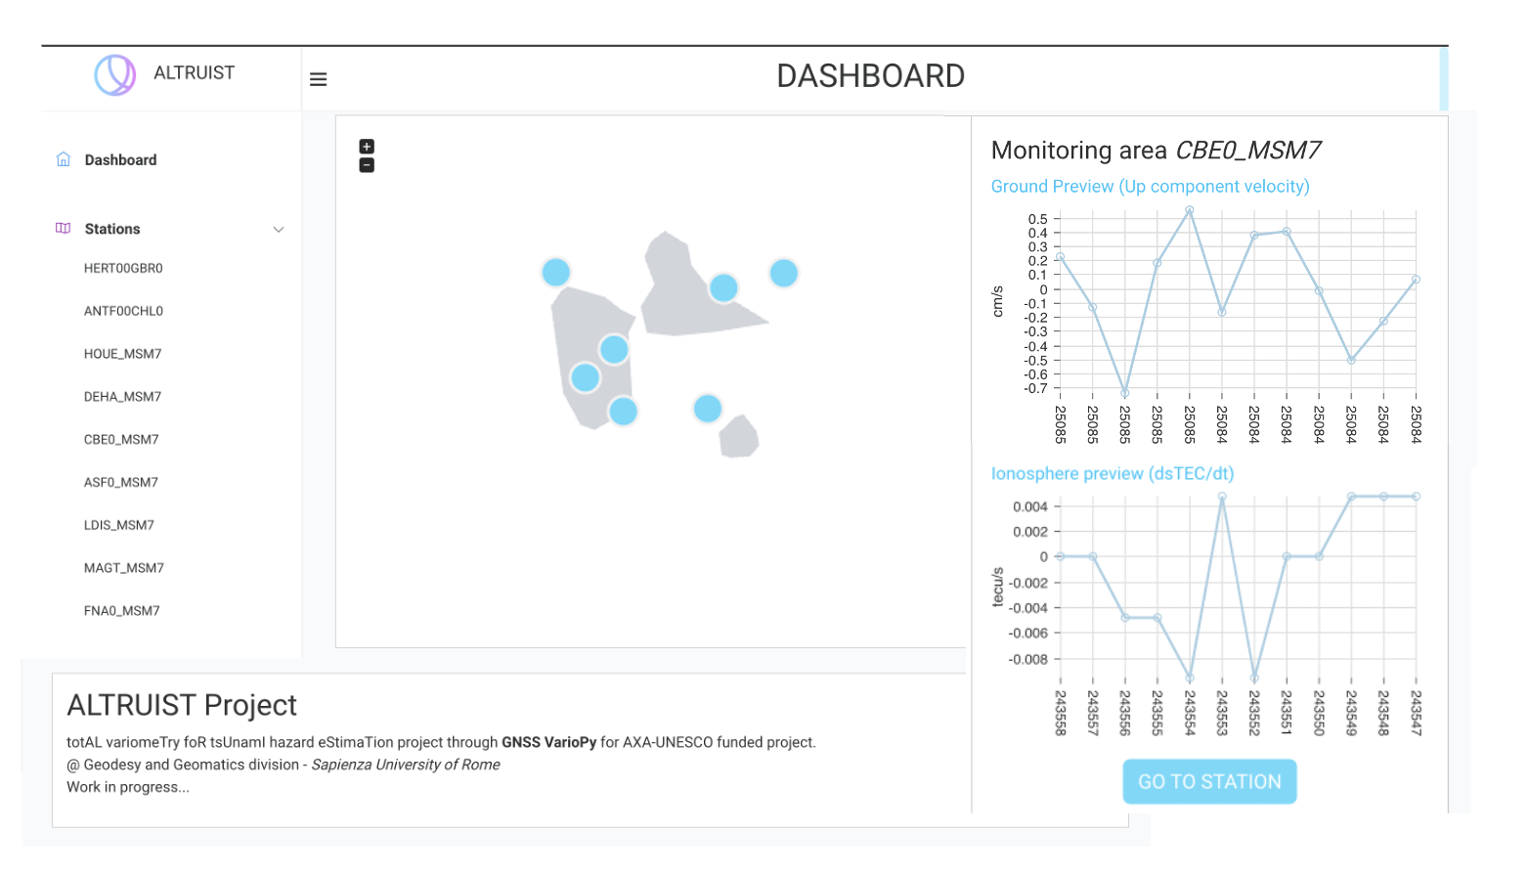
Background Where are we now? Future directions & challenges
Real-time TEC monitoring
Real-time implementation of TVA
Implementation in the of IPGP
Observatoire of Guadeloupe
ALTRUIST
Ravanelli et al., 2021
Ravanelli et al. (2024), ALTRUIST Project
Michela Ravanelli – Joint ICG/PTWS–IUGG/JTC Workshop 07/04/2025
Notes:
We live on a dynamic planet in constant motion that requires long-term continuous quantification of its changes in a truly stable frame of reference

Slide 16
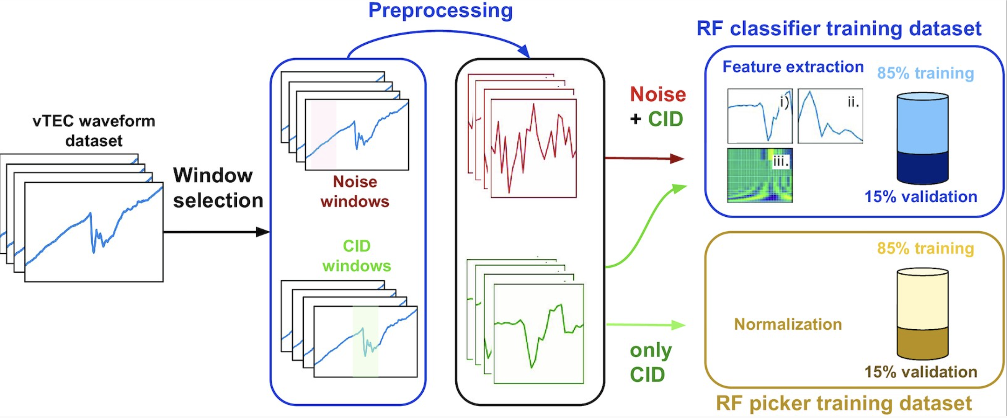
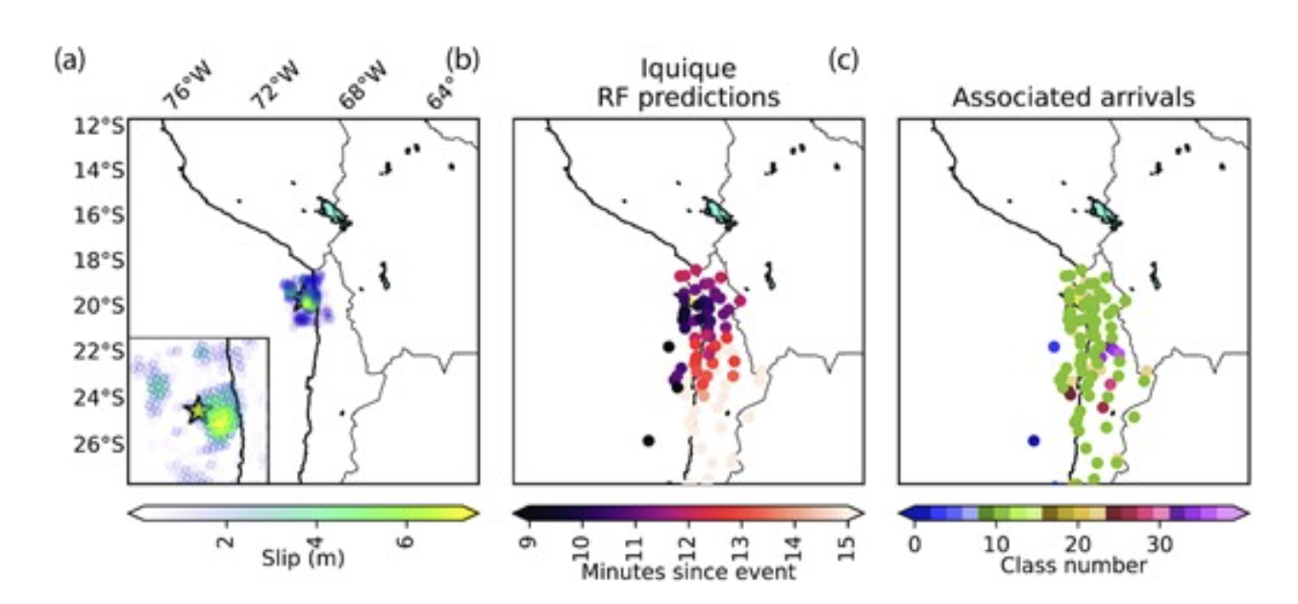
Background Where are we now? Future directions & challenges
The Artificial Intelligence contribution
Automatic procedure for detection, arrival-time picking and association of CIDs
Random forests for Detection and arrival time picking steps trained over a CID data set built from 12 earthquake events
96% TP & 96% TN rate
Arrival-time accuracy with an average error <20 s using a 120 s time delay since the first detection window
Michela Ravanelli – Joint ICG/PTWS–IUGG/JTC Workshop 07/04/2025
Brissaud & Astafyeva (2022)
Notes:
We live on a dynamic planet in constant motion that requires long-term continuous quantification of its changes in a truly stable frame of reference

Slide 17
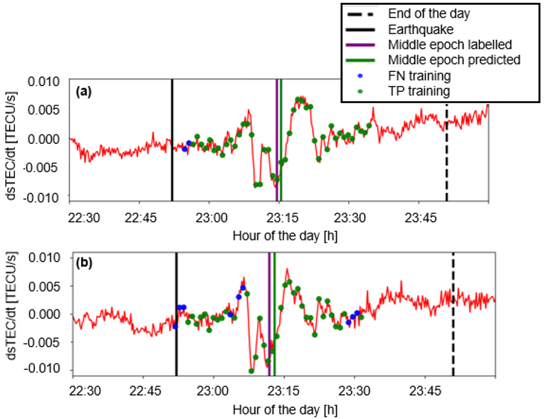
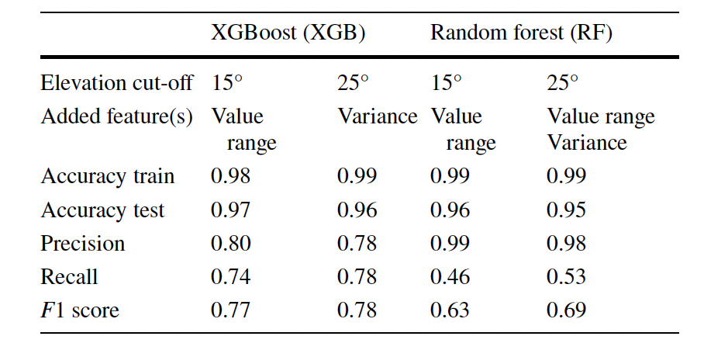
Background Where are we now? Future directions & challenges
The Artificial Intelligence contribution
Single event approach: the 2015 Illapel earthquake
Supervised binary classification task
Classification with Machine Learning
Random Forest
XGBoost
Fuso et al. (2024)
Michela Ravanelli – Joint ICG/PTWS–IUGG/JTC Workshop 07/04/2025

Slide 18
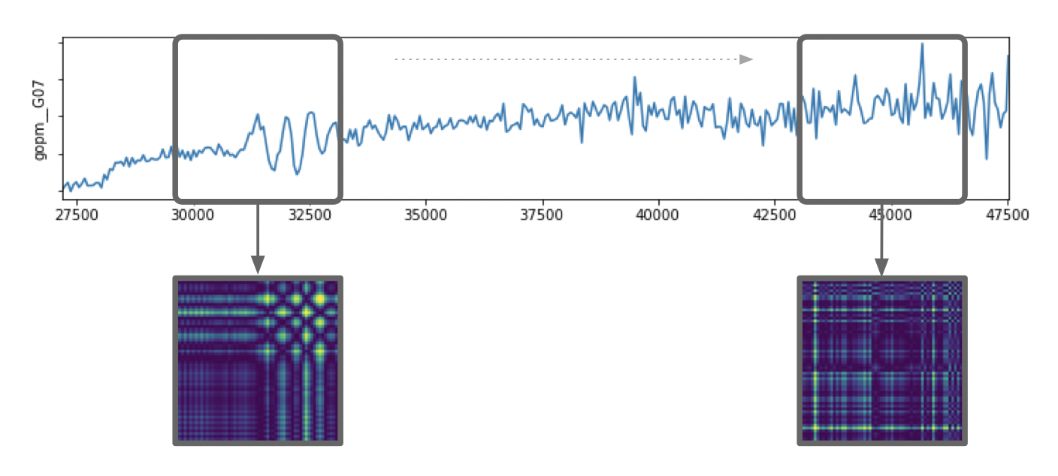
Background Where are we now? Future directions & challenges
The Artificial Intelligence contribution
Multi-event approach in the Pacific area
Gramian Angular Difference Fields that transforms timeseries into images
Convolutional Neural Networks to classify normal/anomalous behaviour
Advantages
anomalous
normal
Preserves Temporal Dependence
Bijective Matrix
Detectable Temporal Correlations
Robust to Missing Data
Leverages Image-based Deep Learning
Visually Interpretable
Working in real-time
Ravanelli et al. (2024)
Michela Ravanelli – Joint ICG/PTWS–IUGG/JTC Workshop 07/04/2025

Slide 19
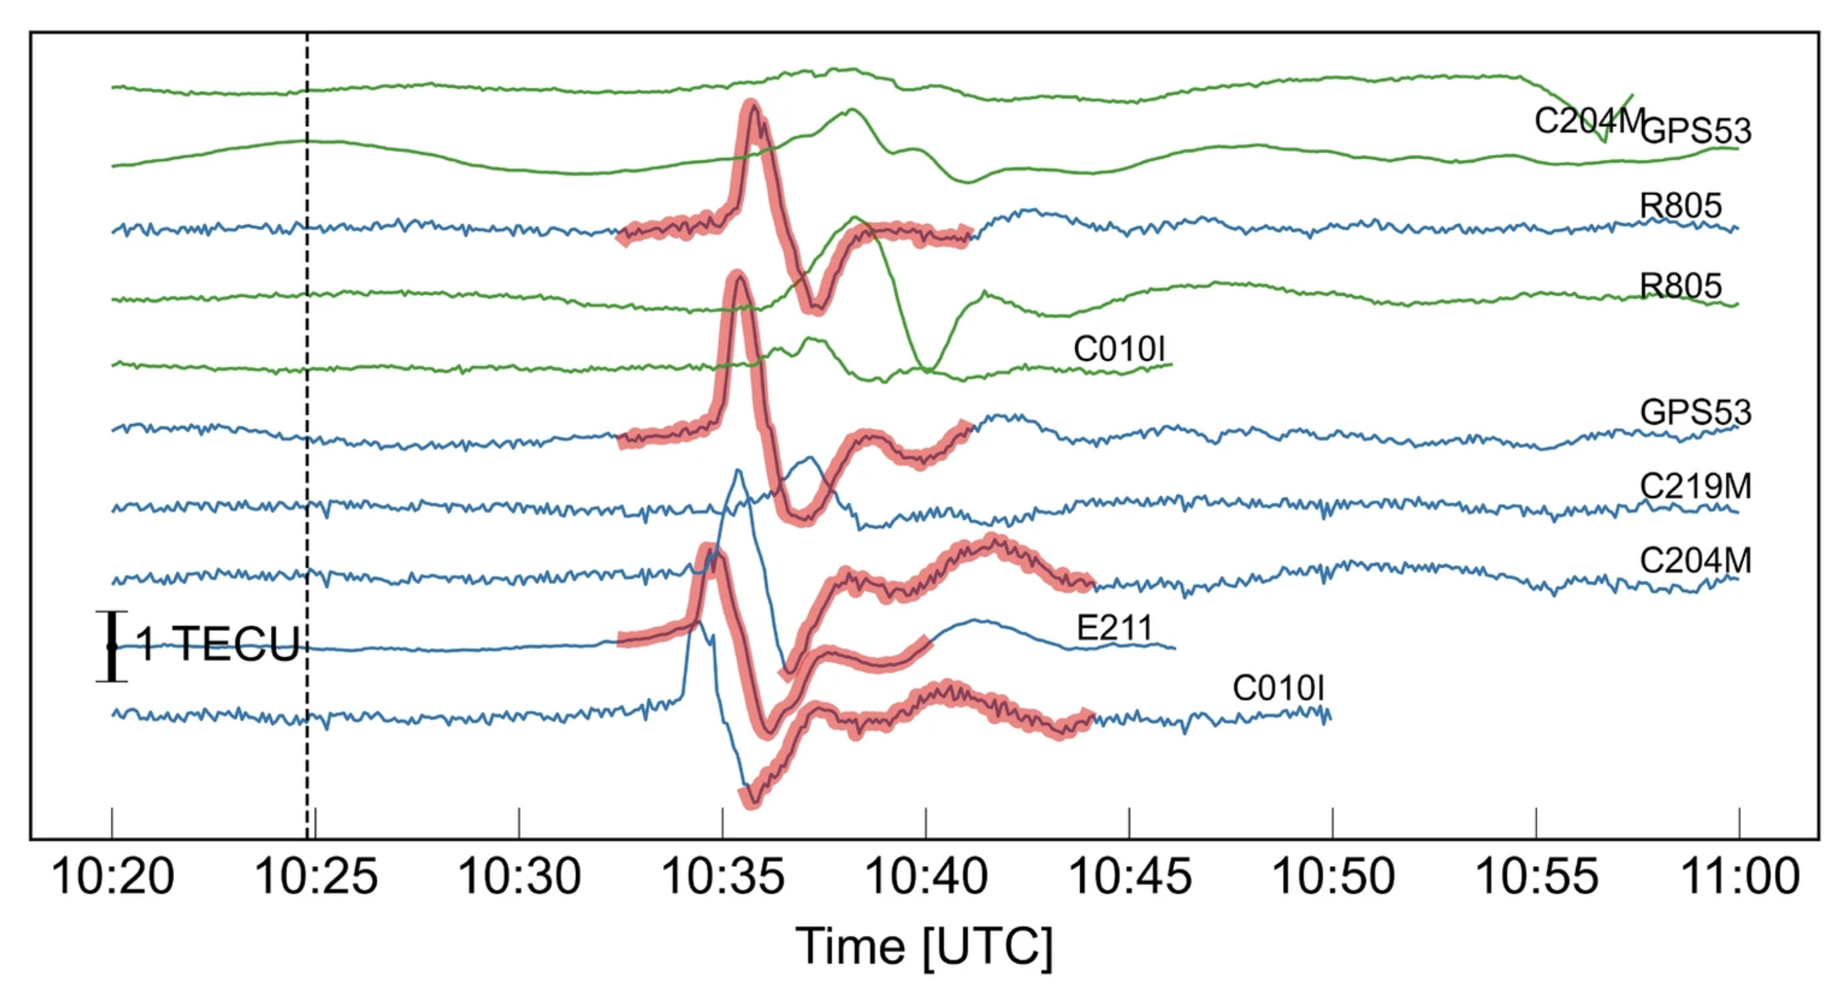
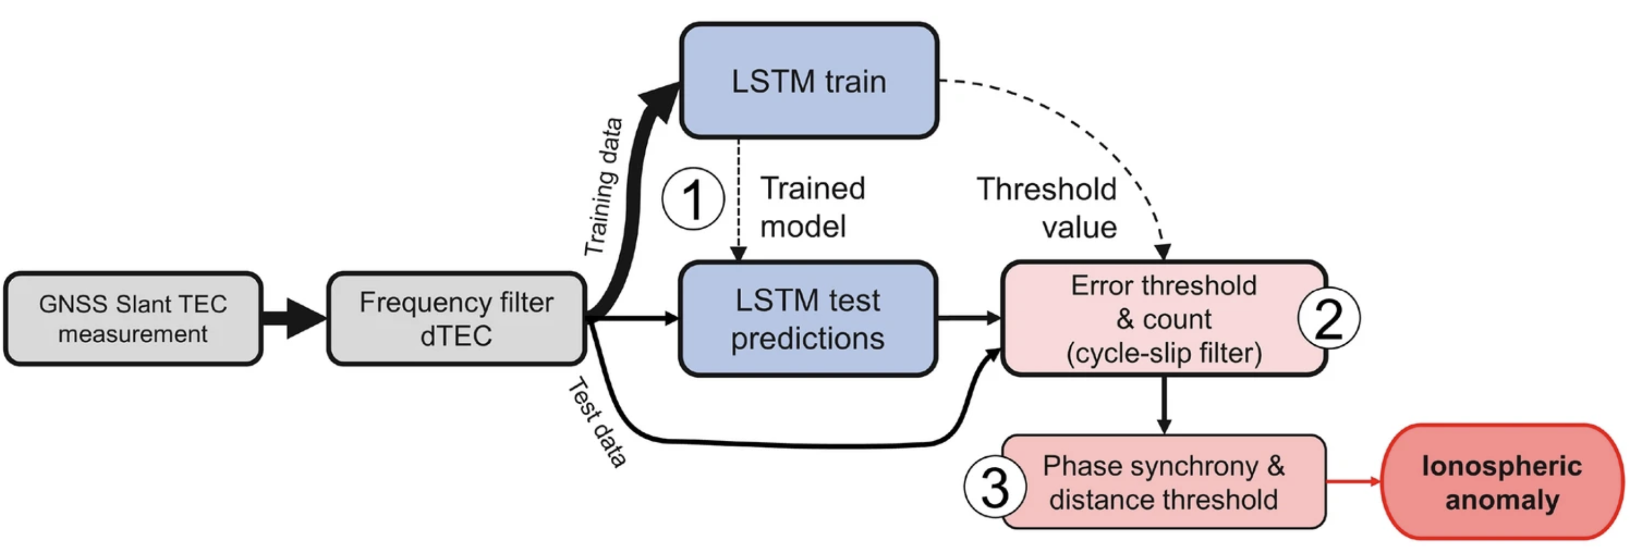
Background Where are we now? Future directions & challenges
The Artificial Intelligence contribution
Test on the simulated GUARDIAN NRT data stream from a sparse GNSS network for and Mw 7.5 Kahramanmaraş earthquake sequence
Long Short-Term Memory to learn the temporal dynamics of differential TEC
Differences between observations and LSTM-expected dynamics represent anomalous ionospheric behaviour
Luhrmann et al. (2025)
Michela Ravanelli – ENS 12/11/2024

Slide 20
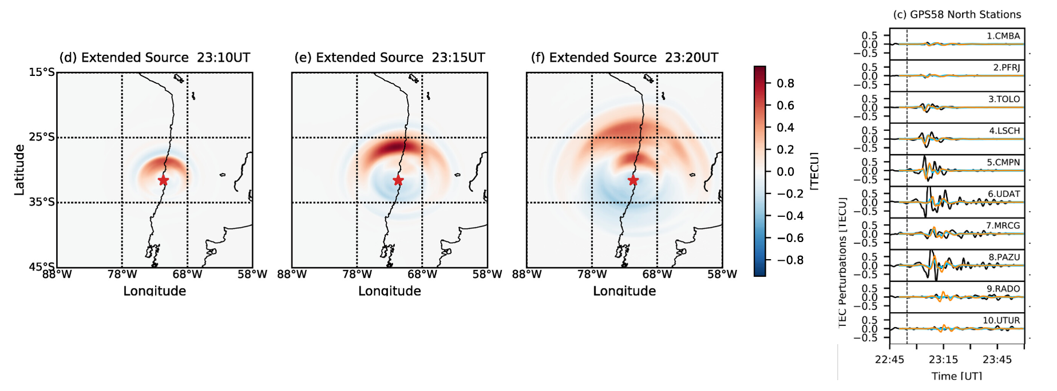
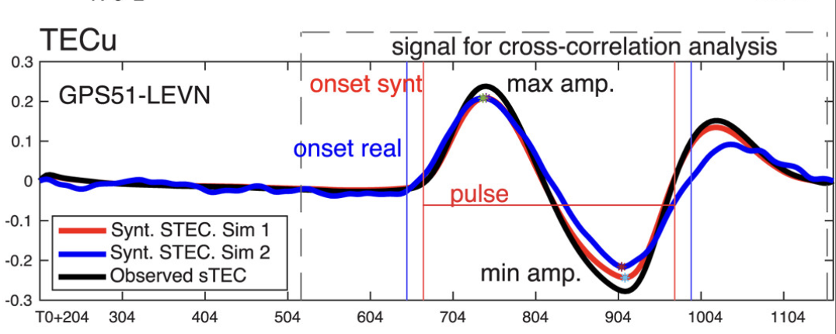
Background Where are we now? Future directions & challenges
Modeling
Simulate the response of the upper atmosphere to atmospheric acoustic-gravity waves generated from surface disturbances
To quantify the seismic and non-seismic contribution
To better infer characteristics of earthquakes from ionospheric disturbances
Meng, Ravanelli et al. (2022)
Inchin et al. (2024)
Michela Ravanelli – Joint ICG/PTWS–IUGG/JTC Workshop 07/04/2025

Slide 21
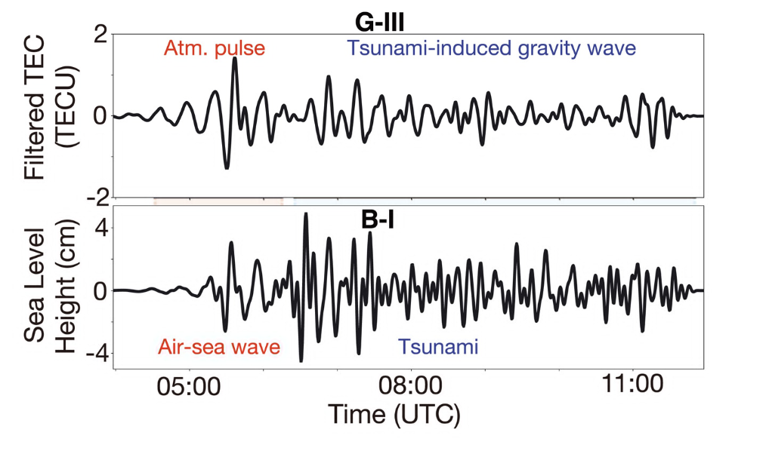
Background Where are we now? Future directions & challenges
Non-seismic tsunami source
2022 Tonga volcanic eruption
Matoza et al. (2022)
Michela Ravanelli – Joint ICG/PTWS–IUGG/JTC Workshop 07/04/2025

Slide 22
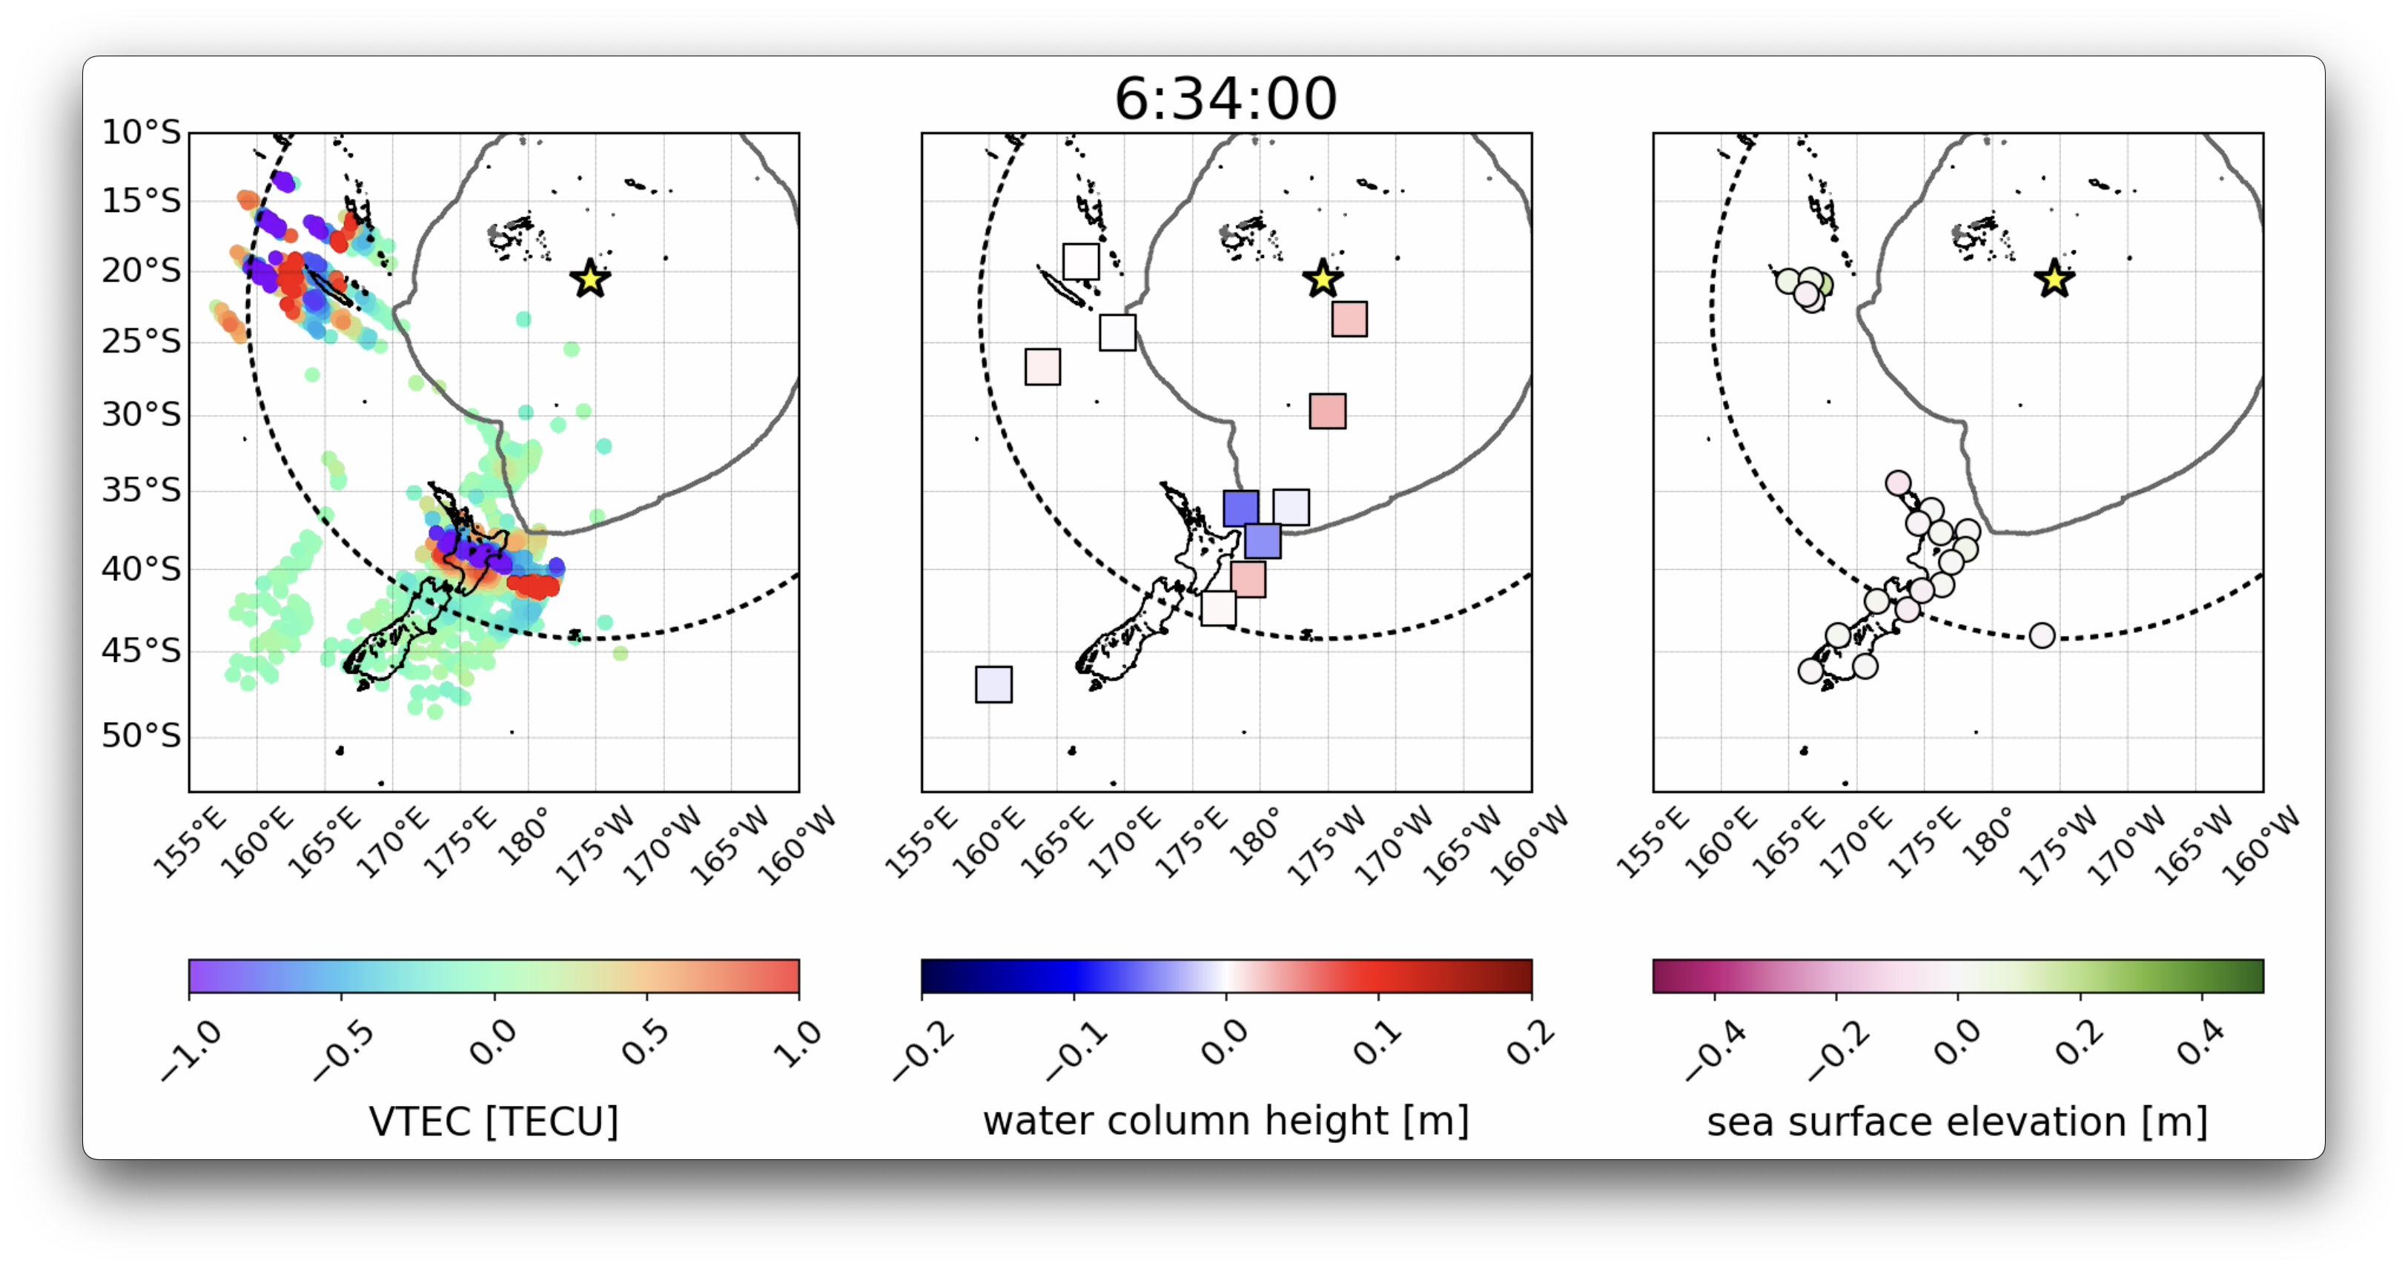
Background Where are we now? Future directions & challenges
Non-seismic tsunami source
2022 Tonga volcanic eruption
Ravanelli et al. (2023)
Michela Ravanelli – Joint ICG/PTWS–IUGG/JTC Workshop 07/04/2025

Slide 23
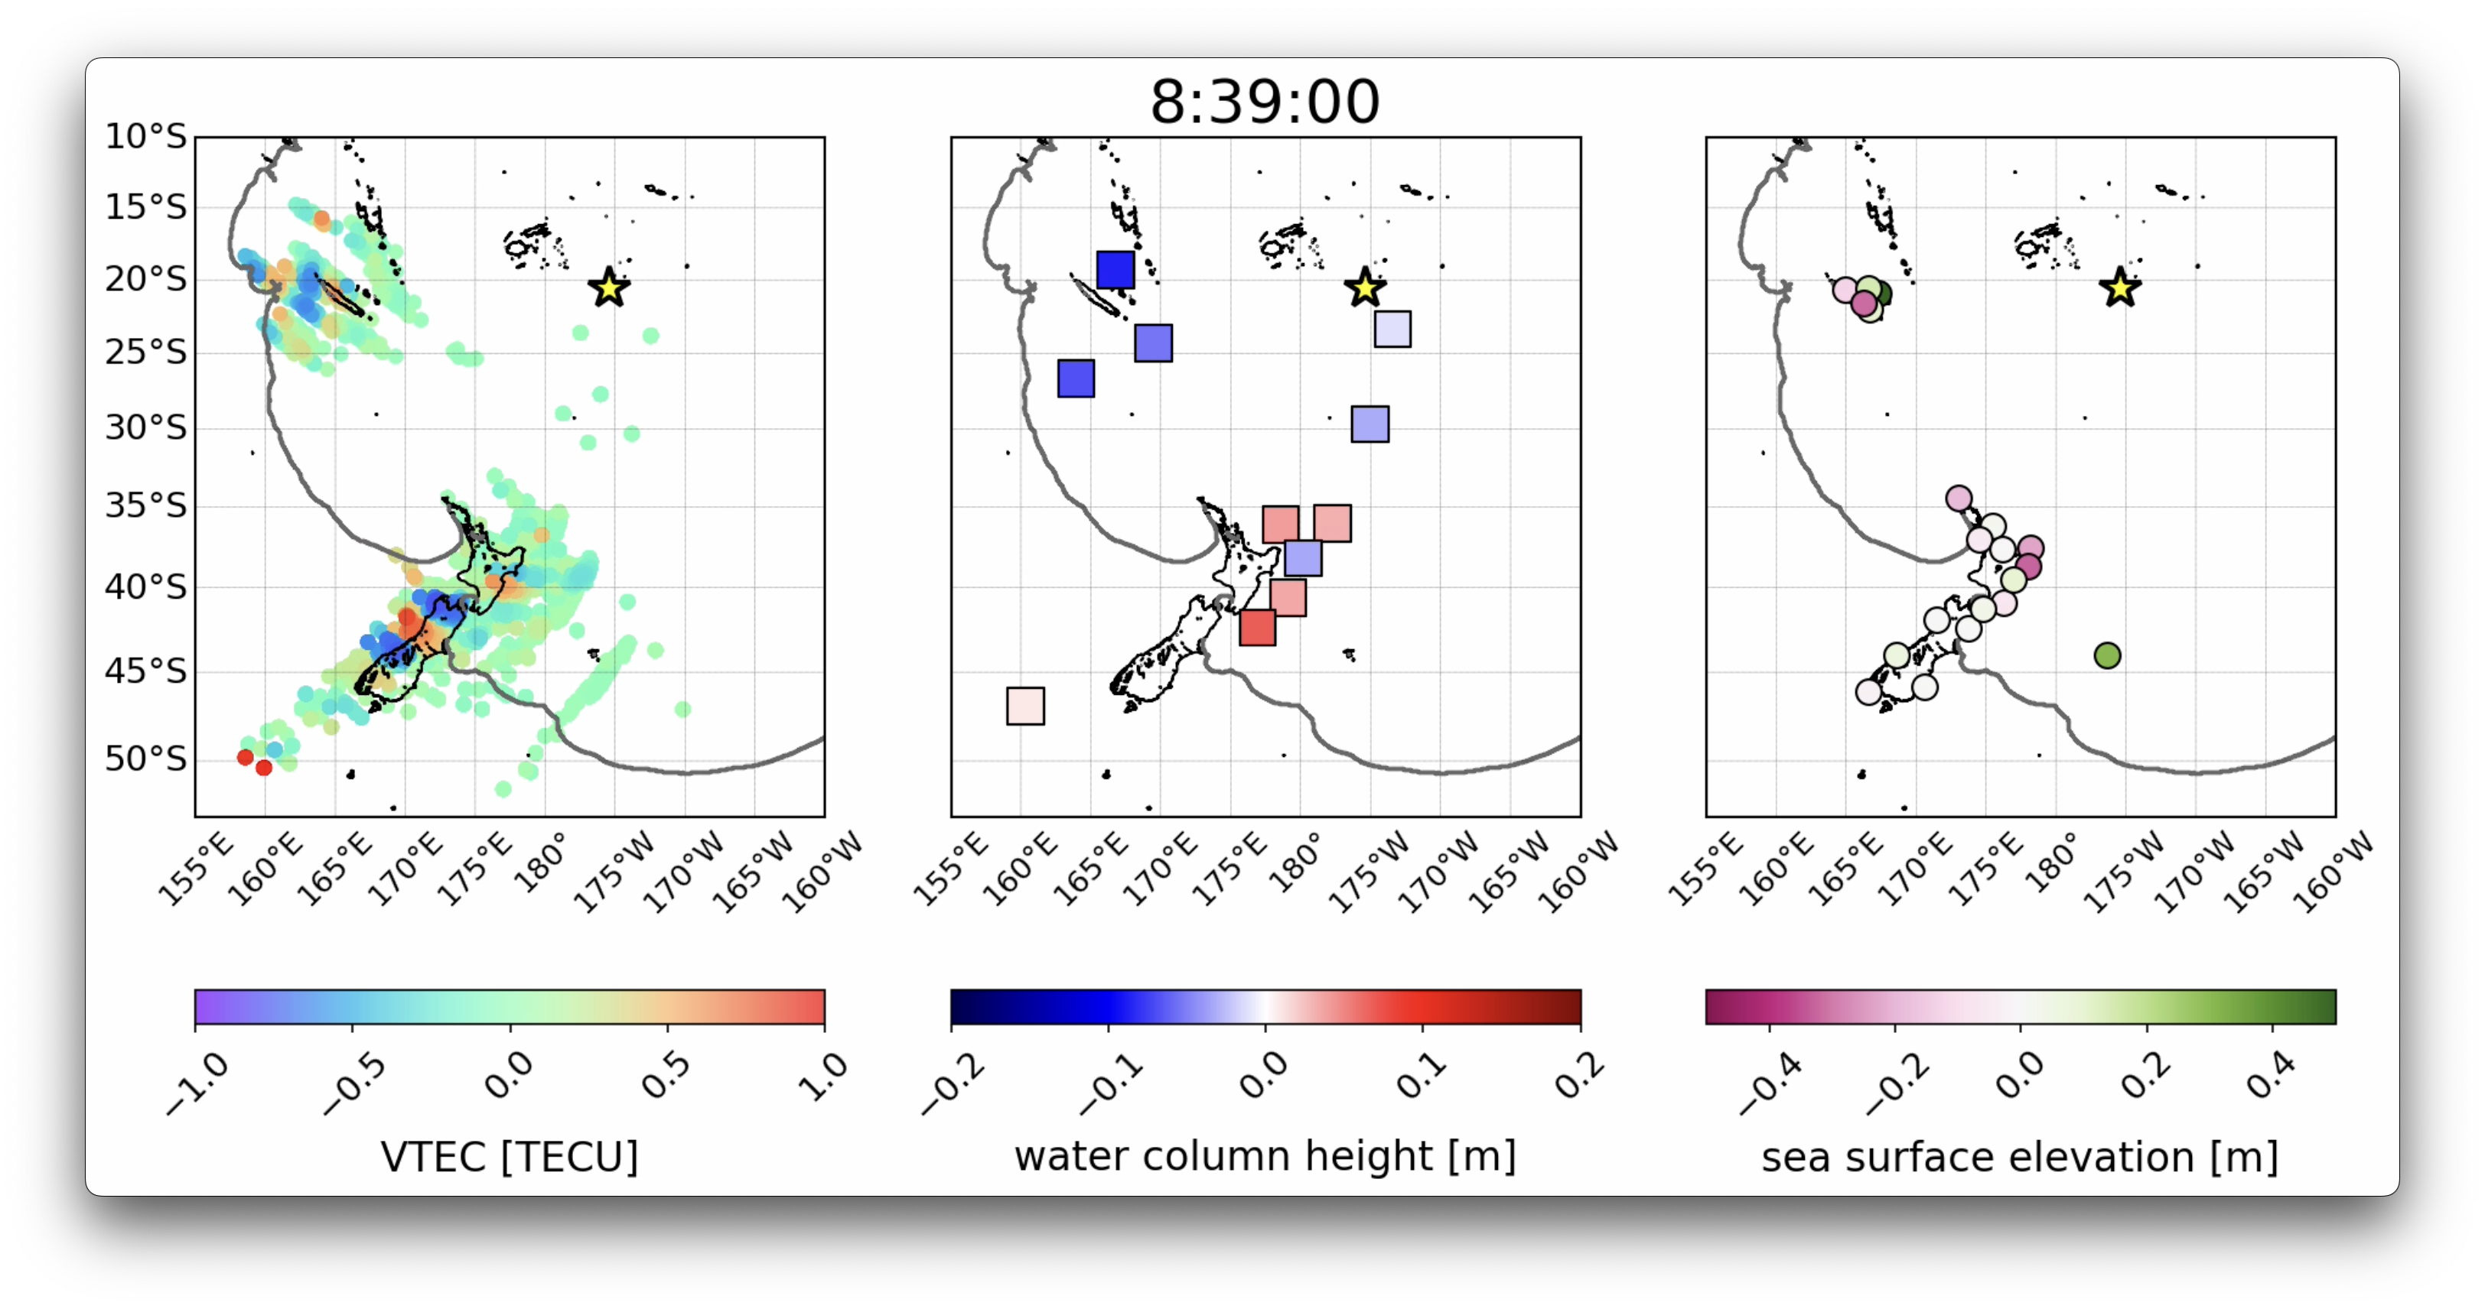
Background Where are we now? Future directions & challenges
Non-seismic tsunami source
2022 Tonga volcanic eruption
Ravanelli et al. (2023)
Michela Ravanelli – Joint ICG/PTWS–IUGG/JTC Workshop 07/04/2025

Slide 24
Background Where are we now? Future directions & challenges
Outline
Background
Where are we now?
Futures directions & challenges
Michela Ravanelli – Joint ICG/PTWS–IUGG/JTC Workshop 07/04/2025

Slide 25
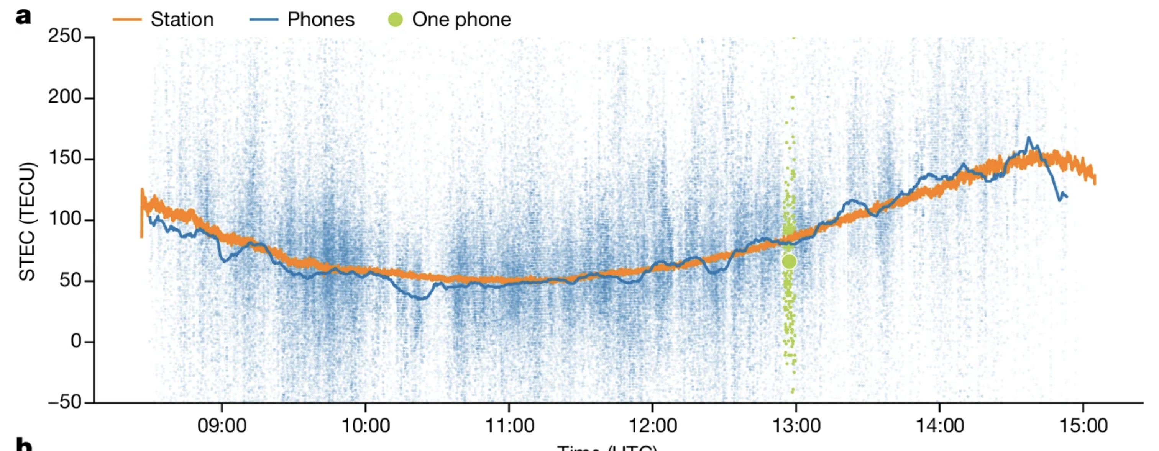
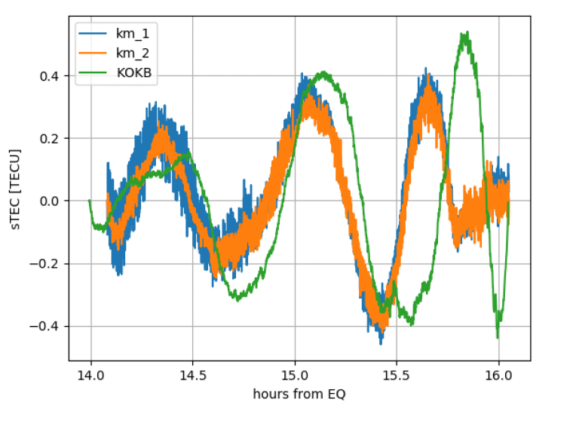
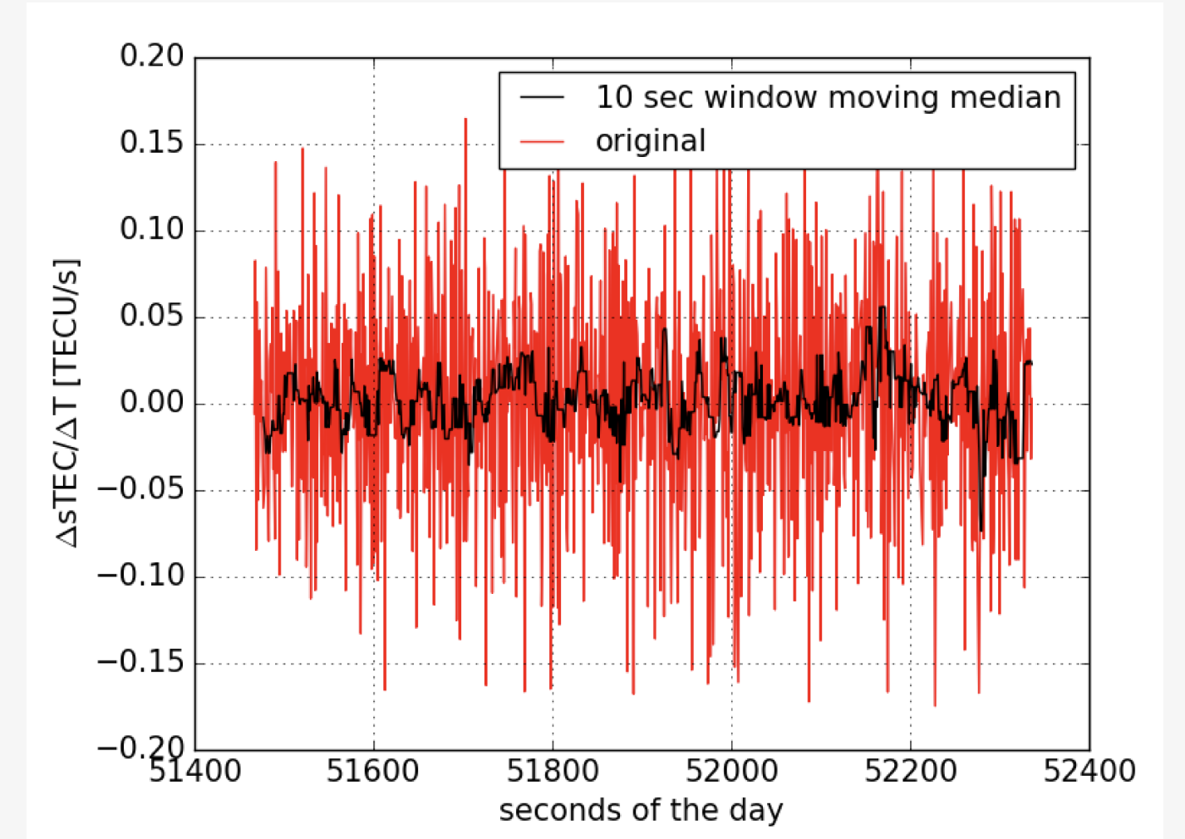
CV Research themes Research proposal
Future directions & challenges
Increase ionospheric coverage using mobile GNSS receiver
Ship-borne GNSS
Smartphones GNSS
Smith et al. (2024)
Ravanelli et al. (2020)
Michela Ravanelli – Joint ICG/PTWS–IUGG/JTC Workshop 07/04/2025
Fortunato, Ravanelli et al. (2019)

Slide 26
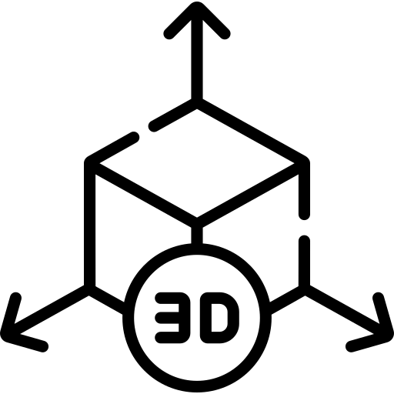
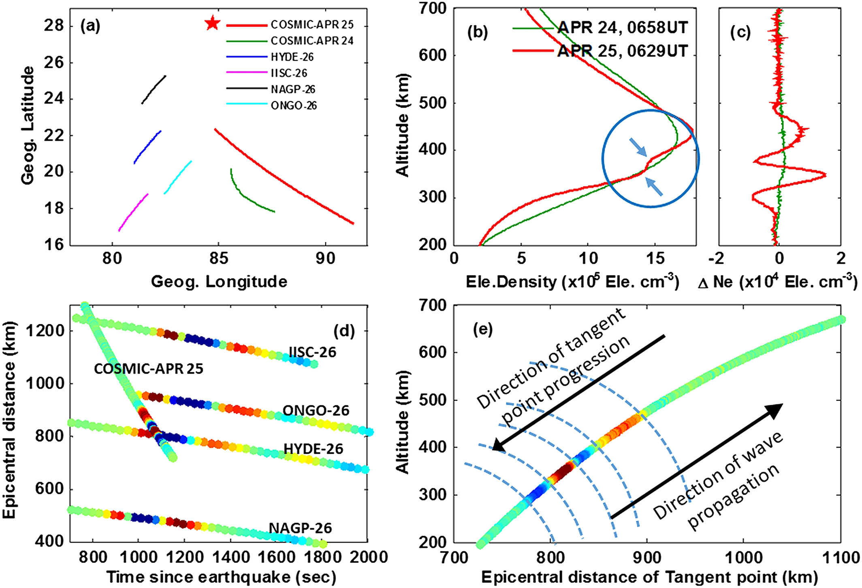
Background Where are we now? Future directions & challenges
Future directions & challenges
3D picture of the ionosphere
Combining space-borne & ground based observations
The vertical structure of the upper atmospheric disturbances is poorly understood
Tulasi Ram et al. (2017)
Michela Ravanelli – Joint ICG/PTWS–IUGG/JTC Workshop 07/04/2025

Slide 27
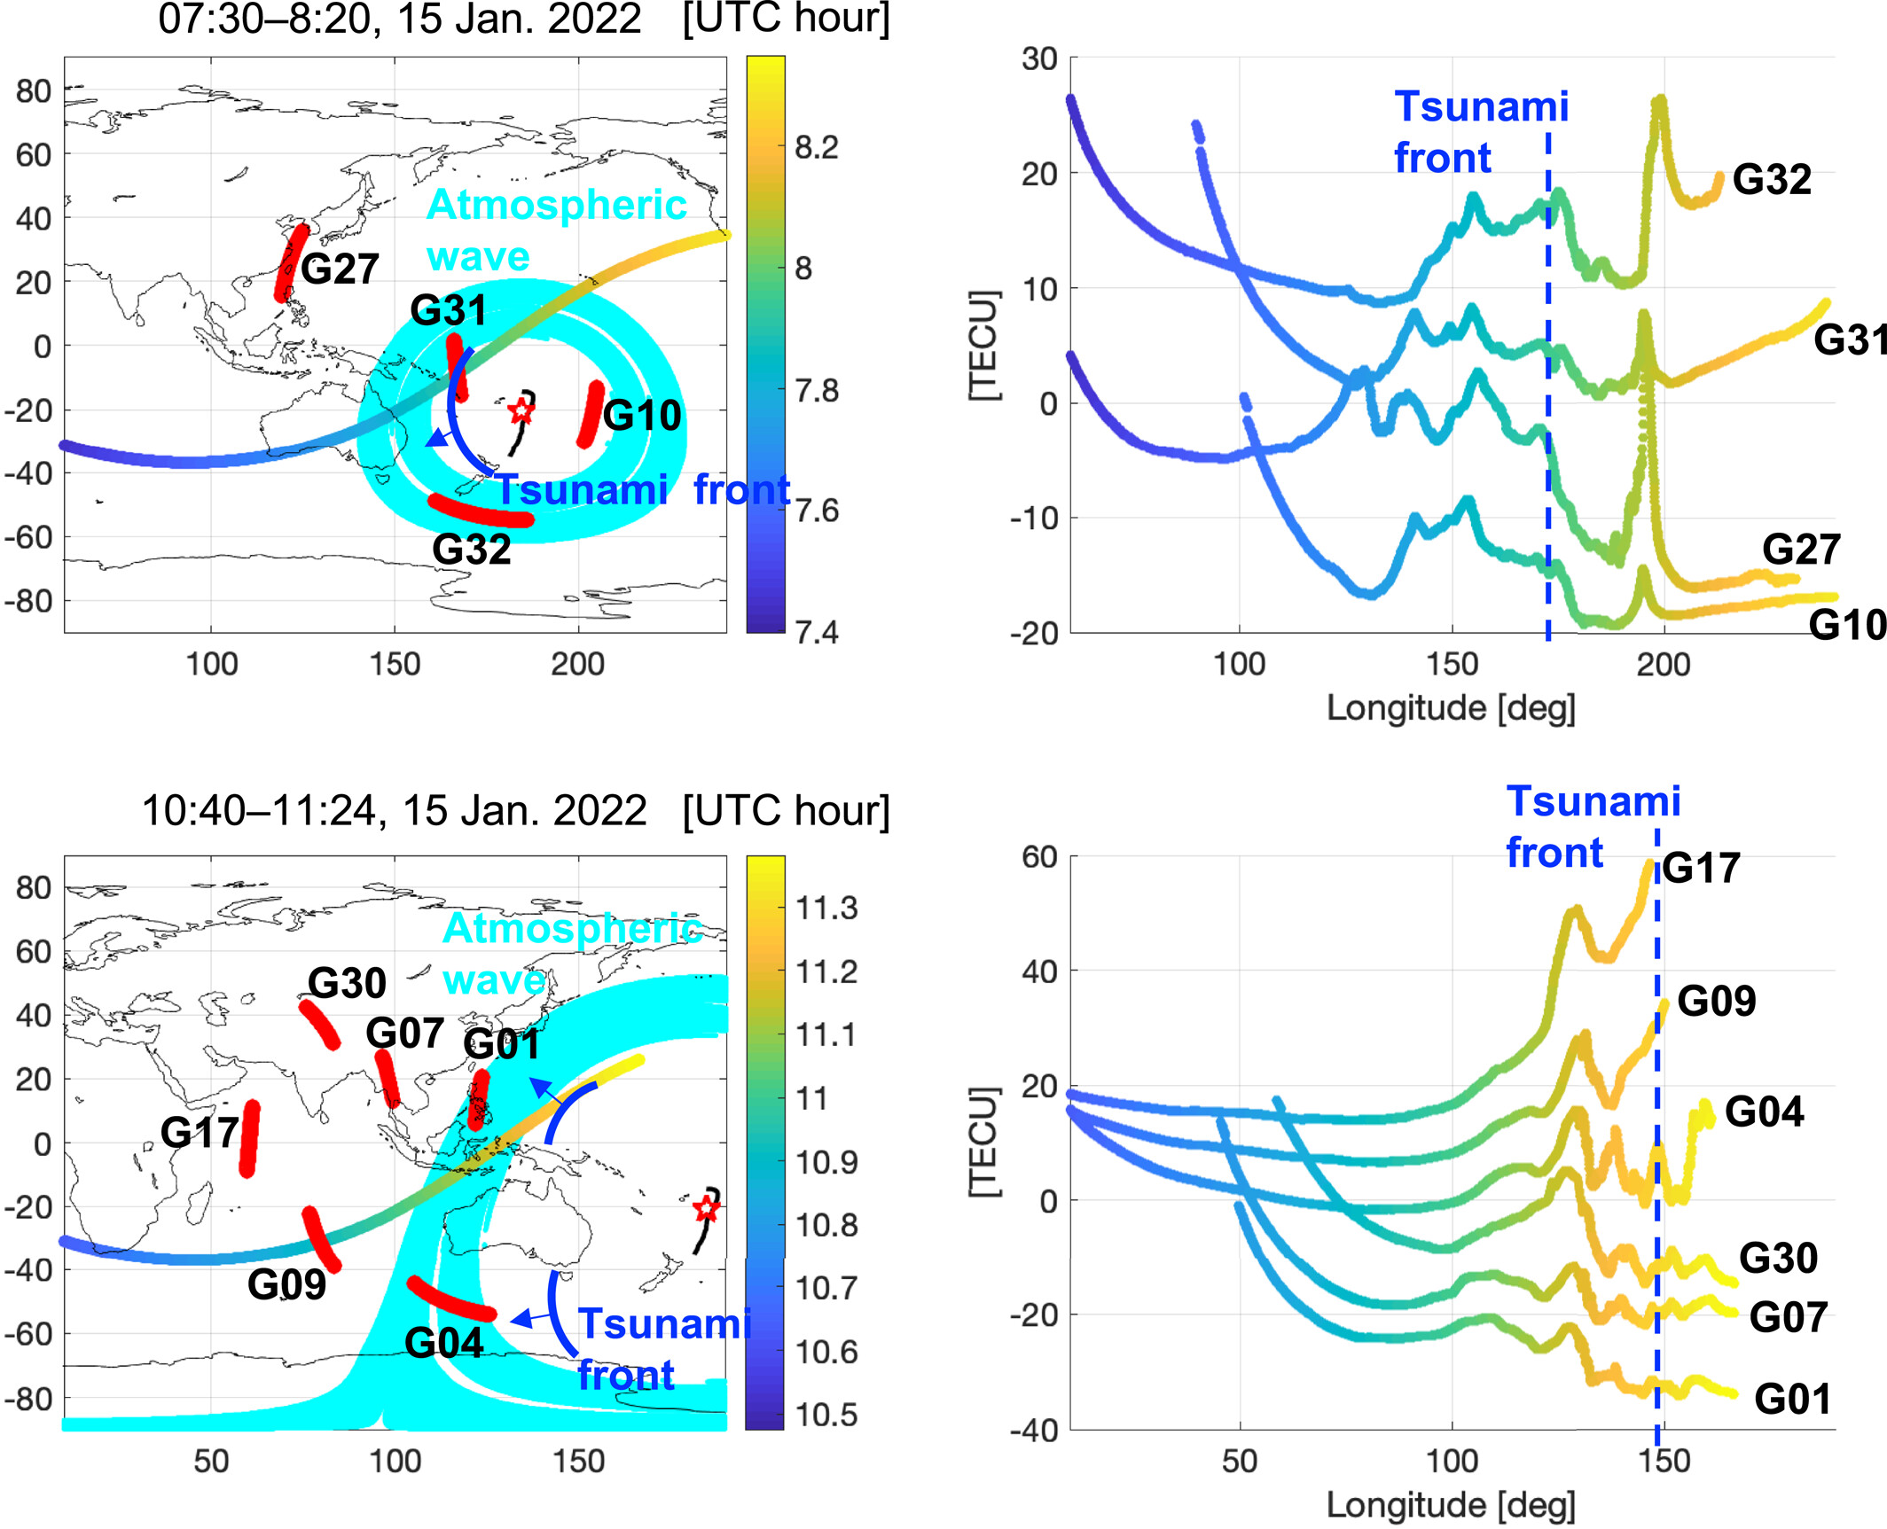
Background Where are we now? Future directions & challenges
Future directions & challenges
3D picture of the ionosphere
2022 Tonga volcanic eruption
Due to the larger spatial coverage over a shorter period of time, the CubeSat measurements provide complementary information to stationary ground receivers
TIDs detected by CubeSats observed a few hours before the conventional tsunami reach the Australian coasts leave time for tsunami source assessment
Han et al. (2023)
Michela Ravanelli – Joint ICG/PTWS–IUGG/JTC Workshop 07/04/2025

Slide 28
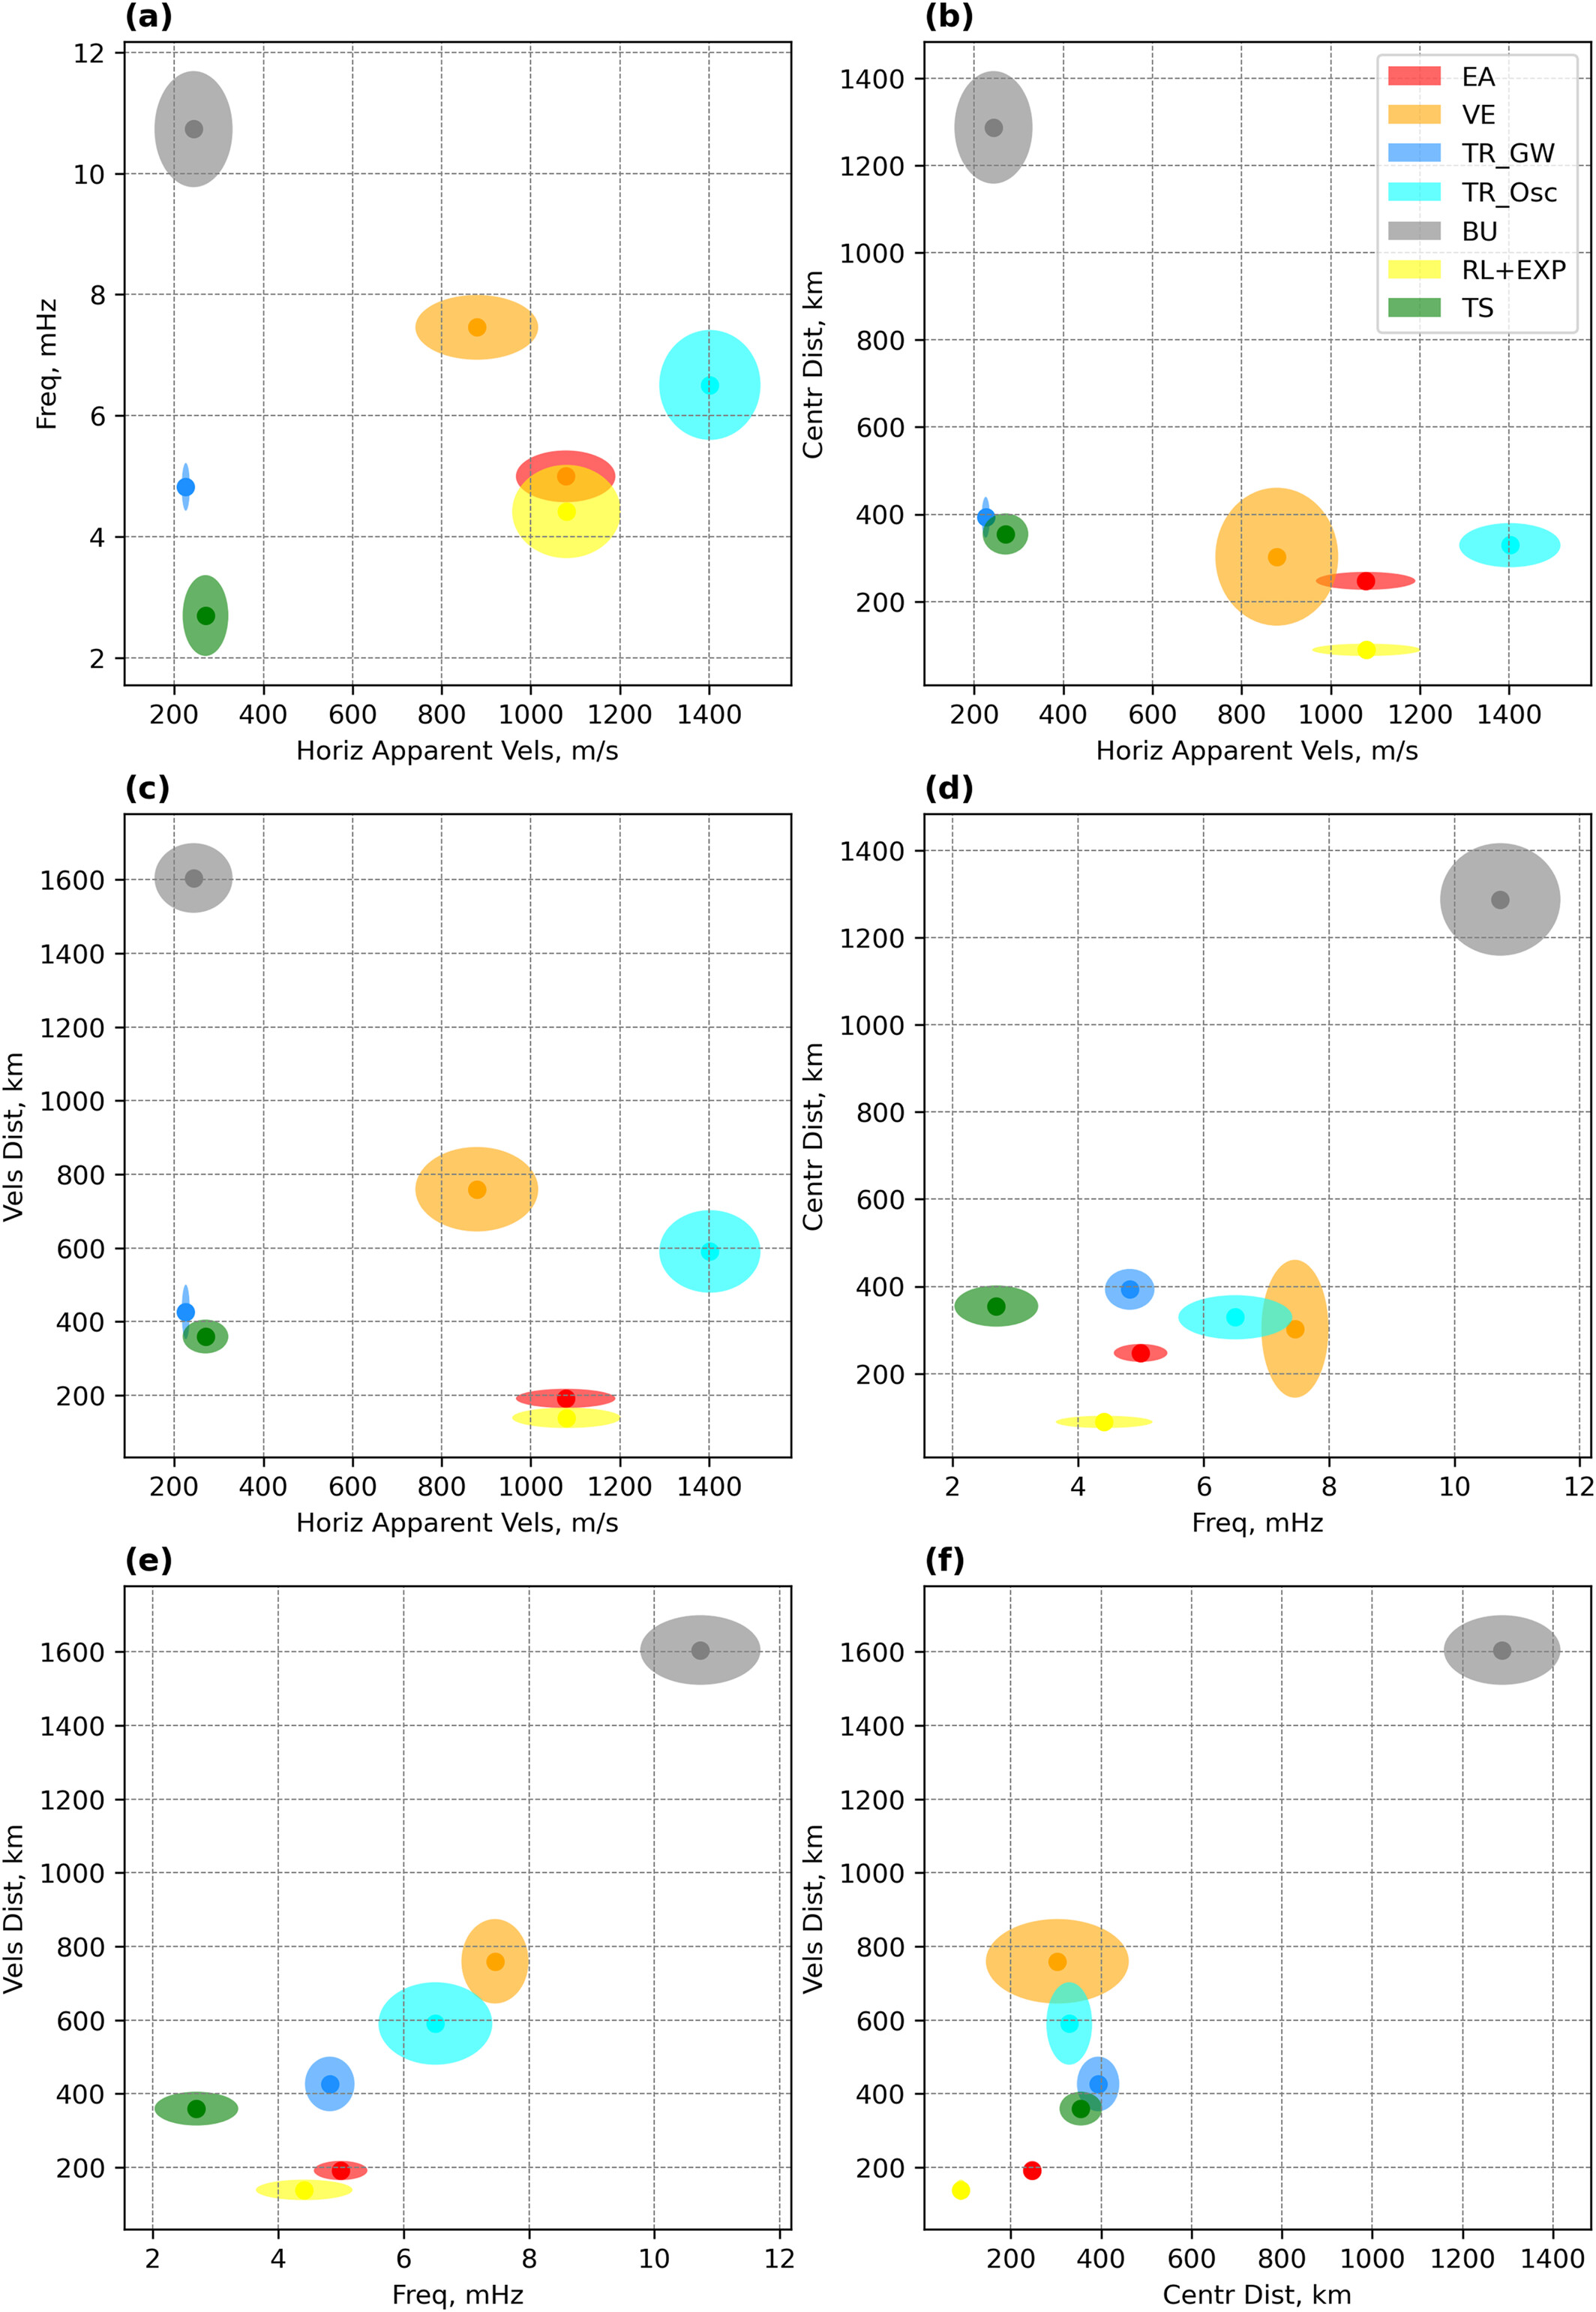
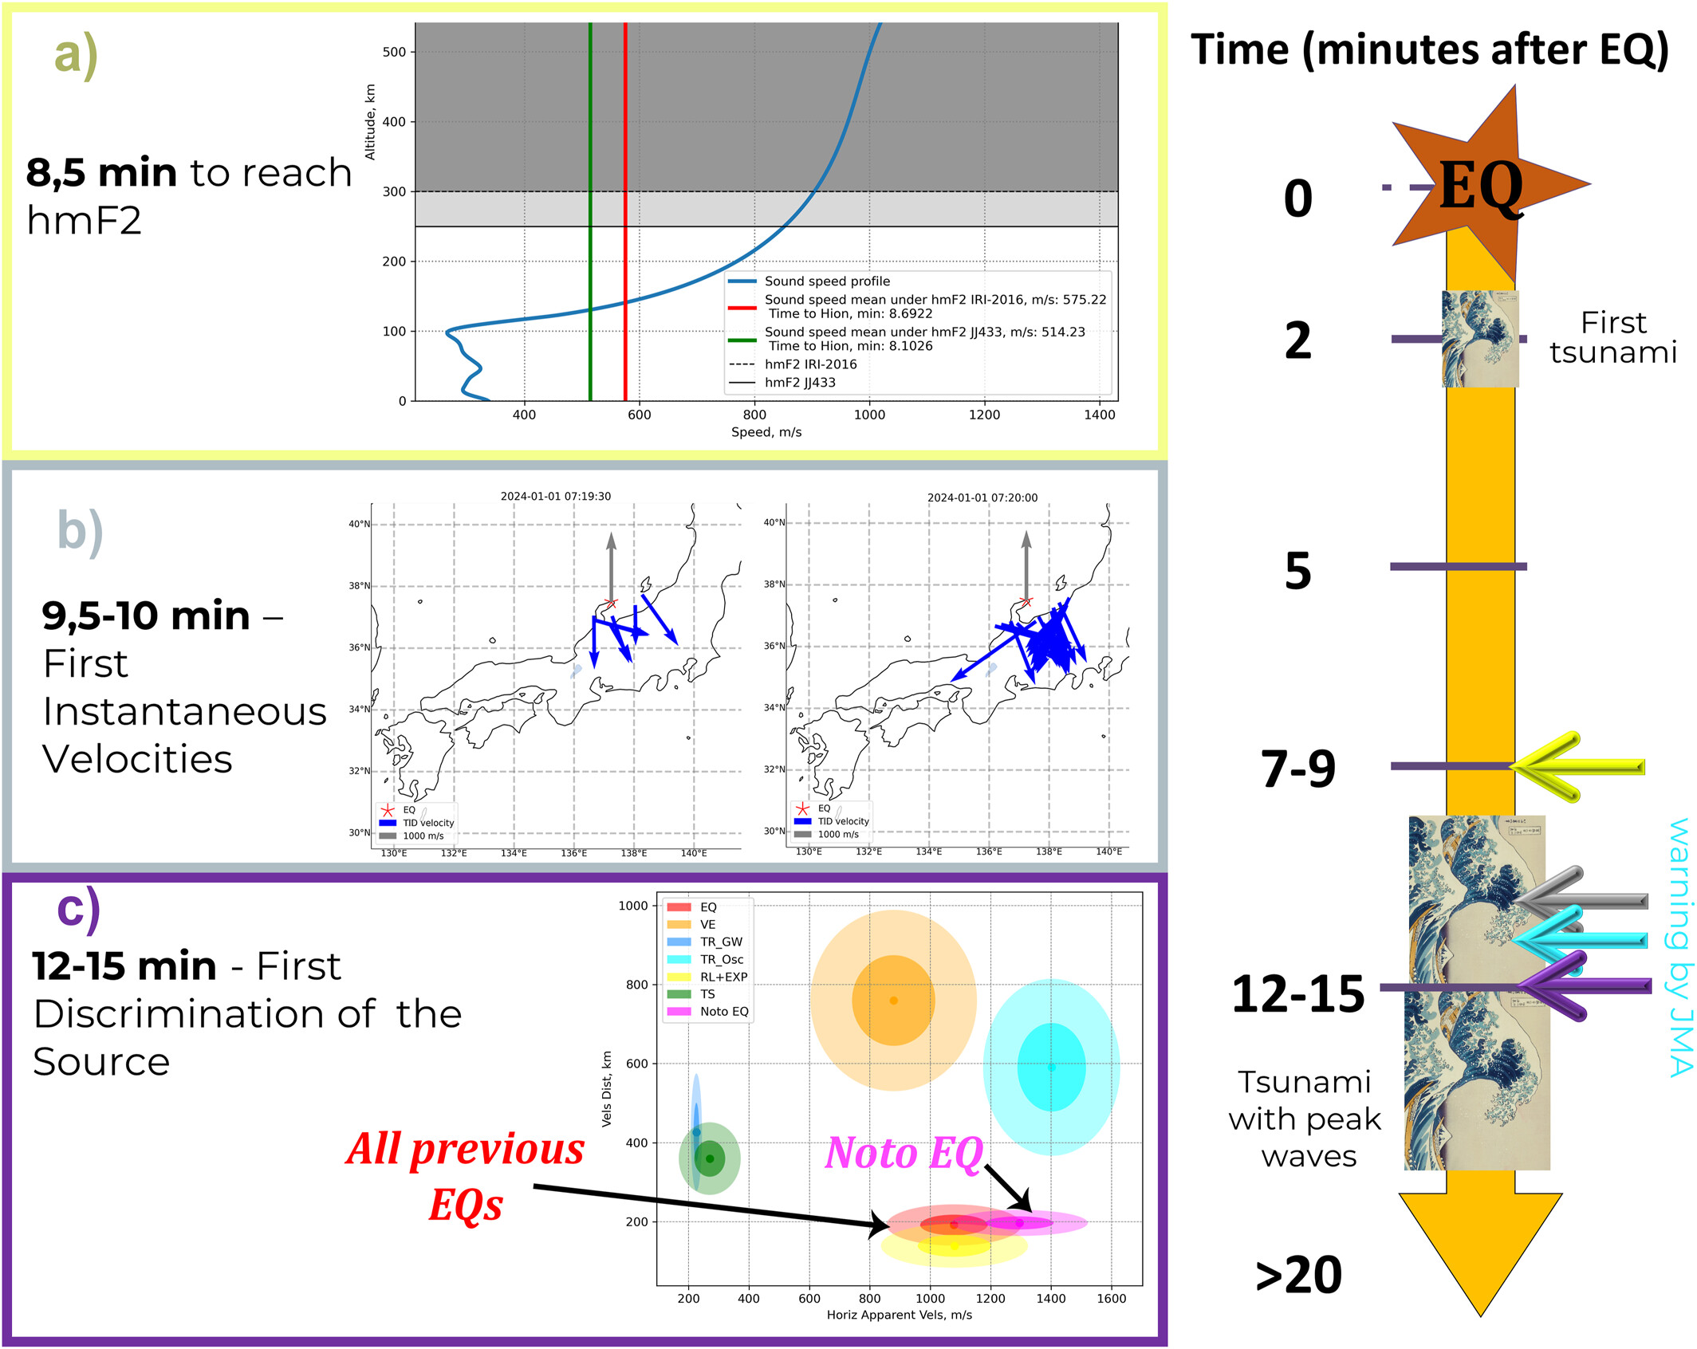
Background Where are we now? Future directions & challenges
Future directions & challenges
Source Identification of Ionospheric Disturbances
Maletckii & Astafyeva (2024)
Michela Ravanelli – Joint ICG/PTWS–IUGG/JTC Workshop 07/04/2025

Slide 29
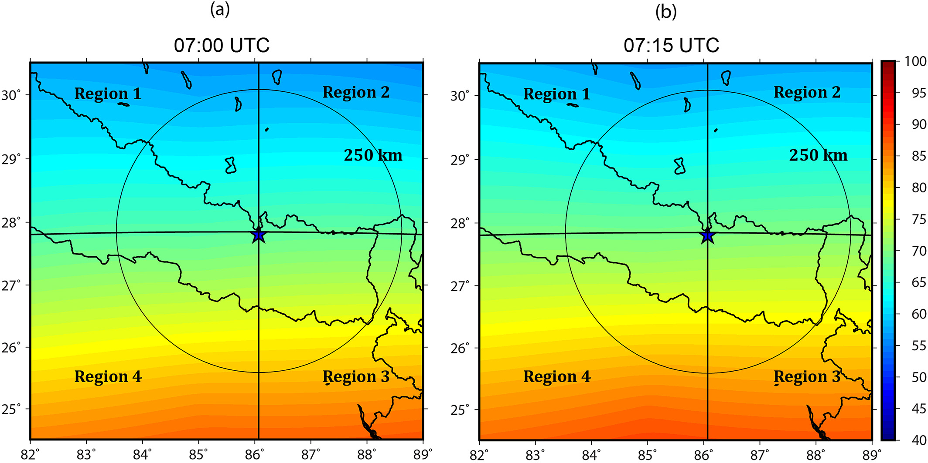
Background Where are we now? Future directions & challenges
Future directions & challenges
Seismic/non-seismic factors
Investigating the role of seismic and non-seismic parameters in manifesting co-seismic ionospheric perturbation
Ionospheric background influence
Bagiya et al. (2017)
Michela Ravanelli – Joint ICG/PTWS–IUGG/JTC Workshop 07/04/2025

Slide 30
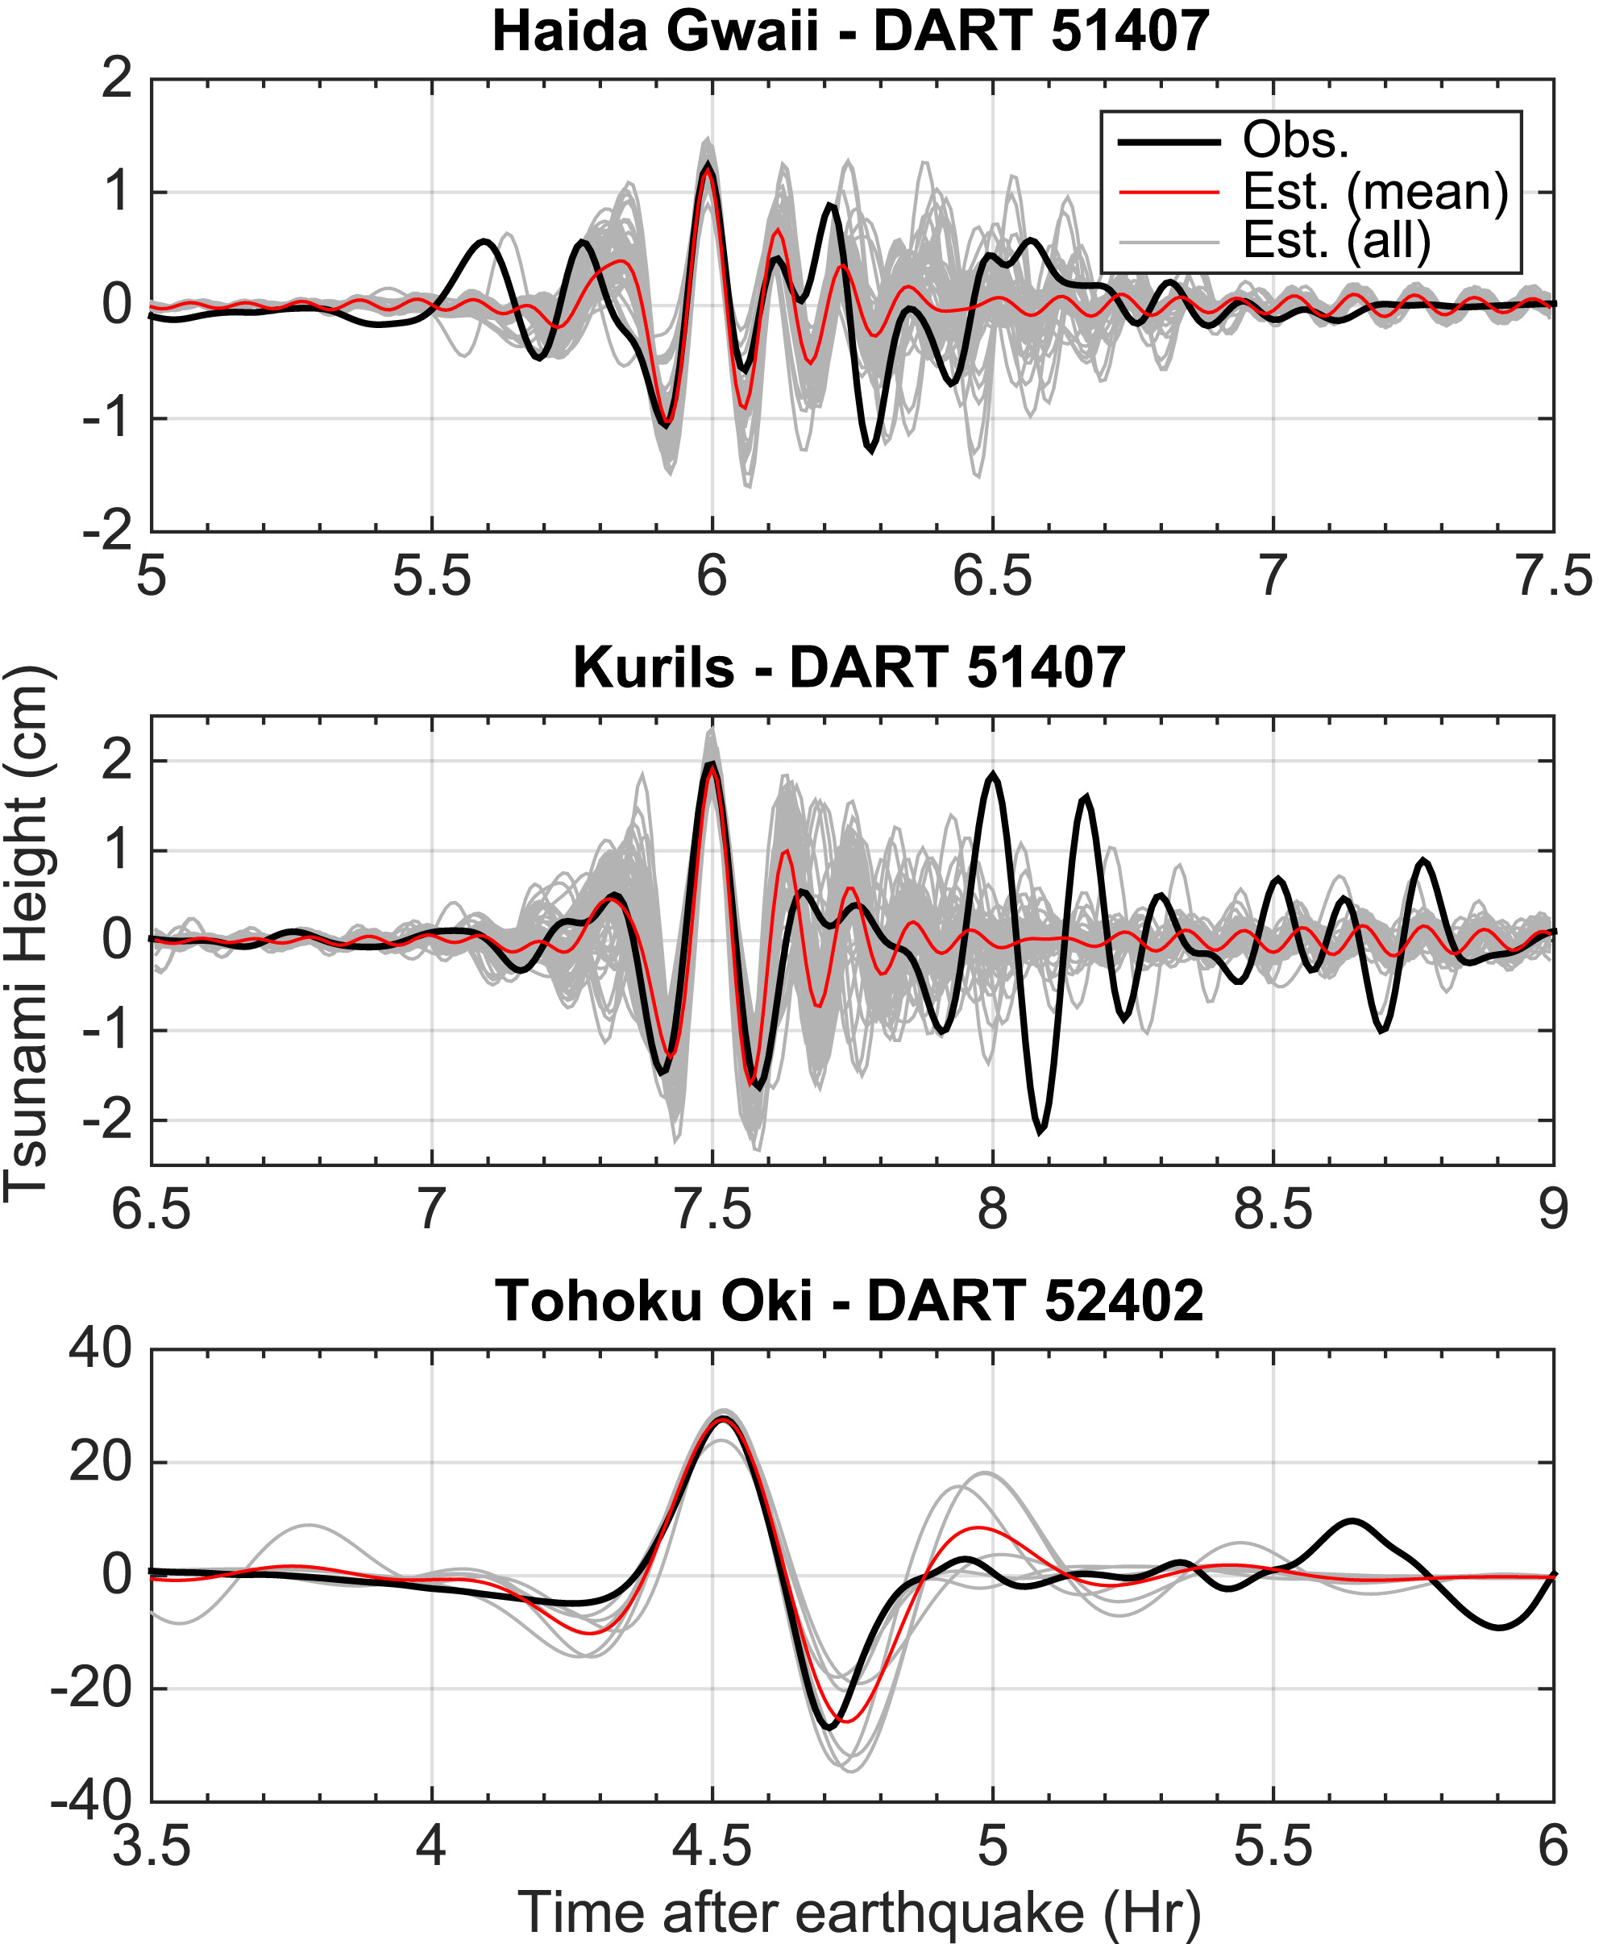
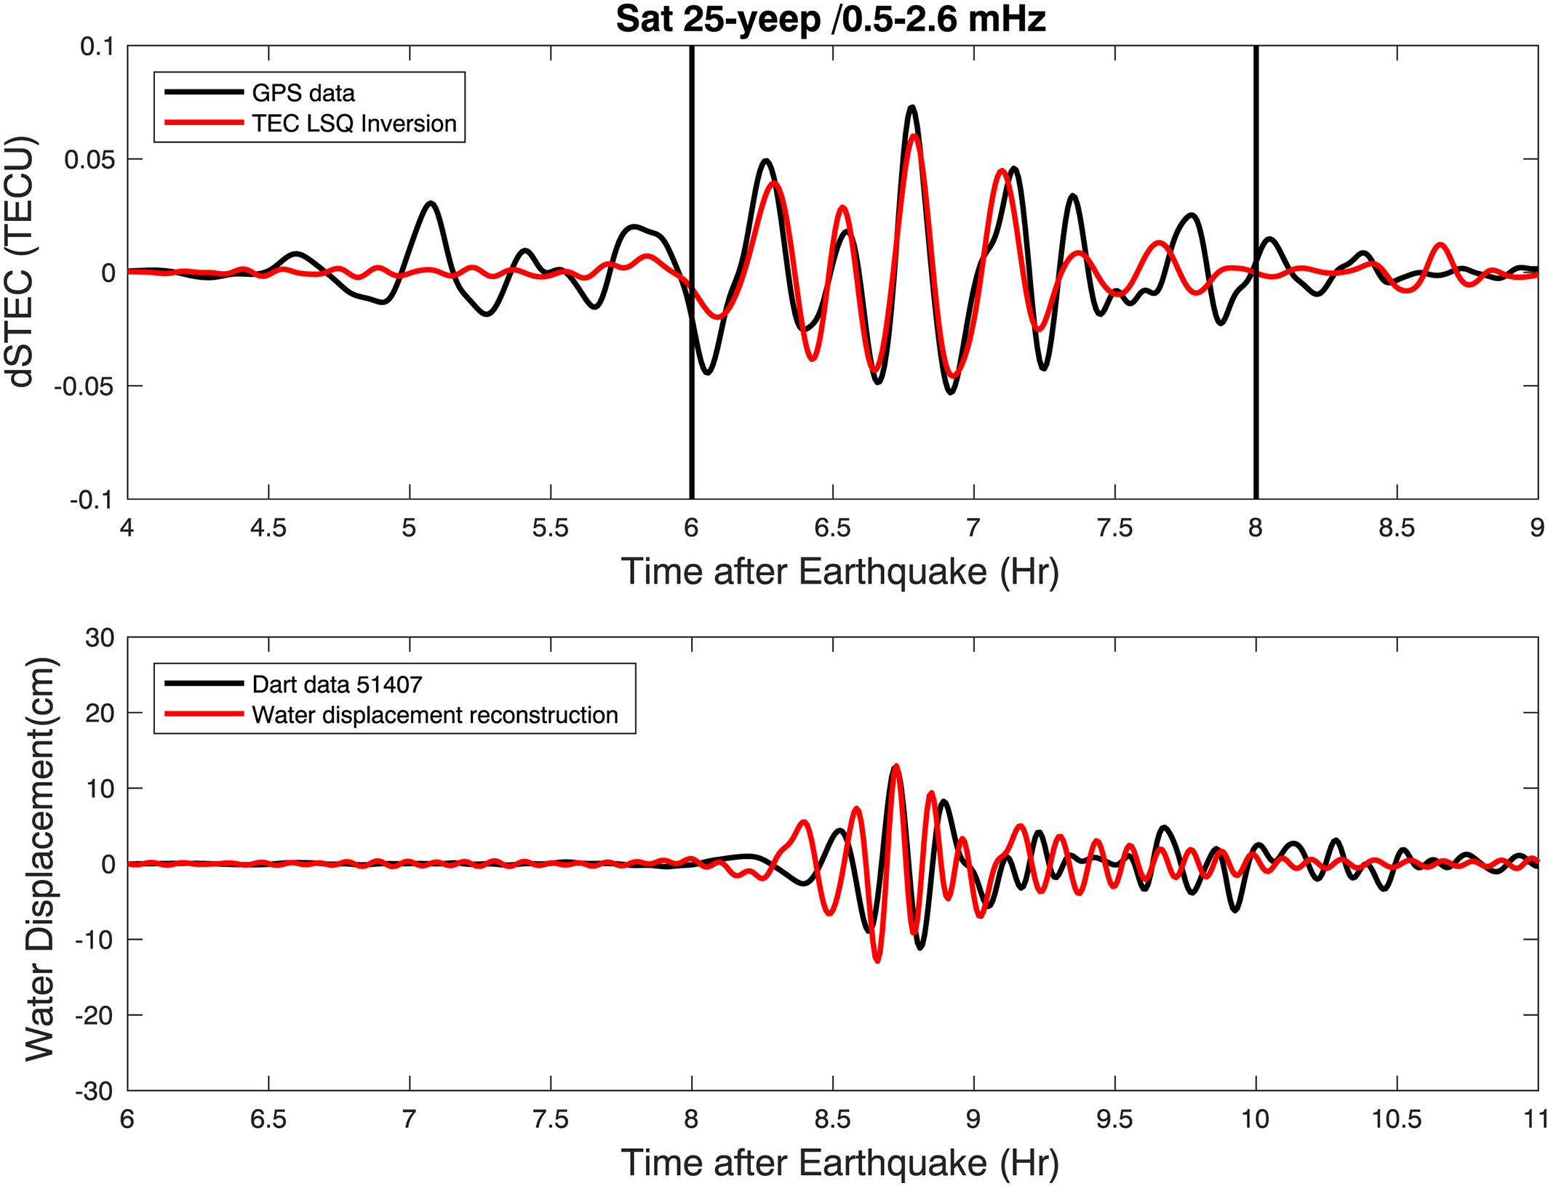
Background Where are we now? Future directions & challenges
Future directions & challenges
Modeling
Coupling between solid earth/ocean and the atmosphere needs to be understood in more detail
Tsunami wave inversion from TEC data
Rakoto et al. (2018)
Michela Ravanelli – Joint ICG/PTWS–IUGG/JTC Workshop 07/04/2025

Slide 31
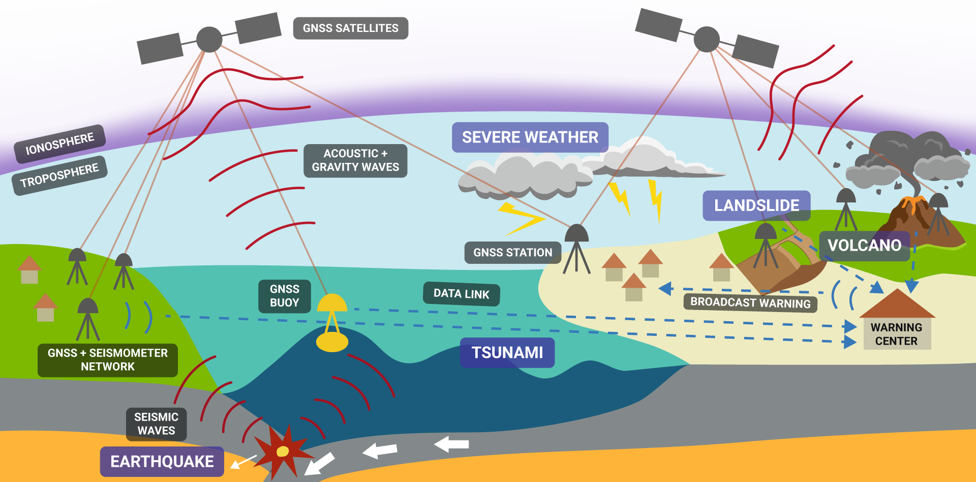
Background Where are we now? Future directions & challenges
Future directions & challenges
Operative implementations
Operative implementation for machine learning algorithm onto real-time streams
Data latency: robust communication infrastructure for real-time GNSS
Integration with existing systems
Hohensinn et al. (2024)
Michela Ravanelli – Joint ICG/PTWS–IUGG/JTC Workshop 07/04/2025

Slide 32
Background Where are we now? Future directions & challenges
Conclusions
The ionosphere is a natural sensor of natural hazards
GNSS- TEC monitoring for natural hazards including tsunamis
Pros
Cons
Ionospheric variability & Geomagnetic and Solar Activity Effects
Ionospheric Response Time (7-40 minutes)
Empirical Mw limit for detecting in the ionosphere
Cost-effective
Good spatial coverage
Suitable for several natural hazards
Complementary role for tsunami early warning systems
Michela Ravanelli – Joint ICG/PTWS–IUGG/JTC Workshop 07/04/2025

Slide 33
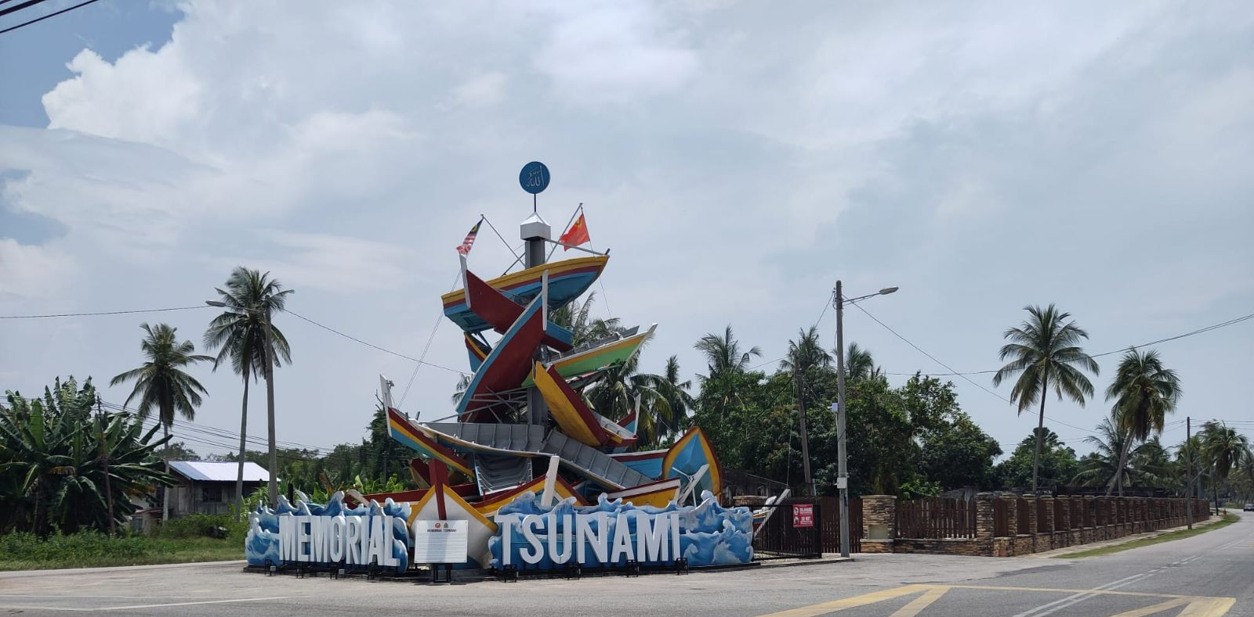
Thanks for your kind attention!
Tugu Sampan Tsunami Kuala Muda 2004, Malesia – Photo taken by Julian Eisenbeis
michela.ravanelli@uniroma1.it

