Slide 1
Overview and Summary of Existing Sensors in the context of UN ODTP forecasting targets
9th Joint ICG/PTWS–IUGG/JTC Workshop 60th Anniversary of the ICG/PTWS – Past and Future, Part II 7th April 2025, Beijing, China
A Moseley | Co-Director, Joint Australian Tsunami Warning Centre

Slide 2
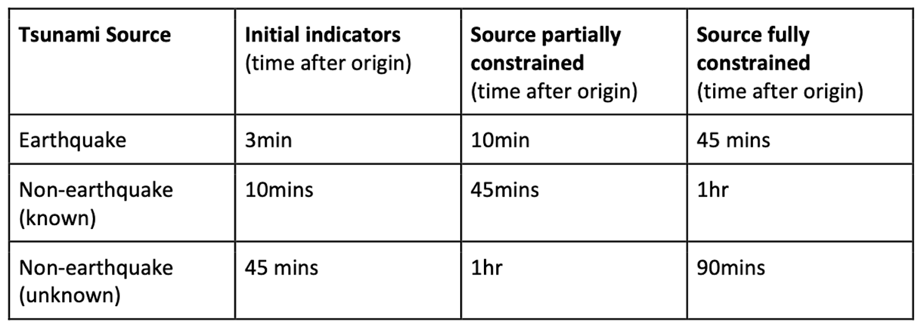
UN ODTP, 2021-2030 Forecasting Targets
Target forecasting goals from the 10-year Research, Development and Implementation Plan of the UN ODTP.
Notes:
In this presentation I’ve included only stations which are open and available in real-time.
This represents the minimum available data for a Regional Tsunami Service Provider.
Of course, some TSPs, may have access to additional stations from private networks – e.g. from their national networks (if not already open), and/or via direct data-sharing/access arrangements with a station operator in another country.
So, in short, some TSPs will have more data than this in some regions. Others may not. This represents the baseline monitoring/observing capability, today.
For the purpose of this analysis, I’ve assumed stations are online and data latencies are small.
Data we’ve
SAGE: Seismological Faciltity for the Advancement of Geoscience, operated by Earthscope --- formerly IRIS
IGS: International GNSS Servics, a service of the International Association of Geodiesy, its Global Geodetic observing system (GGOS), the International Union of Geodesy & … more than 500 GNSS stations.
GOOS: IOC-led Global Ocean Observing System sponsored by WMO, UN Environment Programme and International Science Council (GLOSS: 290 tide gauges;

Slide 3
Current observing technologies
Open, real-time data – TSP baseline capability
Sources:
Earthscope SAGE (seismic);
IAG IGS (GNSS);
GLOSS (sea-level)
Notes:
In this presentation I’ve included only stations which are open and available in real-time.
This represents the minimum available data for a Regional Tsunami Service Provider.
SAGE: Seismological Faciltity for the Advancement of Geoscience, operated by Earthscope --- formerly IRIS
IGS: International GNSS Servics, a service of the International Association of Geodiesy, its Global Geodetic observing system (GGOS), the International Union of Geodesy & … more than 500 GNSS stations.
GOOS: IOC-led Global Ocean Observing System sponsored by WMO, UN Environment Programme and International Science Council (GLOSS: 290 tide gauges;
Of course, some TSPs, may have access to additional stations from private networks – e.g. from their national networks (if not already open), and/or via direct data-sharing/access arrangements with a station operator in another country.
So, in short, some TSPs will have more data than this in some regions. Others may not. This represents the baseline monitoring/observing capability, today.

Slide 4
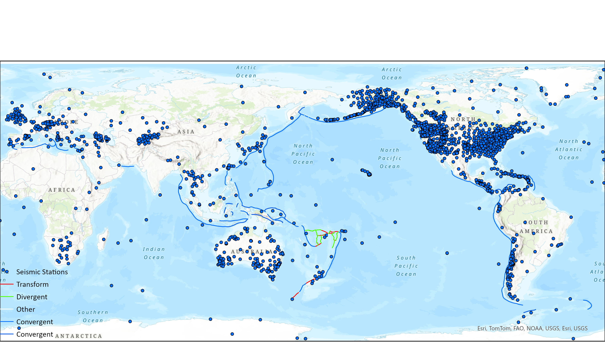
SAGE: seismic (broadband, open, real-time)

Slide 5
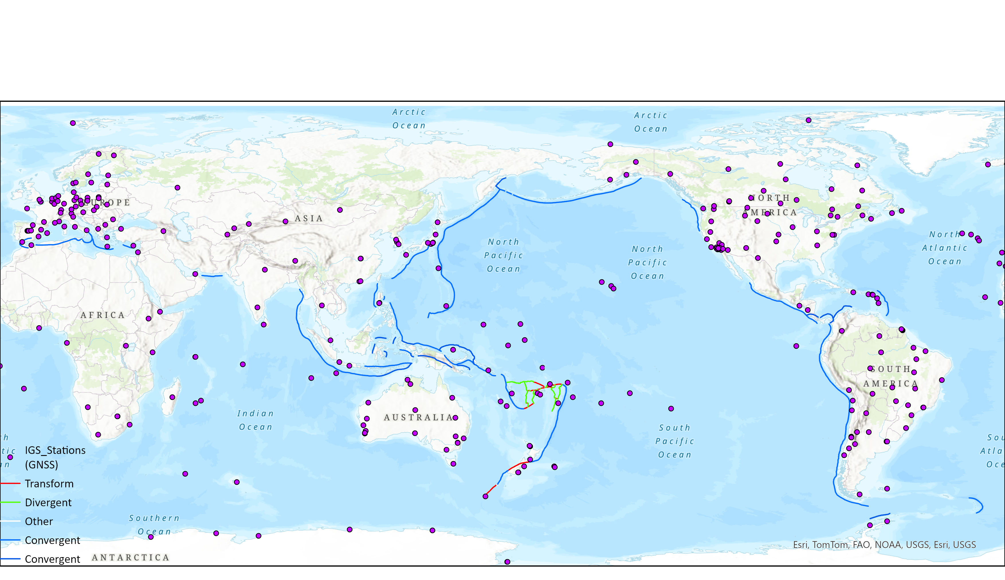
IGS: GNSS stations (open, real-time)

Slide 6
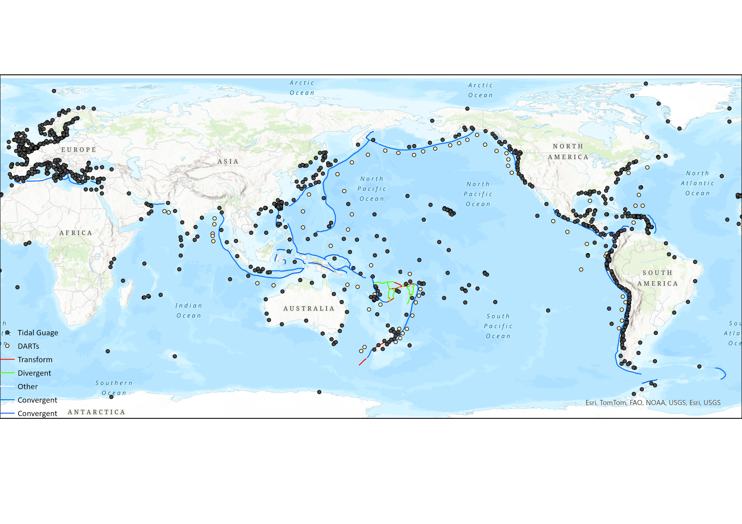
GOOS: tide & DART (open, real-time)

Slide 7
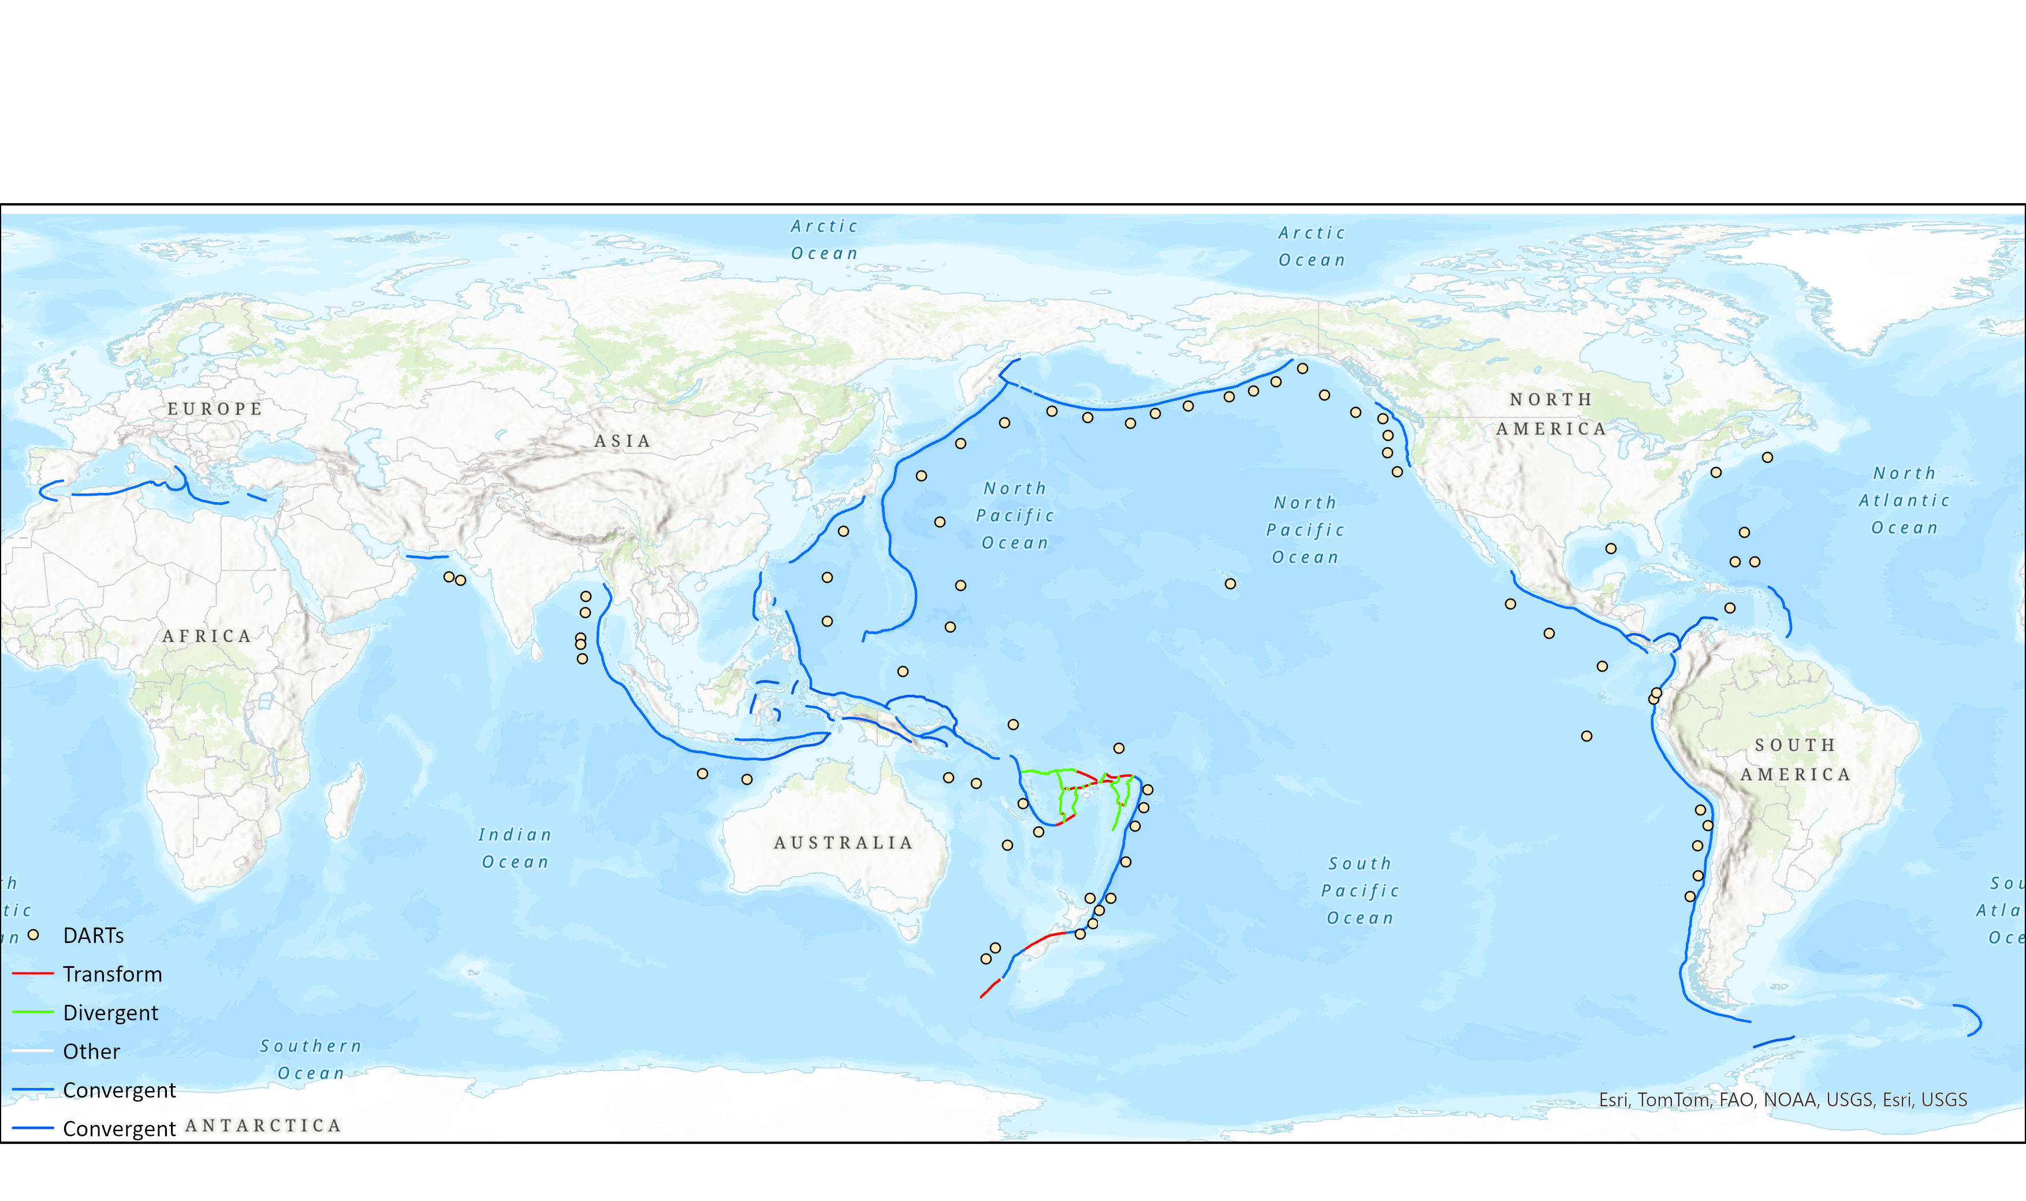
GOOS: DART (open, real-time)

Slide 8
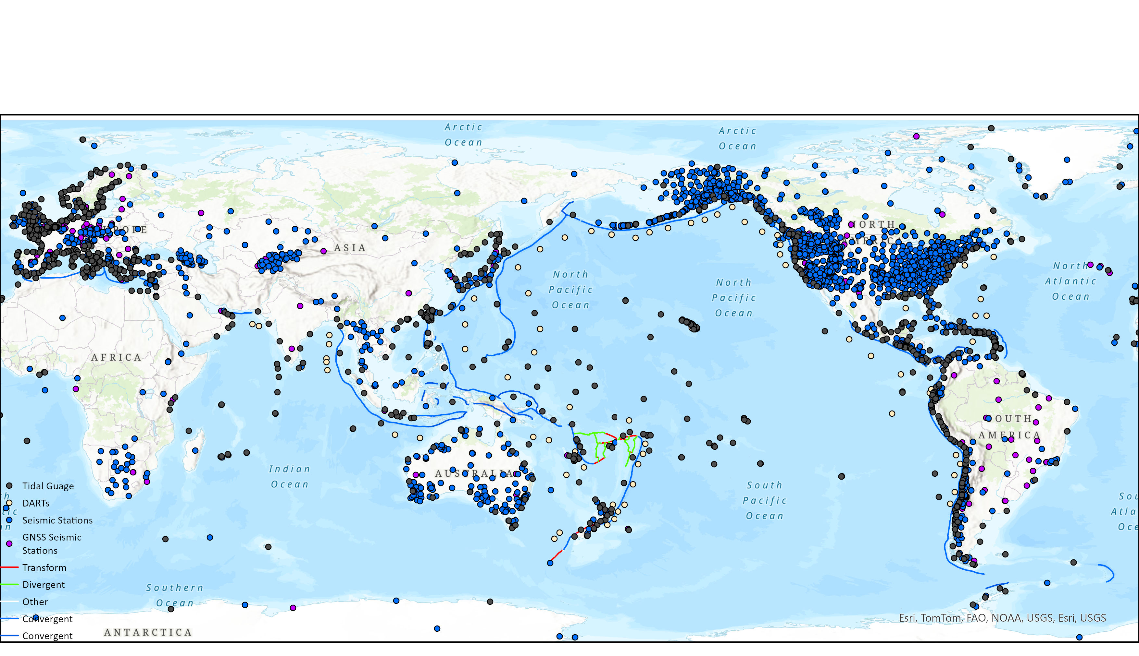
Seismic + GNSS + DART + Tide gauges

Slide 9
Earthquake source

Slide 10
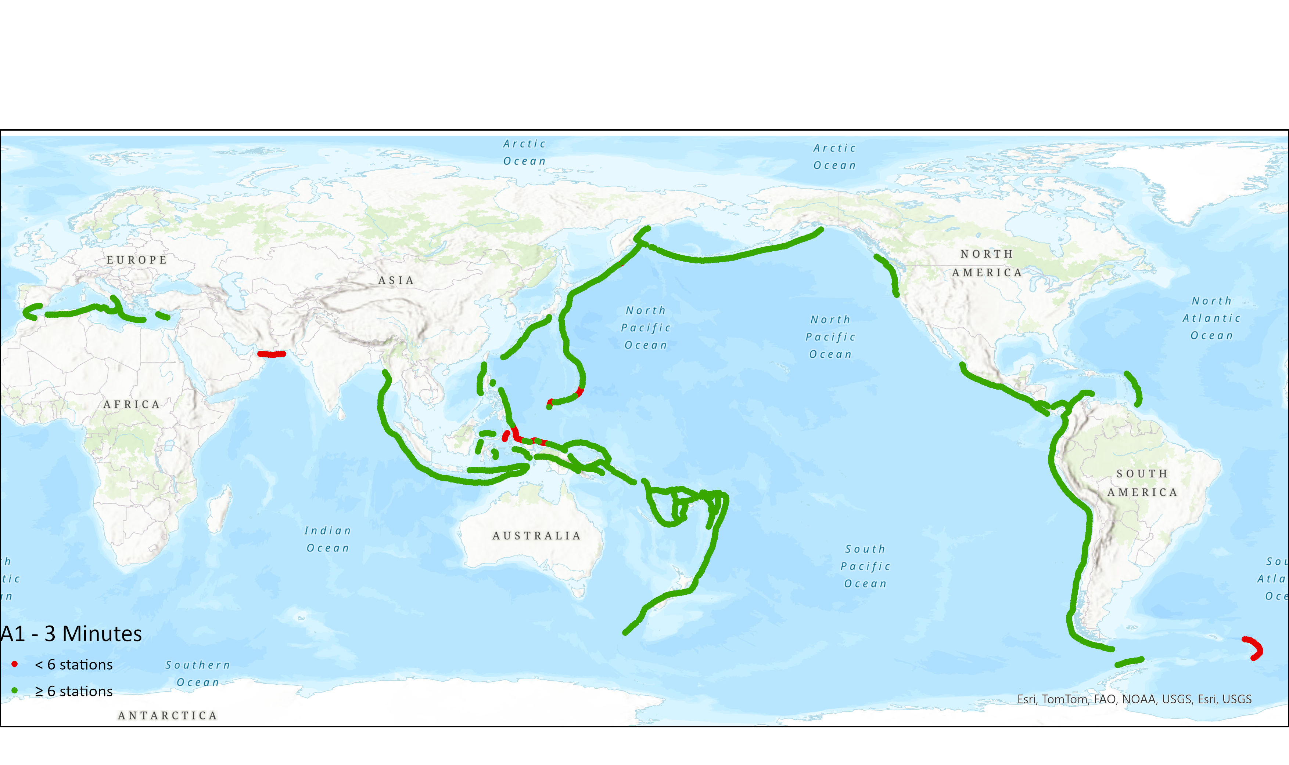
Earthquake: initial indicators, OT+3’
Notes:
A1, Initial Indicators: earthquake - initial location & magnitude [ML, Mwp?]
Method: discretised source zones into 50km points. Allowing for 20s data latency
Requiring 6 stations within ~20deg.
No constraints on azimuthal coverage
Expect: low quality solution: useable location (assume shallow), very unreliable magnitude (ML, Mwp? mb) (assume underestimated); some first motions (assume thrust)

Slide 11
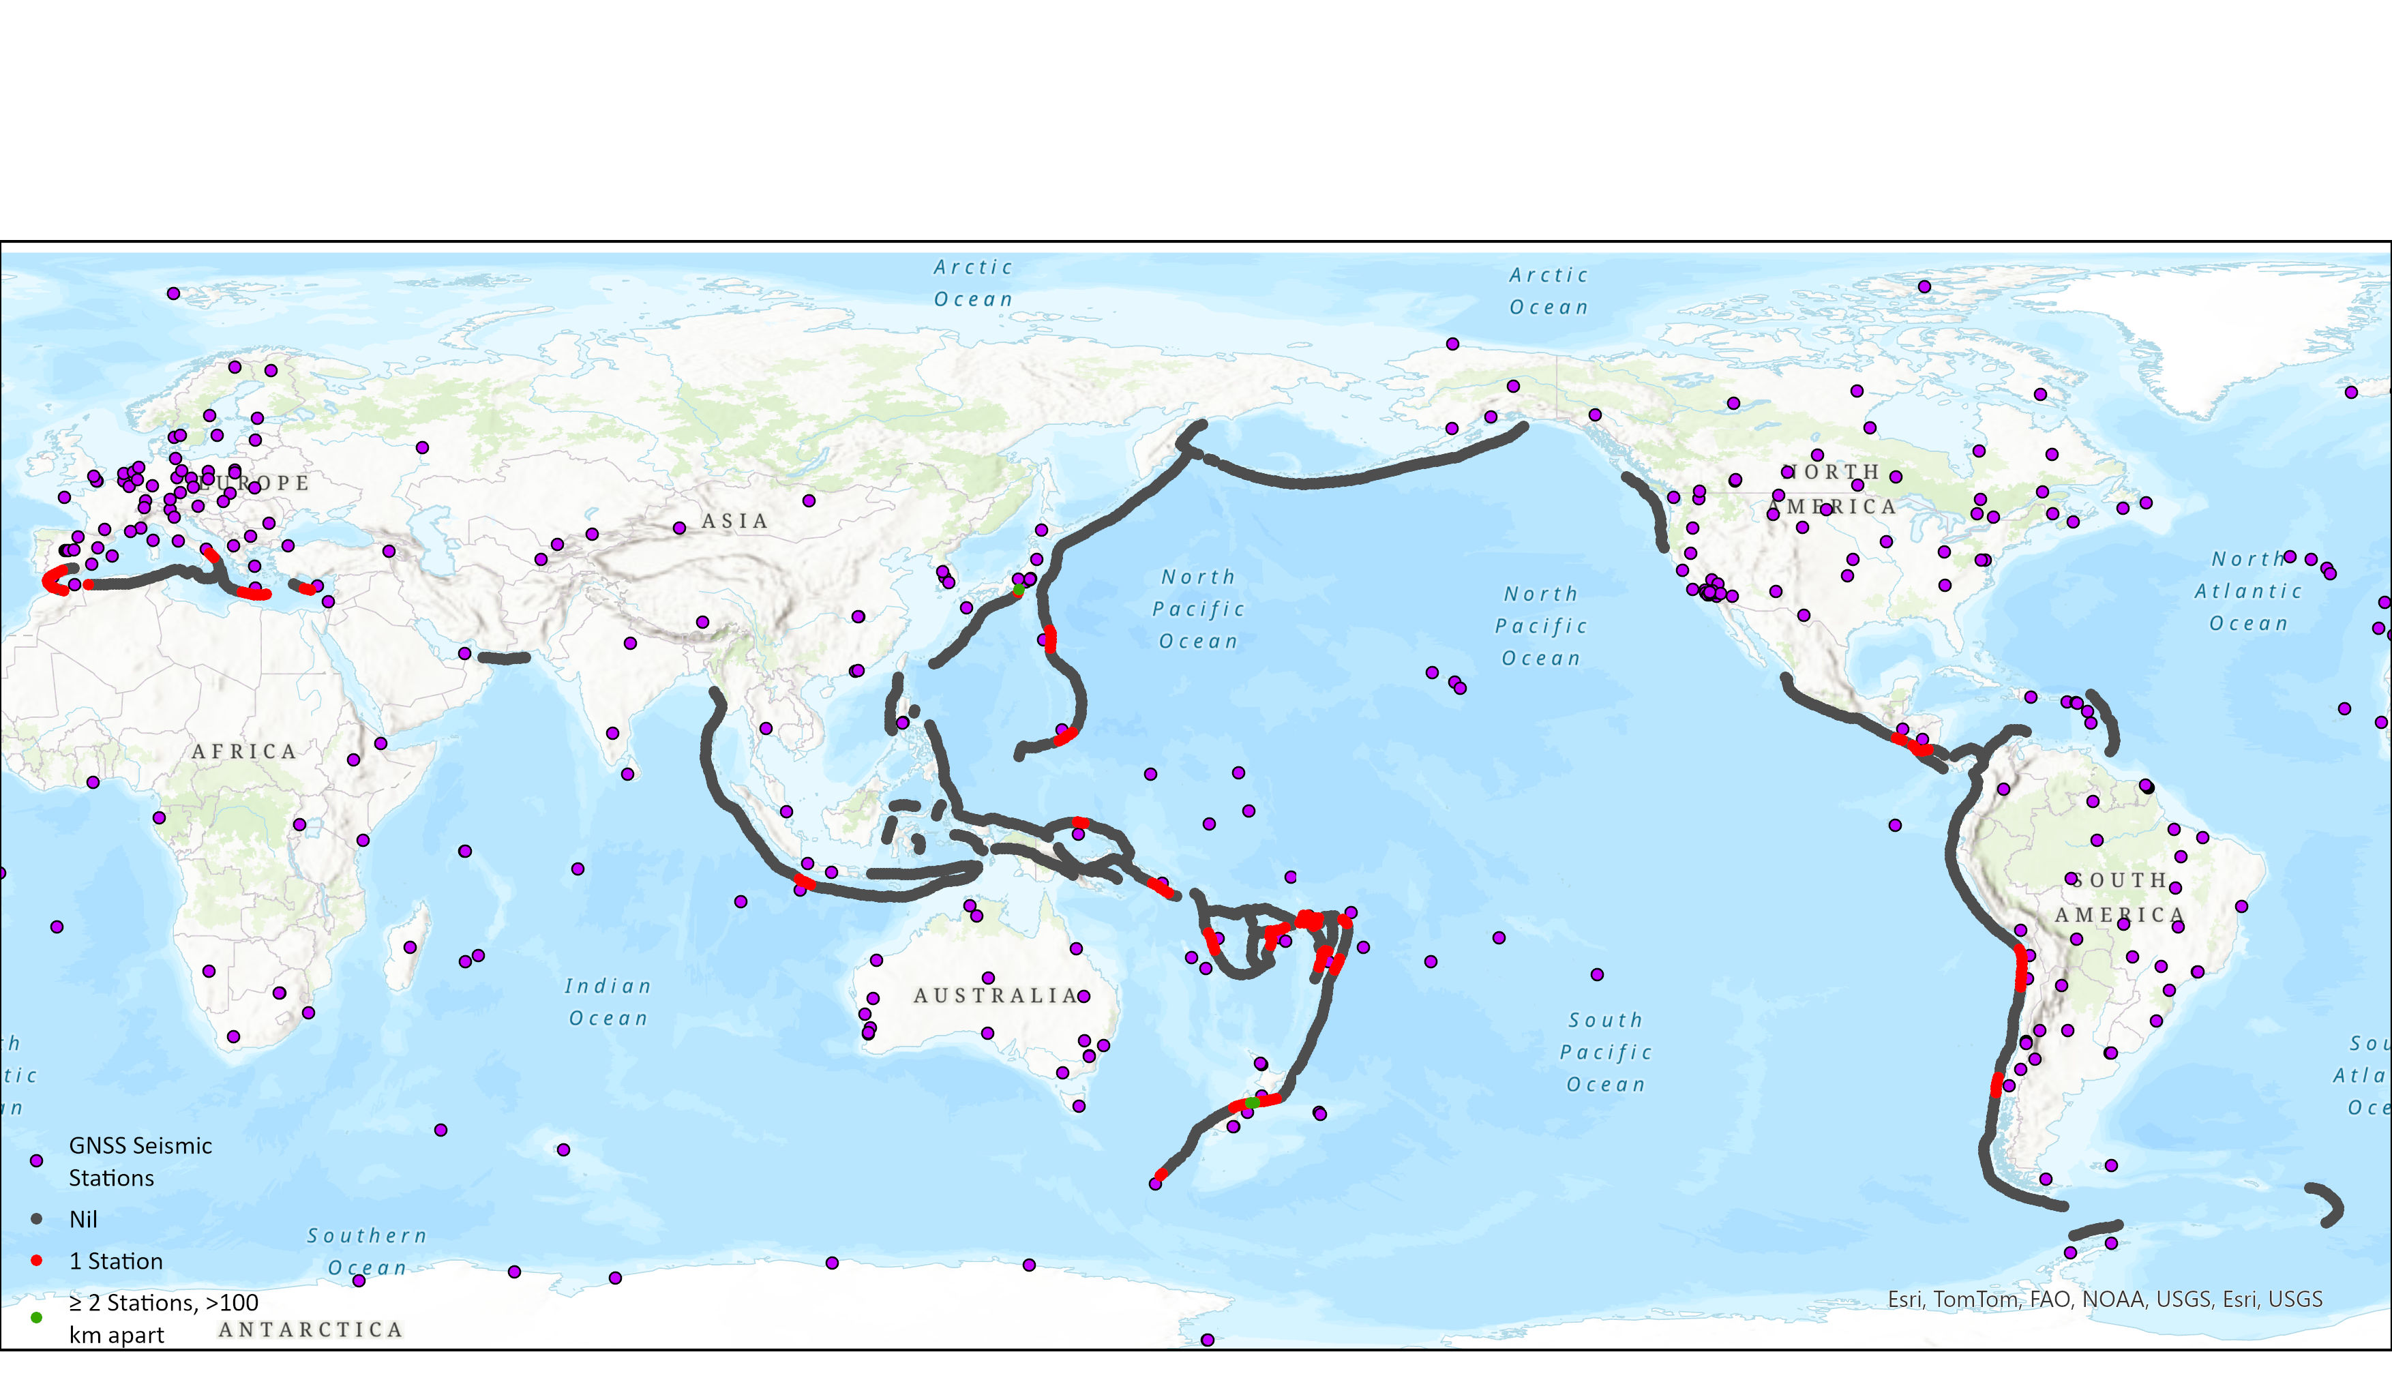
Earthquake: initial indicators, OT+3’
Notes:
A1, Initial Indicators: earthquake - initial location & magnitude [ML, Mwp?]
Method: discretised source zones into 50km points. Allowing for 20s data latency
Requiring 6 stations within ~20deg.
No constraints on azimuthal coverage
Expect: low quality solution: useable location (assume shallow), very unreliable magnitude (ML, Mwp? mb) (assume underestimated); some first motions (assume thrust)

Slide 12

Earthquake: source partially constrained, OT+10’
Notes:
A2 W-phase window is S-P, so at ~9minutes, S roughly 25degrees. But, first-motion mechs, if you want to include them, can be done on P making it ~60 degrees. So, choice, wphase (accepted standard for forecasting) or enough to make a perhaps dubious estimate?
A2, Partially constrained:
Requiring 20 stations within ~60deg [P-arrival];
Max AzGap <180deg
S out to ~25deg (no constraint on AzGap for wphase)
Expect: Mww, centroid, possibly some FM from P-arrivals (assume vertical motion). Acceptable standard for forecasting?

Slide 13
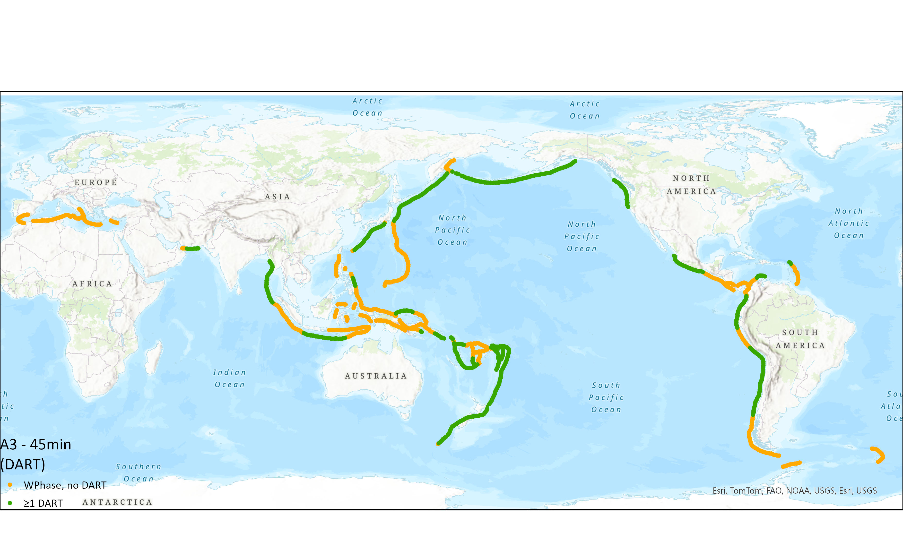
Earthquake: source fully constrained, OT+45’
Notes:
A3, fully constrained:
Requiring wphase + 1 DART or 2 DARTS
Expect: [orange] at least good quality wphase (OT+45);
[green] also confirmation of tsunami with 1 or more wave-height observations for scaling forecast.

Slide 14
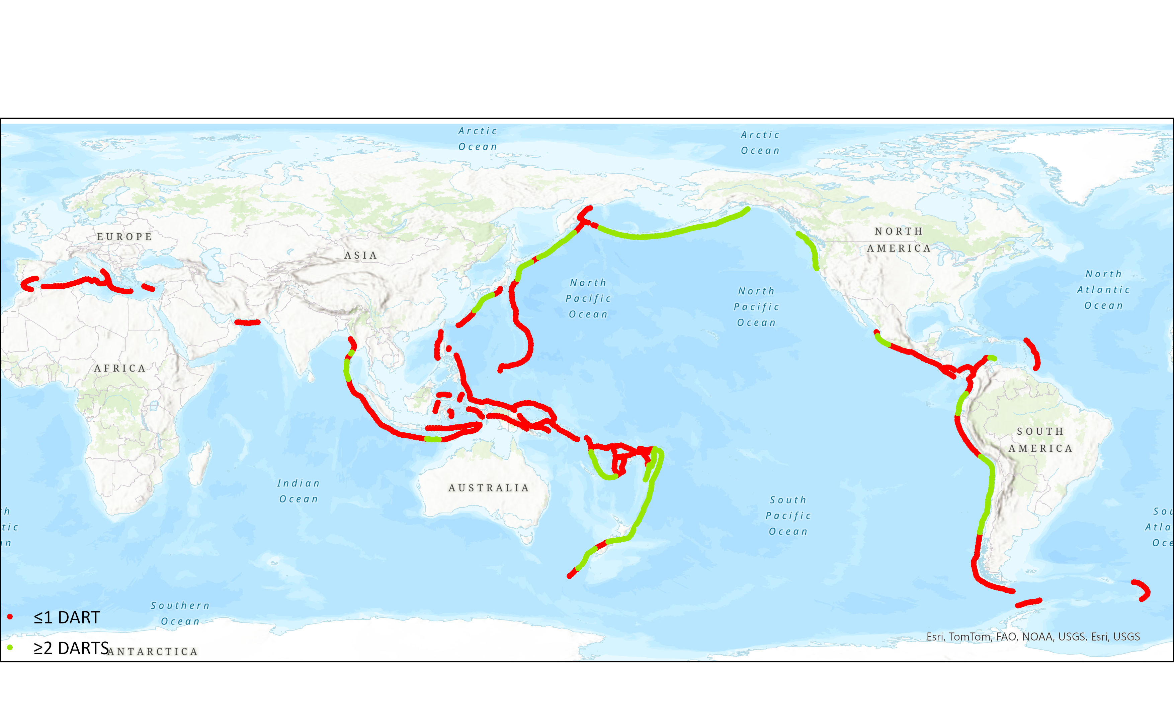
Earthquake: source fully constrained, OT+45’
Notes:
A3, fully constrained:
Requiring wphase + 1 DART or 2 DARTS
Expect: [orange] at least good quality wphase (OT+45);
[green] also confirmation of tsunami with 1 or more wave-height observations for scaling forecast.

Slide 15
Non-earthquake, known source

Slide 16
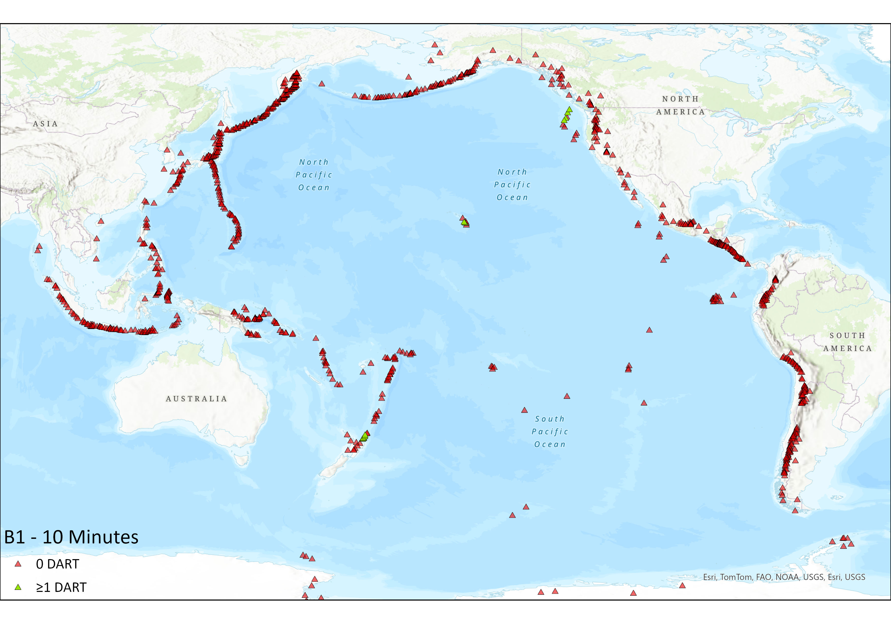
Non earthquake (known): initial indicators, OT+10’
Notes:
B1 Needs something to localise source AND 1 dart. So, seismic info plus 1 dart. Assume Seismic info is P onset -> 20 degrees, seismic, 1 DART
B1, Initial Indicators: volcano or secondary source (landslide from earthquake)
Assuming source can be localised from:
seismic (P-onset): require 6 stations within ~20deg or from
GNSS (2 stations within 200km) – 200km radius; station separation 100km+
PLUS + 1 DART.
Expect: useable location [if you can see it!], wave-height for confirmation (and scaling?)

Slide 17
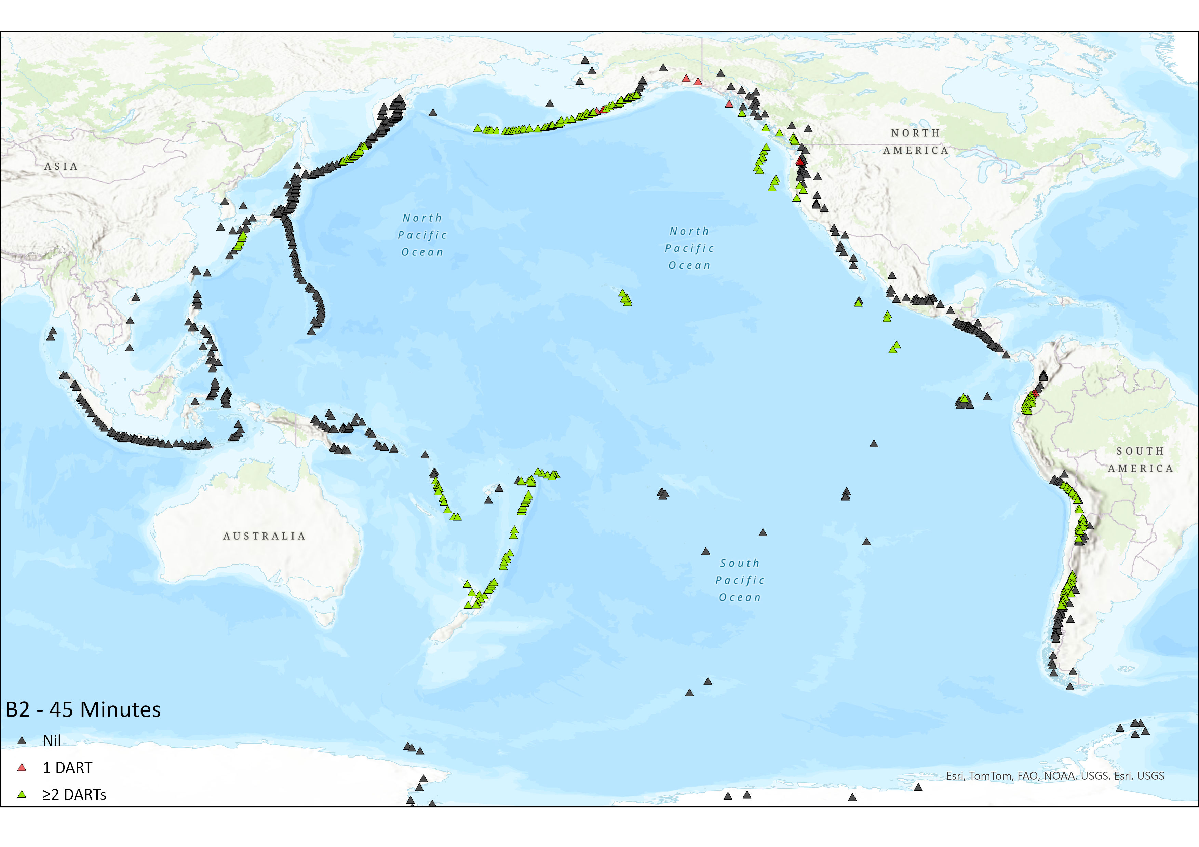
Non earthquake (known): partially constrained, OT+45’
Notes:
B2 – at least, localisation and 2 DARTs. In practice, the DARTs would have to sample the beam propagating toward the forecasted coast.

Slide 18

Non earthquake (known): fully constrained, OT+60’
Notes:
B2 – at least, localisation and 2 DARTs. In practice, the DARTs would have to sample the beam propagating toward the forecasted coast.

Slide 19
Non-earthquake, unknown source

Slide 20
GOOS: tide & DART (open, real-time)

Slide 21
Summary – progress against UN ODTP
OD mid-point…
Currently available data is not enough to achieve UN ODTP forecasting targets.
New infrastructure slow to come into effect (e.g., SMART) – and will data be open?
Large-scale infrastructure investment for ocean observations, not expected.
Necessary next steps:
Increase open data sharing from existing stations
Look to other existing ocean-observing technologies and novel techniques to augment existing capability – e.g., GNSS-TEC, Satellite altimetry, OF interferometry, others?
Collaborate with researches to make novel data forecast-ready for TSPs
Partner with those operators/sectors to access novel data (ad hoc or continuous).

