Slide 1
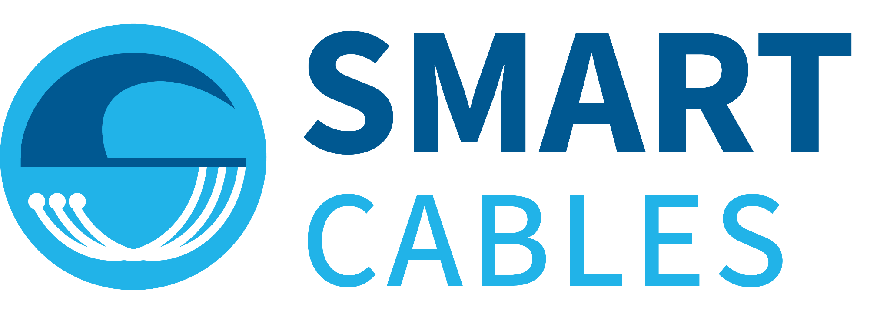



Observing the oceans and Earth with submarine cables,
into the future
Observing the Ocean and Earth with
Ceci Rodríguez Cruz
JTF SMART Cables Initiative
International Programme Office
University Hawaiʻi at Mānoa
9th ICG/PTWS-IUGG Joint Tsunami Commission Technical Workshop
Beijing, China
7 April 2025
Scientific Monitoring And Reliable Telecommunications
Notes:
Good morning, esteemed colleagues, experts, and representatives. It is an honor to be here today to share an innovation that has the potential to transform our ability to monitor the oceans and enhance earthquake and tsunami early warning: SMART Cables.
As we gather to mark the 60th anniversary of the Pacific Tsunami Warning System, we must acknowledge a critical gap that still remains in our global monitoring network—the lack of real-time, detect non-earthquake tsunami, deep-sea seismic and oceanographic data. The consequences? Delayed tsunami detection, insufficient lead time for coastal communities, and gaps in climate and ocean monitoring. But what if we could leverage future subsea cable infrastructure to bridge this gap? That is exactly what the SMART Cables Initiative is doing.

Slide 2

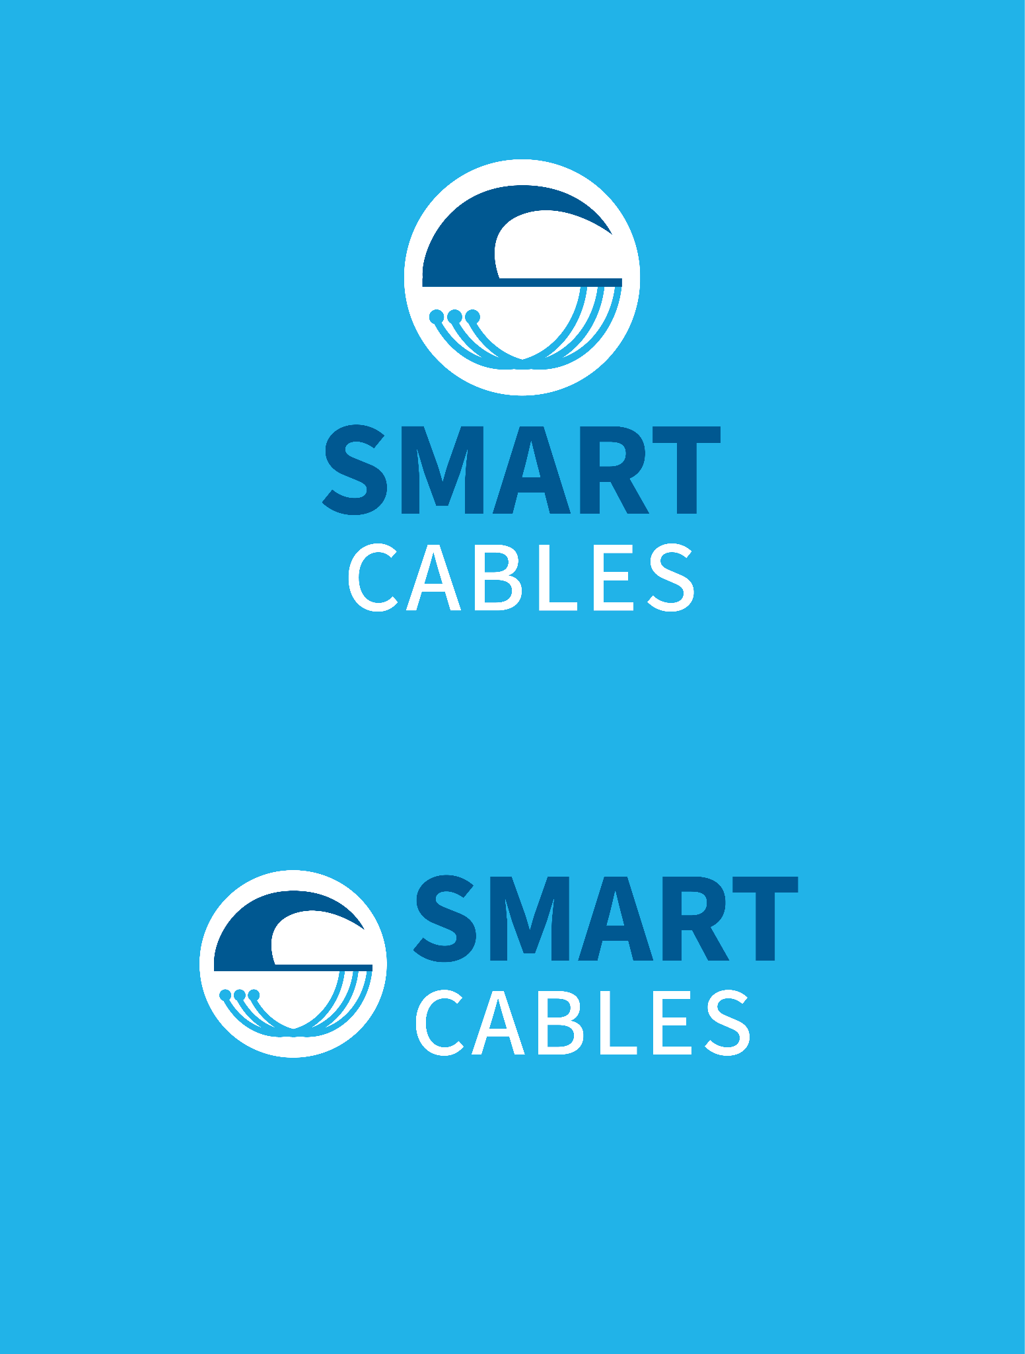

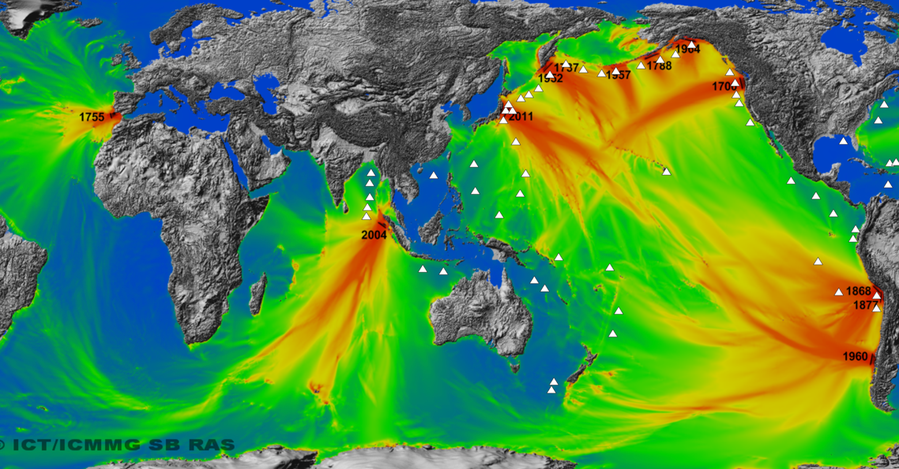
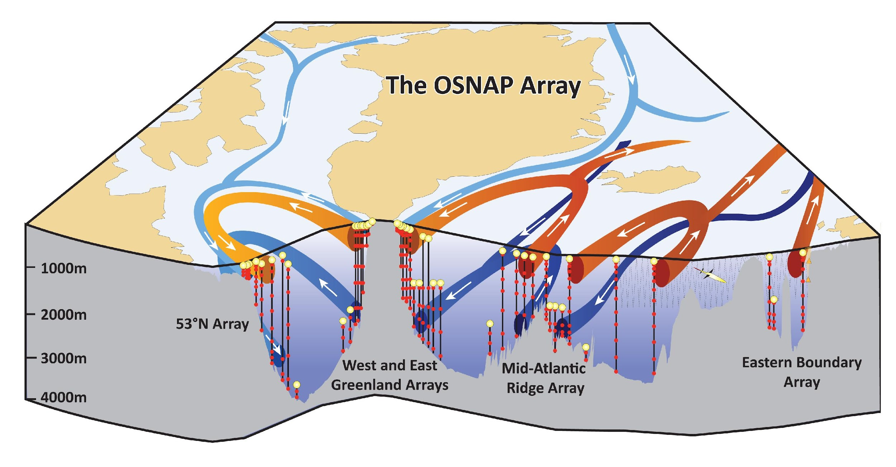

What are SMART Cables and Why do they matter?
SMART Cables integrate sensors into submarine telecommunications cables to measure seafloor temperature, pressure, and seismic motion (SMART modules)
Advancing Climate and Ocean Monitoring
Improving Disaster Risk Reduction
Continuous, long term data for:
Ocean heat content
Sea Level Rise
General ocean circulation
Real time data for:
Earthquakes
Tsunamis
Notes:
Given the global vision of SMART Cables, The Scientific Monitoring And Reliable Telecommunications Cables integrate sensors into subsea telecom infrastructure to measure seafloor temperature, pressure, and seismic motion.
To Advance Climate and Ocean Monitoring providing continuous, long-term data for ocean heat content, sea level rise, and general circulation, contributing to climate models and mitigation strategies.
And improve Disaster Risk Reduction By detecting earthquakes and tsunami-generating events in real time, reducing significantly detection time, enhancing tsunami warning systems.

Slide 3
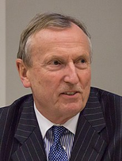

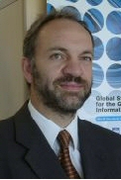


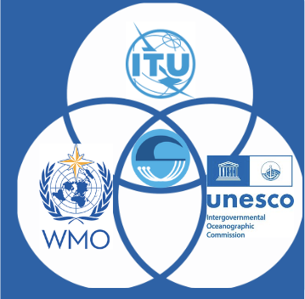
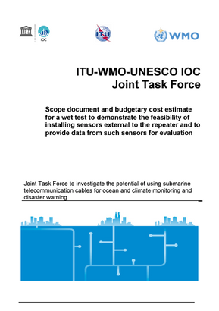
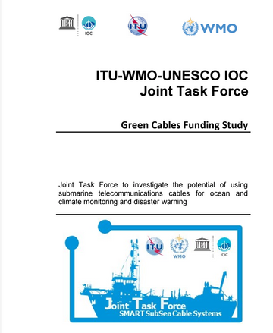
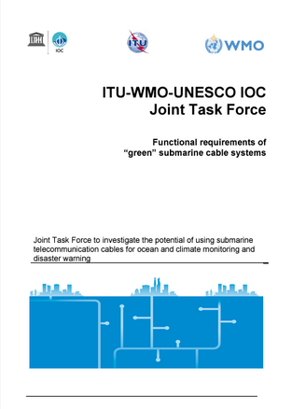
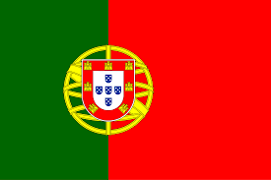
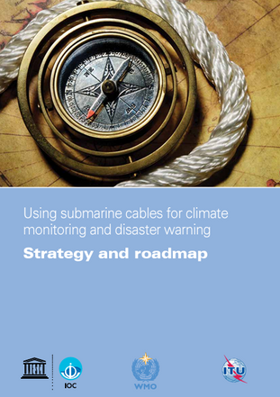
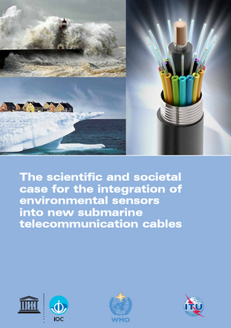
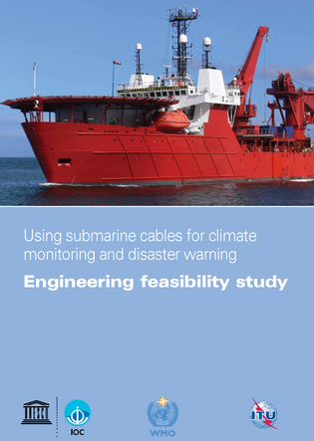


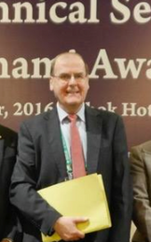


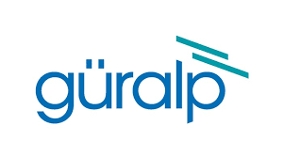

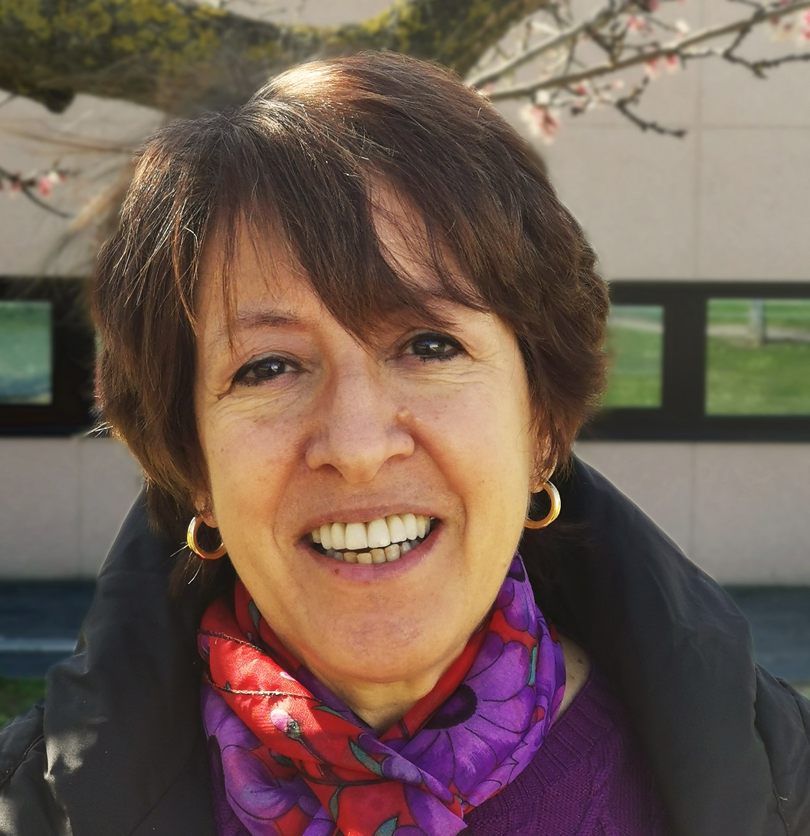
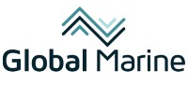

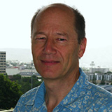

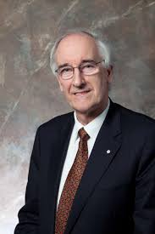

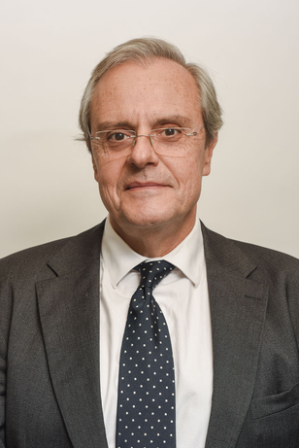
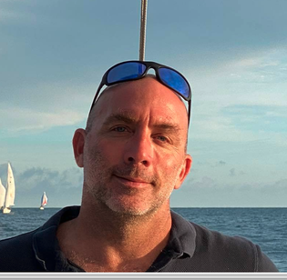
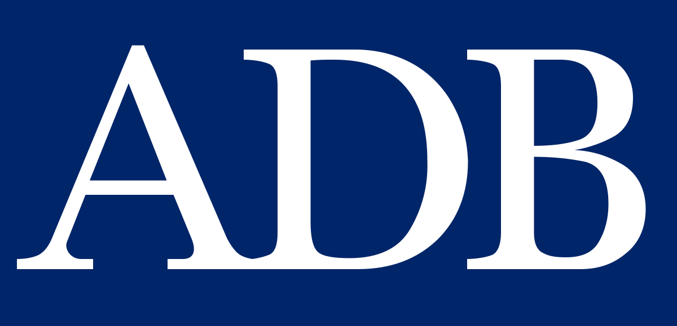

ITU/WMO/UNESCO-IOC JTF SMART Cables
GOAL
Malcolm Johnson
Scholl Reinhard
SMART CABLES GLOBAL NETWORK
John You
NOW
“MOMENTUM”
Thorkild Aarup
2020
Wenjian Zhang
2016
COMMERCIAL AVAILABILITY
FOUNDATIONS
2011
CONCEPT
Laura Beranzoli
Bruce Howe
Chris Barnes
Jose Barros
Jerome Aucan
Notes:
This initiative started back in 2011, when a group of experts from telecom and science formed the ITU/WMO/UNESCO-IOC Joint Task Force at the WMO Workshop on “Submarine Cables for Ocean/Climate Monitoring and Disaster Warning: Science, Engineering, Business and Law” in Rome.
The JTF started under the leadership of Chris Barnes, laying the foundations through papers, white papers, and developing relationships within our UN sponsor agencies' networks.
In 2016, Bruce Howe took over the leadership and has continued the foundational work, focusing on developing the Ocean Bottom Pressure EOV, which achieved success 7 years later in 2023.
In parallel, these three leaders initiated the current three SMART Cable systems:
Laura Beranzoli started the InSEA Wet Demo.
From Portugal’s telecom regulatory sector, José Barros started the Atlantic CAM.
From the scientific South West Pacific community, Jérôme Aucan started the Tamtam SMART Cable system.
Later, in 2020, ASN, a major supplier, committed to developing the SMART capability called the Climate Change Solution, marking the commercial availability of SMART. 😊
Other companies, such as Global Marine, Güralp, and SDS, have also shown interest in developing SMART capabilities.
Currently, SMART Cables has an International Programme Office based in Hawaii. We are an emerging network of GOOS, and telecom cables with SMART capability have a financial structure supported by the European Commission and the Asian Development Bank.

Slide 4
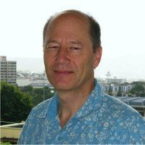
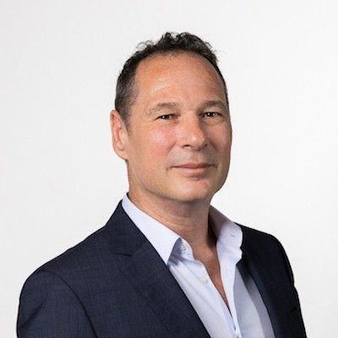
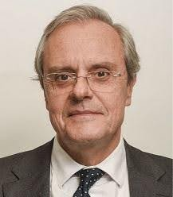

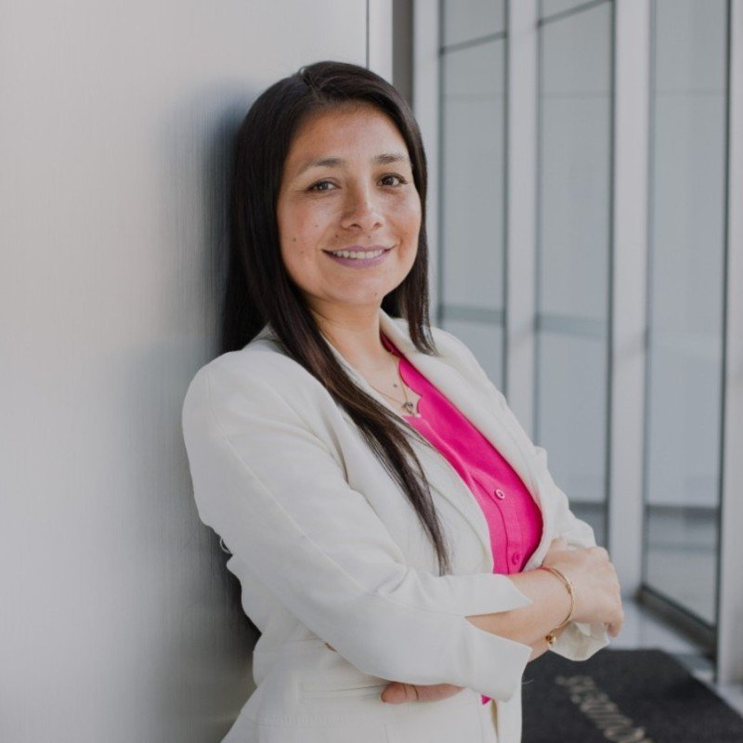
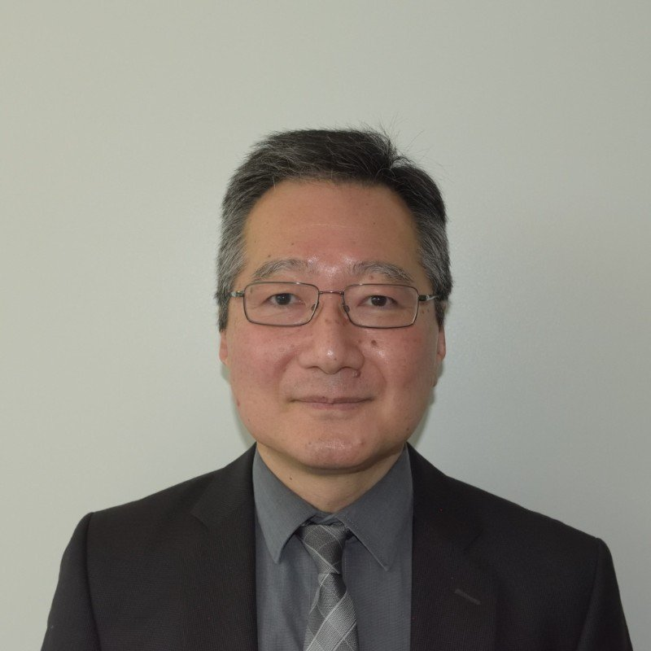
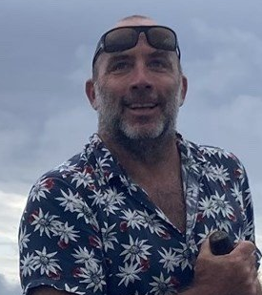
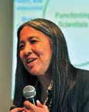
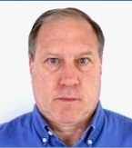
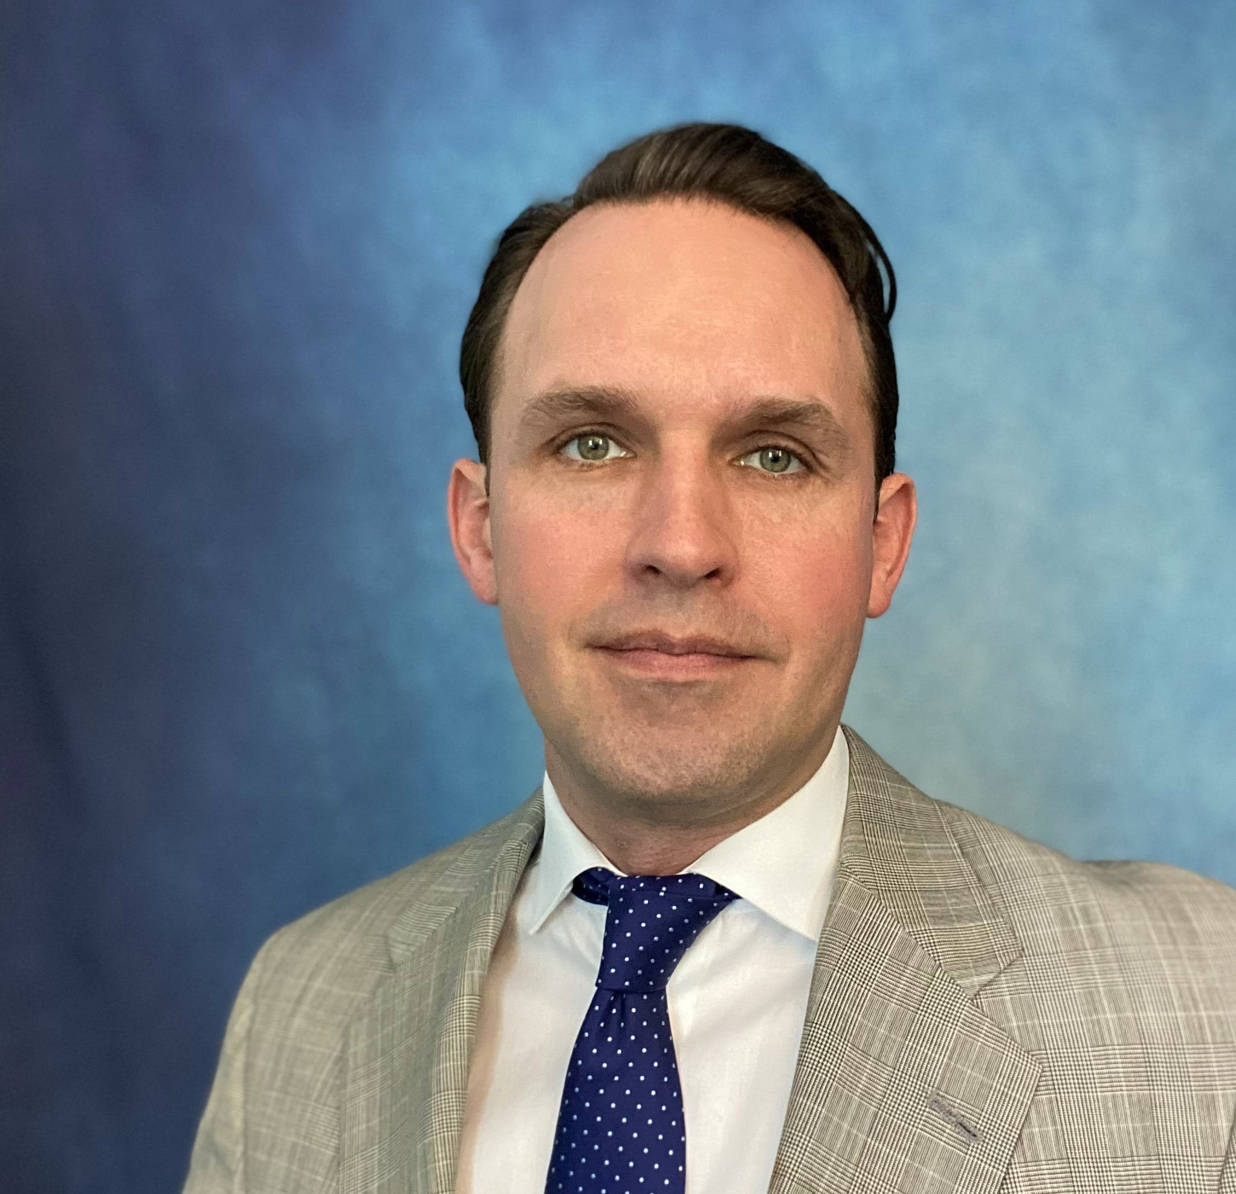
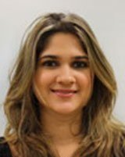
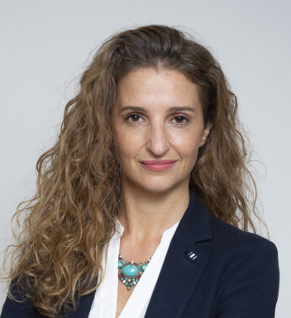

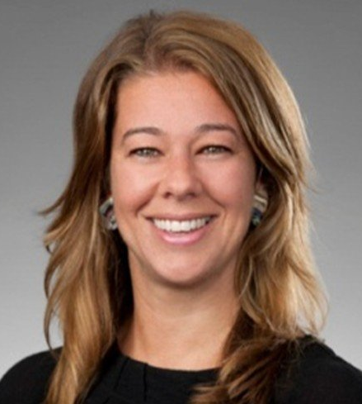
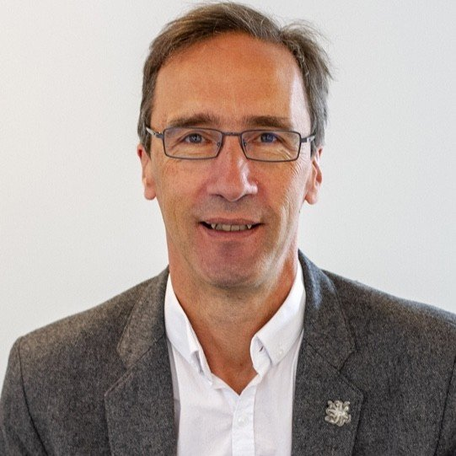
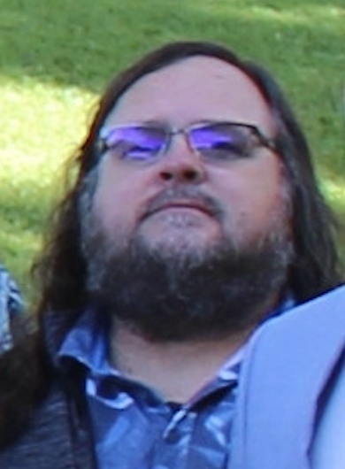
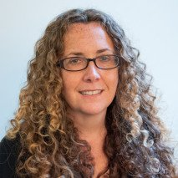
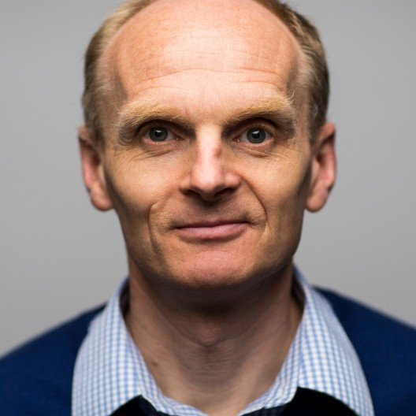
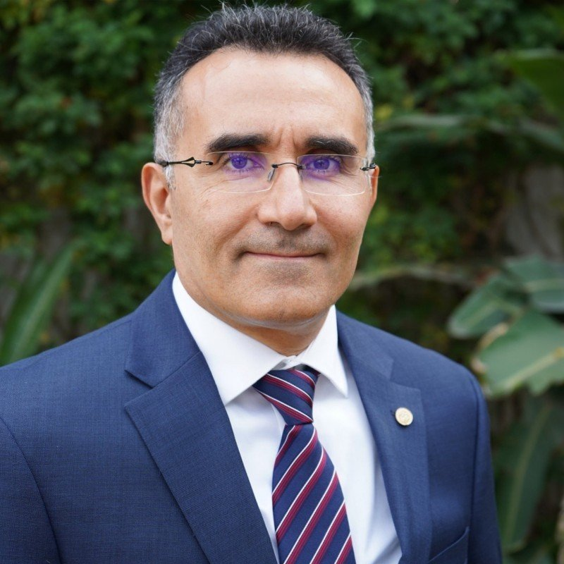
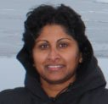
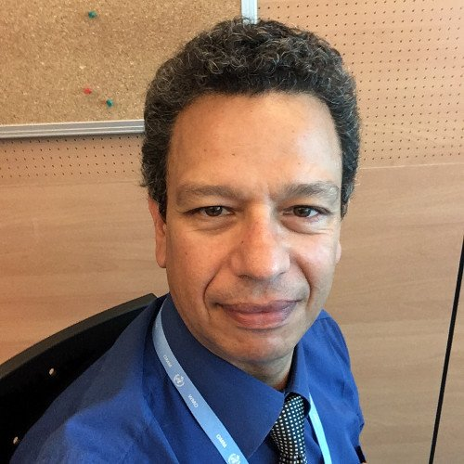
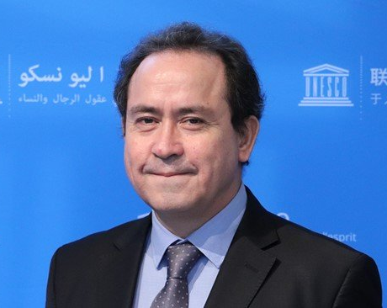
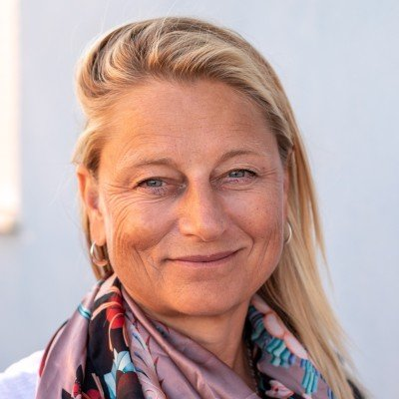
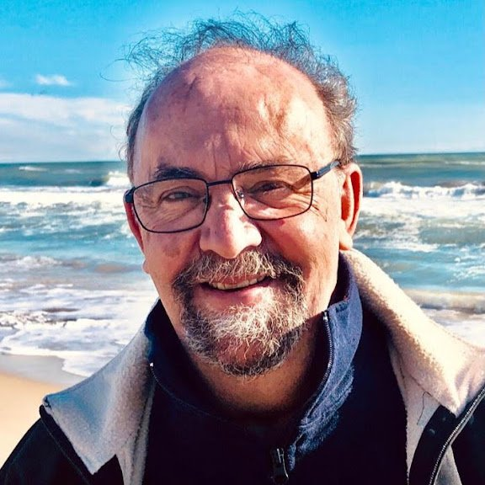
JTF Organization
Executive Council
SECRETARIAT
B. Howe
M. Constable
C. Rodriguez Cruz
Jose Barros
G. Unnikrishnan
O. Hiroshi
Committee Chairs
SRWG
Science and Society
Engineering
Legal And Regulatory
Pub. Awareness and Marketing
Data Management
B. Development
Jerome Aucan
Laura Kong
Steve Lentz
Josh Richards
T. Davenport
V. Tassin
J. El Khoury
K. Panayotou
B. Pirenne
K. O’Brien
L. Wallace
ITU-WMO-UNESCO IOC Staff of the JTF
W. Wilcock
B. Jamoussi
Ch. Gallage
E. Fucile
B. Aliaga
E. Heslop
J. Dañobeitia
Notes:
Currently, the JTF has 400 members and is led by a dedicated leadership team.
ITU serves as the secretariat.
Our structure includes six committees and one working group, bringing together expertise from industry and scientific communities.
We are supported by representatives from UN sponsor agencies, with whom we have collaborated for the past 14 years.
From this specific community, Laura Kong and Bernardo Aliaga play a key role in fostering synergies within UNESCO-IOC programs and the broader scientific community.

Slide 5

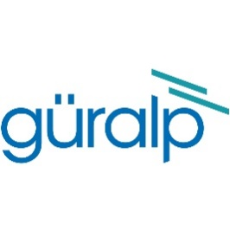

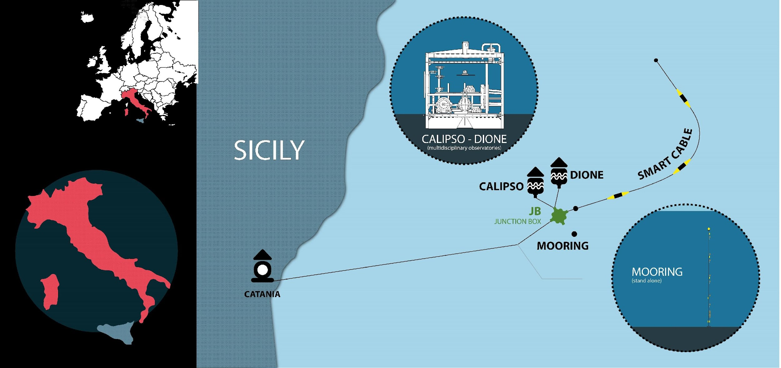
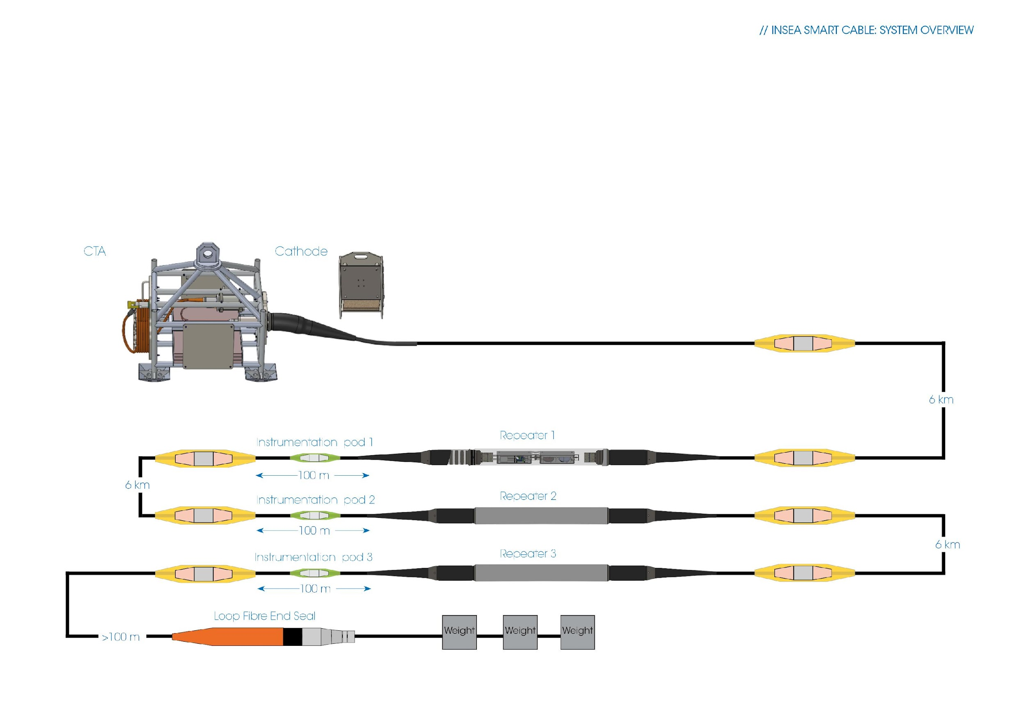
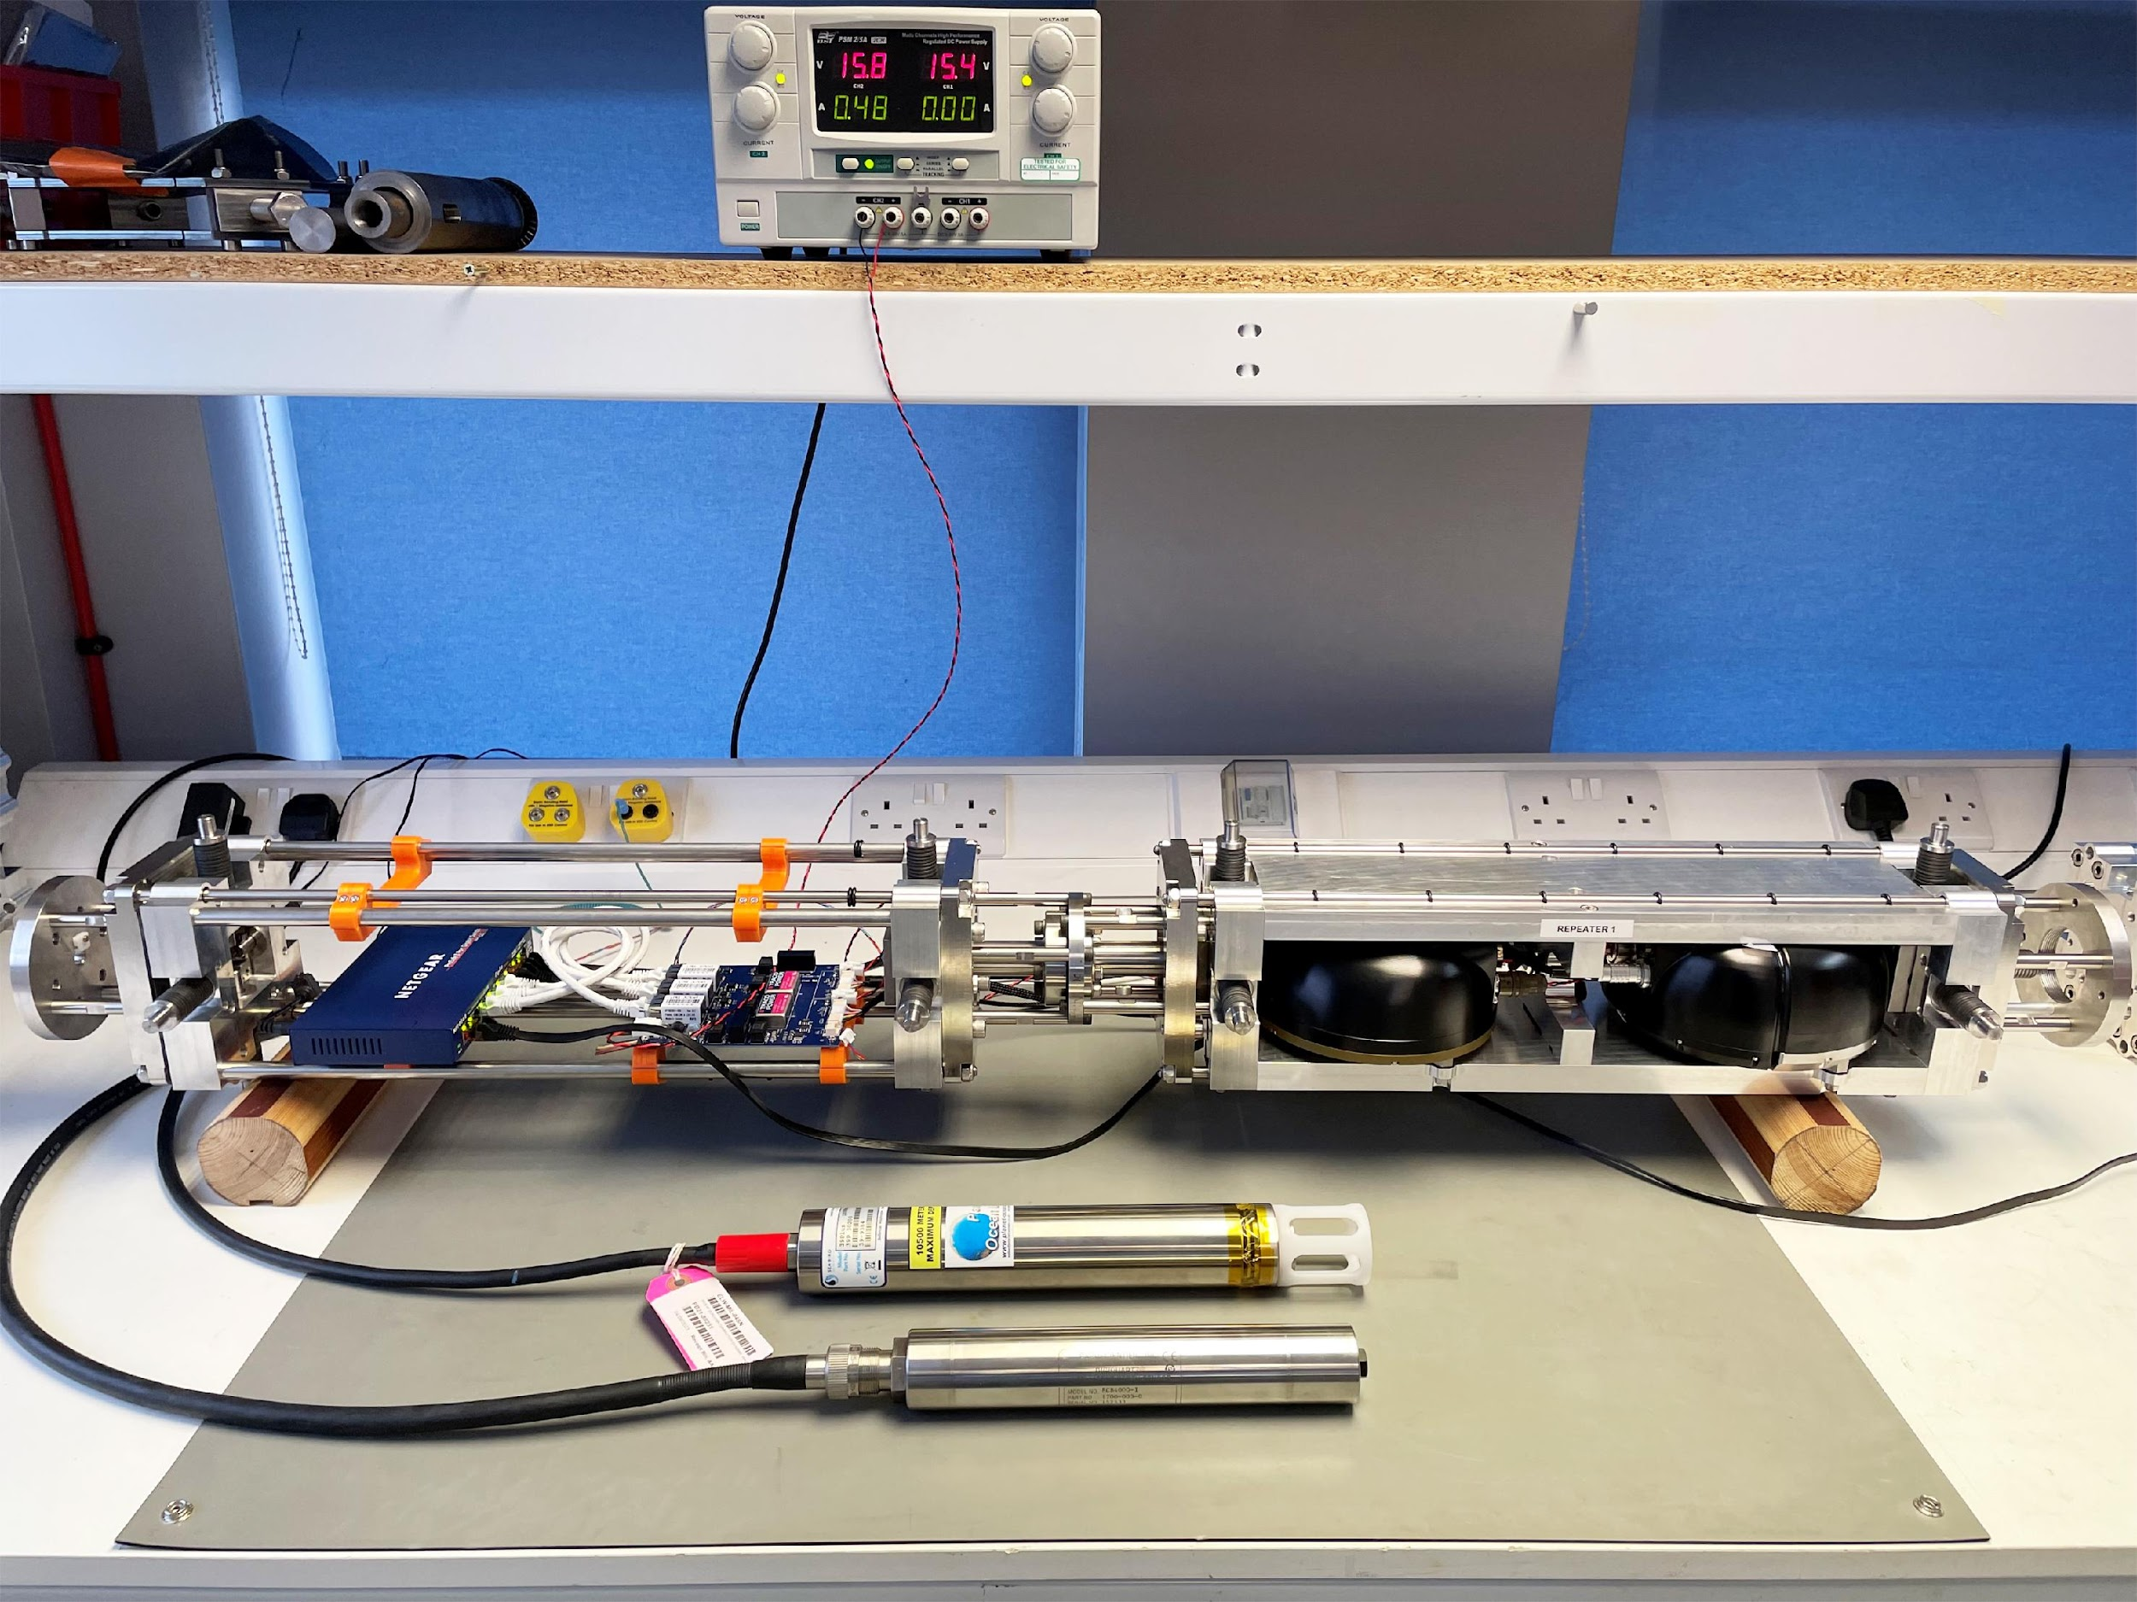

InSEA wet demo SMART cable
System overview
Communication and timinig:
Power:
Repeater:
GURALP Fortimus
GURALP Certimus
Instrument pod:
Seabird SBE 39Plus
Paroscientific 8000 Series
Notes:
SMART Cables are no longer an idea—they are becoming a reality!
Let me highlight three key projects that are setting a precedent:
First, the successful InSEA Wet Demo System, deployed in December 2023 off the coast of Sicily.
This proof-of-concept project has demonstrated real-time data collection from a SMART-enabled cable in the Mediterranean.
It features three SMART modules provided by Guralp and Global Marine.

Slide 6
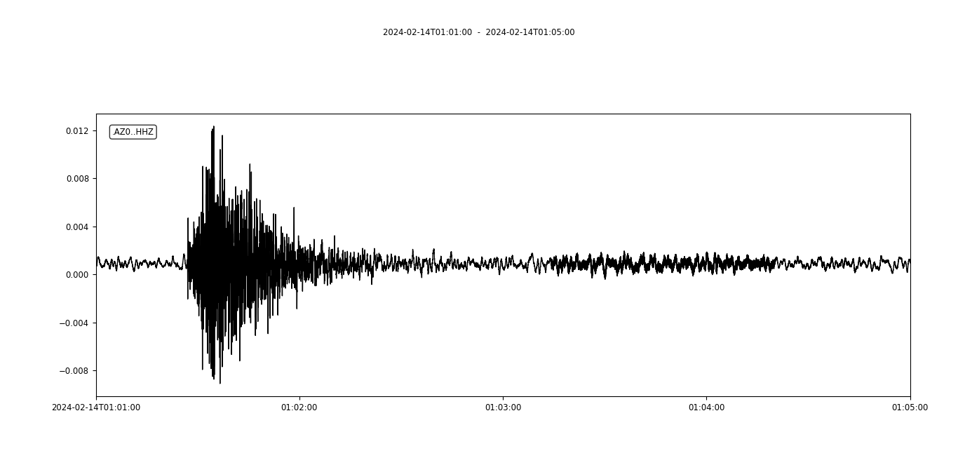












RAW pressure data 1-1-2024🡪29-1-2024
InSEA wet demo SMART cable
temperature data 29-12-2023🡪2-1-2024
pressure data 1-1-2024🡪29-1-2024
CALIPSO observatory seismometer
SMART cable seismometer
REPEATER 3
3-7 Hz filter
CALIPSO
LOCAL EVENT ML 2.9 Ionian Sea
31 km depth
14-02-2024 01:01:17
http://www.moist.it/sites/western_ionian_sea/2/INSEASC
SMART cable PSD
Notes:
Giuditta Marinaro from INGV shared insights comparing data quality from the Calipso Observatory and the SMART Cable System, highlighting their similarity. She also emphasized the open and free access to SMART Cable data through their webpage.
We are collaborating to integrate this data into operational use within the GOOS Data Framework.

Slide 7



Tamtam SMART Cable System
450 km Telecom Cable
Scientific Funding :
4 SMART « CC-nodes »
Other sensing techniques
Data Center
Scientific Research
France + ADB
Notes:
We currently have two SMART Cable systems underway.
The Tamtam SMART Cable System is scheduled for deployment by the end of next year or early 2027.
Financed by France and the ADB, this system will include four SMART modules and a dedicated fiber pair for additional sensing techniques.
It is led by IFREMER in France in coordination with VMGD in Vanuatu.
The University of Hawaii is highlighting this SMART cable as a key system for seismic, acoustic, oceanographic, and tsunami research. This effort is in collaboration with the University of Texas, the University of Louisiana, IRD, SPC, the National University of Vanuatu, VMGD, Caltech and the University of Otago.

Slide 8


Novo Anel CAM
Topologia Física
Atlantic CAM
Physical Layout
Troço
Terceira – Carcavelos
1 590 km
2 CC Nodes
4 CC Nodes
Troço
Terceira- São Miguel 210 km
2 CC Nodes
2 CC Nodes
Extensão Total 3,840 km
6 CC Nodes
2 CC Nodes
Troço
Sines - Machico
990 km
Troço
Funchal - São Miguel 1,050 km
3700 km Telecom Cable
Scientific Funding :
~20 SMART modules
Gov’t €154M. EU support €56M
Other sensing techniques
2 CC Nodes
Notes:
The second system will be the largest SMART Cable System: the Atlantic CAM System. Spanning nearly 4,000 km, it will host 20 SMART modules, strategically placed as shown in the image.
This cable system is funded by the Portuguese government through IP Telecom and the Directorate-General for Communications Networks, Content and Technology (DG CONNECT) of the European Commission.
Additionally, the system will include a dedicated fiber pair for other sensing techniques.

Slide 9

SMART and Other Sensing Techniques
Complementary not Competition
OFS – fiber strain at various time and space resolutions – 1-D ~acoustics
SMART sensors and data types operational
OFS science sensing and data in research state
Measurement characteristics can differ in complementary ways
SMART sensors can calibrate fiber sensing observations
Each can validate unexpected observations
Expectation that a combination will contribute to the protection of the cable itself as well as other cables in the vicinity (most noticeably with DAS)
CAM and Tamtam:
Ideal for investigating capabilities and complementarity
Notes:
With the Tamtam and Atlantic CAM systems underway, we see them as an ideal platform for investigating capabilities and complementarities with other sensing techniques.
The key is collaboration—by working together, we can fully leverage this incredible opportunity.

Slide 10





Why now - South East Pacific Region?
There are observational gaps in the present Seismic and tsunami sensor network
Regions like South America have limited time (< 15 min) between tsunami generation and arrival at the nearest coast
It takes too long for current tsunami networks to be of use for near-field warning
Lead time (between detection and nearest coastal tsunami arrival) is often negative
tsunami travel time from source to nearest DART
tsunami travel time from source to nearest coast
Difference between coastal & DART tsunami arrival
amy.williamson@berkeley.edu
lead time (minutes)
travel time (minutes)
Notes:
With the Pacific Ocean as a reference and the expertise of our JTF volunteers, we have compelling results that highlight the urgency of deploying SMART Cables in key areas of the Pacific.
One critical example comes from simulations in the South East Pacific Region:
Dr. Amy Williamson's research demonstrates, in the left figure, the time it takes for a tsunami to reach the nearest coast—typically 10–15 minutes (represented by warm colors, indicating shallow water with lower tsunami speeds).
The middle figure, she incorporates the current ocean sensors, including the DART Network. Showing, tsunamis reach the coastline much faster than they reach DART buoys.
The right figure illustrates the consequence: negative lead times, meaning the tsunami strikes the coast many minutes before it reaches the DART buoys.

Slide 11



Why now - South East Pacific Region?
A SMART cable just seaward of trench (left) decreases the time to detection, increasing (positive) lead time.
The addition of offshore seismic stations reduces both detection time and azimuthal gap for initial earthquake location estimates.
tsunami travel time from source to SMART cable
Difference between coastal & cable tsunami arrival
SMART seismic and tsunami sensor cable network fills an observational gap
for real-time
earthquake and tsunami
early warning
az. gap with just seismic network
az. gap with seismic & cable
amy.williamson@berkeley.edu
travel time (minutes)
Seismic azimuthal gap
lead time (minutes)
Notes:
Given the current scenario, Amy has implemented the SMART capability along the coast, as outlined in the SEP Regional report, with SMART modules placed every 100 km.
Now, we can observe how SMART Cables significantly reduce detection times. By merging these two networks, we move from negative lead times to generally positive lead times.
This means the SMART capability will provide real-time observation of the tsunami prior to its arrival at the coast.
Additionally, Amy highlights another positive effect of the SMART capability, using Chile as an example, as shown in the two figures on the right. On the left, we can see the seismic stations that Chile currently has, all of them on land. By adding SMART capability, the azimuthal gap is reduced, leading to significantly improved earthquake location estimates.
Based on these results, we can say that placing a cable offshore, close to the trench, will enhance earthquake and tsunami early warning operations. It will provide real-time observation, improve warning operations, and support better decision-making from the initial bulletin through to the event cancellation.

Slide 12



Why now - Caribbean Sea?
Detection times
Existing, NO SMART
Optimistic
all existing cables SMART
Detection times
EXISTING + SMART
100 s
30 s
Detection Times for Earthquakes (at 4th station)
elizabeth.vanacore@upr.edu
Dr Elizabeth A Vanacore,
Chair Task Team CARIBE WAVE 2
Notes:
Similar modeling has been conducted in the Caribbean Sea by Dr. Elizabeth Vanacore, where she presents a simulation comparing the scenario with and without SMART cables in the region.
In the first image we can see it takes over a 100 seconds to detect an earthquake at the fourth receiving station
However, in a hypothetical scenario where SMART capability is added to all existing cables (as shown on the map), the detection time at the fourth station is significantly reduced. With SMART cables, it takes only 0–30 seconds to accurately locate the seismic event.
Currently, we are working to determine the expected cable replacement dates so that we can create a more realistic scenario of improvement over time in the region.
As shown in the image, all seismic stations in the Caribbean are currently located on land. To effectively forecast a tsunami, it's crucial to accurately determine the location of the seismic event, which requires valid signals from at least four stations.
In the first image, considering the current seismic monitoring capabilities, we can see how long it takes to detect an earthquake at the fourth receiving station. In most of the Caribbean, detection time exceeds 100 seconds.
However, in a hypothetical scenario where SMART capability is added to all existing cables (as shown on the map), the detection time at the fourth station is significantly reduced, as seen in the right-hand figure. With SMART cables, it takes only 0–30 seconds to accurately locate the seismic event.

Slide 13





Seismic Instrument Noise and Performance
Barcheck et al., 2020
Bell et al., 2015
OBS data are noisy compared to land, in part due to compliance and tilt noise.
Infragravity waves induce compliance noise, identified through PZ coherence. Depends on water depth.
Bottom currents cause tilt noise, identified through high ZH coherence. Depends on instrument design.
Ongoing Projects Related to SMART:
Original
ATaCR
NoiseCut
Comparisons of seafloor seismic noise at a variety of different locations, instrumentation, and installations – eventually expanding to SMART nodes as data becomes available.
Comparisons of different noise removal techniques to improve data quality and extend methodologies to SMART cable data.
hajanisz@hawaii.edu
Notes:
Here, we can see the progress of Dr. Helen Janiszewski from the University of Hawaii, who is working to identify and reduce oceanographic noise in currently available instrumentation (seismic and acoustic) from the seafloor. She is investigating two types of noise: horizontal noise produced by bottom currents and vertical noise caused by infragravity waves.
This work will help assess seismometer installation methods and determine which noise removal techniques are most effective in improving data quality.
This involves comparing seismic data with data from pressure gauges or hydrophones.
We are currently coordinating with INGV to work with the InSEA Wet Demo data, and it remains to be seen whether the cable installation method impacts noise properties.
Overall, through this project, Helen, along with her graduate students Elliona Maso and Charles Hoots, aims to characterize the variability of noise and data quality in cable systems to better understand how installation methods affect data quality.

Slide 14


Tamtam SMART Cable
Cable Route
Port Vila, Vanuatu – Lifou, New Caledonia with four sensors
Vanuatu subduction zone with frequent tsunamigenic earthquakes
Simulated Earthquake and Tsunami Dataset for System Optimization
2013 Mw 8.0 Santa Cruz Island Earthquake
2021 Mw 7.7 earthquake southeast of the Loyalty Islands
UNESCO IOC Mw 8.8 maximum earthquake scenario and five Mw 8.33 sub events (A, B, C, D, E)
Earthquake and Tsunami Modeling
Finite fault rupture models
Nonhydrostatic tsunami modeling from seafloor deformation
PREM and SYNGINE seismic wave simulator
2013 Mw 8.0
2021 Mw 7.7
2023 Mw 7.7
UNESCO IOC Mw 8.8
A
B
C
D
E
Notes:
Dr. Fai Cheung is developing a Simulated Earthquake and Tsunami Dataset for system optimization, which includes recent historical events as well as worst-case scenarios recommended by UNESCO-IOC in the 2024 expert meeting in Vanuatu. This work focuses on the Tamtam SMART Cable System as a key system in the region.

Slide 15



Global development: Polar and North Atlantic
Polar Connect, Far North Fiber, Tussas, PISCES, IRIS, IOMEA
Antarctica Chile
Drake Passage
AUS/NZ Antarctica
NSF McMurdo
Notes:
The SMART Cables Initiative is a global effort, and we are seeking telecom projects to integrate SMART Capability all around the globe.
In the North Atlantic region, we have approximately 7 future systems in the initial stages, with most of the the projects applying for EC funding.
In the South, we have 2 systems
The Chile Antarctic System - called "Cable antartico", is currently conducting a feasibility study. Due to its location and significance in the ocean for the Drake Passage, is primarily considered a scientific cable and on top telecom. Openning the door to a new business case where government leads change.
The NSF Antartic cable from Australia/NZ to McMurdo base in Antarctica, have completed feasibility studies and continue to progress along their long-term timelines.

Slide 16

SMART – Summary- Call to action
Global Array: Climate, Oceans, Sea Level, Earthquakes, Tsunamis
Marriage of science with telecom
One part of the global environmental monitoring system
Greater understanding of our planet - undeniable humanitarian benefits
Integration of SMART Cables into the Pacific Tsunami Warning System (PTWS)
Establish a UNESCO-IOC SMART Cable Working Group.
Challenges remain – first systems setting positive precedents
Notes:
While challenges remain, early systems are setting positive precedents, demonstrating the successful union of science with telecom.
SMART Cables is an integral part of the Global environmental monitoring system, contributing to a greater understanding of our planet and providing undeniable humanitarian benefits. By integrating SMART Cables into the Pacific Tsunami Warning System (PTWS), we can enhance real-time monitoring capabilities and save lives.
We are also working towards establishing a UNESCO-IOC SMART Cable Working Group to further drive this initiative forward.
SMART Cables is a collaborative initiative that requires partnerships between governments, the private sector, and the scientific community.
The technology is ready, and the first deployments are already happening.
Now, the question is: Will we take the next step to make SMART Cables a global standard?

Slide 17

SMART – Summary
Need Early involvement with projects
Wouldn’t it be nice to have this cable SMART?
Notes:
In the next decade, we have a unique opportunity to transform the way we observe the ocean. By integrating SMART technology into submarine cables, we can enhance earthquake and tsunami early warning, advance climate science, and safeguard coastal communities.
I invite you all—scientists, colleagues, experts and representatives —to join us in making SMART Cables the future of ocean observation. Let’s get the best of this moment, because the next tsunami won’t wait for us to be ready.
Thank you.

Slide 18



SMARTCables.org
ITU/WMO/UNESCO-IOC Joint Task Force
Scan to Join!
Danke Gracias ありがとう 谢谢 Xièxiè Arigatō Thank you Dhanyavaad
Merci Tankyu tumas Terima kasih Takk Grazie Mālō 'aupito Kop koon Salamat po S' efharistó

Slide 19


How SMART Cables work?
Shared Cable Infrastructure: Telecom + science
Integrated Sensors:
Temperature
Pressure
Seismic
Key point:
Essential Ocean Variables
Sensor module
INGV InSEA SMART Wet Demo
Existing Technology
Leverage Existing Technology
Guralp + Global Marine
Notes:
Given the global reach of SMART Cables, the JTF advocates for integrating three key sensors: temperature, pressure, and seismic motion. These sensors contribute to the Essential Ocean Variables (EOVs) of the Global Ocean Observing System (GOOS).

Slide 20













JTF Sponsors
Status Southern Ocean – SMART Can Help
JTF Secretariat
Resolutions on climate change Disaster Risk Reduction (DDR) includes SMART
Recommendations SG15/Q8 G.dsssc/9730.1 and G.SMART/9730.2
Integrates SMART into WMO Information platform
Global Ocean Observing System (GOOS)
Tsunami Programme
UN Ocean Decade: endorsed Project
Emerging Observing Network of GOOS

Slide 21





SMART Repeaters: Subsea Data Systems
3-Axis Omni-Tilt Seismic Sensor
  Low-noise intermediate band switchable seismometer
  Silicon Audio 205 (acceleration); 215 (velocity)
  0.01 to 500 Hz bandwidth
  Best in class noise performance
  183 dB dynamic range (high+low gain digitization)
  30 mm diameter x 35 mm length (each sensing element)
20 cm
SMART Repeater Sensor System
Temperature Sensor (external)
  Glass Coated Thermistor (GCT)
  Sea-Bird SBE 03S
  ±0.002ºC accuracy
  Maintains calibration over time
  49 mm diameter x 256 mm length
Pressure Sensor (external)
  Absolute Pressure Gauge (APG)
  Paroscientific 4*K-101-0
  1 part in 10⁷ resolution
  Few parts in 10⁶ accuracy; mainly limited by drift
  Signals of interest between 0.001 and 1 Hz
  35 mm diameter x 108 mm length
SMART electronics /
seismic sensor in ~20cm / 8in radius cylinder

Slide 22


Slide 23

Separate modules:
+ Variable spacing
+ More flexible sensors
– $/unit
Commercially
available
Sensors:
Nanometrics - OBS + Accel
RBR – A-0-A pressure, temperature

