Slide 1
Improving forecasts through data assimilation
Yuichiro Tanioka
Center for Natural Hazards Research
Hokkaido University

Slide 2
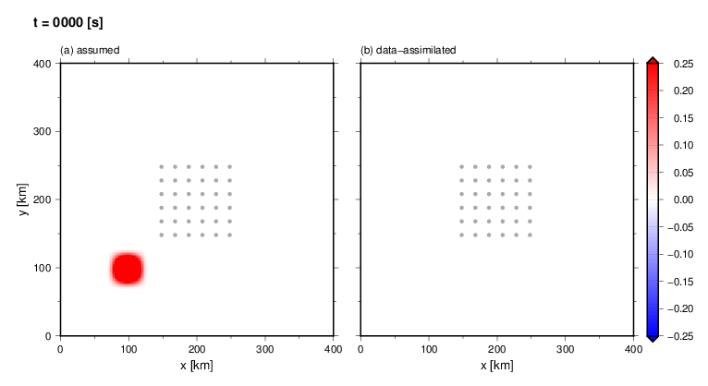
Tsunami Data Assimilation
Data assimilation method:
Major characteristic of data assimilation is that it does not rely on the source information
Tsunami observations from a dense network are continuously assimilated to update the wavefield at each time step and to forecast the coastal tsunami without assuming a tsunami source (Maeda et al., 2015)
① Propagation Step
$x_{n}^{f}$: Forecasted Tsunami Wavefield
$x_{n}^{a}$ : Assimilated Tsunami Wavefield
$F$: Tsunami Propagation Matrix
$x_{n−1}^{a}$ : Wavefield at the previous time step
$y_{n}$ : Observed tsunami
$H$: Observation matrix H
$W$: Weight Matrix
$x_{n}^{f}=Fx_{n−1}^{a}$
② Assimilation Step
$$x_{n}^{a}=x_{n}^{f}+W(y_{n}−Hx_{n}^{f})$$
Example of Data Assimilation:
(Maeda et al. 2015)
Assumed
Data-assimilated
Notes:
Propagation step ① and assimilation step ② are conducted alternately during the calculation.

Slide 3
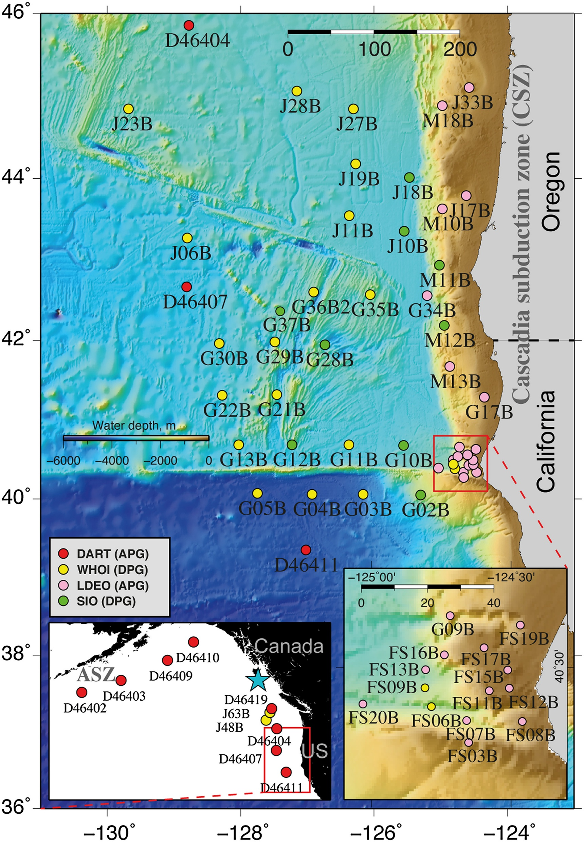
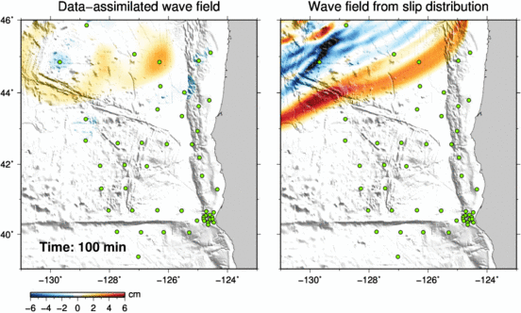
The data assimilation was applied to actual data
The 2012 Haida Gwaii earthquake By Gusman et al. (2016)

Slide 4
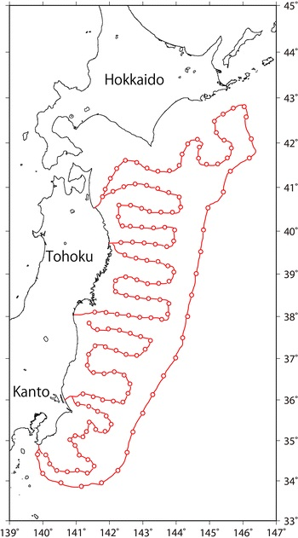
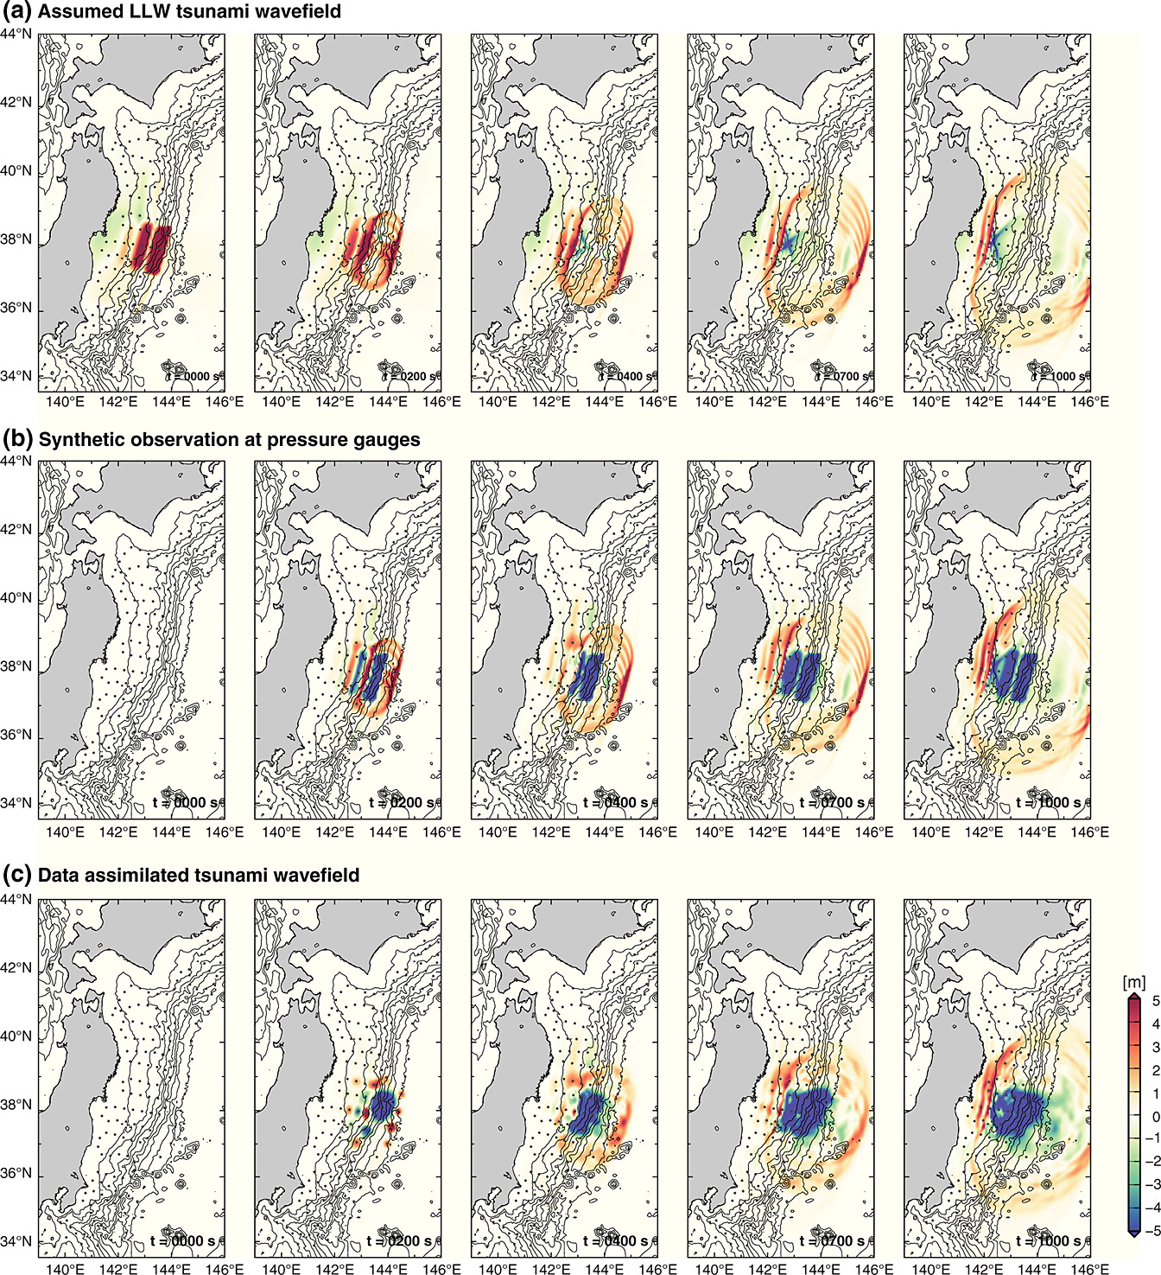
(Maeda et al., 2015)

Slide 5
Tsunami computation generally need the source model
S-NET
(30㎞ apart)
Tsunami assimilation
(Tanioka 2018)
(Tanioka and Gusman, 2019)

Slide 6
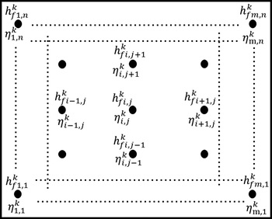
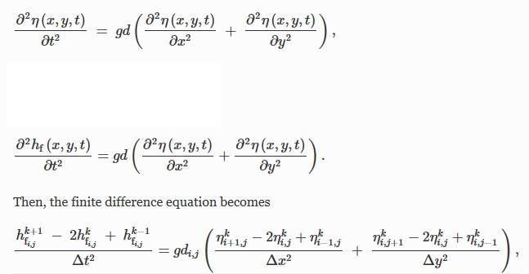

Slide 7
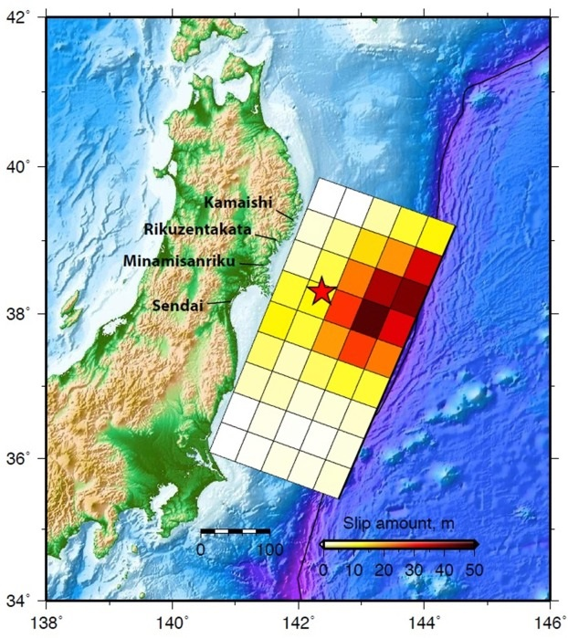

Slide 8
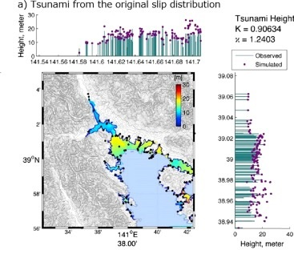
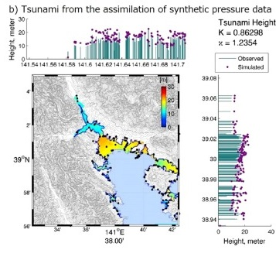
Rikuzen-Takada

Slide 9
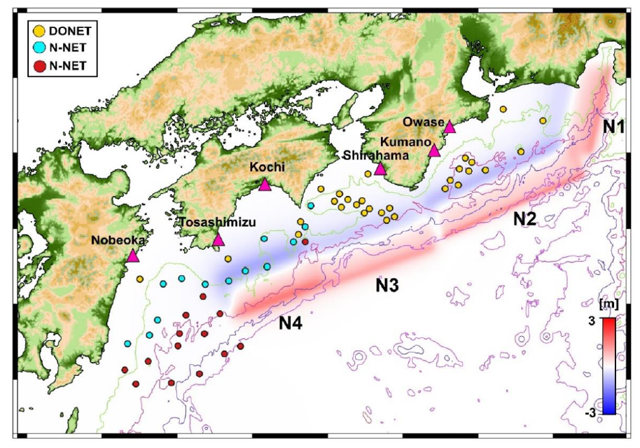
Hybrid Method
1) Rapid preliminary fault model estimated by GNSS data (REGARD)
2) Data assimilation (ocean bottom pressure data)
Nankai Earthquake (1707 Hoei type)
Hybrid Method
Eliminate the stations in the main source area.
Assume a single rectangular fault model as a rapid preliminary fault model.
Sea surface deformation from the preliminary fault model is used to correct the pressure data to the observed tsunami waveform data
Data assimilation

Slide 10
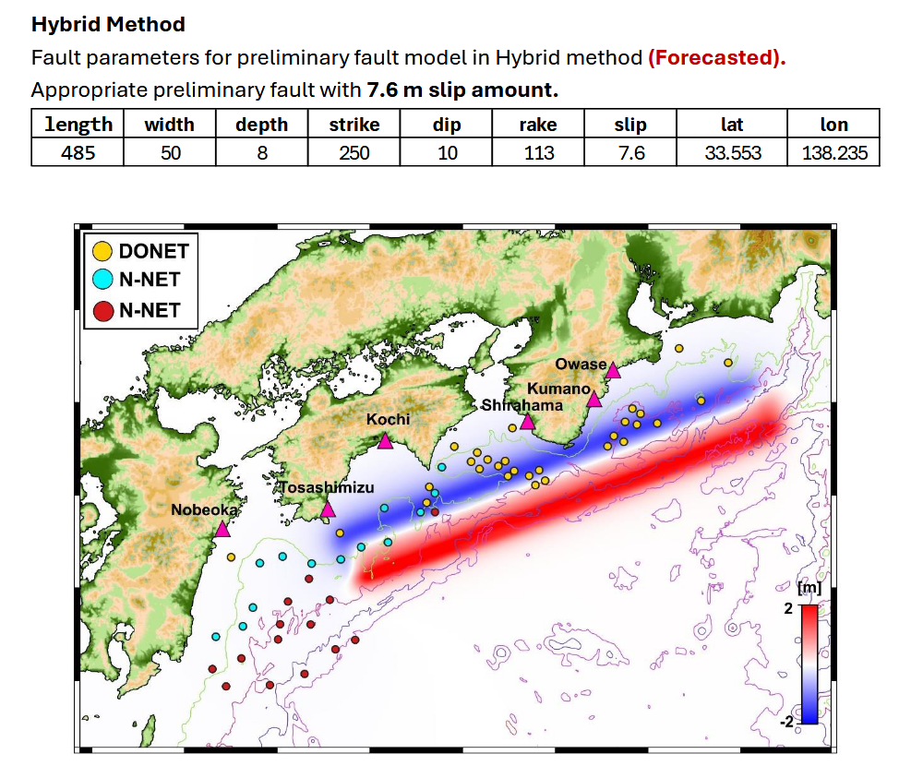

Slide 11
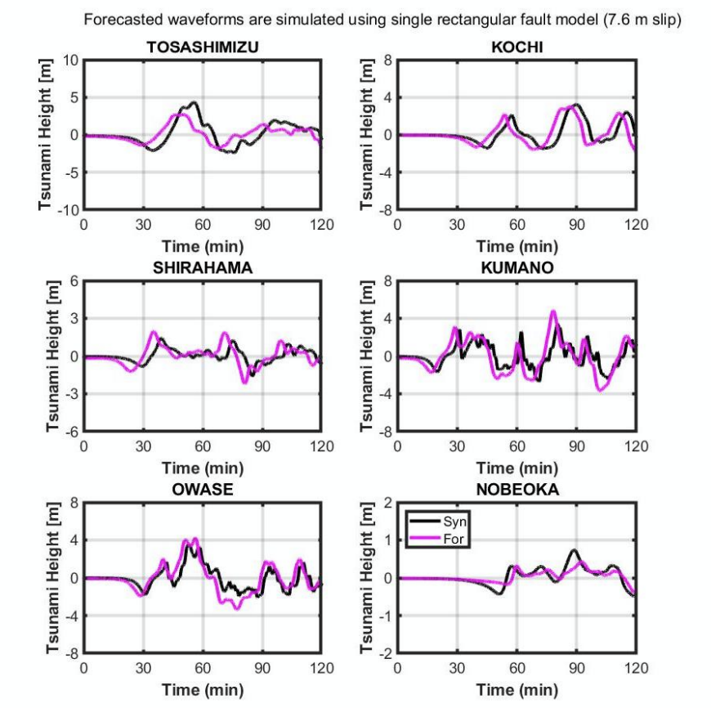

Slide 12
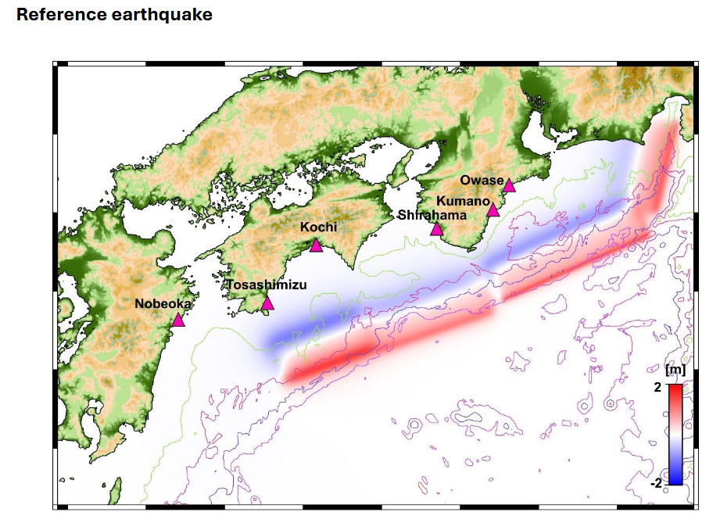
Nankai Earthquake (1707 Hoei type)

Slide 13
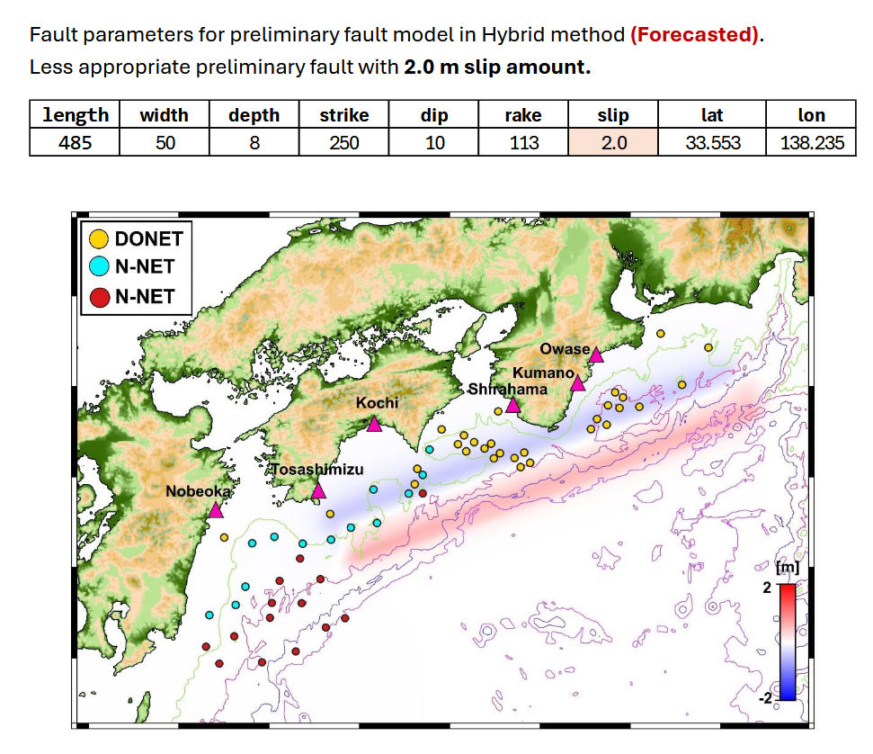

Slide 14
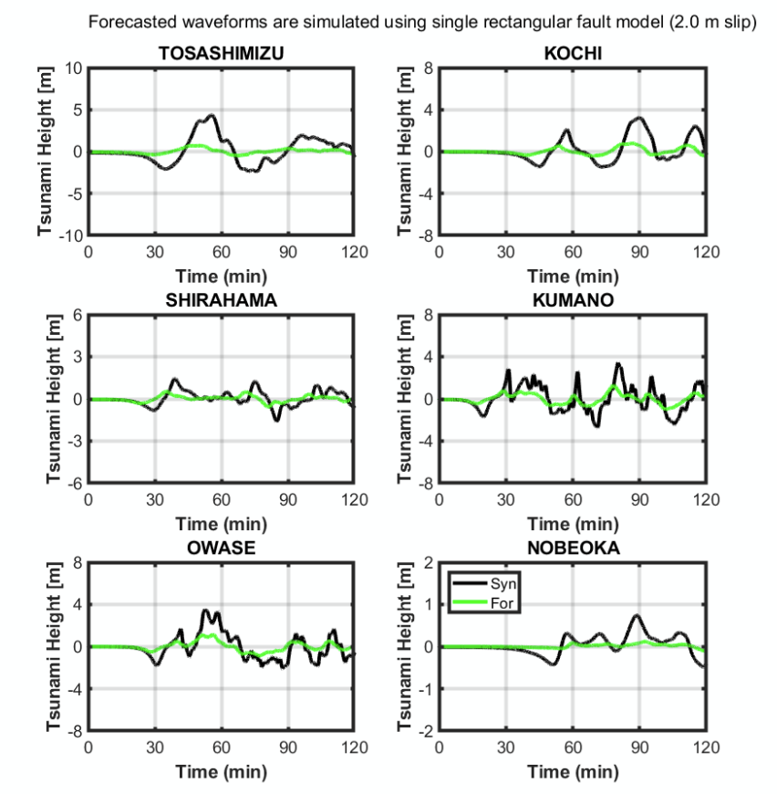
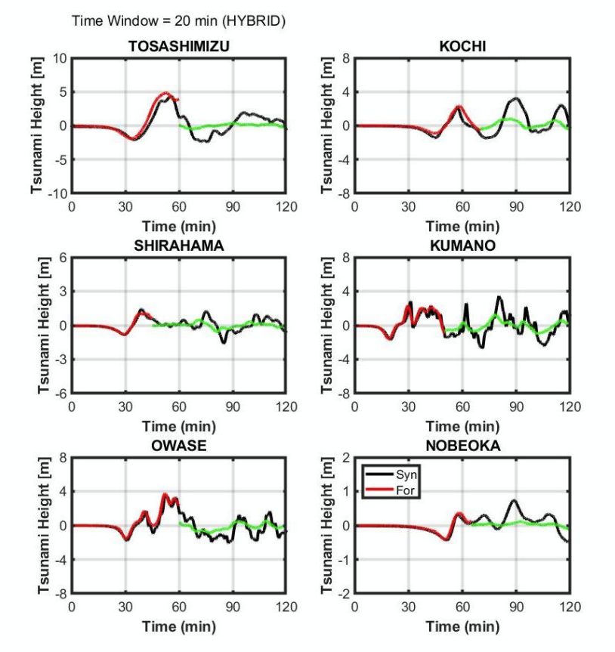

Slide 15
Nankai Earthquake (1707 Hoei type)

Slide 16
Conclusions
Data assimilation methods were developed using dense waveform data
Data assimilation improves the accuracy of the tsunami forecast

