Slide 1













Probabilistic Tsunami Forecasting (PTF)
Stefano Lorito
INGV, Italy
w/ contributions by, at least:
9th Joint ICG/PTWS–IUGG/JTC Workshop
60th Anniversary of the ICG/PTWS – Past and Future
Beijing, China, 7 April 2025

Slide 2
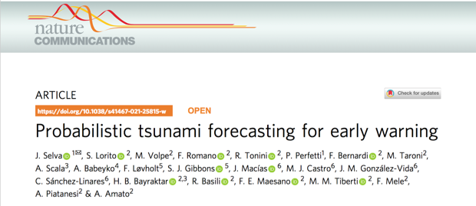
What PTF does
Probabilistic Tsunami Forecasting (PTF, Selva et al., 2021) is a recently introduced methodology that provides a forecast of a tsunami in terms of the probability distribution of a tsunami intensity measure at different forecast points within a few minutes after the occurrence of an earthquake.
Selva, Volpe, Lorito, Romano et al., Nature Communications, 2021
PTF is planned to become operational at CAT-INGV, Italy, NEAMTWS TSP in 2025. At least another NEAMTWS TSP, NOA, Greece, is considering its adoption.
INCOIS is considering PTF in the frame of the People-Centred Early Warning for the Indian Coastlines (PCTWIN) project coordinated by UCL, UK.
Others have started to use or develop ensemble modelling approaches which share some elements with PTF to consider uncertainties in the tsunami forecasting (e.g. New Zealand, Chile, USA NOAA).

Slide 3
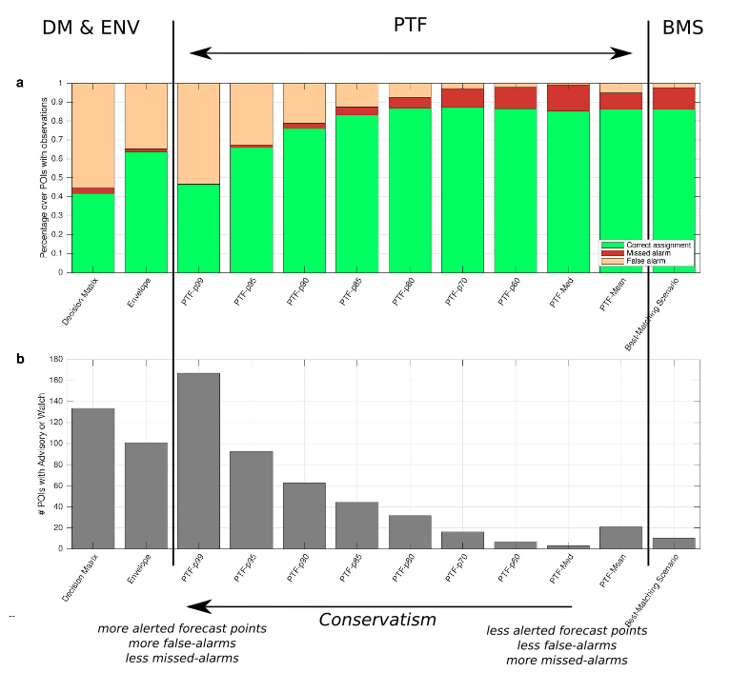
How PTF can be used
Alert levels - linked directly to response actions - can be defined based on the desired level of risk reduction, and they can be used in operational tsunami early warning or rapid post-event assessments.

Slide 4
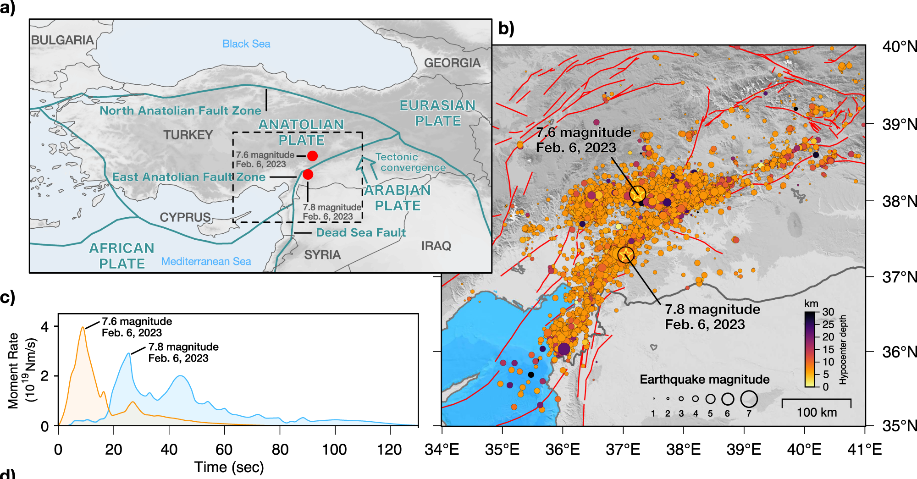
How PTF can be used: near-field
The PTF can provide alerts in the near-field - example
The M7.8 and M7.5 Kahramanmaraş Earthquake Sequence struck near Nurdağı, Turkey (Türkiye) on February 6, 2023
Dal Zilio & Ampuero, 2023

Slide 5
How PTF can be used: near-field
The PTF can provide alerts in the near-field - example

Slide 6
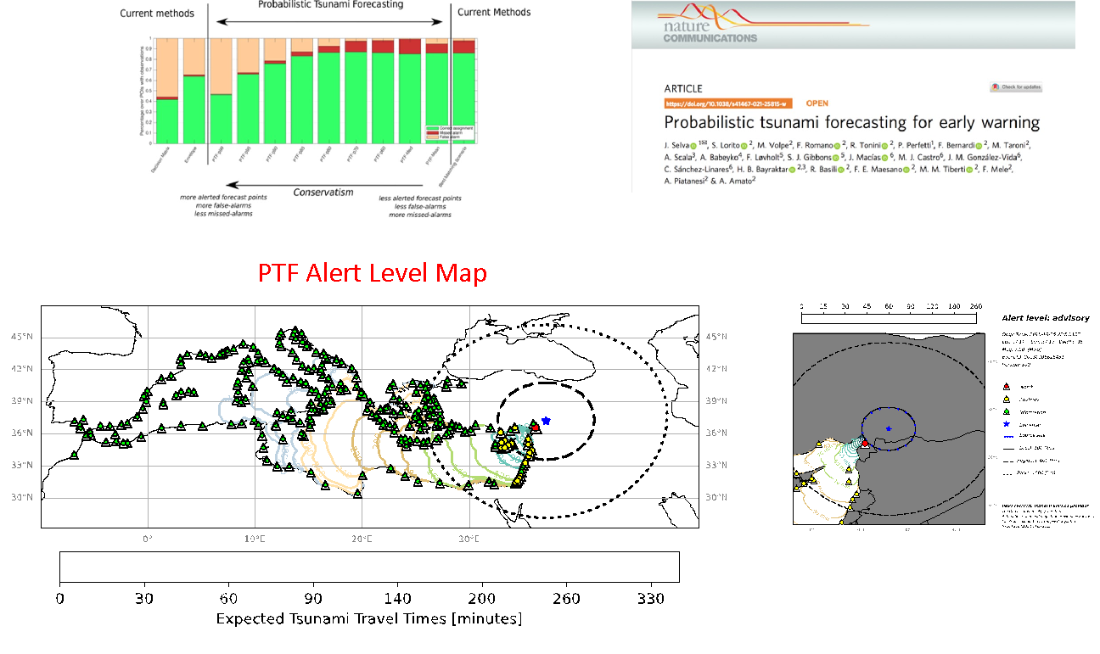
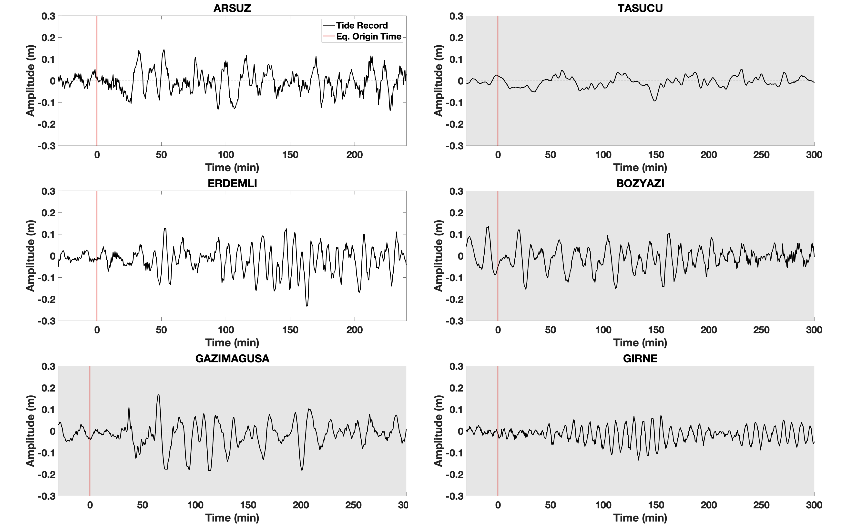
How PTF can be used: near-field
The PTF can provide alerts in the near-field - example
Dal Zilio & Ampuero, 2023

Slide 7
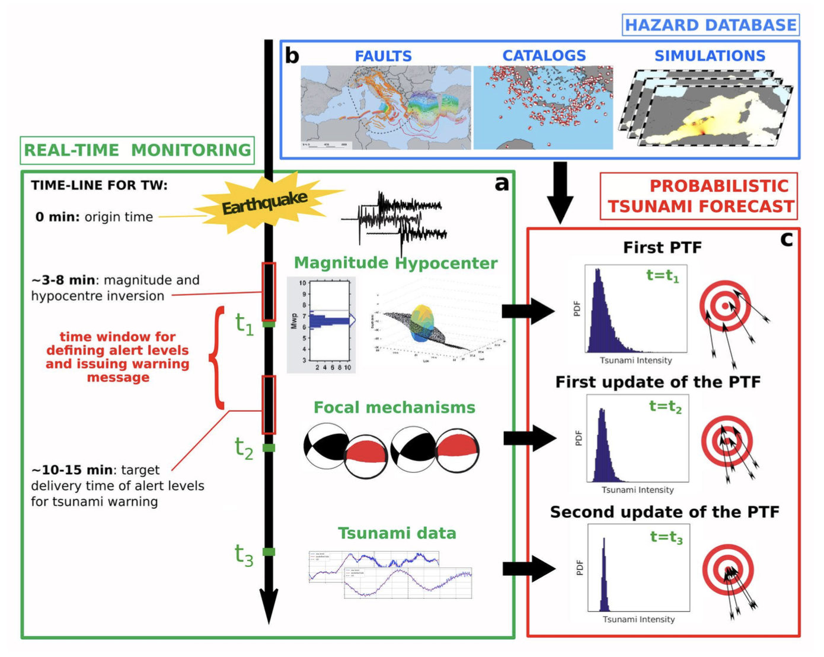
Experimental: GNSS, Seismic, Tsunami data assimilation
The PTF can provide alerts in the near-field. If time allows, and if further data are available, such as the moment tensor and tsunami data, they can be assimilated in the PTF to refine the estimate.
Selva et al., 2021; Cordrie et al., under review

Slide 8
Experimental: GNSS, Seismic, Tsunami data assimilation
The PTF can provide alerts in the near-field. If time allows, and if further data are available, such as the moment tensor and tsunami data, they can be assimilated in the PTF to refine the estimate.
Dal Zilio & Ampuero, 2023

Slide 9
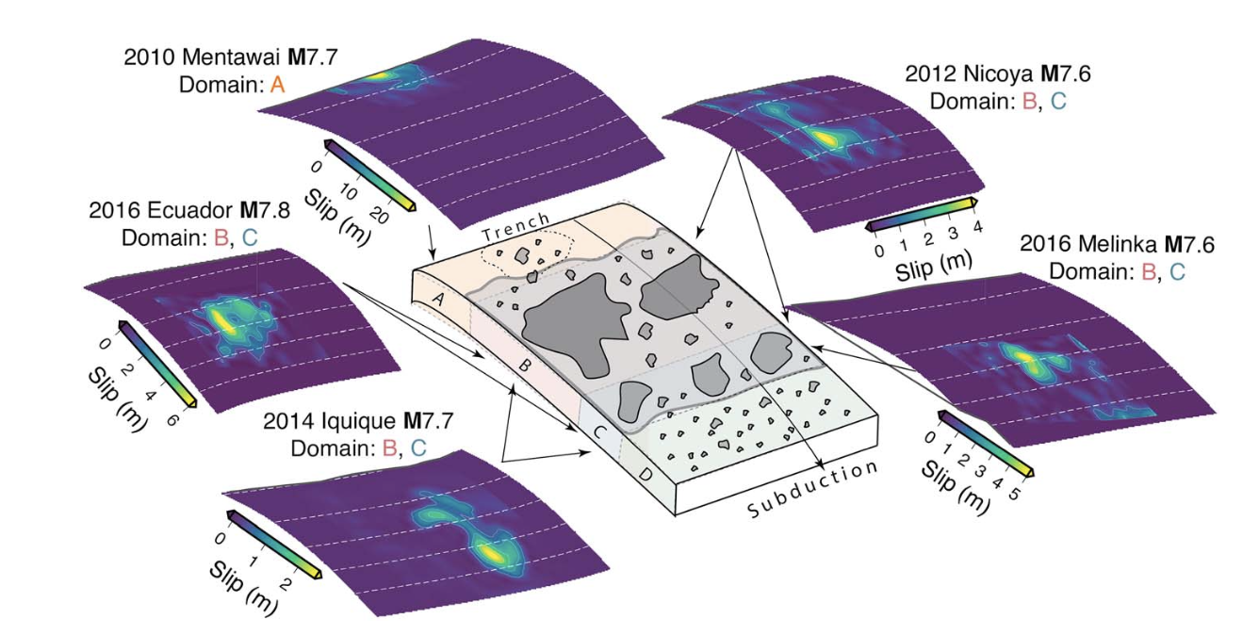
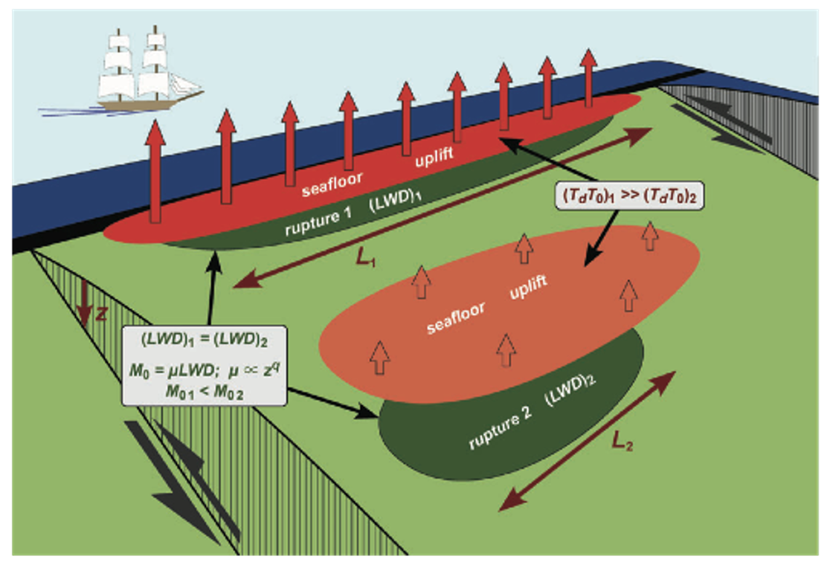
Experimental: GNSS, Seismic, Tsunami data assimilation
Newman & Okal, 1998; Lomax & Michelini, 2011; Sahakian et al., 2019; Lay et al., 2019
Real-time identification of earthquake features such as radiated energy, duration and dominant period, PGA vs PGD, P-wave coda, etc., may also help reducing the uncertainty (e.g. tsunami earthquakes)

Slide 10
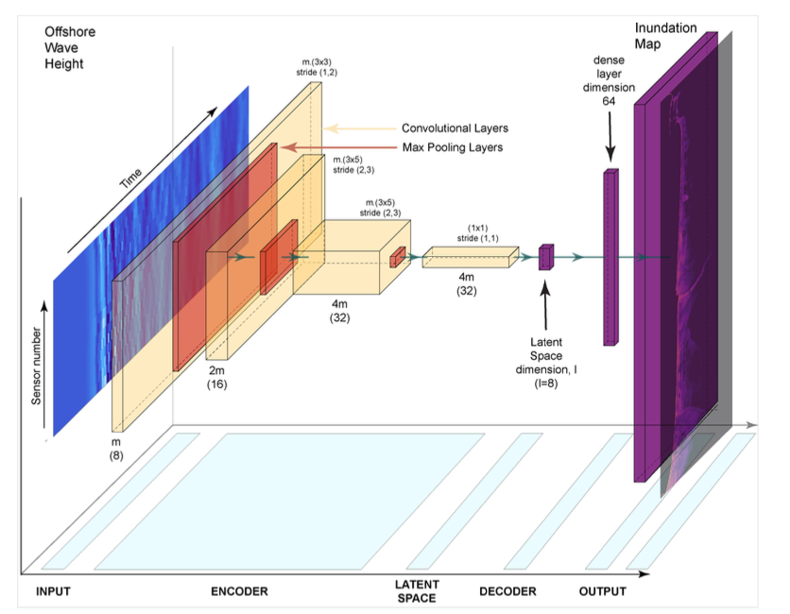
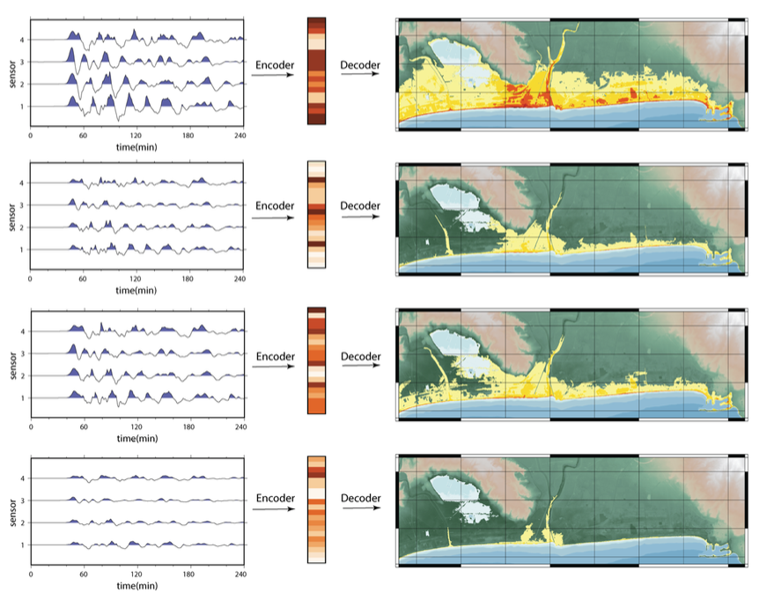
Experimental: AI-based inundation emulators
A Digital Twin for GEOphysical extremes
Storrøsten et al., 2024
Provided topo-bathy data are available, PTF can provide inundation forecasts, which is facilitated by AI-based emulators

Slide 11
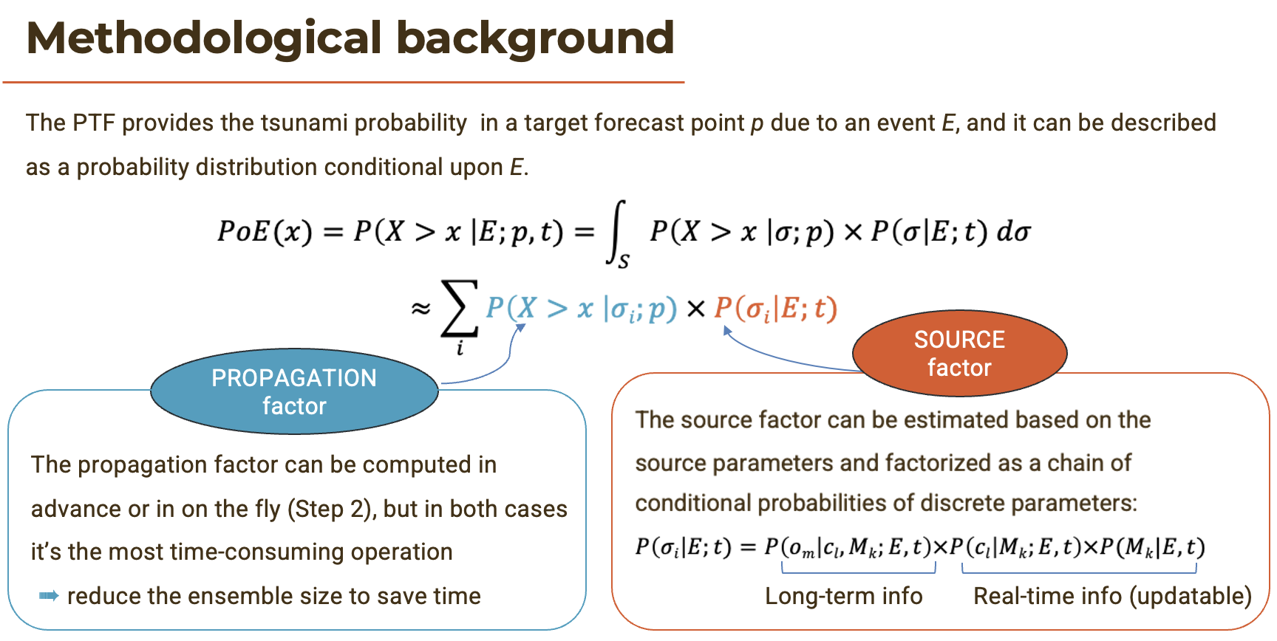
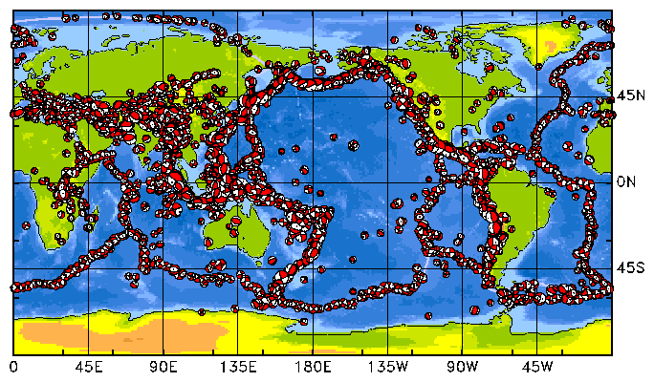
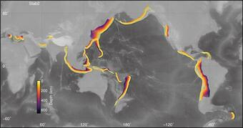
How PTF is done – Magnitude, location, prior earthquake knowledge
The PTF is obtained through an ensemble of source scenarios which are compatible with the location and magnitude of the earthquake which just occurred, and with the seismic history and the seismotectonics of the source zone.
So, even if only the location and magnitude are the only available parameters, the other earthquake parameters needed to initiate a tsunami simulation can be estimated.
Dziewonsky et al., 1981; Ekstrom et al., 2012; Hayes, 2018

Slide 12
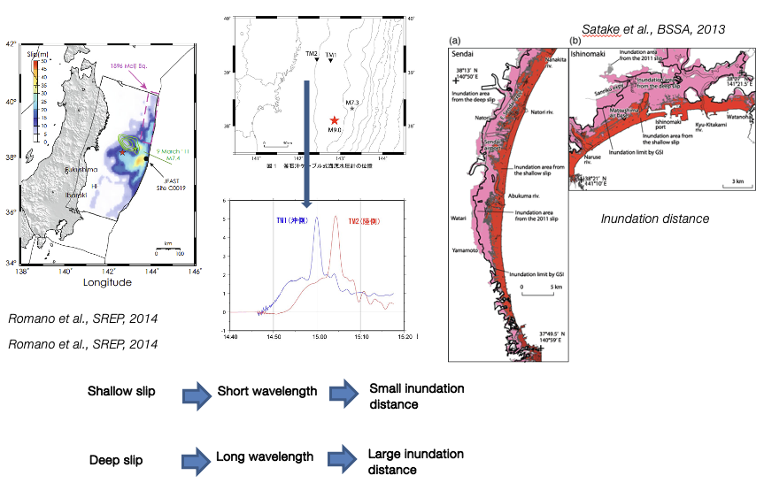
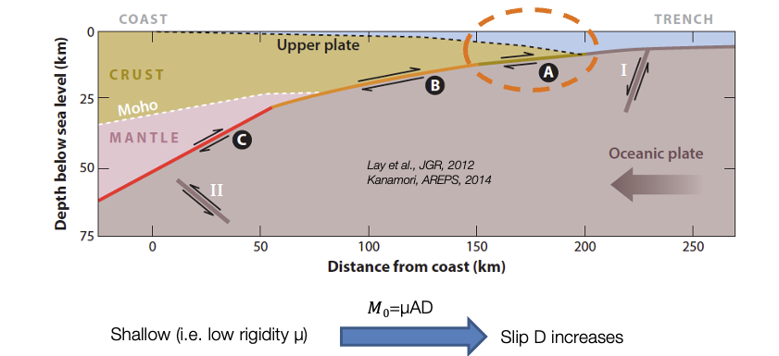
How PTF is done – Ensemble of stochastic slip distributions
Polet & Kanamori, 2009; Lay et al., 2012; Satake et al., 2013
Murphy et al., 2016; Scala et al., 2020

Slide 13
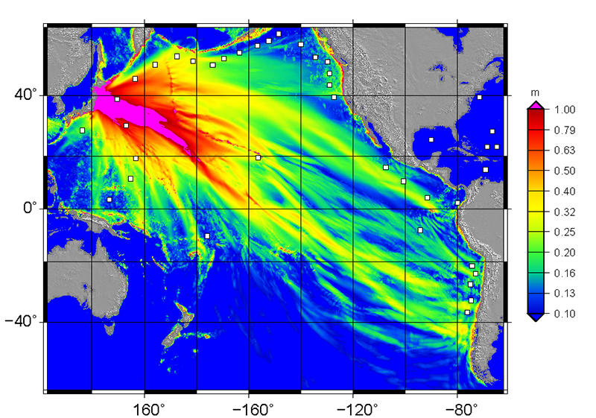
How PTF is done – Tsunami propagation and impact
Pre-calculated tsunami simulations are then exploited to keep the execution time very short.

Slide 14
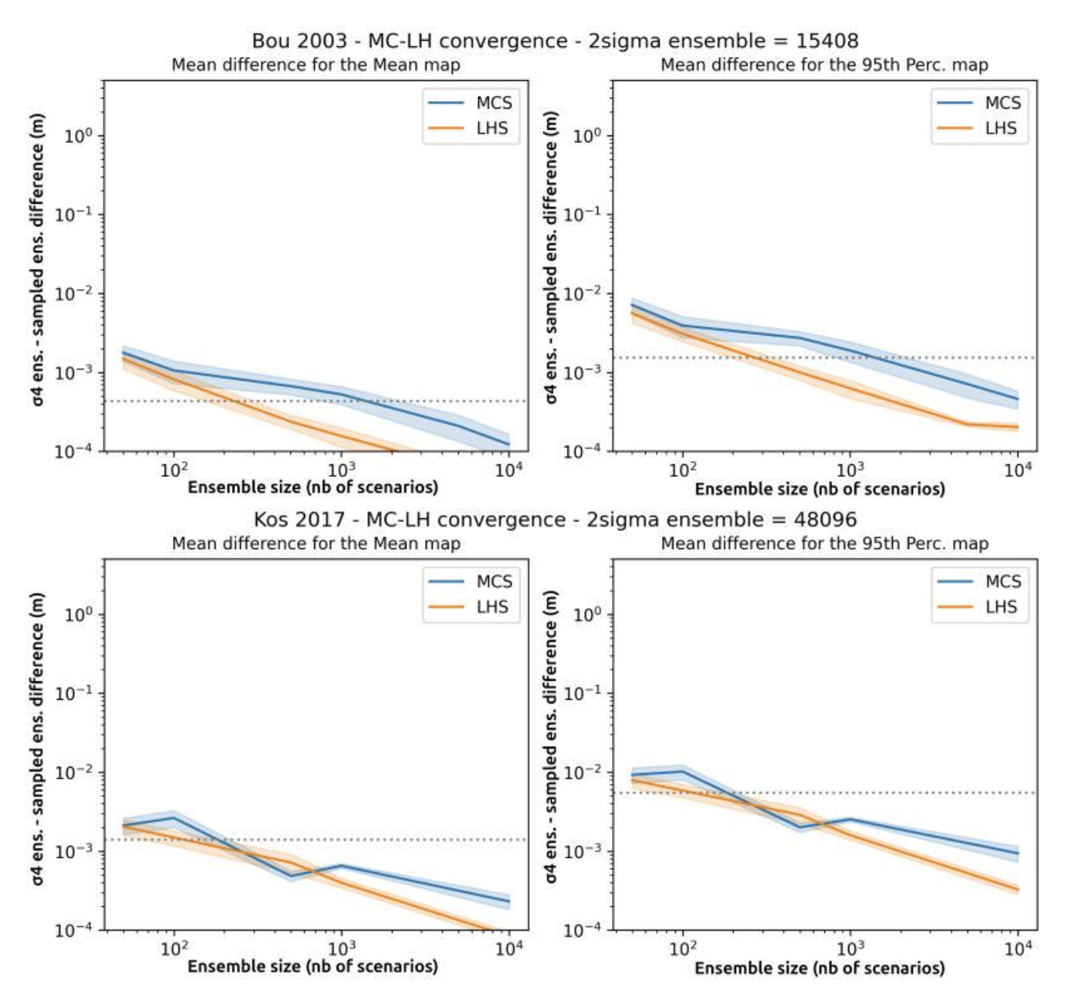
How PTF is done – Tsunami propagation and impact
Scenario number can be greatly contained with simple sampling approaches.
Cordrie et al., under review

Slide 15
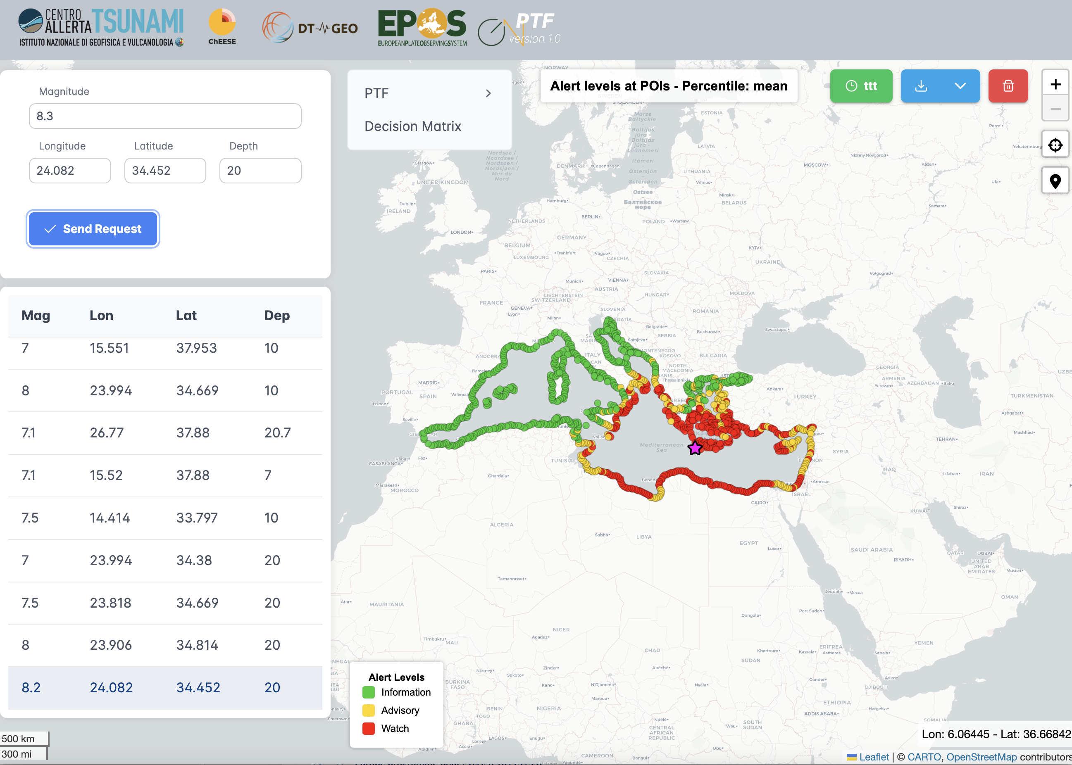
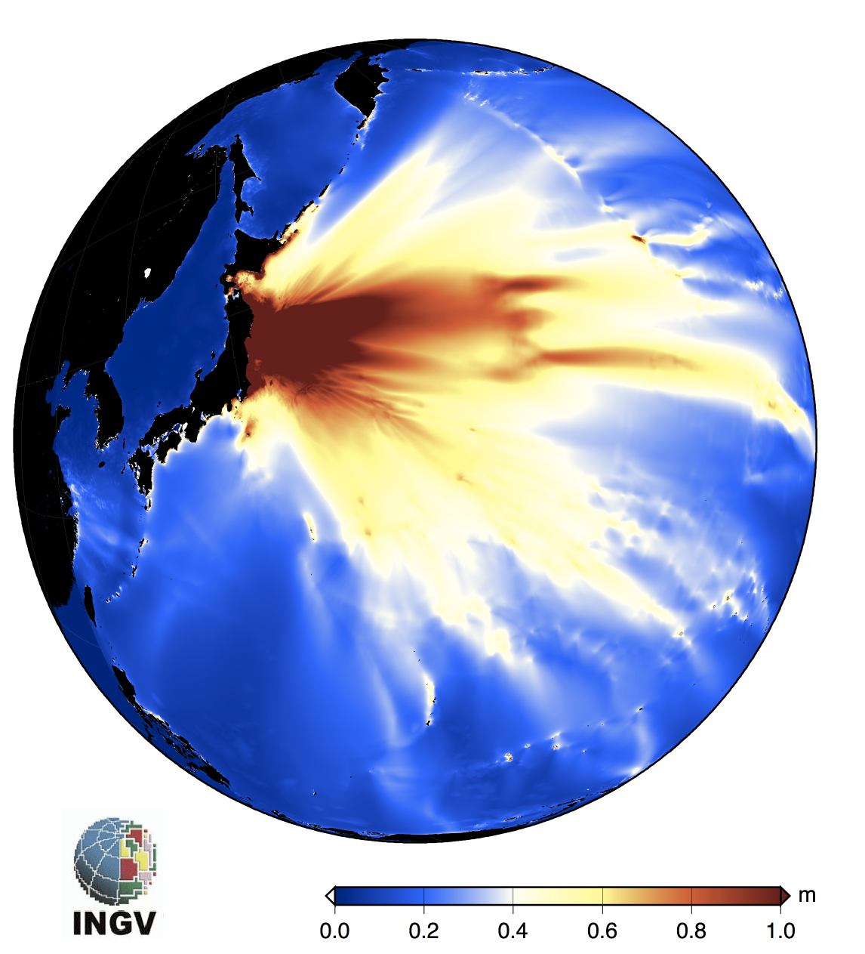
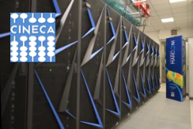
How PTF is done – Tsunami propagation and impact
PRE-CALCULATED SCENARIOS
EARLY WARNING VERSION
Targeting seconds to tens of seconds execution time w/ pre-calculated scenarios
It works in near-real time at the CAT-INGV Tsunami Warning Centre (https://www.ingv.it/cat/en/), which is a NEAMTWS Tsunami Service Provider (http://www.ioc-tsunami.org/).
It is in the Calibration/Validation towards the fully Operational deployment later this year
On-the-fly SCENARIOS (Urgent Computing)
POST-EVENT ASSESSMENT VERSION
Targeting minutes to tens of minutes execution time w/ also on-the-fly simulations
Prototype for applications in ARISTOTLE, event analysis at CAT-INGV and potentially other Tsunami Service Providers worldwide. Global scope.
Simulation ensembles to be run from scratch on large enough HPC clusters in urgent computing mode.

Slide 16
What PTF does – source probability → tsunami probability → alert level
The forecast is aggregated according to weights based on the resemblance of each scenario with the real earthquake. The PTF is finally converted into alert levels based on a pre-defined rule.

Slide 17

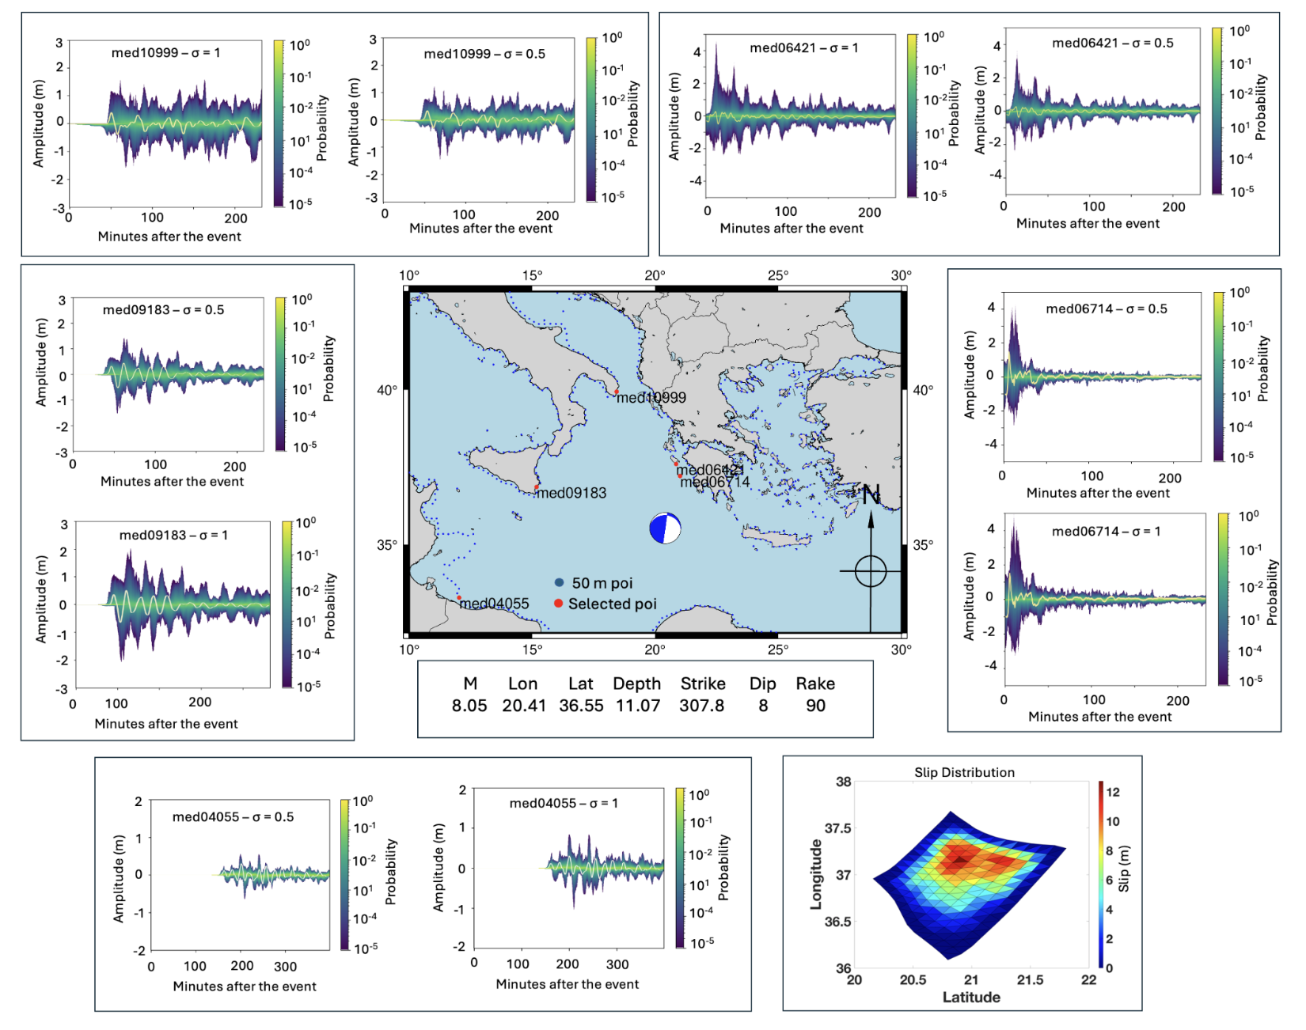
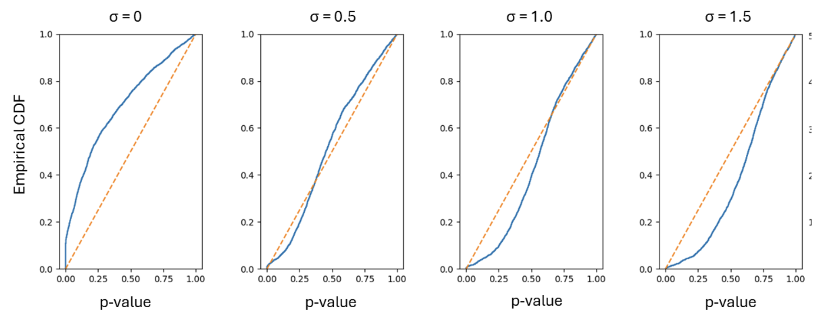
PTF calibration
The PTF is being presently calibrated with massive ensembles of synthetic tsunamis and with observations and it is expected to become operational at the CAT-INGV NEAMTWS Tsunami Service Provider in 2025.
200 kyr synthetic catalogue

Slide 18
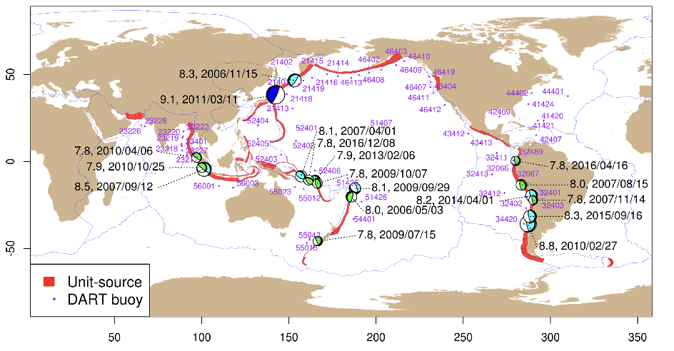
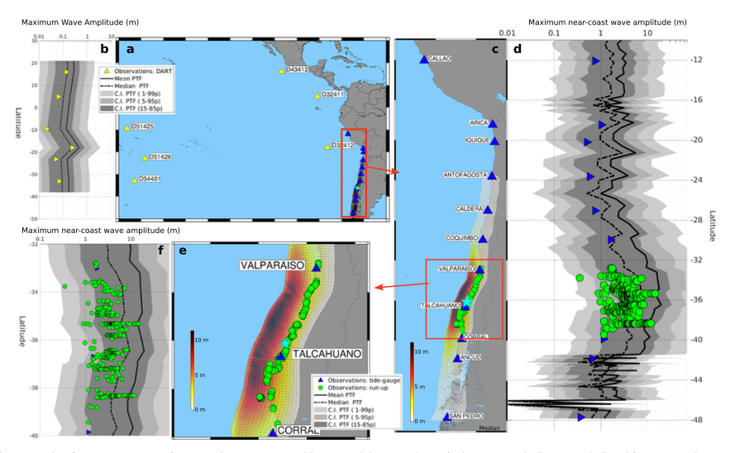
PTF calibration
The PTF is being presently calibrated with massive ensembles of synthetic tsunamis and with observations and it is expected to become operational at the CAT-INGV NEAMTWS Tsunami Service Provider in 2025.
Davies et al., 2019

Slide 19
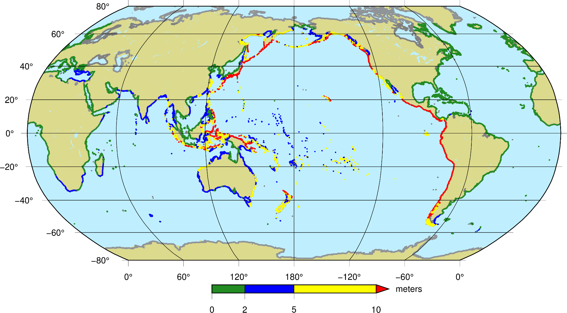
A PTF “by-product”: the GTM stochastic tsunami scenarios
The Global Tsunami Model is in the process of issuing an updated Global PTHA
Within the EUROHPC-JU funded project ChEESE-2P (Center of Excellence for Exascale in the Solid Earth), an update to the Global Tsunami Hazard Map is being developed
This flagship GTM product involves the following objectives in short-, medium-, and long-term perspectives:
A Global Hazard Model Workflow
(The GTM PTHA Engine)
Standardized output for Risk Calculations
Flexibility in input seismic source model
Multiple scales (both source and coastline)
Interoperability with GEM Input/Output
Interoperability with Probabilistic Tsunami Forecasting (PTF)
Davies et al., Geological Society Pub., 2018

Slide 20
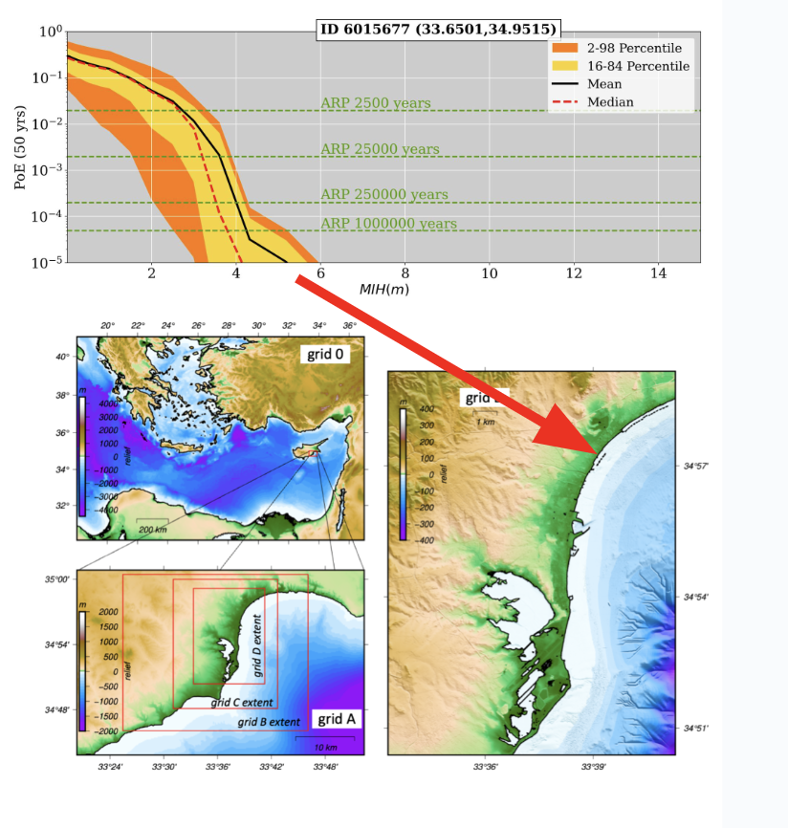
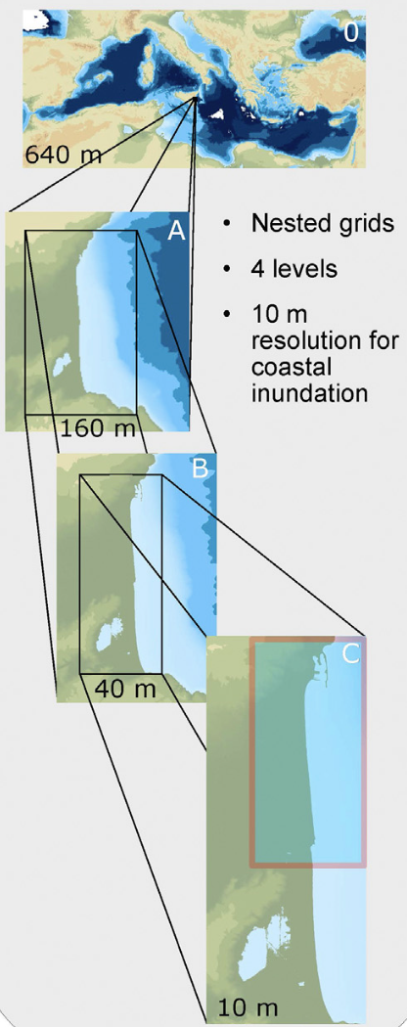
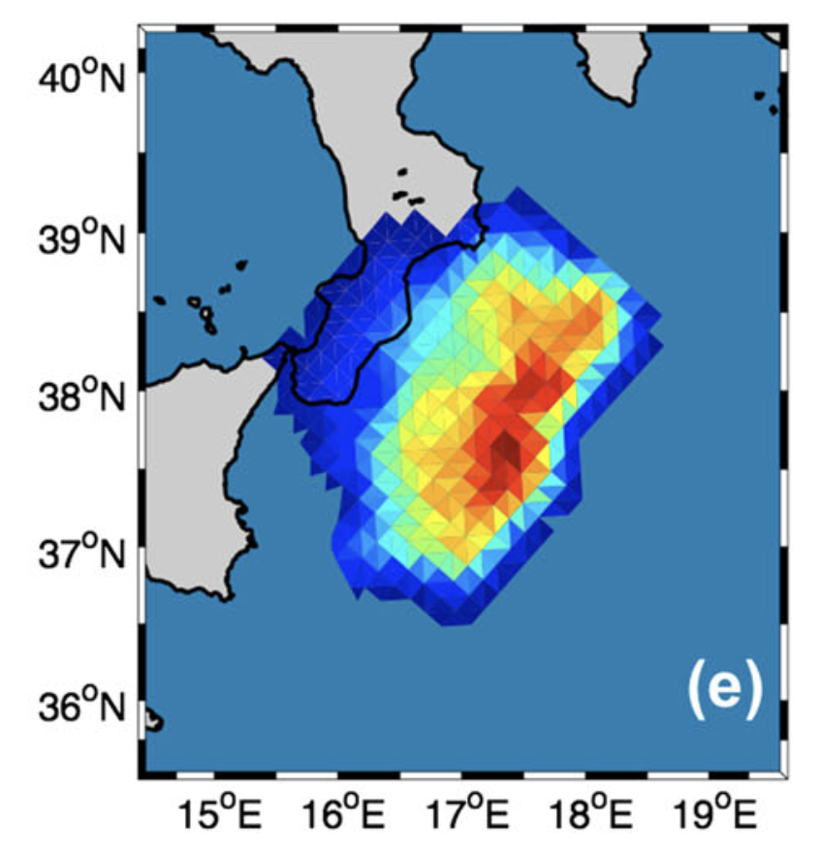
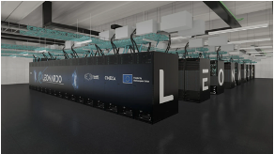
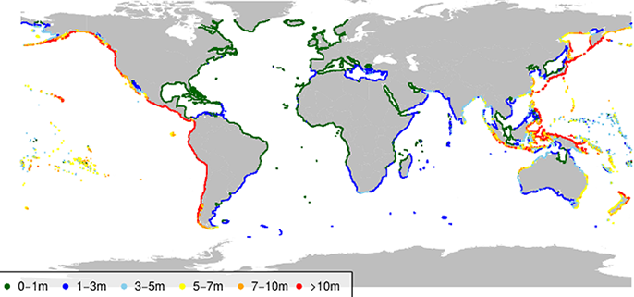
A PTF “by-product”: the GTM stochastic tsunami scenarios
The scenarios will be available for further modelling, on a global grid, and at the scale of the Pacific Islands.
GTM PTHA engine
Any input seismic source model (e.g. seismic rates or MC or stratified scenario parameters and rates)
Local inundation
map

Slide 21
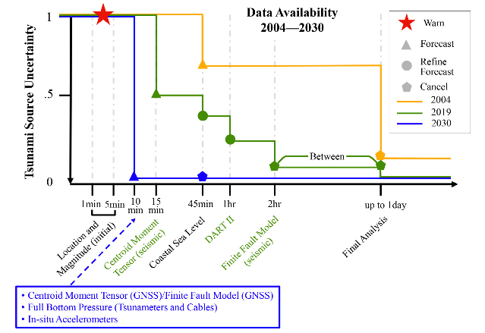
Conclusions. PTF is aligned with UN Decade Goals!
Uncertainty Quantification/Reduction for tsunami forecasting
Provide the decision-makers with actionable information
Account for tsunami propagation complexity (not only distance)
Avoid hard-thresholds → jumps of the alert levels
Angove et al., 2019

Slide 22
谢谢
stefano.lorito@ingv.it
9th Joint ICG/PTWS–IUGG/JTC Workshop
60th Anniversary of the ICG/PTWS – Past and Future
Beijing, China, 7 April 2025

Slide 23
Panel Discussion: Bring it Together – UQ and UR
Uncertainty Quantification (UQ) allows for clear separation of scientific information communication and political decisions
UQ is complementary to Uncertainty Reduction (UR) obtained with instrumental coverage
UR is not always possible and is not possible everywhere to the same extent
Angove et al., 2019

