Slide 1
TT Forecasting From Direct Ocean Observations
WG2 TT FOO
7 April, 2023
Beijing, China
Co-Chairs:
Vasily Titov
Bill Fry

Slide 2
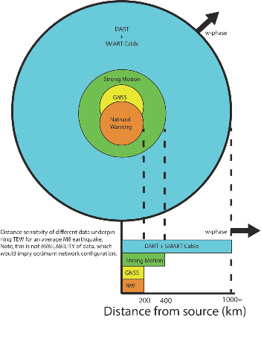
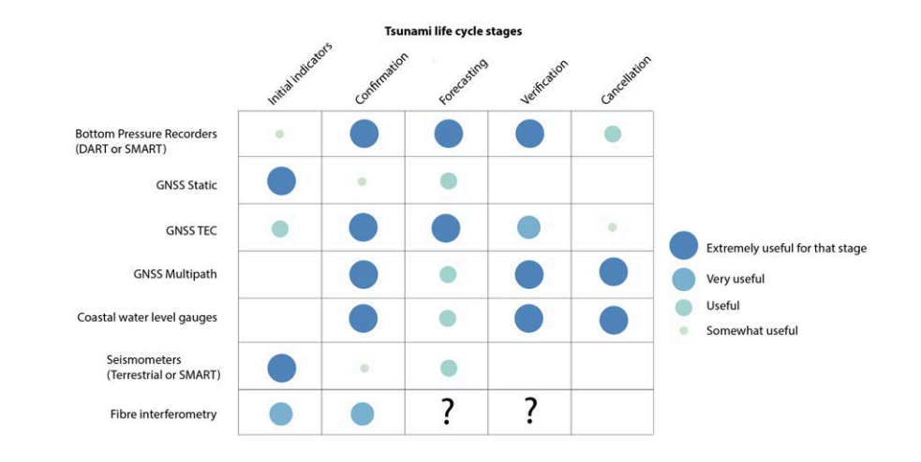
Justification for multi-data/multi-sensor

Slide 3
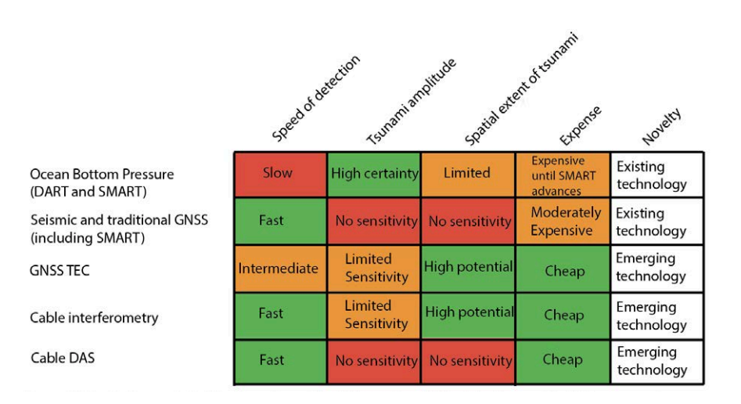
Justification for multi-data/multi-sensor

Slide 4
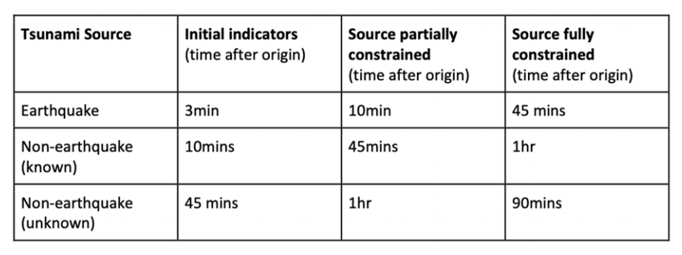
ODIP target metrics

Slide 5
Classes of forecasting
Forecasting from indirect observations
2) Hybrid
3) Forecasting from direct observations

Slide 6
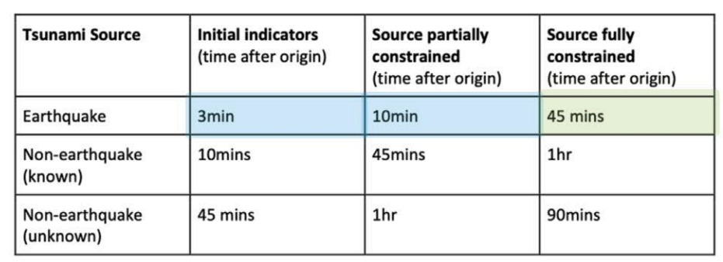
Forecasting from indirect observations (including ensembles)
Current paradigm in most warning centres
In some cases, when event is close to shore, it can be argued that source fully constrained is met

Slide 7
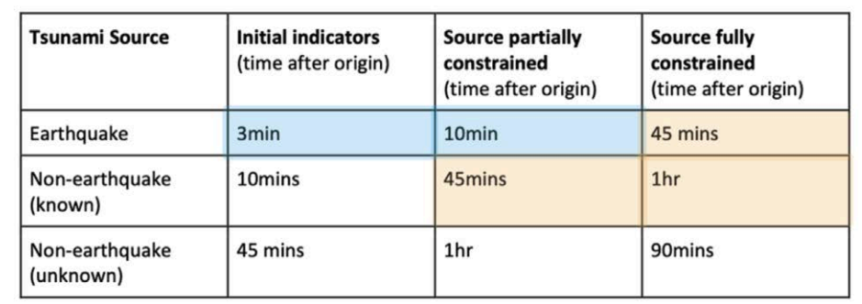
Hybrid forecasting
Using direct ocean observations to scale proxy forecasts
E.g. HTHH

Slide 8
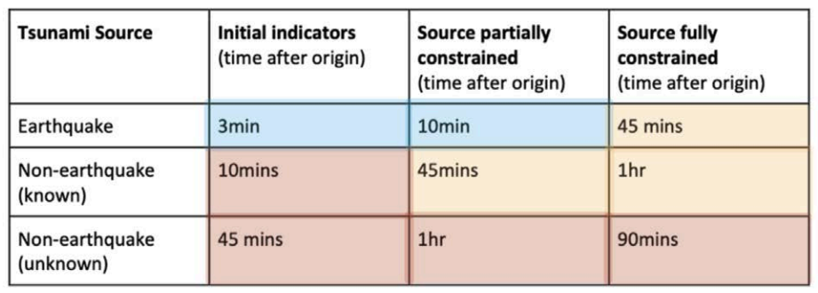
Forecasting from indirect observations
Including existing (e.g. tFISH) or aspirational (assimilation, other A.I., etc.). Require in most cases novel measurements.

Slide 9
Time dependence and inundation/impacts

Slide 10
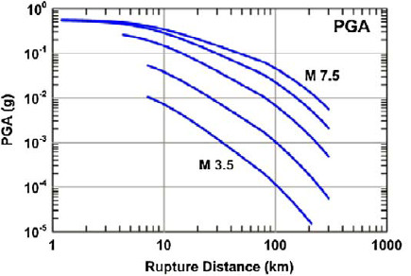
Gap and sensitivity analysis for multisensor network
Detour: strong motion seismology and local source tsunamis
We assume an M7.5 will generate natural warning for the closest coastlines – also possible to invoke strong motion seismic approaches and ABE equations of tsunami prediction
NGA-2 West

Slide 11
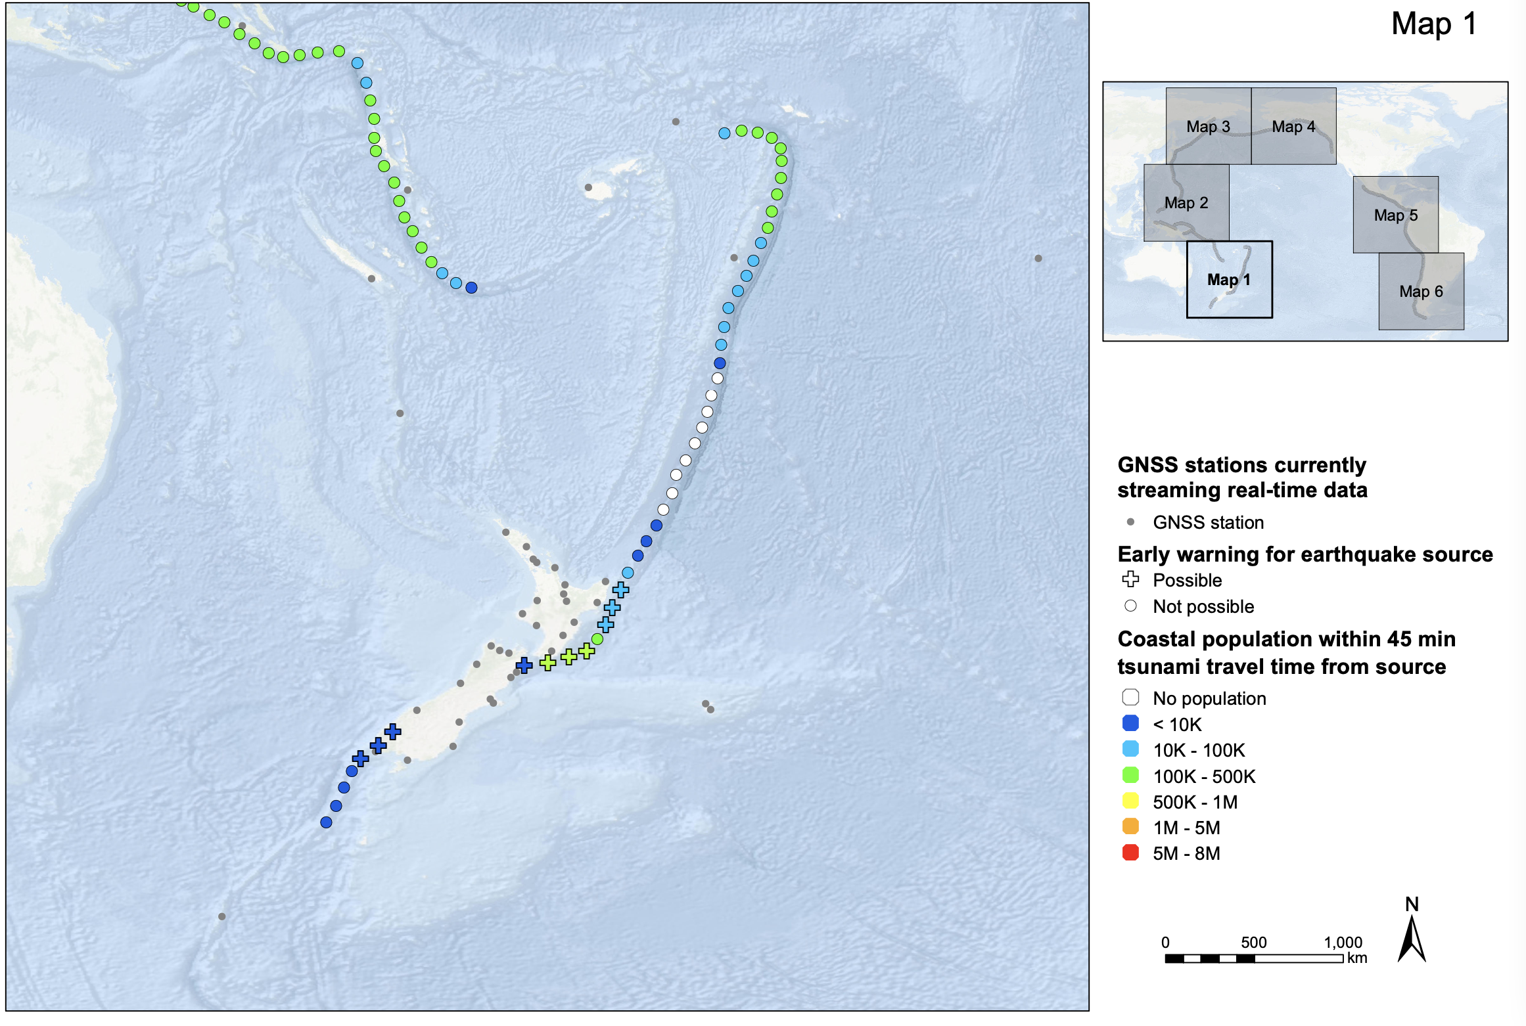
Gap and sensitivity analysis for multisensor network
GNSS inversion for earthquake source (finite fault)
GNSS inversion for finite fault (e.g. GFAST) on propDB unit source
Based on list of “active” stations, we have done the same for “all” possible
5 GNSS stations within 200 km of fault (edges of unit source)
Maximum distance between 2 GNSS stations at least 100 km (minimum aperture)
Population based on # of people living within 10 km of coast at an elevation <50m.

Slide 12
Integrating emerging techniques and sensor technologies: SMART Cables
GNSS coverage assumes that every GNSS station that has ever streamed publicly available data were still functional

Slide 13
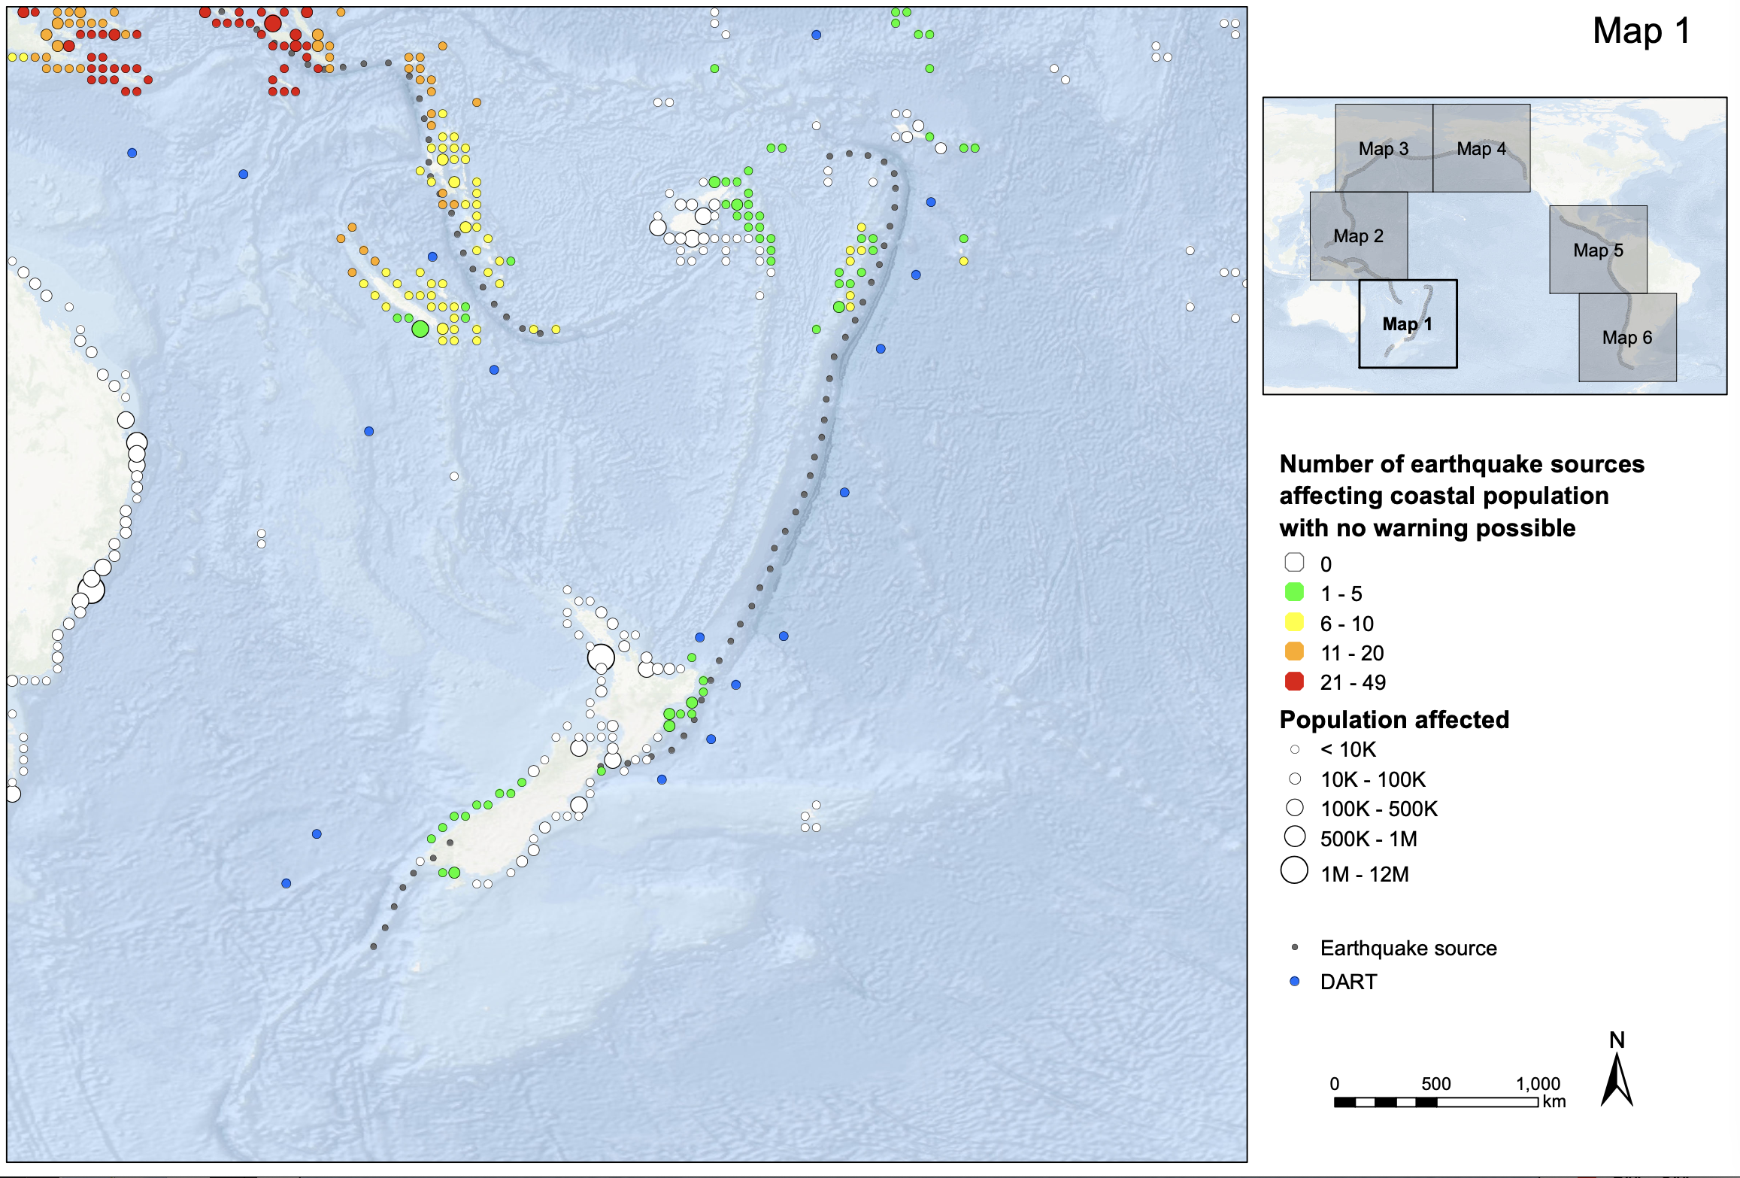
“Where possible, include cost-benefit analysis of the potential technologies being considered.”
We have developed a risk-based approach
Exposed population = live within 10km of coast at elevation < 50m (conservative)
Pre-impact warning time of 20 minutes considered
WarnTime=Tcoast-max(D1,D2)
Population based on # of people living within 10 km of coast at an elevation <50m.

Slide 14
Initial Indicator
A Note on GNSS
PPP: Real time GNSS Precise Point Positioning can improve characterisation of large local/regional earthquakes, providing rapid estimates of magnitude and fault geometry/slip distribution. Currently used by USGS-ShakeAlert, NOAA, Japan-REGARD, etc)
Iono: source agnostic application that infers impact of gravitational waves caused by tsunamis on the ionosphere from GNSS data: several examples in literature, currently operational at Nasa-JPL (Guardian)
[Murray et al., BSSA 2023]
Tsunami measurement
[Manta et al., SciRep 2020]

Slide 15
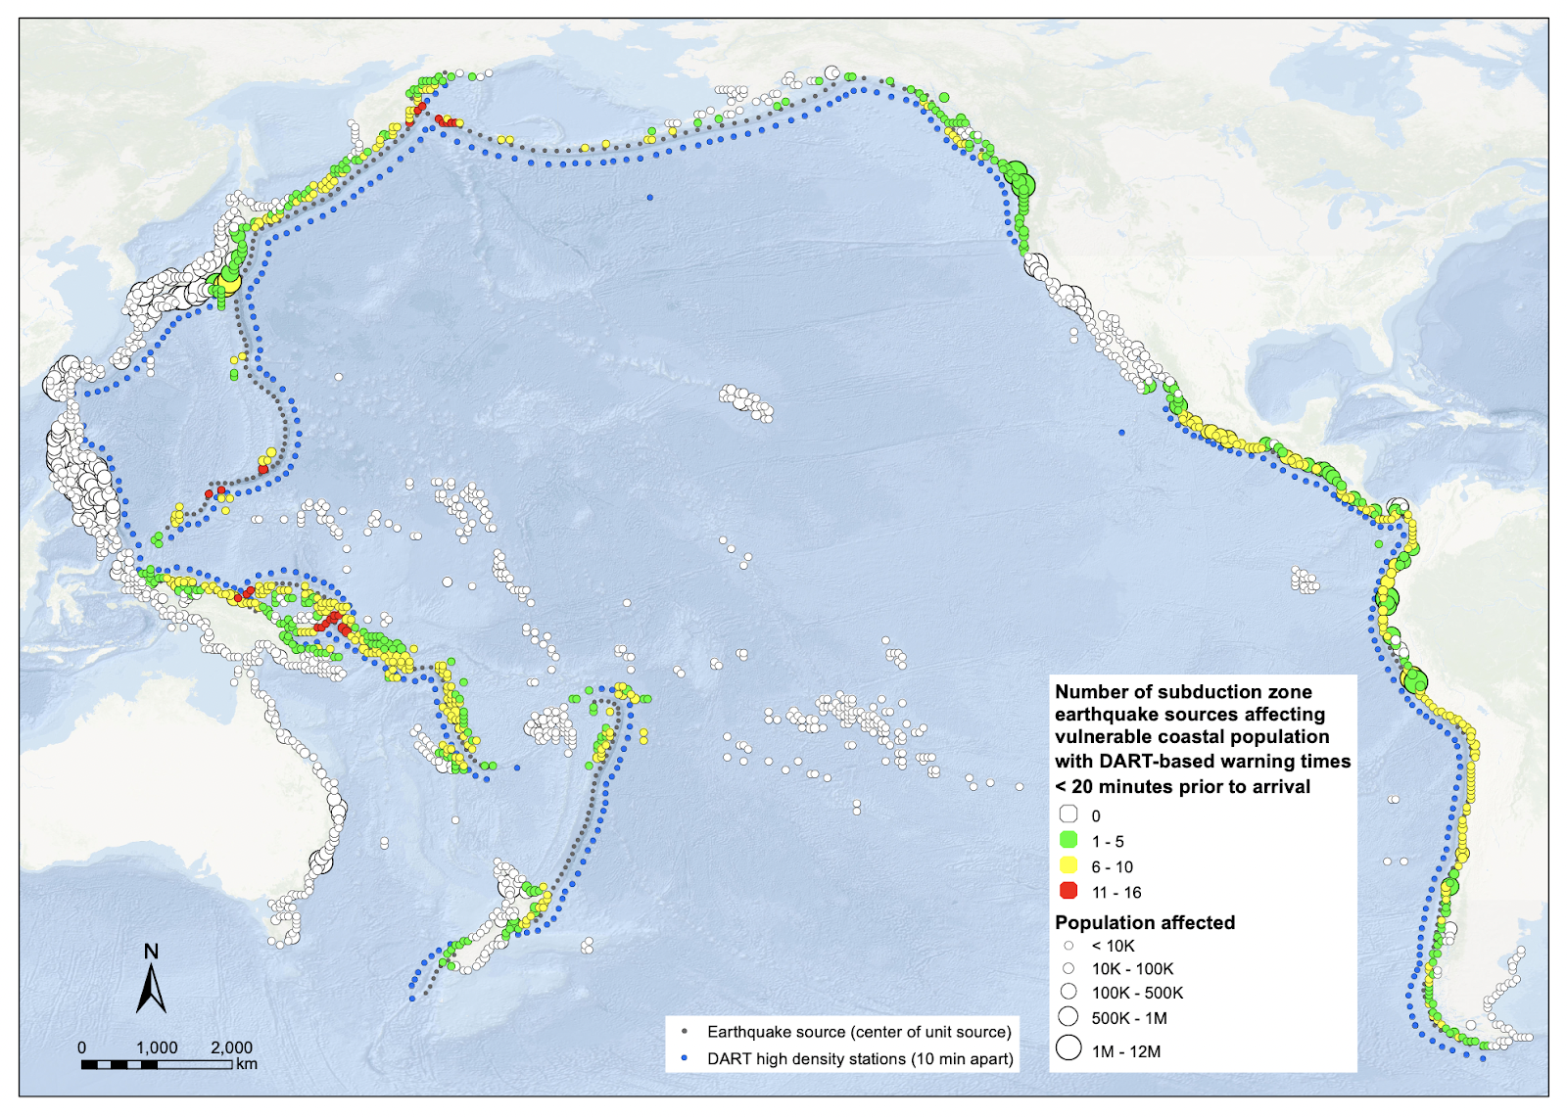
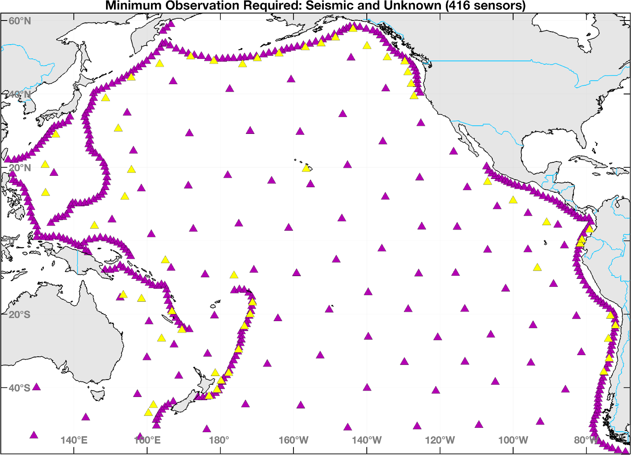
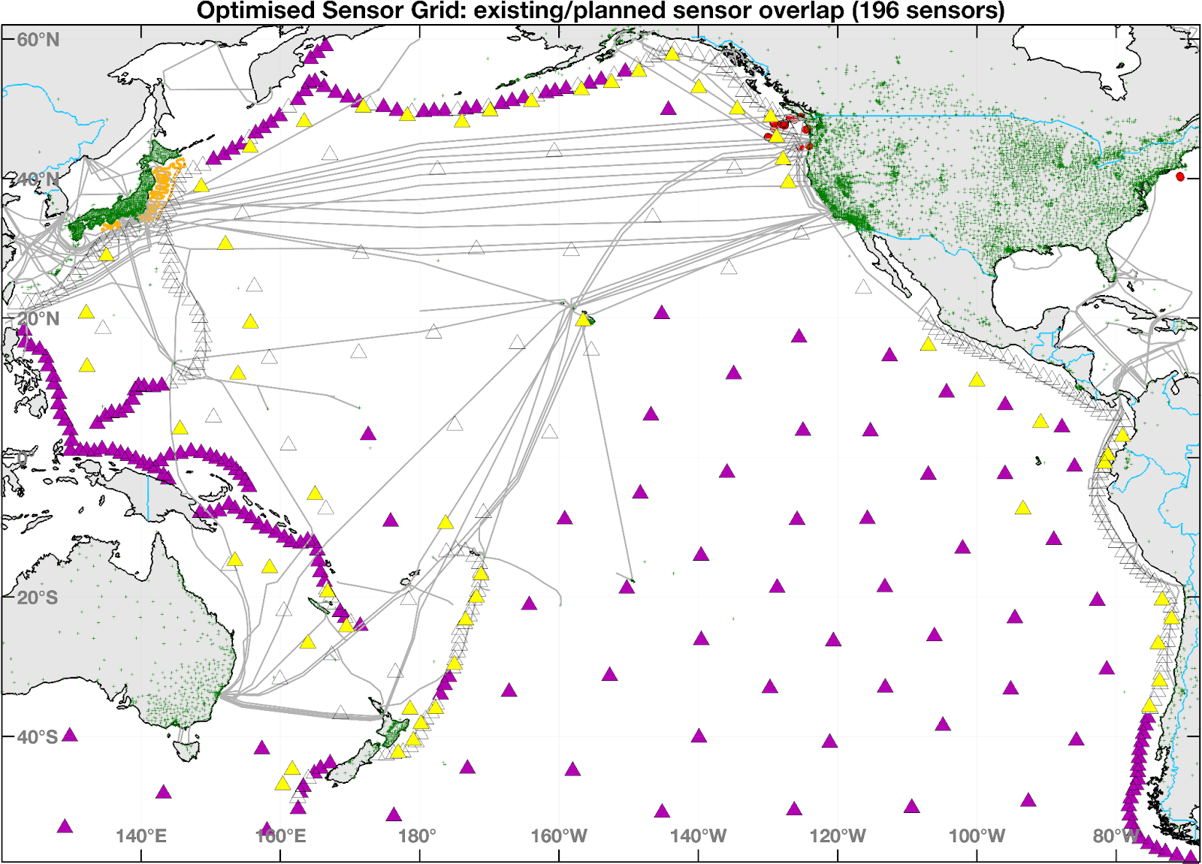
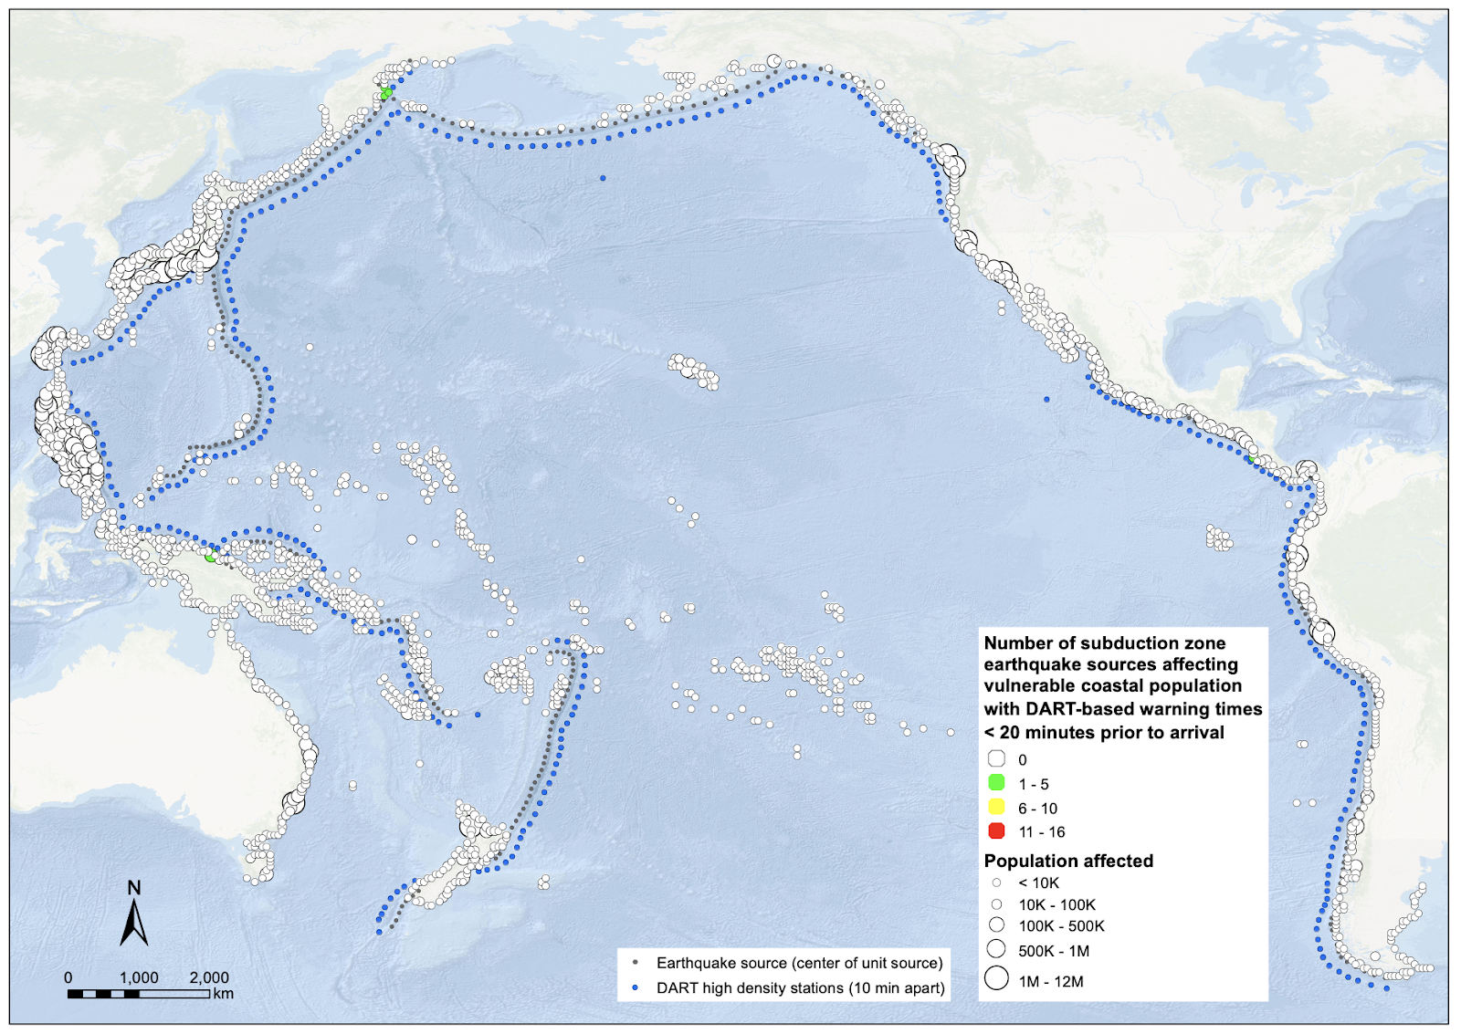
10-minute detection at SZ
Exposure with optimized grid
A thought experiment on optimised sensor grids for source agnostic TEW
416 sensors
Exposure with optimized grid, assuming 100km natural warning
196 sensors
Figure courtesy C. Moore

Slide 16
Recommendations
WG2 recommends the ICG/PTWS continue to work closely with the JTF for SMART Cables and the IUGG GeTEWS project to utilise monitoring data from these efforts when they are available.
WG2 recommends the TT on Integrated networks develop a framework based on the Research, Development and Implementation Plan for the Ocean Decade Tsunami Programme by which member states can contribute instruments/data/telemetry, etc in order to achieve ODTP tsunami detection, measurement and forecasting goals within PTWS.
WG2 recommends that ICG/PTWS continue the Task Team on Integrated PTWS Sensor Networks.

Slide 17
Thank you very much for your kind attention.

