Slide 1
Observations Coordination Group
- OCG 16 -
David Legler, NOAA (Emma Heslop, Ann-Christine Zinkann, and the OCG Executive Leadership team)
OCG-16 Session, 07 - 11 April 2025
Ifremer, Brest, France
Notes:
Ann

Slide 2
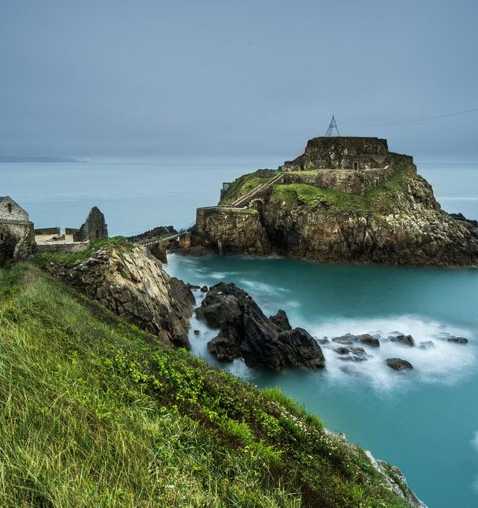
Welcome
To
Brest!

Slide 3
Recap since OCG-16
Observations Coordination Group/GOOS continues its core & central role in GOOS developing an efficient, coordinated, and useful ocean observing system
Data Implementation Plan is advancing and being implemented within networks
Endorsed 3 emerging networks (FVON, SOCONET, SmartCables) and USV’s to be assessed this week
OceanOPS IT transitioned to Ifremer and restructuring complete
Finalized OceanOPS Service Level Agreements and Draft Letters of Agreements
Searching for a new OCG Chair (and leadership team members)
Notes:
Ann

Slide 4
Major OCG Achievements
OCG Data
OceanOPS
WMO
Cross-network OCG Data Task Team
Minimum metadata - passport
Identify global data nodes, expand ERDDAP
Prevenance work initiated
Proposed IOC Data Architecture
OCG Data Strategy and ERDDAP serves foundational component
Crosswalk with BioEco data flows
OceanOPS restructuring completed
OceanOPS services are back online
Service Level Agreement paradigm
Consultation with Networks is underway
Letters of Agreement to be signed after OCG-16
WMO’s WIS2.0 system (replacing the GTS in 2030) is underway
Joint Collaborative Board re-energized & established two task teams
Developing SoG for Ocean Applications together with GOOS
Network readiness level
Best Practices
OCG Business
Task Team on Maturity and Metrics continues, supported by Signe (see POSTER - give feedback)
Metrics for data, metadata, and other attributes developed as network ‘health’ index
Metrics to be linked to OBIS/BioEco Portal
More GOOS Endorsed Best Practices
GOOS SC recognized relevance of OBPS to all IOC programmes, called on IOC to consider OBPS as an IOC-wide activity
3 Task Teams in operation, tacking core issues, a tremendous amount of work and progress
Notes:
Capacity Building
Ocean Observations for Weather Forecast and Climate Prediction, 2024 Indonesia (DBCP)
Leadership Opportunities!
Standards and Best Practices Call for Vice Chair
OCG Call for Chair

Slide 5
Major Challenges
Continued erosion of resourcing of many ocean observations
No guidance or process to integrate and/or prioritize observing activities. How? And around what areas (e.g., platform? Need? EOV?). Who? GOOS-wide challenge
Engaging and guiding private sector interests? Talk -> Action
Are there opportunities to increase efficiencies through new technologies, AI, etc?
Specific guiding processes to mature as a network
Valuation of ocean observing remains a challenge
More efficiently identify and manage risks
Notes:
Ann

Slide 6
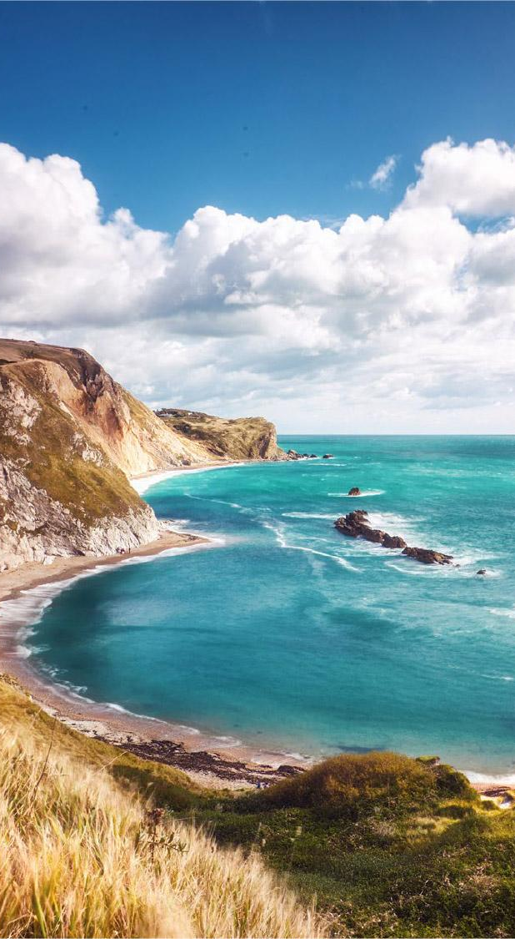
Opportunities
Sub-group under JCB to develop guidance on expanding WMO GBON into ocean-based observations
Public/Private Partnerships - Ocean Enterprise Initiative⁺
Developing of metrics (measures) to track and clarify OCG network maturity and status - ongoing - definition of maturity and network health index - ongoing work - POSTER for input
Observing technology development: OCG/network roles in assessing/testing/ and infusing new technologies (eg sensors, platforms, AI).
Implementation of OCG data strategy and integration into a larger IOC-wide infrastructure - is there a resource need?
Improving engagement with other initiatives (e.g., Ocean Observing Co-Design) to strengthen value chains for impact
Notes:
Ann

Slide 7
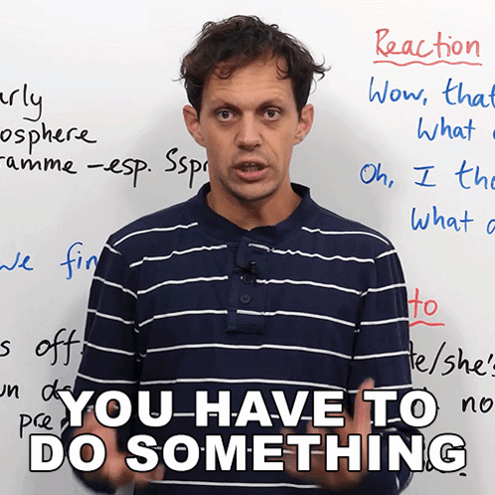
Food for
Thought
Call for Action

Slide 8
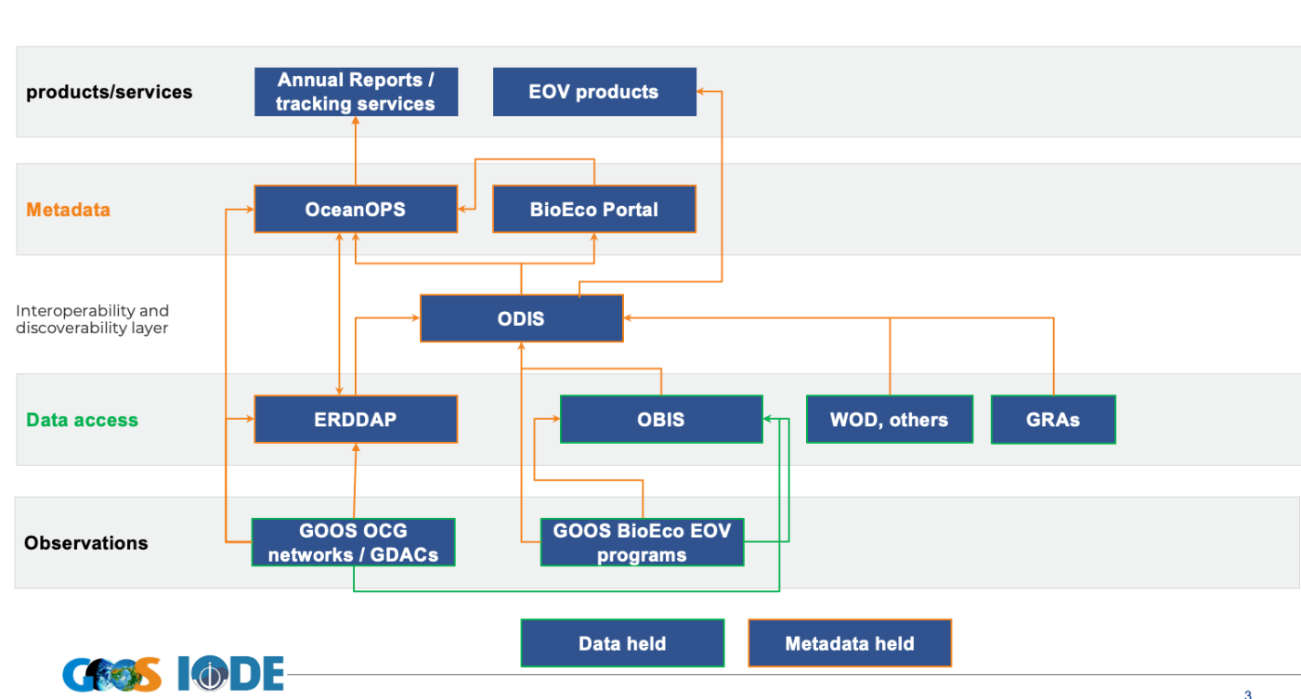
Integrated Data Infrastructure
A IOC Data Architecture was discussed at a joint meeting with experts from ODIS, OBIS, OceanOPS, GOOS, SDG, IOCCP, IODE, DCC/DCO
Draft structure is being developed for review at 2025 EC
Establishment of a working group to devise vision, governance, technical aspects, deliverables, risk, resource needs etc.
How will this effort affect GOOS Networks? How can plans best be communicated to the Networks?
Notes:
Ann

Slide 9
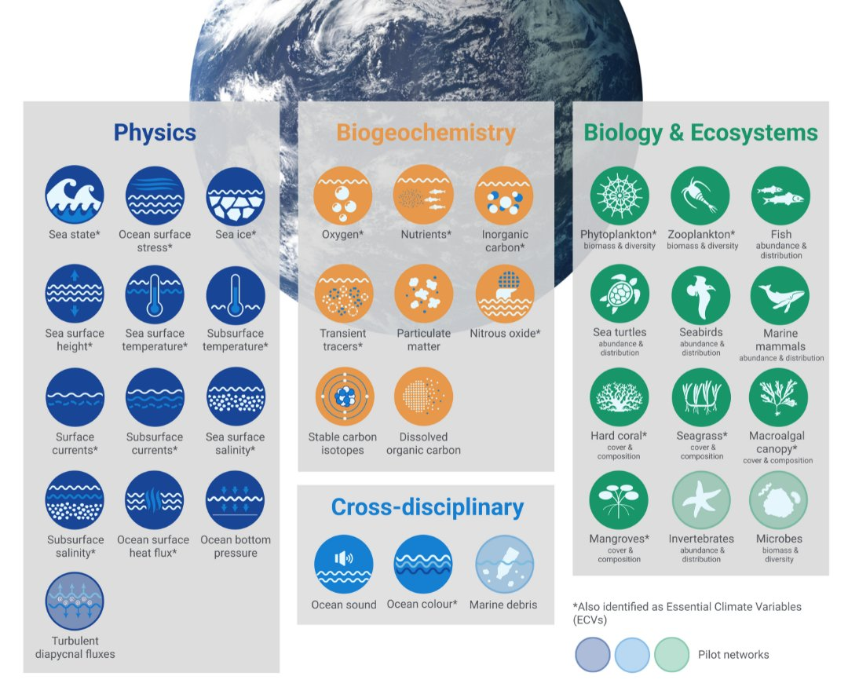
EOV Framework
WMO RRR have a process around assessing observations requirements
GOOS Decade programs utilize EOVs and requirements processes to define observational needs
EU projects aimed to improve the delivery of essential ocean variables and enhance operational global observing and forecasting systems
What are the opportunities for Networks in this context? How are they already engaging in these efforts? How can OCG assist in advancing the Networks in these engagements?
Notes:
Ann

Slide 10
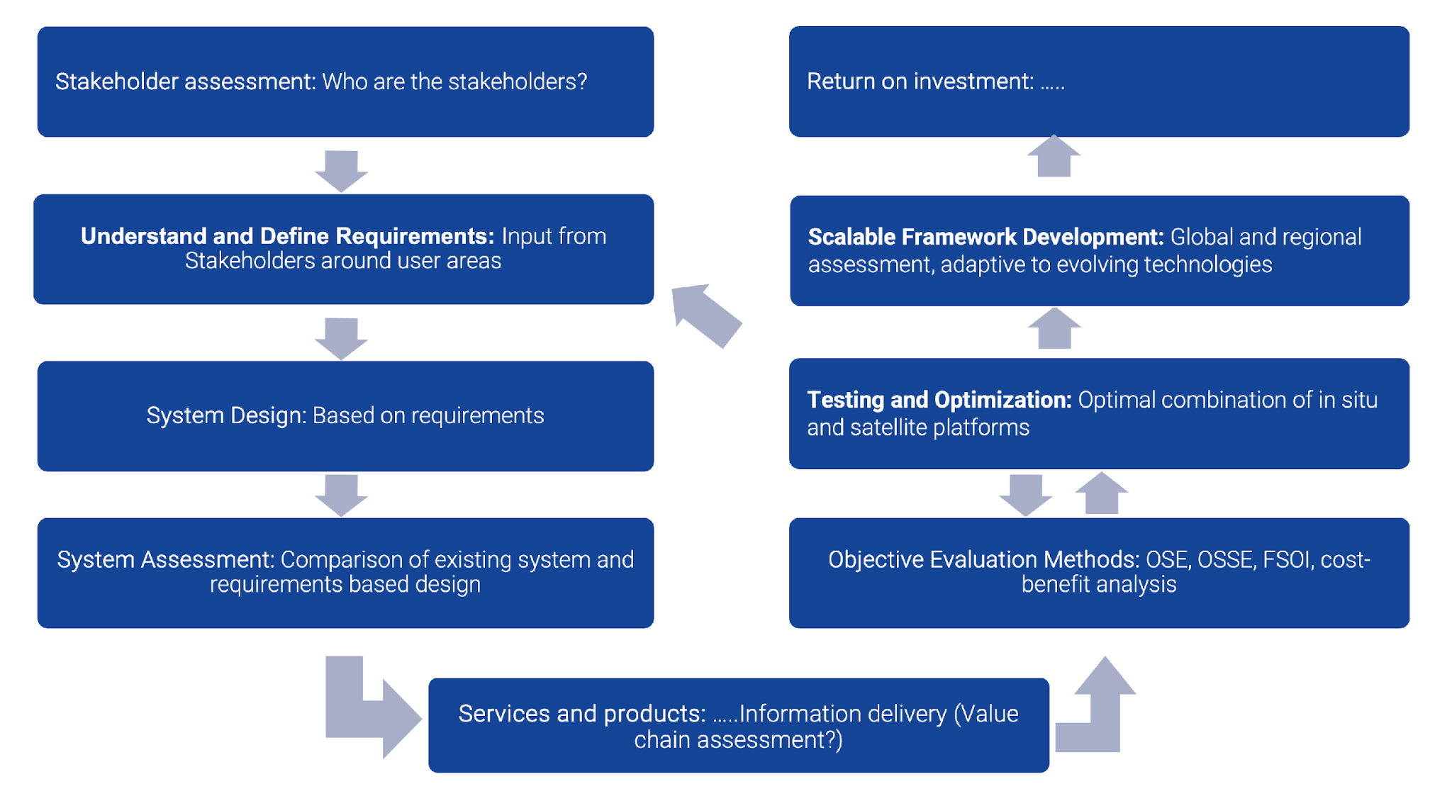
Observing Solutions for the future
Co-Design Program advancing 6 societal impact areas
Recent workshop developed requirements for a backbone Boundary Current (BC) system
Program developed a draft co-design process based on the BC workshop
Phase 1 : Engagement and Design
Phase 2 : Pilot activity
Phase 3 : Implementation
How do we best engage the Networks? Do they need to be engaged? These project are becoming more common and are changing the paradigm on how networks have previously operated. How do we best leverage this evolution?
Notes:
Ann

Slide 11
Private Sector
Roadmap outlines a set of actions that will enhance all components of the Ocean Enterprise across the Ocean Information Value Chain.
Engaging and guiding private sector interests? What are the key topics we NEED to engage with the private sector? NEED to identify ACTIONS that OCG can push/lead!
Ocean Enterprise Initiative interested in identifying opportunities for investment - what do the Networks want to see?
Identify topics of common interest and identify the specific sector for engagement
MARKET PLACE
focuses on improving the market visibility, aggregation of demand and rethinking risk to accelerate growth.
COLLABORATION
focuses on data as an asset and missions as a service, private-public exchange, standards, developing intermediaries, and public and private data access.
THE FUTURE
focuses on workforce development and the utilization of emerging technologies in the public sector services.
Notes:
Ann

Slide 12
Numbers Game & Growth
Will OCG continue to add emerging networks, Is there a limit?
How can OCG support more networks with no additional resources? What is the potential to seek resources and how can OCG assist in this space?
Currently there does not seem to be a need to place a limit, new emerging networks engaged with existing networks to assess fit and connections, fulfill unique roles, have found support for their work.
What about platforms that are not connected to GOOS networks? Is this the role of OCG?
Notes:
Ann

Slide 13
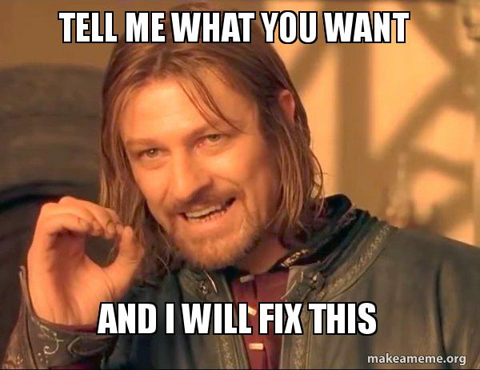
OCG Action Prioritizations
Primarily GOOS Networks have been updating OCG at the Roundtables and annual sessions through reports and posters
Are there other ways to ensure that OCG exec is clear on Network needs and identify prioritized actions?
How can we engage the networks to ensure that common needs/risks/opportunities are acted upon across all networks?
Notes:
Ann

Slide 14
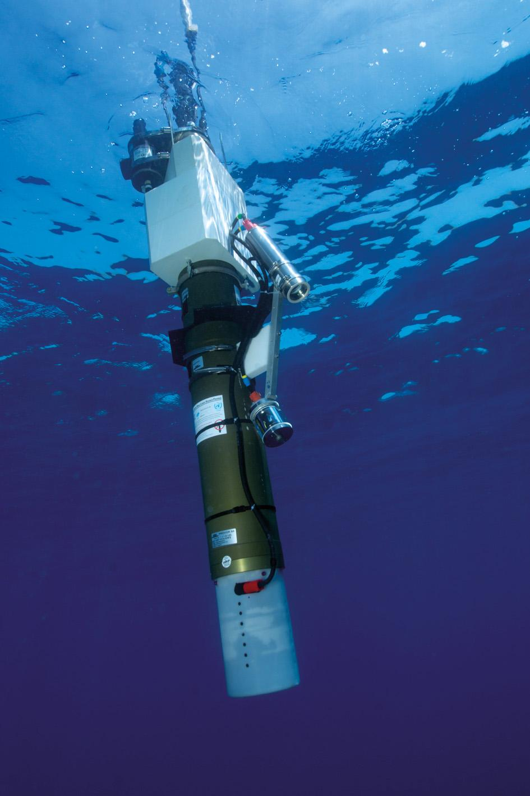
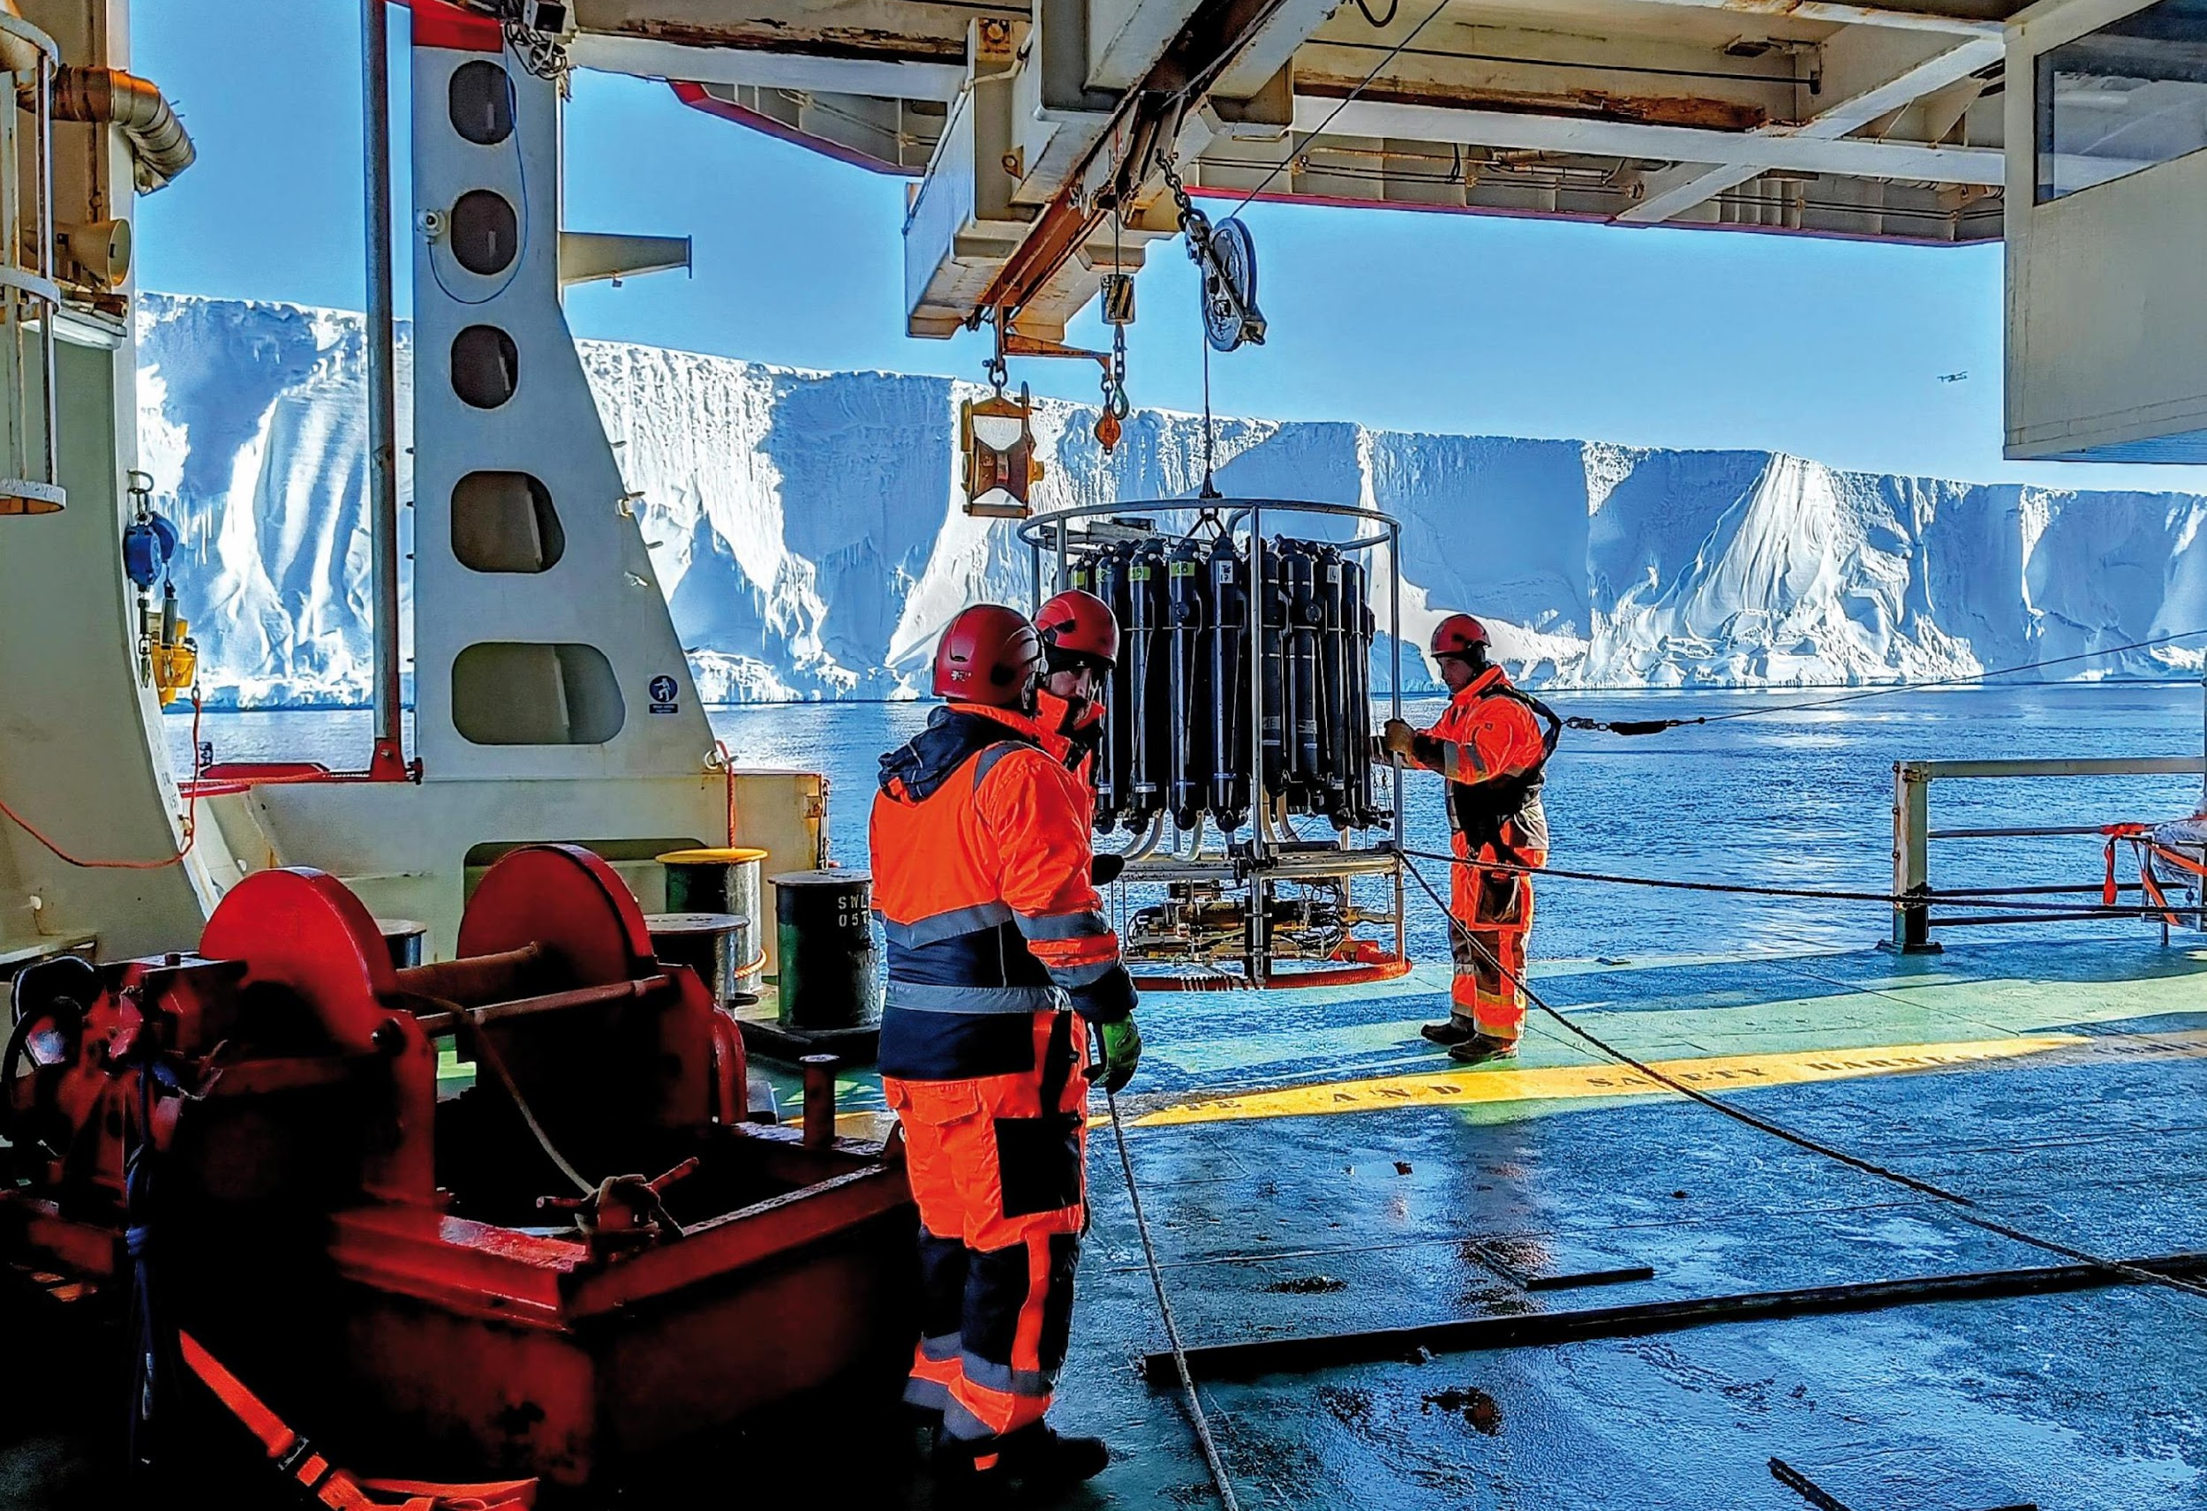
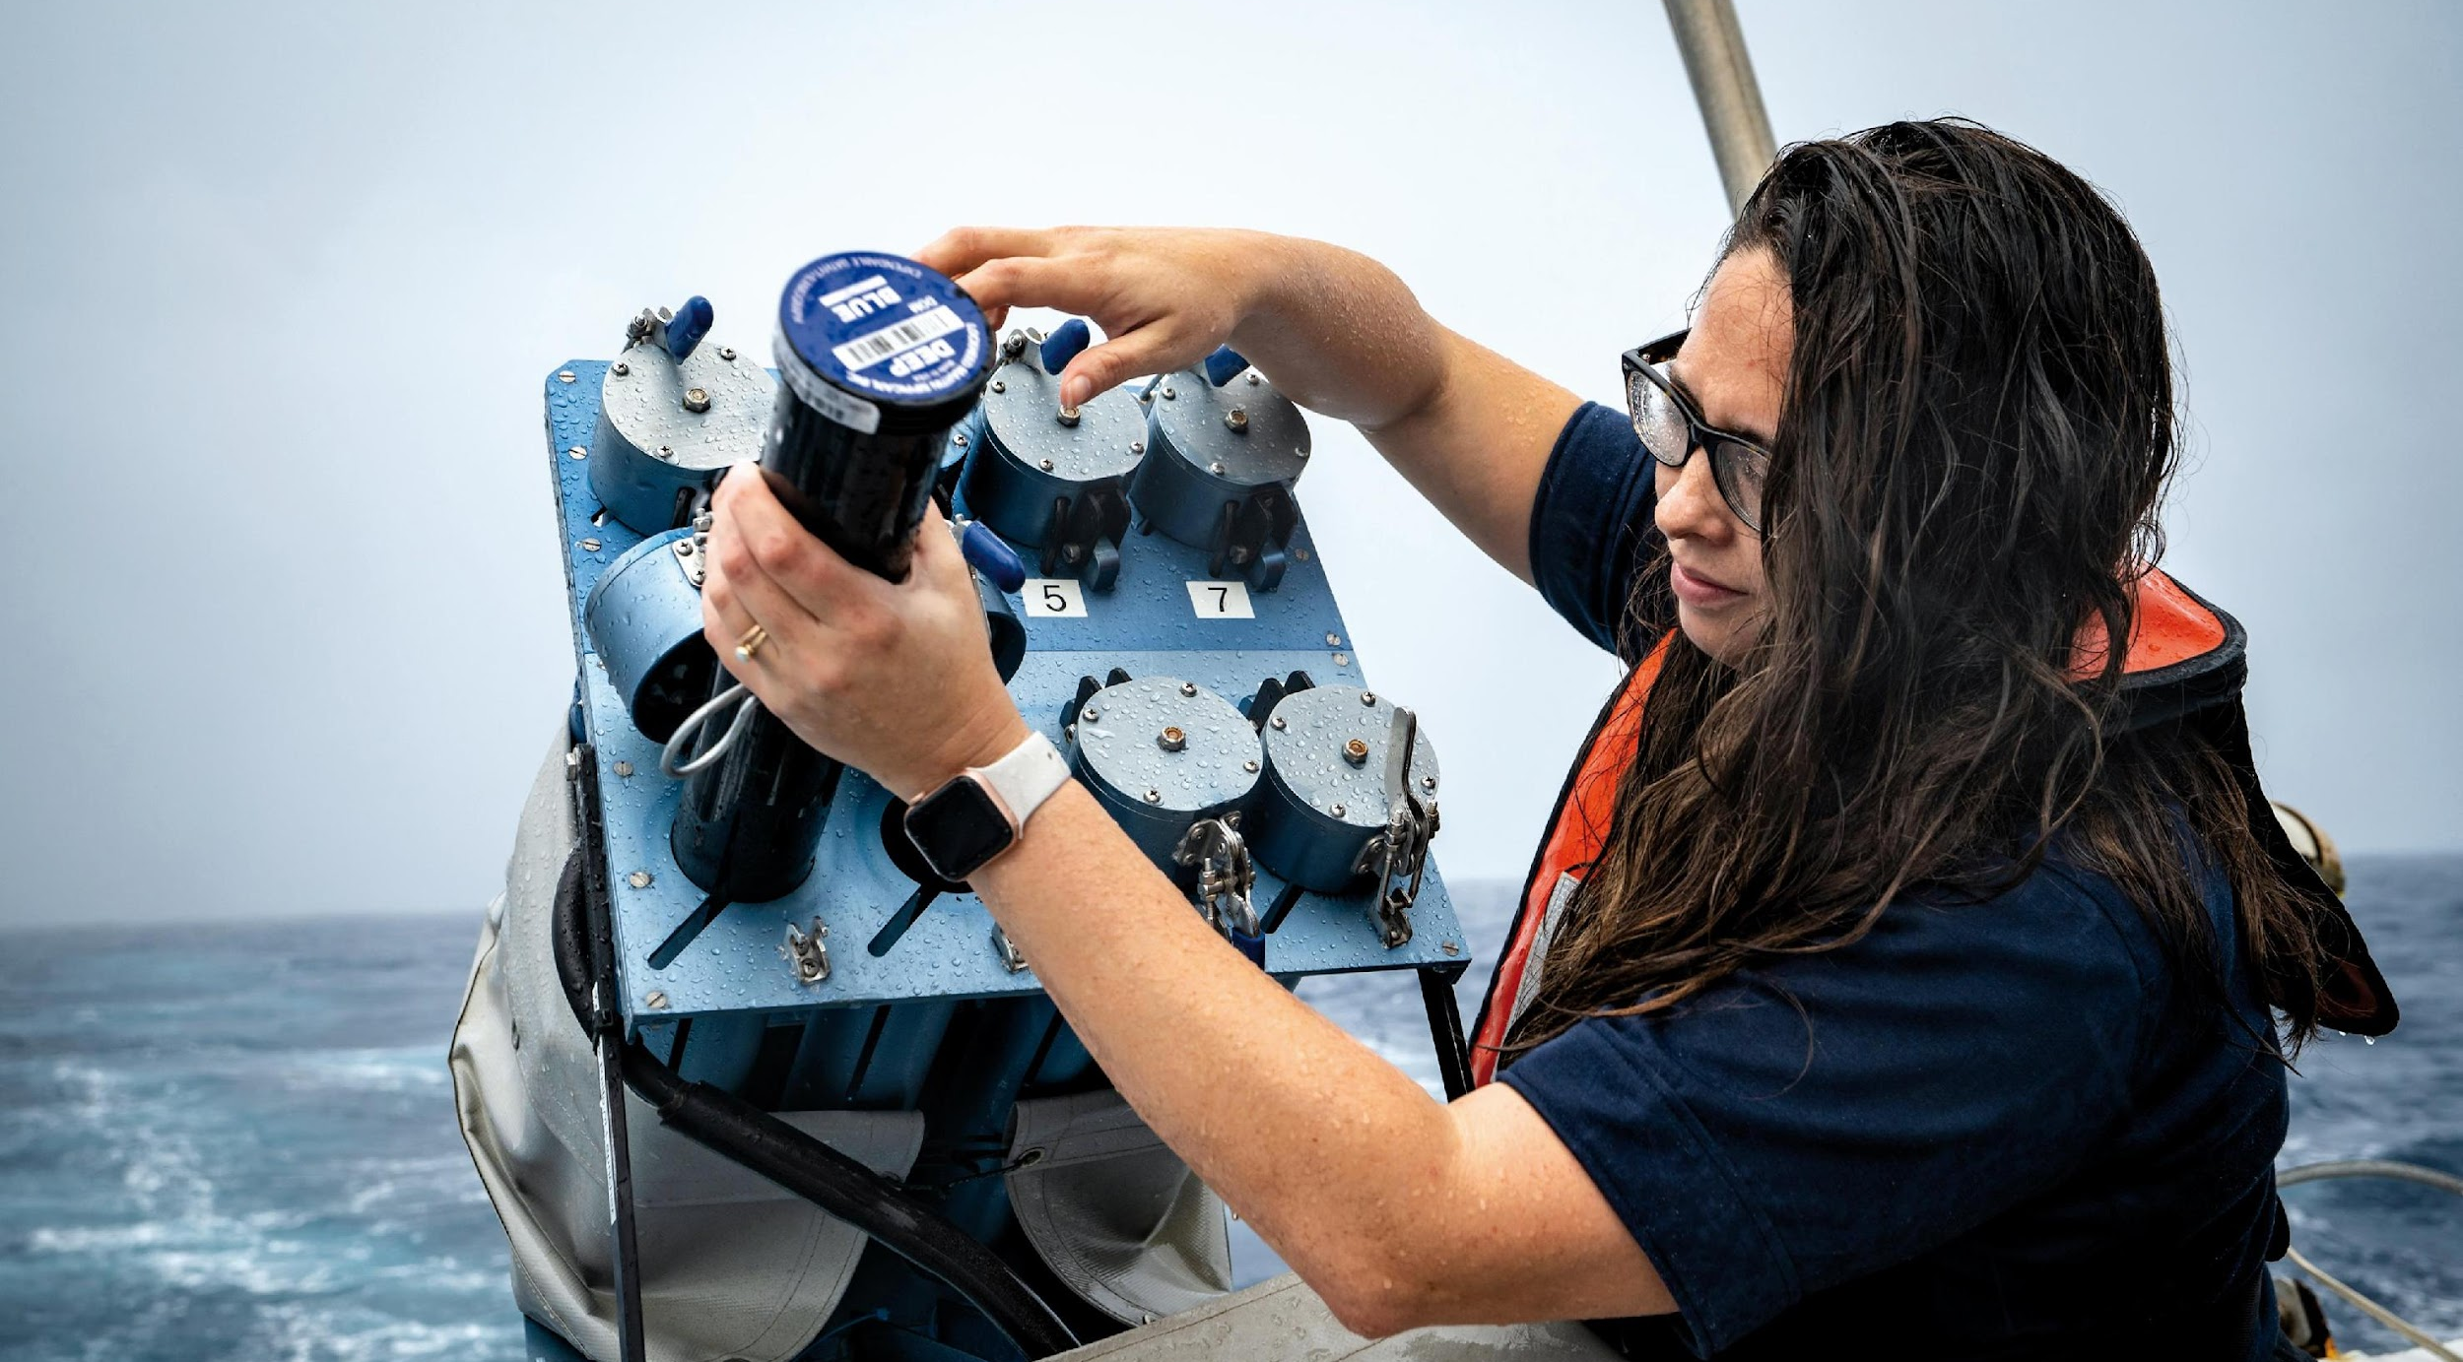
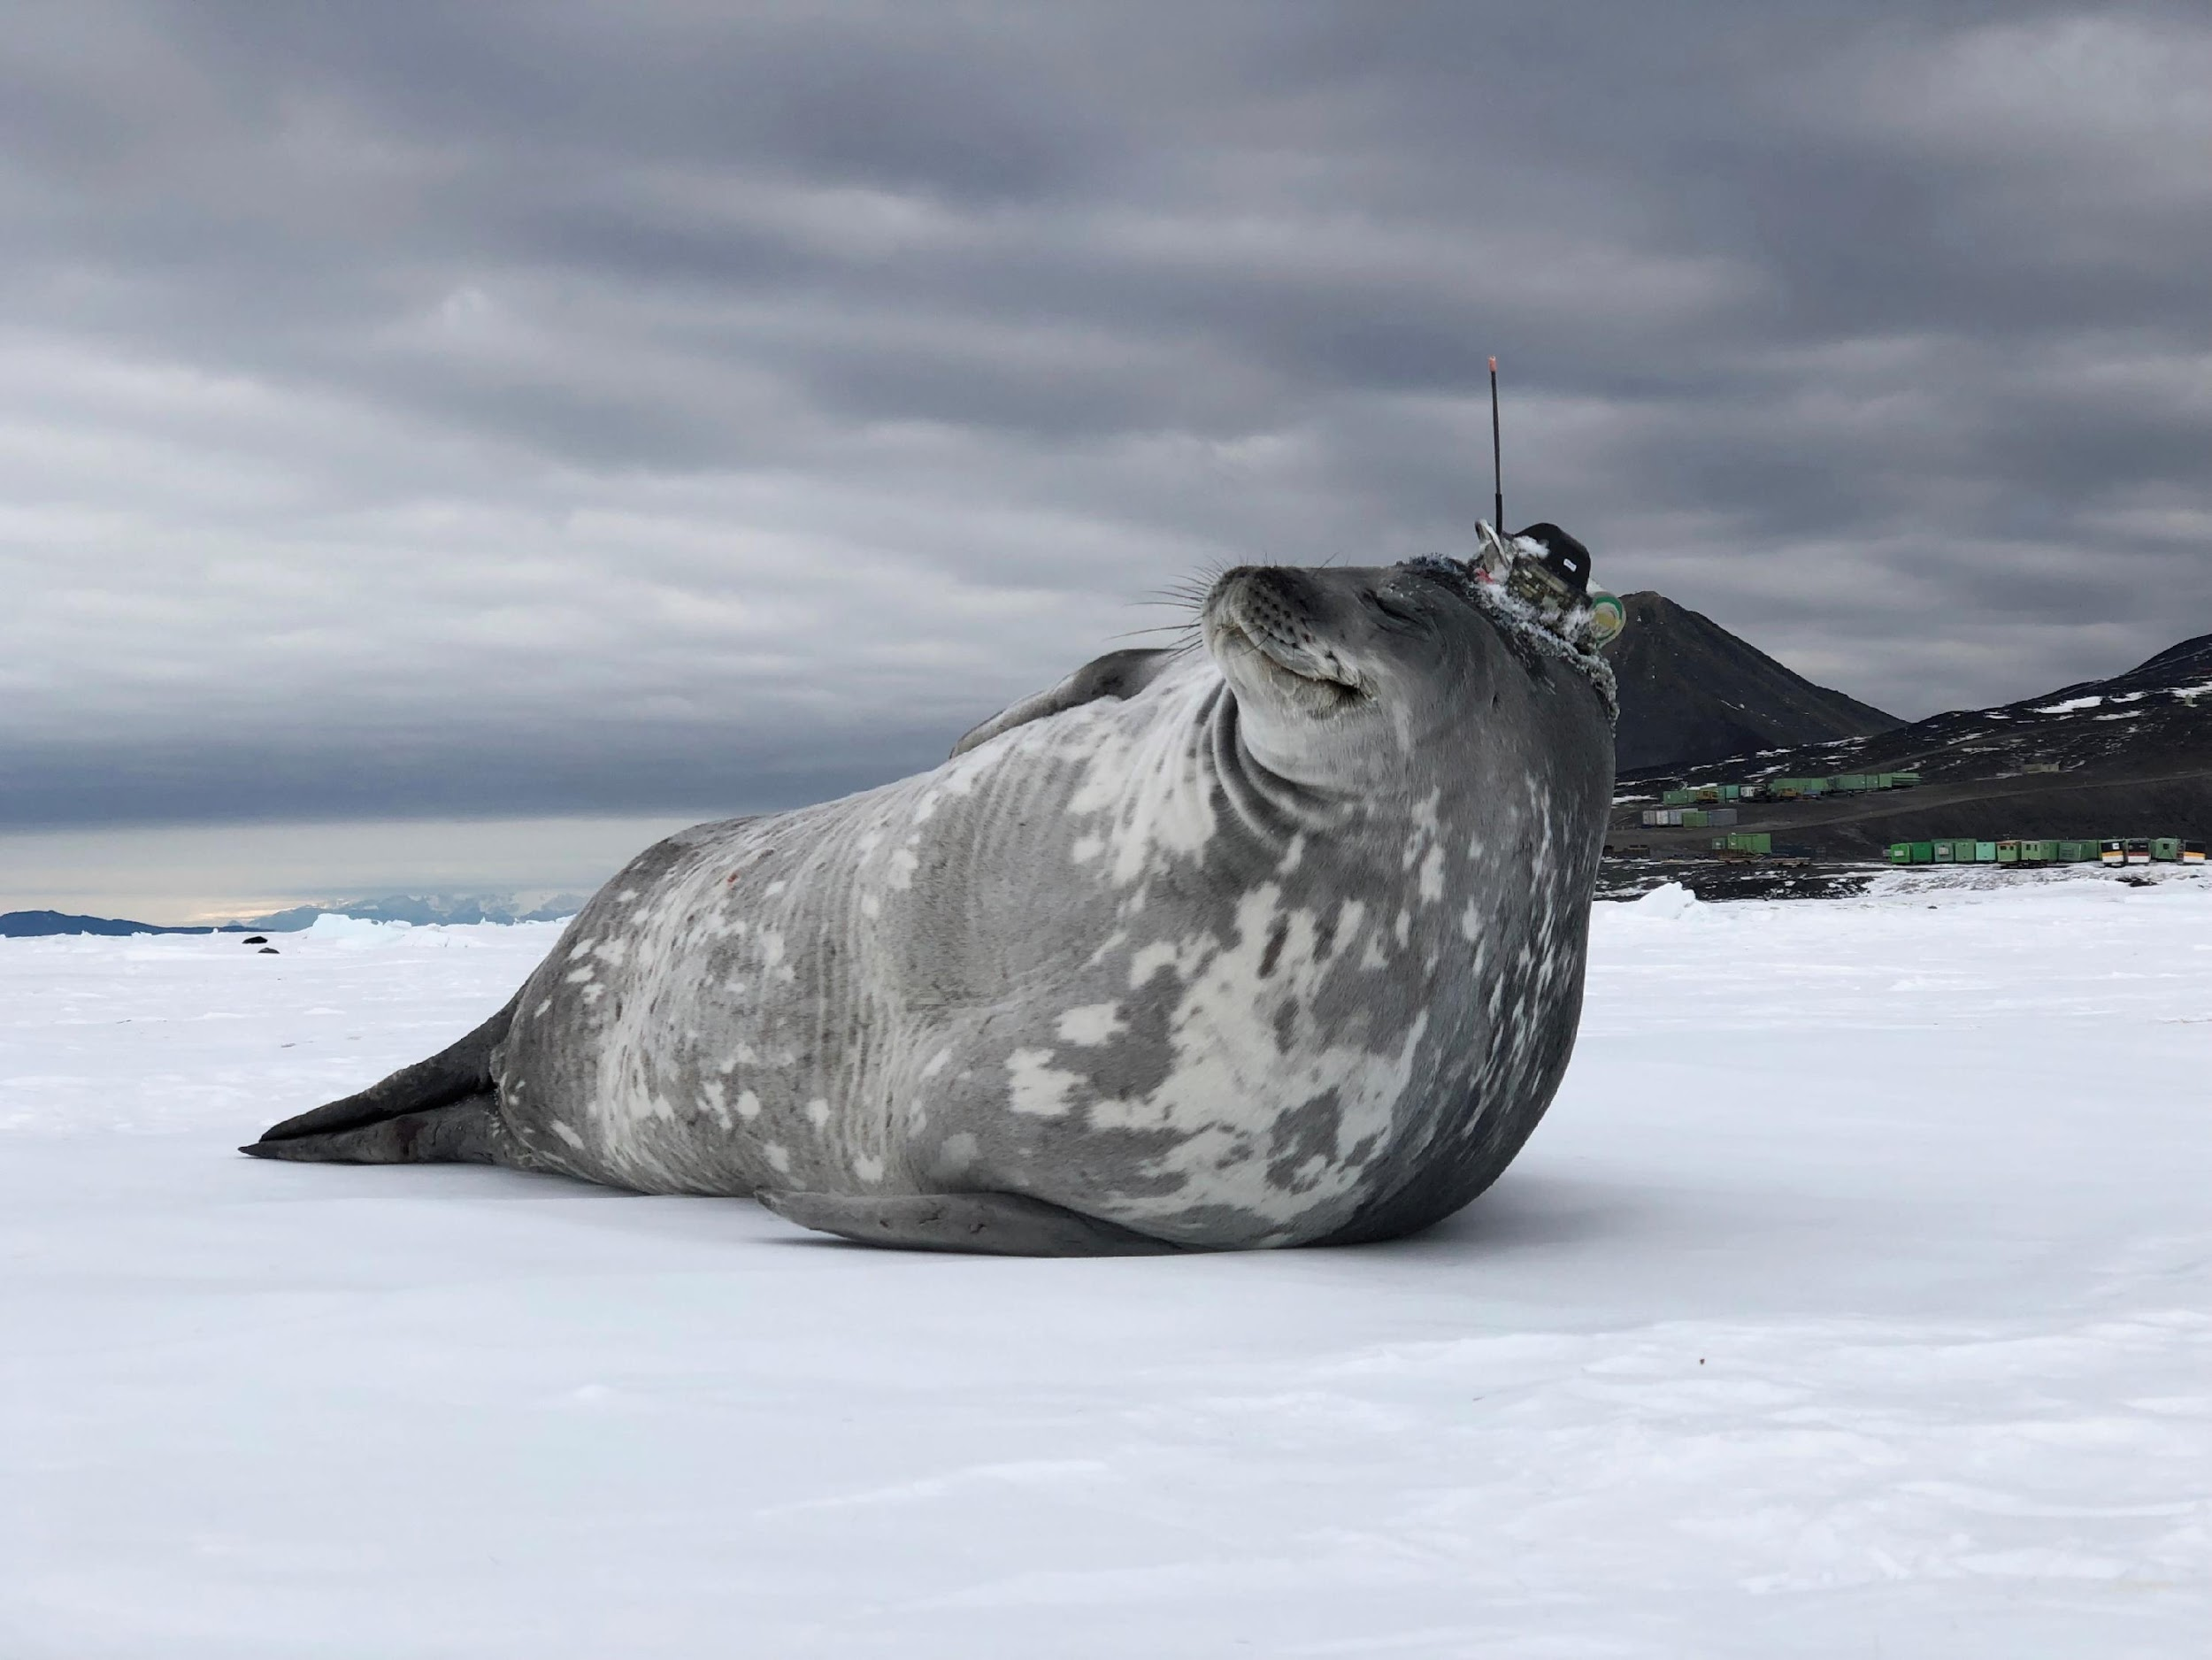
Thank you
goosocean.org

Slide 15
This Week and the Way Ahead
Celebrate successes!
Identify priority actions for the year & core business surrounding our foci areas
Cross dialogue on Network updates, risks, opportunities and barriers
Identify data and metadata work towards the IOC Data Architecture and WIS 2.0
Enhance engagement with the Networks, GOOS Panels, and network “users”
Success in advancing Data Task Team
OceanOPS Work Plan, finalize SLA & planning for new strategy to 2030
Discuss draft framework for assessing network maturity, health, health and risk
Planning for new GOOS Report Card and GOOS messaging
Assist IOCARIBE in planning for a regional ocean observing system
Notes:
Ann

Slide 16
Food for thought & Call for Action
Integrated Data Infrastructure - Opportunities and risks
EOV Framework - requirements processes and links to Networks
Observing solutions of the future will be more integrated across platforms, providers, and communities (eg. co-design program activities, ocean carbon, marine ecology, etc)
Strategically - thinking big and long-term to guide OCG future development
Private Sector engagement
Risk Management
Notes:
Ann

Slide 17
OCG-16 Format
Meeting time: Mo-Thur - 9 - 17:30 pm
Annotated Agenda at the bottom of the timetable outlines questions and intended outcomes for each session
Agenda topic, presenter and materials are linked in the Agenda and on the OCG-16 website
Notes and Key points will be recorded and reviewed daily
Interactive Network Poster and discussion Session
Workshop: IOCARIBE-GOOS, supporting regional priorities (Thursday)
Notes:
Ann

Slide 18
OCG-16 Etiquette
Keep your microphone muted unless you are speaking and try to use video.
For question or comment, please use the chat box or indicate by raising your hand in order to be called upon by the moderator.
Please be succinct in both your questions and answers.
The sessions will be recorded for the purpose of writing the report, and the recordings deleted afterwards.
Attendees who are joining as observers please edit their names and note OBS_ in front of their name.
Notes:
Ann

Slide 19
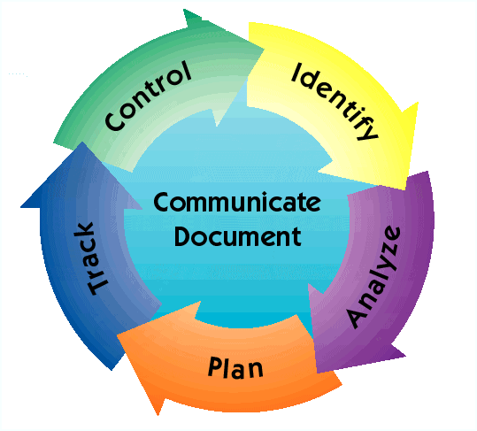
Risk Management Process
Continuous activities throughout life cycle to view and manage risks
Process steps: Identify, Analyze, Plan, Track, Control, Communicate and Document
Identifying impacts and likelihood of occurrence
Example Metrics to monitor:
National funding (e.g. # countries contributing)
Data management
Resourcing/personnel
Ship time needs/schedules/capabilities, availability/projections
Legal (e.g. EEZ permissions)
Piracy/vandalism (incidents)
Instrument and platform diversification, reliabilities
Resiliency (spare instruments, redundancy, etc)
Notes:
Identify: Search for and locate risks before they become problems
Analyze: Convert risk data into useable information for determining priorities and making decisions
Plan: Translate risk information into planning decisions and mitigating actions (both present and future), and implement those actions
Track: Monitor risk indicators and mitigation actions
Control: Correct risk mitigation plans deviations and decide on future actions
Communicate and Document: Provide information to project on risk activities and current/future risks, and emerging risks

