Slide 1
Session 7.2.
IOC Data architecture
Emma Heslop, Programme Specialist, GOOS
Sixteenth Observations Coordination Group Meeting (OCG-16)
7-10 April 2025, IFREMER, Brest, France.

Slide 2
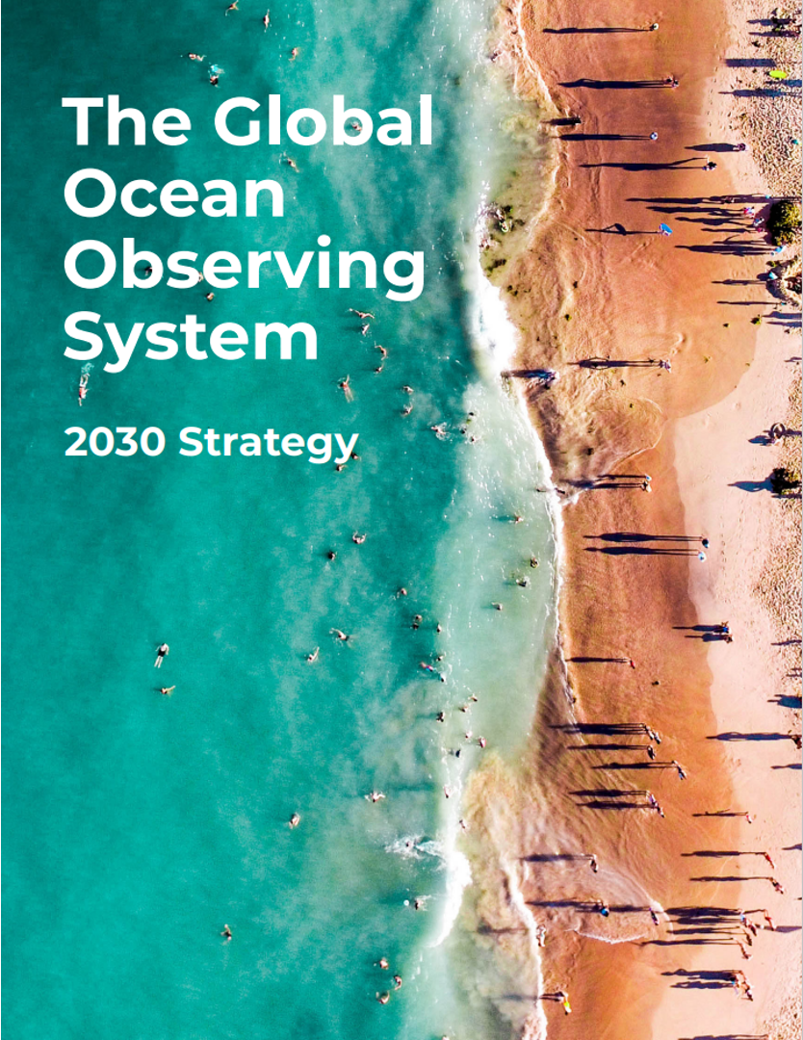
Global Ocean Observing System 2030 Strategy
Goal 2: System integration and delivery, provide authoritative guidance on integrated observing system design, sustain, strengthen and expand observing system implementation, and ensure FAIR data
SO7. Ensure GOOS ocean observing data and information are FAIR with appropriate quality and latency
Outcomes foreseen:
An identified GOOS data architecture as part of broader oceanographic, atmospheric, earth system data architectures
Data products based on EOVs/ECVs
More data available, more appropriately, to more users
Meaningful data metrics
Notes:
(findable, accessible, interoperable, and reusable)

Slide 3
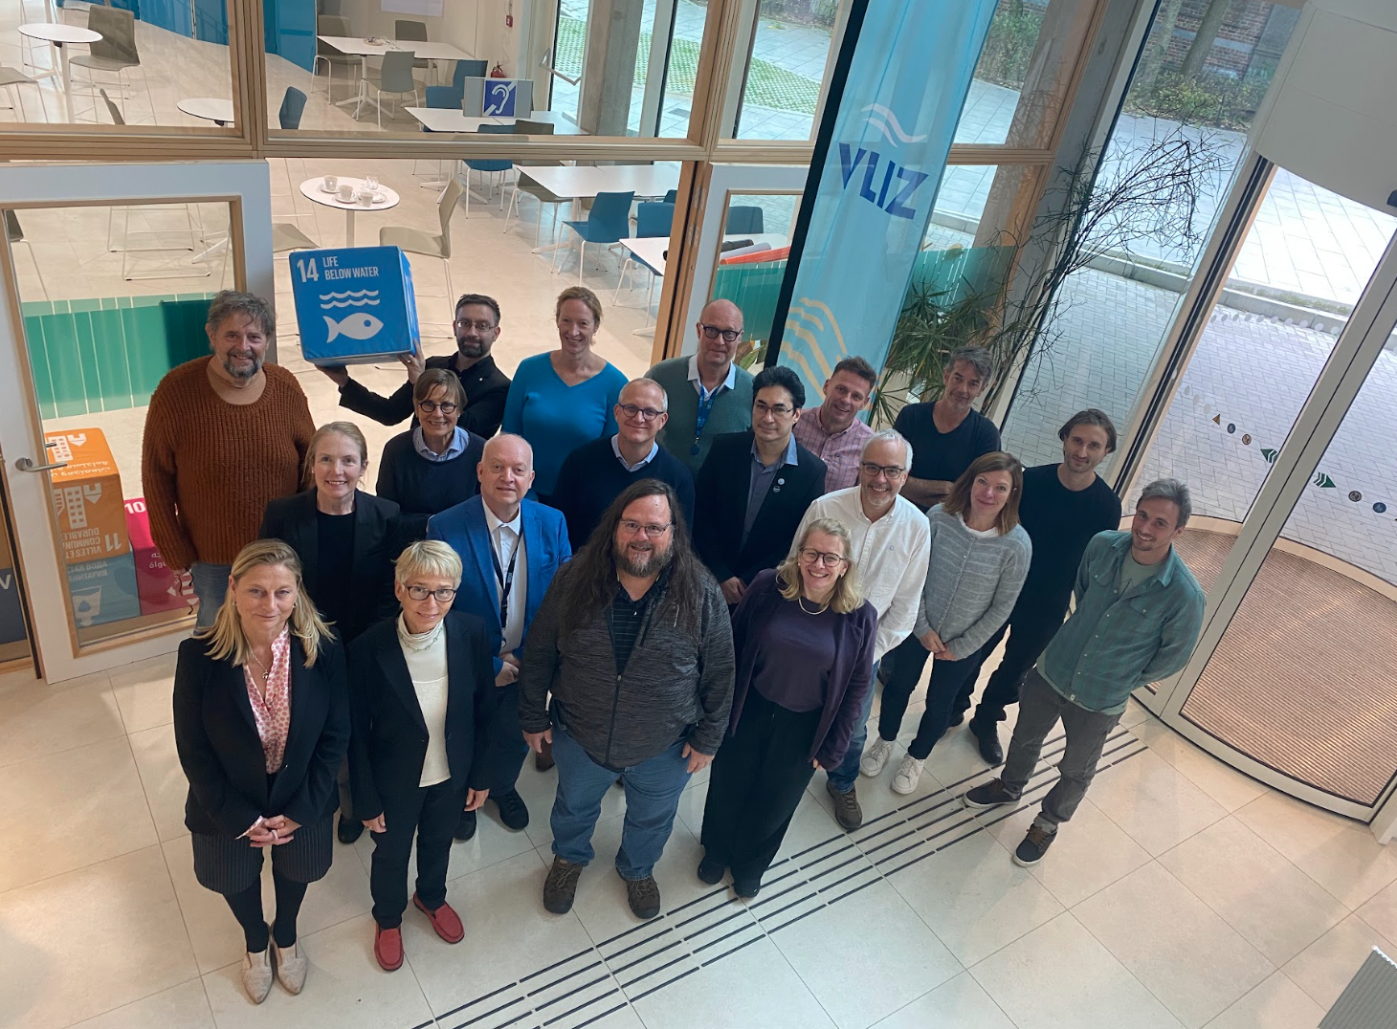
First IODE-GOOS Data Workshop
Support data access for the future - looking across disciplines and sections
Identify roles and synergies
Develop a joint vision
Technical solutions identified
Coordination & future planning
OCG, BGC Panel, BioEco Panel, OceanOPS, OBIS, plus IOC Ocean Science Section,Tsunami Unit, Ocean Decade (DCO/DCC)
WMO presented WIS2 and discussed connections to ODIS
Notes:
The different programmes of IOC are collecting, managing, analysing, and delivering ocean data, services, information and knowledge, based on ocean . The IOC has embraced and adopted the FAIR data principles and the IOC Data Policy, but to date have not had an collective internal vision for a data backbone. Society - government, commercial, science and others, have a growing need for ocean data to inform decision making, and at the same time the digital information revolution means that they expect to be able to access this data easily and seamlessly.
In recent years GOOS, IODE, and in dialogue with WMO, have been aligning their developments around broad adoption of open architectures and federated system approach (ODIS, WIS2.0, ERDDAP™), several key IOC data systems are are now ready to be robustly interlinked.

Slide 4
Joint Vision – north star to aim for
Defined a clear niche in the digital ecosystem which is unique to IOC, that is unique, valuable, built on existing infrastructure, and aligned with other (open) architectures
EOV data of documented quality, following FAIR & CARE principals, available for all
IOC providing a (federated) gateway to all ocean data, with GOOS certified EOV data clearly identified
Harnessing the IOC value chain to deliver trusted information to as many as possible
High value products that deliver EOV data into global assessments and multilateral processes, and that can be traced back to the point of truth (i.e. observations)
Wherever you are in the world to be able to appropriately access EOV data
IOC has a clearly defined role in digital ecosystem which is unique and investable
Help bridge the digital divide and mature digital ecosystems globally

Slide 5
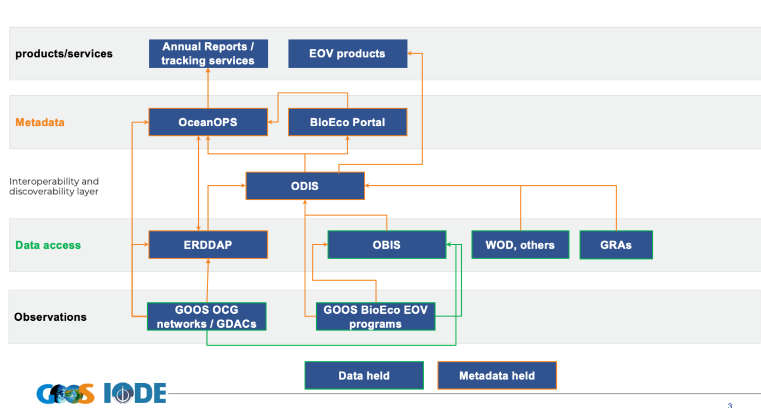
Data Architecture
Agreed IOC Data Architecture – major step forward
Based on ODIS, EOVs, FAIR & CARE principals, and metadata linked to original source
Form a Working Group and prepare a joint proposal for IOC Assembly June 2025
GOOS OCG ERDDAP is a Hyper node
OBIS is a Super GDAC for BioEco EOVs
OceanOPS / BioEco Portal will interface for services
Harvest and compile EOVs, support creation data products,, e.g. O2 GOOS metadata tag to signal quality
Need provenance and licensing in metadata
Meeting Report

Slide 6
Work underway…
Notes:
Ocean Observing has made great progress… BUT not sufficient for societies current and future needs but
Right now, we are driving into our future in darkness. And GOOS aims to turn on the headlights.

Slide 7
Working Group Members
ODIS- Lucy Scott/Pier Luigi Butttigieg
OBIS/BioEco - Ward Appeltans/Pieter Provoost
OCG/OceanOPS - Kevin O’Brien/Mathieu Belbeoch
GOOS general - Emma Heslop/Joanna Post
SDG 14.3.1/Science - Katherina Schoo/Kirsten Isensee
GOOS BGC/IOCCP - Veronique Garcon/Nico Lange
IODE general - Peter Pissierssens/Lotta Fyrberg
DCC/DCOs Infrastructure - Terry McConnell, Enrique Alvarez, Adam Leadbetter
IOC Tsunami Unit - Bernardo Aliaga
IOC Sustainable Ocean Planning and Management - Fanny Douvere

Slide 8
Work on the concept
Vision: A harmonised and tightly coordinated suite of IOC data systems delivering open, actionable, and freely available data for the ocean’s digital ecosystem.
GOOS, IODE, dialogue with WMO, have been aligning development around broad adoption of open architectures and federated system approach (ODIS, WIS2.0, OCG ERDDAP™).-
Many elements of the proposed IOC Data Architecture already exist, and the workshop outlined an approach to optimise connections to strengthen delivery of ocean data
Adopting a data fabric architecture model, each layer of the fabric, has well-developed data management practices to ensure quality and integrity.
In a relatively simple manner this creates an integrated IOC ‘data system’ that can underpin data availability and supercharge the production of data products

Slide 9
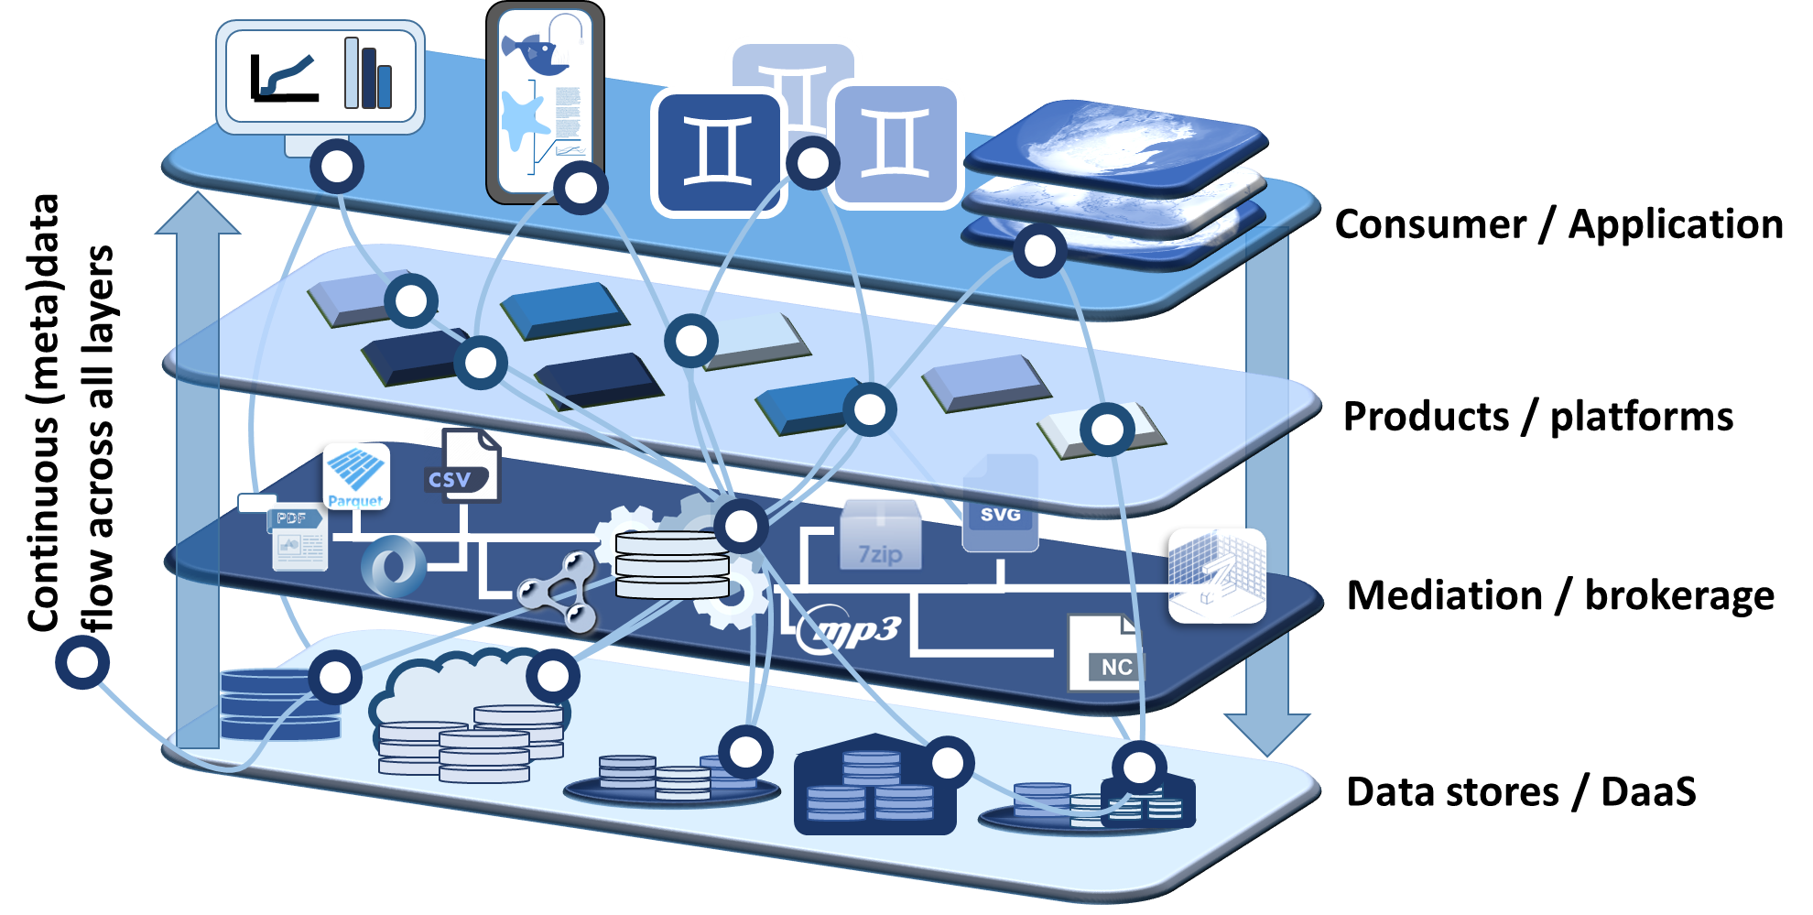
Work on the concept
Vision: A harmonised and tightly coordinated suite of IOC data systems delivering open, actionable, and freely available data for the ocean’s digital ecosystem.

Slide 10
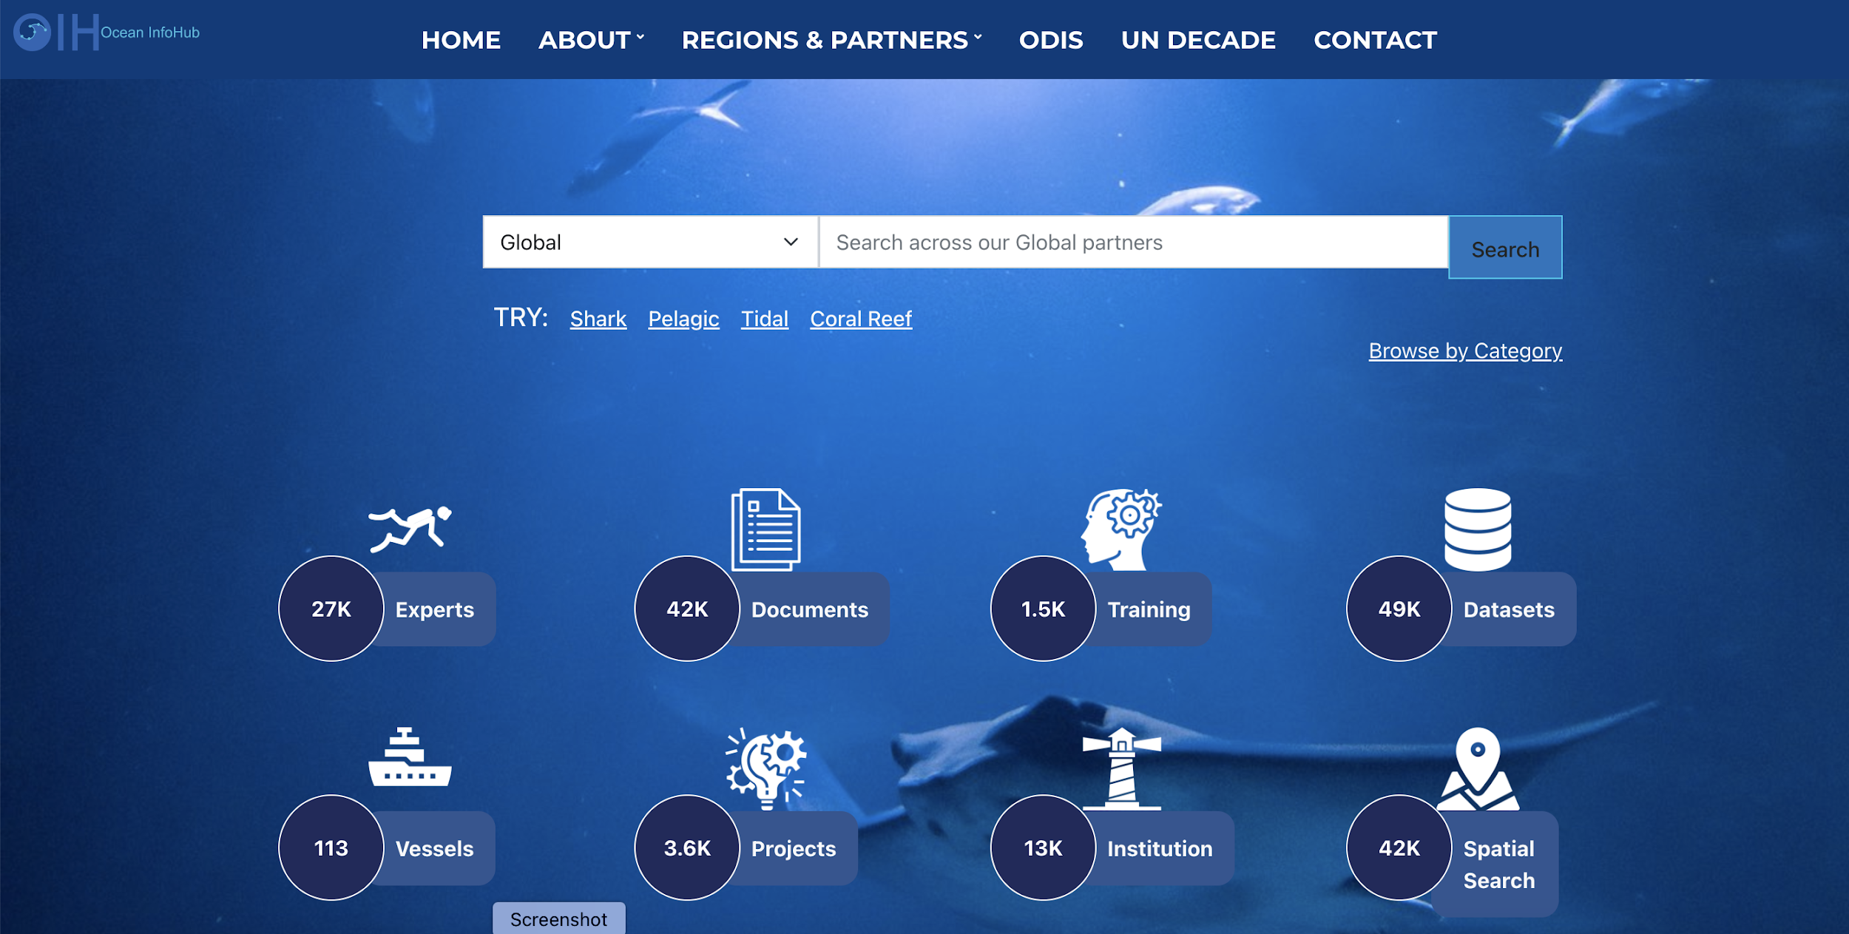
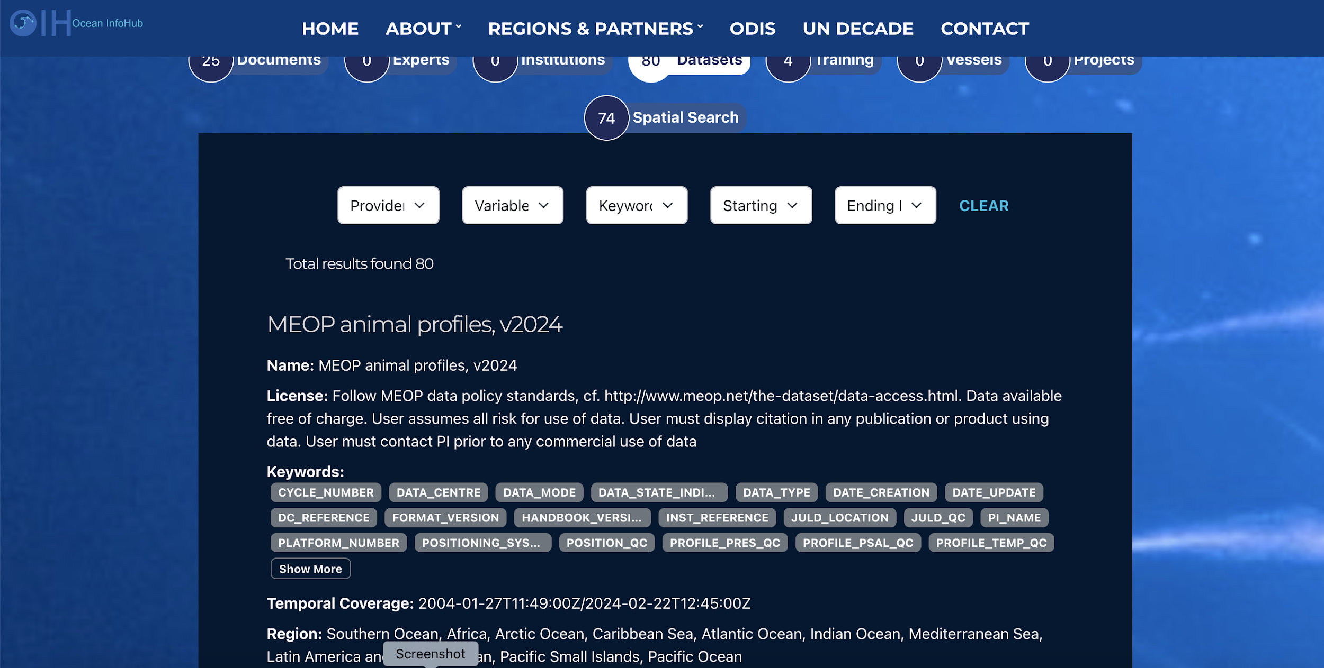
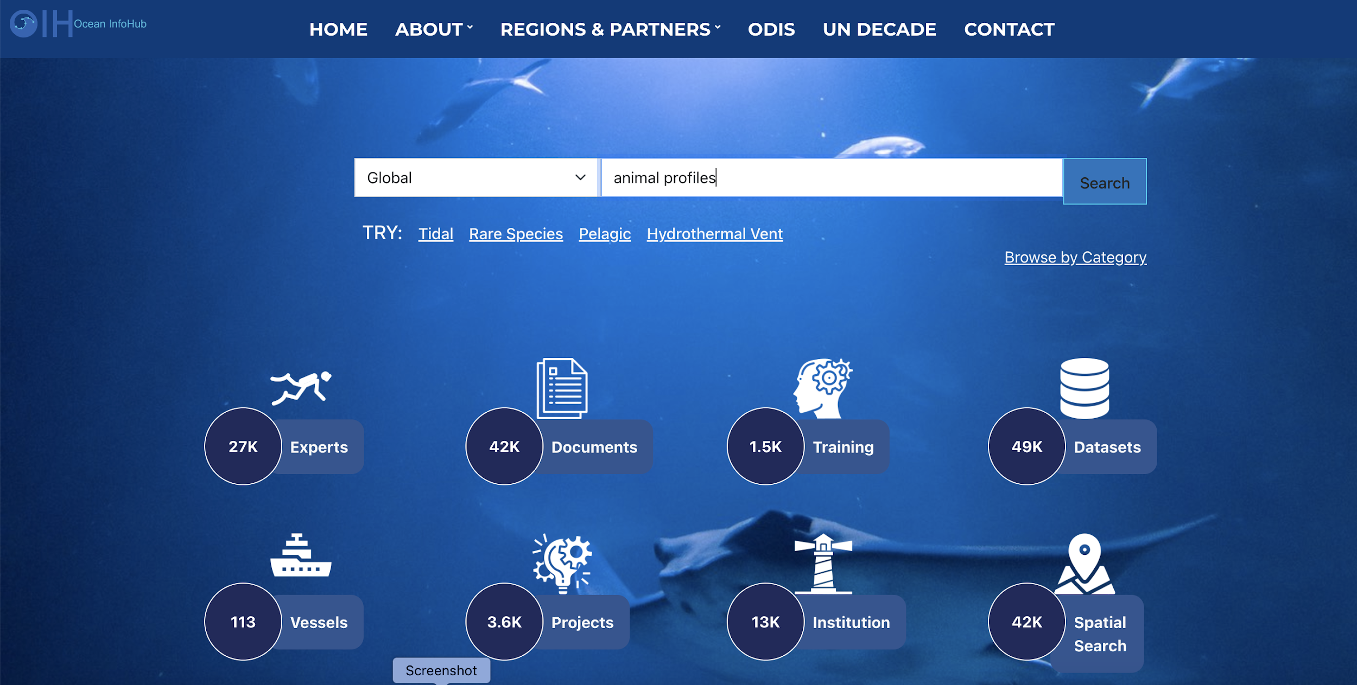
GOOS OCG Data Hypernode -
Connection to ODIS and IOC Architecture
Ocean Data Information System (ODIS)
ODIS Harvest
AniBOS
Drifters
User query
Argo
GO-SHIP
Data Access
GOOS Federated Data (aka Hypernode)

Slide 11
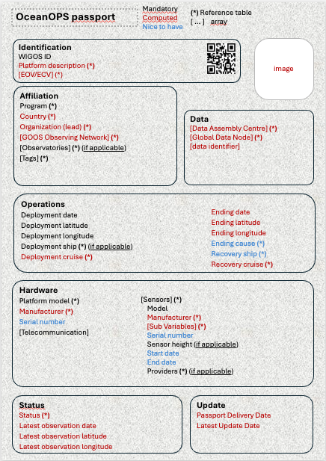
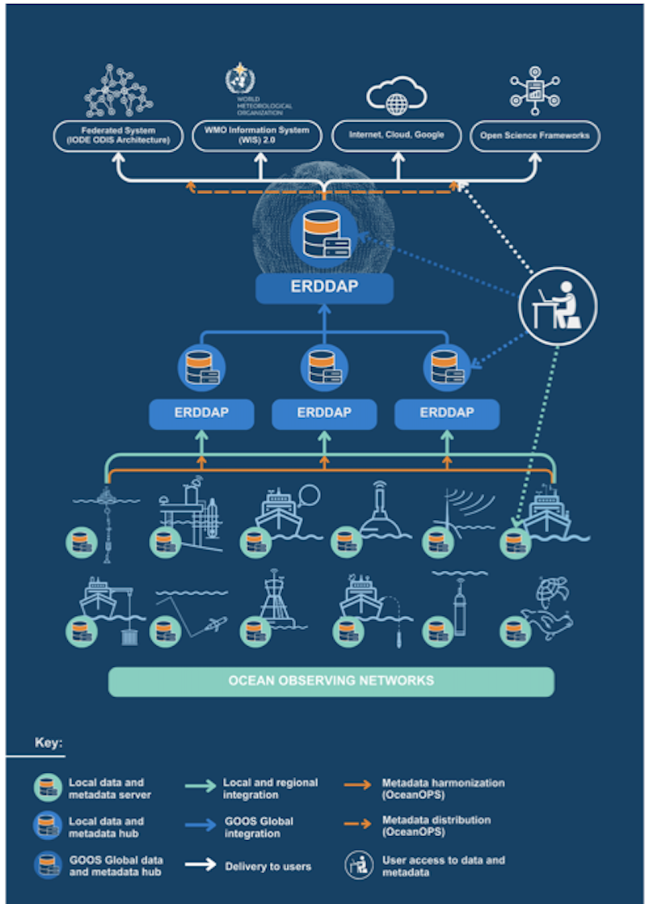
OCG Data Task Team
OceanOPS Metadata “Passport”
Improve metadata content (minimum required metadata) and flows to OceanOPS
Ensure metadata specifications meet needed requirements (i.e., WMO/OSCAR, GOOS reporting needs, IOC Data Architecture)
Identify global data nodes for federation, expand ERDDAP
Define/agree minimum metadata flow between network data systems, OceanOPS, and external stakeholders (WMO, IODE, etc)
OCG Federated Network

Slide 12
IOC Assembly A33 Preparation
Agenda item 3.4.3
Concept Note (INF) in prep. Due 30/04
Decision and background paper developed
Endorses the IOC Data Architecture concept as outlined in IOC/A-33/3.4.3.Doc(1)
Approves the Terms of Reference of the intersessional Working Group on the development of the IOC Data Architecture, as outlined in the annex to this decision.
Requests the IOC Data Architecture working group of experts to deliver a detailed implementation plan and minimum viable product demonstrators for the consideration of the fifty ninth IOC Executive Council, June 2026.

Slide 13
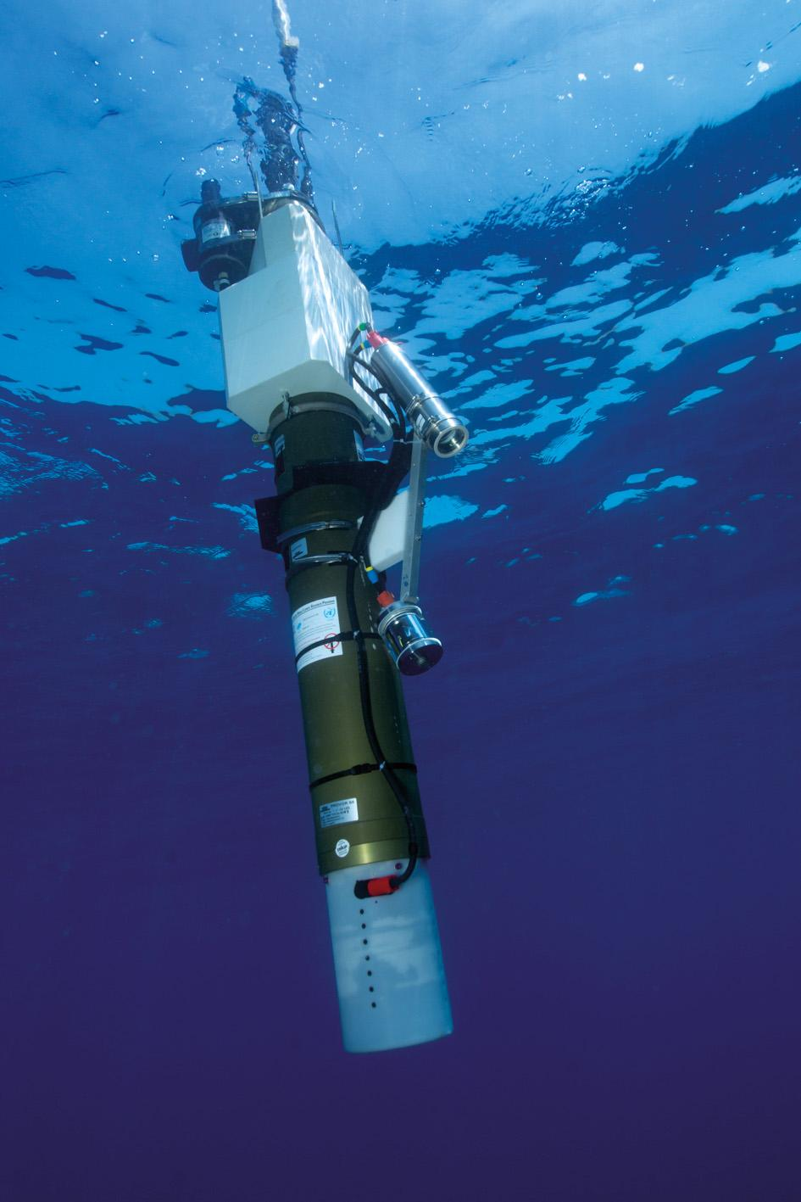
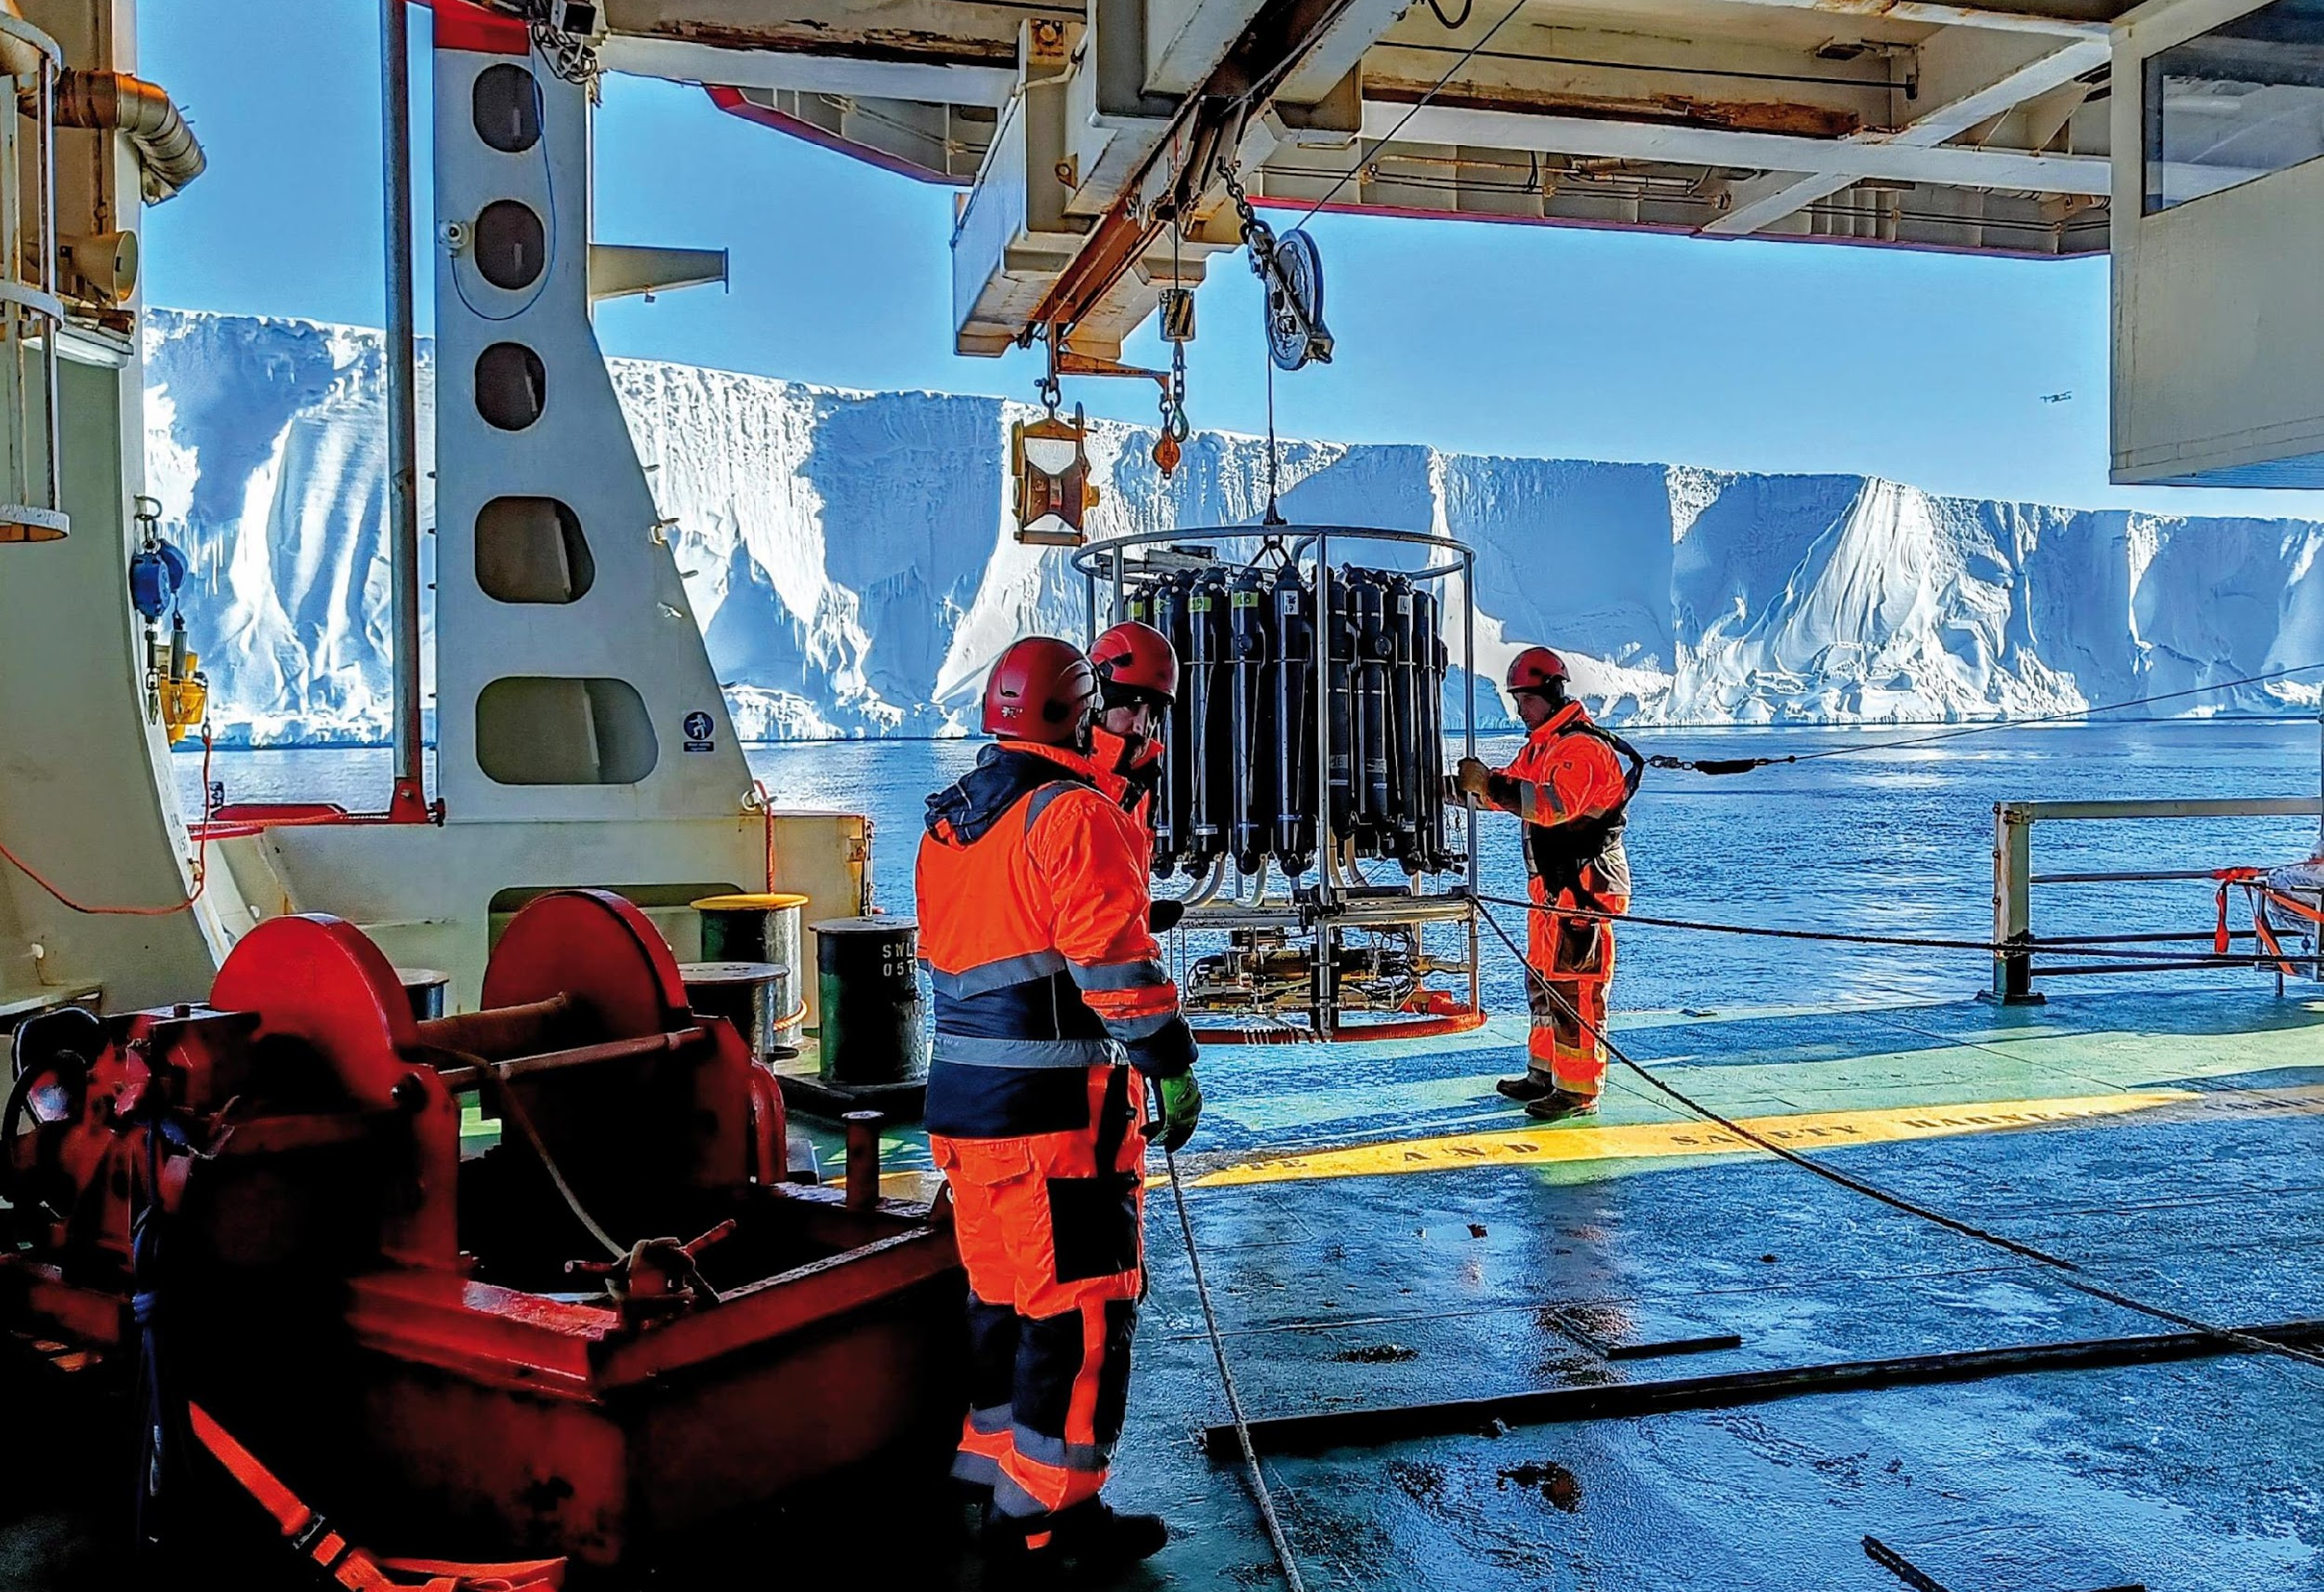
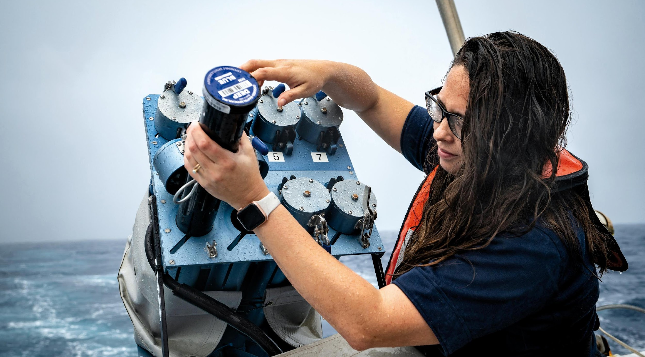
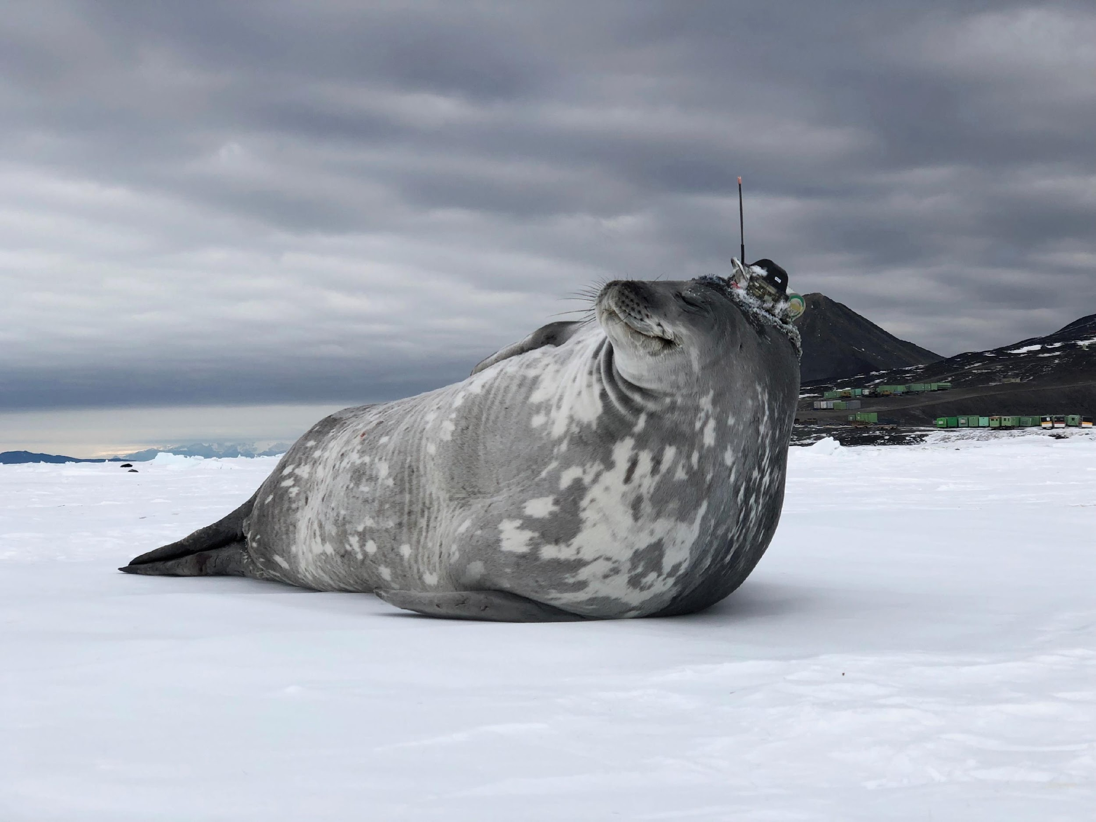
Thank you
goosocean.org

Slide 14
Global Ocean Observing System 2030 Strategy
Goal 2: System integration and delivery, provide authoritative guidance on integrated observing system design, sustain, strengthen and expand observing system implementation, and ensure FAIR data
SO7. Ensure GOOS ocean observing data and information are FAIR with appropriate quality and latency
Outcomes foreseen:
An identified GOOS data architecture as part of broader oceanographic, atmospheric, earth system data architectures
Data products based on EOVs/ECVs
More data available, more appropriately, to more users
Meaningful data metrics
Notes:
(findable, accessible, interoperable, and reusable)

