Slide 1
Session 7: ERDDAP and WIS 2
Kevin O’Brien, OCG Vice-chair for Data, University of Washington/CICOES
Sixteenth Observations Coordination Group Meeting (OCG-16)
7-10 April 2025, IFREMER, Brest, France.

Slide 2
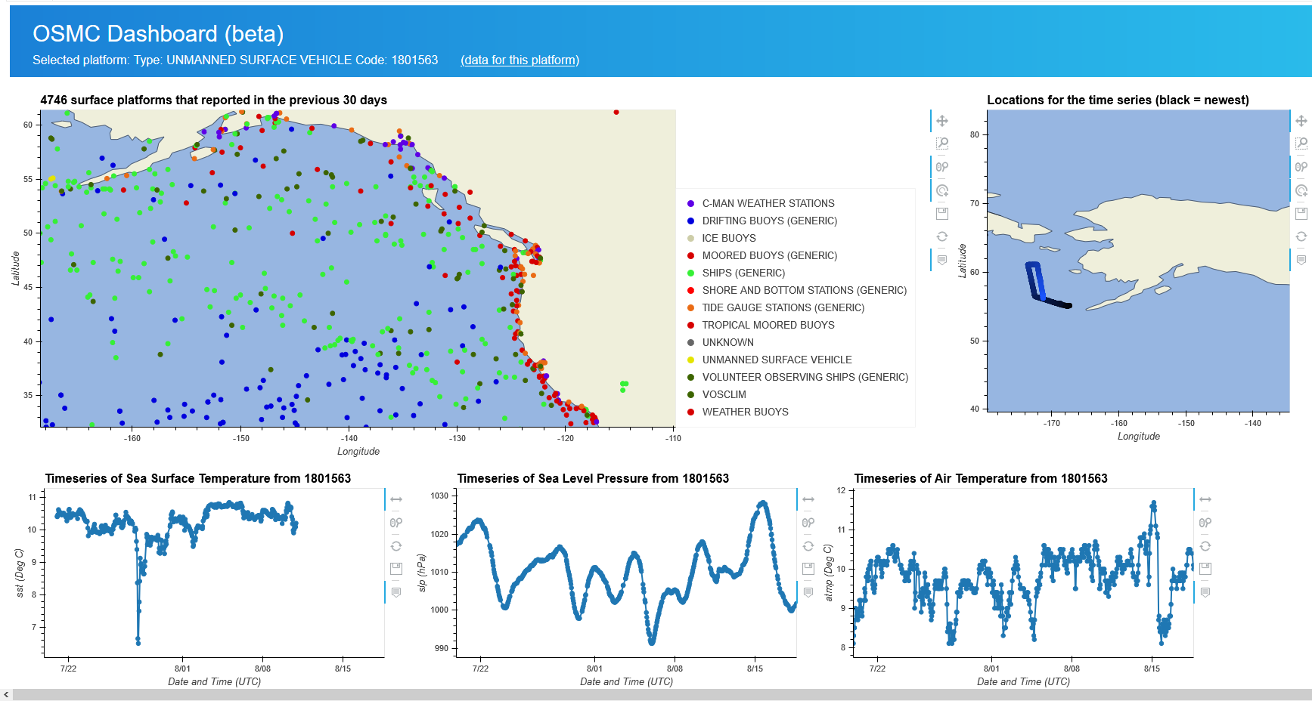
GOOS Open-GTS Data Exchange Workflow
The Open-GTS currently uses the GTS for exchanging data in near real-time
NOAA/PMEL
NOAA/NDBC
GTS
Platform
Platform
Local storage
Harvest and encode
Platform
ERDDAP*
*Supports many data formats
However, the ERDDAP data/metadata endpoints are available to the public.
Notes:
Data is avbialgble either through the traditional GTS, but also through interoperable data services, thanks to the ERDDAP server.

Slide 3
Open-GTS, WMO and WIS 2.0
Subscribe
Retrieve
Platform
Platform
Local storage
Publish
Pub/sub
broker
Retrieve
Platform
ERDDAP*
*Supports many data formats
Subscribe
User might receive:
CSV/NCCSV file
NetCDF file
Service URL to access the data
Notes:
Data is avbialgble either through the traditional GTS, but also through interoperable data services, thanks to the ERDDAP server.

Slide 4
ERDDAP and WIS 2 - Challenges
ERDDAP does not currently have native mqtt* supprt
Solution: Wrap ERDDAP with mqtt services utilizing ERDDAPs other notification options (RSS, API, etc)
Solution: Integrate mqtt support into ERDDAP – already a ticket for this task in ERDDAP github
Solution: ODIS could potentially act as a mqtt broker for the community
Useful for others in the ocean community who cannot set up WIS 2 node
*MQTT (Message Queuing Telemetry Transport) is a lightweight, publish-subscribe based messaging protocol designed for resource-constrained devices and low-bandwidth, high-latency, or unreliable networks, making it ideal for IoT applications.

Slide 5
ERDDAP and WIS 2 - Challenges
ERDDAP does not support BUFR format
Solution: None
ERDDAP will not (most likely) ever integrate BUFR support
However, exchanging NetCDF (or json) across WIS 2 is gaining traction
Can also “exchange” access URLs that will allow user to choose their own access format – ERDDAP excels at this.
Things will be simpler for GOOS if we can leverage ERDDAP for WIS2

Slide 6
Session 7: ERDDAP and WIS 2 Thank you!
Kevin O’Brien, OCG Vice-chair for Data, University of Washington/CICOES
Sixteenth Observations Coordination Group Meeting (OCG-16)
7-10 April 2025, IFREMER, Brest, France.

