Slide 1
Marine Climate Data System Update
David I. Berry, Champika Gallage

Slide 2
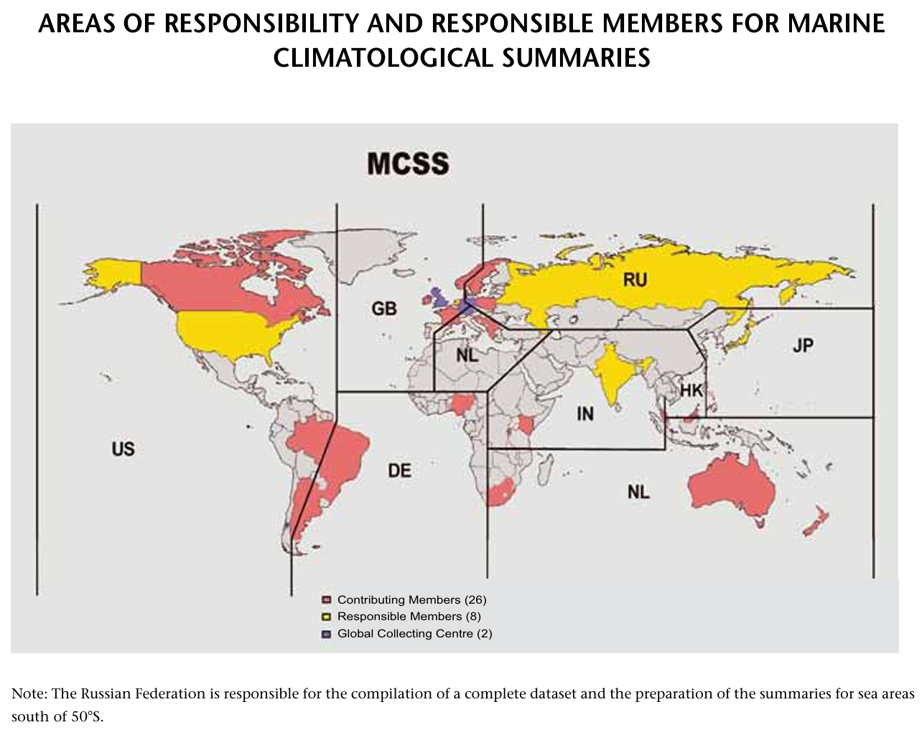
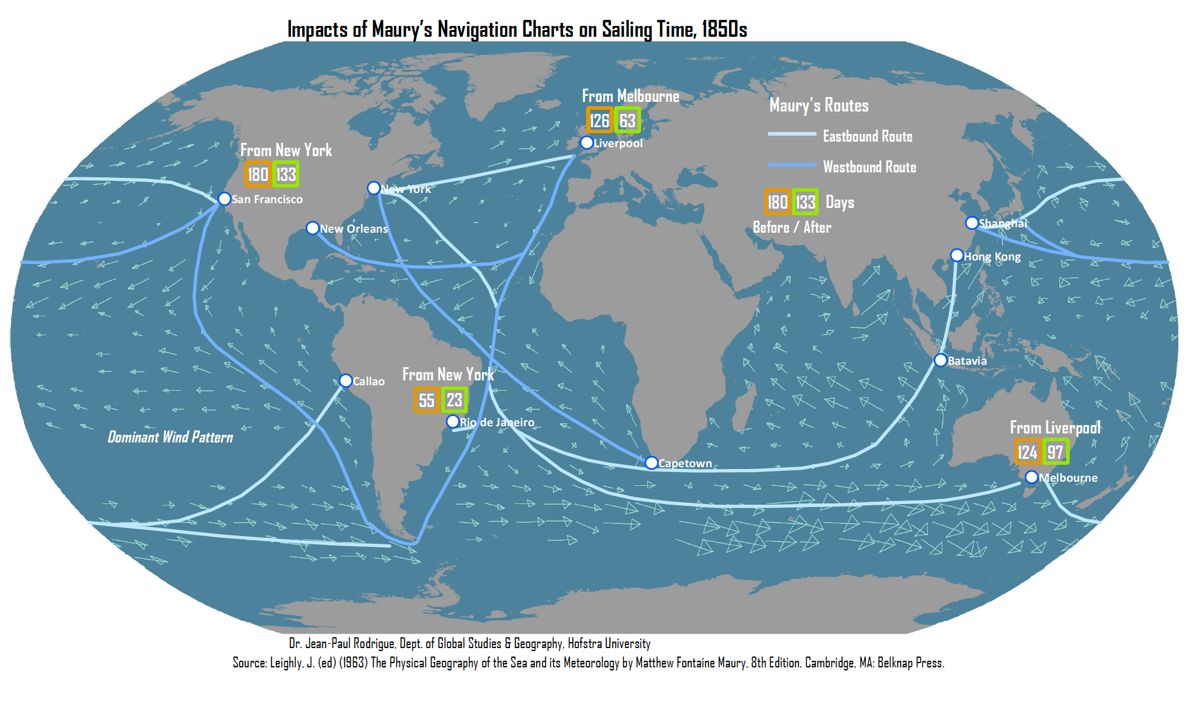
Background
The value of marine meteorological and oceanographic data has long been recognised, both economically and from a safety of life at sea perspective
International coordination from at least 1853, e.g. first international maritime conference
WMO Marine Climatological Summary Scheme (MCSS) established in 1963 by the Commission for Marine Meteorology
Global Collecting Centres (GCCs) established in 1994 (hosted by UKMO and DWD)
“I am officially informed that it was stated, in a paper read before the British Association last year, that it was estimated in India that a set of wind and current charts of the Indian Ocean, like those that have been constructed at this office for the Atlantic Ocean, would produce an annual saving to British commerce, in those seas alone, of not less than $1,000,000 a year (250,000 pounds), and for British commerce in all seas of $10,000,000 a year. This estimate was based on the condition of shortening the voyage only one tenth (whereas the average length of the passage to all places beyond the equator has been shortened much more); and the estimate was again repeated at the last meeting of the Association in Liverpool. It has also been estimated that the value of these charts to the commerce and navigation of the United States is equivalent, in the saving of time, to several millions a year.’
(Annual Report of the Secretary of the Navy, December 4th, 1854.)

Slide 3
Background - MCSS
Moored buoys
CM1
CM2
…
CM26
Drifting buoys
RM1
...
RM8
Coastal stations
GCC-UK
GCC-DE
ICOADS

Slide 4
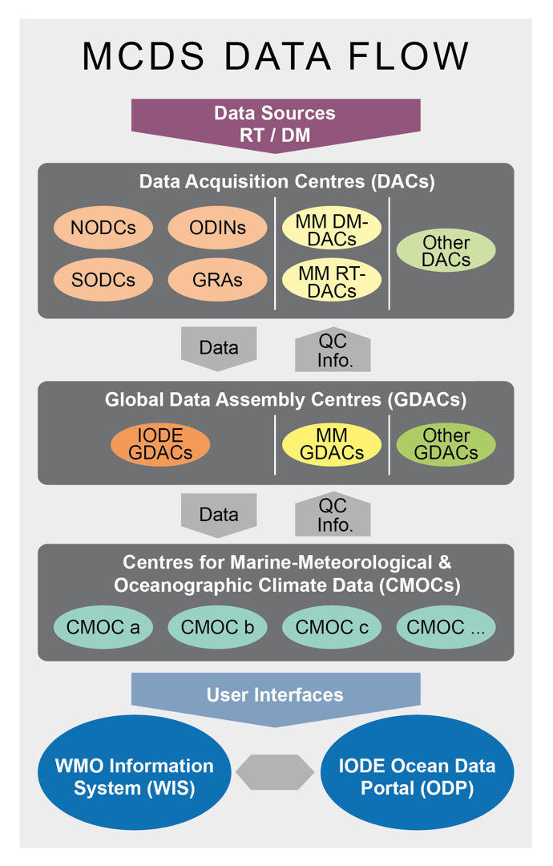
Development of the Marine Climate Data System
Recognising:
the increasing number and complexity of data types;
the need for more timely data;
and to meet the developing needs of climate services
JCOMM approved the modernisation of the MCSS, forming the Marine Climate Data System (MCDS)
MCDS expanded to include both oceanographic and meteorological data, noting many similarities between the two domains
Design and governance of the MCDS coordinated between the WMO and IOC/IODE under JCOMM Data Management Coordination Group (DMCG) and Expert Teams

Slide 5
Current status
Data Assembly Centres (DACs)
Germany (VOS)
Hong Kong, China (VOS)
India (VOS)
Japan (VOS)
Russian Federation (VOS)
United kingdom (VOS)
Lagrangian Drifter Laboratory(LDL), SIO, USA (Global Drifter Program)
Atlantic Oceanographic and Meteorological Laboratory (AOML), NOAA, USA (drifting buoys)
Global Data Assembly Centres (GDACs)
Germany (VOS)
United Kingdom (VOS)
Coriolis, France (Moored buoys)
Coriolis, France (Drifting buoys)
MEDS, Canada (Drifting buoys)
Centres for marine Meteorological and Oceanographic Climate data (CMOCs)
NEMDIS, China
WOD, NCEI, USA

Slide 6
Issues
Governance
Following WMO reform and disbandment of JCOMM, governance and monitoring of MCDS has been unclear
Recognition and approval process for centres ad-hoc
Limited coordination between IODE and WMO, no formal mechanisms
WMO Unified Data Policy approved, IOC equivalent?
Parallel developments?
WIS2.0 / ODIS
Since design of MCDS, WIS and ODP have both evolved to WIS2.0 and ODIS
New requirements for both systems, not recongised in WMO Technical Regulations or Manuals

Slide 7
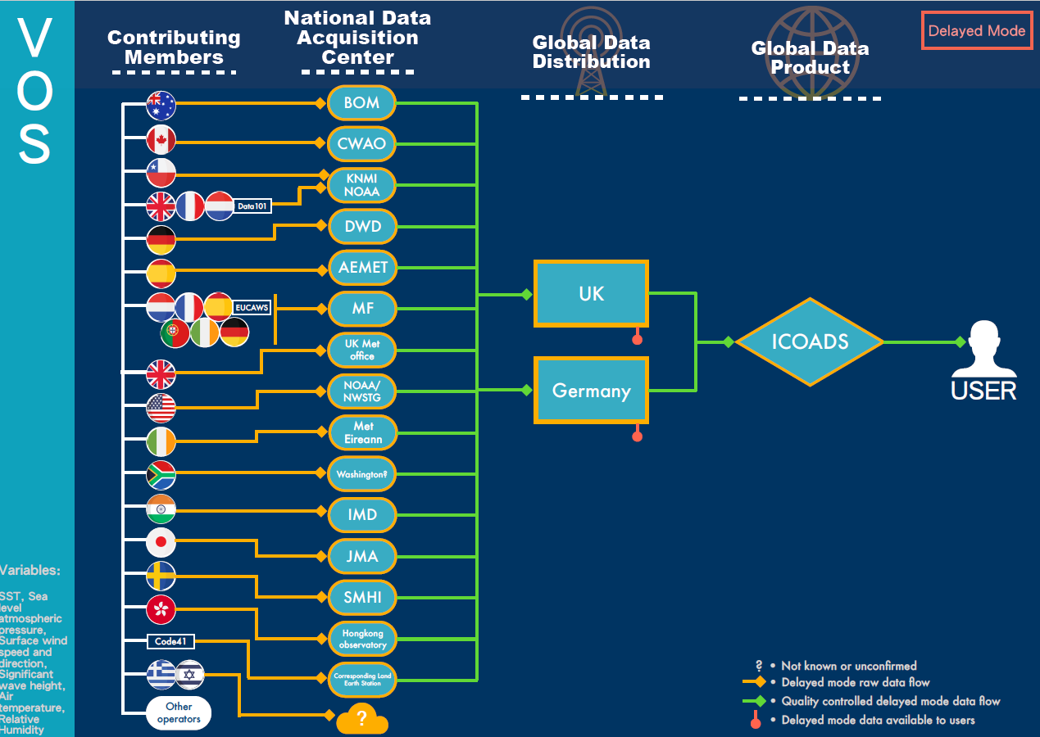
DACs?
GDACs
CMOC?

Slide 8
Future
Issues around MCDS governance recognised
New JCB sub-group on data management approved at last JCB session
ToR include (next slide):
WIS2.0 / ODIS inter-operability
WIS2.0 topic hierarchy
MCDS governance
Comparison of data policy
Membership under development, proposals from IODE but need proposed members from WMO

Slide 9
JCB sub-group on data management - ToR
Propose actions for enhanced interoperability for an integrated observing and data system, improving data sharing between the WMO Information System (WIS) and the IOC/IODE Ocean Data and Information System (ODIS).
Review and propose updates to the topic hierarchy for ocean data.
Coordinate, with the relevant WMO and IOC groups, the migration of both publishers and users of ocean data currently distributed on the WMO Global Telecommunication System to the WIS 2.0 by 2033.
Establish pilot project(s) from the ocean community to act as DCPCs within the WIS2.0.
Propose a mechanism for mirroring between ODIS and WIS catalogues and seamless integration of the respective systems.
Review and propose updates to the governance procedures for the Marine Climate Data System (MCDS), including:
Nomination and recognition process for centres within the MCDS.
Terms of reference and scope centre types within the MCDS.
Evaluation and monitoring of MCDS centres.
Coordinate scientific and data workshops as part of the Advances in Marine Climatology (CLIMAR) series.
Review and compare WMO and IOC/IODE data policies and the datasets in scope of those policies to identify areas of concern for interoperability. Propose opportunities to align terminology, categories and guidance on terms of use and licenses.

Slide 10
Questions

